Slide 1
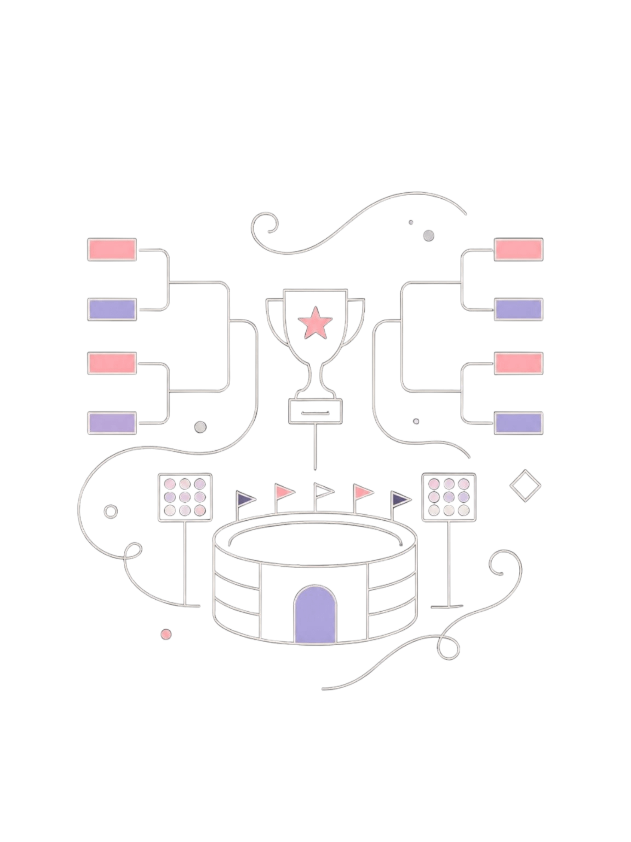



Tournament Bracket Management and Recovery System
A DSA-Based Knockout Tournament Management System in C
BINARY TREE
STACK
FILE HANDLING
DSA PROJECT · C PROGRAMMING
PRESENTED BY:
HARDIK DUBEY
NETIK SHARMA
RAUNIKA GULATI

Slide 2
Problem Statement
⚠ Existing Challenges
✅ Proposed Solution
No automatic bracket updates after entering a result
No way to correct an accidentally entered match result
Tournament data is lost when the program closes
Manual tracking of winners and progression is error-prone
Build a C-based system that manages an 8-team knockout tournament using DSA concepts — automatically advancing winners, supporting Undo via a Stack, and Recovery via file handling.

Slide 3
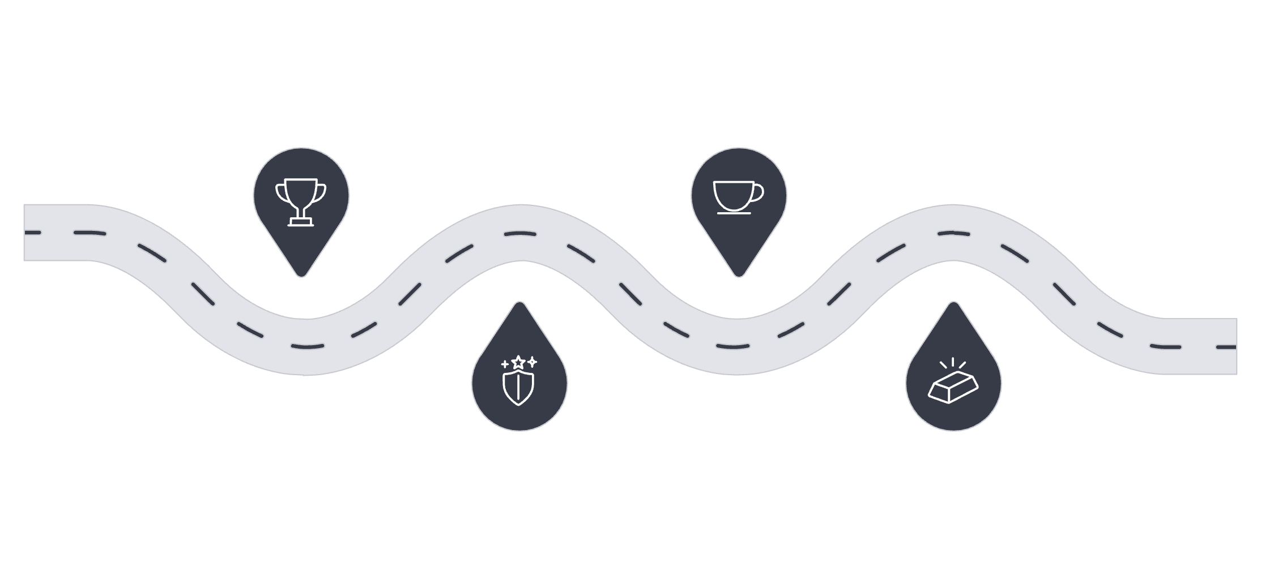
How Our Model Works
Quarterfinals
Final
8 teams compete in four matches
2 winners face off for the title
Semifinals
Champion
4 winners play in two matches
1 team crowned tournament winner
The tournament advances from 8 teams through three rounds until one champion remains.
Binary Tree
Stack
Represents match relationships and winner progression
Stores previous states for Undo functionality
.dat File
C Structures
Persists tournament data across program sessions
Dynamic memory holds match node information

Slide 4
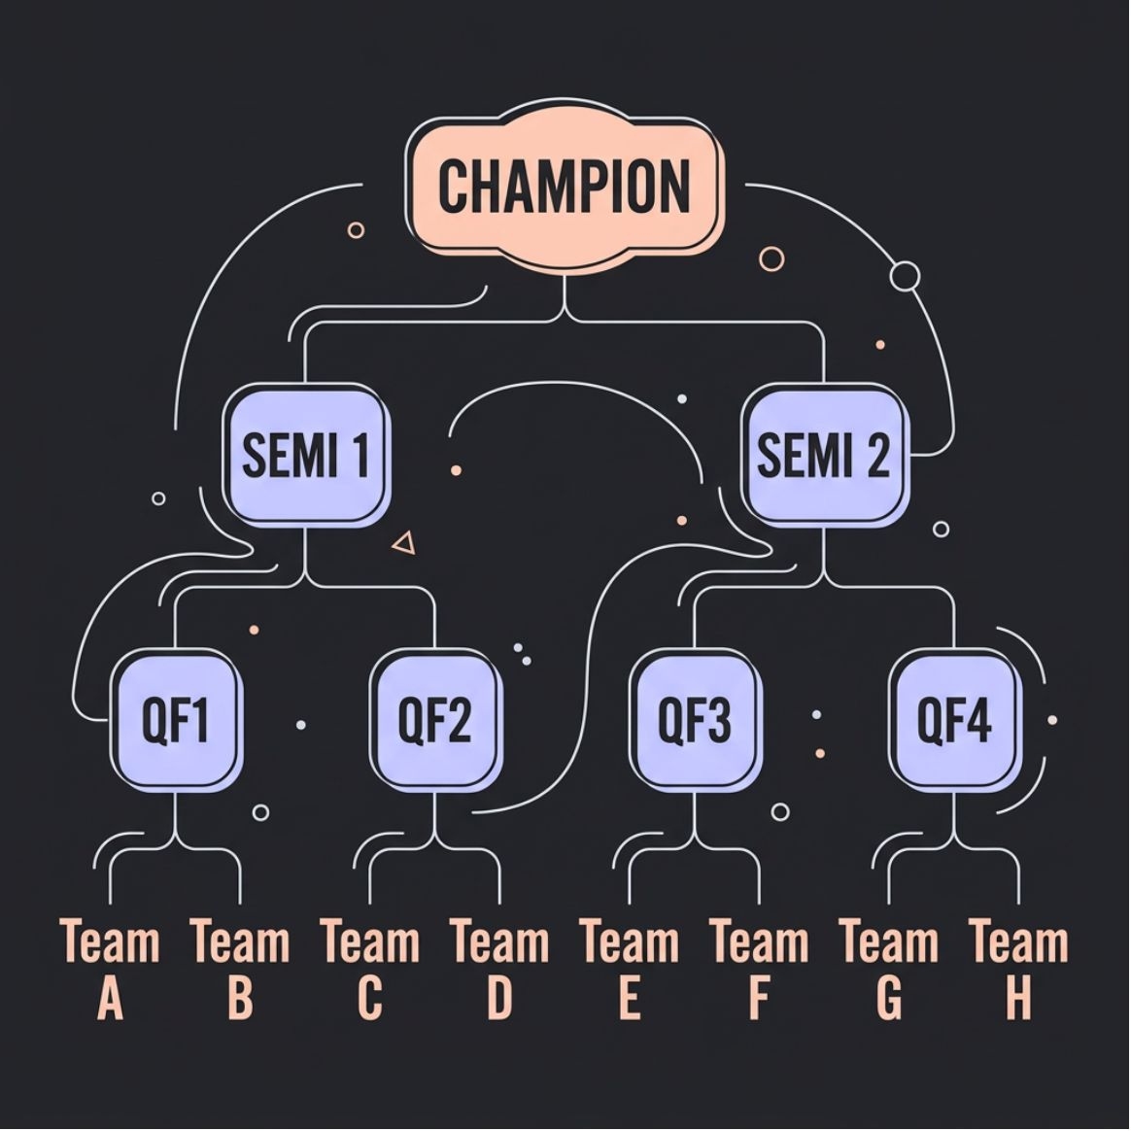
Data Structures Used
Tournament Binary Tree
Each match is a node. Children are previous-round matches; the parent receives the winner.
Undo Stack — LIFO
Before every result entry, the current state is pushed onto the stack. Undo pops the most recent state and restores it.
TOS → State 3 (Latest)
State 2
Bottom → State 1 (Oldest)

Slide 5
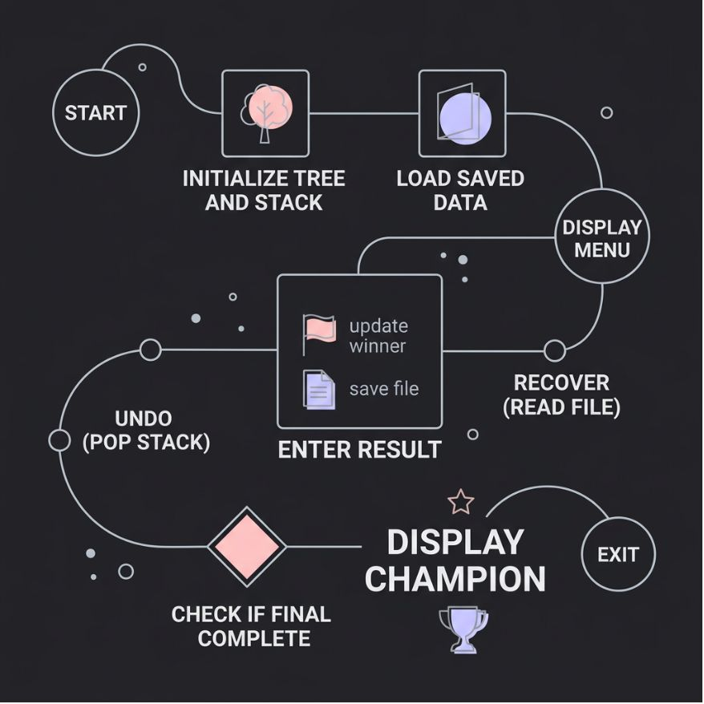
Algorithm
Step-by-Step Flow
01
Initialize the tournament tree and undo stack
02
Load saved data from tournament.dat if available
03
Display menu; read user choice
04
Before a result: push current state to stack
05
Record winner; update parent match node
06
Save updated tree to tournament.dat
07
Undo → pop from stack; Recover → read from file
08
When Final is complete, display Champion

Slide 6
Pseudocode
START
Initialize Tournament Tree
Initialize Undo Stack
IF saved tournament exists
Recover tournament data from file
END IF
REPEAT
Display Menu
Read user choice
IF choice = Display Bracket
Print tournament tree
ELSE IF choice = Enter Result
Push current state to Stack
Record match winner
Update parent match node
Save tree to tournament.dat
ELSE IF choice = Undo
Pop previous state from Stack
Restore tournament
ELSE IF choice = Recover
Load tournament from tournament.dat
ELSE IF choice = Champion
Display champion team
UNTIL choice = Exit
END

Slide 7
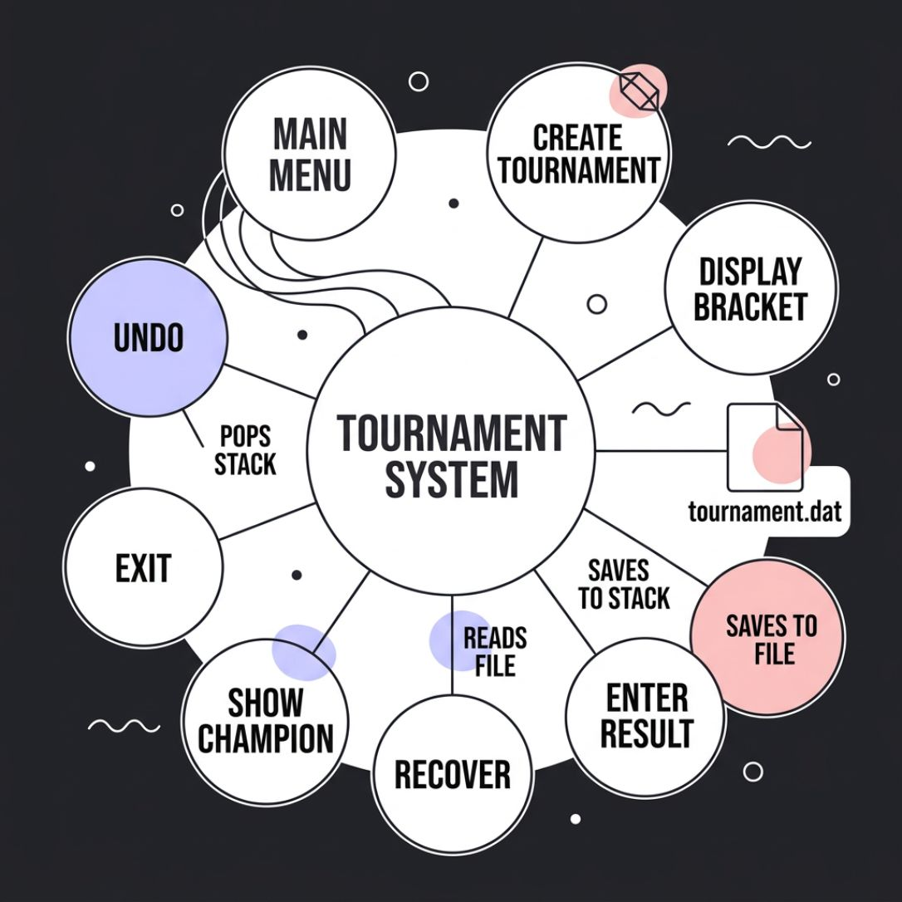
Complete Project Menu
System Menu Options
1
Create / Setup Tournament
Initialize 8-team bracket
2
Display Tournament Bracket
Visualize full tree structure
3
Enter Match Result
Record winner, advance to parent
4
Undo Last Result
Restore previous state from stack
5
Recover Tournament
Reload data from tournament.dat
6
Show Champion
Display the final winner
7
Exit
Save and close program

Slide 8
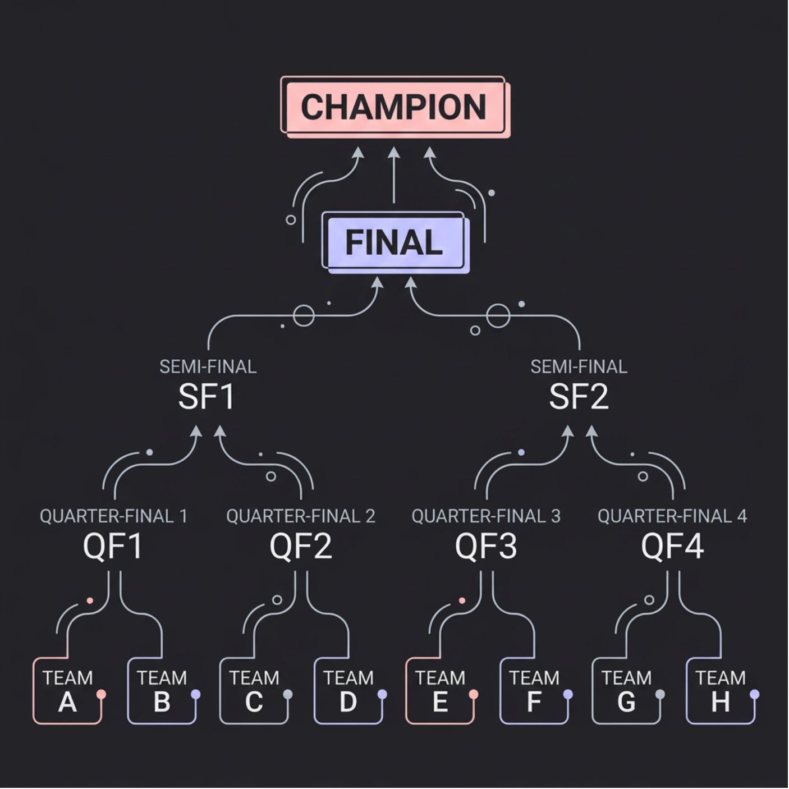
Complete System Architecture
8-Team Bracket Visualization
Architecture Overview
🌲 Binary Tree
📚 Stack
Manages bracket structure and winner flow
Tracks state history for Undo
📁 .dat File
🏆 Champion
Persists data between sessions
Root node after Final match

Slide 9
Recovery and Undo Mechanism
↩ Undo — Stack (Temporary)
💾 Recovery — File (Persistent)
Save current state before any change
After each update, write tree to tournament.dat
Push snapshot onto the stack
Program closes; data is preserved
User selects Undo
On restart, check for saved file
Pop top state; restore bracket
Read and restore full tournament state
Stack = volatile, in-memory history
.dat file = permanent storage across sessions

Slide 10

Conclusion
🌲 Binary Tree
Models the full 8-team knockout bracket with automatic winner progression
📚 Stack
Provides reliable Undo functionality using LIFO state restoration
📁 File Handling
Ensures tournament data survives program restarts via tournament.dat
✅ DSA in Practice
Reduces manual errors and demonstrates real-world application of core DSA concepts in C
DSA in Action: Manage → Update → Undo → Recover → Champion 🏆

