Slide 1
LIVE DIGITAL TWIN
10:30 · R07 ⚠
NEXUS
R1
R3
AI-native Digital Twin & Autonomous Operations Platform
R4
R7
A virtual world that mirrors a physical operation — and AI agents that understand, predict, simulate and optimize what happens inside it. Before executing an action, NEXUS simulates it.
R9
R2
Simulate before execute
Local-first · no API keys
OR-Tools CP-SAT
Apache-2.0
orders 46 · robots 11/12 · predicted breach 39.4%
Raunit Thakur · raunit.thakur@gmail.com · github.com/raunitgrey7/nexus
August 2026 · Digital Twin + Physical AI + Multi-Agent AI + Simulation + Operations Research
Notes:
Open on the name. One sentence: a virtual world that mirrors a physical operation, plus AI agents that understand, predict, simulate and optimize what happens inside it — and simulate before they act.

Slide 2
THE PROBLEM
Operations react. Dashboards describe. Nobody simulates.
Reactive
Descriptive
Untested
• A robot fails → an alert fires → whoever is on shift improvises.
• Every minute of delay compounds into missed SLAs; the recovery plan is invented under pressure.
• WMS and BI dashboards show what has happened — not what will happen next, nor what to do about it.
• Forecasts, if any, live in spreadsheets far from the floor.
• Interventions are executed on the real floor. The first time a plan is tried is in production.
• There is no way to compare alternatives before committing robots, people and inventory.
39.4%
+332%
18.8 s
of orders projected late within the hour after one robot of twelve fails at the peak — if nobody acts
average fulfilment time without intervention (2.1 → 9.2 min)
for NEXUS to evaluate 9 candidate plans and 21 task allocations in forked twins — and pick one
NEXUS · Autonomous Operations Intelligence
02
Notes:
Three failure modes of today's operations software. The numbers at the bottom are from our own twin: one robot out of twelve at the peak is enough to put 39% of orders at risk within the hour if nobody acts.

Slide 3
THE DIFFERENCE
What a normal system says — and what NEXUS says
A NORMAL SYSTEM SAYS
NEXUS SAYS
R07 failure (motor fault) will increase average order fulfilment time from 2.1 to 9.2 min over the next 60 minutes — projected SLA breach 39.4% without intervention.
I evaluated 9 candidate plans and 21 task allocations in 18.8 s.
Recommended plan #1 — Add 2 robots + batching. Estimated impact: SLA breach 39.4% → 3.1%, average fulfilment 9.2 → 4.5 min, throughput 438 → 546 orders/h.
Risk LOW (stable across 3 seeds, σ 0.2%); auto-approved — projected SLA breach improves by ≥ 2 pp.
Robot R07 offline.
…and a tile turns red. Tasks pile up in R07's zone, the SLA clock keeps running, and what happens next depends on whoever is on shift — with no way to know which reaction would actually help.
Rendered from a decision record (nexus/agents/explain.py). Every number comes from simulating each candidate in a forked copy of the twin, scoring it with a multi-objective cost and risk-checking it. Numbers: `uv run nexus demo`, 2026-08-30.
NEXUS · Autonomous Operations Intelligence
03
Notes:
This is the exact operator briefing rendered by the platform on the demo incident. Every number is computed by simulating each candidate plan in a forked copy of the twin. The LLM only proposes candidates; mathematics disposes.

Slide 4
THE VISION
From screens into environments
• The shift. AI is moving from answering questions on a screen to perceiving, reasoning and acting inside physical operations — warehouses, factories, hospitals, airports.
• The gap. Robots and sensors produce the data; nobody turns it into safe, explainable decisions in real time.
• Analyst themes 2025–26. physical AI, multi-agent systems, domain-specific intelligence and spatial AI (strategic technology trends); digital twins, autonomous systems, logistics optimization and foundation models (smart-manufacturing roadmap); robotics, autonomous forklifts, inspection drones and digital twins (physical-AI briefs).
• The market. warehouse automation and industrial digital twins are multi-billion-dollar categories growing at double-digit rates; every site that adds robots needs an intelligence layer above the fleet manager.
NEXUS THESIS
The digital twin is the operating system of physical AI: the place where agents perceive, reason, simulate and act — safely.
• Perceive — the twin knows where everything is, what is happening and what is supposed to happen.
• Reason — agents forecast, plan and explain in the operator's language.
• Act — only after simulation, risk assessment and policy or human approval.
Physical AI
Multi-agent systems
Spatial AI
Digital twins
Autonomous systems
Logistics optimization
Foundation models
Domain intelligence
Themes as named in 2025–26 industry analyst publications (Gartner strategic technology trends; NIST smart-manufacturing roadmap; World Economic Forum physical-AI briefs). Market sizing is described qualitatively on purpose — figures differ by source.
NEXUS · Autonomous Operations Intelligence
04
Notes:
AI is moving from chat windows into physical operations. Analysts name physical AI, multi-agent systems, spatial AI and digital twins as strategic themes. NEXUS's thesis: the digital twin is the operating system of physical AI.

Slide 5
THE PRODUCT
NEXUS in one picture
EVENT ENGINE
every change is a typed event · idempotent store · replay · audit
LIVE UI · API
Next.js + Three.js 3D twin · FastAPI + WebSocket
SIMULATION ENGINE
deterministic ticks · fork the present into many futures · 6k ticks/s
OPTIMIZATION
CP-SAT assignment · order batching · deadline sequencing · routing policies
DIGITAL TWIN
single source of truth · zones, shelves, robots, workers, orders, inventory, docks, chargers · spatial graph
MULTI-AGENT RUNTIME
plan → validate → optimize → simulate → risk → approve → execute
FORECASTING
demand (Holt-Winters + prior) · battery · congestion · bottlenecks
WHAT-IF · NL CONSOLE
scenario DSL, 12 presets, multi-strategy comparison · grounded answers
PERSISTENCE · OBSERVABILITY
PostgreSQL · Redis · Prometheus · Grafana · OpenTelemetry
NEXUS · Autonomous Operations Intelligence
05
Notes:
The twin is the single source of truth. Around it: an event engine that makes every change auditable and replayable, a deterministic simulation engine that can fork the present into many futures, an optimization engine, a multi-agent runtime that plans, validates, simulates, risk-checks, approves and executes, plus forecasting, a what-if lab and a natural-language console.

Slide 6
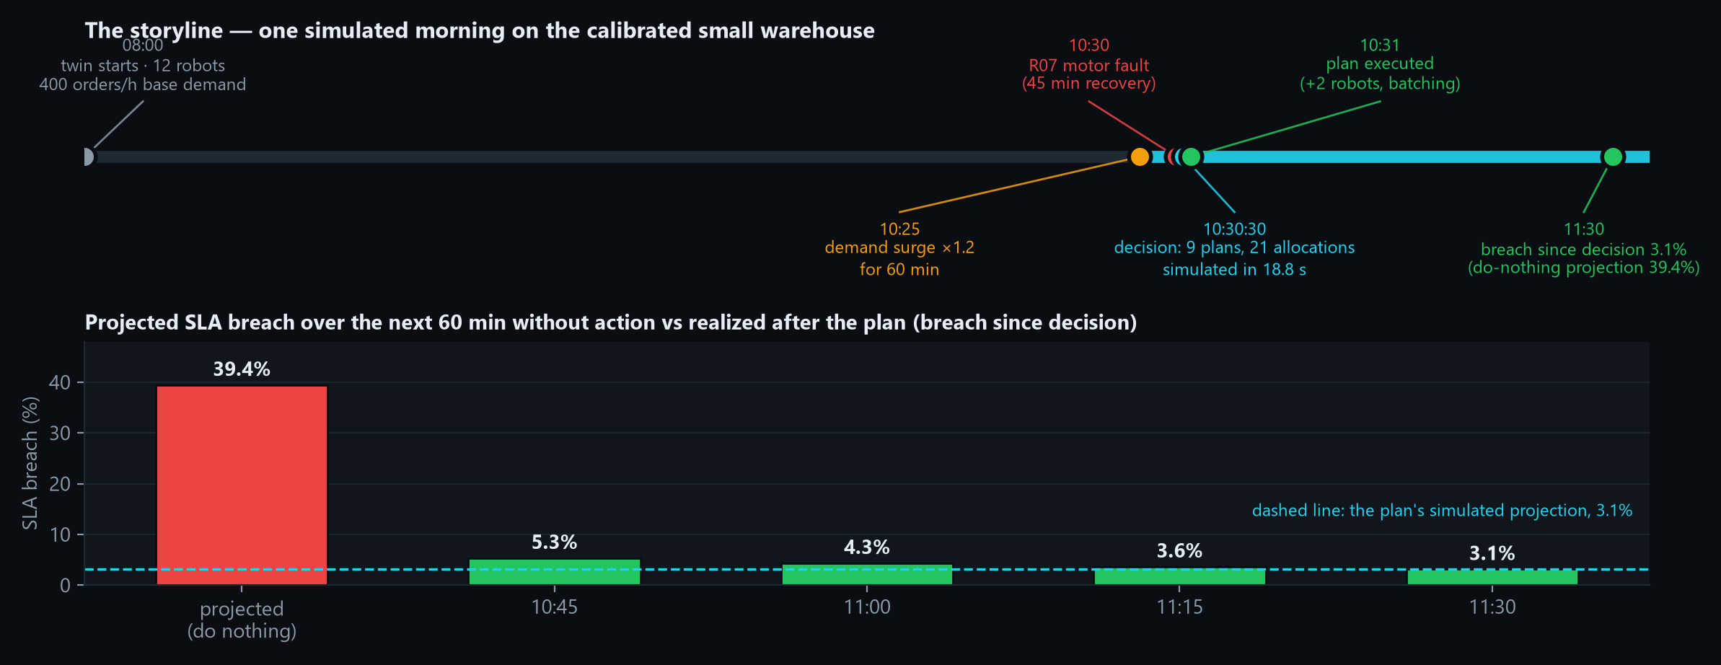
THE DEMO
One simulated morning: surge, failure, decision, recovery
39.4%
3.1%
18.8 s
3.1%
projected breach, do nothing
simulated breach, recommended plan
9 plans · 21 allocations · risk-checked
realized breach since decision at 11:30
NEXUS · Autonomous Operations Intelligence
06
Notes:
Walk the timeline: the twin runs from 08:00; at 10:25 demand surges 20%; at 10:30 R07 fails; within 19 seconds NEXUS has simulated nine plans and 21 allocations; the recommended plan executes; the realised breach converges to the simulated projection.

Slide 7
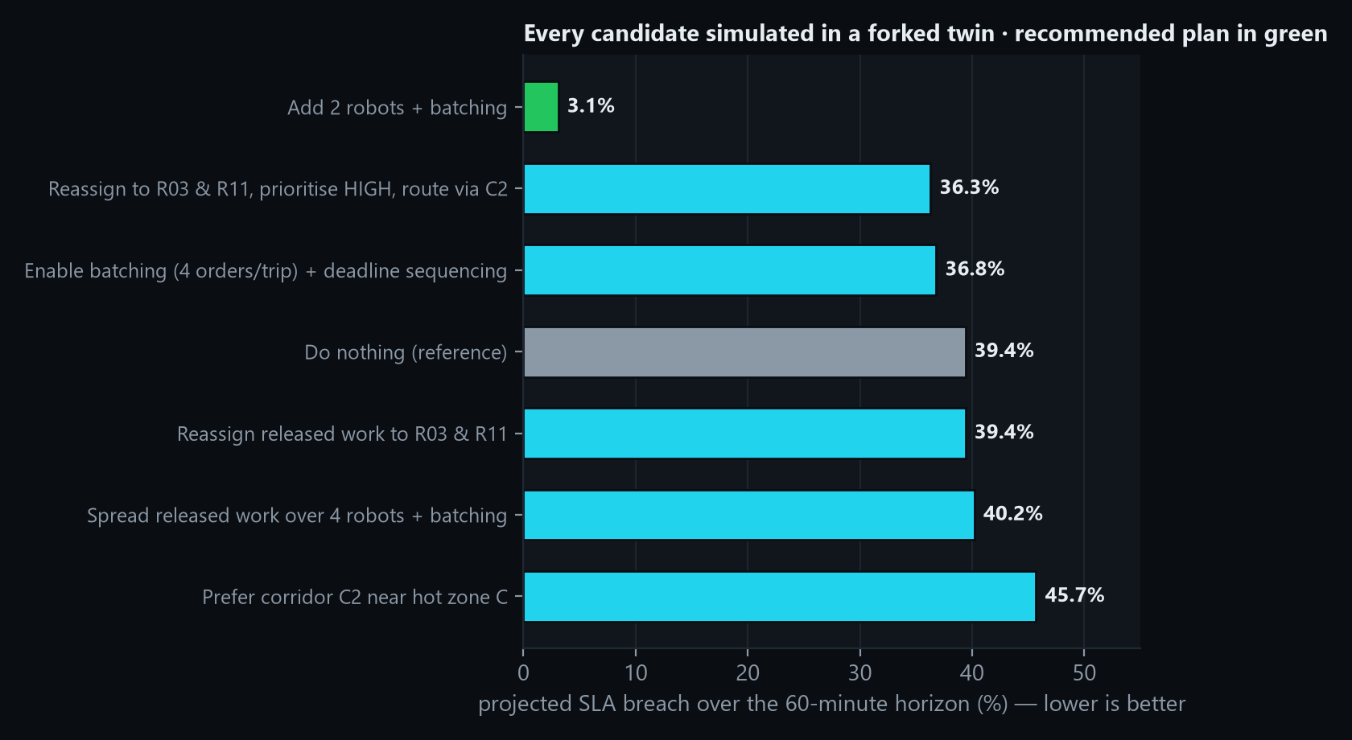
THE DECISION
Nine candidates, one horizon, one recommendation
HOW IT WAS DECIDED
• Playbooks + (optional) LLM propose 9 candidates; every action is from a closed vocabulary of 16 types.
• Constraint validation drops or clamps anything unsafe (fleet limits, zones, docks).
• Forked-world simulation 60 min each, in a process pool, with the same engine as the live twin.
• Multi-objective score ranks plans (lateness, delay, tail, congestion, distance, energy).
• Risk agent re-simulates the winner under 2 extra seeds: σ 0.2% → LOW; no deadlocks, no depletion.
• Approval policy LOW risk and ≥ 2 pp gain → auto-approved; otherwise a human decides.
39.4% → 3.1%
9.2 → 4.5 min
438 → 546/h
Timings: planning 1 ms · simulation 12.1 s · risk 7.2 s · total 18.8 s (4 worker processes).
SLA breach
avg fulfilment
throughput
NEXUS · Autonomous Operations Intelligence
07
Notes:
Left: every candidate's projected SLA breach after a 60-minute simulation in a forked twin. Reassignment plans don't beat doing nothing because the optimized scheduler already reassigns released tasks within seconds; capacity levers do. Right: the pipeline that produced the ranking.

Slide 8
ARCHITECTURE
One engine, three planes: twin, agents, events
NEXUS UI
Next.js 15 · Three.js 3D/2D twin · decisions · what-if lab · forecast · console · timeline · benchmarks
API LAYER
FastAPI · pydantic contract · REST · WebSocket /ws/live · Prometheus /metrics
TWIN ENGINE
WorldState · occupancy grid · semantic spatial graph · snapshots · SHA-256 digest · fork
AGENT RUNTIME
Ops Manager · Planner · Validator · Optimizer · Simulator · Risk · Policy · Executor
EVENT ENGINE
typed events · idempotent append-only store · pure reducer · bus · replay
PERSISTENCE & DATA
PostgreSQL — events, snapshots, decisions, what-ifs · Redis fan-out · SQLite for tests · in-memory when unset
SIMULATION ENGINE
deterministic ticks · kinematics · A* · faults · KPIs · forks
OBSERVABILITY & LLM
Prometheus metrics · Grafana dashboard · OpenTelemetry tracing · Ollama (qwen2.5, local, optional)
OPTIMIZATION ENGINE
CP-SAT · Hungarian · GA · batching · EDF · routing policies
docker compose: postgres · redis · backend · frontend · prometheus · grafana · ollama (profile) — everything runs on one laptop, no paid APIs.
NEXUS · Autonomous Operations Intelligence
08
Notes:
UI talks to a FastAPI/WebSocket layer. Below it three planes share the world: the twin engine (state), the agent runtime (decisions) and the event engine (truth). The simulation engine runs the same code for the live twin and for every forked future; the optimization engine is called by the scheduler and by the agents.

Slide 9
DIGITAL TWIN
Every entity has state; the world is the source of truth
ENTITY MODEL
scale | robots | storage zones | docks | chargers | SKUs | inventory | orders/h | grid | shelves
tiny | 4 | 4 (2×2) | 2 | 2 | 120 | 4,000 | 90 | 29×29 | 192
small | 12 | 12 (4×3) | 4 | 4 | 600 | 18,000 | 400 | 53×41 | 576
medium | 40 | 24 (6×4) | 8 | 10 | 2,000 | 60,000 | 1000 | 77×53 | 1,152
large | 100 | 50 (10×5) | 16 | 24 | 5,000 | 150,000 | 1800 | 125×65 | 2,400
Warehouse (WorldState)
├─ Zones storage · corridor · dock · charging · capacity
├─ Shelves cell · access cell · inventory {SKU: qty}
├─ Robots cell · battery · status · task · path · load
├─ Workers role · dock · status (delays)
├─ Orders lines · priority · deadline · status
├─ Tasks waypoints (pick… → deliver) · leg
├─ Docks open · queue Chargers slots · occupants
└─ Clock · seeded RNG · id counters · demand profile · config · stats
Base demand × hourly profile (08:00–18:00 operating window). The small world is the calibrated demo: ≈ 4,000 orders/day, 12 robots, near capacity at the late-morning peak.
5 / 26 ms
SHA-256
2,400
world fork (small / large) — pickle round-trip
deterministic digest of all behaviour-relevant state
shelves · 150k units · 100 robots at large scale
Domain-agnostic by construction: the engine only knows entity shapes; a DomainModel (warehouse today) supplies the layout, demand and vocabulary. Spatial reasoning lives in a semantic graph derived from the world (R07 is_inside Zone C · Zone C adjacent_to C2 · ORD-8821 requires Shelf C-41).
NEXUS · Autonomous Operations Intelligence
09
Notes:
The twin is a dataclass world: fast to copy, trivial to hash. Four built-in scales from a tiny test world to 100 robots / 50 zones / 2,400 shelves. Forking a world costs milliseconds, which is what makes simulate-before-execute affordable.

Slide 10
EVENT-SOURCED WORLD
Everything is an event: replayable, idempotent, auditable
• Typed, closed vocabulary. orders, tasks, robots, workers, infrastructure, inventory, demand, plans, system — every change has a type and a payload.
• Append-only, idempotent store. sequence numbers, idempotency keys for external commands (a retried command applies once), ring buffer for the live feed.
• Reducer-only mutation. one pure function applies events to the world; engines and agents never poke at entities.
• Replay = snapshot + external events. engine events are regenerated deterministically; the replayed world's digest equals the original (test gate).
• Attribution. origin (engine · scenario · agent · user), cause (plan id) and key on every event — an audit trail for free.
• Ephemeral kinematics. per-tick movement events are streamed to observers but not persisted; the engine reproduces them.
Engine · agents · users emit
Event store — seq, idempotency key, ring buffer
Reducer — pure, the only writer
World state
Bus → UI · persistence · metrics
ORDER_CREATED
TASK_CREATED
ITEM_PICKED
ORDER_DELIVERED
BATTERY_LOW
ROBOT_FAILURE
AISLE_BLOCKED
ZONE_CLOSED
DEMAND_CHANGED
PLAN_EXECUTED
Replay verified: snapshot + 3 external events → identical SHA-256 digest (tests/test_simulation.py).
NEXUS · Autonomous Operations Intelligence
10
Notes:
Only the reducer mutates the world. Engines and agents emit events. Replay is a snapshot plus the external events; the deterministic engine regenerates the rest and the digest must match — this is tested.

Slide 11
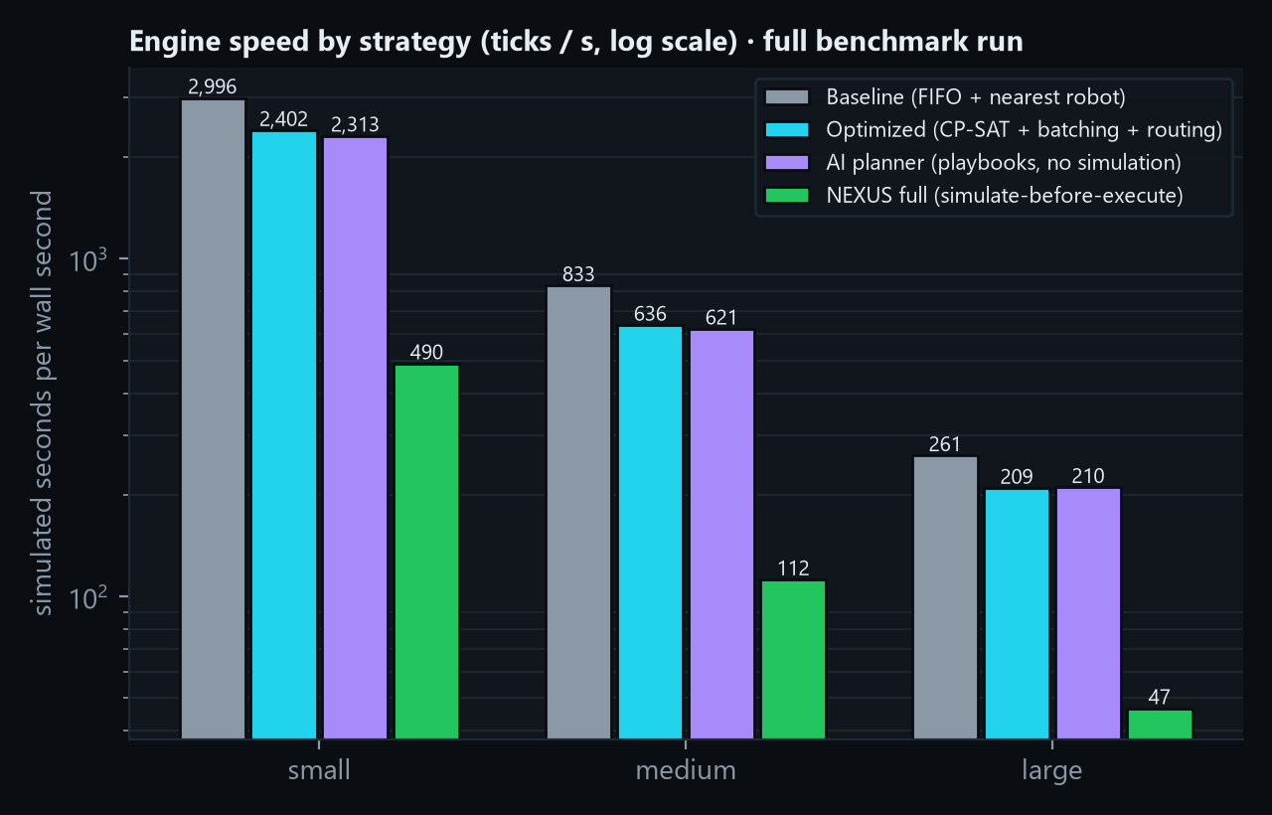
DETERMINISTIC SIMULATION
Deterministic worlds you can fork into many futures
ONE TICK, IN ORDER
1
Order arrivals — Poisson × hourly profile; Zipf SKU popularity creates natural hot zones
2
Faults — scheduled scenario events + seeded spontaneous failures
3
Recoveries and worker delays expire
4
Inventory replenishment (every 5 min)
5
Strategy decisions — assignments, batching, routing, charging
6
Robot kinematics in id order — move (congestion slows), pick, unload, charge, battery
7
Hooks (history recorder, agents) · TICK with utilization & congestion stats
digest ==
fork ==
replay ==
Also: A* with congestion-aware costs and a path cache, BFS distance fields for the optimizer, capacity-limited cells, deterministic slow-down in congested zones, battery drain/charge model, 10/5/3-minute SLAs.
same seed ⇒ identical world hash
a forked world continues identically
snapshot + external events reproduce it
NEXUS · Autonomous Operations Intelligence
11
Notes:
The engine is a discrete-time lockstep simulation with a fixed order of operations. Determinism is what makes forks, replays and benchmarks trustworthy. Speed: thousands of simulated seconds per wall second.

Slide 12
OPTIMIZATION
Operations research in the loop, not an AI wrapper
OBJECTIVE (LOWER IS BETTER)
ASSIGNMENT MODEL
LEVERS THE AGENTS PULL
J = Σ w·[ lateness, delivery time, p95 tail, congestion, distance, energy, backlog, priority ]
• CP-SAT (OR-Tools): x[r][b] ∈ {0,1}; each batch ≤ 1 robot, each robot ≤ 1 batch; maximise assignments, minimise cost; 0.2 s limit; single worker + fixed seed → deterministic.
• Costs: exact BFS distances, trip estimate, lateness vs deadline, battery risk, congestion of zones touched.
• Fallback chain: CP-SAT → Hungarian (scipy) → greedy; a genetic allocator generates alternative allocations.
• Batching — 2–4 orders per trip clustered by zone proximity, deadline-aware.
• Weighted EDF — sequence by deadline slack over priority weight.
• Routing policies — avoid zones, prefer corridors, soft capacities, with expiry.
• Pre-emptive charging — robots charge before exhaustion, never a quarter of the fleet at once.
• one scorer for the scheduler, plan ranking and what-if comparison
• weights: lateness 100 · delivery time 1 · tail 0.25 · congestion 2 · distance 0.005 · energy 0.1
• constraints: capacity, battery with reserve, sourceable lines, open dock, one robot per task
~420 → ~600+/h
0.4% vs 48%
0.2 s
capacity of 12 robots: naive dispatch vs optimized scheduler (peak sweep)
SLA breach at 504 orders/h: optimized vs baseline (90 min, same seed)
CP-SAT time limit per planning cycle; ≈ 2k ticks/s end-to-end on the small world
NEXUS · Autonomous Operations Intelligence
12
Notes:
The objective is a weighted multi-objective cost shared by the scheduler, the plan ranking and the what-if comparison. Assignment is a CP-SAT model with fallbacks; batching, deadline sequencing and routing policies are the levers the agents pull.

Slide 13
FORECASTING
NEXUS does not just respond — it anticipates
Demand
Battery
• Holt-Winters (additive, damped) over per-minute arrivals, blended with the twin's demand-profile prior
• 15-minute buckets with prediction intervals; trend; capacity/h from fleet × task duration; projected utilization
• per robot: drain rate from history vs remaining workload → predicted exhaustion minutes
• charger ETA via pathfinding; risk high if exhaustion < ETA + 10 min
• "Send R04 to charging after its current task (exhaustion in 23 min, charger 4 min away)"
Congestion
Bottlenecks
• per zone: robots inside + en route + the wave of open orders that require the zone (Little's law) + history trend
• projected load vs capacity, ETA to congestion, drivers ("14 open orders require Zone C")
• rules with severities 0–1: zone load, dock queues, charger saturation, failed robots, hot-SKU stock-outs, loader delays, demand vs capacity, backlog age
• each with a concrete recommendation: "Pre-position inventory in Zone B", "+2 robots or enable batching"
“Demand rising to ~419 orders/h (+23%) over the next 90 min; projected utilization 1.32 — above capacity. Zone F congestion +325% expected: 4.2 robots vs capacity 3. Recommended: +3 robots or enable batching to lift capacity to ~636 orders/h.” — Forecast.summary, small world, 09:30 after an R07 failure
3.5 / 8.8 ms
full forecast, small / large world
NEXUS · Autonomous Operations Intelligence
13
Notes:
Four forecasters run every simulated minute: demand, battery, congestion and bottlenecks. They feed the planner prompt, the risk agent and the UI. Milliseconds, deterministic.

Slide 14
MULTI-AGENT RUNTIME
The LLM proposes. Mathematics and policy dispose.
GOAL + TRIGGER
minimise SLA breach · ROBOT_FAILURE:R07
FORECASTER
demand · battery · congestion · bottlenecks
SITUATION
KPIs · fleet · hot zones · backlog · events
PLANNER
playbooks + LLM (Ollama) + SOP retrieval → candidates
VALIDATOR
closed vocabulary · clamps · drops unsafe actions
OPTIMIZER
CP-SAT assignment · concrete robot choices
SIMULATOR
forked twins · process pool · horizon KPIs
RISK
deadlock · safety · exhaustion · regression · stability seeds
POLICY → EXECUTOR
auto if LOW risk & ≥ 2 pp gain, else human · idempotent events
• Decision record. situation, baseline, every candidate with simulation + risk + rank, approval, explanation, timings — 9 plans / 21 allocations in 18.8 s on the demo incident (planning 1 ms · simulation 12.1 s · risk 7.2 s).
• Autopilot. failures, closures, blockages and demand changes trigger a decision (15-minute cooldown) in a background thread while the twin keeps ticking; benchmark strategies ai_planner and nexus_full run this loop inside the simulation.
NEXUS · Autonomous Operations Intelligence
14
Notes:
Nine stages. The planner is the only place a language model appears, and it is optional: deterministic playbooks guarantee coverage. Everything downstream is validation, optimization, simulation, risk and policy.

Slide 15
SAFETY ARCHITECTURE
Simulate before execute, with a human in the loop
• Closed action vocabulary. 16 typed actions with parameter shapes; no free-form commands can reach the world.
• Constraint validation. ≤ ¼ of the fleet to charge · never remove > ⅓ of the fleet · at least one storage zone and one dock stay open · unknown ids dropped, ranges clamped.
• Simulate before execute. every candidate runs in a forked twin with the real engine over the decision horizon; the do-nothing reference is always simulated alongside.
• Risk agent. findings from diagnostics, baseline comparison and stability re-runs under extra seeds (table).
• Approval policy. auto-approve only if risk LOW and projected SLA gain ≥ 2 pp; otherwise proposed → operator approves, picks another candidate, or rejects.
• Attributable, idempotent execution. origin · cause (plan id) · key on every event; executing a plan twice is a no-op.
finding | trigger | severity
constraint | plan infeasible · actions dropped by validation | critical · info
deadlock | robot blocked ≥ 60 s or > 600 stuck robot-s · ≥ 25 s / > 150 | high · medium
safety | zones over 2× capacity ≥ 5% of horizon · ≥ 1% · transient | high · medium · low
resource exhaustion | battery < 5% · < 12% · charger starvation · stock-outs | high · medium · low
regression | breach worse than doing nothing · throughput −5% · congestion +50% | high · medium · low
capacity | utilization > 97% — no slack | low
instability | σ of breach across seeds > 5% · > 2.5% · else | high · medium · info
Score = Σ severity weights (low 0.12 · medium 0.30 · high 0.55 · critical 1.0). LOW < 0.2 ≤ MEDIUM < 0.45 ≤ HIGH; any critical finding → CRITICAL.
LIMITATIONS, STATED HONESTLY
The twin is a calibrated simulation, not a physics engine; fidelity against a real site must be measured (planned: historical replay ingestion, Webots/Gazebo/Isaac bridges). No plan reaches real equipment without a fleet-manager integration and an operator.
NEXUS · Autonomous Operations Intelligence
15
Notes:
Safety is a stack of controls, not a feature: closed vocabulary, validation, forked simulation, risk assessment including stability re-runs, approval policy, attributable idempotent events. The limitations are stated honestly.

Slide 16
SPATIAL AI
Relationships, not just coordinates
• Relations. is_inside · adjacent_to · located_in · requires · requires_zone · assigned_to · serves · charging_at · unloading_at
• Queries. entities in a zone, orders requiring a zone, zone-level routes (BFS honouring closures), per-zone load, relations of any entity
• Used by the planner — nearest helpers by zone hops from a failed robot; spare neighbour zones for inventory repositioning; corridors adjacent to hot zones
• Used by the risk agent and the console — "Zone C congestion accounts for ~61% of predicted delay"-style attribution grounded in the graph
• Grid + graph. the occupancy grid (A*, congestion, blockages) and the semantic graph are two views of one world — geometry for robots, semantics for agents and people
SEMANTIC GRAPH (EXCERPT)
Zone A
Zone B
Zone C
C1
corridor
C2
corridor
Zone D
Zone E
Zone F
R07 is_inside Zone C Zone C adjacent_to C2
ORD-8821 requires Shelf C-41 Shelf C-41 located_in Zone C
zone_route(A → C) = A → C1 → C2 → C (closures honoured)
NEXUS · Autonomous Operations Intelligence
16
Notes:
A semantic spatial graph is derived from the world on demand: zones, corridors, shelves, robots, orders and their relations. The planner uses it to pick helpers by zone hops and spare neighbours for inventory; the console uses it to explain.

Slide 17
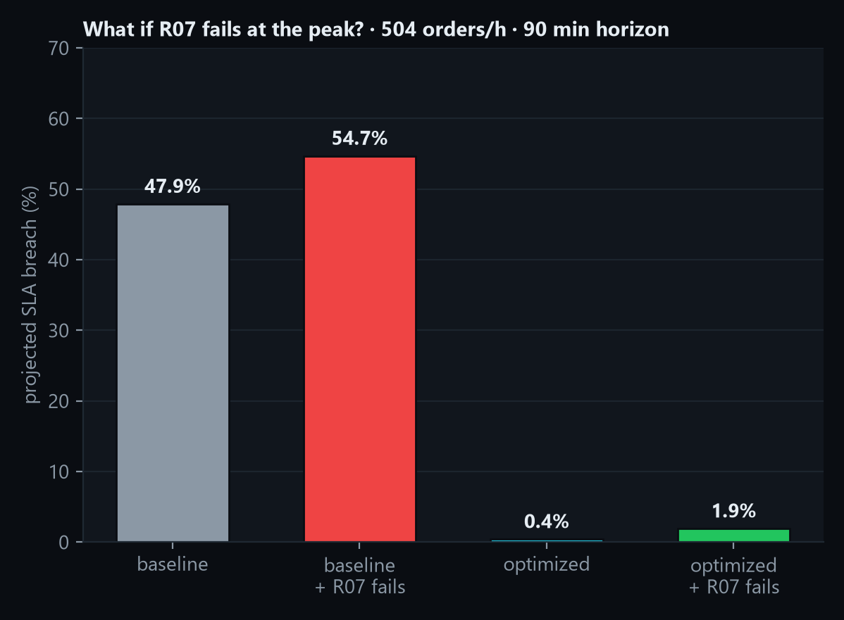
WHAT-IF ENGINE
Ask about one future, get four back — compared
HOW IT WORKS
• fork the current state → apply scenario mutations as scheduled events → run every strategy × seeds in a process pool
• compare on the shared KPI definitions, score with the optimization objective, keep the unmodified world as reference
• a deterministic narrative + comparison table; results stream back to the UI
PRESETS (ALSO REACHABLE BY ASKING IN PLAIN ENGLISH)
› Demand +40%
› Loading dock D2 closes
› Demand doubles for 30 min
› Charging capacity halved
› Robot R07 fails
› Aisle blocked in Zone C (30 min)
› Remove 2 robots
› Move hot inventory C → B
› Add 2 robots
› Enable 3-order batching
Under the same peak demand, the R07 failure costs the naive scheduler 7 pp of SLA breach and the optimized scheduler 1.5 pp — resilience is a scheduling property, not only a hardware count.
› Zone B inaccessible (60 min)
› R07 fails during a +30% demand spike
NEXUS · Autonomous Operations Intelligence
17
Notes:
A scenario is a list of typed mutations applied to a forked world; each strategy runs it in parallel; results are compared on the shared KPIs and scored with the optimization objective. Twelve presets, or any question in the console.

Slide 18
NATURAL-LANGUAGE CONSOLE
Ask the operation. Get grounded numbers, not vibes.
How many orders are open right now?
STATUS
What happens if order volume increases by 40%?
WHATIF
At 10:29: 40 open orders (28 pending), 11/12 robots operational (2 charging), projected SLA breach 0.5%, average fulfillment 2.1 min (p95 3.8), throughput 363 orders/h, utilization 74%, congestion index 0.03. 1 robot(s) are down.
Scenario “demand ×1.40”: demand ×1.40. Horizon 45 min, 2 strategies × 1 seed(s) simulated in 8.0s. Reference (no scenario, optimized): SLA breach 11.4%, avg fulfillment 6.9 min, throughput 444/h. optimized: SLA breach 54.9%, avg fulfillment 11.8 min, throughput 401/h, congestion 0.04. baseline: SLA breach 62.1%, avg fulfillment 16.0 min, throughput 349/h, congestion 0.04. Best strategy: optimized — SLA breach 54.9% vs 62.1% for baseline. Under this scenario the current strategy (optimized) projects an SLA breach of 54.9% (vs 11.4% today).
deterministic · 8 ms · LLM off
deterministic · 7892 ms · LLM off
Why are orders slowing down?
EXPLAIN
Where is R03 and what is it doing?
ENTITY
Fleet capacity backlog is currently the largest contributor, accounting for approximately 74% of predicted delay (28 orders waiting for a free robot (oldest 5 min)). Other contributors: Robot unavailability (R07) 13%; Robots charging (R06,R11) 13%. Right now: 40 open orders (28 pending), projected SLA breach 0.5%, p95 fulfillment 3.8 min, utilization 74%.
R03 is delivering in zone A at cell (11, 13), battery 88%, task TASK-000754, 67 orders completed, 5309 cells traveled. Relations: R03 is_inside A; TASK-000754 assigned_to R03.
deterministic · 2 ms · LLM off
deterministic · 14 ms · LLM off
Captured at 10:29 sim time after a x1.2 surge and an R07 failure; deterministic answers (LLM off). Intents: status · explain · whatif · forecast · recommend · entity.
NEXUS · Autonomous Operations Intelligence
18
Notes:
Every answer is computed by the engine — attribution, forecast, what-if, entity lookup — then optionally rewritten by the local LLM, which is discarded if it changes a number. These examples were captured from a run with the LLM off.

Slide 19
VISUALIZATION
A control room, not a dashboard
route | what it shows
/ | Live Twin — 3D/2D view, KPI bar, sim controls (play · pause · step · speed · reset · autopilot), events/robots/orders/zones panel, fault injection, Decide now
/decisions | situation · baseline vs candidates (recommended highlighted) · actions with rationale · risk findings · approve / reject / execute · timeline chart · timings · LLM badge
/whatif | preset cards · scenario builder (mutation vocabulary) · async runs · comparison table · KPI bars · timelines · best strategy · narrative
/forecast | demand band chart · capacity vs forecast · projected utilization · battery table · congestion bars · bottleneck list
/console | natural-language chat with suggestion chips, intent chip, LLM/deterministic badge, inline what-if card
/timeline | KPI history with notable-event markers · snapshot scrubber · playback in the 2D view
/benchmarks | grouped KPI bars per scale · normalised radar · results table
THE 3D TWIN
• instanced shelves (up to 2,400), zones tinted by occupancy / capacity
• robots coloured by status with id labels and remaining path; failed robots pulse red
• docks, chargers, blocked cells, hatched closed zones
• smooth interpolation between ~20 tick frames/s over one WebSocket
• 2D canvas toggle and snapshot playback
• dark control-room design system; responsive to 1280 px
Next.js 15 · React 19 · TypeScript strict · Tailwind v4 · @react-three/fiber + drei · recharts · zustand · typed API client mirroring the pydantic contract · NEXT_PUBLIC_MOCK=1 runs every page offline against an in-browser sim.
NEXUS · Autonomous Operations Intelligence
19
Notes:
The UI is a Next.js + Three.js twin: instanced shelves, congestion-tinted zones, robots coloured by status with their remaining paths, a KPI bar, fault injection, and the decision drawer. Seven pages; works fully offline in mock mode.

Slide 20
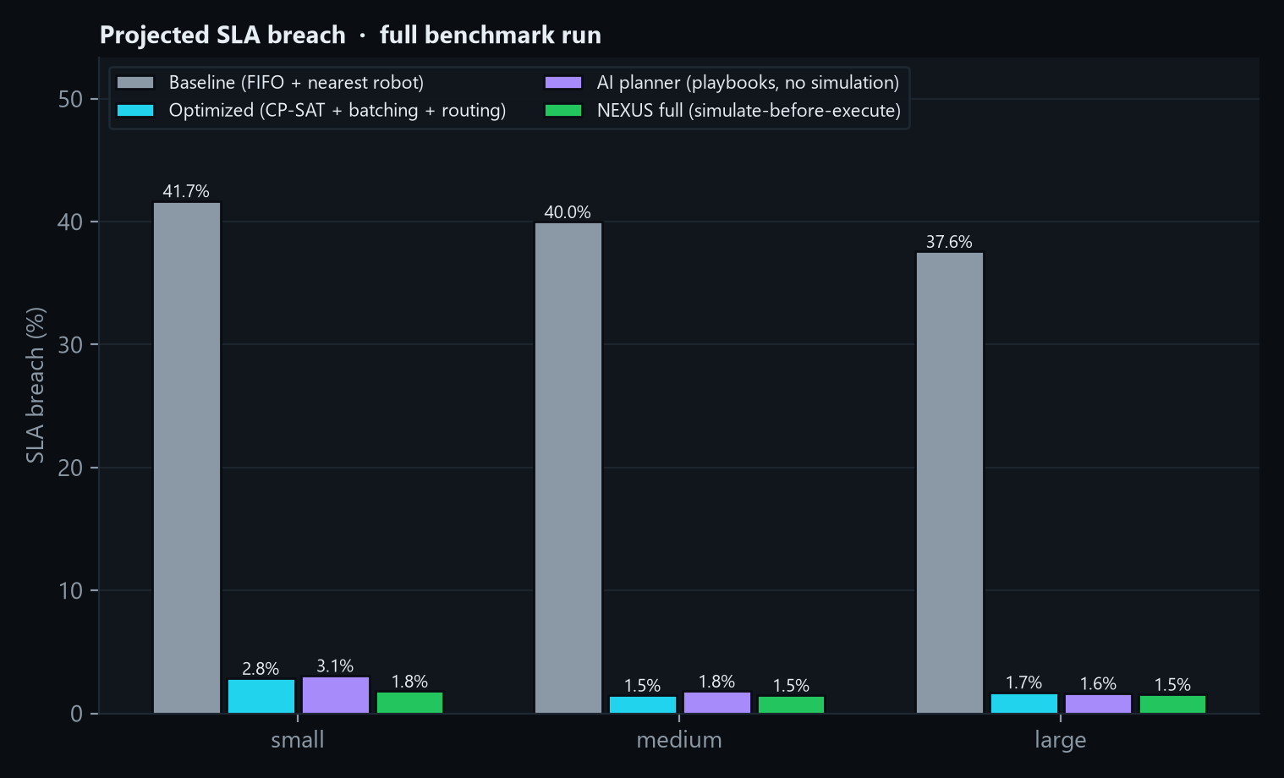
BENCHMARKS I
Four strategies, identical worlds, identical incidents
SETUP
• Runs: 120 simulated minutes × 3 seed(s) per cell · scales small, medium, large
• Incidents: robot failure at +30 min (45 min recovery) · demand ×1.5 for 30 min at +60 · aisle blocked at +90 (15 min)
• Strategies: baseline (FIFO + nearest) · optimized (CP-SAT + batching + routing) · ai_planner (playbooks, no simulation) · nexus_full (simulate-before-execute, risk-gated)
• Same KPI definitions everywhere: metrics.py → benchmarks → UI → this deck
• Reproduce: make bench · results JSON + docs/BENCHMARKS.md + charts
Data: backend/benchmarks/results (full benchmark run) · generated 2026-08-30 19:12:10 · wall time 325.1 s.
NEXUS · Autonomous Operations Intelligence
20
Notes:
All strategies see the same seeds, orders and incident schedule (robot failure at +30 min, demand surge at +60 min, aisle blocked at +90 min). SLA breach is the headline KPI.

Slide 21
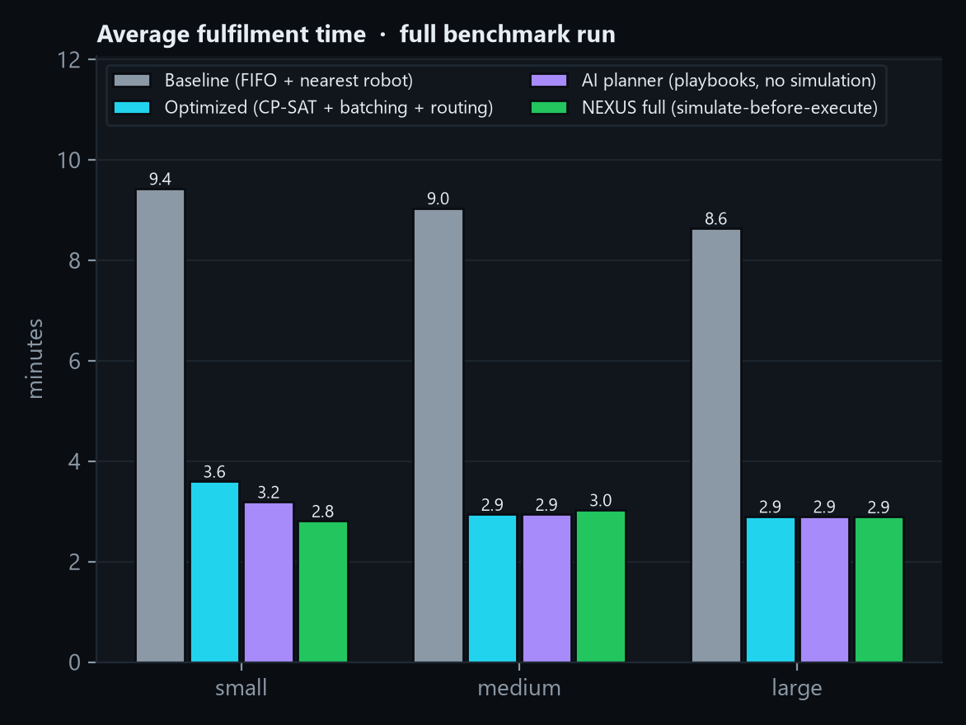
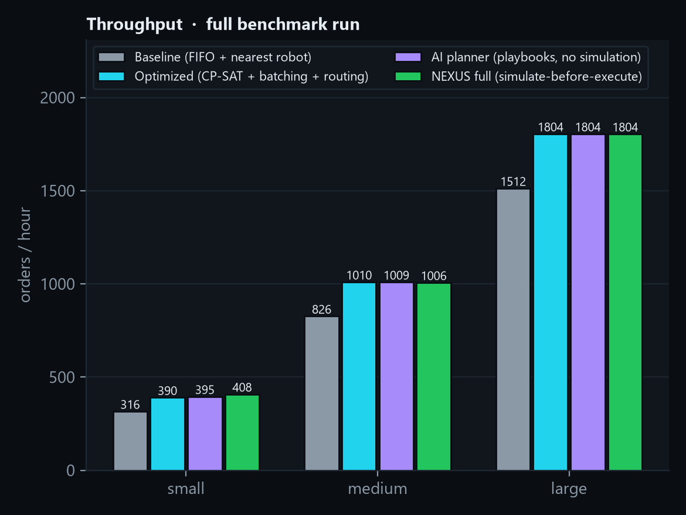
BENCHMARKS II
Speed and throughput: what the optimization buys
Baseline → optimized, same worlds: small: breach 41.7% → 2.8%, fulfilment 9.4 → 3.6 min, p95 26.7 → 10.6 min · medium: breach 40.0% → 1.5%, fulfilment 9.0 → 2.9 min, p95 24.5 → 5.7 min · large: breach 37.6% → 1.7%, fulfilment 8.6 → 2.9 min, p95 22.2 → 5.1 min
NEXUS · Autonomous Operations Intelligence
21
Notes:
Average fulfilment time and throughput per strategy and scale. Throughput is demand-limited when the fleet keeps up; the gap opens as the scheduler falls behind.

Slide 22
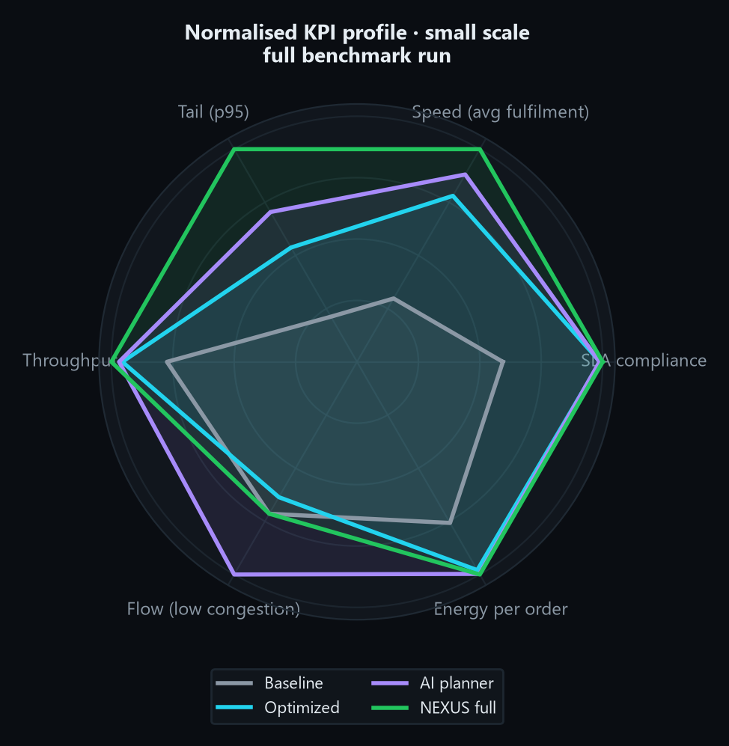
BENCHMARKS III
The full picture: every KPI, every strategy
scale | strategy | breach | Δ vs base | avg ft | p95 | thr/h | util | cong. | t/s
small | baseline | 41.69% | +0.00 pp | 9.43 | 26.70 | 316 | 81% | 0.05 | 2,996
small | optimized | 2.84% | -38.85 pp | 3.60 | 10.55 | 390 | 80% | 0.06 | 2,402
small | ai_planner | 3.07% | -38.61 pp | 3.19 | 8.05 | 395 | 80% | 0.04 | 2,313
small | nexus_full | 1.80% | -39.88 pp | 2.81 | 5.67 | 408 | 78% | 0.05 | 490
medium | baseline | 39.98% | +0.00 pp | 9.04 | 24.46 | 826 | 80% | 0.87 | 833
medium | optimized | 1.47% | -38.51 pp | 2.94 | 5.69 | 1010 | 76% | 0.65 | 636
medium | ai_planner | 1.80% | -38.19 pp | 2.94 | 5.69 | 1009 | 76% | 0.54 | 621
medium | nexus_full | 1.47% | -38.51 pp | 3.03 | 6.72 | 1006 | 76% | 0.63 | 112
large | baseline | 37.57% | +0.00 pp | 8.64 | 22.16 | 1512 | 73% | 1.57 | 261
large | optimized | 1.72% | -35.85 pp | 2.90 | 5.14 | 1804 | 64% | 1.25 | 209
large | ai_planner | 1.63% | -35.94 pp | 2.90 | 5.09 | 1804 | 65% | 1.24 | 210
large | nexus_full | 1.54% | -36.03 pp | 2.89 | 5.12 | 1804 | 64% | 1.24 | 47
full benchmark run · normalised radar on the small scale: SLA compliance, speed, tail, throughput, flow and energy per order, each relative to the best strategy.
NEXUS · Autonomous Operations Intelligence
22
Notes:
Left: the summary table straight from the benchmark runner. Right: a normalised radar — each axis is scaled so that the best strategy scores 1.

Slide 23
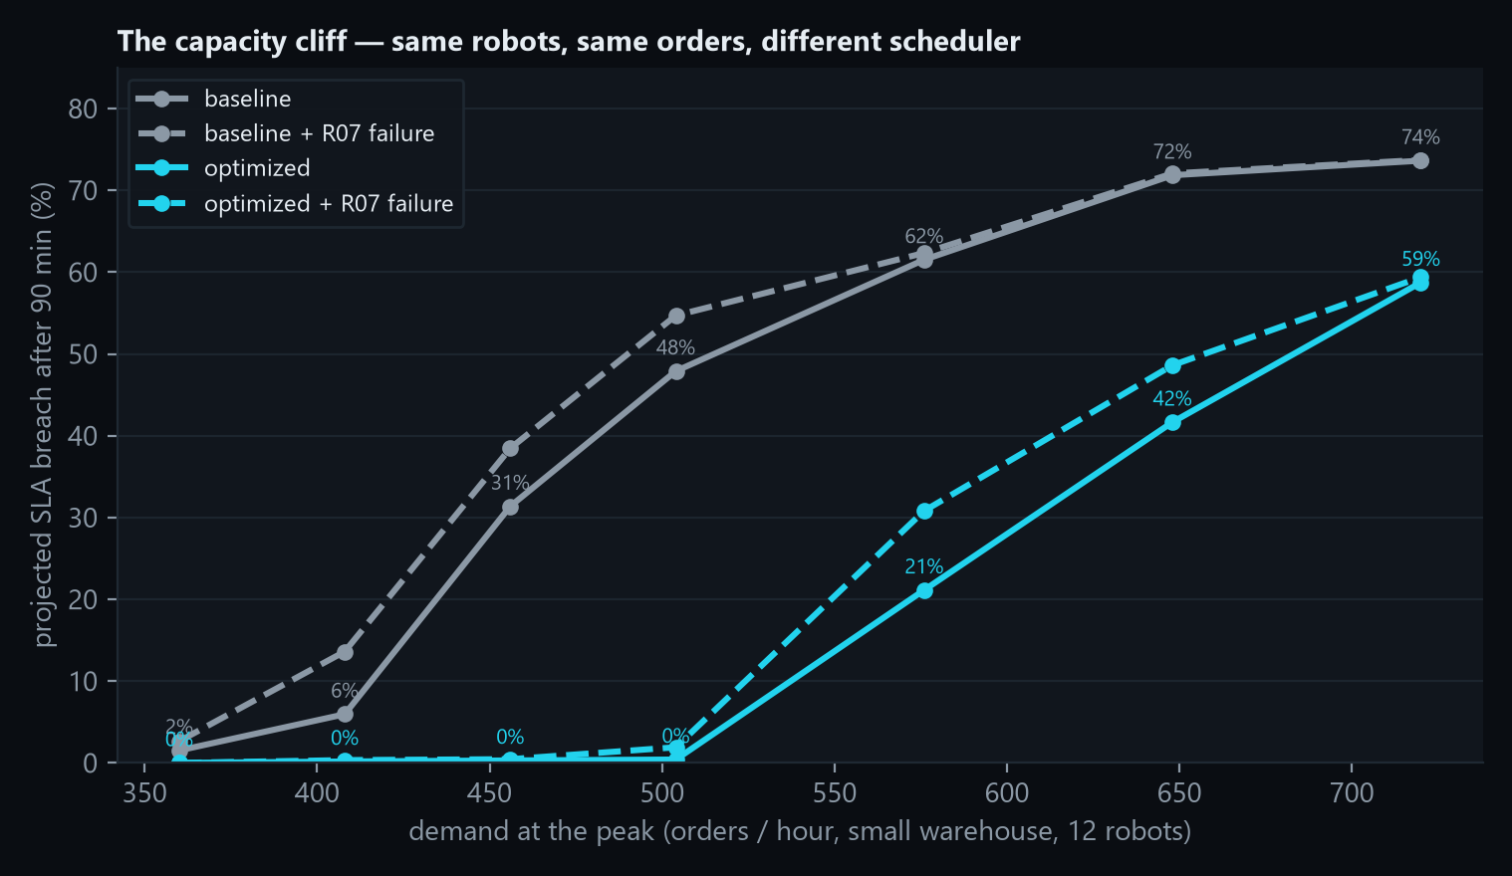
THE CAPACITY CLIFF
Why the naive baseline collapses, and why it matters
READING THE CURVE
• A queueing cliff. past capacity, backlog and lateness explode; below it, SLAs are trivially met.
• Same robots, same orders. the only difference between the two solid lines is the scheduler.
• Batching ≈ 2× capacity. 2–4 orders per trip amortise travel — the single biggest lever before buying hardware.
• Resilience. dashed lines add an R07 failure at +30 min; the optimized scheduler absorbs it until the cliff.
• Design consequence. the benchmark's incident schedule is set where the naive scheduler is near its cliff — that is where decisions matter.
Small world (12 robots), flat x1.2 demand profile, 90 simulated minutes, seed 42; 'fail' = R07 motor fault at +30 min (45 min recovery). Projected SLA breach = late delivered + open-overdue over delivered + open.
NEXUS · Autonomous Operations Intelligence
23
Notes:
Queueing systems have a cliff: past capacity, backlog and lateness explode. Batching and optimized assignment roughly double the capacity of the same 12 robots, which is why the baseline collapses in the benchmarks at demand the optimized scheduler handles comfortably.

Slide 24
ENGINEERING QUALITY
Tested, typed, deterministic, containerised
• Determinism gates. same seed ⇒ identical digest · fork continues identically · replay from snapshot + external events reproduces the digest.
• Static quality. ruff (lint + format) and mypy clean across 87 source files; TypeScript strict, ESLint clean.
• CI (GitHub Actions). backend: ruff · mypy · pytest with coverage · determinism smoke · micro-benchmark; frontend: lint · typecheck · build; docker: both images.
• Contract-first API. pydantic schemas → OpenAPI → TypeScript mirrors; WebSocket frames documented.
• Operations. Docker Compose stack (7 services), Prometheus metrics + Grafana dashboard, OpenTelemetry tracing, PostgreSQL persistence; backend image 1.43 GB.
• Local-first. everything — including the LLM — runs on one laptop with zero paid APIs.
92 tests in 9 files — share by area
92
87
3
7
tests passing
typed source files
CI jobs
compose services
NEXUS · Autonomous Operations Intelligence
24
Notes:
92 tests across nine areas, determinism and replay gates, ruff and mypy clean, three CI jobs, Docker images. The API contract is pydantic on the backend and mirrored in TypeScript.

Slide 25
TECH STACK
Free, open, and measured: what the platform is made of
layer | technology
Twin, events, simulation | Python 3.13 · dataclasses · orjson · networkx
Optimization | OR-Tools CP-SAT · SciPy (Hungarian) · genetic allocator
Forecasting | NumPy · Holt-Winters · Little's-law congestion estimator
Agents & LLM | pydantic structured output · Ollama (qwen2.5) · TF-IDF SOP retrieval
API & runtime | FastAPI · WebSocket · pydantic-settings · structlog
Data | PostgreSQL (SQLAlchemy async / asyncpg) · Redis · SQLite for tests
UI | Next.js 15 · React 19 · TypeScript · Tailwind v4 · Three.js (R3F) · recharts · zustand
Ops | Docker Compose · Prometheus · Grafana · OpenTelemetry · GitHub Actions · uv
25,961 non-blank lines across 190 files (measured at build time)
₹0 / $0
Apache-2.0
to run the whole stack — no paid APIs
open-source licence
NEXUS · Autonomous Operations Intelligence
25
Notes:
Line counts are measured by walking the repository at build time. The entire stack costs nothing to run.

Slide 26
THE GRANDER VISION
Same engine, different worlds
DIGITAL TWIN ENGINE
events · simulation · optimization · agents · what-if · forecasting
WAREHOUSE
today: robots, orders, shelves, docks, chargers, workers
FACTORY
workcells = zones · WIP = orders · AGVs = robots · tool changes = charging
HOSPITAL
wards = zones · transport orders · porters & carts = agents · bays = docks
AIRPORT
gates & stands · baggage & turnaround jobs · ground vehicles
DATA CENTER
racks & rows · tickets = jobs · technicians · spare-parts inventory
FLEET / SUPPLY CHAIN
depots = zones · shipments = orders · vehicles = robots · fuel = battery
• DomainModel protocol: build(scale, seed) → world · vocabulary() (agent = robot, job = order, resource = shelf, sink = dock, energy = battery, area = zone) · describe(world) for LLM context.
• What stays: event sourcing, deterministic simulation, forks, CP-SAT assignment, batching, routing policies, forecasting, the agent pipeline, the safety stack, the API and the UI. What changes: layout, entities' meaning, KPIs' names.
NEXUS · Autonomous Operations Intelligence
26
Notes:
The engine never imports the warehouse. A DomainModel supplies the layout, demand and vocabulary. Factory, hospital, airport, data center and fleets map onto the same shapes: agents, jobs, resources, sinks, energy, areas.

Slide 27
BUSINESS MODEL & GO-TO-MARKET
Pilot → platform per site → domain packs
1 · PILOT
twin of one site · replay historical events · benchmark the four strategies · 8–12 weeks · fixed fee
2 · PLATFORM
live twin + agents + what-if per site · subscription tiered by robots and zones · on-prem or VPC
3 · DOMAIN PACKS
factory, hospital, airport models · WMS / fleet-manager connectors · simulator bridges
4 · ENTERPRISE
multi-site, SSO / RBAC / audit, local LLM, SLAs · OEM licensing to WMS and robotics vendors
WHO BUYS, AND WHY
PRICING SHAPE (ILLUSTRATIVE)
• Buyers: VP / Director of Operations, 3PL site leads, robotics integrators, WMS vendors (OEM).
• SLA protection: on the demo incident, doing nothing projects 39.4% late orders in the hour; the recommended plan 3.1%.
• Capacity deferral: batching and optimized assignment roughly double the capacity of the same fleet before new robots are bought.
• Incident response in seconds: nine simulated plans in 18.8 s instead of an improvised reaction.
• Auditability: every executed action is an attributable event with the simulation that justified it.
• Pilot: fixed project fee; deliverable = calibrated twin + benchmark report + decision log.
• Platform: per site per month, tiered by fleet size (≤ 25 · ≤ 100 · > 100 robots) and zones.
• Packs & integrations: priced per connector / domain model; simulator bridges as add-ons.
• Why it sticks: the twin accumulates the site's history, calibration and playbooks — switching cost grows with every incident handled.
• Cost base: no per-token API fees — local models and open-source solvers keep gross margin high.
NEXUS · Autonomous Operations Intelligence
27
Notes:
Land with a pilot on one site using historical events; expand to a per-site platform subscription; grow through domain packs and integrations. Buyers are operations leaders, 3PLs and robotics integrators who already own the fleets.

Slide 28
COMPETITIVE LANDSCAPE
No one else closes the loop from prediction to action
 | live twin | predicts | simulates before acting | optimizes (OR) | safety & approval | explains in language | local-first
WMS / BI dashboards | partial | – | – | – | – | – | ✓
Robot fleet managers (vendor) | ✓ (own fleet) | – | – | partial | partial | – | ✓
Discrete-event simulation tools | – | offline | offline | partial | – | – | ✓
Generic LLM copilots | – | – | – | – | – | ✓ | rarely
NEXUS | ✓ | ✓ | ✓ | ✓ | ✓ | ✓ | ✓
• Position: the intelligence layer above the fleet manager and the WMS — vendor-neutral, integrating through events rather than replacing what a site already runs.
• Moat: the calibrated twin + the decision log + domain playbooks; determinism and simulation-first safety are architectural, not features that can be bolted onto a dashboard.
NEXUS · Autonomous Operations Intelligence
28
Notes:
Dashboards describe, fleet managers execute, simulation tools plan offline, LLM copilots chat. NEXUS is the layer that connects prediction, simulation, optimization and safe execution — and it runs locally.

Slide 29
ROADMAP
13 milestones shipped; next: real robots, more worlds
SHIPPED — August 2026
M0 Foundation
M1 Twin core
M2 Event engine
M3 Simulation
M4 Optimization
M5 Forecasting
M6 Agent runtime
M7 What-If
M8 API & ops
M9 Twin UI
M10 Benchmarks
M11 Docs & ADRs
M12 Ship
M13 Pitch deck
NEXT 3 MONTHS
3–9 MONTHS
9–18 MONTHS
• Historical-event ingestion: replay a real site's WMS / fleet logs into the twin
• Calibration harness: measure simulation fidelity against realised KPIs
• Webots / Gazebo bridge: robots in a physics simulator driven by NEXUS plans
• Design-partner pilots (2–3 sites)
• Reinforcement-learning dispatch policy trained inside the twin, benchmarked against CP-SAT
• Factory and hospital domain packs (DomainModel)
• WMS and fleet-manager connectors; Isaac Sim bridge
• Multi-site twins with shared inventory
• Enterprise: SSO, RBAC, audit export, SLAs
• Fine-tuned local planner model on the decision log
• Marketplace of playbooks and domain packs
• OEM licensing to WMS / robotics vendors
NEXUS · Autonomous Operations Intelligence
29
Notes:
M0–M13 are done and in the repository. Next quarters: simulator bridges, reinforcement-learning dispatch policies, factory and hospital domain packs, multi-site, and enterprise hardening.

Slide 30
TEAM & PORTFOLIO
One engineer, four layers of AI systems
SHERRY
Personal AI OS execute tasks for a human
SENTINEL
AI incident investigation diagnose failures in software infrastructure
AEGIS
AI cybersecurity investigation detect threats — 100% detection / 2% FPR on a reproducible benchmark
NEXUS
Digital twin & autonomous operations predict · simulate · optimize physical reality
AI operating systems → AI infrastructure → AI security → AI physical intelligence
RAUNIT THAKUR — AI ENGINEER
• Systems + AI: event-sourced deterministic simulation, operations research (CP-SAT, Hungarian, GA), forecasting, multi-agent runtimes with structured LLM output, real-time UIs (Three.js), production tooling (Docker, CI, observability).
• Working style: benchmark-first, local-first, zero-API-key architectures; every claim reproducible with one command.
• Looking for: design partners with robot fleets, advisors in robotics and supply-chain operations, and early-stage backing to build the bridges to real equipment.
• Contact: raunit.thakur@gmail.com · github.com/raunitgrey7 (sentinel, aegis, nexus are public)
NEXUS · Autonomous Operations Intelligence
30
Notes:
A deliberate progression: an AI operating system for people, AI for software infrastructure, AI for security, and now AI for physical operations. Each project is public, benchmarked and local-first.

Slide 31
THE ASK
Help NEXUS meet its first real robots
DESIGN PARTNERS
2–3 warehouse / 3PL sites with robot fleets for calibrated pilots: replay history, benchmark strategies, run what-ifs on real questions
PRE-SEED SUPPORT
12–18 months of runway for simulator bridges (Webots / Gazebo / Isaac), fleet-manager connectors and domain packs
ADVISORS
robotics, warehouse operations and supply-chain leaders who have lived through the incidents NEXUS is built for
Everything in this deck runs on one laptop:
docker compose up --build → UI :3000 · API :8000/docs · Grafana :3001 · Prometheus :9090
uv run nexus demo → the storyline in the terminal (twin → surge → R07 fails → nine plans simulated → best plan executed)
Raunit Thakur · raunit.thakur@gmail.com · github.com/raunitgrey7/nexus
Apache-2.0 · local-first · zero API keys · simulate before execute
NEXUS · Autonomous Operations Intelligence
31
Notes:
Three concrete asks: pilots, backing for the physical bridges, and advisors. Everything shown runs on a laptop today; the next step is a real site.

Slide 32
APPENDIX A
KPI definitions and the action vocabulary
KPI | definition
Avg fulfilment time | mean(delivered_at − created_at) over delivered orders
SLA breach (projected) | late delivered + open-overdue orders over delivered + open — the headline number
Throughput | delivered orders per simulated hour
Robot utilization | share of robot-ticks in a productive state (moving to pick / deliver, picking, unloading)
Congestion index | mean over ticks of Σ zones max(0, robots_in_zone − capacity)
Distance / energy | cells travelled · battery percentage points consumed (per order in the benchmark tables)
Planning latency | wall-clock seconds to produce a decision (plan → optimize → simulate → risk)
ACTION VOCABULARY (16 TYPES)
REASSIGN_TASKS
REPRIORITIZE_ORDERS
SEND_TO_CHARGE
REROUTE_AVOID_ZONE
PREFER_CORRIDOR
REPOSITION_INVENTORY
SET_BATCHING
SET_ZONE_CAPACITY
CLOSE_ZONE
OPEN_ZONE
ADD_ROBOTS
REMOVE_ROBOTS
DISPATCH_WORKER
CANCEL_TASKS
SLA targets in the calibrated world: LOW 20 min · NORMAL 10 · HIGH 5 · CRITICAL 3. Pick 6 s per line, unload 4 s (×2 without a loader), battery 0.02 %/cell, charge 0.15 %/s, low-battery threshold 20 %. All constants live in SimConfig and are part of the world (forks carry them).
SET_STRATEGY
NOOP
NEXUS · Autonomous Operations Intelligence
32
Notes:
Reference material: the KPI definitions shared by every component, and the sixteen action types a plan may contain.

Slide 33
APPENDIX B
API surface and live stream
TWIN & CONTROL
WEBSOCKET /WS/LIVE
GET /api/health · /api/status
POST /api/sim/control (start · pause · step · reset · speed · autopilot)
GET /api/world · /world/robots · /world/orders · /world/entity/{id} · /world/relations/{id}
GET /api/kpis · /api/spatial · /api/timeline · /api/snapshots/{tick}
server → client
hello world + KPIs + status
tick robots, KPIs, zones, docks, chargers (≤ 20 / s)
event notable + order / task events
decision · forecast · whatif · status
client → server
control {action, ticks_per_second, autopilot}
subscribe {tick_every}
ping → pong
EVENTS & FAULTS
GET /api/events?since_seq · /api/events/recent
POST /api/events/inject (idempotent by key)
GET /api/faults/presets · POST /api/faults/{preset}
INTELLIGENCE
GET /api/forecast?horizon_min
POST /api/decisions · GET /api/decisions[/{id}] · POST /api/decisions/{id}/actions (approve · reject · execute)
POST /api/whatif (async) · /api/whatif/run (sync) · GET /api/whatif[/{id}] · /api/whatif/presets
POST /api/nlq · GET /api/strategies · GET /api/benchmarks · GET /metrics
NEXUS · Autonomous Operations Intelligence
33
Notes:
The REST surface and the WebSocket frames. Shapes are defined once in pydantic and mirrored in TypeScript.

