Slide 1
◆
SENTINEL
Evidence-driven incident intelligence for modern software systems
Detects production incidents · correlates logs, metrics, traces, deployments and code · investigates root causes
with a deterministic engine and a local model · proves every claim with evidence · keeps humans in the loop.
Open source · self-hosted · no paid APIs · 119 benchmark cases · 100% root-cause accuracy
https://github.com/raunitgrey7/sentinel
https://sentinel-phi-seven-74.vercel.app
SENTINEL · evidence-driven incident intelligence
1

Slide 2
THE PROBLEM
Monitoring tells you a service is unhealthy. Nobody tells you why — with proof.
TYPICAL WAR ROOM
TIME SPENT
SIGNAL SOURCES
AI OPS TODAY
5–12
~70%
5+
0
engineers pulled in per severity-1 incident
of MTTR is diagnosis, not the fix
logs, metrics, traces, deploys, git, config
root causes that cite their evidence
▸ The 2:13 PM problem — payment errors climb, latency climbs, DB connections climb. Dashboards light up. Every tool says “something is wrong”; none says what changed, and why.
▸ Diagnosis is manual correlation — an engineer opens six tabs, guesses, and checks the deploy log last.
▸ LLM ops tools made it worse, not better — a chat box over logs produces a confident paragraph with no evidence, no reproducibility, and a prompt-injection surface the size of your log volume.
▸ What teams actually need — a system that reasons over evidence, ranks explanations, says how sure it is, shows what contradicts it, and never acts without a human.
Left-hand figures are illustrative of common incident-response experience, not measurements from Sentinel.
SENTINEL · evidence-driven incident intelligence
2

Slide 3
WHAT WE BUILT
Sentinel is not an AI-first system. The LLM is one component inside a deterministic pipeline.
Telemetry
logs · metrics · traces
Normalisation
OTel attributes, templates
Detection
sustained rules, alerts
Correlation
7 investigators
Evidence graph
cited handles E1…En
Hypotheses
catalog + scoring
LLM narration
local model, cites only
Verification
rejects, calibrates
Human decision
approve · reject
Action
rollback, verify
▸ Deterministic where it matters — detection, clustering, correlation, scoring and verification are code with unit tests — reproducible in CI.
▸ The model narrates, reorders and cites — it cannot invent evidence, categories or numbers; the verifier discards unknown handles and re-derives confidence.
▸ Works with no model at all — a deterministic narrator renders every model-shaped output, so the benchmark measures the pipeline and the model separately.
▸ Recommendation-only by default — four-eyes approval, audit trail, agents get read-only tools.
SENTINEL · evidence-driven incident intelligence
3

Slide 4
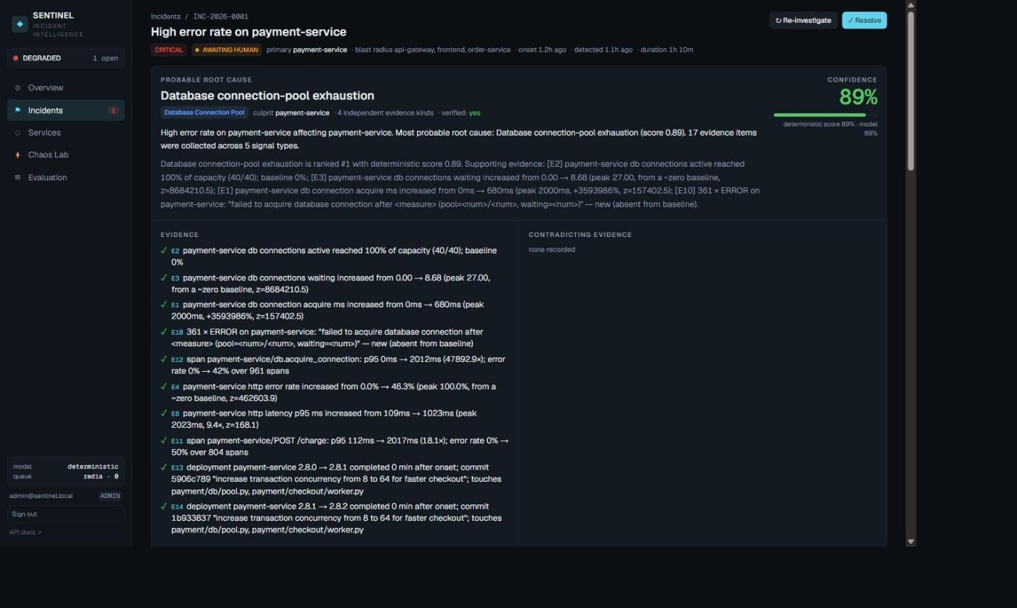
THE PRODUCT
A real incident, end to end: INC-2026-0001 — High error rate on payment-service
ROOT CAUSE
Database…
Database connection-pool exhaustion
CONFIDENCE
89%
deterministic score 89% · verified yes
EVIDENCE
17
metric 9 · deployment 3 · trace 2 · dependency 2 · log 1
BLAST RADIUS
4
services merged into one incident, primary re-pointed to the deepest failing callee
Screenshot from the running platform (Docker Compose stack, PostgreSQL + Redis, separate worker). The fault was a bad deployment that raised transaction concurrency past the pool.
SENTINEL · evidence-driven incident intelligence
4

Slide 5
ENGINE
How an investigation works: eleven checkpointed stages, resumable after a crash
Timeline
37 ms
Metrics
121 ms
Log
44 ms
Trace
1176 ms
Deployment
9 ms
Dependency
118 ms
Historical
12 ms
Hypothesis Generator
1 ms
Root Cause Synthesizer
5 ms
Evidence Verifier
1 ms
Persist Results
57 ms
Stage | What it does | Output
Metrics | baseline vs incident deviation (z-score, % change), saturation vs ceiling, monotonic trend; 'remained normal' contradictions | metric evidence + signals
Logs | template mining (Drain-style masking), burst ratio vs baseline, keyword → signal catalog, new-exception detection | log evidence, error clusters
Traces | per-operation p95 vs baseline, error spans, client-slow/server-ok → network, critical path of slowest trace | trace evidence
Deployments | versions, commits, changed files, config diffs with proximity-to-onset scoring | deployment/config evidence
Dependency | downstream health, blast radius, shared-dependency culprit hints on the service graph | culprit hints
Historical | incident signature → embedding → cosine retrieval over resolved incidents (RAG) | 'resembles INC-031' evidence
Hypotheses → Synthesizer → Verifier | catalog of 13 failure modes with required/contradicting signals; explicit score; model narrates & cites; verifier re-derives confidence and blocks large reorders | ranked, cited, calibrated
SENTINEL · evidence-driven incident intelligence
5

Slide 6
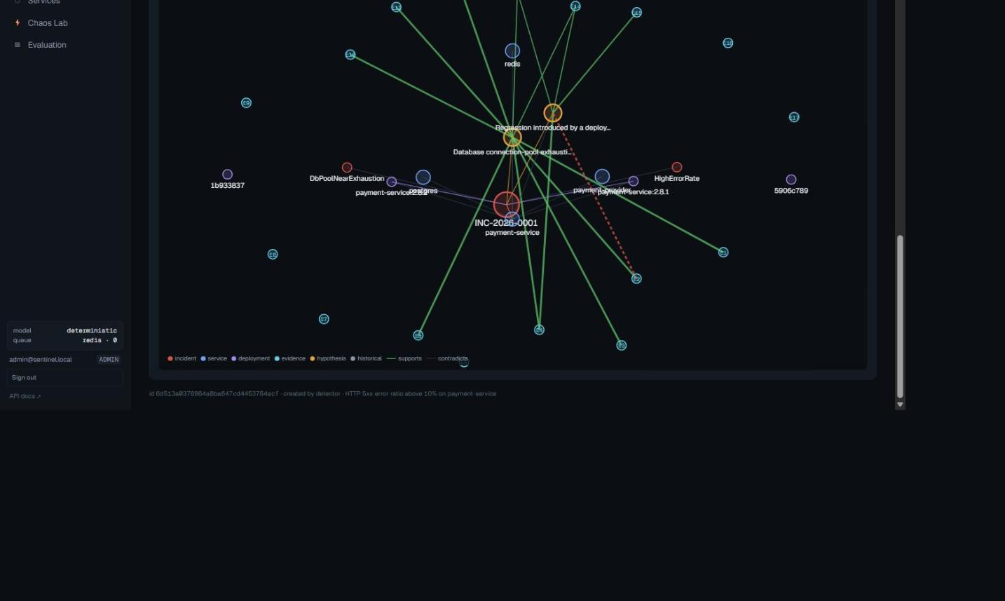
ENGINE
The evidence graph: root-cause analysis as graph + temporal reasoning, not semantic vibes
▸ Nodes — incident, services, deployments, commits, alerts, evidence (E1…En), hypotheses, similar past incidents.
▸ Edges — affects · depends_on · triggered_by · correlated_with · supports · contradicts · resembles — with weights.
▸ Handles are minted by the system — the model may only cite E-handles that exist; the verifier drops anything else and records it.
▸ Contradictions are first-class — 'CPU remained normal' is stored as evidence and shown on the root-cause card; it lowers confidence rather than being hidden.
▸ Score breakdown is stored per hypothesis — signal support + temporal + dependency + historical − contradictions → a number the UI can explain.
SENTINEL · evidence-driven incident intelligence
6

Slide 7
THESIS
Deterministic-first is the product. The model is the least interesting part.
 | Chat-box over logs (typical 'AI ops') | Sentinel
Reproducibility | different answer every run | same evidence → same ranking; benchmarked in CI
Evidence | prose, no references | every claim cites system-minted evidence handles; invalid citations are rejected
Confidence | whatever the model says | re-derived from evidence kinds, contradictions and citation validity; capped at 95%; < 55% → human review
Prompt injection | log content can steer the answer | telemetry rendered as data blocks; model cannot add categories/evidence; deterministic ranking guarded
Model dependency | paid API, data leaves the network | local Ollama or no model at all — the platform works fully without one
Remediation | 'AI rolled back prod' | playbooks proposed; four-eyes approval; adapter executes; verification; audit log
Measurability | anecdotes | 119 scenarios, ground truth, healthy controls, calibration, latency — quality gate in CI
SENTINEL · evidence-driven incident intelligence
7

Slide 8
EVALUATION
Measured, not claimed: 119 synthetic production failures, ground truth never reaches the pipeline
CASES
MEDIAN TIME
119
0.39s
113 faults · 6 healthy controls
p95 0.63s
FIRST ITERATION
CALIBRATION
96.5%
0.32
top-1, before symptom/cause + noise fixes
ECE — under-confident by design
▸ 14 root-cause categories — × target services × intensity / noise / confounding-deploy variants.
▸ Same code path as production — detector → orchestrator → verifier; telemetry synthesised for the whole topology with realistic propagation.
▸ Quality gate in CI — accuracy ≥ 85%, false positives ≤ 10%, citation validity ≥ 95%.
Honesty note: telemetry is synthetic and the catalog and scenarios share an author — see docs/evaluation/methodology.md, threats to validity.
SENTINEL · evidence-driven incident intelligence
8

Slide 9
EVALUATION
Every failure mode, individually: detection and top-1 accuracy per fault type
Fault type | Cases | Detected | Top-1 | Top-3 | Mean conf.
bad_deployment | 7 | 7 | 100% | 100% | 0.89
config_regression | 7 | 7 | 100% | 100% | 0.70
cpu_saturation | 11 | 11 | 100% | 100% | 0.55
database_latency | 11 | 11 | 100% | 100% | 0.58
db_pool_exhaustion | 11 | 11 | 100% | 100% | 0.79
deadlock | 9 | 9 | 100% | 100% | 0.69
dependency_failure | 4 | 4 | 100% | 100% | 0.56
http_500_spike | 9 | 9 | 100% | 100% | 0.65
memory_leak | 11 | 11 | 100% | 100% | 0.75
network_latency | 4 | 4 | 100% | 100% | 0.50
packet_loss | 4 | 4 | 100% | 100% | 0.70
queue_backlog | 7 | 7 | 100% | 100% | 0.68
redis_failure | 9 | 9 | 100% | 100% | 0.70
thread_starvation | 9 | 9 | 100% | 100% | 0.67
SENTINEL · evidence-driven incident intelligence
9

Slide 10
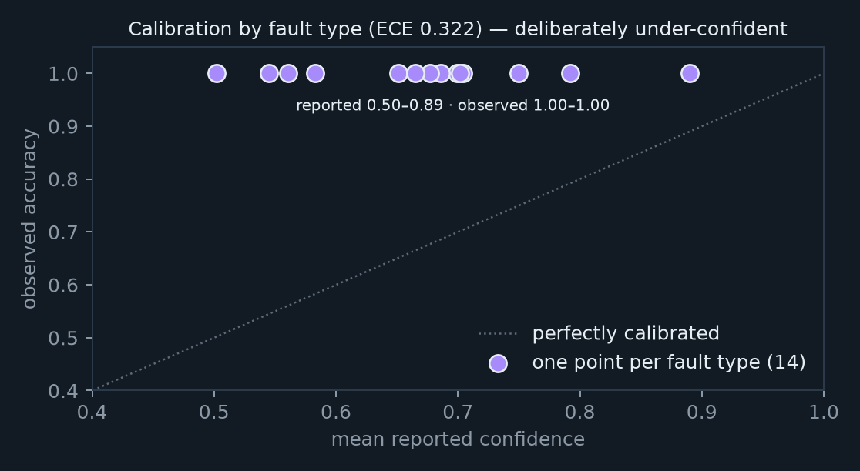
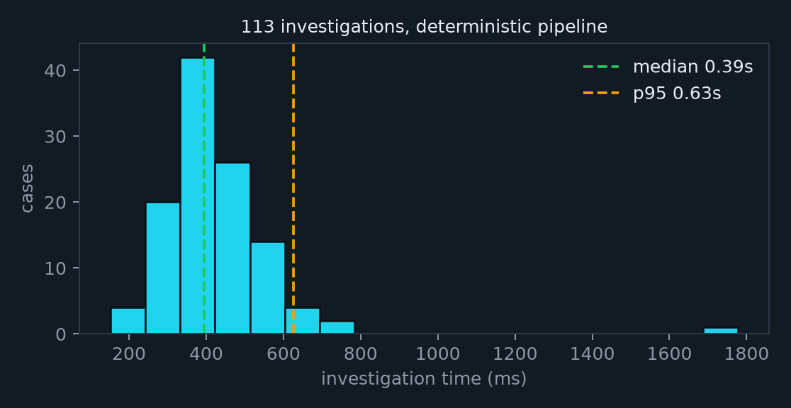
EVALUATION
Confidence you can defend: calibrated, capped, conservative — and fast
▸ Confidence is re-derived, never trusted — score × citation validity − contradictions; ×0.6 if verification fails; capped at 0.75 with < 3 evidence kinds; never above 0.95.
▸ The gap is in the safe direction — reported confidence sits below observed accuracy (ECE 0.32) — the system says 'probably' when it is right, not 'certainly' when it is wrong.
▸ Below 0.55 → HUMAN_REVIEW — the incident is routed to a person instead of a playbook.
▸ Median 0.39s per investigation — on SQLite, in-process; PostgreSQL + worker is the production shape.
SENTINEL · evidence-driven incident intelligence
10

Slide 11
ENGINE
Where the evidence comes from, and where the time goes
Evidence mix for INC-2026-0001 (17 items across 5 signal types)
Investigator time for the same incident — total 1.6s, model time 0s (deterministic narrator)
SENTINEL · evidence-driven incident intelligence
11

Slide 12
AI LAYER
What a local model adds — measured honestly, including when it hurt
Run | Top-1 | Citation validity | Median time | Notes
Deterministic narrator (reference) | 3/3 | 100% | 0.4 s | the pipeline alone
qwen2.5:3b, free reordering | 2/3 | 100% | 248 s | narrator flipped a correct answer on a 0.25 score gap
qwen2.5:3b + rank-stability guard | 3/3 | 100% | 261 s | flip rejected and recorded; cross-exam over-skeptical → human review
▸ Provider abstraction — generate · structured · embed. Ollama on localhost (no key, nothing leaves the host), deterministic fallback, circuit breaker, JSON-schema validation with repair and one re-prompt.
▸ Two guard rails validated by the study — (1) the narrator may reorder only within a 0.10 deterministic score gap; (2) model verification can lower confidence, never raise it.
▸ Conclusion — a 3B model improves prose, not root-cause identification — so it is optional. 7B+ on a GPU is the next experiment; the harness is ready (SENTINEL_LLM_PROVIDER=ollama make eval).
▸ Cost — ₹0 in API spend — measured as latency and tokens instead.
SENTINEL · evidence-driven incident intelligence
12

Slide 13
SAFETY
Human-in-the-loop remediation: Sentinel proposes, people decide, everything is audited
Root cause
verified
Playbook actions
proposed
Request
ENGINEER+
Approve
SRE+, not requester
Execute
adapter, allow-listed kinds
Verify
service healthy?
Audit log
who · what · why · result
Control | Implementation | Tested
Recommendation-only default | every action starts as `proposed`; nothing executes automatically | ✓
Four-eyes | requester cannot approve their own action (ADMIN excepted) | ✓
Execute gate | 409 unless approved; only `executable` kinds (rollback, restart, scale, clear_fault) | ✓ live on the compose stack
Agent tool boundary | read_logs/metrics/traces/git allowed; rollback/restart/scale denied unless granted | ✓
Audit | who, what, when, why, outcome — for logins, faults, rules, approvals, executions | ✓
Adapter | simulator release manager today; Kubernetes / Argo / feature flags behind the same 2-method interface | —
SENTINEL · evidence-driven incident intelligence
13

Slide 14
PLATFORM
Production engineering is where we earn the word 'production'
Reliability
Retries + exponential backoff | ✓
Idempotent jobs, de-duplicated enqueue | ✓
Per-step timeouts, job timeouts | ✓
Circuit breakers (model, simulator) | ✓
Dead-letter queue | ✓
Checkpoint + resume after crash | ✓
Graceful shutdown, worker recovery | ✓
Rate limiting (memory / Redis) | ✓
Security & operations
JWT + API keys with scopes, RBAC (4 roles) | ✓
Audit logs, four-eyes approval | ✓
Prompt-injection hardening + verifier | ✓
Threat model, runbooks, ADRs | ✓
Prometheus metrics for Sentinel itself + Grafana | ✓
Alembic migrations, PostgreSQL/SQLite | ✓
Docker Compose stack, CI with eval quality gate | ✓
69 unit / integration / chaos tests | ✓
Known gaps, on purpose: OIDC, PII redaction at ingestion, pgvector at scale, Kubernetes manifests — each has an ADR or a threat-model entry.
SENTINEL · evidence-driven incident intelligence
14

Slide 15
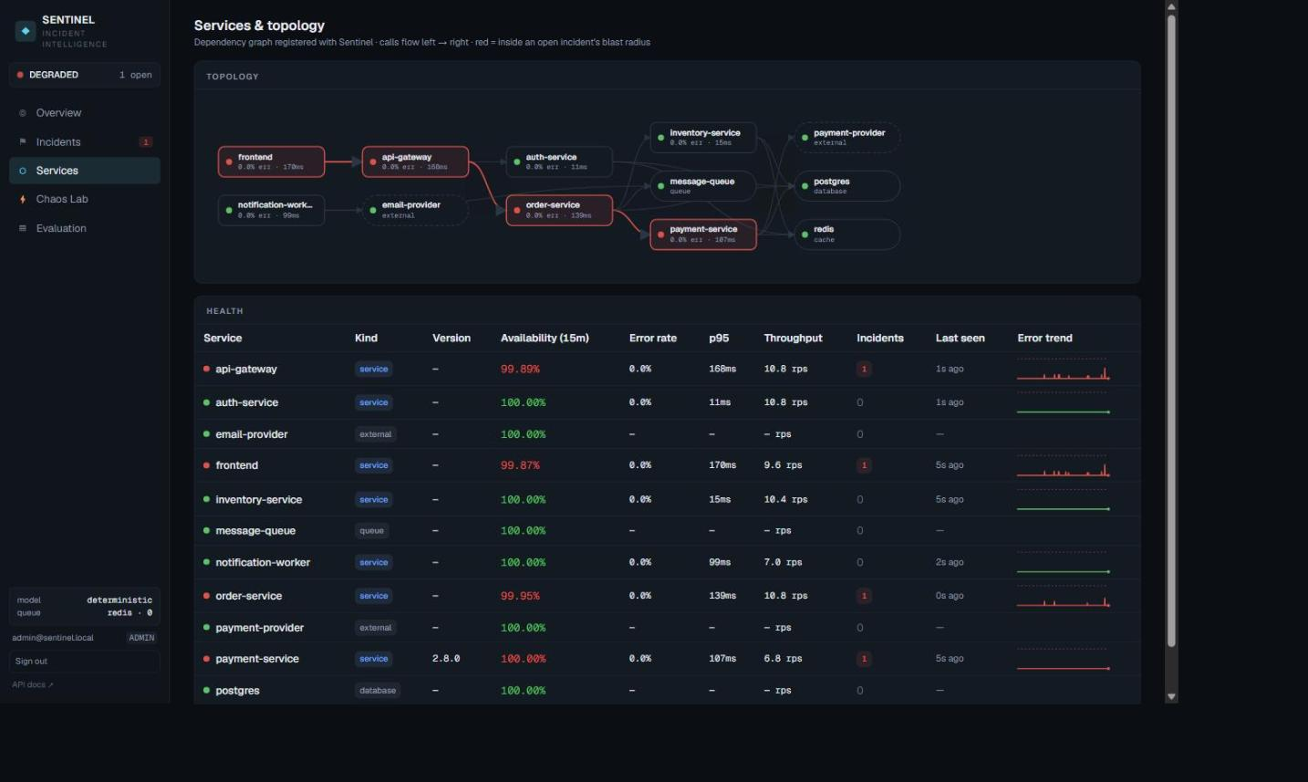
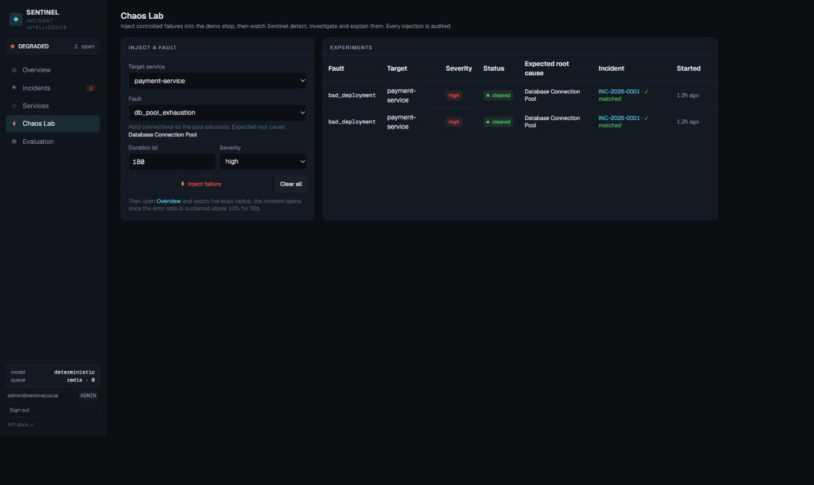
TESTBED
Our own production to break: a seven-service shop over real HTTP with a fourteen-fault chaos engine
▸ Real — seven uvicorn services, real inter-service calls with trace propagation, telemetry pushed to Sentinel and scraped by Prometheus, deployments announced with synthetic Git metadata.
▸ Simulated in-process — DB pool (semaphore + acquire timeout), cache, queue, worker pool, CPU/memory — faithful failure shapes, deterministic and safe.
▸ Faults — pool exhaustion · bad deployment · DB latency · Redis outage · memory leak · CPU · 500 spike · config regression · network latency · packet loss · queue backlog · thread starvation · deadlock · dependency failure.
SENTINEL · evidence-driven incident intelligence
15

Slide 16
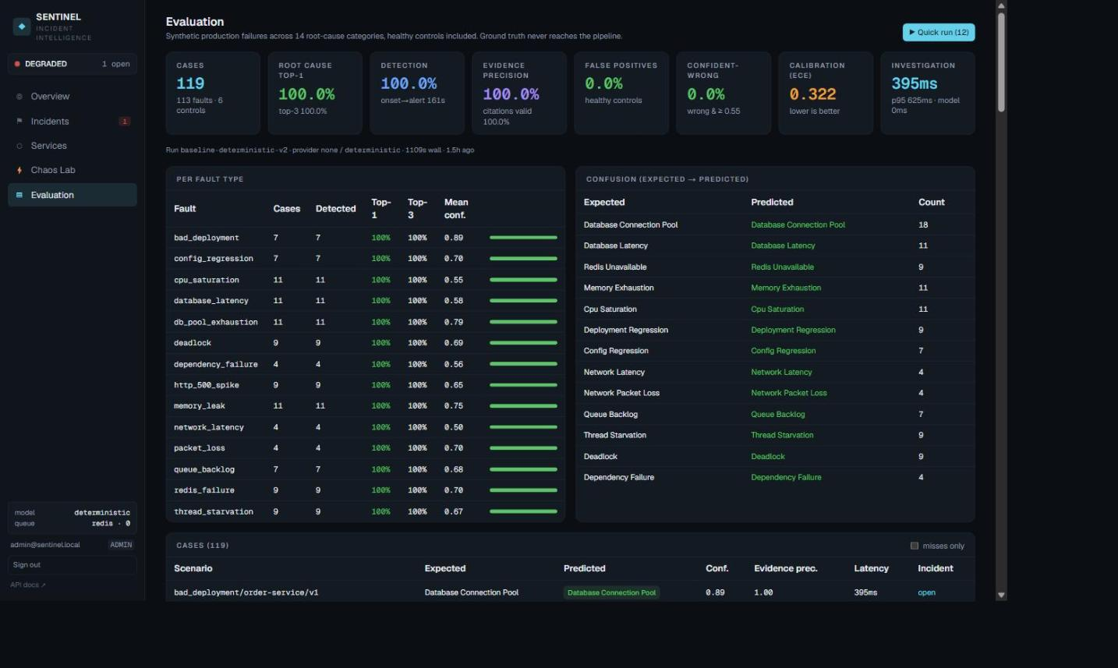
EVALUATION
The evaluation is part of the product: engineers see the same numbers investors do
▸ Per-fault accuracy and confidence
▸ Confusion matrix (expected → predicted)
▸ Every case links to its incident, evidence and hypotheses
▸ 'Quick run' re-executes 12 scenarios from the UI
▸ make eval regenerates docs/evaluation/latest.md
SENTINEL · evidence-driven incident intelligence
16

Slide 17
DEPLOYMENT
Runs anywhere: a laptop with nothing installed, Docker Compose, or Vercel + Railway
Laptop (zero infra)
Docker Compose
Cloud (this deck's links)
sentinel dev
PostgreSQL · Redis
Vercel → Next.js dashboard
SQLite · in-process queue
api · worker (ARQ)
Railway → API (+ scheduler)
deterministic narrator
simulator · web
Railway → PostgreSQL
demo shop :9000–9007
Prometheus · Alertmanager
Railway → demo simulator
web :3000
Grafana · OTel collector · Ollama
same image, SENTINEL_ROLE=…
No code path changes between shapes — only SENTINEL_* settings. Real services plug in through the same ingestion API or the OpenTelemetry collector.
web https://sentinel-phi-seven-74.vercel.app
api https://sentinel-api-mf68.onrender.com
repo https://github.com/raunitgrey7/sentinel
SENTINEL · evidence-driven incident intelligence
17

Slide 18
POSITIONING
Who it is for, and how it is different
 | Observability suites | Incident-management tools | 'AI SRE' chat assistants | Sentinel
Detects | ✓ (alerts) | ✓ (pages) | — | ✓ deterministic rules + Alertmanager
Explains why | partial (anomaly widgets) | — | prose | ranked hypotheses with cited evidence
Shows contradictions & confidence | — | — | — | ✓ calibrated, capped, human-review routing
Data stays on-prem | usually not | not applicable | rarely | ✓ local-first, local model or none
Acts | — | runbooks, paging | sometimes, unsafely | human-approved, audited, verified
Measured accuracy | — | — | — | ✓ 119-case public benchmark
▸ Buyer — platform / SRE teams at companies with 10–500 services who already own their telemetry and cannot ship it to a third-party model.
▸ Wedge — ingestion is OpenTelemetry-shaped and Alertmanager-compatible — Sentinel sits beside existing monitoring, it does not replace it.
▸ Model — open-source core (Apache-2.0); commercial adapters (Kubernetes/Argo/flags), SSO, multi-tenant control plane, support.
SENTINEL · evidence-driven incident intelligence
18

Slide 19
NEXT
Roadmap
Now
Next quarter
Two quarters
Beyond
▸ deterministic pipeline, 14 failure modes
▸ benchmark + CI gate
▸ compose stack, Vercel + Railway
▸ local-model study (3B)
▸ real-target adapters: Kubernetes, Argo, feature flags
▸ PII redaction at ingestion
▸ per-service ingestion credentials, OIDC
▸ 7B+ model study on GPU
▸ learned scoring from labelled real incidents
▸ pgvector retrieval, multi-project control plane
▸ design partners: 3 teams on real telemetry
▸ public benchmark contributions
▸ cross-team incident graphs
▸ change-risk prediction before deploys
▸ managed offering with on-prem data plane
Every item maps to an ADR or a threat-model gap already written down.
SENTINEL · evidence-driven incident intelligence
19

Slide 20
◆
Reality → Evidence → Hypotheses → Verification → Human decision
That architecture is the product. The LLM is the least interesting part.
▸ Try it — https://sentinel-phi-seven-74.vercel.app (admin@sentinel.local / admin12345)
▸ Read it — https://github.com/raunitgrey7/sentinel — architecture, ADRs, threat model, evaluation methodology
▸ Break it — Chaos Lab → inject a fault → watch the investigation → ask it Why?
▸ Talk — raunit.thakur@gmail.com
SENTINEL · evidence-driven incident intelligence
20

