Slide 1


ENTRUST Ensuring Secure & Safe Connected Medical Devices Design with Zero Trust Principles
https://www.entrust-he.eu/
Date: 28/11/2024

Slide 2
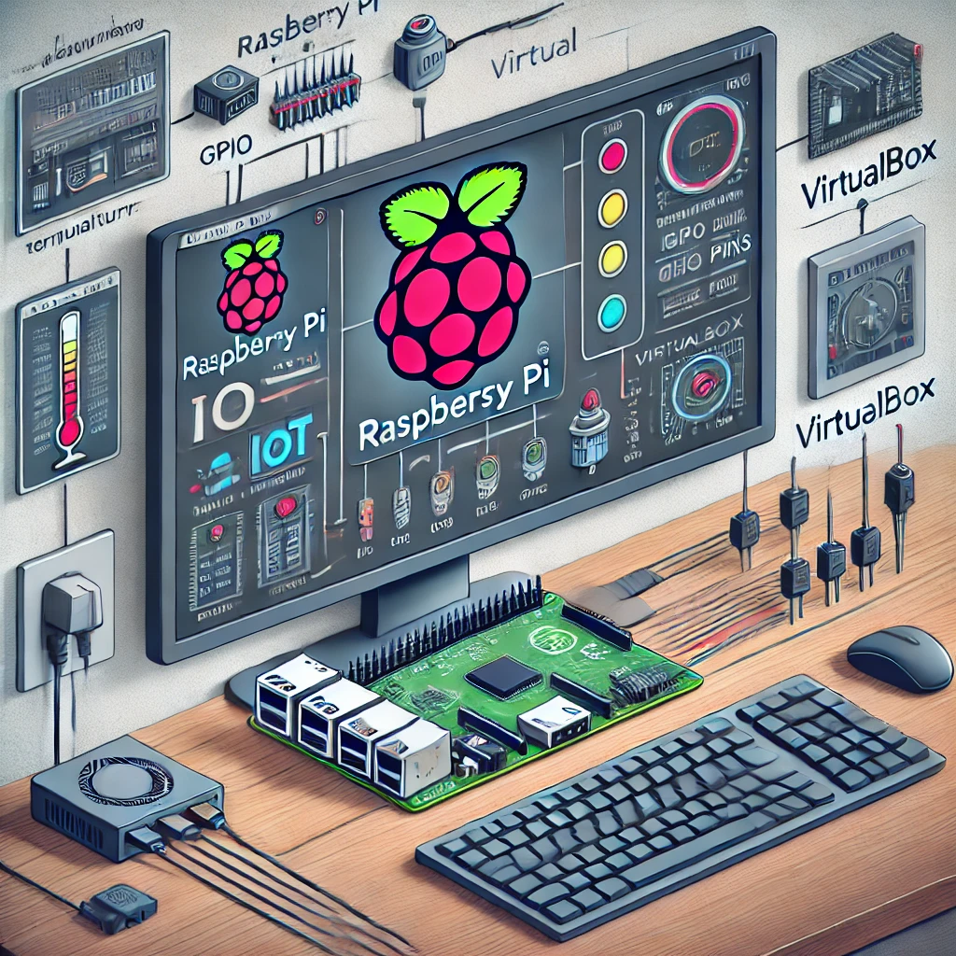
Hardware Emulation
We have used Virtual Box 7.0 to host the Raspberry PI OS image that will act as a hardware emulator for the Raspberry Pi / IoT devices.
Attacks are performed on the emulated Raspberry PI OS and monitored.
Source: Image Generated through CoPilot

Slide 3
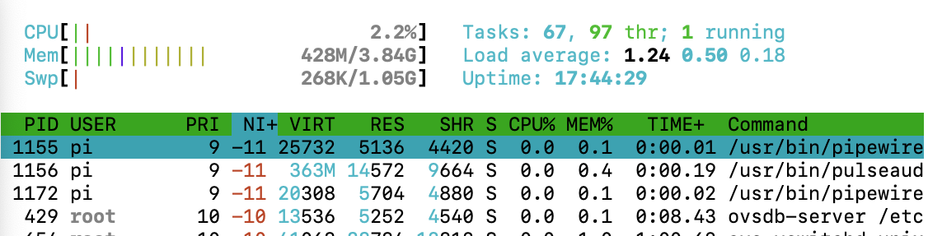
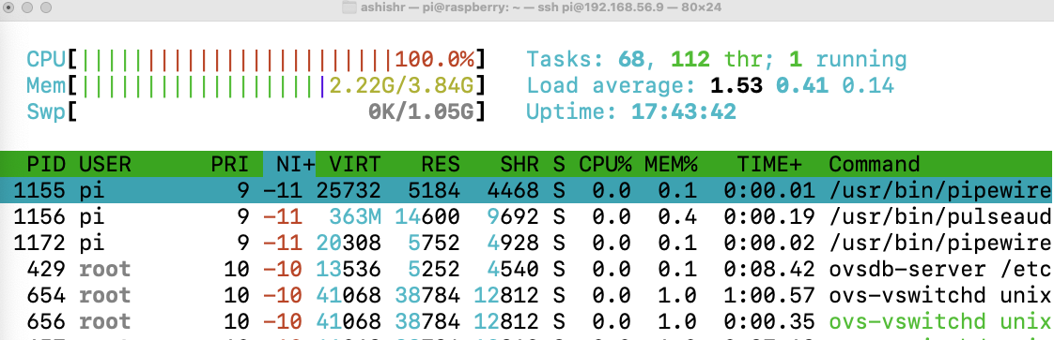
Denial of Service (DoS) Attack on Emulated Raspberry PI
Before the launch of DoS attack
Launching DoS attack on Raspberry Pi through Python Script
Ongoing DoS attack on Raspberry Pi. Notice the CPU and memory utilization

Slide 4
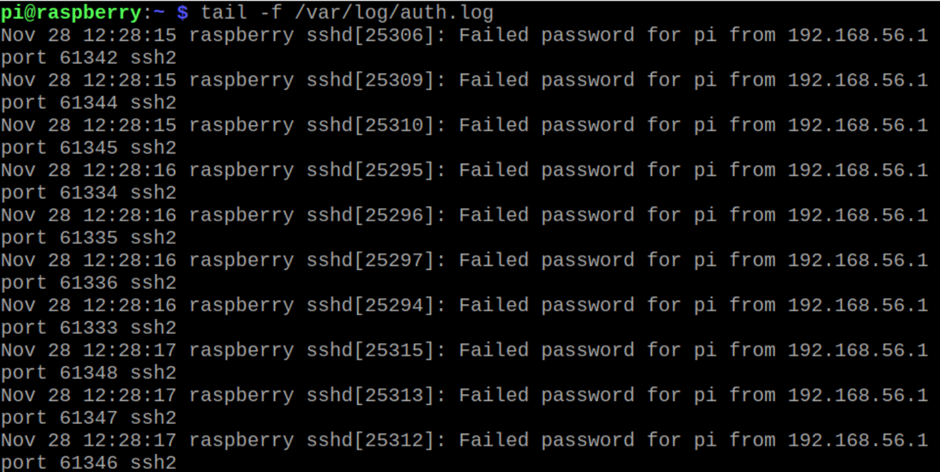
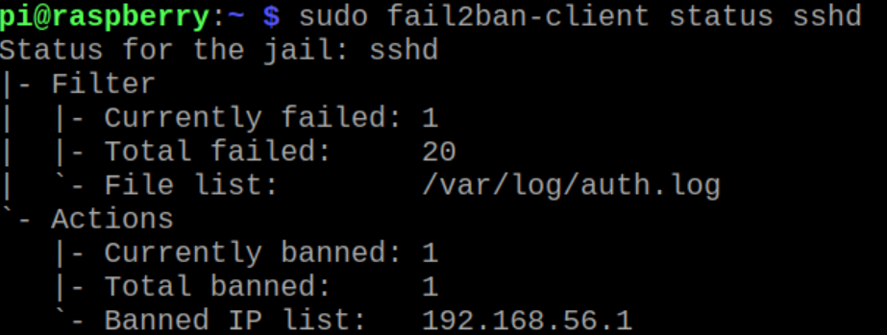
Brute Force Attack on Emulated Raspberry PI
Launching Brute Force Attack on Raspberry PI
Status of Brute Force Attack on Raspberry PI
We can observe the failed password attempted from IP 192.168.56.1
fail2ban banned the IP 192.168.56.1 as a preventive measure against the ongoing Brute Force Attack

Slide 5
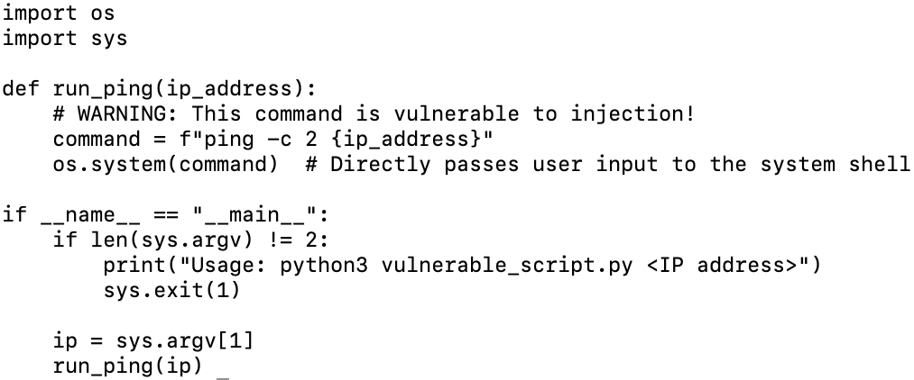
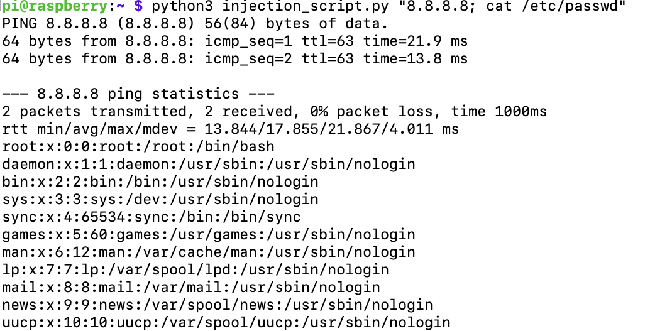
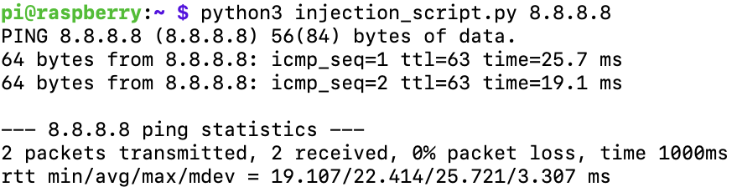
Injection Attack on Emulated Raspberry PI
Vulnerable function for injection attack
Ongoing injection attack to know system details such as passwords
Vulnerable function intended behaviour

Slide 6
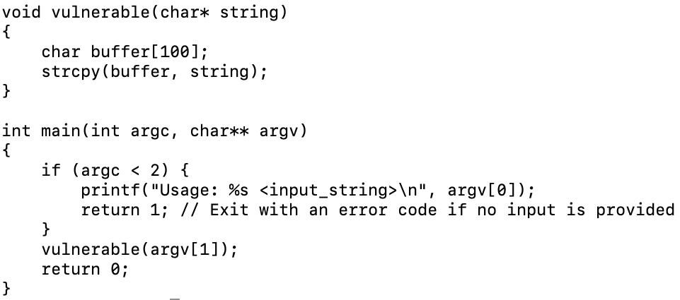
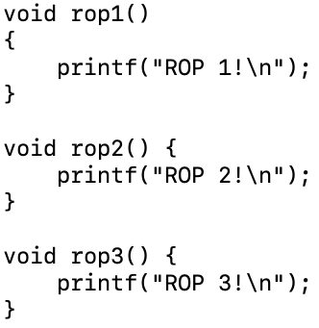
Return Oriented Programming (ROP) Chaining Attack on Emulated Raspberry PI
In ROP Chaining Attack, our aim is to exploit the vulnerable functions of the program running on the Raspberry PI, and take control to execute our own defined functions / launch attacks.
Vulnerable function to be exploited for attack
Functions of interest for attack execution

Slide 7
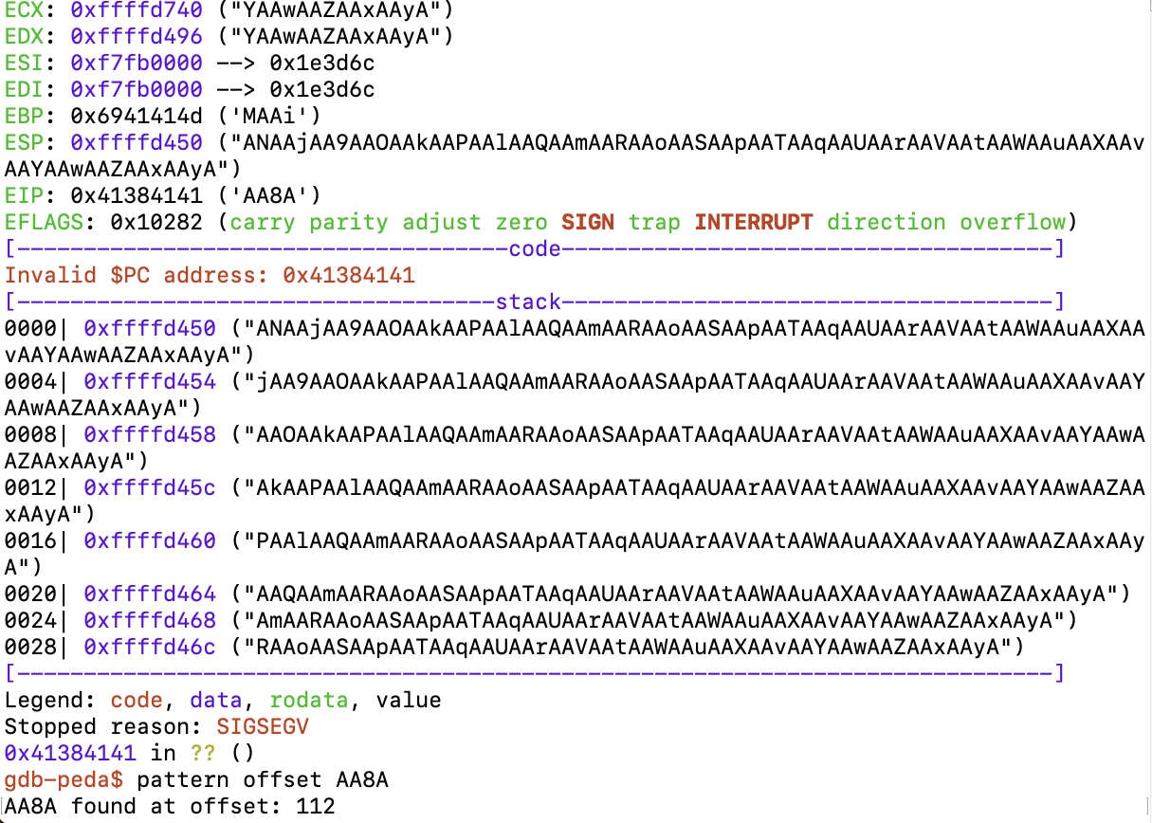
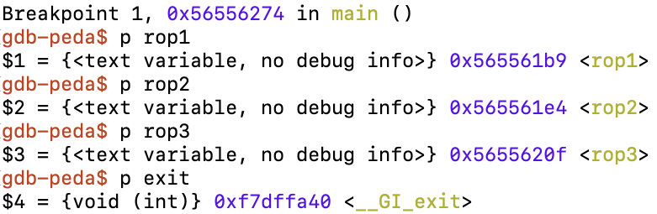
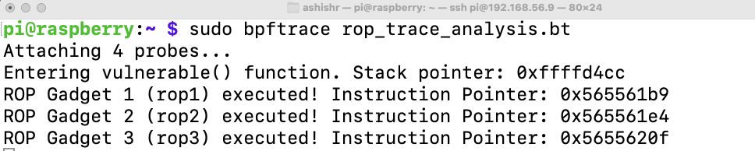
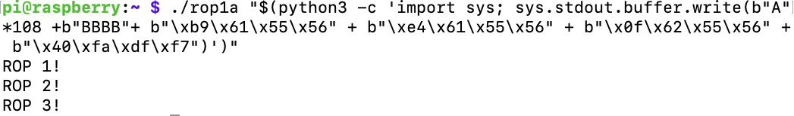
Return Oriented Programming (ROP) Chaining Attack on Emulated Raspberry PI
Memory Addresses of functions of interest for attack execution
Memory Registers Addresses
Memory Tracer – Pointing out Addresses
Need at least 112 bytes to fill up the memory buffer to perform ROP Chaining attack
Payload for Attack Execution
Source Code: https://github.com/rauniyar01/ENTRUST

Slide 8
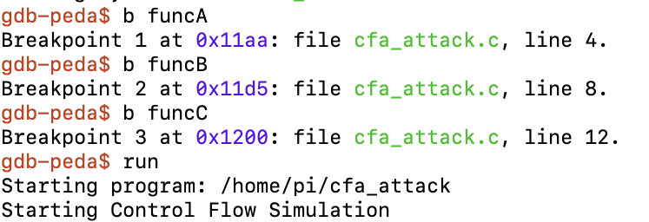
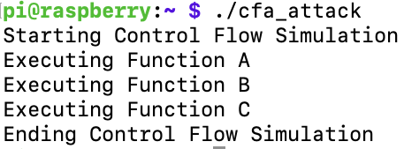
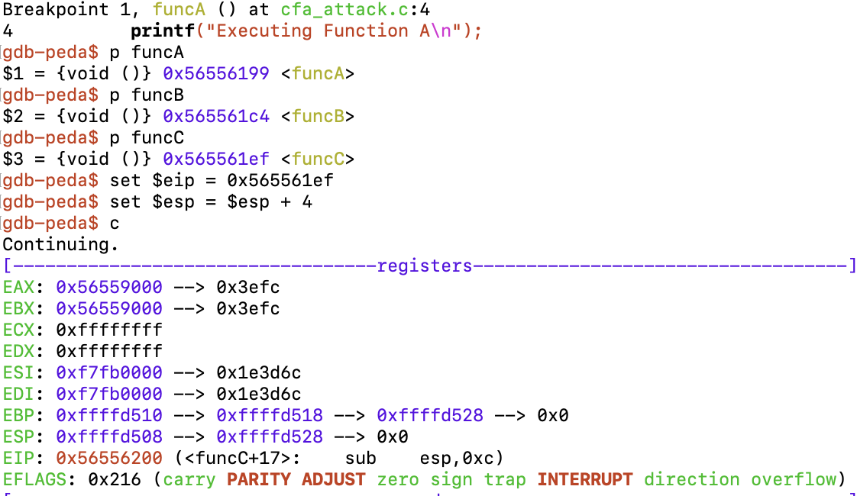
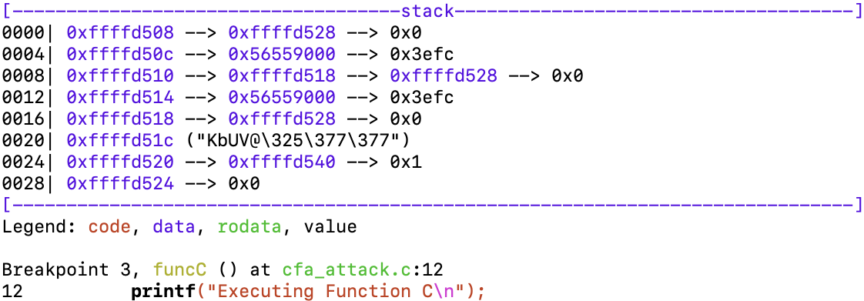
Control Flow Attestation (CFA) Attack on Emulated Raspberry PI OS
Original flow of the program
Setting up breakpoints to verify if we can alter the flow of functions execution
Setting up the Instruction Pointer Register and Stack Pointer Register to point it to the memory address of funcC.
Our aim is to break the flow of the program i.e., skip executing funcB
CFA succeeded as we exploited the program to skip executing funcB and jump directly to executing funcC after funcA

