Slide 1


A Case for Subarray-Level Parallelism (SALP) in DRAM
Yoongu Kim, Vivek Seshadri, Donghyuk Lee, Jamie Liu, Onur Mutlu

Slide 2
Executive Summary
Problem: Requests to same DRAM bank are serialized
Our Goal: Parallelize requests to same DRAM bank at a low cost
Observation: A bank consists of subarrays that occassionally share global structures
Solution: Increase independence of subarrays to enable parallel operation
Result: Significantly higher performance and energy-efficiency at low cost (+0.15% area)

Slide 3
Outline
Motivation & Key Idea
Background
Mechanism
Related Works
Results

Slide 4
Introduction
DRAM
Bank
Bank conflict!
Req
Bank
Req
Req
Req
Req
Req
Bank
Req
4x latency
Bank
Req

Slide 5
Bank conflicts degrade performance
Three Problems
Requests are serialized
Serialization is worse after write requests
Thrashing in row-buffer
Bank
Row
Row
Req
Req
Req
Row
Row
Thrashing: increases latency
Row-Buffer

Slide 6
Case Study: Timeline
Case #1. Different Banks
Bank
Wr
Rd
time
Bank
Wr
Rd
time
Case #2. Same Bank
Delayed
Served in parallel
Bank
Wr
Wr
3
Wr
Wr
2
2
Wr
3
Rd
Wr
2
Rd
2
Rd
Rd
Rd
3
Rd
time
3. Thrashing Row-Buffer
1. Serialization
2. Write Penalty

Slide 7
Our Goal
Goal: Mitigate the detrimental effects of bank conflicts in a cost-effective manner
Naïve solution: Add more banks
Very expensive
We propose a cost-effective solution

Slide 8
Key Observation #1
A DRAM bank is divided into subarrays
Logical Bank
Physical Bank
Row
Subarray₆₄
Row
Local Row-Buf
32k rows
Row
Subarray₁
Row
Local Row-Buf
Row-Buffer
Global Row-Buf
A single row-buffer cannot drive all rows
Many local row-buffers, one at each subarray

Slide 9
Key Observation #2
Each subarray is mostly independent…
except occasionally sharing global structures
Subarray₆₄
Local Row-Buf
Global Decoder
···
Subarray₁
Local Row-Buf
Bank
Global Row-Buf

Slide 10
Key Idea: Reduce Sharing of Globals
1. Parallel access to subarrays
Local Row-Buf
Global Decoder
···
Local Row-Buf
Bank
Global Row-Buf
2. Utilize multiple local row-buffers

Slide 11
Overview of Our Mechanism
Subarray₆₄
Local Row-Buf
1. Parallelize
2. Utilize multiple local row-buffers
···
Req
Req
Req
Req
To same bank...
but diff. subarrays
Subarray₁
Local Row-Buf
Global Row-Buf

Slide 12
Outline
Motivation & Key Idea
Background
Mechanism
Related Works
Results

Slide 13
Organization of DRAM System
DRAM System
CPU
Channel
Rank
Rank
Bus
Bank
Bank

Slide 14
Naïve Solutions to Bank Conflicts
More channels: expensive
More ranks: low performance
More banks: expensive
DRAM System
Channel
Bus
Channel
Channel
Channel
Bus
Low frequency
Rank
R
R
R
R
Many CPU pins
Significantly increases DRAM die area
Channel
Bus
Bank
Channel
Bus
Large load

Slide 15
Logical Bank
bitlines
Row
0
V_{DD}
addr
Row
0
Decoder
wordlines
Row
0
Total latency: 50ns!
Row
0
data
Row-Buffer
RD/WR
ACTIVATE
Precharged
State
?
Activated State
PRECHARGE

Slide 16
Physical Bank
Local bitlines: short
very long bitlines: hard to drive
Subarray₆₄
512 rows
Local Row-Buf
···
32k rows
Subarray₁
Local Row-Buf
Row-Buffer
Global Row-Buf

Slide 17
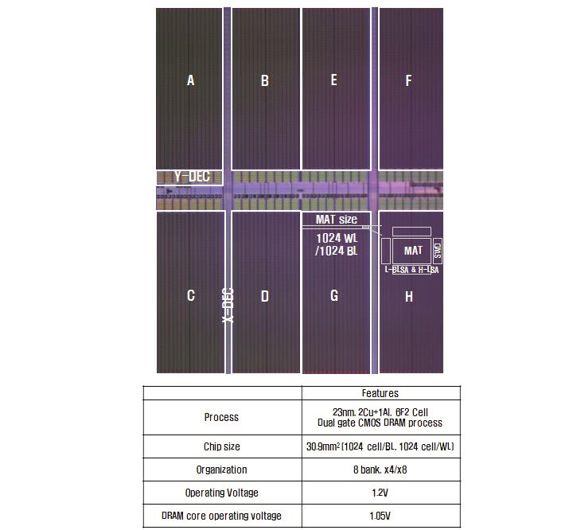
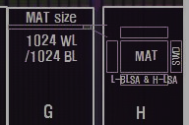
Hynix 4Gb DDR3 (23nm) Lim et al., ISSCC’12
Subarray Decoder
Subarray
Bank0
Bank1
Bank2
Bank3
Bank5
Bank6
Bank7
Bank8
Tile
Magnified

Slide 18
Bank: Full Picture
Bank
Global bitlines
Local bitlines
Subarray₆₄
Local Row-Buf
Global Decoder
Subarray Decoder
···
Latch
Local bitlines
Subarray₁
Local Row-Buf
Global Row-Buf

Slide 19
Outline
Motivation & Key Idea
Background
Mechanism
Related Works
Results

Slide 20
Problem Statement
To different subarrays
Local Row-Buf
···
Req
Req
Serialized!
Local Row-Buf
Global Row-Buf

Slide 21
Overview: MASA
MASA (Multitude of Activated Subarrays)
V_{DD}
ACTIVATED
Local Row-Buf
addr
addr
Challenges: Global Structures
Global Decoder
···
V_{DD}
ACTIVATED
Local Row-Buf
READ
READ
Global Row-Buf

Slide 22
Challenges: Global Structures
1. Global Address Latch
2. Global Bitlines

Slide 23
Challenge #1. Global Address Latch
V_{DD}
PRECHARGED
ACTIVATED
Local row-buffer
addr
addr
Global Decoder
···
Latch
Latch
Latch
V_{DD}
ACTIVATED
Local row-buffer
Global row-buffer

Slide 24
Solution #1. Subarray Address Latch
V_{DD}
ACTIVATED
Local row-buffer
Global Decoder
···
Latch
Latch
Latch
V_{DD}
ACTIVATED
Local row-buffer
Global row-buffer

Slide 25
Challenges: Global Structures
1. Global Address Latch
Problem: Only one raised wordline
Solution: Subarray Address Latch
2. Global Bitlines

Slide 26
Challenge #2. Global Bitlines
Global bitlines
Local row-buffer
Switch
Collision
Local row-buffer
Switch
READ
Global row-buffer

Slide 27
Solution #2. Designated-Bit Latch
Global bitlines
Wire
Local row-buffer
D
D
Switch
Local row-buffer
D
D
Switch
READ
READ
Global row-buffer

Slide 28
Challenges: Global Structures
1. Global Address Latch
Problem: Only one raised wordline
Solution: Subarray Address Latch
2. Global Bitlines
Problem: Collision during access
Solution: Designated-Bit Latch

Slide 29
MASA: Advantages
Baseline (Subarray-Oblivious)
MASA
1. Serialization
Wr
2
3
Wr
2
3
Rd
3
Rd
time
2. Write Penalty
3. Thrashing
Saved
Wr
Rd
time
Wr
Rd

Slide 30
MASA: Overhead
DRAM Die Size: Only 0.15% increase
Subarray Address Latches
Designated-Bit Latches & Wire
DRAM Static Energy: Small increase
0.56mW for each activated subarray
But saves dynamic energy
Controller: Small additional storage
Keep track of subarray status (< 256B)
Keep track of new timing constraints

Slide 31
Cheaper Mechanisms
Latches
3. Thrashing
1. Serialization
2. Wr-Penalty
D
MASA
SALP-2
D
SALP-1

Slide 32
Outline
Motivation & Key Idea
Background
Mechanism
Related Works
Results

Slide 33
Related Works
Randomized bank index [Rau ISCA’91, Zhang+ MICRO’00, …]
Use XOR hashing to generate bank index
Cannot parallelize bank conflicts
Rank-subsetting [Ware+ ICCD’06, Zheng+ MICRO’08, Ahn+ CAL’09, …]
Partition rank and data-bus into multiple subsets
Increases unloaded DRAM latency
Cached DRAM [Hidaka+ IEEE Micro’90, Hsu+ ISCA’93, …]
Add SRAM cache inside of DRAM chip
Increases DRAM die size (+38.8% for 64kB)
Hierarchical Bank [Yamauchi+ ARVLSI’97]
Parallelize accesses to subarrays
Adds complex logic to subarrays
Does not utilize multiple local row-buffers

Slide 34
Outline
Motivation & Key Idea
Background
Mechanism
Related Works
Results

Slide 35
Methodology
DRAM Area/Power
Micron DDR3 SDRAM System-Power Calculator
DRAM Area/Power Model [Vogelsang, MICRO’10]
CACTI-D [Thoziyoor+, ISCA’08]
Simulator
CPU: Pin-based, in-house x86 simulator
Memory: Validated cycle-accurate DDR3 DRAM simulator
Workloads
32 Single-core benchmarks
SPEC CPU2006, TPC, STREAM, random-access
Representative 100 million instructions
16 Multi-core workloads
Random mix of single-thread benchmarks

Slide 36
Configuration
System Configuration
CPU: 5.3GHz, 128 ROB, 8 MSHR
LLC: 512kB per-core slice
Memory Configuration
DDR3-1066
(default) 1 channel, 1 rank, 8 banks, 8 subarrays-per-bank
(sensitivity) 1-8 chans, 1-8 ranks, 8-64 banks, 1-128 subarrays
Mapping & Row-Policy
(default) Line-interleaved & Closed-row
(sensitivity) Row-interleaved & Open-row
DRAM Controller Configuration
64-/64-entry read/write queues per-channel
FR-FCFS, batch scheduling for writes

Slide 37
Single-Core: Instruction Throughput
17%
20%
MASA achieves most of the benefit of having more banks (“Ideal”)

Slide 38
Single-Core: Instruction Throughput
20%
17%
13%
7%
DRAM Die Area | < 0.15% | 0.15% | 36.3%
SALP-1, SALP-2, MASA improve performance at low cost

Slide 39
Single-Core: Sensitivity to Subarrays
You do not need many subarrays for high performance

Slide 40
Single-Core: Row-Interleaved, Open-Row
15%
12%
MASA’s performance benefit is robust to mapping and page-policy

Slide 41
Single-Core: Row-Interleaved, Open-Row
-19%
+13%
MASA increases energy-efficiency

Slide 42
Other Results/Discussion in Paper
Multi-core results
Sensitivity to number of channels & ranks
DRAM die area overhead of:
Naively adding more banks
Naively adding SRAM caches
Survey of alternative DRAM organizations
Qualitative comparison

Slide 43
Conclusion
Problem: Requests to same DRAM bank are serialized
Our Goal: Parallelize requests to same DRAM bank at a low cost
Observation: A bank consists of subarrays that occassionally share global structures
MASA: Reduces sharing to enable parallel access and to utilize multiple row-buffers
Result: Significantly higher performance and energy-efficiency at low cost (+0.15% area)

Slide 44
A Case for Subarray-Level Parallelism (SALP) in DRAM
Yoongu Kim, Vivek Seshadri, Donghyuk Lee, Jamie Liu, Onur Mutlu

