Slide 1



High-performance Memory Hierarchy Design for Throughput Processors
Rachata Ausavarungnirun
Architecture Research Group
The Sirindhorn Thai-German Graduate Study, KMUTNB

Slide 2

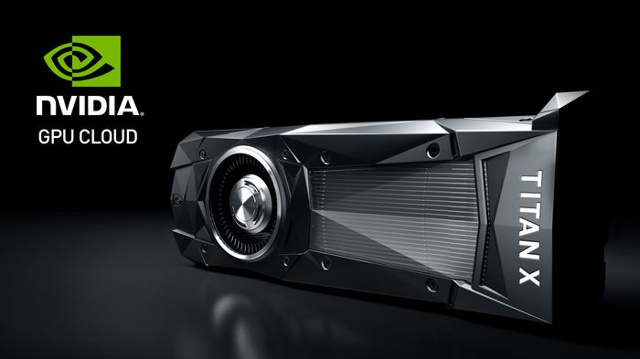
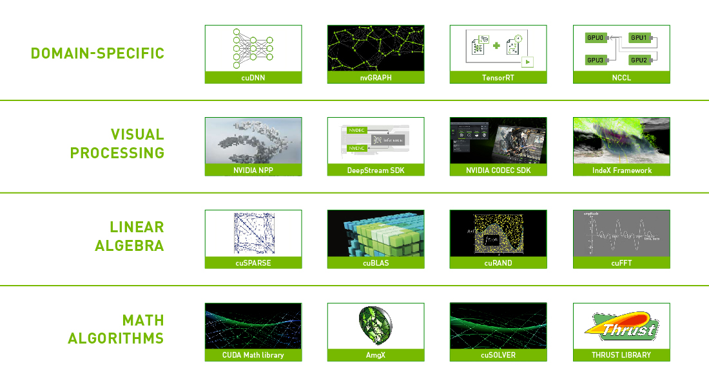
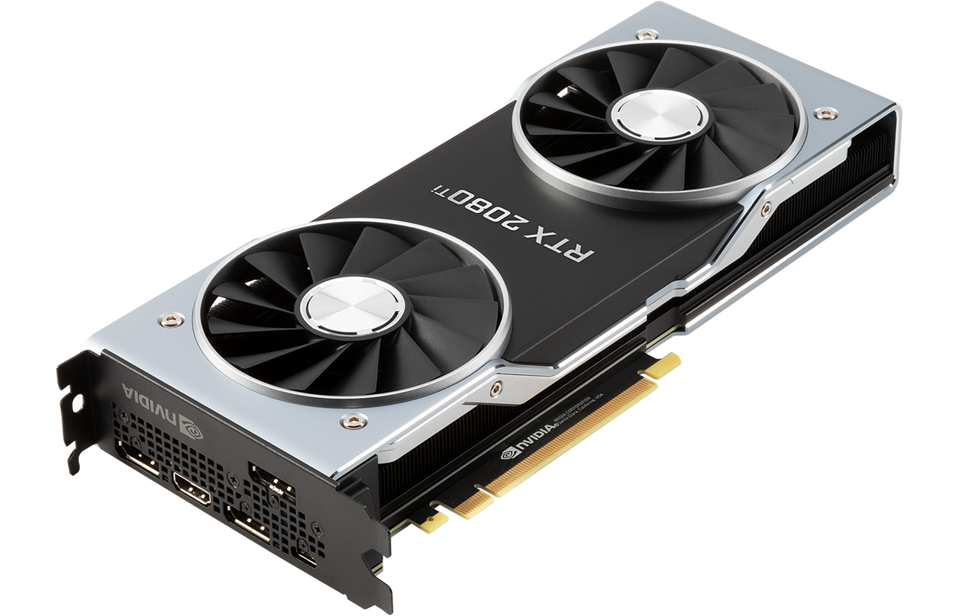


GPU in Modern Systems
GPUs gain their popularity through their massive parallelism
https://developer.nvidia.com/cuda-toolkit
https://nvidianews.nvidia.com/news/nvidia-gpu-cloud-now-available-to-hundreds-of-thousands-of-ai-researchers-using-nvidia-desktop-gpus
Notes:
No animation to make it faster

Slide 3
Parallelism in GPU
Time
GPU Core
Status
GPU Core
8 Loads
Warp A
Warp B
32 Loads
Active
Warp C
Warp D
Lockstep
Execution
GPU is much more (4x-20x) memory-intensive
than memory-intensive CPU applications
Stall
Thread
Active
Notes:
The following figure shows the structure of the GPUs and how they execute a program. When a program is sent to be executed on the GPU, it will be broken down to thousands and million of threads. The GPU core will execute a collection of thread, which is called a warp, in lockstep as shown. As a result, when there is a long latency memory instruction, as shown in this red block. There will be parallel memory requests coming out of the GPU.

Slide 4
Memory Bottlenecks in the GPU
Memory divergence at the caches and the main memory
Warp A
Cache Hit
Stall Time
Time
Main Memory
Cache Miss
Cache Hit
Notes:
No animation to make it faster

Slide 5
Memory Bottlenecks in the GPU
Memory divergence at the caches and the main memory
Interference at the main memory
Notes:
No animation to make it faster

Slide 6
Memory Bottlenecks in the GPU
Memory divergence at the caches and the main memory
Interference at the main memory
Core 1
Core 2
Core 3
Core 4
GPU
Req
Req
Req
Req
Req
Req
Req
Req
Req
Req
Req
Req
Req
Req
Req
Req
Req
Req
Req
Req
Req
Req
Req
Req
Req
Memory Scheduler
To DRAM
Notes:
No animation to make it faster

Slide 7
Memory Bottlenecks in the GPU
Memory divergence at the caches and the main memory
Interference at the main memory
Limited TLB reach and high address translation latency
GPU Core
GPU Core
GPU Core
GPU Core
Private TLB
Private TLB
Private TLB
Private TLB
Private
Shared TLB
Limited TLB reach
Shared
Page Table Walkers
High latency page walks
Page Table
(Main memory)
Data
(Main Memory)
Notes:
No animation to make it faster

Slide 8
Memory Bottlenecks in the GPU
Memory divergence at the caches and the main memory
Interference at the main memory
Limited TLB reach and high address translation latency
High latency CPU-GPU data transfer
High latency
I/O
GPU-side memory
CPU-side memory
Data
(GPU Main Memory)
CPU Memory
Notes:
No animation to make it faster

Slide 9
Redesigning GPU Memory Hierarchy
Memory divergence at the caches and the main memory
Interference at the main memory
Limited TLB reach and high address translation latency
High latency CPU-GPU data transfer
Notes:
No animation to make it faster

Slide 10
Redesigning GPU Memory Hierarchy
Memory divergence at the caches and the main memory
Interference at the main memory
Limited TLB reach and high address translation latency
High latency CPU-GPU data transfer
Notes:
No animation to make it faster

Slide 11



Exploiting Inter-Warp Heterogeneity to Improve GPGPU Performance
Rachata Ausavarungnirun
Saugata Ghose, Onur Kayiran, Gabriel H. Loh
Chita Das, Mahmut Kandemir, Onur Mutlu
PACT-24 | San Francisco, CA | 2015

Slide 12
Inefficiency: Memory Divergence
Warp A
Cache Hit
Stall Time
Time
Main Memory
Q: How to fully take advantage of the low latency L1 and L2 caches?
Cache Miss
Cache Hit

Slide 13
Observation 1: Divergence Heterogeneity
Mostly-hit warp
Mostly-miss warp
All-hit warp
All-miss warp
Reduced
Stall Time
Time
Goals 1:
Convert mostly-hit warps to all-hit warps
Convert mostly-miss warps to all-miss warps
Cache Miss
Cache Hit

Slide 14
Observation 2: Stable Divergence Char.
Warp retains its hit ratio during a program phase
Q: Can we lower memory requests latency even further?

Slide 15
Observation 3: Queuing at L2 Banks
Request Buffers
Shared L2 Cache
Bank 0
Memory
Scheduler
Bank 1
Bank 2
To
DRAM
……
……
Bank n
45% of requests stall 20+ cycles at the L2 queue
Goal 2: Bypass some cache accesses
Reduce cache queuing latency
Reduce cache contention
Notes:
9 mins
----- Meeting Notes (10/9/15 12:39) -----
Heterogeneity here as well

Slide 16
Memory Divergence Correction
Warp-type-aware Cache Bypassing
Mostly-miss, All-miss
Mostly-hit and all-hit: high priority queue
Bypass mostly-miss and all-miss accesses
Identify warp-type
Shared L2 Cache
Bank 0
Warp-type-aware
Memory Scheduler
Bank 1
Low Priority
Bank 2
N
Warp Type Identification Logic
Memory
Request
Bypassing Logic
High Priority
Mostly-miss and all-miss accesses: LRU
Others: MRU
……
Y
To
DRAM
Bank n
Any Requests
in High Priority
Memory Scheduler
Warp-type-aware Cache Insertion Policy

Slide 17
Results: Performance of MeDiC
21.8%
MeDiC is effective in identifying warp-type and taking advantage of divergence heterogeneity

Slide 18
MeDiC: Summary
Problem: memory divergence
Threads execute in lockstep, but not all threads hit in the cache
A single long latency thread can stall an entire warp
Key Observations:
Memory divergence characteristic differs across warps
Some warps mostly hit in the cache, some mostly miss
Divergence characteristic is stable over time
L2 queuing exacerbates memory divergence problem
Our Solution: Memory Divergence Correction
Uses cache bypassing, cache insertion and memory scheduling to prioritize mostly-hit warps and deprioritize mostly-miss warps
Key Results:
21.8% better performance and 20.1% better energy efficiency compared to state-of-the-art caching policy on GPU

Slide 19
Redesigning GPU Memory Hierarchy
Memory divergence at the caches and the main memory
Interference at the main memory
TLB reach and address translation
High latency CPU-GPU data transfer
Notes:
No animation to make it faster

Slide 20
Staged Memory Scheduling
Rachata Ausavarungnirun
Kevin Chang, Lavanya Subramanian, Gabriel H. Loh, Onur Mutlu
ISCA-39 | Portland, OR | 2012
Notes:
Good afternoon everyone. Today I am going to present Staged Memory Scheduling. This is work done by [my name], …, …, …, and my advisor …

Slide 21
CPU-GPU Heterogeneous Systems
Modern chips integrate GPUs on the same die as CPUs
Basic rendering can be done through the integrated GPUs
These integrated GPUs share off-chip memory
Heavy Interference at the main memory
Lower performance
Notes:
When GPU is introduced into the system <click>, because the GPU is memory-intensive, requests from cores contend heavily with request from the GPU, as you can see from this example
<click>
The memory-intensive GPU application will send a lot of request to the memory request buffer
<click>
As a result, some of the requests are unable to be inject into the request buffer, as illustrated by this blue request from core 2.
<click>
When only some of the memory requests can inject into the request buffer, memory scheduler cannot observe full applications behavior. This can lead to a poor scheduling decision
<click… transition>
A naïve solution to this problem is to increase the size of the monolithic request buffer…

Slide 22
Interference in the Main Memory
All cores contend for limited off-chip bandwidth
Inter-application interference degrades system performance
The memory scheduler can help mitigate the problem
Core 1
Core 2
Core 3
Core 4
Req
Req
Req
Req
Req
Req
Req
Req
Memory Request Buffer
Req
Memory Scheduler
Data
Data
To DRAM
Notes:
Main memory is a major bottleneck in current multi-core systems
<click three times>,
Because memory requests from different core contend for a limited off-chip bandwidth
<click>
This inter-application interference degrades system performance. And designing a good memory scheduler can mitigate the problem…
<click>
But how does memory scheduler deliver good performance and fairness.
<click to the next slide>

Slide 23
Introducing the GPU into the System
GPU occupies a significant portion of the request buffers
Limits the MC’s visibility of the CPU applications’ differing memory behavior → can lead to a poor scheduling decision
Core 1
Core 2
Core 3
Core 4
GPU
Req
Req
Req
Req
Req
Req
Req
Req
Req
Req
Req
Req
Req
Req
Req
Req
Req
Req
Req
Req
Req
Req
Req
Req
Req
Memory Scheduler
To DRAM
Notes:
When GPU is introduced into the system <click>, because the GPU is memory-intensive, requests from cores contend heavily with request from the GPU, as you can see from this example
<click>
The memory-intensive GPU application will send a lot of request to the memory request buffer
<click>
As a result, some of the requests are unable to be inject into the request buffer, as illustrated by this blue request from core 2.
<click>
When only some of the memory requests can inject into the request buffer, memory scheduler cannot observe full applications behavior. This can lead to a poor scheduling decision
<click… transition>
A naïve solution to this problem is to increase the size of the monolithic request buffer…

Slide 24
Naïve Solution: Large Monolithic Buffer
Core 1
Core 2
Core 3
Core 4
GPU
Req
Req
Req
Req
Req
Req
Req
Req
Req
Req
Req
Req
Req
Req
Req
Req
Req
Req
Req
Req
Req
Req
Req
Req
Req
Req
Req
Req
Req
Req
Req
Req
Req
Req
Req
Req
Req
Req
Req
Req
Req
Req
Memory Scheduler
To DRAM
Notes:
The naïve solution is to increase the size of the batch scheduler
<click> transition: however …

Slide 25
Problems with Large Monolithic Buffer
Req
Req
Req
Req
Req
Req
Req
Req
Req
Req
Req
Req
Req
Req
Req
Req
A large buffer requires more complicated logic to:
Analyze memory requests (e.g., determine row buffer hits)
Analyze application characteristics
Assign and enforce priorities
This leads to high complexity, high power, large die area
Req
Req
Req
Req
Req
Req
Req
Req
Req
Req
Req
Req
Req
Req
Req
Req
Req
Req
Req
Req
Req
Req
Req
Req
Req
Req
Memory Scheduler
More Complex Memory Scheduler
Goal: Design an application-aware scalable
memory controller that reduces interference
Notes:
<However (continue from the previous slide) a large buffer requires more complicated logic to analyze memory requests (for example, to determine if each request is a row hit), analyze application characteristics, assign and enforce priorities.
<click>
This leads to high complexity, high power, and large die area
<click, the big Mem sched. Appears>
<click, transition>
Our goal in this project is…

Slide 26
Key Functions of a Memory Controller
1) Maximize row buffer hits
Maximize memory bandwidth
Stage 1: Batch Formation
→ Group requests within an application into batches
2) Manage contention between applications
Maximize system throughput and fairness
Stage 2: Batch Scheduler
Schedule batches from different applications
Idea: Decouple the functional tasks of the memory controller
Partition tasks across several simpler HW structures
Notes:
… we observe that there are three key functions that an application aware memory scheduler need to provide concurrently when choosing the next request
<click>
First, a memory scheduler should maximize row buffer hits because this increases the bandwidth utlization
<click>
Second, a memory scheduler should be able to manage contention between different applications. This will increase system throughput and fairness
<click>
Third, a memory scheduler need to satisfy DRAM timing constraints
<click>
Current systems use a centralized memory controller design to accomplish these functions, which is complex when the request buffer is large
<click … transition>
So, our key idea is to …

Slide 27
Stage 1: Batch Formation Example
Stage 1
Next request goes to a different row
Core 1
Core 2
Core 3
Core 4
Batch Formation
Row C
Row E
Row A
Row B
Row E
Row B
Row D
Row A
Row D
Row F
Time window expires
Batch Boundary
To Stage 2 (Batch Scheduling)
Notes:
I will show an example of how the batch formation work
<click>
When there is an incoming requests that access the same row as an earlier requests. (This yellow request that accesses row B), they will be batched. And a batch will become ready to be scheduled under two conditions. First, it will become ready when a subsequent request wants to access a different row, in this case row C. The earlier request to row B will become ready to be scheduled.
A batch can become ready to be scheduled under another condition, which is when the time window for the batch formation expires, which is shown in this example in core 1. this batch formation will happen across all the cores including the GPU.

Slide 28
Staged Memory Scheduling
Core 1
Core 2
Core 3
Core 4
GPU
Stage 1:
Batch
Formation
Stage 2:
Batch Scheduler
SJF
Round-Robin
Probability p : SJF
Probability 1-p : Round-robin
Bank 1
Bank 2
Bank 3
Bank 4
SJF prioritizes CPU applications
Round-robin prioritizes GPU applications
Notes:
In this example, the system consist of 4 CPU cores and a GPU, and the color represent a row the request wants to access. Similar color means these requests want to access the same row.
In the batch formation stage, memory requests that access the same row will be batched.
<click>
One criteria that a batch becomes ready to be scheduled is when the next request is going to a different row, as illustrated in this example at core 2 and core 3. <click click>
Another criteria is when the timeout for the batch formation expires.
This batching process will happen across all cores including the GPU
<click>
<click> and how the batch scheduler will select one of these front batch to send to <click> the DRAM command scheduler.
The scheduler can either use a shortest job poilcy
<click> which will pick this purple request because it is from an application with the fewest number of requests.
Or a round-robin policy
<click>
Whenever the bank is ready to schedule a next request. DRAM command scheduler will schedule the requests in an in-order manner.
<click>
Now that I told you about how SMS works, let me tell you about the complexity of SMS
<click … transition>

Slide 29
Performance at Different GPU Weights
Best Previous
Scheduler
ATLAS
TCM
FR-FCFS
ATLAS [Kim et al., HPCA’10]
Good Multi Core CPU Performance
TCM [Kim et al., MICRO’10]
Good Fairness
FR-FCFS [Rixner et al., ISCA’00]
Good Throughput
Notes:
In this plot, we show the performance of SMS, compared to the best performing scheduler. Note that the best previous algorithm is different for different weights. We vary the GPU weight of 0.001 to 1000. The Y-Axis shows the system performance measured by dividing the CPU-GPU weighted speedup by the total weight to make sure it is bound between 0 and 1.

Slide 30
Performance at Different GPU Weights
At every GPU weight, SMS outperforms the best previous scheduling algorithm for that weight
Best Previous
Scheduler
SMS
Notes:
We found that at every GPU weight, we can configure the probablity of using shortest job first batch scheduling policy such that SMS outperforms the best previous mechanism for that weight

Slide 31
SMS: Summary
Observation: Heterogeneous CPU-GPU systems require memory schedulers with large request buffers
Problem: Existing monolithic application-aware memory scheduler designs are hard to scale to large request buffer size
Solution: Staged Memory Scheduling (SMS)
decomposes the memory controller into three simple stages:
1) Batch formation: maintains row buffer locality
2) Batch scheduler: reduces interference between applications
3) DRAM command scheduler: issues requests to DRAM
Compared to state-of-the-art memory schedulers:
SMS is significantly simpler and more scalable
SMS provides higher performance and fairness
Notes:
We observe that Heterogeneous CPU-GPU systems require memory schedulers with large request buffers and this becomes a problem for existing monolithic application-aware memory scheduler designs because they are hard to scale to large request buffer size
Our Solution is to decomposes MC into three simpler stages:
1) Batch formation: maintains row buffer locality by forming batches of row-hitting requests.
2) Batch scheduler: reduces interference between applications by picking the next batch to prioritize.
3) DRAM command scheduler: issues requests to DRAM
Compared to state-of-the-art memory schedulers:
SMS is significantly simpler and more scalable
SMS provides higher performance and fairness, especially in heterogeneous CPU-GPU systems.

Slide 32
Redesigning GPU Memory Hierarchy
Memory divergence at the caches and the main memory
Interference at the main memory
Limited TLB reach and high address translation latency
Increase TLB reach
Reduce address translation latency
High latency CPU-GPU data transfer
Notes:
No animation to make it faster

Slide 33



Mosaic: A GPU Memory Manager with Application-Transparent Support for Multiple Page Sizes
Rachata Ausavarungnirun
Joshua Landgraf Vance Miller Saugata Ghose
Jayneel Gandhi Christopher J. Rossbach Onur Mutlu
MICRO-50 | Boston, MA | 2017

Slide 34

Demands for Memory Protection in GPUs
Enables multiple GPGPU applications to run concurrently
Better resource utilization
An application often cannot utilize an entire GPU
Different compute and bandwidth demands
Enables GPU sharing in the cloud
Multiple users spatially share each GPU
Key requirement: fine-grained memory protection
Notes:
GPU can benefit from sharing. For example, a cloud provider can increase GPU utilization by allowing multiple users to share the GPU. Applications with heterogeneous resource demand can be co-schedule and executed concurrently to maximize all the available GPU resources. For example, application that demands high compute units can concurrently share GPU resource with applications that demand high memory bandwidth.
However, to safely share GPU across multiple applications, the GPU needs to be able to provide memory protection, which can be enabled to virtual address translation.

Slide 35
Virtual Memory on GPUs
GPU Core
GPU Core
GPU Core
GPU Core
Private TLB
Private TLB
Private TLB
Private TLB
Private
Shared
Shared TLB
Limited TLB reach
High latency page walks
Page Table Walkers
High latency
I/O
GPU-side memory
CPU-side memory
Page Table
(Main memory)
Data
(Main Memory)
CPU Memory
Notes:
In the state-of-the-art virtual memory design on GPUs, the GPU cores contain the private TLB, which cache virtual-to-physical translation data. These private TLB all share the same shared TLB. If a TLB lookup is a miss, there will be a page table walker that performs page table walk, which need to access the GPU main memory multiple times. As you can see here, there are two factor that can affect the performance of virtual memory, which are the limited TLB reach and the high latency of page walks.
Additionally, if the data is not present in GPU memory, then, GPUs need to grab the data all the way from the CPU memory, which is a high latency I/O operation,

Slide 36
Trade-Off with Page Size
Larger pages:
Better TLB reach
High demand paging latency
Smaller pages:
Lower demand paging latency
Limited TLB reach
Can we get the best of both page sizes?
Notes:
With the state-of-the-art design, we found some key tradeoffs based on the page size configuration. We found that if larger pages are used. Then, the GPU has a very good TLB reach; however, we found that large page suffer from high demand paging latency. If small page is used, the GPU has lower demand paging latency, but has a limited TLB reach,

Slide 37


Challenges with Multiple Page Sizes
State-of-the-Art
Time
App 1 Allocation
GPU Memory
Large Page Frame 1
App 2 Allocation
Large Page Frame 2
App 1 Allocation
Large Page Frame 3
Large Page Frame 4
App 2 Allocation
Large Page Frame 5
Cannot coalesce
(without migrating multiple 4K pages)
Coalesce
App 1 Pages
Coalesce
App 2 Pages
Need to search
which pages to coalesce
Unallocated
App 1
App 2
Notes:
To understand the key challenge of using multiple page sizes, let’s go over a simple example. To the right, we show the GPU memory. We further break down the GPU memory into large page frame, which we define as a collection of small pages that can be combined into a large page. In the the state-of-the-art memory manager where the GPU is shared by two application. These two application start allocating data in an interleaved manner as shown in this example, which fill in these large page frames. However, as you can see, when the GPU want to coalesce these small pages into a large page, only one of them can be done. We found that in many cases the GPU cannot coalesce small pages without moving multiple 4K pages. On top of this, the GPU also needs to search for which page should be coalesced

Slide 38
Desirable Allocation
Desirable Behavior
Time
App 1 Allocation
GPU Memory
Large Page Frame 1
App 2 Allocation
Large Page Frame 2
App 1 Allocation
Large Page Frame 3
Large Page Frame 4
App 2 Allocation
Large Page Frame 5
Coalesce
App 1 Pages
Can coalesce
(without moving data)
Coalesce
App 2 Pages
Unallocated
App 1
App 2
Notes:
In an ideal scenario, with the same allocation pattern from these two applications, what the GPU memory should do in order to maximize the number of coalescable pages is to ensure that pages from these two applications are allocated in a separate large page frame as shown in the following example. As you can see here, the GPU can coalesce these small pages without moving the data.

Slide 39
Mosaic Design Goals
High TLB reach
Low demand paging latency
Application transparency
Programmers do not need to modify the applications
Notes:
To this end, our design goal are the following: we would like to be able to achieve high TLB reach with low demand paging latency. In addition, we want our design our mechanism to be application-transparent such that programmers do not need to modify GPGPU applications to take advantage of our design.

Slide 40
Mosaic
GPU Runtime
Contiguity-Conserving
Allocation
In-Place
Coalescer
Contiguity-Aware
Compaction
Hardware
Notes:
Mosaic consists of three different components to GPU runtime as well as the GPU hardware . These three components are working together. The first component is called Contiguity conserving allocation, which is a part of the GPU runtime. The second component is called the In place coalescer, which is a part of both the GPU runtime and the GPU hardware. The last component is called the Contiguity aware compaction, which also is a part of the GPU runtime and the GPU hardware.

Slide 41
Mosaic: Data Allocation
GPU Runtime
1
Application Demands Data
Contiguity-Conserving
Allocation
In-Place
Coalescer
Contiguity-Aware
Compaction
Conserves contiguity within the large page frame
Hardware
2
Allocate Memory
Large Page Frame
Page
Table
Soft guarantee:
A large page frame contains
pages from only a single address space
Data
Notes:
When the GPGPU application demands data. The contiguity conserving allocation starts allocating memory by modifying the page table entries.During this process, the contiguity aware allocator enforce a soft guarantee, ensuring that pages within a large page frame only comes from one single application as shown in this following example. This soft guarantee conserve memory contiguity of the large page frame

Slide 42
Mosaic: Data Allocation
GPU Runtime
1
Application Demands Data
Data transfer is done at a small page granularity
A page that is transferred is immediately ready to use
Contiguity-Conserving
Allocation
In-Place
Coalescer
Contiguity-Aware
Compaction
Hardware
2
Allocate Memory
Large Page Frame
Page
Table
Data
Transfer Data
CPU Memory
3
System I/O Bus
Notes:
One the allocation phases finish, the allocator starts copying data from the CPU memory to the GPU memory; however, data transfer is done at a small page granularity. This ensures that a page that is transferred is ready to be used immediately.

Slide 43
Mosaic: Data Allocation
GPU Runtime
Contiguity-Conserving
Allocation
In-Place
Coalescer
Contiguity-Aware
Compaction
Hardware
4
Transfer Done
Large Page Frame
Page
Table
Data
Transfer Data
CPU Memory
3
System I/O Bus
Notes:
One the data transfer is done, the GPU signals the contiguity conserving allocation, which finish the memory allocation process.

Slide 44
Mosaic: Coalescing
GPU Runtime
Fully-allocated large page frame → Coalesceable
Allocator sends the list of coalesceable pages to the In-Place Coalescer
Contiguity-Conserving
Allocation
In-Place
Coalescer
Contiguity-Aware
Compaction
Hardware
1
List of large pages
Large Page Frame
Large Page Frame
Notes:
After data allocation, the contiguity aware allocation has a full information of which large page frames are fully allocated. In Mosaic, we treat these fully allocated pages, which is shown here, as coalesceable. We treat non-fully-allocated large page frame as not coalescaeable. With this knowledge, the allocator sends the list of these coalesceable pages to the In-place coalescer as shown in this example.

Slide 45
Mosaic: Coalescing
GPU Runtime
In-Place Coalescer has:
List of coalesceable large pages
Key Task: Perform coalescing without moving data
Simply need to update the page tables
Contiguity-Conserving
Allocation
In-Place
Coalescer
Contiguity-Aware
Compaction
Hardware
1
List of large pages
2
Update page tables
Page
Table
Data
Notes:
With the knowledge of the list of coalesceable pages. The only job the in-place coalescer has to perform is to coalesce these small pages in-place. This in-place coalescing does not require data movement and can simply be done by updating the page table.

Slide 46
Mosaic: Coalescing
GPU Runtime
Contiguity-Conserving
Allocation
In-Place
Coalescer
Contiguity-Aware
Compaction
Hardware
1
List of large pages
2
Update page tables
Page
Table
Large Page Table
Small Page Table
1
0
Data
Coalesced Bit
Application-transparent
Data can be accessed using either page size
No TLB flush
Notes:
To update the page table, the in-place coalescer will set the coalseced bit in the page table entry that correspond to the large page base entry. Then, the in-place coalescer will set the disabled bit in all the small page table entries for all the small pages within this large page frame. This provides the additional benefit as our mechanism is application transparent. Data can still be accessed using either page size. In addition, because there is no modification in the small page table entries, there is no need to flush the TLB

Slide 47
Mosaic: Data Deallocation
GPU Runtime
Application Deallocates Data
1
Splinter only frames with deallocated pages
Contiguity-Conserving
Allocation
In-Place
Coalescer
Contiguity-Aware
Compaction
Hardware
Page
Table
2
Splinter Pages (reset the coalesced bit)
Large Page Frame
Data
Notes:
Our mechanism splinter pages when pages are deallocated. As shown here, when an application deallocate a region of memory, the contiguity-aware copmaction start the splinter pages that are deallocated by resetting the coalesced bit, which allows pages to be operated in a small page mode. This allows pages that are still active to be available to be used while the contiguity-aware compaction deallocated other pages.

Slide 48
Mosaic: Compaction
GPU Runtime
2
List of free pages
Compaction decreases memory bloat
Happens only when memory is highly fragmented
Contiguity-Conserving
Allocation
In-Place
Coalescer
Contiguity-Aware
Compaction
Hardware
Large Page Frames
Free large page
Page
Table
Free large page
Data
1
Compact Pages
Notes:
After the GPU are running for a while, the GPU can have memory fragmentation as allocated data can be scattered across the GPU memory as shown in this example. To reduce fragmentation, the contiguity-aware compaction will compact GPU memory by moving data that scattered all over large page frames into a single contiguous physical region within the GPU memory as shown in this example. This allows the memory to free up large page frame, making free large pages. After the compaction finishes compacting the GPU memory, the list of these free large pages are sent back to the contiguity-conserving allocation for future uses.

Slide 49
Performance
Homogeneous
Heterogeneous
33.8%
39.0%
23.7%
43.1%
55.4%
31.5%
61.5%
21.4%
95.0%
Mosaic consistently improves performance
across a wide variety of workloads
Mosaic performs within 10% of the ideal TLB
Notes:
In terms of performance, I am going to show both homogeneous workloads as well as heterogeneous workloads. On the Y-axis, we show the performance using weighted speedup. On the X-axis, we show the performance of each workload category depending on the number of concurrently running applications. Here are the performance of GPU-MMU baseline, Mosaic and the Ideal TLB. As you can see here, Mosaic outperform the GPU-MMU baseline in every single category as we observe that Mosaic is effective in increasing the TLB reach as well as reducing the address translation overhead. Additionally, we observe that Mosaic performs within 10% of the ideal TLB baseline.

Slide 50
Mosaic: Summary
Problem: No single best page size for GPU virtual memory
Large pages: Better TLB reach
Small pages: Lower demand paging latency
Our goal: Transparently enable both page sizes
Key observations
Can easily coalesce an application’s contiguously-allocated small pages into a large page
Interleaved memory allocation across applications breaks page contiguity
Key idea: Preserve virtual address contiguity of small pages when allocating physical memory to simplify coalescing
Mosaic is a hardware/software cooperative framework that:
Coalesces small pages into a large page without data movement
Enables the benefits of both small and large pages
Key result: 55% average performance improvement over state-of-the-art GPU memory management mechanism
Notes:
Before we begin, let me go over the high level overview of this talk. In this work, we take a look at the GPU virtual memory and found that there is no single best page size as large page gains better TLB reach while small page can lower demand paging latency. In this work, our goal is to be able to transparently enable the benefit of both page sizes. In order to do this, we provide key observation where pages can be easily coalesced if applications’ pages are contiguously allocated within a large page. However, we found that interleaving memory allocation typically breaks this contiguity preventing possible coaleasing. Our key idea is to ensure that applications pages are allocated in different regions in order to preserve contiguity of small pages and allows data to be transferred only at the small page granularity. Our proposal, Mosaic, provides a hardare-software cooperative framework that enables this in an application transparent manner to benefit from both small and large pages. Our results show 55% average performance improvement over the state-of-the-art memory allocator.

Slide 51
Redesigning GPU Memory Hierarchy
Memory divergence at the caches and the main memory
Interference at the main memory
Limited TLB reach and high address translation latency
Increase TLB reach
Reduce address translation latency
High latency CPU-GPU data transfer
Notes:
No animation to make it faster

Slide 52


MASK: Redesigning the GPU Memory Hierarchy to Support Multi-Application Concurrency
Rachata Ausavarungnirun
Vance Miller Joshua Landgraf Saugata Ghose
Jayneel Gandhi Adwait Jog Christopher J. Rossbach Onur Mutlu
ASPLOS-23 | Williamsburg, VA | 2018

Slide 53
State-of-the-art Address Translation in GPUs
GPU Core
GPU Core
GPU Core
GPU Core
Private TLB
Private TLB
Private TLB
Private TLB
Private
Shared
Shared TLB
Page Table Walkers
App 1
Page Table
(in main memory)
App 2
Notes:
In this example, the GPU contains four cores and is shared among two applications, app 1 and app 2. In this scenario, when the GPU want to load or store data, it first needs to translate the virtual address into the physical address. To do this, the page table walk walk the page table using the virtual address. This process incur multiple reads to the main memory, and is a high latency operation. To alleviate this performance penalty, modern processor, including the state-of-the-art GPU design employs a private translation lookaside buffer to reduce the latency of address translation. This TLB can include the private per-core TLB, as shown in this example, and a second level shared TLB. With these structures, the page table walker only need to translate addresses that miss in both private and the shared TLB. However, we found that as the GPU is shared across multiple applications, each application generates contention at the shared TLB, decreasing the effectiveness of these components.

Slide 54

A TLB Miss Stalls Multiple Warps
Data in a page is shared by many threads
Stalled
GPU Core
Stalled
GPU Core
GPU Core
GPU Core
Private TLB
Private TLB
Private TLB
Private TLB
Private
Shared
Shared TLB
Page Table Walkers
All threads
access the same page
App 1
Page Table
(in main memory)
App 2
Notes:
Make the warp lines bigger

Slide 55
Multiple Page Walks Happen Together
Data in a page is shared by many threads
GPU’s parallelism creates parallel page walks
GPU Core
GPU Core
GPU Core
GPU Core
Stalled
Stalled
Stalled
Stalled
Private TLB
Private TLB
Private TLB
Private TLB
Private
Shared
Shared TLB
Page Table Walkers
All threads
access the same page
App 1
Page Table
(in main memory)
App 2
Notes:
High number of concurrent walks
Get rid of the warp thingy
Stalled have different color

Slide 56
Effect of Translation on Performance
Normalized Performance
Notes:
As a result, we found that the long latency page walk and the contention at the shared TLB leads to two phenomenon. First, because GPU execute instructions in a lockstep, each TLB miss stalls multiple warps, leading to significantly lower throughput. Furthermore, the high amount of parallelism generate high number of concurrent page walks. Both of these limits the latency hiding capability of the GPUs, leading to lower performance.
In our evaluation, we found that address translation leads to 45.6% performance degradation even with the state-of-the-art GPU MMU design. So, we would like to identify any inefficiency in order to reduce the overhead of address translation.

Slide 57
Effect of Translation on Performance
Normalized Performance
Notes:
As a result, we found that the long latency page walk and the contention at the shared TLB leads to two phenomenon. First, because GPU execute instructions in a lockstep, each TLB miss stalls multiple warps, leading to significantly lower throughput. Furthermore, the high amount of parallelism generate high number of concurrent page walks. Both of these limits the latency hiding capability of the GPUs, leading to lower performance.
In our evaluation, we found that address translation leads to 45.6% performance degradation even with the state-of-the-art GPU MMU design. So, we would like to identify any inefficiency in order to reduce the overhead of address translation.

Slide 58
Effect of Translation on Performance
What causes the large performance loss?
37.4%
Normalized Performance
Notes:
As a result, we found that the long latency page walk and the contention at the shared TLB leads to two phenomenon. First, because GPU execute instructions in a lockstep, each TLB miss stalls multiple warps, leading to significantly lower throughput. Furthermore, the high amount of parallelism generate high number of concurrent page walks. Both of these limits the latency hiding capability of the GPUs, leading to lower performance.
In our evaluation, we found that address translation leads to 45.6% performance degradation even with the state-of-the-art GPU MMU design. So, we would like to identify any inefficiency in order to reduce the overhead of address translation.

Slide 59
Problem 1: Contention at the Shared TLB
Multiple GPU applications contend for the TLB
3DS_HISTO
CONS_LPS
MUM_HISTO
RED_RAY
Notes:
To further understand the performance overhead in more detail, we provide three key observations. First, we found that there is a significant amount of thrashing at the shared TLB when GPU is being shared across multiple applications. In this example, on the y-axis we show the TLB miss rate of each application pair assuming that it is running along on the GPU.

Slide 60
Problem 1: Contention at the Shared TLB
Multiple GPU applications contend for the TLB
3DS_HISTO
CONS_LPS
MUM_HISTO
RED_RAY
Contention at the shared TLB leads to lower performance
Notes:
And this red bar shows the TLB miss rate of the application pair when the two applications are running together. As shown here, when multiple applications are sharing the shared L2 TLB, the TLB miss rate significantly increases, and each individual applications on all four pairs observe higher than 40% shared TLB miss rate. As you can see here, we found this shared TLB contention leads to significant trashing and causing unnecessary high number of page table walks.

Slide 61
Problem 2: Thrashing at the L2 Cache
L2 cache can be used to reduce page walk latency
→ Partial translation data can be cached
Thrashing Source 1: Parallel page walks
→ Different address translation data evicts each other
Thrashing Source 2: GPU memory intensity
→ Demand-fetched data evicts address translation data
L2 cache is ineffective at reducing page walk latency
Notes:
If we have the data use the data, if not say thrashing from multiple page walk requests + normal data requests

Slide 62
Observation: Address Translation Is Latency Sensitive
Multiple warps share data from a single page
A single TLB miss causes 8 warps to stall on average
Notes:
Say the average PER CORE

Slide 63
Observation: Address Translation Is Latency Sensitive
Multiple warps share data from a single page
GPU’s parallelism causes multiple concurrent page walks
High address translation latency → More stalled warps
Notes:
Say the average

Slide 64
MASK Design Goals
Reduce shared TLB contention
Improve L2 cache utilization
Lower page walk latency
Notes:
To this end, our design goal are the following: we would like to be able to achieve high TLB reach with low demand paging latency. In addition, we want our design our mechanism to be application-transparent such that programmers do not need to modify GPGPU applications to take advantage of our design.

Slide 65
MASK: A Translation-aware Memory Hierarchy
Reduce shared TLB contention
A. TLB-fill Tokens
Improve L2 cache utilization
B. Translation-aware L2 Bypass
Lower page walk latency
C. Address-space-aware Memory Scheduler
Notes:
To this end, our design goal are the following: we would like to be able to achieve high TLB reach with low demand paging latency. In addition, we want our design our mechanism to be application-transparent such that programmers do not need to modify GPGPU applications to take advantage of our design.

Slide 66
A: TLB-fill Tokens
Goal: Limit the number of warps that can fill the TLB
→ A warp with a token fills the shared TLB
→ A warp with no token fills a very small bypass cache
Number of tokens changes based on TLB miss rate
→ Updated every epoch
Tokens are assigned based on warp ID
Benefit: Limits contention at the shared TLB
Notes:
We limit the Prioritizing warps with a token

Slide 67
B: Translation-aware L2 Bypass
L2 hit rate decreases for deep page walk levels
Page Table Level 1
L2 Cache Hit Rate
Notes:
Put in the radix tree
Make it horizontal. Use it for the graph of the next slide, show what is cached and what is bypassed
Move the title down to the first bullet and keep the title

Slide 68
B: Translation-aware L2 Bypass
L2 hit rate decreases for deep page walk levels
Page Table Level 1
Page Table Level 2
L2 Cache Hit Rate
Notes:
Put in the radix tree
Make it horizontal. Use it for the graph of the next slide, show what is cached and what is bypassed
Move the title down to the first bullet and keep the title

Slide 69
B: Translation-aware L2 Bypass
L2 hit rate decreases for deep page walk levels
Page Table Level 1
Page Table Level 2
Page Table Level 3
L2 Cache Hit Rate
Notes:
Put in the radix tree
Make it horizontal. Use it for the graph of the next slide, show what is cached and what is bypassed
Move the title down to the first bullet and keep the title

Slide 70
B: Translation-aware L2 Bypass
L2 hit rate decreases for deep page walk levels
Page Table Level 1
Page Table Level 2
Page Table Level 3
Page Table Level 4
L2 Cache Hit Rate
Some address translation data does not benefit from caching
Only cache address translation data with high hit rate
Notes:
Put in the radix tree
Make it horizontal. Use it for the graph of the next slide, show what is cached and what is bypassed
Move the title down to the first bullet and keep the title

Slide 71
B: Translation-aware L2 Bypass
Goal: Cache address translation data with high hit rate
Average L2 Cache Hit Rate
Page Table Level 1
Page Table Level 2
Page Table Level 3
Page Table Level 4
Bypass
Cache
L2 Cache Hit Rate
Benefit 1: Better L2 cache utilization for translation data
Benefit 2: Bypassed requests → No L2 queuing delay
Notes:
Make it horizontal. Use it for the graph of the next slide, show what is cached and what is bypassed
Banner: Same width

Slide 72
C: Address-space-aware Memory Scheduler
Cause: Address translation requests are treated similarly to data demand requests
Address Translation Requests
Data Demand Requests
Idea: Lower address translation request latency

Slide 73
C: Address-space-aware Memory Scheduler
Idea 1: Prioritize address translation requests over data demand requests
High Priority
Golden Queue
Address Translation Request
To
DRAM
Normal Queue
Data Demand Request
Low Priority
Memory Scheduler
Notes:
This one should not have the silver queue
Double check the term

Slide 74
C: Address-space-aware Memory Scheduler
Idea 1: Prioritize address translation requests over data demand requests
Idea 2: Improve quality-of-service using the Silver Queue
High Priority
Golden Queue
Address Translation Request
Silver Queue
Data Demand Request
(Applications take turns)
To
DRAM
Normal Queue
Data Demand Request
Low Priority
Memory Scheduler
Each application takes turn injecting into the Silver Queue
Notes:
Motion path for blue (if have time)

Slide 75
Performance
58.7%
61.2%
57.8%
52.0%
MASK outperforms state-of-the-art design for every workload
Notes:
We compare Mosaic to two baselines. The first baseline is the state-of-the-art CPU-GPU memory management proposed by Power et al in HPCA 2014. We call this baseline GPU-MMU. We also compare our mechanism against the Ideal TLB baseline with every single TLB access is a TLB hit.

Slide 76
MASK: Summary
Problem: Address translation overheads limit the latency hiding capability of a GPU
Key Idea
Prioritize address translation requests over data requests
MASK: a translation-aware GPU memory hierarchy
TLB-fill Tokens reduces shared TLB contention
Translation-aware L2 Bypass improves L2 cache utilization
Address-space-aware Memory Scheduler reduces page walk latency
MASK improves system throughput by 57.8% on average
over state-of-the-art address translation mechanisms
High contention at the shared TLB
Low L2 cache utilization
Large performance loss vs. no translation
Notes:
Add the intro to running multiple application before jumping right in.
Too micro level animation

Slide 77
Redesigning GPU Memory Hierarchy
Memory divergence at the caches and the main memory
Interference at the main memory
Limited TLB reach and high address translation latency
Increase TLB reach
Reduce address translation latency
High latency CPU-GPU data transfer
→ Skip to summary
Notes:
No animation to make it faster

Slide 78



A Framework for Memory Oversubscription Management in Graphics Processing Units
`
Chen Li, Rachata Ausavarungnirun, Christopher J. Rossbach,
Youtao Zhang, Onur Mutlu, Yang Guo, Jun Yang
ASPLOS-24 | Providence, RI | 2019
Notes:
Hello, I am Chen Li from NUDT China. Today I am going to talk about how to reduce the overhead of memory oversubscription in Unified Virtual Memory. This work was done when I was visiting University of Pittsburgh, and in collaboration with CMU, UT Austin and ETH.

Slide 79

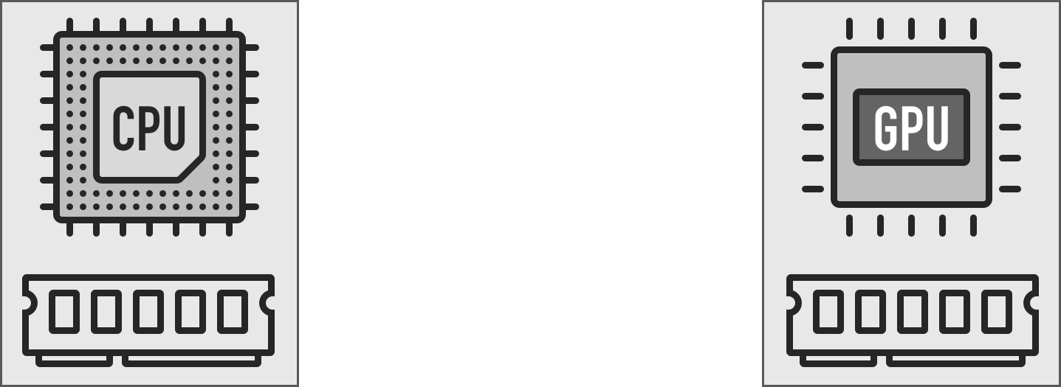




Memory Oversubscription
Unified virtual memory and demand paging enable memory oversubscription support
Degrades GPU performance or
crash the entire system
Notes:
[click]
In modern GPUs, the unified virtual memory[click] and demand paging capabilities[click] free developers from manually managing data movement between CPU memory and GPU memory. As a result, the allocated memory size can be larger than the GPU memory capacity, which means that memory can be oversubscribed.
[click]
However, moving data between CPU memory and GPU memory incurs a long latency, and our measurements on a real GPU system show that applications could experience severe performance degradation or, in several cases, crash.

Slide 80
Memory Oversubscription
Hand tuning
Technique 1: Overlap prefetch requests with eviction requests
Technique 2: Duplicate read-only data
Downsides
Need to manually move data
Require knowledge of current working set at runtime
No visibility between each VM’s working set
Demand for an application-transparent mechanism
Notes:
[click]
In modern GPUs, the unified virtual memory[click] and demand paging capabilities[click] free developers from manually managing data movement between CPU memory and GPU memory. As a result, the allocated memory size can be larger than the GPU memory capacity, which means that memory can be oversubscribed.
[click]
However, moving data between CPU memory and GPU memory incurs a long latency, and our measurements on a real GPU system show that applications could experience severe performance degradation or, in several cases, crash.

Slide 81
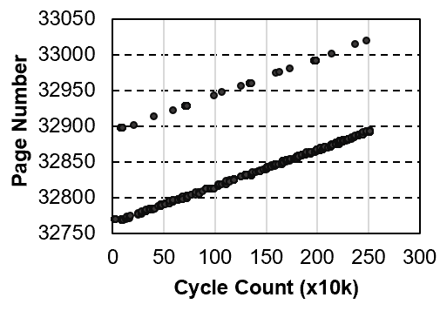
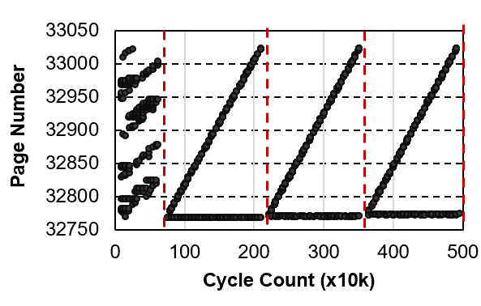
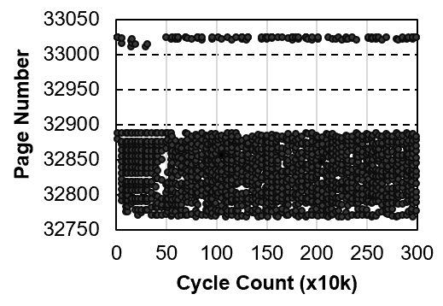
Demand for Different Techniques
Representative traces of 3 applications
Regular applications
with no data sharing
Regular applications
with data sharing
3DCONV
LUD
Irregular applications
ATAX
Hiding Eviction Latency
Hiding Eviction Latency;
Reducing data migration
Reducing working set size
Different techniques are needed to mitigate different sources of overhead
Streaming access
Small working set
Data reuse by kernels
Small working set
Random access
Large working set
Waiting for Eviction
Moving data back and forth for several times
Thrashing
Notes:
We collect the memory access traces for all those benchmarks and 3 representative traces can be observed.
[click]
In these figures, the x-axis represents the execution time in cycles; the y-axis shows the page ID in memory.
The first benchmark 3DCONV performs streaming access and the working set is small.
Due to streaming access, a page usually will not be accessed again after a period from the first access.
[click]
Waiting for the eviction at page faults is the only overhead for these type of applications.
[click]
The second benchmark LUD is similar to the first one, but the data is reused by different kernels. Each page is accessed for several times.
[click]
Although it is also streaming access at each phase, between different kernels there are synchronizations.
[click]
Therefore, each page has to be moved back and forth (between CPU and GPU?) for several times which cause large performance degradation.
[click]
The last benchmark ATAX performs much differently from the first two.
[click]
It is fairly randomly accessing the memory space. The working set of this type is very large and looks stable. When the working set is larger than the available memory space,
[click]
thrashing will occur which could lead to system crash.
According to these observations,
[click]
we classify the applications as regular application with no data sharing or data sharing, and irregular applications.
[click]
Therefore we need different techniques to overcome different bottlenecks which can mitigate different sources of overhead.

Slide 82
Our Proposal: ETC
ETC Framework
Application Classification
Proactive Eviction
Memory-aware Throttling
Capacity Compression
Notes:
Our ETC framework consists of two parts.
[click]
The first part is application classification. It determines the type of the running application.
[click]
And then we have proactive eviction
[click]
Memory-aware Throttling
[click]
And capacity compression.
They focus on different bottlenecks and reduce the memory oversubscription overhead.

Slide 83
ETC Framework
No single technique can work for
all applications
Regular applications with no data sharing
Proactive Eviction
Memory-aware Throttling
Regular applications with data sharing
Capacity Compression
Irregular applications
Notes:
[click]
We found that no single techniques can work for all applications, ETC dynamically selects the most effective combinations of these techniques based on the type of application.

Slide 84
Performance
3.1%
6.1%
59.2%
102%
436%
61.7%
ETC is effective at identifying application’s type and correctly apply it’s policies to improve performance
Notes:
[click]
In terms of performance, I am going to show the ETC performance of these 3 types of applications normalized to a GPU with unlimited memory. The x-axis is the 3 types of applications with ETC or not, and the y-axis is the normalized performance to the baseline with unlimited memory.
[click]
We make 3 conclusions.
[click]
First, ETC is effective at recovering the performance loss from the memory oversubscription for regular applications with no data sharing, because the eviction latency can be fully hidden by our proactive eviction techniques.
[click]
Second, additional page migrations are incurred due to the synchronization for regular applications with data sharing, but we still improve the performance by an average of 60.4%
[click]
Third, ETC can also improve the performance of irregular applications by 2.7X compared to the baseline, as thrashing can be eliminated.

Slide 85
ETC: Summary
Problem: Memory oversubscription causes GPU performance degradation or, in several cases, crash
Motivation: Prior hand tuning techniques require heavy loads on programmers and have no visibility into other VMs in the cloud
Application-transparent mechanisms in GPU are needed
Observations: Different applications have different sources of memory oversubscription overhead
ETC: an application-transparent framework that
Proactive Eviction Overlaps eviction latency of GPU pages
Memory-aware Throttling Reduces thrashing cost
Capacity Compression Increases effective memory capacity
Conclusion: ETC outperforms the state-of-the-art baseline on all different applications
Notes:
[click]
In this work we take a look at the memory oversubscription overhead and proposed ETC Framework with 3 effective techniques
[click]
Experimental results shows that the overhead of regular applications with no data sharing can be fully mitigated, while the performance of regular applications with data sharing and irregular applications can be improved by 60.4% and 270% compared with the state-of-the-art baseline.

Slide 86
Other Works
GPU Designs:
Managing GPU concurrency
Kayiran et al., MICRO’14
Improving GPU efficiency
Vijaykumar et al. ISCA’15
Kayiran et al., PACT ’16
Sadrosarati et al., ASPLOS’18
DRAM Designs:
Low-latency DRAM
Seshadri et al., MICRO ’13
Lee et al. PACT ’15
Lee et al., SIGMETRICS ’17
Processing-in-Memory
Boroumand et al., ASPLOS’18
Boroumand et al., ISCA’19
Hybrid memory
Yoon et al., ICCD’12
Notes:
Just talk about the main bullets

Slide 87
Other Works
Network-on-chip Designs:
Energy efficient on-chip network design
Fallin et al., NOCs ’12
Chang et al., SBAC-PAD ’12
Das et al., HPCA’13
Ausavarungnirun et al., SBAC-PAD’14,
Ausavarungnirun et al., PARCO ’16
Sadrosarati et al., ACM TACO’18
Scalable NoC design
Besta et al., ASPLOS’18
Handling faults in on-chip network
Fattah et al., NoCs ‘15
Many other ongoing topics
Notes:
Just talk about the main bullets

Slide 88
Acknowledgements
Onur Mutlu and SAFARI Research Group
Gabriel H. Loh
Christopher Rossbach and SCEA Research Group
VMware, AMD, Intel, NVIDIA, SRC
Colleagues: Jishen Zhao, Donghyuk Lee, Vivek Seshadri, Lavanya Subramanian, Kevin Chang, Chris Fallin, Justin Meza, Hanbin Yoon, Samira Khan, Maciej Besta, Reetu Das, Saugata Ghose, Adwait Jog, Onur Kayiran, Mohammad Fattah, Anup Das, and many others
Student Mentees: Chen Li, Damla Senol, Amirali Boroumand, Hui Shi, Xiao Liu, Adarsha Balaji, Taha Shahroodi
Notes:
Just talk about the main bullets

Slide 89
About SSE at TGGS
Collaboration between KMUTNB and RWTH Aachen
Double degree
Invited lecturers from RWTH Aachen
Industry oriented
MS and PhD degrees
Tuition fee waiving for excellent students
DAAD scholarship for foreign students
More information at: https://tggs.kmutnb.ac.th/scholarships/
Very high faculty:student ratio (~1:3)
SSE Program
Computer Architecture (me)
Data analytic
CAD and VLSI
High-performance computing
Computer vision
Apply at: https://tggs.kmutnb.ac.th/apply-now/
Notes:
Just talk about the main bullets

Slide 90
High-performance Memory Hierarchy Design for Throughput Processors
Rachata Ausavarungnirun
https://rausavar.github.io/
Architecture Research Group
The Sirindhorn Thai-German Graduate Study, KMUTNB

