Slide 1


CHIPPER: A Low-complexity Bufferless Deflection Router
Chris Fallin
Chris Craik
Onur Mutlu

Slide 2
Motivation
In many-core chips, on-chip interconnect (NoC) consumes significant power.
Intel Terascale: ~30%; MIT RAW: ~40% of system power
Must maintain low latency and good throughput
critical path for cache misses
Core
L1
L2 Slice
Router

Slide 3
Motivation
Recent work has proposed bufferless deflection routing (BLESS [Moscibroda, ISCA 2009])
Energy savings: ~40% in total NoC energy
Area reduction: ~40% in total NoC area
Minimal performance loss: ~4% on average
Unfortunately: unaddressed complexities in router
➔ long critical path, large reassembly buffers
Goal: obtain these benefits while simplifying the router
in order to make bufferless NoCs practical.
Notes:
Router area: see 7.7 in BLESS paper → 60.4% * 75% - 18.75% * 25% = 40.6%

Slide 4
Bufferless Deflection Routing
Key idea: Packets are never buffered in the network. When two packets contend for the same link, one is deflected.
New traffic can be injected
whenever there is a free
output link.
C No buffers ➔ lower power, smaller area
C Conceptually simple
Destination

Slide 5
Problems that Bufferless Routers Must Solve
1. Must provide livelock freedom
➔ A packet should not be deflected forever
2. Must reassemble packets upon arrival
Flit: atomic routing unit
Packet: one or multiple flits
0 1 2 3

Slide 6
A Bufferless Router: A High-Level View
Crossbar
Deflection
Routing
Logic
Router
Local Node
Problem 2: Packet Reassembly
Inject
Eject
Problem 1: Livelock Freedom
Reassembly
Buffers

Slide 7
Complexity in Bufferless Deflection Routers
1. Must provide livelock freedom
Flits are sorted by age, then assigned in age order to output ports
➔ 43% longer critical path than buffered router
2. Must reassemble packets upon arrival
Reassembly buffers must be sized for worst case
➔ 4KB per node
(8x8, 64-byte cache block)

Slide 8
Problem 1: Livelock Freedom
Crossbar
Deflection
Routing
Logic
Inject
Eject
Problem 1: Livelock Freedom
Reassembly
Buffers

Slide 9
Livelock Freedom in Previous Work
What stops a flit from deflecting forever?
All flits are timestamped
Oldest flits are assigned their desired ports
Total order among flits
But what is the cost of this?
Guaranteed
progress!
New traffic is lowest priority
<
<
<
<
<
Flit age forms total order

Slide 10
Age-Based Priorities are Expensive: Sorting
Router must sort flits by age: long-latency sort network
Three comparator stages for 4 flits
4
1
2
3

Slide 11
Age-Based Priorities Are Expensive: Allocation
After sorting, flits assigned to output ports in priority order
Port assignment of younger flits depends on that of older flits
sequential dependence in the port allocator
1
East?
GRANT: Flit 1 ➔ East
{N,S,W}
2
East?
DEFLECT: Flit 2 ➔ North
{S,W}
3
South?
GRANT: Flit 3 ➔ South
{W}
4
South?
DEFLECT: Flit 4 ➔ West
Age-Ordered Flits

Slide 12
Age-Based Priorities Are Expensive
Overall, deflection routing logic based on Oldest-First has a 43% longer critical path than a buffered router
Question: is there a cheaper way to route while guaranteeing livelock-freedom?
Priority Sort
Port Allocator

Slide 13
Solution: Golden Packet for Livelock Freedom
What is really necessary for livelock freedom?
Key Insight: No total order. it is enough to:
1. Pick one flit to prioritize until arrival
2. Ensure any flit is eventually picked
Guaranteed
progress!
New traffic is
lowest-priority
Guaranteed
progress!
Flit age forms total order
<
<
<
<
partial ordering is sufficient!
“Golden Flit”

Slide 14
What Does Golden Flit Routing Require?
Only need to properly route the Golden Flit
First Insight: no need for full sort
Second Insight: no need for sequential allocation
Priority Sort
Port Allocator

Slide 15
Golden Flit Routing With Two Inputs
Let’s route the Golden Flit in a two-input router first
Step 1: pick a “winning” flit: Golden Flit, else random
Step 2: steer the winning flit to its desired output
and deflect other flit
➔ Golden Flit always routes toward destination

Slide 16
Golden Flit Routing with Four Inputs
Each block makes decisions independently!
Deflection is a distributed decision
N
N
E
S
S
E
W
W

Slide 17
Permutation Network Operation
wins → swap!
wins → swap!
x
Golden:
N
N
N
Priority Sort
Port Allocator
E
E
S
S
S
E
deflected
W
W
W
wins → no swap!
wins → no swap!

Slide 18
Which Packet is Golden?
We select the Golden Packet so that:
1. a given packet stays golden long enough to ensure arrival
→ maximum no-contention latency
2. the selection rotates through all possible packet IDs
→ static rotation schedule for simplicity
Source
Dest
Request ID
Packet Header:
Cycle
Golden
0
100
200
300
400
500
600
700
Src 0
Src 1
Src 2
Src 3
Src 0
Src 1
Src 2
Src 3
Req 0
Req 1

Slide 19
Permutation Network-based Pipeline
Inject/Eject
Inject
Eject
Reassembly
Buffers

Slide 20
Problem 2: Packet Reassembly
Inject/Eject
Inject
Eject
Reassembly
Buffers

Slide 21
Reassembly Buffers are Large
Worst case: every node sends a packet to one receiver
Why can’t we make reassembly buffers smaller?
Node 0
Node 1
…
Node N-1
N sending nodes
one packet in flight
per node
Receiver
O(N) space!

Slide 22
Small Reassembly Buffers Cause Deadlock
What happens when reassembly buffer is too small?
Many Senders
cannot inject new traffic
network full
Network
Remaining flits
must inject for
forward progress
cannot eject:
reassembly
buffer full
reassembly
buffer
One Receiver

Slide 23
Reserve Space to Avoid Deadlock?
What if every sender asks permission from the receiver before it sends?
➔ adds additional delay to every request
Reserve Slot
ACK
Send Packet
Sender
Receiver
Reserve Slot?
reassembly buffers
ACK
Reserved

Slide 24
Escaping Deadlock with Retransmissions
Sender is optimistic instead: assume buffer is free
If not, receiver drops and NACKs; sender retransmits
→ no additional delay in best case
→ transmit buffering overhead for all packets
→ potentially many retransmits
Send (2 flits)
Drop, NACK
Other packet completes
Retransmit packet
ACK
Sender frees data
Sender
Receiver
Retransmit
Buffers
NACK!
ACK
Reassembly
Buffers

Slide 25
Solution: Retransmitting Only Once
Key Idea: Retransmit only when space becomes available.
→ Receiver drops packet if full; notes which packet it drops
→ When space frees up, receiver reserves space so
retransmit is successful
→ Receiver notifies sender to retransmit
Pending: Node 0 Req 0
Sender
Receiver
Retransmit
Buffers
NACK
Reserved
Reassembly
Buffers

Slide 26
Using MSHRs as Reassembly Buffers
Inject/Eject
C Using miss buffers for reassembly makes this a
truly bufferless network.
Inject
Eject
Reassembly
Buffers
Miss Buffers (MSHRs)

Slide 27
CHIPPER: Cheap Interconnect Partially-Permuting Router
Baseline Bufferless Deflection Router
Crossbar
Long critical path:
1. Sort by age
2. Allocate ports sequentially
Golden Packet
→ Permutation Network
Deflection
Routing
Logic
Large buffers for worst case
Retransmit-Once
→Cache buffers
Inject
Eject
Reassembly
Buffers

Slide 28
CHIPPER: Cheap Interconnect Partially-Permuting Router
Inject/Eject
Inject
Eject
Miss Buffers (MSHRs)

Slide 29
EVALUATION

Slide 30
Methodology
Multiprogrammed workloads: CPU2006, server, desktop
8x8 (64 cores), 39 homogeneous and 10 mixed sets
Multithreaded workloads: SPLASH-2, 16 threads
4x4 (16 cores), 5 applications
System configuration
Buffered baseline: 2-cycle router, 4 VCs/channel, 8 flits/VC
Bufferless baseline: 2-cycle latency, FLIT-BLESS
Instruction-trace driven, closed-loop, 128-entry OoO window
64KB L1, perfect L2 (stresses interconnect), XOR mapping

Slide 31
Methodology
Hardware modeling
Verilog models for CHIPPER, BLESS, buffered logic
Synthesized with commercial 65nm library
ORION for crossbar, buffers and links
Power
Static and dynamic power from hardware models
Based on event counts in cycle-accurate simulations

Slide 32
Results: Performance Degradation
1.8%
13.6%
C Minimal loss for low-to-medium-intensity workloads
3.6%
49.8%

Slide 33
Results: Power Reduction
73.4%
54.9%
C Removing buffers ➔ majority of power savings
C Slight savings from BLESS to CHIPPER

Slide 34
Results: Area and Critical Path Reduction
-29.1%
+1.1%
-36.2%
-1.6%
C CHIPPER maintains area savings of BLESS
C Critical path becomes competitive to buffered

Slide 35
Conclusions
Two key issues in bufferless deflection routing
livelock freedom and packet reassembly
Bufferless deflection routers were high-complexity and impractical
Oldest-first prioritization → long critical path in router
No end-to-end flow control for reassembly → prone to deadlock with reasonably-sized reassembly buffers
CHIPPER is a new, practical bufferless deflection router
Golden packet prioritization → short critical path in router
Retransmit-once protocol → deadlock-free packet reassembly
Cache miss buffers as reassembly buffers → truly bufferless network
CHIPPER frequency comparable to buffered routers at much lower area and power cost, and minimal performance loss

Slide 36
Thank you!
The packet flew quick through the NoC,
Paced by the clock’s constant tock.
But the critical path
Soon unleashed its wrath –
And further improvements did block.

Slide 37
CHIPPER: A Low-complexity Bufferless Deflection Router
Chris Fallin
Chris Craik
Onur Mutlu

Slide 38
Backup Slides

Slide 39
What about High Network Loads?
Recall, our goal is to enable bufferless deflection routing as a compelling design point. This is orthogonal to the question of spanning the whole spectrum.
If performance under very high workload intensity is important, hybrid solutions (e.g., AFC [Jafri10]) can be used to enable buffers selectively. Congestion control might also be used.
Any system that incorporates bufferless deflection routing at lower load points benefits from CHIPPER’s contributions.

Slide 40
What About Injection and Ejection?
Local access is conceptually separate from in-network routing
Separate pipeline stage
(before permutation stage)
Eject locally-bound flits
Inject queued new traffic,
if there is a free slot
Ejection obeys priority rules (Golden Packet first)
ejection into
reassembly buffers
injection from
FIFO queue

Slide 41
Use MSHRs as Reassembly Buffers
Miss Status Handling Register (MSHR)
Outstanding
Cache Misses
Pending
Block 0x3C
Status
Address
Data Buffer
Reassembly buffering for “free”
A truly bufferless NoC!

Slide 42
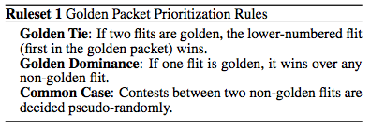
Golden Packet vs. Golden Flit
It is actually Golden Packet, not Golden Flit
Within the Golden Packet, each arbiter breaks ties with flit sequence numbers
Rare!
Packet golden when injected: its flits never meet each other.
BUT, if it becomes golden later: flits could be anywhere, and might contend.

Slide 43
Sensitivity Studies
Locality:
We assumed simple striping across all cache slices.
What if data is more intelligently distributed?
10 mixed multiprogrammed workloads, Buffered→CHIPPER:
8x8 baseline: 11.6% weighted-speedup degradation
4x4 neighborhoods: 6.8% degradation
2x2 neighborhoods: 1.1% degradation
Golden Packet:
Percentage of packets that are Golden: 0.37% (0.41% max)
Sensitivity to epoch length (8 – 8192 cycles): 0.89% delta

Slide 44
Retransmit-Once Operation
Requesters always opportunistically send first packet.
Response to request implies a buffer reservation.
If receiver can’t reserve space, it drops and makes a note.
When space becomes free later, reserves it and requests a retransmit. ➔ only one retransmit necessary!
Beyond this point, reassembly buffer is reserved until requester releases it.

Slide 45
Retransmit-Once: Example
Example: (Core to L2): Request → Response → Writeback
Send packet: Request
Drop (buffers full)
Other packet completes
Receiver reserves space
Send Retransmit packet
Sender regenerates request
Data response
Dirty writeback
Pending: Node 0 Req 0
Sender
Node 0
Receiver
Retransmit
Request State
Reserved
Reassembly
Buffers

Slide 46
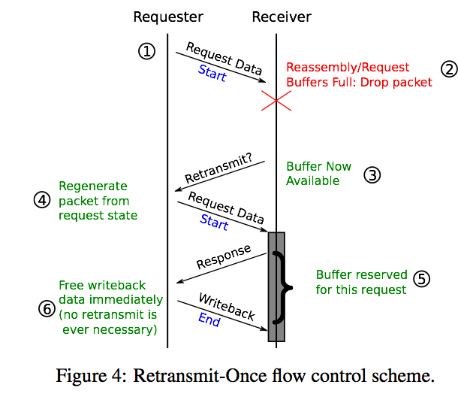
Retransmit-Once: Multiple Packets

Slide 47
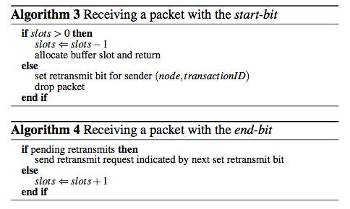
Retransmit-Once: Multiple Packets

Slide 48
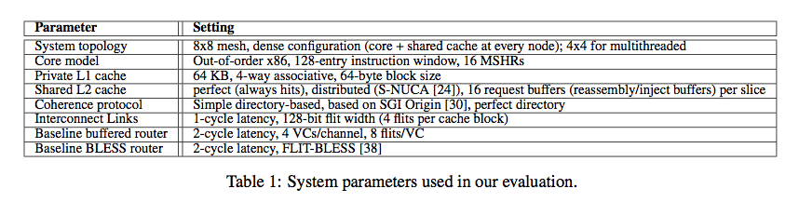
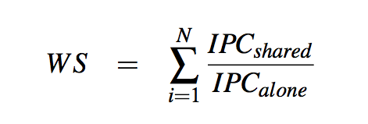
Parameters for Evaluation

Slide 49
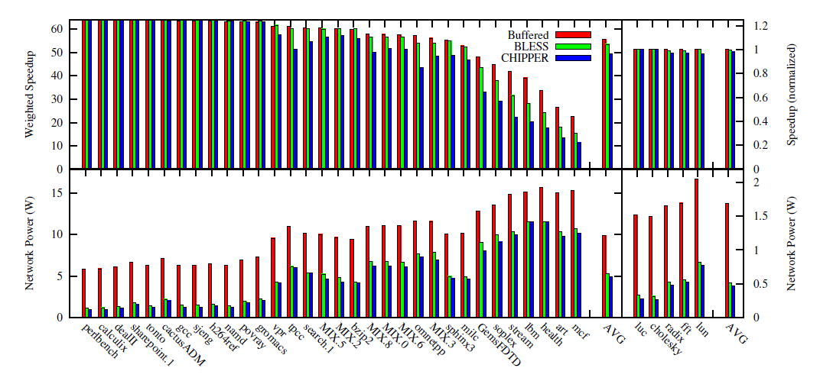
Full Workload Results

Slide 50
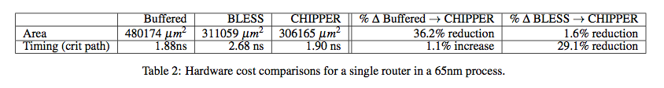
Hardware-Cost Results

Slide 51
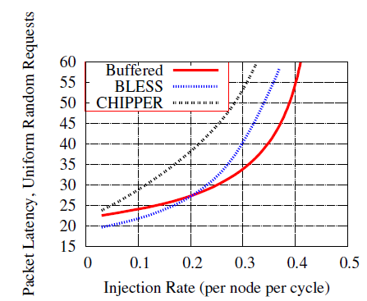
Network-Level Evaluation: Latency

Slide 52
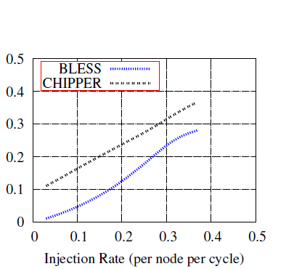
Network-Level Evaluation: Deflections

Slide 53
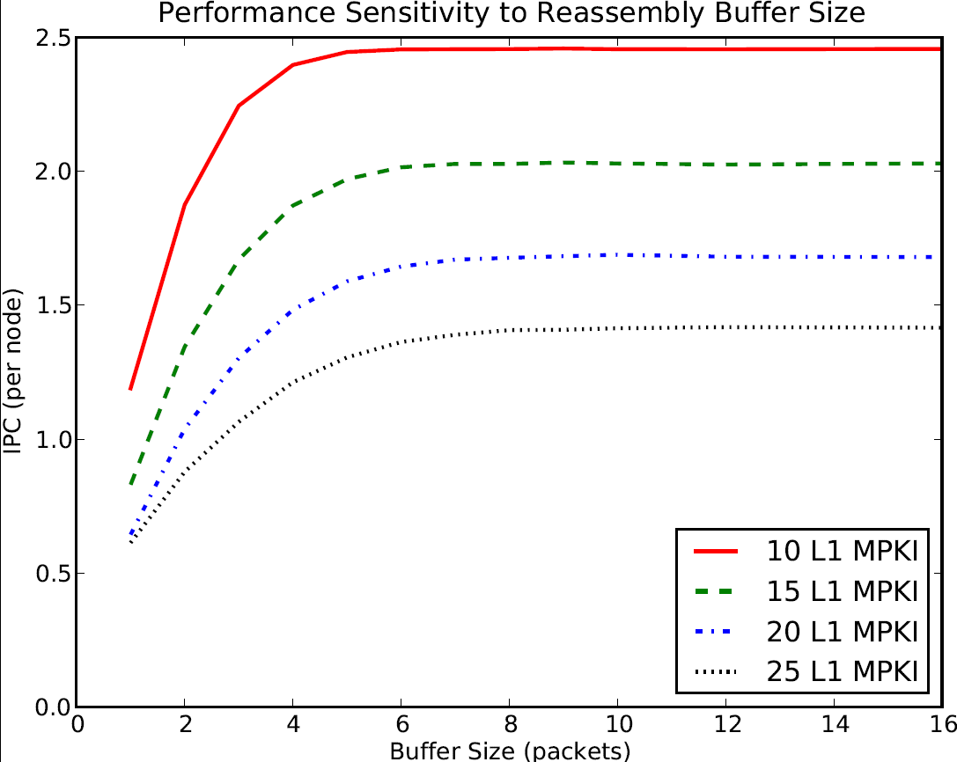
Reassembly Buffer Size Sensitivity

