Slide 1

Next Generation On-Chip Networks:
What Kind of Congestion Control
Do We Need?
George Nychis✝, Chris Fallin✝, Thomas Moscibroda★, Onur Mutlu✝
Carnegie Mellon University ✝
Microsoft Research ★

Slide 2
Chip Multiprocessor (CMP) Background
Trend: towards ever larger chip multiprocessors (CMPs)
  the CMP overcomes diminishing returns of increasingly complex single-core processors
Communication: critical to the CMP’s performance
  between cores, cache banks, DRAM controllers ...
  delays in information can stall the pipeline
Common Bus: does not scale beyond 8 cores:
  electrical loading on the bus significantly reduces its speed
  the shared bus cannot support the bandwidth demand

Slide 3
The On-Chip Network
Build a network, routing information between endpoints
Increased bandwidth and scales with the number of cores
CMP (3x3)
Network
Links
Core
+
Router

Slide 4
On-Chip Networks Are Walking a Familiar Line
Scale of the networking is increasing
  Intel’s “Single-chip Cloud Computer” ... 48 cores
  Tilera Corperation TILE-Gx ... 100 cores
What should the topology be?
How should efficient routing be done?
What should the buffer size be? (hot in arch. community)
Can QoS guarantees be made in the network?
How do you handle congestion in the network?
All historic topics in the networking field...

Slide 5
Can We Apply Traditional Solutions?
On-chip networks have a very different set of constraints
Three first-class considerations in processor design:
  Chip area & space, power consumption, impl. complexity
This impacts: integration (e.g., fitting more cores), cost, performance, thermal dissipation, design & verification ...
The on-chip network has a unique design
  likely to require novel solutions to traditional problems
  chance for the networking community to weigh in

Slide 6
Outline
Unique characteristics of the Network-on-Chip (NoC)
  likely requiring novel solutions to traditional problems
Initial case study: congestion in a next generation NoC
  background on next generation bufferless design
  a study of congestion at network and application layers
Novel application-aware congestion control mechanism

Slide 7
NoC Characteristics - What’s Different?
Topology
known, fixed, and regular
Links
expensive, can’t
over-provision
CMP (3x3)
No Net Flow
one-to-many cache access
Latency
2-4 cycles for
router & link
Src
R
R
Coordination
global is often
less expensive
Routing
min. complexity,
low latency
Notes:
topology: known and fixed beyond the design stage, and regular for efficiency reasons
routing: routing is very minimal in complexity and low latency for maintaing efficient communication
links: are thin for area constraints, and for the same reason cannot be overprovisioned to handle temporal
bursts of traffic
net flow: with cache banks spread across all of the cores, a single core’s traffic pattern is one-to-many
latency: network latency is very low, only 1-2 cycles through the router, and 1-2 cycles over a link
coordination: while global coordination is not feasible in the Internet, global coordination is often less
expensive than distributed techniques on the chip

Slide 8
Next Generation: Bufferless NoCs
Architecture community is now heavily evaluating buffers:
  30-40% of static and dynamic energy (e.g., Intel Tera-Scale)
  75% of NoC area in a prototype (TRIPS)
Push for bufferless (BLESS) NoC design:
  energy is reduced by ~40%, and area by ~60%
  comparable throughput for low to moderate workloads
BLESS design has its own set of unique properties:
  no loss, retransmissions, or (N)ACKs
Notes:
As previously mentioned, the question of buffer size is currently hot in debate by the architecture community. this is also driven by the first-class design constraints of chip area and power. For example,

Slide 9
Outline
Unique characteristics of the Network-on-Chip (NoC)
  likely requiring novel solutions to traditional problems
Initial case study: congestion in a next generation NoC
  background on next generation bufferless design
  a study of congestion at network and application layers
Novel application-aware congestion control mechanism

Slide 10
How Bufferless NoCs Work
Packet Creation: L1 miss, L1 service, write-back..
Injection: only when an output port is available
CMP
D
Routing: commonly X,Y-routing (first X-dir, then Y)
S1
0
1
2
Arbitration: oldest flit-first (dead/live-lock free)
1
Deflection: arbitration causing non-optimal hop
0
S2
contending for top port, oldest first, newest deflected
age is initialized

Slide 11
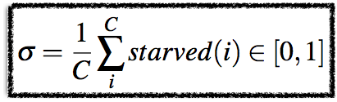
Starvation in Bufferless NoCs
Remember, injection only if an output port is free...
CMP
Starvation cycle occurs when a core cannot inject
Starvation rate (σ) is the fraction of starved cycles
Keep starvation in mind ...
Flit created but can’t inject without a free output ports

Slide 12
Outline
Unique characteristics of the Network-on-Chip (NoC)
  likely requiring novel solutions to traditional problems
Initial case study: congestion in a next generation NoC
  background on next generation bufferless design
  a study of congestion at network and application layers
Novel application-aware congestion control mechanism

Slide 13
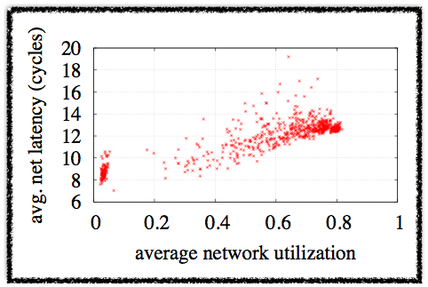
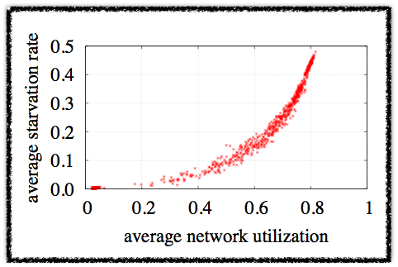
Congestion at the Network Level
Evaluate 700 real application workloads in bufferless 4x4
Finding: net latency remains stable with congestion/deflects
Net latency is not sufficient for detecting congestion
What about starvation rate?
Starvation increases significantly in congestion
+4x
Separation
Separation of non-congested and congested net latency is only ~3-4 cycles
Finding: starvation rate is representative of congestion
Each point represents a single workload

Slide 14

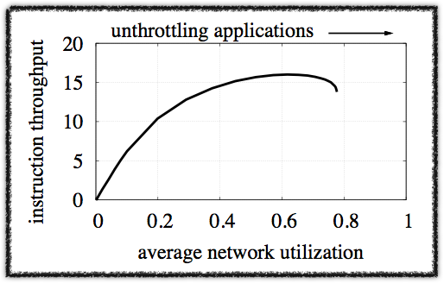
Congestion at the Application Level
Define system throughput as sum of instructions-per-cycle (IPC) of all applications on CMP:
Sample 4x4, unthrottle apps:
Finding 1: Throughput decreases under congestion
Sub-optimal
with congestion
Finding 2: Self-throttling cores prevent collapse
Finding 3: Static throttling can provide some gain (e.g., 14%), but we will show up to 27% gain with app-aware throttling

Slide 15
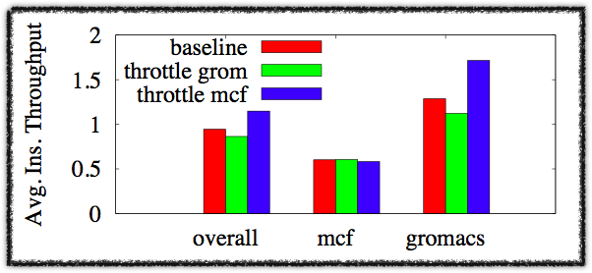
Need for Application Awareness
System throughput can be improved, throttling with congestion
  Under congestion, what application should be throttled?
Construct 4x4 NoC, alternate 90% throttle rate to applications
Finding 1: the app that is throttled impacts system performance
Finding 2: instruction throughput does not dictate who to throttle
Overall system throughput increases or decreases based on throttling decision
Finding 3: different applications respond differently to an increase in network throughput (unlike gromacs, mcf barely gains)
MCF has lower application-level throughput, but should be throttled under congestion

Slide 16

Instructions-Per-Flit (IPF): Who To Throttle
Key Insight: Not all flits (packet fragments) are created equal
  apps need different amounts of traffic to retire instructions
  if congested, throttle apps that gain least from traffic
IPF is a fixed value that only depends on the L1 miss rate
  independent of the level of congestion & execution rate
  low value: many flits needed for an instruction
We compute IPF for our 26 application workloads
  MCF’s IPF: 0.583, Gromacs IPF: 12.41
  IPF explains MCF and Gromacs throttling experiment

Slide 17
App-Aware Congestion Control Mechanism
From our study of congestion in a bufferless NoC:
  When To Throttle: monitor starvation rate
  Whom to Throttle: based on the IPF of applications in NoC
  Throttling Rate: proportional to application intensity (IPF)
Controller: centrally coordinated control
  evaluation finds it less complex than a distributed controller
  149 bits per-core (minimal compared to 128KB L1 cache)
Controller is interval based, running only every 100k cycles

Slide 18
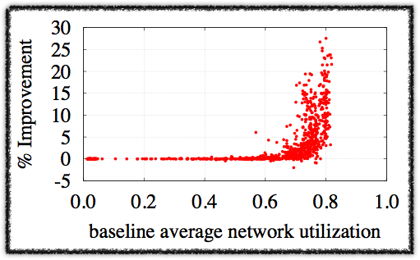
Evaluation of Congestion Controller
Evaluate with 875 real workloads (700 16-core, 175 64-core)
  generate balanced set of CMP workloads (cloud computing)
  Parameters: 2d mesh, 2GHz, 128-entry ins. win, 128KB L1
Improvement up to 27% under congested workloads
Does not degrade
non-congested workloads
Only 4/875 workloads have perform. reduced > 0.5%
The improvement in system throughput for workloads
Do not unfairly throttle applications down, but do reduce starvation (in paper)
Network Utilization With No Congestion Control

Slide 19
Conclusions
We have presented NoC, and bufferless NoC design
  highlighted unique characteristics which warrant novel solutions to traditional networking problems
We showed a need for congestion control in a bufferless NoC
  throttling can only be done properly with app-awareness
  achieve app-awareness through novel IPF metric
  improve system performance up to 27% under congestion
Opportunity for networking community to weigh in on novel solutions to traditional networking problems in a new context

Slide 20
Discussion / Questions?
We focused on one traditional problem, others problems?
  load balancing, fairness, latency guarantees (QoS) ...
Does the on-chip networking need a layered architecture?
Multithreaded application workloads?
What are the right metrics to focus on?
  instructions-per-cycle (IPC) is not all-telling
  what is the metric of fairness? (CPU bound & net bound)

