Slide 1

Thread Cluster Memory Scheduling: Exploiting Differences in Memory Access Behavior
Yoongu Kim
Michael Papamichael
Onur Mutlu
Mor Harchol-Balter

Slide 2
Motivation
Memory is a shared resource
Threads’ requests contend for memory
Degradation in single thread performance
Can even lead to starvation
How to schedule memory requests to increase both system throughput and fairness?
Core
Core
Memory
Core
Core

Slide 3
Previous Scheduling Algorithms are Biased
Better fairness
System throughput
bias
Better system throughput
Fairness
bias
Ideal
No previous memory scheduling algorithm provides both the best fairness and system throughput

Slide 4
Why do Previous Algorithms Fail?
Throughput biased approach
Fairness biased approach
Prioritize less memory-intensive threads
Take turns accessing memory
Good for throughput
Does not starve
thread A
less memory intensive
thread B
higher
priority
thread C
thread A
thread B
thread C
not prioritized ➔
reduced throughput
starvation ➔ unfairness
Single policy for all threads is insufficient

Slide 5

Insight: Achieving Best of Both Worlds
higher
priority
For Throughput
Prioritize memory-non-intensive threads
thread
thread
thread
For Fairness
thread
Unfairness caused by memory-intensive being prioritized over each other
Shuffle threads
Memory-intensive threads have different vulnerability to interference
Shuffle asymmetrically
thread
thread
thread
thread
thread
thread
thread
thread

Slide 6
Outline
Motivation & Insights
Overview
Algorithm
Bringing it All Together
Evaluation
Conclusion

Slide 7
Overview: Thread Cluster Memory Scheduling
Group threads into two clusters
Prioritize non-intensive cluster
Different policies for each cluster
higher
priority
Memory-non-intensive
Non-intensive
cluster
thread
Throughput
thread
thread
thread
thread
thread
Prioritized
higher
priority
thread
thread
thread
thread
Threads in the system
Memory-intensive
Intensive cluster
Fairness

Slide 8
Outline
Motivation & Insights
Overview
Algorithm
Bringing it All Together
Evaluation
Conclusion

Slide 9
TCM Outline
1. Clustering

Slide 10
Clustering Threads
Step1 Sort threads by MPKI (misses per kiloinstruction)
higher
MPKI
thread
thread
thread
thread
thread
thread
Non-intensive
cluster
Intensive
cluster
αT
T
α < 10% ClusterThreshold
T = Total memory bandwidth usage
Step2 Memory bandwidth usage αT divides clusters

Slide 11
TCM Outline
1. Clustering
2. Between
Clusters

Slide 12
Prioritization Between Clusters
Prioritize non-intensive cluster
Increases system throughput
Non-intensive threads have greater potential for making progress
Does not degrade fairness
Non-intensive threads are “light”
Rarely interfere with intensive threads
>
priority

Slide 13
TCM Outline
3. Non-Intensive
Cluster
1. Clustering
Throughput
2. Between
Clusters

Slide 14
Non-Intensive Cluster
Prioritize threads according to MPKI
Increases system throughput
Least intensive thread has the greatest potential for making progress in the processor
higher
priority
lowest MPKI
thread
thread
thread
thread
highest MPKI

Slide 15
TCM Outline
3. Non-Intensive
Cluster
1. Clustering
Throughput
2. Between
Clusters
4. Intensive
Cluster
Fairness

Slide 16

Intensive Cluster
Periodically shuffle the priority of threads
Is treating all threads equally good enough?
BUT: Equal turns ≠ Same slowdown
higher
priority
Most prioritized
thread
thread
thread
thread
Increases fairness
thread
thread

Slide 17
Case Study: A Tale of Two Threads
Case Study: Two intensive threads contending
random-access
streaming
Which is slowed down more easily?
Prioritize random-access
Prioritize streaming
11x
7x
prioritized
1x
prioritized
1x
random-access thread is more easily slowed down

Slide 18
Why are Threads Different?
random-access
streaming
req
stuck
req
req
req
req
req
req
req
req
req
req
req
req
req
req
req
activated row
rows
Bank 1
Bank 2
Bank 3
Bank 4
Memory
All requests parallel
High bank-level parallelism
All requests ➔ Same row
High row-buffer locality
Vulnerable to interference

Slide 19
TCM Outline
3. Non-Intensive
Cluster
1. Clustering
Throughput
2. Between
Clusters
4. Intensive
Cluster
Fairness

Slide 20
Niceness
How to quantify difference between threads?
Niceness
High
Low
Bank-level parallelism
Row-buffer locality
Vulnerability to interference
Causes interference
+
Niceness
-

Slide 21

Shuffling: Round-Robin vs. Niceness-Aware
Round-Robin shuffling
Niceness-Aware shuffling
⬅ What can go wrong?
GOOD: Each thread prioritized once
Most prioritized
D
A
B
C
D
Priority
D
Nice thread
C
B
Least nice thread
A
Time
ShuffleInterval

Slide 22
Shuffling: Round-Robin vs. Niceness-Aware
Round-Robin shuffling
Niceness-Aware shuffling
⬅ What can go wrong?
GOOD: Each thread prioritized once
Most prioritized
D
A
B
C
D
Priority
D
A
B
C
D
Nice thread
C
D
A
B
C
B
C
D
A
B
Least nice thread
A
B
C
D
A
Time
BAD: Nice threads receive lots of interference
ShuffleInterval

Slide 23
Shuffling: Round-Robin vs. Niceness-Aware
Round-Robin shuffling
Niceness-Aware shuffling
GOOD: Each thread prioritized once
Most prioritized
D
C
B
A
D
Priority
D
Nice thread
C
B
Least nice thread
A
Time
ShuffleInterval

Slide 24
Shuffling: Round-Robin vs. Niceness-Aware
Round-Robin shuffling
Niceness-Aware shuffling
GOOD: Each thread prioritized once
Most prioritized
D
C
B
A
D
Priority
D
D
B
A
D
Nice thread
C
C
C
B
C
B
B
D
C
B
Least nice thread
A
A
A
D
A
Time
GOOD: Least nice thread stays
mostly deprioritized
ShuffleInterval

Slide 25
TCM Outline
3. Non-Intensive
Cluster
3. Non-Intensive
Cluster
1. Clustering
1. Clustering
Throughput
2. Between
Clusters
2. Between
Clusters
4. Intensive
Cluster
4. Intensive
Cluster
Fairness

Slide 26
Outline
Motivation & Insights
Overview
Algorithm
Bringing it All Together
Evaluation
Conclusion

Slide 27
Quantum-Based Operation
Previous quantum (~1M cycles)
Current quantum
(~1M cycles)
Time
Shuffle interval
(~1K cycles)
During quantum:
Monitor thread behavior
Memory intensity
Bank-level parallelism
Row-buffer locality
Beginning of quantum:
Perform clustering
Compute niceness of intensive threads

Slide 28
TCM Scheduling Algorithm
Highest-rank: Requests from higher ranked threads prioritized
Non-Intensive cluster > Intensive cluster
Non-Intensive cluster: lower intensity ➔ higher rank
Intensive cluster: rank shuffling
Row-hit: Row-buffer hit requests are prioritized
Oldest: Older requests are prioritized

Slide 29
Implementation Costs
Required storage at memory controller (24 cores)
No computation is on the critical path
Thread memory behavior | Storage
MPKI | ~0.2kb
Bank-level parallelism | ~0.6kb
Row-buffer locality | ~2.9kb
Total | < 4kbits

Slide 30
Outline
Motivation & Insights
Overview
Algorithm
Bringing it All Together
Evaluation
Conclusion
Throughput
Fairness

Slide 31
Metrics & Methodology
Metrics
System throughput
Unfairness
Methodology
Core model
4 GHz processor, 128-entry instruction window
512 KB/core L2 cache
Memory model: DDR2
96 multiprogrammed SPEC CPU2006 workloads

Slide 32
Previous Work
FRFCFS [Rixner et al., ISCA00]: Prioritizes row-buffer hits
Thread-oblivious ➔ Low throughput & Low fairness
STFM [Mutlu et al., MICRO07]: Equalizes thread slowdowns
Non-intensive threads not prioritized ➔ Low throughput
PAR-BS [Mutlu et al., ISCA08]: Prioritizes oldest batch of requests while preserving bank-level parallelism
Non-intensive threads not always prioritized ➔ Low throughput
ATLAS [Kim et al., HPCA10]: Prioritizes threads with less memory service
Most intensive thread starves ➔ Low fairness

Slide 33
Results: Fairness vs. Throughput
Averaged over 96 workloads
Better fairness
5%
Better system throughput
39%
5%
8%
TCM provides best fairness and system throughput

Slide 34
Results: Fairness-Throughput Tradeoff
When configuration parameter is varied…
Better fairness
STFM
Better system throughput
ATLAS
PAR-BS
TCM
Adjusting ClusterThreshold
TCM allows robust fairness-throughput tradeoff

Slide 35
Operating System Support
ClusterThreshold is a tunable knob
OS can trade off between fairness and throughput
Enforcing thread weights
OS assigns weights to threads
TCM enforces thread weights within each cluster

Slide 36
Outline
Motivation & Insights
Overview
Algorithm
Bringing it All Together
Evaluation
Conclusion
Throughput
Fairness

Slide 37
Conclusion
No previous memory scheduling algorithm provides both high system throughput and fairness
Problem: They use a single policy for all threads
TCM groups threads into two clusters
Prioritize non-intensive cluster ➔ throughput
Shuffle priorities in intensive cluster ➔ fairness
Shuffling should favor nice threads ➔ fairness
TCM provides the best system throughput and fairness

Slide 38
Thank You

Slide 39
Thread Cluster Memory Scheduling: Exploiting Differences in Memory Access Behavior
Yoongu Kim
Michael Papamichael
Onur Mutlu
Mor Harchol-Balter

Slide 40
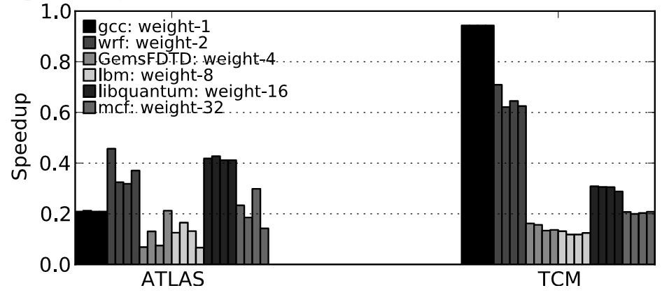
Thread Weight Support
Even if heaviest weighted thread happens to be the most intensive thread…
Not prioritized over the least intensive thread

Slide 41
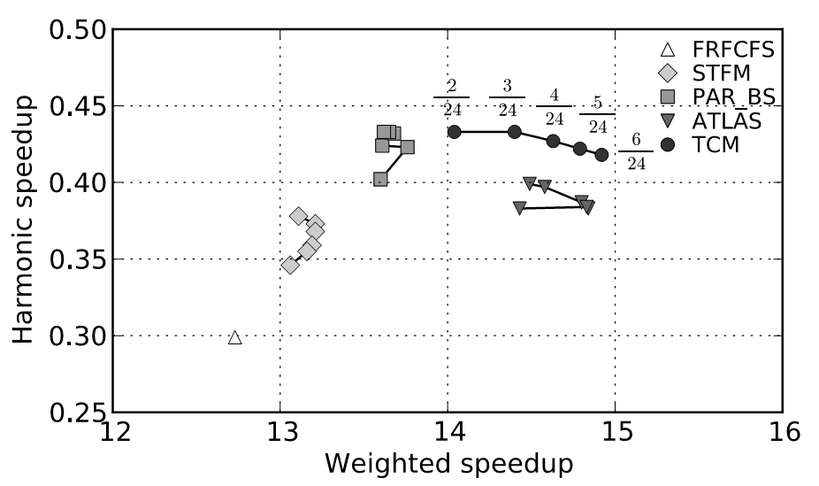
Harmonic Speedup
Better fairness
Better system throughput

Slide 42
Shuffling Algorithm Comparison
Niceness-Aware shuffling
Average of maximum slowdown is lower
Variance of maximum slowdown is lower
 | Shuffling Algorithm
 | Round-Robin | Niceness-Aware
E(Maximum Slowdown) | 5.58 | 4.84
VAR(Maximum Slowdown) | 1.61 | 0.85

Slide 43
Sensitivity Results
 | ShuffleInterval (cycles)
 | 500 | 600 | 700 | 800
System Throughput | 14.2 | 14.3 | 14.2 | 14.7
Maximum Slowdown | 6.0 | 5.4 | 5.9 | 5.5
 | Number of Cores
 | 4 | 8 | 16 | 24 | 32
System Throughput (compared to ATLAS) | 0% | 3% | 2% | 1% | 1%
Maximum Slowdown (compared to ATLAS) | -4% | -30% | -29% | -30% | -41%

