Slide 1


Application-Aware Memory Channel Partitioning
Sai Prashanth Muralidhara § Lavanya Subramanian †
Onur Mutlu † Mahmut Kandemir §
Thomas Moscibroda ‡
§ Pennsylvania State University † Carnegie Mellon University
‡ Microsoft Research

Slide 2
Main Memory is a Bottleneck
Core
Main Memory
Core
Memory Controller
Channel
Core
Main memory latency is long
Core stalls, performance degrades
Multiple applications share the main memory

Slide 3
Problem of Inter-Application Interference
Core
Main Memory
Memory Controller
Channel
Req
Req
Req
Core
Applications’ requests interfere at the main memory
This inter-application interference degrades system performance
Problem further exacerbated due to
Increasing number of cores
Limited off-chip pin bandwidth

Slide 4
Outline
Goal:
Mitigate
Inter-Application Interference
Previous Approach:
Application-Aware Memory Request Scheduling
Our First Approach:
Application-Aware Memory Channel Partitioning
Our Second Approach: Integrated Memory Partitioning and Scheduling

Slide 5
Background: Main Memory
Columns
Bank 0
Bank 0
Bank 1
Bank 1
Bank 2
Bank 2
Bank 3
Bank 3
Rows
Row Buffer
Row Buffer
Row Buffer
Row Buffer
Row Buffer
Memory Controller
Channel
FR-FCFS memory scheduling policy [Zuravleff et al., US Patent ‘97; Rixner et al., ISCA ‘00]
Row-buffer hit first
Oldest request first
Unaware of inter-application interference

Slide 6
Previous Approach
Goal:
Mitigate
Inter-Application Interference
Previous Approach:
Application-Aware Memory Request Scheduling
Previous Approach:
Application-Aware Memory Request Scheduling
Our First Approach:
Application-Aware Memory Channel Partitioning
Our Second Approach: Integrated Memory Partitioning and Scheduling

Slide 7
Application-Aware Memory Request Scheduling
Monitor application memory access characteristics
Rank applications based on memory access characteristics
Prioritize requests at the memory controller, based on ranking

Slide 8
An Example: Thread Cluster Memory Scheduling
higher
priority
Non-intensive
cluster
Memory-non-intensive
thread
Throughput
thread
thread
thread
thread
thread
Prioritized
higher
priority
thread
thread
thread
thread
Threads in the system
Memory-intensive
Intensive cluster
Fairness
Figure: Kim et al., MICRO 2010

Slide 9
Application-Aware Memory Request Scheduling
Advantages
Reduces interference between applications by
request reordering
Improves system performance
Disadvantages
Requires modifications to memory scheduling logic for
Ranking
Prioritization
Cannot completely eliminate interference by request reordering

Slide 10
Our Approach
Goal:
Mitigate
Inter-Application Interference
Previous Approach:
Application-Aware Memory Request Scheduling
Our First Approach:
Application-Aware Memory Channel Partitioning
Our First Approach:
Application-Aware Memory Channel Partitioning
Our Second Approach: Integrated Memory Partitioning and Scheduling

Slide 11
Observation: Modern Systems Have Multiple Channels
Core
Red App
Memory Controller
Memory
Channel 0
Core
Blue App
Memory Controller
Memory
Channel 1
A new degree of freedom
Mapping data across multiple channels

Slide 12
Data Mapping in Current Systems
Core
Red App
Memory Controller
Memory
Page
Channel 0
Core
Blue App
Memory Controller
Memory
Channel 1
Causes interference between applications’ requests

Slide 13
Partitioning Channels Between Applications
Core
Red App
Memory Controller
Memory
Page
Channel 0
Core
Blue App
Memory Controller
Memory
Channel 1
Eliminates interference between applications’ requests

Slide 14
Overview: Memory Channel Partitioning (MCP)
Goal
Eliminate harmful interference between applications
Basic Idea
Map the data of badly-interfering applications to different channels
Key Principles
Separate low and high memory-intensity applications
Separate low and high row-buffer locality applications

Slide 15
Key Insight 1: Separate by Memory Intensity
High memory-intensity applications interfere with low memory-intensity applications in shared memory channels
Time Units
Time Units
Channel 0
Channel 0
5
4
3
2
1
5
4
3
2
1
Core
Bank 0
Core
Bank 0
Red App
Red App
Bank 1
Bank 1
Core
Core
Saved Cycles
Bank 0
Bank 0
Blue App
Blue App
Bank 1
Saved Cycles
Bank 1
Channel 1
Channel 1
Conventional Page Mapping
Channel Partitioning
Map data of low and high memory-intensity applications
to different channels

Slide 16
Key Insight 2: Separate by Row-Buffer Locality
Request Buffer State
Channel 0
Request Buffer State
Channel 0
High row-buffer locality applications interfere with low
row-buffer locality applications in shared memory channels
R1
Bank 0
Bank 0
R0
R3
R2
R0
Bank 1
R0
R0
Bank 1
Bank 0
R1
Bank 0
R4
R4
Bank 1
R3
R2
Bank 1
Time units
Time units
Service Order
Channel 1
Service Order
Channel 1
Channel 0
Channel 0
6
5
4
3
2
1
6
5
4
3
2
1
R1
Bank 0
Bank 0
R3
R2
R0
R0
Bank 1
R0
R0
Bank 1
R4
Bank 0
R1
R4
Bank 0
Bank 1
Saved
Cycles
Bank 1
Map data of low and high row-buffer locality applications to different channels
R3
R2
Channel 1
Channel 1
Conventional Page Mapping
Channel Partitioning

Slide 17
Memory Channel Partitioning (MCP) Mechanism
Hardware
1. Profile applications
2. Classify applications into groups
3. Partition channels between application groups
4. Assign a preferred channel to each application
5. Allocate application pages to preferred channel
System Software

Slide 18
1. Profile Applications
Hardware counters collect application memory access characteristics
Memory access characteristics
Memory intensity:
Last level cache Misses Per Kilo Instruction (MPKI)
Row-buffer locality:
Row-buffer Hit Rate (RBH) - percentage of accesses that hit in the row buffer

Slide 19
2. Classify Applications
Test MPKI
Low
High
Low Intensity
High Intensity
Test RBH
Low
High
High Intensity
Low Row-Buffer Locality
High Intensity
High Row-Buffer Locality

Slide 20
3. Partition Channels Among Groups: Step 1
Channel 1
Low Intensity
Channel 2
Assign number of channels proportional to number of applications in group
Channel 3
High Intensity
Low Row-Buffer Locality
.
.
.
High Intensity
High Row-Buffer Locality
Channel N-1
Channel N

Slide 21
3. Partition Channels Among Groups: Step 2
Channel 1
Channel 1
Low Intensity
Low Intensity
Channel 2
Channel 2
Channel 3
Channel 3
High Intensity
Low Row-Buffer Locality
High Intensity
Low Row-Buffer Locality
.
.
.
.
.
.
.
.
Assign number of channels proportional to bandwidth demand of group
Channel N-1
Channel N-1
High Intensity
High Row-Buffer Locality
Channel N-1
High Intensity
High Row-Buffer Locality
Channel N
Channel N
Channel N

Slide 22
4. Assign Preferred Channel to Application
Assign each application a preferred channel from its group’s allocated channels
Distribute applications to channels such that group’s bandwidth demand is balanced across its channels
Channel 1
MPKI: 1
Low Intensity
MPKI: 3
MPKI: 1
MPKI: 3
Channel 2
MPKI: 4
MPKI: 4

Slide 23
5. Allocate Page to Preferred Channel
Enforce channel preferences computed in the previous step
On a page fault, the operating system
allocates page to preferred channel if free page available in preferred channel
if free page not available, replacement policy tries to allocate page to preferred channel
if it fails, allocate page to another channel

Slide 24
Interval Based Operation
Current Interval
Next Interval
time
1. Profile applications
5. Enforce channel preferences
2. Classify applications into groups
3. Partition channels between groups
4. Assign preferred channel to applications

Slide 25
Integrating Partitioning and Scheduling
Goal:
Mitigate
Inter-Application Interference
Previous Approach:
Application-Aware Memory Request Scheduling
Our First Approach:
Application-Aware Memory Channel Partitioning
Our Second Approach: Integrated Memory Partitioning and Scheduling

Slide 26
Observations
Applications with very low memory-intensity rarely access memory → Dedicating channels to them results in precious memory bandwidth waste
They have the most potential to keep their cores busy → We would really like to prioritize them
They interfere minimally with other applications → Prioritizing them does not hurt others

Slide 27
Integrated Memory Partitioning and Scheduling (IMPS)
Always prioritize very low memory-intensity applications in the memory scheduler
Use memory channel partitioning to mitigate interference between other applications

Slide 28
Hardware Cost
Memory Channel Partitioning (MCP)
Only profiling counters in hardware
No modifications to memory scheduling logic
1.5 KB storage cost for a 24-core, 4-channel system
Integrated Memory Partitioning and Scheduling (IMPS)
A single bit per request
Scheduler prioritizes based on this single bit

Slide 29
Methodology
Simulation Model
24 cores, 4 channels, 4 banks/channel
Core Model
Out-of-order, 128-entry instruction window
512 KB L2 cache/core
Memory Model – DDR2
Workloads
240 SPEC CPU 2006 multiprogrammed workloads (categorized based on memory intensity)
Metrics
System Performance

Slide 30
Previous Work on Memory Scheduling
FR-FCFS [Zuravleff et al., US Patent 1997, Rixner et al., ISCA 2000]
Prioritizes row-buffer hits and older requests
Application-unaware
ATLAS [Kim et al., HPCA 2010]
Prioritizes applications with low memory-intensity
TCM [Kim et al., MICRO 2010]
Always prioritizes low memory-intensity applications
Shuffles request priorities of high memory-intensity applications

Slide 31
Comparison to Previous Scheduling Policies
Averaged over 240 workloads
11%
5%
7%
1%
Better system performance than the best previous scheduler
at lower hardware cost
Significant performance improvement over baseline FRFCFS

Slide 32
Interaction with Memory Scheduling
Averaged over 240 workloads
IMPS improves performance regardless of scheduling policy
Highest improvement over FRFCFS as IMPS designed for FRFCFS

Slide 33
Summary
Uncontrolled inter-application interference in main memory degrades system performance
Application-aware memory channel partitioning (MCP)
Separates the data of badly-interfering applications to different channels, eliminating interference
Integrated memory partitioning and scheduling (IMPS)
Prioritizes very low memory-intensity applications in scheduler
Handles other applications’ interference by partitioning
MCP/IMPS provide better performance than application-aware memory request scheduling at lower hardware cost

Slide 34
Thank You

Slide 35
Application-Aware Memory Channel Partitioning
Sai Prashanth Muralidhara § Lavanya Subramanian †
Onur Mutlu † Mahmut Kandemir §
Thomas Moscibroda ‡
§ Pennsylvania State University † Carnegie Mellon University
‡ Microsoft Research

Slide 36
System Software Overhead
MCP/IMPS require system software to
Perform preferred channel assignment
Enforce channel preferences
Preferred channel assignment
Off the critical path
Previously computed assignments can be used
Enforcing channel preferences
Only on a page fault
N (512) extra entries in circular page list scanned
Takes less than 10000 extra cycles as compared to baseline page fault time overhead of millions of cycles

Slide 37
Migration
Less than 12% of all pages in our workloads go to non-preferred channels
When application phase changes
Application characteristics could change
→ Preferred channel could change
However, we observe working set also changes
→ New working set pages allocated to new preferred channel
What to do with the old working set in the old preferred channel?
Exploring migrating old working set to new channel
Ideas
Migrate periodically without hurting demand traffic
Migrate “hot” (highly accessed) pages

Slide 38
Effect on Page Faults
MCP/IMPS do not hard partition memory capacity
Replacement policy
tries to allocate an application’s pages to its preferred channel
assigns pages to another channel if replacement candidate not found in application’s preferred channel
Das et al., (Safari TR 2011) show that this replacement policy reduces applications’ page fault rates, as it mitigates interference by capacity partitioning

Slide 39
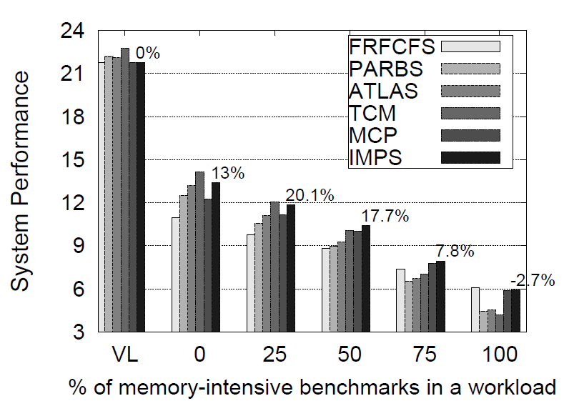
Different Intensity Categories

Slide 40
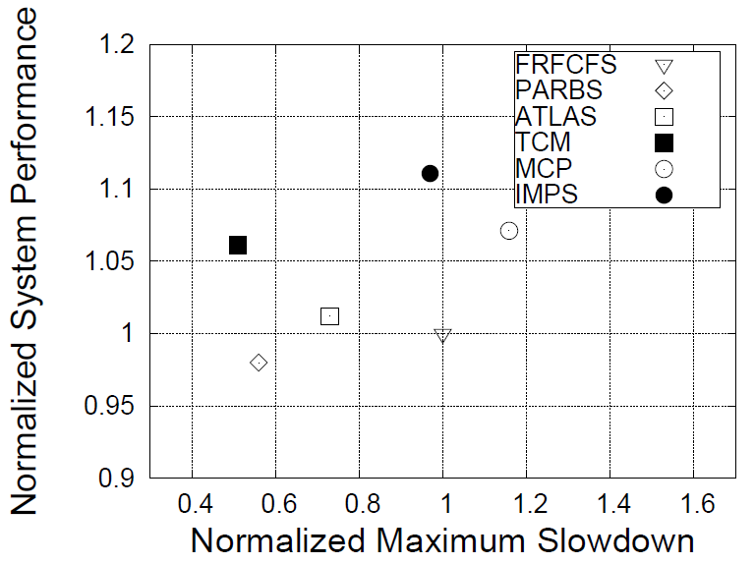
Fairness and System Performance

Slide 41
Scaling Number of MCs

Slide 42
Scaling Number of MCs: IMPS bridges the gap
IMPS bridges more than half the gap between 4 and 8 memory controller systems

Slide 43
Scaling Number of Cores

Slide 44
Scaling Cache Size

Slide 45
Comparison to Application-Unaware Memory Controller Load Balancing (Awasthi et al., PACT `10)
AFT – Adaptive First Touch, DPM – Dynamic Page Migration –application-unaware load balancing policies
MCP/IMPS outperform AFT and DPM by 7/12.4% respectively (averaged across 40 workloads)

