Slide 1

Data Mapping for Higher Performance and Energy Efficiency in Multi-Level Phase Change Memory
HanBin Yoon*, Naveen Muralimanoharǂ, Justin Meza*, Onur Mutlu*, Norm Jouppiǂ
*Carnegie Mellon University, ǂHP Labs

Slide 2
Overview
MLC PCM: Strengths and weaknesses
Data mapping scheme for MLC PCM
Exploits PCM characteristics for lower latency
Improves data integrity
Row buffer management for MLC PCM
Increases row buffer hit rate
Performance and energy efficiency improvements

Slide 3
Why MLC PCM?
Emerging high density memory technology
Projected 3-12× denser than DRAM¹
Scalable DRAM alternative on the horizon
Access latency comparable to DRAM
Multi-Level Cell: 1 of key strengths over DRAM
Further increases memory density (by 2×–4×)
But MLC also has drawbacks
[¹Lee+ ISCA’09]

Slide 4
Higher MLC Latencies and Energy
MLC program/read operation is more complex
Finer control/detection of cell resistances
Generally leads to higher latencies and energy
~2× for reads, ~4× for writes (depending on tech. & impl.)
Number of cells
11
1
10
01
0
00
Resistance

Slide 5
MLC Multi-bit Faults
In MLC, single cell failure can lead to multi-bit faults
cell
MSB
row
word line
bit
bit
bit
bit
bit
bit
bit
bit
bit
bit
bit
bit
bit
bit
bit
bit
bit
bit
bit
bit
LSB
bit line
bit
bit
bit
bit
bit
bit
bit
bit
bit
bit
bit
bit
bit
bit
bit
bit
bit
bit
bit
bit
column

Slide 6
Motivation
MLC PCM strength:
Scalable, dense memory
MLC PCM weaknesses:
Higher latencies
Higher energy
Multi-bit faults
Endurance
Mitigate through
bit mapping schemes
and
row buffer management
based on the following observations

Slide 7
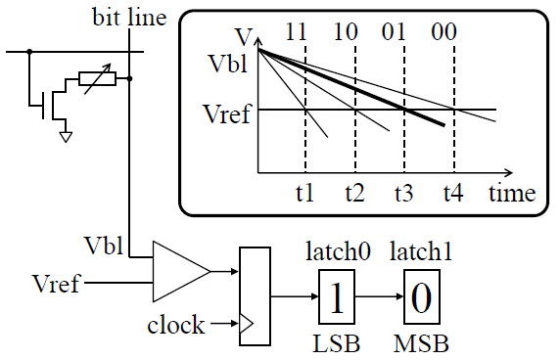
Observation #1: Read Asymmetry
Read latency depends on cell state
Higher cell resistance → higher read latency
[²Qureshi+ ISCA’10]

Slide 8
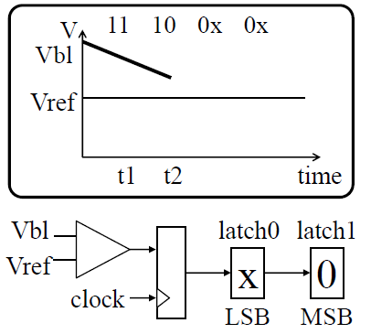
Observation #1: Read Asymmetry
MSB can be determined before read completes
Quicker MSB read ← group LSB & MSB separately

Slide 9
Observation #2: Program Asymmetry
0
0
75ns
210ns
0
1
Program latency depends on cell state
75ns
210ns
MSB
LSB
MSB
LSB
75ns
210ns
250ns
200ns
250ns
200ns
1
0
1
1
50ns
200ns
MSB
LSB
MSB
LSB
[³Joshi+ HPCA’11]

Slide 10
Observation #2: Program Asymmetry
0
0
75ns
210ns
0
1
Single-bit change reduces LSB program latency
Quicker LSB prog. ← group LSB & MSB separately
75ns
210ns
MSB
LSB
Not allowed
MSB
LSB
75ns
210ns
250ns
200ns
250ns
200ns
1
0
1
1
50ns
200ns
MSB
LSB
MSB
LSB

Slide 11
Observation #3: Distributed Bit Faults
Bit mapping affects distribution of bit faults
1 cell failure: 2 faults in 1 block vs. 1 fault each in 2 blocks (ECC-wise better)
Distributed faults ← group LSB & MSB separately
MSB bits
bit
bit
bit
bit
bit
bit
bit
bit
bit
bit
bit
bit
bit
bit
bit
bit
bit
bit
bit
bit
bit
bit
bit
bit
bit
bit
bit
bit
bit
bit
bit
bit
bit
bit
bit
bit
LSB bits
MSB bits
bit
bit
bit
bit
bit
bit
bit
bit
bit
bit
bit
bit
bit
bit
bit
bit
bit
bit
bit
bit
bit
bit
bit
bit
bit
bit
bit
bit
bit
bit
bit
bit
bit
bit
bit
bit
LSB bits

Slide 12
Idea #1: Bit-Decoupled Mapping
Coupled
Decoupled bit mapping scheme
Reduced read latency for MSB pages (read asym.)
Reduced program latency for LSB pages (prog asym.)
Distributed bit faults between LSB and MSB blocks
Worse endurance
bit
Row
= Page
1
bit
3
bit
5
bit
7
bit
9
bit
11
bit
13
bit
15
bit
17
bit
19
bit
0
bit
2
bit
4
bit
6
bit
8
bit
10
bit
12
bit
14
bit
16
bit
18
Decoupled
MSB page
bit
256
bit
257
bit
258
bit
259
bit
260
bit
261
bit
262
bit
263
bit
264
bit
265
bit
0
bit
1
bit
2
bit
3
bit
4
bit
5
bit
6
bit
7
bit
8
bit
9
LSB page

Slide 13
Coalescing Writes
PCM row: Decoupled bit mapping
Assuming spatial locality in writebacks
Interleaving blocks facilitates write coalescing
Improved endurance ← interleave blocks between LSB & MSB
32
33
34
35
36
37
38
39
40
41
42
43
44
45
46
47
MSB blocks
0
1
1
2
2
3
4
4
5
5
6
6
7
7
8
9
10
11
12
13
14
15
LSB blocks
cache blocks
dirty cache blocks
PCM row: Decoupled bit mapping + block interleaving
1
MSB blocks
1
3
5
5
7
7
9
11
13
15
17
19
21
23
25
27
29
31
0
2
2
4
4
6
6
8
10
12
14
16
18
20
22
24
26
28
30
LSB blocks

Slide 14
Idea #2: LSB-MSB Block Interleaving
Decoupled
LM-Interleaved (LMI) bit mapping scheme
Mitigates cell wear
MSB page
256
257
258
259
260
261
262
263
264
265
0
1
2
3
4
5
6
7
8
9
LSB page
Decoupled and LM-Interleaved (LMI)
MSB page
bit
8
bit
9
bit
10
bit
11
bit
12
bit
13
bit
14
bit
15
bit
24
bit
25
bit
0
bit
1
bit
2
bit
3
bit
4
bit
5
bit
6
bit
7
bit
16
bit
17
LSB page

Slide 15
Row Buffer Management
Coupled
Opportunity: Two latches per cell in row buffer
Use single row buffer as two “page buffers”
1
3
5
7
9
11
13
15
17
19
Row
= Page
0
2
4
6
8
10
12
14
16
18
Decoupled
MSB page
256
257
258
259
260
261
262
263
264
265
0
1
2
3
4
5
6
7
8
9
LSB page
Row buffer
MSB bits
LSB bits

Slide 16
Idea #3: Split Page Buffering (SPB)
Increased row buffer hit rate
MSB page
768
769
770
771
772
773
774
775
776
777
512
513
514
515
516
517
518
519
520
521
LSB page
MSB page
256
257
258
259
260
261
262
263
264
265
0
1
2
3
4
5
6
7
8
9
LSB page
Row buffer
LSB/MSB
512
513
514
515
516
517
518
519
520
521
0
1
2
3
4
5
6
7
8
9
LSB/MSB

Slide 17
Evaluation Methodology
Cycle-level x86 CPU-memory simulator
CPU: 8 out-of-order cores, 32 KB private L1 per core
L2: 512 KB shared per core, DRAM-Aware LLC Writeback^{4,5}
Dual channel DDR3 1066 MT/s, 2 ranks, aggregate PCM capacity 16 GB (2 bits per cell)
Multi-programmed SPEC CPU2006 workloads
Misses per kilo-instructions > 10
[⁴Lee+ UTA-TechReport’10; ⁵Stuecheli+ ISCA’10]

Slide 18
Comparison Points and Metrics
Baseline: Coupled bit mapping
Decoupled: Decoupled bit mapping
LMI-4: LSB-MSB interleaving every 4 blocks
LMI-16: LSB-MSB interleaving every 16 blocks
Weighted speedup (performance) = sum of thread speedups versus when run alone
Max slowdown (fairness) = highest slowdown experienced by any thread

Slide 19
Performance
Weighted Speedup (norm.)
Decoupled schemes benefit from reduced read latency (MSB) & program latency (LSB)

Slide 20
Fairness
Maximum Slowdown (norm.)
Individual thread speedups and increased row buffer hit rate

Slide 21
Energy Efficiency
Performance per Watt (norm.)
Lower read energy (dominant case) due to exploiting read asymmetry

Slide 22
Memory Lifetime
Memory Lifetime (norm.)
5-year lifespan feasible for system design?
Point of on-going research…

Slide 23
Conclusion
MLC PCM is a scalable, dense memory tech.
Exhibits higher latency and energy compared to SLC
LSB-MSB decoupled bit mapping
Exploits read asymmetry & program asymmetry
Distributes multi-bit faults
LSB-MSB block interleaving
Mitigates cell wear
Split page buffering
Increases row buffer hit rate
Enhances perf. and energy eff. of MLC PCM

Slide 24
Thank you! Questions?

