Slide 1


Bottleneck Identification and Scheduling in Multithreaded Applications
José A. Joao
M. Aater Suleman
Onur Mutlu
Yale N. Patt

Slide 2
Executive Summary
Problem: Performance and scalability of multithreaded applications
are limited by serializing bottlenecks
  different types: critical sections, barriers, slow pipeline stages
  importance (criticality) of a bottleneck can change over time
Our Goal: Dynamically identify the most important bottlenecks and
accelerate them
  How to identify the most critical bottlenecks
  How to efficiently accelerate them
Solution: Bottleneck Identification and Scheduling (BIS)
  Software: annotate bottlenecks (BottleneckCall, BottleneckReturn) and implement waiting for bottlenecks with a special instruction (BottleneckWait)
  Hardware: identify bottlenecks that cause the most thread waiting and accelerate those bottlenecks on large cores of an asymmetric multi-core system
Improves multithreaded application performance and scalability, outperforms previous work, and performance improves with more cores

Slide 3
Outline
Executive Summary
The Problem: Bottlenecks
Previous Work
Bottleneck Identification and Scheduling
Evaluation
Conclusions

Slide 4
Bottlenecks in Multithreaded Applications
Definition: any code segment for which threads contend (i.e. wait)
Examples:
Amdahl’s serial portions
  Only one thread exists → on the critical path
Critical sections
  Ensure mutual exclusion → likely to be on the critical path if contended
Barriers
  Ensure all threads reach a point before continuing → the latest thread arriving is on the critical path
Pipeline stages
  Different stages of a loop iteration may execute on different threads,
  slowest stage makes other stages wait → on the critical path

Slide 5
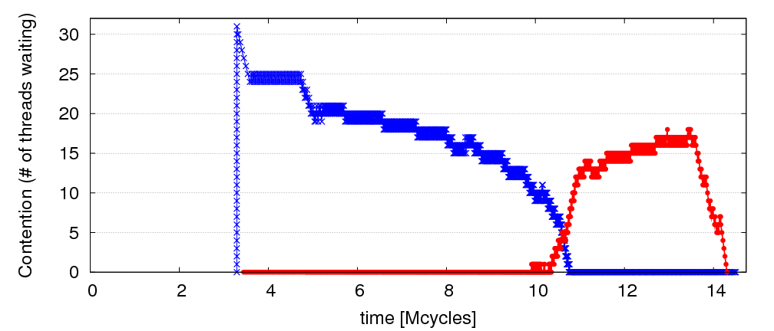
Observation: Limiting Bottlenecks Change Over Time
A=full linked list; B=empty linked list
repeat
Lock A
Traverse list A
Remove X from A
Unlock A
Lock B
Traverse list B
Insert X into B
Unlock B
until A is empty
32 threads
Lock B is limiter
Lock A is limiter

Slide 6
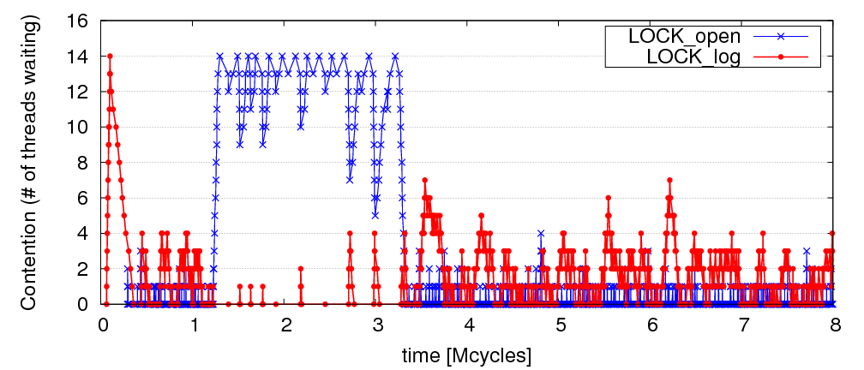
Limiting Bottlenecks Do Change on Real Applications
MySQL running Sysbench queries, 16 threads
Notes:
Similar behavior occurs on real-world applications also. This is a section of Mysql running queries from Sysbench with 16 threads, showing that contention for the two most important locks (LOCK_open and LOCK_log) quickly changes during execution.

Slide 7
Outline
Executive Summary
The Problem: Bottlenecks
Previous Work
Bottleneck Identification and Scheduling
Evaluation
Conclusions

Slide 8
Previous Work
Asymmetric CMP (ACMP) proposals [Annavaram+, ISCA’05]
[Morad+, Comp. Arch. Letters’06] [Suleman+, Tech. Report’07]
  Accelerate only the Amdahl’s bottleneck
Accelerated Critical Sections (ACS) [Suleman+, ASPLOS’09]
  Accelerate only critical sections
  Does not take into account importance of critical sections
Feedback-Directed Pipelining (FDP) [Suleman+, PACT’10 and PhD thesis’11]
  Accelerate only stages with lowest throughput
  Slow to adapt to phase changes (software based library)
No previous work can accelerate all three types of bottlenecks or
quickly adapts to fine-grain changes in the importance of bottlenecks
Our goal: general mechanism to identify performance-limiting bottlenecks of any type and accelerate them on an ACMP
Notes:
[1] ACMPs were first proposed to accelerate only the serial portions of a parallel program.
[2] Later, Accelerated Critical Sections (ACS) added acceleration of only critical sections, but it does not adapt well to changes on the importance of the critical sections like the ones I’ve just showed, because it disables acceleration of many critical sections for an extended period (10M instr.).
[3] Feedback-directed pipelining (FDP) is a software library that assigns pipeline stages to cores based on stage throughput and accelerates the stage with lowest throughput. Even though it is adaptive to major phase changes, it is slow to adapt because it is software based and it needs to execute an iterative learning process on every major change.
[4] We conclude that previous work only targets specific bottlenecks, i.e. it lacks generality, and is unable to adapt to fast changes in the dominant bottlenecks that happen in many applications.
[5] Therefore, our goal is to identify the bottlenecks of any type that are limiting performance at any given time, to then accelerate them on an ACMP.

Slide 9
Outline
Executive Summary
The Problem: Bottlenecks
Previous Work
Bottleneck Identification and Scheduling (BIS)
Methodology
Results
Conclusions

Slide 10
Bottleneck Identification and Scheduling (BIS)
Key insight:
  Thread waiting reduces parallelism and
  is likely to reduce performance
  Code causing the most thread waiting → likely critical path
Key idea:
  Dynamically identify bottlenecks that cause
  the most thread waiting
  Accelerate them (using powerful cores in an ACMP)

Slide 11
Bottleneck Identification and Scheduling (BIS)
Compiler/Library/Programmer
Hardware
Annotate
bottleneck code
Implement waiting
for bottlenecks
Measure thread
waiting cycles (TWC)
for each bottleneck
Accelerate bottleneck(s)
with the highest TWC
Binary containing
BIS instructions

Slide 12
Critical Sections: Code Modifications
…
…
…
BottleneckCall bid, targetPC
…
targetPC: while cannot acquire lock
Wait loop for watch_addr
acquire lock
…
release lock
BottleneckReturn bid
while cannot acquire lock
Wait loop for watch_addr
acquire lock
…
release lock
BottleneckWait bid, watch_addr
Used to enable acceleration
Used to keep track of waiting cycles

Slide 13
Barriers: Code Modifications
…
BottleneckCall bid, targetPC
enter barrier
while not all threads in barrier
BottleneckWait bid, watch_addr
exit barrier
…
targetPC: code running for the barrier
…
BottleneckReturn bid

Slide 14
Pipeline Stages: Code Modifications
BottleneckCall bid, targetPC
…
targetPC: while not done
while empty queue
BottleneckWait prev_bid
dequeue work
do the work …
while full queue
BottleneckWait next_bid
enqueue next work
BottleneckReturn bid

Slide 15
Bottleneck Identification and Scheduling (BIS)
Compiler/Library/Programmer
Hardware
Annotate
bottleneck code
Implements waiting
for bottlenecks
Measure thread
waiting cycles (TWC)
for each bottleneck
Accelerate bottleneck(s)
with the highest TWC
Binary containing
BIS instructions

Slide 16
BIS: Hardware Overview
Performance-limiting bottleneck identification and acceleration are independent tasks
Acceleration can be accomplished in multiple ways
  Increasing core frequency/voltage
  Prioritization in shared resources [Ebrahimi+, MICRO’11]
  Migration to faster cores in an Asymmetric CMP
Small
core
Small
core
Large core
Small
core
Small
core
Small
core
Small
core
Small
core
Small
core
Small
core
Small
core
Small
core
Small
core

Slide 17
Bottleneck Identification and Scheduling (BIS)
Compiler/Library/Programmer
Hardware
Annotate
bottleneck code
Implements waiting
for bottlenecks
Measure thread
waiting cycles (TWC)
for each bottleneck
Accelerate bottleneck(s)
with the highest TWC
Binary containing
BIS instructions

Slide 18
Determining Thread Waiting Cycles for Each Bottleneck
Small Core 1
Large Core 0
BottleneckWait x4500
bid=x4500, waiters=0, twc = 11
bid=x4500, waiters=1, twc = 0
bid=x4500, waiters=1, twc = 1
bid=x4500, waiters=2, twc = 7
bid=x4500, waiters=1, twc = 10
bid=x4500, waiters=2, twc = 5
bid=x4500, waiters=1, twc = 9
bid=x4500, waiters=1, twc = 3
bid=x4500, waiters=1, twc = 4
bid=x4500, waiters=1, twc = 5
bid=x4500, waiters=1, twc = 11
bid=x4500, waiters=1, twc = 2
bid=x4500, waiters=2, twc = 9
Small Core 2
Bottleneck
Table (BT)
BottleneckWait x4500
…

Slide 19
Bottleneck Identification and Scheduling (BIS)
Compiler/Library/Programmer
Hardware
Annotate
bottleneck code
Implements waiting
for bottlenecks
Measure thread
waiting cycles (TWC)
for each bottleneck
Accelerate bottleneck(s)
with the highest TWC
Binary containing
BIS instructions

Slide 20
Bottleneck Acceleration
Small Core 1
Large Core 0
BottleneckCall x4700
BottleneckCall x4600
bid=x4700, pc, sp, core1
BottleneckReturn x4700
Execute locally
Execute remotely
Acceleration
Index Table (AIT)
bid=x4700, pc, sp, core1
bid=x4700 , large core 0
Execute remotely
Scheduling Buffer (SB)
Execute locally
bid=x4600, twc=100
← twc < Threshold
Small Core 2
bid=x4700, twc=10000
← twc > Threshold
Bottleneck
Table (BT)
AIT
bid=x4700 , large core 0
…

Slide 21
BIS Mechanisms
Basic mechanisms for BIS:
  Determining Thread Waiting Cycles ✓
  Accelerating Bottlenecks ✓
Mechanisms to improve performance and generality of BIS:
  Dealing with false serialization
  Preemptive acceleration
  Support for multiple large cores

Slide 22
False Serialization and Starvation
Observation: Bottlenecks are picked from Scheduling Buffer in Thread Waiting Cycles order
Problem: An independent bottleneck that is ready to execute
has to wait for another bottleneck that has higher thread waiting cycles → False serialization
Starvation: Extreme false serialization
Solution: Large core detects when a bottleneck is ready to execute in the Scheduling Buffer but it cannot → sends the bottleneck back to the small core

Slide 23
Preemptive Acceleration
Observation: A bottleneck executing on a small core can become the bottleneck with the highest thread waiting cycles
Problem: This bottleneck should really be accelerated (i.e., executed on the large core)
Solution: The Bottleneck Table detects the situation and
sends a preemption signal to the small core. Small core:
  saves register state on stack, ships the bottleneck to the large core
Main acceleration mechanism for barriers and pipeline stages

Slide 24
Support for Multiple Large Cores
Objective: to accelerate independent bottlenecks
Each large core has its own Scheduling Buffer
(shared by all of its SMT threads)
Bottleneck Table assigns each bottleneck to
a fixed large core context to
  preserve cache locality
  avoid busy waiting
Preemptive acceleration extended to send multiple instances of a bottleneck to different large core contexts

Slide 25
Hardware Cost
Main structures:
  Bottleneck Table (BT): global 32-entry associative cache, minimum-Thread-Waiting-Cycle replacement
  Scheduling Buffers (SB): one table per large core,
  as many entries as small cores
  Acceleration Index Tables (AIT): one 32-entry table
  per small core
Off the critical path
Total storage cost for 56-small-cores, 2-large-cores < 19 KB

Slide 26
BIS Performance Trade-offs
Bottleneck identification:
  Small cost: BottleneckWait instruction and Bottleneck Table
Bottleneck acceleration on an ACMP (execution migration):
  Faster bottleneck execution vs. fewer parallel threads
    Acceleration offsets loss of parallel throughput with large core counts
  Better shared data locality vs. worse private data locality
    Shared data stays on large core (good)
    Private data migrates to large core (bad, but latency hidden with
    Data Marshaling [Suleman+, ISCA’10])
  Benefit of acceleration vs. migration latency
    Migration latency usually hidden by waiting (good)
    Unless bottleneck not contended (bad, but likely to not be on critical path)

Slide 27
Outline
Executive Summary
The Problem: Bottlenecks
Previous Work
Bottleneck Identification and Scheduling
Evaluation
Conclusions

Slide 28
Methodology
Workloads: 8 critical section intensive, 2 barrier intensive and 2 pipeline-parallel applications
  Data mining kernels, scientific, database, web, networking, specjbb
Cycle-level multi-core x86 simulator
  8 to 64 small-core-equivalent area, 0 to 3 large cores, SMT
  1 large core is area-equivalent to 4 small cores
Details:
  Large core: 4GHz, out-of-order, 128-entry ROB, 4-wide, 12-stage
  Small core: 4GHz, in-order, 2-wide, 5-stage
  Private 32KB L1, private 256KB L2, shared 8MB L3
  On-chip interconnect: Bi-directional ring, 2-cycle hop latency

Slide 29
Comparison Points (Area-Equivalent)
SCMP (Symmetric CMP)
  All small cores
  Results in the paper
ACMP (Asymmetric CMP)
  Accelerates only Amdahl’s serial portions
  Our baseline
ACS (Accelerated Critical Sections)
  Accelerates only critical sections and Amdahl’s serial portions
  Applicable to multithreaded workloads
  (iplookup, mysql, specjbb, sqlite, tsp, webcache, mg, ft)
FDP (Feedback-Directed Pipelining)
  Accelerates only slowest pipeline stages
  Applicable to pipeline-parallel workloads (rank, pagemine)

Slide 30
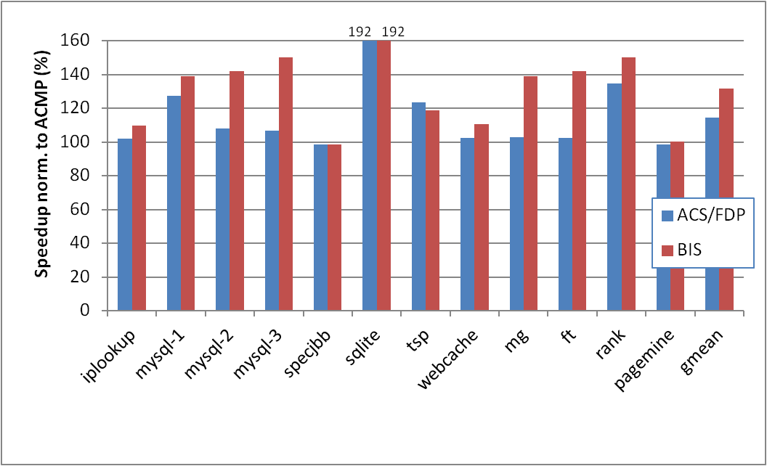
BIS Performance Improvement
Optimal number of threads, 28 small cores, 1 large core
limiting bottlenecks change over time
barriers, which ACS
cannot accelerate
BIS outperforms ACS/FDP by 15% and ACMP by 32%
BIS improves scalability on 4 of the benchmarks
ACS
FDP
Notes:
This graph shows the speedups of for an area equivalent of 32 small cores (including one large core) with optimal number of threads, i.e. the number of threads that maximizes performance for each application on each configuration. BIS significantly improves over ACS/FDP when the critical bottlenecks change over time [1] (iplookup, all mysql, webcache, rank), and when barriers [2] are important bottlenecks (mg and ft) because ACS could not accelerate them. Otherwise [3] it matches approximately matches its performance (sqlite, specjbb, tsp, pagemine).
On average, BIS outperforms ACS/FDP by 15% and ACMP by 32%.

Slide 31
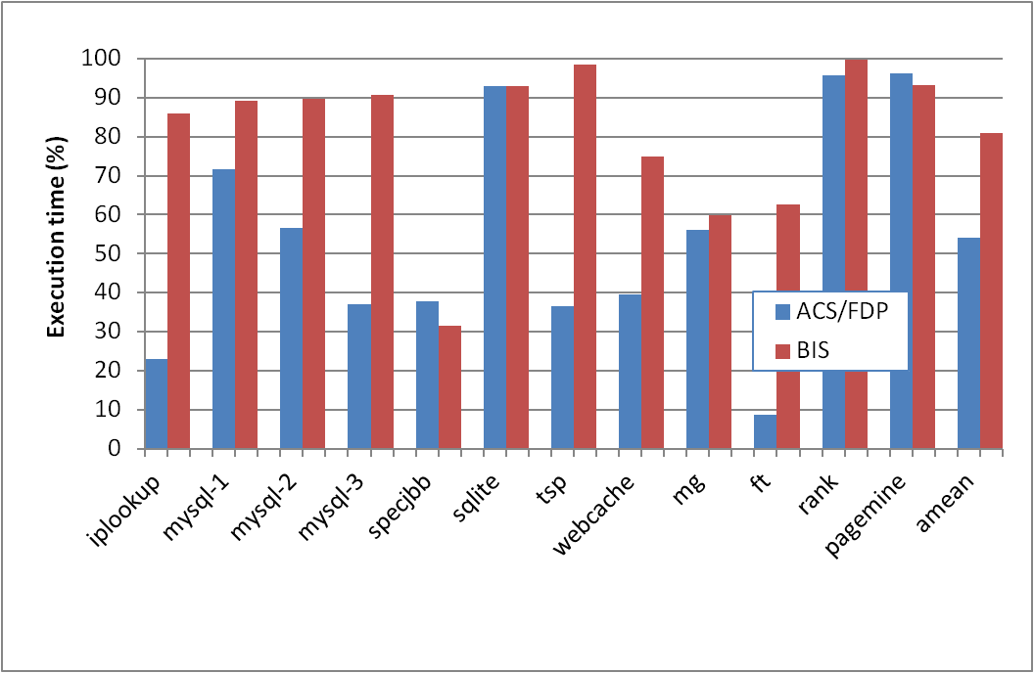
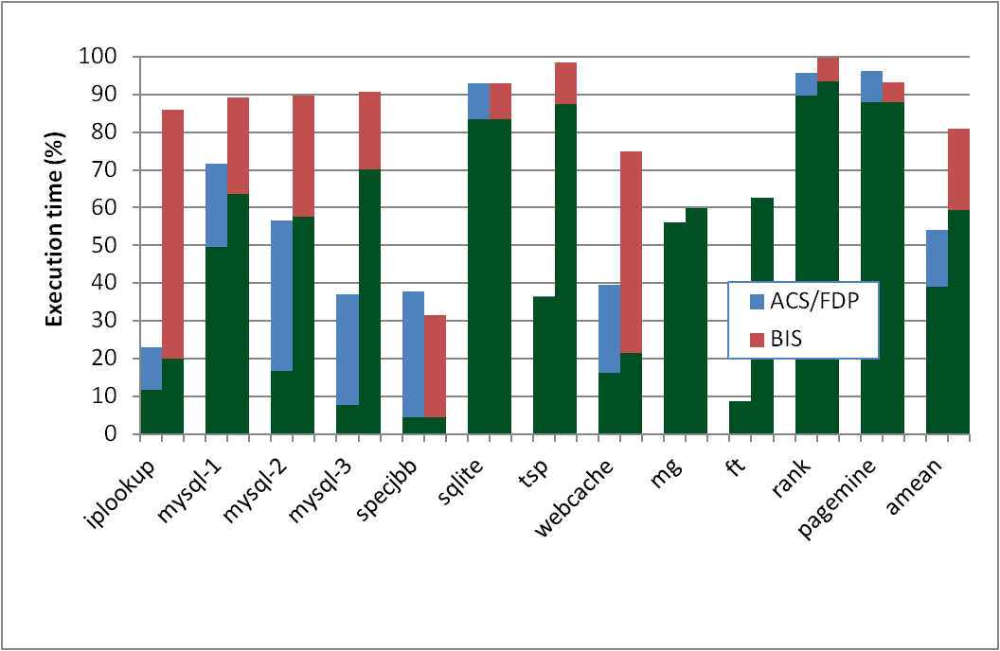
Why Does BIS Work?
Fraction of execution time spent on predicted-important bottlenecks
Actually critical
Coverage: fraction of program critical path that is actually identified as bottlenecks
  39% (ACS/FDP) to 59% (BIS)
Accuracy: identified bottlenecks on the critical path over total identified bottlenecks
  72% (ACS/FDP) to 73.5% (BIS)
Notes:
This graph shows normalized execution time spent on identified bottlenecks on and off the critical path with an area of 32. To avoid changing the critical path on the fly due to acceleration, this experiment only identifies the bottlenecks that would be accelerated without actually accelerating them. The graph shows that not all of the identified bottlenecks are actually on the critical path. We define accuracy as the fraction of the execution time of identified bottlenecks that is actually on the critical path. BIS [1] slightly improves accuracy from 72% to 73.5% wrt ACS/FDP. We define coverage as the fraction of the critical path that is actually identified as bottleneck. BIS [2] significantly improves coverage from 39% to 59%, which results in performance improvement because BIS identifies and accelerates a larger fraction of the critical path.

Slide 32
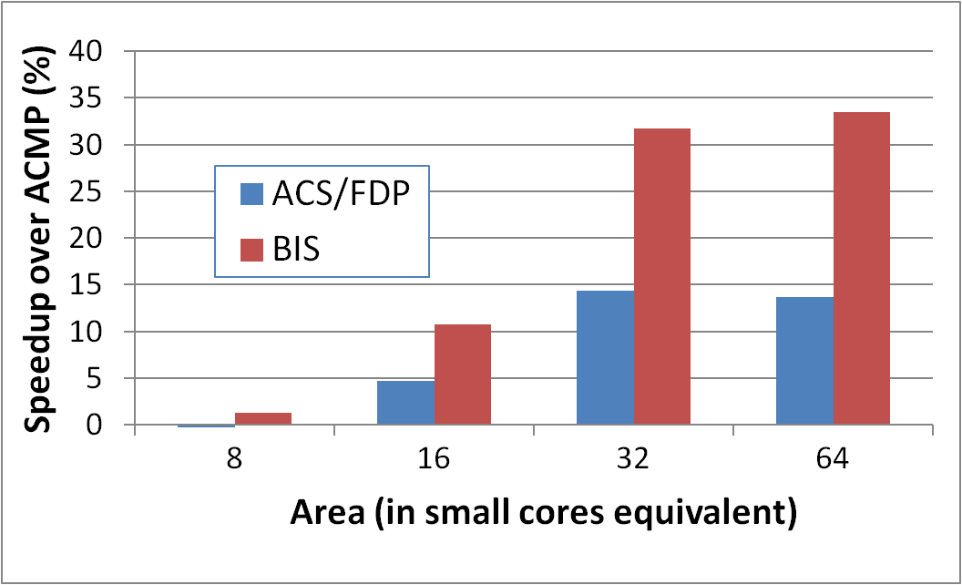
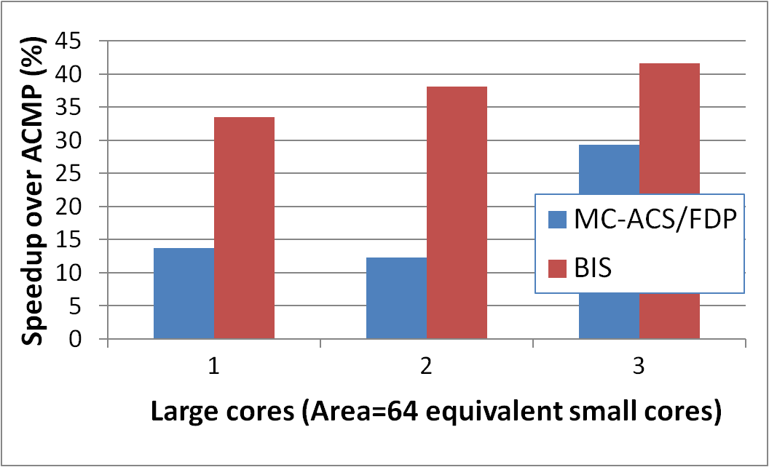
Scaling Results
Performance increases with:
1) More small cores
  Contention due to bottlenecks increases
  Loss of parallel throughput due to large core reduces
2) More large cores
  Can accelerate
  independent bottlenecks
  Without reducing parallel throughput (enough cores)
15%
19%
6.2%
2.4%

Slide 33
Outline
Executive Summary
The Problem: Bottlenecks
Previous Work
Bottleneck Identification and Scheduling
Evaluation
Conclusions

Slide 34
Conclusions
Serializing bottlenecks of different types limit performance of multithreaded applications: Importance changes over time
BIS is a hardware/software cooperative solution:
  Dynamically identifies bottlenecks that cause the most thread waiting and accelerates them on large cores of an ACMP
  Applicable to critical sections, barriers, pipeline stages
BIS improves application performance and scalability:
  15% speedup over ACS/FDP
  Can accelerate multiple independent critical bottlenecks
  Performance benefits increase with more cores
Provides comprehensive fine-grained bottleneck acceleration for future ACMPs without programmer effort

Slide 35
Thank you.

Slide 36
Bottleneck Identification and Scheduling in Multithreaded Applications
José A. Joao
M. Aater Suleman
Onur Mutlu
Yale N. Patt

Slide 37
Backup Slides

Slide 38
Major Contributions
New bottleneck criticality predictor: thread waiting cycles
  New mechanisms (compiler, ISA, hardware) to accomplish this
Generality to multiple bottlenecks
Fine-grained adaptivity of mechanisms
Applicability to multiple cores

Slide 39
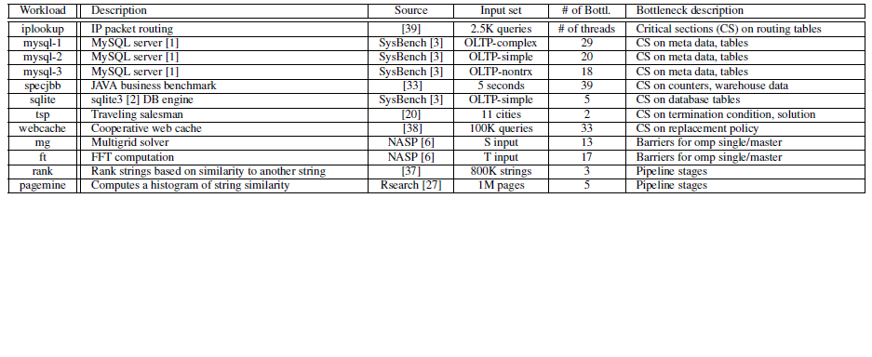
Workloads

Slide 40
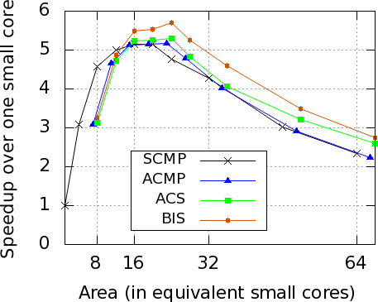
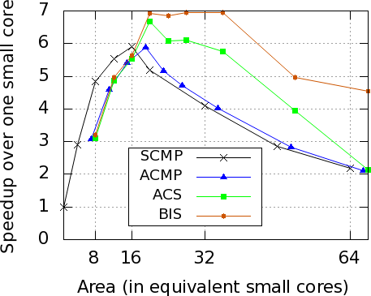
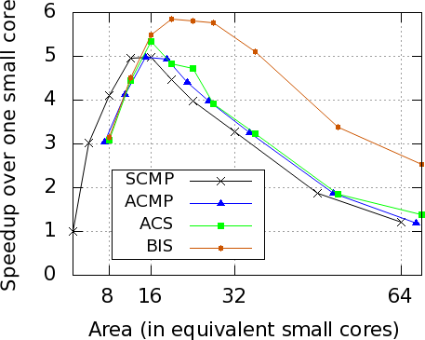
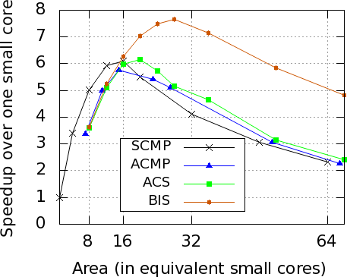
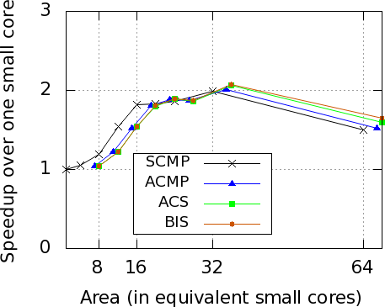
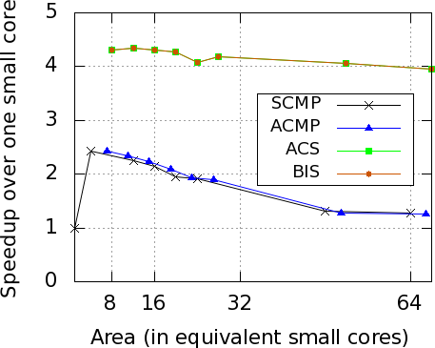
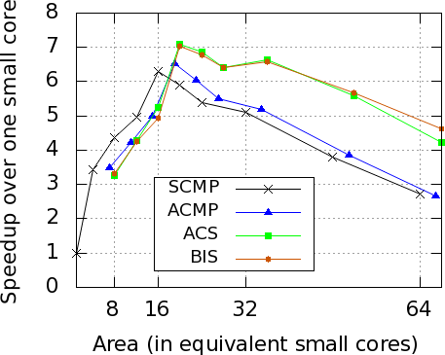
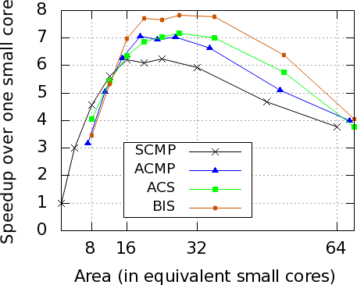
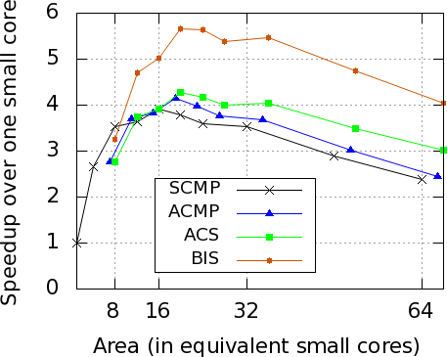
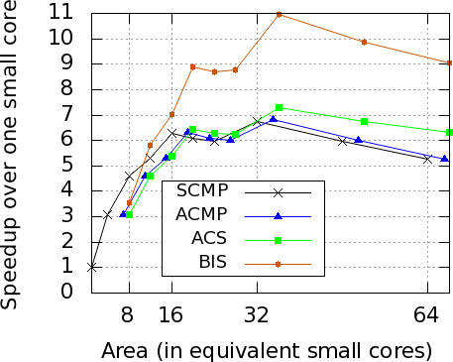
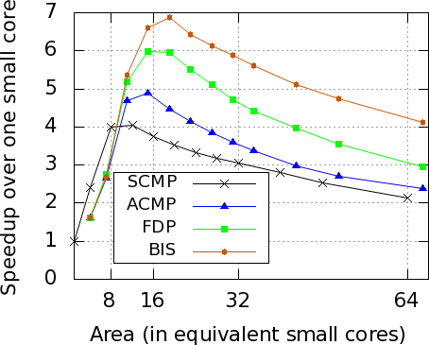
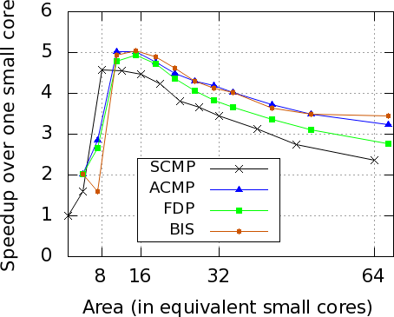
Scalability at Same Area Budgets
iplookup
mysql-1
mysql-2
mysql-3
specjbb
sqlite
tsp
webcache
mg
ft
rank
pagemine
Notes:
These graphs show speedups over a single small core for different area budgets, with the maximum number of threads that can run on each configuration, for BIS, ACD or FDP, ACMP. The benefit of BIS generally increases with the number of threads for workloads where the critical bottlenecks change over time. On workloads where the critical bottlenecks do not change over time, BIS matches the performance of ACS. Pagemine has two very similar pipeline stages that frequently limit performance, but they require two large cores to be simultaneously accelerated. Therefore, BIS with a a single large core does not improve over FDP.

Slide 41
Scalability with #threads = #cores (I)
iplookup
mysql-1

Slide 42
Scalability with #threads = #cores (II)
mysql-2
mysql-3

Slide 43
Scalability with #threads = #cores (III)
specjbb
sqlite

Slide 44
Scalability with #threads = #cores (IV)
tsp
webcache

Slide 45
Scalability with #threads = #cores (V)
mg
ft

Slide 46
Scalability with #threads = #cores (VI)
rank
pagemine

Slide 47
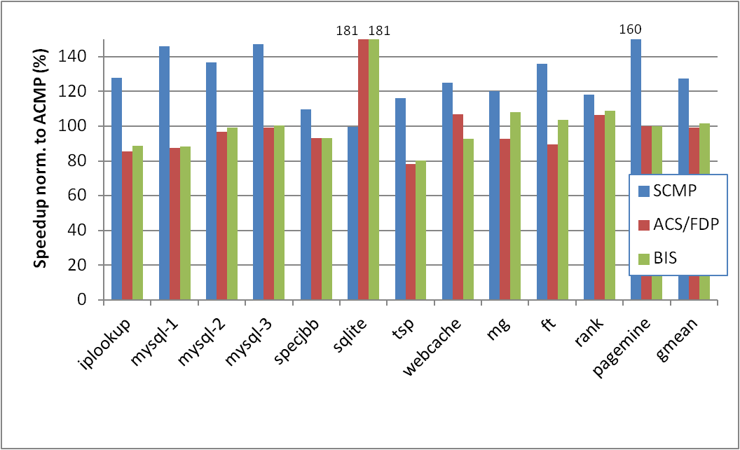
Optimal number of threads – Area=8

Slide 48
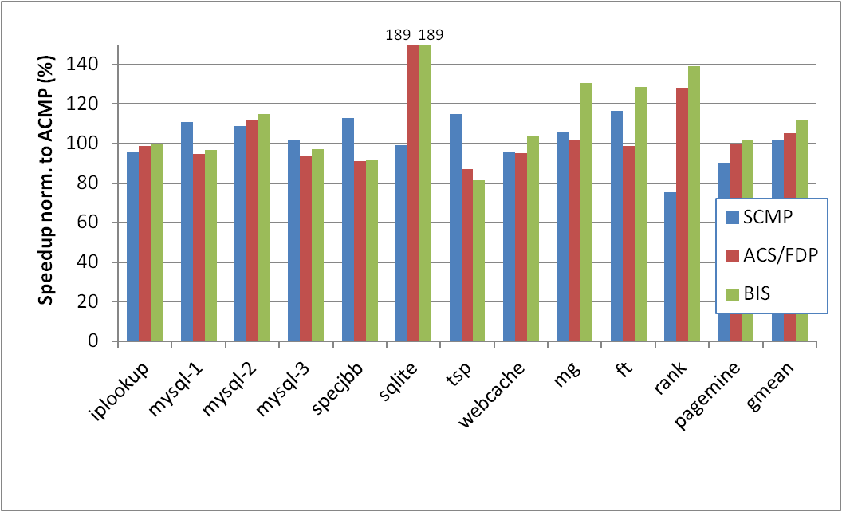
Optimal number of threads – Area=16

Slide 49
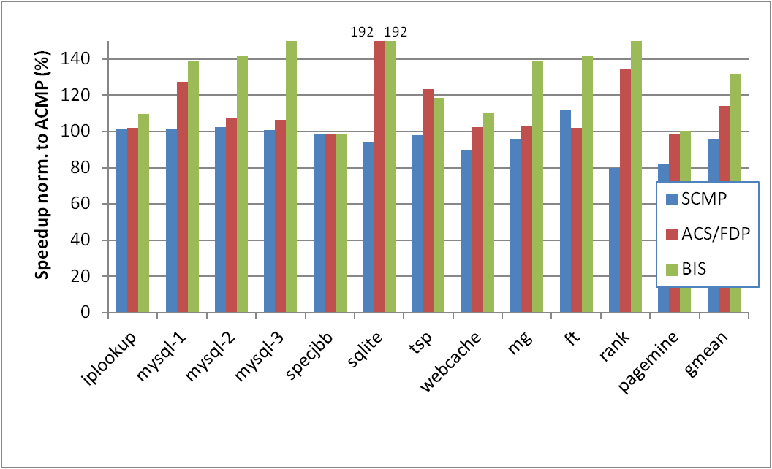
Optimal number of threads – Area=32

Slide 50
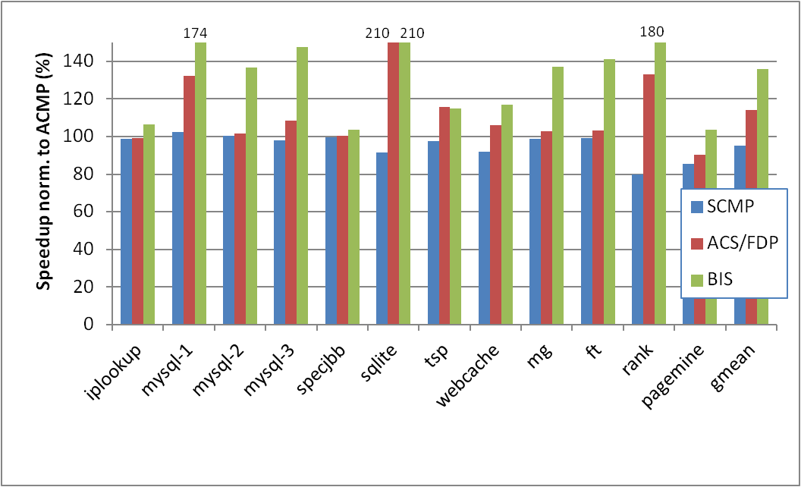
Optimal number of threads – Area=64

Slide 51
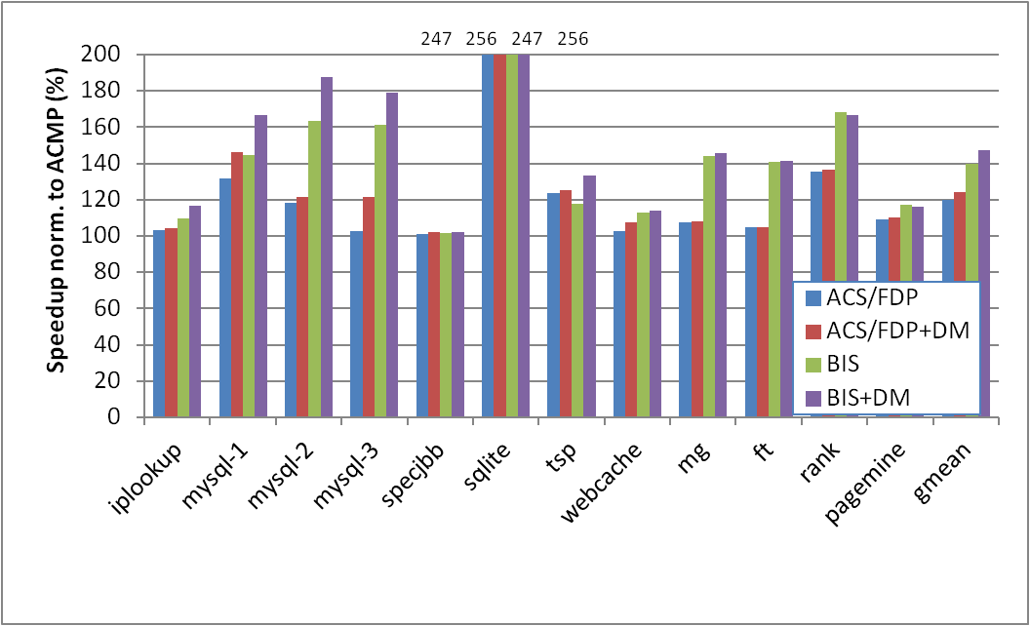
BIS and Data Marshaling, 28 T, Area=32

