Slide 1



Staged Memory Scheduling
Rachata Ausavarungnirun, Kevin Chang, Lavanya Subramanian,
Gabriel H. Loh*, Onur Mutlu
Carnegie Mellon University, *AMD Research
June 12th 2012
Notes:
Good afternoon everyone. Today I am going to present Staged Memory Scheduling. This is work done by [my name], …, …, …, and my advisor …

Slide 2
Executive Summary
Observation: Heterogeneous CPU-GPU systems require memory schedulers with large request buffers
Problem: Existing monolithic application-aware memory scheduler designs are hard to scale to large request buffer sizes
Solution: Staged Memory Scheduling (SMS)
decomposes the memory controller into three simple stages:
1) Batch formation: maintains row buffer locality
2) Batch scheduler: reduces interference between applications
3) DRAM command scheduler: issues requests to DRAM
Compared to state-of-the-art memory schedulers:
SMS is significantly simpler and more scalable
SMS provides higher performance and fairness
Notes:
We observe that Heterogeneous CPU-GPU systems require memory schedulers with large request buffers and this becomes a problem for existing monolithic application-aware memory scheduler designs because they are hard to scale to large request buffer size
Our Solution, staged memory scheduling, decomposes MC into three simpler stages:
1) Batch formation: maintains row buffer locality by forming batches of row-hitting requests.
2) Batch scheduler: reduces interference between applications by picking the next batch to prioritize.
3) DRAM command scheduler: issues requests to DRAM
Compared to state-of-the-art memory schedulers:
SMS is significantly simpler and more scalable
SMS provides higher performance and fairness, especially in heterogeneous CPU-GPU systems.

Slide 3
Outline
Background
Motivation
Our Goal
Observations
Staged Memory Scheduling
1) Batch Formation
2) Batch Scheduler
3) DRAM Command Scheduler
Results
Conclusion
Notes:
<continue from previous slide>
Let me first go over some background on memory scheduling
<click>

Slide 4
Main Memory is a Bottleneck
Core 1
Core 2
Core 3
Core 4
All cores contend for limited off-chip bandwidth
Inter-application interference degrades system performance
The memory scheduler can help mitigate the problem
How does the memory scheduler deliver good performance and fairness?
Req
Req
Req
Req
Req
Req
Req
Req
Memory Request Buffer
Req
Memory Scheduler
Data
Data
To DRAM
Notes:
Main memory is a major bottleneck in current multi-core systems
<click three times>,
Because memory requests from different core contend for a limited off-chip bandwidth
<click>
This inter-application interference degrades system performance. And designing a good memory scheduler can mitigate the problem…
<click>
But how does memory scheduler deliver good performance and fairness.
<click to the next slide>

Slide 5
Three Principles of Memory Scheduling
Prioritize row-buffer-hit requests [Rixner+, ISCA’00]
To maximize memory bandwidth
Prioritize latency-sensitive applications [Kim+, HPCA’10]
To maximize system throughput
Ensure that no application is starved [Mutlu and Moscibroda, MICRO’07]
To minimize unfairness
Older
Req 1 | Row A
Req 2 | Row B
Req 3 | Row C
Req 4 | Row A
Req 5 | Row B
Currently open row
B
Application | Memory Intensity (MPKI)
1 | 5
2 | 1
3 | 2
4 | 10
Newer
Notes:
State-of-the-art memory schedulers can deliver good performance and fairness generally based on three principles.
<click>
The first principle is to prioritize row-buffer-hit requests over other requests. The reason is because DRAM can service row-buffer-hit requests faster than requests that miss in the row buffer. This principle will maximize memory bandwidth
<click>
For example, suppose that there are five requests sorted by age as shown, and the current open row is row B. Even though request 1 is older than request 2, in this case, servicing a row hitting requests 2 first is faster than servicing requests that go to other rows. As a result, request 2 is prioritized over other requests.
<click>
The second principle is the scheduler should prioritize latency sensitive applications. Previous works have shown that latency sensitive applications can make faster forward progress when their memory requests are serviced quickly. In order to identify a latency sensitive application, memory intensity is generally used as a metric because application with lower memory intensity can make faster progress when a memory request is serviced.
<click>
For example, suppose that there are four applications in the system, and the memory intensity is defined by misses per thousand instructions. In this case, application number two will have more priority than other applications because it has the lowest memory intensity.
<click>
The third principle is the scheduler needs to make sure that the system is fair by ensuring that every application are making progress and none of the applications are starved.
<transition>
So far I have talked about memory scheduling in CPU-only systems. Now I will talk about the CPU-GPU heterogeneous system because current and future systems integrate a GPU along with multiple cores.

Slide 6
Outline
Background
Motivation: CPU-GPU Systems
Our Goal
Observations
Staged Memory Scheduling
1) Batch Formation
2) Batch Scheduler
3) DRAM Command Scheduler
Results
Conclusion
Notes:
So far I have talked about memory scheduling in CPU-only systems. Now I will talk about the CPU-GPU heterogeneous system because current and future systems integrate a GPU along with multiple cores.

Slide 7
Memory Scheduling for CPU-GPU Systems
Current and future systems integrate a GPU along with multiple cores
GPU shares the main memory with the CPU cores
GPU is much more (4x-20x) memory-intensive than CPU
How should memory scheduling be done when GPU is integrated on-chip?
Notes:
So far I have talked about memory scheduling in CPU-only systems. Now I will talk about the CPU-GPU heterogeneous system because current and future systems integrate a GPU along with multiple cores.
This integrated GPU shares the main memory with the CPU cores; however, the GPU is four to twenty times more memory-intensive compared to CPU. So, how should the memory scheduling be done when GPU is integrated on-chip?
Let’s see how does the memory scheduling problem change when we add a GPU into the system
[picture of the current APU/Sandy Bridge]

Slide 8
Introducing the GPU into the System
GPU occupies a significant portion of the request buffers
Limits the MC’s visibility of the CPU applications’ differing memory behavior → can lead to a poor scheduling decision
Core 1
Core 2
Core 3
Core 4
GPU
Req
Req
Req
Req
Req
Req
Req
Req
Req
Req
Req
Req
Req
Req
Req
Req
Req
Req
Req
Req
Req
Req
Req
Req
Req
Memory Scheduler
To DRAM
Notes:
When GPU is introduced into the system <click>, because the GPU is memory-intensive, requests from cores contend heavily with request from the GPU, as you can see from this example
<click>
The memory-intensive GPU application will send a lot of request to the memory request buffer
<click>
As a result, some of the requests are unable to be inject into the request buffer, as illustrated by this blue request from core 2.
<click>
When only some of the memory requests can inject into the request buffer, memory scheduler cannot observe full applications behavior. This can lead to a poor scheduling decision
<click… transition>
A naïve solution to this problem is to increase the size of the monolithic request buffer…

Slide 9
Naïve Solution: Large Monolithic Buffer
Core 1
Core 2
Core 3
Core 4
GPU
Req
Req
Req
Req
Req
Req
Req
Req
Req
Req
Req
Req
Req
Req
Req
Req
Req
Req
Req
Req
Req
Req
Req
Req
Req
Req
Req
Req
Req
Req
Req
Req
Req
Req
Req
Req
Req
Req
Req
Req
Req
Req
Memory Scheduler
To DRAM
Notes:
The naïve solution is to increase the size of the batch scheduler
<click> transition: however …

Slide 10
Problems with Large Monolithic Buffer
A large buffer requires more complicated logic to:
Analyze memory requests (e.g., determine row buffer hits)
Analyze application characteristics
Assign and enforce priorities
This leads to high complexity, high power, large die area
Req
Req
Req
Req
Req
Req
Req
Req
Req
Req
Req
Req
Req
Req
Req
Req
Req
Req
Req
Req
Req
Req
Req
Req
Req
Req
Req
Req
Req
Req
Req
Req
Req
Req
Req
Req
Req
Req
Req
Req
Req
Req
Memory Scheduler
More Complex Memory Scheduler
Notes:
<However (continue from the previous slide) a large buffer requires more complicated logic to analyze memory requests (for example, to determine if each request is a row hit), analyze application characteristics, assign and enforce priorities.
<click>
This leads to high complexity, high power, and large die area
<click, the big Mem sched. Appears>
<click, transition>
Our goal in this project is…

Slide 11
Our Goal
Design a new memory scheduler that is:
Scalable to accommodate a large number of requests
Easy to implement
Application-aware
Able to provide high performance and fairness, especially in heterogeneous CPU-GPU systems
Notes:
Our goal in this project is to design a new memory scheduler that is <click> scalable to accommodate a large number of requests, <click> easy-to-implement, <click> application-aware and <click> able to provide high performance and fairness especially in heterogeneous CPU-GPU systems.
<transition … >
To this end, we have made several observations that lead to our new memory scheduler design

Slide 12
Outline
Background
Motivation: CPU-GPU Systems
Our Goal
Observations
Staged Memory Scheduling
1) Batch Formation
2) Batch Scheduler
3) DRAM Command Scheduler
Results
Conclusion
Notes:
<continue from previous slide>
To this end, we have made several observations that lead to our new memory scheduler design
<click>

Slide 13
Key Functions of a Memory Controller
Memory controller must consider three different things concurrently when choosing the next request:
1) Maximize row buffer hits
Maximize memory bandwidth
2) Manage contention between applications
Maximize system throughput and fairness
3) Satisfy DRAM timing constraints
Current systems use a centralized memory controller design to accomplish these functions
Complex, especially with large request buffers
Notes:
… we observe that there are three key functions that an application aware memory scheduler need to provide concurrently when choosing the next request
<click>
First, a memory scheduler should maximize row buffer hits because this increases the bandwidth utlization
<click>
Second, a memory scheduler should be able to manage contention between different applications. This will increase system throughput and fairness
<click>
Third, a memory scheduler need to satisfy DRAM timing constraints
<click>
Current systems use a centralized memory controller design to accomplish these functions, which is complex when the request buffer is large
<click … transition>
So, our key idea is to …

Slide 14
Key Idea: Decouple Tasks into Stages
Idea: Decouple the functional tasks of the memory controller
Partition tasks across several simpler HW structures (stages)
1) Maximize row buffer hits
Stage 1: Batch formation
Within each application, groups requests to the same row into batches
2) Manage contention between applications
Stage 2: Batch scheduler
Schedules batches from different applications
3) Satisfy DRAM timing constraints
Stage 3: DRAM command scheduler
Issues requests from the already-scheduled order to each bank
Notes:
Our key idea is to decouple these functional tasks <click> into different stages.
<click>
We partition these three <click> tasks across several simpler hardware structures, which we call stages.
<click>
Stage 1 is the batch formation. This stage maximizes row buffer hits by grouping requests that access the same row within each application into batches
<click>
Stage 2 is the batch scheduler. This stage manages contention by scheduling batches from different applications
<click>
And stage 3 is the DRAM command scheduler. This stage issues requests from an already scheduled order and make sure that it satisfy DRAM timing constraints
<click … transition>
With these key observations, we will show how we can decouple a monolithic schedulers into a simpler design through …

Slide 15
Outline
Background
Motivation: CPU-GPU Systems
Our Goal
Observations
Staged Memory Scheduling
1) Batch Formation
2) Batch Scheduler
3) DRAM Command Scheduler
Results
Conclusion
Notes:
<transition>
With these key observations, we will show how we can decouple a monolithic schedulers into a simpler design through …

Slide 16
SMS: Staged Memory Scheduling
Core 1
Core 2
Core 3
Core 4
GPU
Stage 1
Req
Req
Req
Req
Req
Req
Req
Req
Batch Formation
Req
Req
Req
Req
Req
Req
Req
Req
Req
Req
Req
Req
Req
Req
Req
Req
Req
Req
Req
Req
Req
Req
Req
Req
Stage 2
Batch Scheduler
Monolithic Scheduler
Req
Req
Req
Req
Req
Req
Req
Req
Req
Req
Req
Memory Scheduler
Stage 3
DRAM Command Scheduler
Bank 1
Bank 2
Bank 3
Bank 4
To DRAM
Notes:
With these key observations, we will show how we can decouple a monolithic schedulers into a simpler design through <click> stage 1, the batch formation, <click> stage 2, the batch scheduler, <click> stage 3, the DRAM command scheduler

Slide 17
SMS: Staged Memory Scheduling
Core 1
Core 2
Core 3
Core 4
GPU
Stage 1
Batch Formation
Stage 2
Batch Scheduler
Req
Req
Stage 3
DRAM Command Scheduler
Bank 1
Bank 2
Bank 3
Bank 4
To DRAM
Notes:
Now, let me explain how the batch formation works …

Slide 18
Stage 1: Batch Formation
Goal: Maximize row buffer hits
At each core, we want to batch requests that access the same row within a limited time window
A batch is ready to be scheduled under two conditions
1) When the next request accesses a different row
2) When the time window for batch formation expires
Keep this stage simple by using per-core FIFOs
Notes:
The goal in the batch formation stage is to maximize row buffer hits.
<click>
At each core, we want to batch request that access the same row within a limited time window
<click>
And a batch is ready to be scheduled by the batch scheduler under to conditions. The first condition is when the next request accesses a different row. The second condition is when the time window for batch formation expires to ensure forward progress
<click>
We keep this stage simple by using per-core FIFO queues
<click … transition>
And now I will show an example of how batch formation works.

Slide 19
Stage 1: Batch Formation Example
Stage 1
Next request goes to a different row
Core 1
Core 2
Core 3
Core 4
Batch Formation
Row C
Row E
Row A
Row B
Row E
Row B
Row D
Row A
Row D
Row F
Time window expires
Batch Boundary
To Stage 2 (Batch Scheduling)
Notes:
I will show an example of how the batch formation work
<click>
When there is an incoming requests that access the same row as an earlier requests. (This yellow request that accesses row B), they will be batched. And a batch will become ready to be scheduled under two conditions. First, it will become ready when a subsequent request wants to access a different row, in this case row C. The earlier request to row B will become ready to be scheduled.
A batch can become ready to be scheduled under another condition, which is when the time window for the batch formation expires, which is shown in this example in core 1. this batch formation will happen across all the cores including the GPU.

Slide 20
SMS: Staged Memory Scheduling
Core 1
Core 2
Core 3
Core 4
GPU
Stage 1
Batch Formation
Stage 2
Batch Scheduler
Req
Req
Stage 3
DRAM Command Scheduler
Bank 1
Bank 2
Bank 3
Bank 4
To DRAM
Notes:
<transition>
Now, let me tell you how Stage 2 works: the batch scheduler.

Slide 21
Stage 2: Batch Scheduler
Goal: Minimize interference between applications
Stage 1 forms batches within each application
Stage 2 schedules batches from different applications
Schedules the oldest batch from each application
Question: Which application’s batch should be scheduled next?
Goal: Maximize system performance and fairness
To achieve this goal, the batch scheduler chooses between two different policies
Notes:
The goal for the batch scheduler is to minimize interference between applications.
Because the batch formation forms batches within each application
<click>
The batch scheduler only need schedule batches among different applications
<click>
And because batches in stage 1 is sorted in a FIFO order, the batch scheduler only needs to consider the oldest batch from each application
<click>
The question is how can the scheduler pick the next batch?
<click>
The goal is to maximize system performance and fairness. And in order to achieve this goal, we employ two batch scheduling algorithms.
<click … transition>

Slide 22
Stage 2: Two Batch Scheduling Algorithms
Shortest Job First (SJF)
Prioritize the applications with the fewest outstanding memory requests because they make fast forward progress
Pro: Good system performance and fairness
Con: GPU and memory-intensive applications get deprioritized
Round-Robin (RR)
Prioritize the applications in a round-robin manner to ensure that memory-intensive applications can make progress
Pro: GPU and memory-intensive applications are treated fairly
Con: GPU and memory-intensive applications significantly slow down others
Notes:
The first algorithm we employ is the Shortest Job First policy, which
Prioritizes the applications with the fewest outstanding memory requests because they make fast forward progress
The benefit is shortest job first policy is it provides good system performance and fairness
However, the GPU and memory-intensive applications get deprioritized
In order to mitigate this problem, the batch scheduler can use Round-Robin policy, which
Prioritizes the applications in a round-robin manner to ensure that memory-intensive applications can make progress
The benefit of using a round-robin policy is it provides high GPU performance (because it is memory-intensive)
However, the GPU and memory-intensive applications significantly slow down others

Slide 23
Stage 2: Batch Scheduling Policy
The importance of the GPU varies between systems and over time → Scheduling policy needs to adapt to this
Solution: Hybrid Policy
At every cycle:
With probability p : Shortest Job First → Benefits the CPU
With probability 1-p : Round-Robin → Benefits the GPU
System software can configure p based on the importance/weight of the GPU
Higher GPU importance → Lower p value
Notes:
The importance of the GPU varies between systems and also over time. The batch scheduling policy needs to adapt to this change.<click>
In order to adapt to this change, we propose a hybrid policy, where at every cycle:
<click> at every cycle <click>
With a probability of p, the scheduler will use SJF policy. <click>
With a probability of 1-p, the scheduler will use RR policy.<click>
And the system software can configure p based on the importance of the GPU. The more important the GPU, the low p value
<transition>
And with these two stages, batch formation and batch scheduler, both inter-application and intra-application ordering are handled. Now, I will explain the last stage of our design: the DRAM command scheduler.

Slide 24
SMS: Staged Memory Scheduling
Core 1
Core 2
Core 3
Core 4
GPU
Stage 1
Batch Formation
Stage 2
Batch Scheduler
Req
Req
Stage 3
DRAM Command Scheduler
Bank 1
Bank 2
Bank 3
Bank 4
To DRAM
Notes:
And with these two stages, batch formation and batch scheduler, both inter-application and intra-application ordering are handled. Now, I will explain the last stage of our design, which is the DRAM command scheduler.

Slide 25
Stage 3: DRAM Command Scheduler
High level policy decisions have already been made by:
Stage 1: Maintains row buffer locality
Stage 2: Minimizes inter-application interference
Stage 3: No need for further scheduling
Only goal: service requests while satisfying DRAM timing constraints
Implemented as simple per-bank FIFO queues
Notes:
Because high level policy decisions have already been made by stages 1 and 2, where stage 1 maintains row buffer locality and stage 2 minimizes inter-application interference. There is no need for this stage to optimize for row buffer locality, performance or fairness.
<click>
As a result, the goal of this stage is to service requests while satisfying DRAM timing constraints
<click>
And this can be implemented as simpler per-bank FIFO queues
<transition>
Now, we will show an example of how the three stages work with each other.

Slide 26
Putting Everything Together
Core 1
Core 2
Core 3
Core 4
GPU
Stage 1:
Batch
Formation
Stage 2:
Batch Scheduler
Current Batch Scheduling Policy
RR
Current Batch Scheduling Policy
SJF
Stage 3: DRAM Command Scheduler
Bank 1
Bank 2
Bank 3
Bank 4
Notes:
In this example, the system consist of 4 CPU cores and a GPU, and the color represent a row the request wants to access. Similar color means these requests want to access the same row.
In the batch formation stage, memory requests that access the same row will be batched.
<click>
One criteria that a batch becomes ready to be scheduled is when the next request is going to a different row, as illustrated in this example at core 2 and core 3. <click click>
Another criteria is when the timeout for the batch formation expires.
This batching process will happen across all cores including the GPU
<click>
<click> and how the batch scheduler will select one of these front batch to send to <click> the DRAM command scheduler.
The scheduler can either use a shortest job poilcy
<click> which will pick this purple request because it is from an application with the fewest number of requests.
Or a round-robin policy
<click>
Whenever the bank is ready to schedule a next request. DRAM command scheduler will schedule the requests in an in-order manner.
<click>
Now that I told you about how SMS works, let me tell you about the complexity of SMS
<click … transition>

Slide 27
Complexity
Compared to a row hit first scheduler, SMS consumes*
66% less area
46% less static power
Reduction comes from:
Monolithic scheduler → stages of simpler schedulers
Each stage has a simpler scheduler (considers fewer properties at a time to make the scheduling decision)
Each stage has simpler buffers (FIFO instead of out-of-order)
Each stage has a portion of the total buffer size (buffering is distributed across stages)
* Based on a Verilog model using 180nm library
Notes:
<transition from the previous slide>
Now that I told you about how SMS works, let me tell you about the complexity of SMS.
Compared to a row hit first scheduler, which is the one of the simplest memory scheduling algorithm that has been proposed, SMS consumes 66% less area and 46% less static power
The reduction in area and static power comes from:
Decoupling the monolithic scheduler into stages of simpler schedulers
Each stage has simpler scheduler, which considers fewer properties at a time to make the scheduling decision
Each stage has simpler buffers, which is a FIFO instead of out-of-order buffers
Each stage has a portion of the total buffer size and buffering is distributed across stages

Slide 28
Outline
Background
Motivation: CPU-GPU Systems
Our Goal
Observations
Staged Memory Scheduling
1) Batch Formation
2) Batch Scheduler
3) DRAM Command Scheduler
Results
Conclusion
Notes:
<continue from previous slide>
And I will go over the results
<click>

Slide 29
Methodology
Simulation parameters
16 OoO CPU cores, 1 GPU modeling AMD Radeon™ 5870
DDR3-1600 DRAM 4 channels, 1 rank/channel, 8 banks/channel
Workloads
CPU: SPEC CPU 2006
GPU: Recent games and GPU benchmarks
7 workload categories based on the memory-intensity of CPU applications
→ Low memory-intensity (L)
→ Medium memory-intensity (M)
→ High memory-intensity (H)
Notes:
We use an in-house cycle level simulator that models 16 OoO CPU cores and 1 GPU modeling AMD Radeon 5870. We model the main memory using DDR3 DRAM with 4 channels, 1 rank and 8 banks.
<click>
We use SPEC 2006 for the CPU applications and recent games and GPU Benchmarks for the GPU. We divide the workload into 7 workload categories based on the memory intensity of the CPU and this varies from low, medium and high memory-intensity applications measured based on LLC MPKI
<click, transition>

Slide 30
Comparison to Previous Scheduling Algorithms
FR-FCFS [Rixner+, ISCA’00]
Prioritizes row buffer hits
Maximizes DRAM throughput
Low multi-core performance ⬅ Application unaware
ATLAS [Kim+, HPCA’10]
Prioritizes latency-sensitive applications
Good multi-core performance
Low fairness ⬅ Deprioritizes memory-intensive applications
TCM [Kim+, MICRO’10]
Clusters low and high-intensity applications and treats each separately
Good multi-core performance and fairness
Not robust ⬅ Misclassifies latency-sensitive applications
Notes:
We compare our proposed mechanism with three previous state-of-the-art memory scheduling algorithms.
<click>
The first algorithm we compare to is a row-hit first algorithm that prioritize row buffer hitting requests first. And this will maximizes DRAM throughput. However, as previous work have shown, FR-FCFS has low multi-core performance because it is application unaware
<click>
The second algorithm we compare to is adaptive per thread least attained service memory scheduling algorithm, which prioritizes latency sensitive applications. This algorithm gives good multi-core performance. However, previous work has shown that this algorithm is unfair because memory-intensive applications are deprioritized
<click>
The last algorithm we compare to is thread cluster memory scheduling algorithm, which cluster low and high memory intensity applications into two different clusters, and treats each cluster differently to improve both performance and fairness. However, we observe that TCM is not robust enough in the context of CPU-GPU heterogeneous system. Because TCM misclassify latency sensitive applications and put these applications in a wrong cluster, and it uses a wrong scheduling policy on these miss-classified applications.
<click … transition>

Slide 31
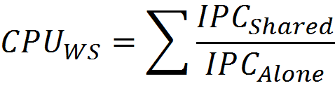

Evaluation Metrics
CPU performance metric: Weighted speedup
GPU performance metric: Frame rate speedup
CPU-GPU system performance: CPU-GPU weighted speedup
Notes:
We evaluated CPU performance using weighted speedup which is defined by the sum of IPC of the CPU when it is running with other applications compared to when it is running alone
<click>
We evaluated GPU performance using GPU speedup which is defined by the frame rate speedup of the GPU when it is running with other applications compared to when it is running alone
<click>
In terms of the system performance, we use CPU-GPU weighted speedup, which is the sum of CPU weighted speedup and the GPU speedup. However, we multiply the GPU speedup with the GPU weight <click> which can be changed based on the important of the GPU.
<click … transition>

Slide 32
Evaluated System Scenarios
CPU-focused system
GPU-focused system
Notes:
We will evaluate SMS using two different scenarios
<click> The first scenario is the CPU-focus system <click> and the second scenario is the GPU-focused system.
We will now talk about the CPU-focused system

Slide 33
Evaluated System Scenario: CPU Focused
GPU has low weight (weight = 1)
Configure SMS such that p, SJF probability, is set to 0.9
Mostly uses SJF batch scheduling → prioritizes latency-sensitive applications (mainly CPU)
1
Notes:
On a CPU-focused system <click> The GPU has low weight of 1, and in this case, SMS is configured such that P, the probablity of using the shortest job first batch scheduling policy, is set to 0.9. This will mostly use shortest job first batch scheduling, which prioritize latency sensitive applications.
<click>

Slide 34
Performance: CPU-Focused System
SJF batch scheduling policy allows latency-sensitive applications to get serviced as fast as possible
+17.2% over ATLAS
SMS is much less complex than previous schedulers
p=0.9
Workload Categories
Notes:
This plot shows the performance of SMS on a CPU focused system. The y-axis represents the system performance measured by the CPU-GPU weighted speedup with the GPU weight of 1, and the X-axis is the performance on each workload categories sorted from low intensity to high intensity.
<click>
When the CPU performance is important, setting the probability of using the shortest job first batch scheduling policy to a high value, allows the latency-sensitive applications to get serviced as fast as possible. <click> This improve system performance by 17.2% on average compared to the previous best scheduling mechanism.
<click>
In addition to the performance gain, the design of SMS is much simpler compared to previous designs.

Slide 35
Evaluated System Scenario: GPU Focused
GPU has high weight (weight = 1000)
Configure SMS such that p, SJF probability, is set to 0
Always uses round-robin batch scheduling → prioritizes memory-intensive applications (GPU)
1000
Notes:
On a GPU-focused system <click> The GPU has high weight of 1000, and in this case, SMS is configured such that P, the probability of using the shortest job first batch scheduling policy, is set to 0. This will use round-robin batch scheduling policy all the time, which gives priority to the GPU.
<click>

Slide 36
Performance: GPU-Focused System
Round-robin batch scheduling policy schedules GPU requests more frequently
+1.6% over FR-FCFS
SMS is much less complex than previous schedulers
p=0
Workload Categories
Notes:
This plot shows the performance of SMS on a GPU focused system. The y-axis represents the system performance measured by the CPU-GPU weighted speedup with the GPU weight of 1000, and the X-axis is the performance on each workload categories sorted from low intensity to high intensity.
<click>
When the GPU performance is important, always using the round-robin policy will schedule GPU requests more frequently.
<click> This improve system performance by 1.6% on average compared to the previous best scheduling mechanism, which is FR-FCFS.
<click>
In addition to the performance gain, the design of SMS is much simpler compared to previous designs.

Slide 37
Performance at Different GPU Weights
Best Previous
Scheduler
ATLAS
TCM
FR-FCFS
Notes:
In this plot, we show the performance of SMS, compared to the best performing scheduler. Note that the best previous algorithm is different for different weights. We vary the GPU weight of 0.001 to 1000. The Y-Axis shows the system performance measured by dividing the CPU-GPU weighted speedup by the total weight to make sure it is bound between 0 and 1.

Slide 38
Performance at Different GPU Weights
At every GPU weight, SMS outperforms the best previous scheduling algorithm for that weight
Best Previous
Scheduler
SMS
Notes:
We found that at every GPU weight, we can configure the probablity of using shortest job first batch scheduling policy such that SMS outperforms the best previous mechanism for that weight

Slide 39
Additional Results in the Paper
Fairness evaluation
47.6% improvement over the best previous algorithms
Individual CPU and GPU performance breakdowns
CPU-only scenarios
Competitive performance with previous algorithms
Scalability results
SMS’ performance and fairness scales better than previous algorithms as the number of cores and memory channels increases
Analysis of SMS design parameters
Notes:
In addition to the previous results, we also provide other key results in the paper. We have shown that SMS provides significant fairness improvement over previous algorithms. We also provided individual CPU and GPU performance breakdowns. SMS performs competitively in CPU-only scenarios. We have shown that SMS scales better with the increasing number of cores and memory channels, and we also provide an analysis of different design parameters in the paper.

Slide 40
Outline
Background
Motivation: CPU-GPU Systems
Our Goal
Observations
Staged Memory Scheduling
1) Batch Formation
2) Batch Scheduler
3) DRAM Command Scheduler
Results
Conclusion
Notes:
Now I will conclude

Slide 41
Conclusion
Observation: Heterogeneous CPU-GPU systems require memory schedulers with large request buffers
Problem: Existing monolithic application-aware memory scheduler designs are hard to scale to large request buffer size
Solution: Staged Memory Scheduling (SMS)
decomposes the memory controller into three simple stages:
1) Batch formation: maintains row buffer locality
2) Batch scheduler: reduces interference between applications
3) DRAM command scheduler: issues requests to DRAM
Compared to state-of-the-art memory schedulers:
SMS is significantly simpler and more scalable
SMS provides higher performance and fairness
Notes:
We observe that Heterogeneous CPU-GPU systems require memory schedulers with large request buffers and this becomes a problem for existing monolithic application-aware memory scheduler designs because they are hard to scale to large request buffer size
Our Solution is to decomposes MC into three simpler stages:
1) Batch formation: maintains row buffer locality by forming batches of row-hitting requests.
2) Batch scheduler: reduces interference between applications by picking the next batch to prioritize.
3) DRAM command scheduler: issues requests to DRAM
Compared to state-of-the-art memory schedulers:
SMS is significantly simpler and more scalable
SMS provides higher performance and fairness, especially in heterogeneous CPU-GPU systems.

Slide 42
Staged Memory Scheduling
Rachata Ausavarungnirun, Kevin Chang, Lavanya Subramanian,
Gabriel H. Loh*, Onur Mutlu
Carnegie Mellon University, *AMD Research
June 12th 2012
Notes:
Good afternoon everyone. Today I am going to present Staged Memory Scheduling. This is work done by myself, …, …, …, and my advisor …

Slide 43
Backup Slides

Slide 44
Row Buffer Locality on Batch Formation
OoO batch formation improves the performance of the system by:
~3% when the batch scheduler uses SJF policy most of the time
~7% when the batch scheduler uses RR most of the time
However, OoO batch formation is more complex
OoO buffering instead of FIFO queues
Need to fine tune the time window of the batch formation based on application characteristics (only 3%-5% performance gain without fine tuning)

Slide 45
Row Buffer Locality on Batch Formation

Slide 46
Key Differences Between CPU and GPU
L2 MPKI
~4x difference
Graphic Applications
CPU Applications

Slide 47
MLP and RBL
Key differences between a CPU application and a GPU application

Slide 48
CPU-GPU Performance Tradeoff
Notes:
CPU performs better with high SJF probability
GPU performs better with low SJF probability
[Say: summarize the other key results in the paper]

Slide 49
Dealing with Multi-Threaded Applications
Batch formation: Groups requests from each application in a per-thread FIFO
Batch scheduler: Detects critical threads and prioritizes them over non-critical threads
Previous works have shown how to detect and schedule critical threads
1) Bottleneck Identification and Scheduling in MT applications [Joao+, ASPLOS’12]
2) Parallel Application Memory Scheduling
[Ebrahimi, MICRO’11]
DRAM command scheduler: Stays the same

Slide 50
Dealing with Prefetch Requests
Previous works have proposed several solutions:
Prefetch-Aware Shared-Resource Management for Multi-Core Systems [Ebrahimi+, ISCA’11]
Coordinated Control of Multiple Prefetchers in Multi-Core Systems [Ebrahimi+, MICRO’09]
Prefetch-aware DRAM Controller [Lee+, MICRO’08]
Handling Prefetch Requests in SMS:
SMS can handle prefetch requests before they enter the memory controller (e.g., source throttling based on prefetch accuracy)
SMS can handle prefetch requests by prioritizing/deprioritizing prefetch batch at the batch scheduler (based on prefetch accuracy)

Slide 51
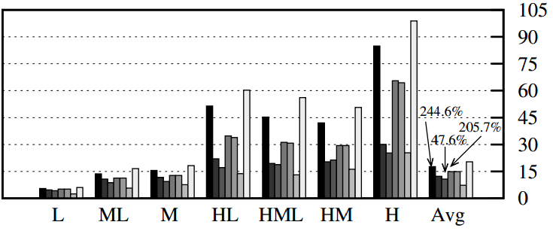

Fairness Evaluation
Unfairness (Lower is better)

Slide 52
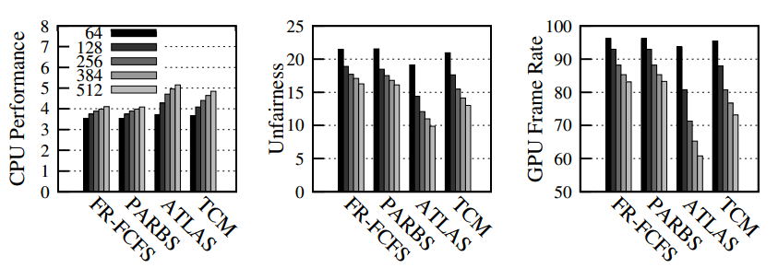
Performance at Different Buffer Sizes

Slide 53
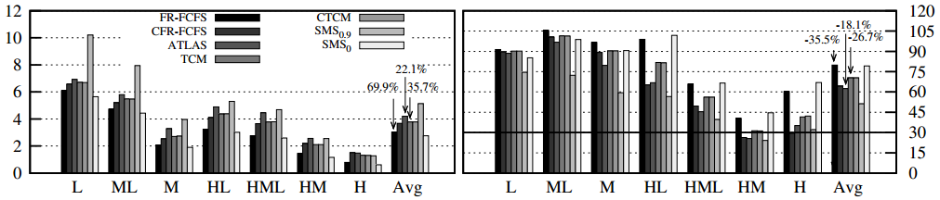
CPU and GPU Performance Breakdowns
CPU WS
Frame Rate

Slide 54
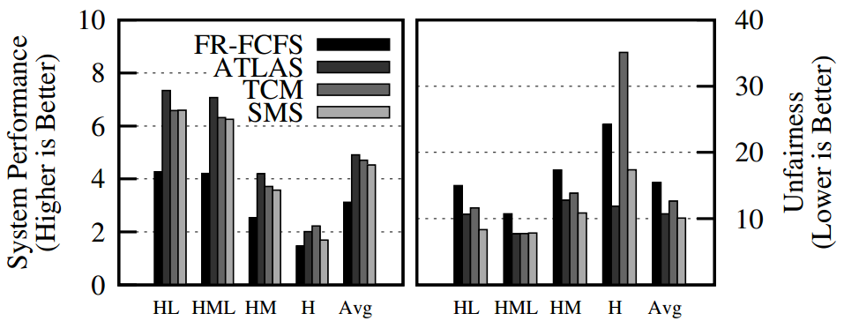
CPU-Only Results

Slide 55
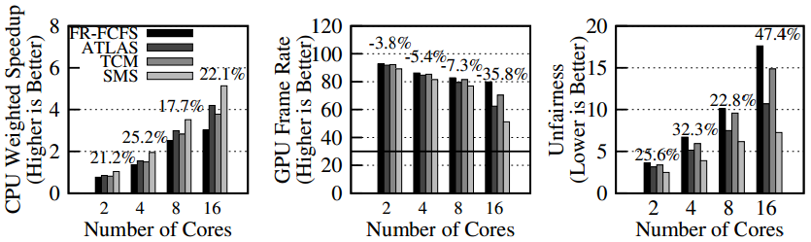
Scalability to Number of Cores

Slide 56
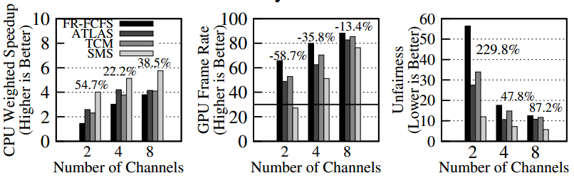
Scalability to Number of Memory Controllers

Slide 57
Detailed Simulation Methodology
Number of cores | 16 | GPU Max throughput | 1600 ops/cycle
Number of GPU | 1 | GPU Texture/Z/Color units | 80/128/32
CPU reorder buffers | 128 entries | DRAM Bus | 64 bits/channel
L1 (private) cache size | 32KB, 4 ways | DRAM row buffer size | 2KB
L2 (shared) cache size | 8MB, 16 ways | MC Request buffer size | 300 entries
ROB Size | 128 entries

Slide 58
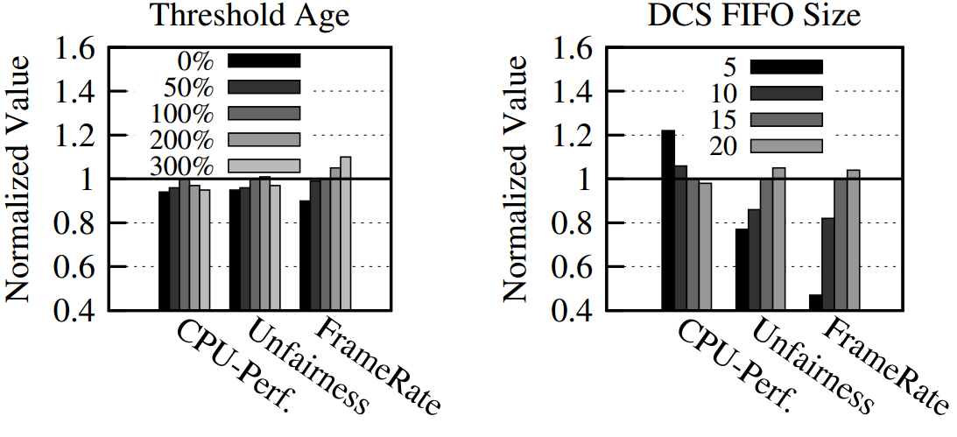
Analysis to Different SMS Parameters

Slide 59
Global Bypass
What if the system is lightly loaded?
Batching will increase the latency of requests
Global Bypass
Disable the batch formation when the number of total requests is lower than a threshold

Slide 60
Putting Everything Together
Core 1
Core 2
Core 3
Core 4
GPU
Stage 1:
Batch
Formation
Stage 2:
Batch Scheduler
Current Batch Scheduling Policy
RR
Current Batch Scheduling Policy
SJF
Stage 3: DRAM Command Scheduler
Bank 1
Bank 2
Bank 3
Bank 4
Notes:
In this example, the system consist of 4 CPU cores and a GPU, and the color represent a row the request wants to access. Similar color means these requests want to access the same row.
In the batch formation stage, memory requests that access the same row will be batched.
<click>
One criteria that a batch becomes ready to be scheduled is when the next request is going to a different row, as illustrated in this example at core 2 and core 3. <click click>
Another criteria is when the timeout for the batch formation expires.
This batching process will happen across all cores including the GPU
<click>
<click> and how the batch scheduler will select one of these front batch to send to <click> the DRAM command scheduler.
The scheduler can either use a shortest job poilcy
<click> which will pick this purple request because it is from an application with the fewest number of requests.
Or a round-robin policy
<click>
Whenever the bank is ready to schedule a next request. DRAM command scheduler will schedule the requests in an in-order manner.
<click>
Now that I told you about how SMS works, let me tell you about the complexity of SMS
<click … transition>

