Slide 1

HAT: Heterogeneous Adaptive Throttling for On-Chip Networks
Kevin Kai-Wei Chang
Rachata Ausavarungnirun
Chris Fallin
Onur Mutlu

Slide 2
Executive Summary
Problem: Packets contend in on-chip networks (NoCs), causing congestion, thus reducing system performance
Approach: Source throttling (temporarily delaying packet injections) to reduce congestion
1) Which applications to throttle? Observation: Throttling network-intensive applications leads to higher system performance ➔Key idea 1: Application-aware source throttling
2) How much to throttle? Observation: There is no single throttling rate that works well for every application workload ➔Key idea 2: Dynamic throttling rate adjustment
Result: Improves both system performance and energy efficiency over state-of-the-art source throttling policies

Slide 3
Outline
Background and Motivation
Mechanism
Comparison Points
Results
Conclusions

Slide 4
On-Chip Networks
Connect cores, caches, memory controllers, etc.
Buses and crossbars are not scalable
PE
PE
PE
…
PE
IInterconnect
Processing Element
(Cores, L2 Banks, Memory Controllers, etc)
PE

Slide 5
On-Chip Networks
Connect cores, caches, memory controllers, etc
Buses and crossbars are not scalable
Packet switched
2D mesh: Most commonly used topology
Primarily serve cache misses and memory requests
PE
PE
PE
R
R
R
PE
PE
PE
R
R
R
PE
PE
PE
R
R
R
R
Router
Processing Element
(Cores, L2 Banks, Memory Controllers, etc)
PE

Slide 6
Network Congestion Reduces Performance
Limited shared resources (buffers and links)
due to design constraints: Power, chip area, and timing
PE
PE
PE
P
R
R
R
PE
PE
PE
Congestion
P
P
P
R
R
R
Network congestion:
⬇system performance
PE
PE
PE
P
R
R
R
R
Router
P
Packet
Processing Element
(Cores, L2 Banks, Memory Controllers, etc)
PE

Slide 7
Goal
Improve system performance in a highly congested network
Observation: Reducing network load (number of packets in the network) decreases network congestion, hence improves system performance
Approach: Source throttling (temporarily delaying new traffic injection) to reduce network load

Slide 8
Source Throttling
…
PE
PE
PE
P
P
I
P
P
P
P
P
P
P
P
P
P
P
P
P
Long network latency when the network is congested
I
Network
P
Packet
Processing Element
(Cores, L2 Banks, Memory Controllers, etc)
PE

Slide 9
Source Throttling
P
P
…
P
PE
PE
PE
P
P
P
Throttle
Throttle
Throttle
P
P
I
P
P
P
P
P
P
P
P
P
P
P
P
P
P
Throttling makes some packets wait longer to inject
Average network throughput increases, hence higher
system performance
I
Network
P
Packet
Processing Element
(Cores, L2 Banks, Memory Controllers, etc)
PE

Slide 10
Key Questions of Source Throttling
Every cycle when a node has a packet to inject, source throttling blocks the packet with probability P
We call P “throttling rate” (ranges from 0 to 1)
Throttling rate can be set independently on every node
Two key questions:
Which applications to throttle?
How much to throttle?
Naïve mechanism: Throttle every single node with a constant throttling rate

Slide 11
Key Observation #1
Throttling network-intensive applications leads to higher system performance
Configuration: 16-node system, 4x4 mesh network,
8 gromacs (network-non-intensive), and 8 mcf (network-intensive)
…
gromacs
mcf
Throttle
I
P
P
P
P
P
P
P
P
P
P
Throttling gromacs decreases system performance by 2% due to minimal network load reduction

Slide 12
Key Observation #1
Throttling network-intensive applications leads to higher system performance
Configuration: 16-node system, 4x4 mesh network,
8 gromacs (network-non-intensive), and 8 mcf (network-intensive)
…
gromacs
mcf
Throttle
I
P
P
P
P
P
P
P
P
P
P
Throttling mcf increases system performance by 9% (gromacs: +14% mcf: +5%) due to reduced congestion

Slide 13
Key Observation #1
Throttling network-intensive applications leads to higher system performance
Configuration: 16-node system, 4x4 mesh network,
8 gromacs (network-non-intensive), and 8 mcf (network-intensive)
…
gromacs
mcf
Throttle
I
P
P
P
P
Throttling network-intensive applications reduces congestion
Benefits both network-non-intensive and network-intensive applications
P
Throttling mcf reduces congestion
gromacs benefits more from less network latency

Slide 14
Key Observation #2
There is no single throttling rate that works well for every application workload
Network runs best at or below a certain network load
Dynamically adjust throttling rate to avoid overload and under-utilization
…
…
gromacs
gromacs
mcf
mcf
Throttle 0.8
Throttle 0.8
Throttle 0.8
Throttle 0.8
I
I
P
P
P
P
P
P
P
P
P
P
P

Slide 15
Outline
Background and Motivation
Mechanism
Comparison Points
Results
Conclusions

Slide 16
Heterogeneous Adaptive Throttling (HAT)
Application-aware throttling: Throttle network-intensive applications that interfere with network-non-intensive applications
Network-load-aware throttling rate adjustment: Dynamically adjust throttling rate to adapt to different workloads and program phases

Slide 17
Heterogeneous Adaptive Throttling (HAT)
Application-aware throttling: Throttle network-intensive applications that interfere with network-non-intensive applications
Network-load-aware throttling rate adjustment: Dynamically adjust throttling rate to adapt to different workloads and program phases

Slide 18
Application-Aware Throttling
Measure applications’ network intensity
Throttle network-intensive applications
Use L1 MPKI (misses per thousand instructions) to estimate network intensity
How to select unthrottled applications?
Leaving too many applications unthrottled overloads the network
➔Select unthrottled applications so that their total network
intensity is less than the total network capacity
Network-non-intensive
(Unthrottled)
Network-intensive
(Throttled)
App
Σ MPKI < Threshold
Higher L1 MPKI

Slide 19
Heterogeneous Adaptive Throttling (HAT)
Application-aware throttling: Throttle network-intensive applications that interfere with network-non-intensive applications
Network-load-aware throttling rate adjustment: Dynamically adjust throttling rate to adapt to different workloads and program phases

Slide 20
Dynamic Throttling Rate Adjustment
Different workloads require different throttling rates to avoid overloading the network
But, network load (fraction of occupied buffers/links) is an accurate indicator of congestion
Key idea: Measure current network load and dynamically adjust throttling rate based on load
if network load > target:
Increase throttling rate
else:
Decrease throttling rate
If network is congested, throttle more
If network is not congested, avoid unnecessary throttling

Slide 21
Heterogeneous Adaptive Throttling (HAT)
Application-aware throttling: Throttle network-intensive applications that interfere with network-non-intensive applications
Network-load-aware throttling rate adjustment: Dynamically adjust throttling rate to adapt to different workloads and program phases

Slide 22
Epoch-Based Operation
Application classification and throttling rate adjustment are expensive if done every cycle
Solution: recompute at epoch granularity
During epoch:
Every node:
Measure L1 MPKI
Measure network load
Beginning of epoch:
All nodes send measured info to a central controller, which:
Classifies applications
Adjusts throttling rate
Sends new classification and throttling rate to each node
Time
Current Epoch
(100K cycles)
Next Epoch
(100K cycles)

Slide 23
Putting It Together: Key Contributions
1. Application-aware throttling
Throttle network-intensive applications based on applications’ network intensities
2. Network-load-aware throttling rate adjustment
Dynamically adjust throttling rate based on network load to avoid overloading the network
HAT is the first work to combine application-aware throttling and network-load-aware rate adjustment

Slide 24
Outline
Background and Motivation
Mechanism
Comparison Points
Results
Conclusions

Slide 25
Comparison Points
Source throttling for bufferless NoCs [Nychis+ Hotnets’10, SIGCOMM’12]
Throttle network-intensive applications when other applications cannot inject
Does not take network load into account
We call this “Heterogeneous Throttling”
Source throttling for buffered networks [Thottethodi+ HPCA’01]
Throttle every application when the network load exceeds a dynamically tuned threshold
Not application-aware
Fully blocks packet injections while throttling
We call this “Self-Tuned Throttling”

Slide 26
Outline
Background and Motivation
Mechanism
Comparison Points
Results
Conclusions

Slide 27
Methodology
Chip Multiprocessor Simulator
64-node multi-core systems with a 2D-mesh topology
Closed-loop core/cache/NoC cycle-level model
64KB L1, perfect L2 (always hits to stress NoC)
Router Designs
Virtual-channel buffered router: 4 VCs, 4 flits/VC [Dally+ IEEE TPDS’92]
Input buffers to hold contending packets
Bufferless deflection router: BLESS [Moscibroda+ ISCA’09]
Misroute (deflect) contending packets

Slide 28
Methodology
Workloads
60 multi-core workloads of SPEC CPU2006 benchmarks
4 network-intensive workload categories based on the network intensity of applications (Low/Medium/High)
Metrics System performance: Fairness: Energy efficiency:

Slide 29
Performance: Bufferless NoC (BLESS)
+ 9.4%
+ 11.5%
+ 7.4%
+ 11.3%
+ 8.6%
1. HAT provides better performance improvement than state-of-the-art throttling approaches
2. Highest improvement on heterogeneous workloads
- L and M are more sensitive to network latency

Slide 30
Performance: Buffered NoC
+ 3.5%
HAT provides better performance improvement than prior approaches

Slide 31
Application Fairness
- 5%
- 15%
HAT provides better fairness than prior works

Slide 32
Network Energy Efficiency
+ 8.5%
+ 5%
HAT increases energy efficiency by reducing network load by 4.7% (BLESS) or 0.5% (buffered)

Slide 33
Other Results in Paper
Performance on CHIPPER [Fallin+ HPCA’11]
HAT improves system performance
Performance on multithreaded workloads
HAT is not designed for multithreaded workloads, but it slightly improves system performance
Parameter sensitivity sweep of HAT
HAT provides consistent system performance improvement on different network sizes

Slide 34
Conclusions
Problem: Packets contend in on-chip networks (NoCs), causing congestion, thus reducing system performance
Approach: Source throttling (temporarily delaying packet injections) to reduce congestion
1) Which applications to throttle? Observation: Throttling network-intensive applications leads to higher system performance ➔Key idea 1: Application-aware source throttling
2) How much to throttle? Observation: There is no single throttling rate that works well for every application workload ➔Key idea 2: Dynamic throttling rate adjustment
Result: Improves both system performance and energy efficiency over state-of-the-art source throttling policies

Slide 35
HAT: Heterogeneous Adaptive Throttling for On-Chip Networks
Kevin Kai-Wei Chang
Rachata Ausavarungnirun
Chris Fallin
Onur Mutlu

Slide 36
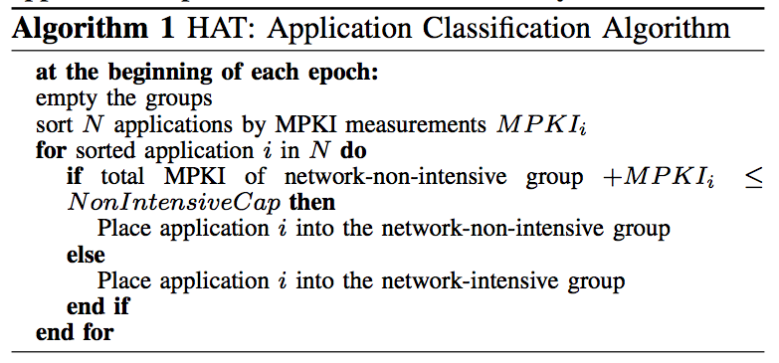
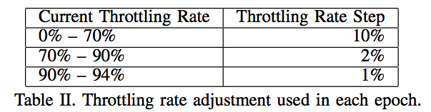
Throttling Rate Steps

Slide 37
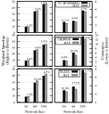
Network Sizes

Slide 38

Performance on CHIPPER/BLESS
Injection rate (number of injected packets / cycle):
+8.5% (BLESS) or +4.8% (CHIPPER)

Slide 39
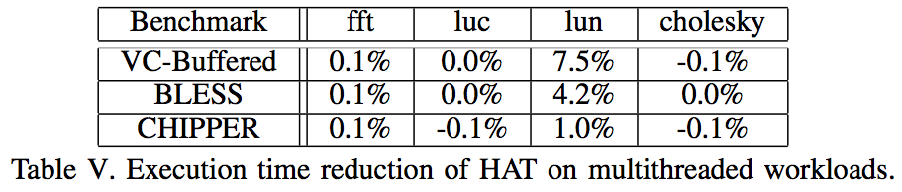
Multithreaded Workloads

Slide 40
Motivation
90%
94%

Slide 41

Sensitivity to Other Parameters
Network load target: WS peaks at b/w 50% and 65% network utilization
Drops more than 10% beyond that
Epoch length: WS varies by less than 1% b/w 20K and 1M cycles
Low-intensity workloads: HAT does not impact system performance
Unthrottled network intensity threshold:

Slide 42
Implementation
L1 MPKI: One L1 miss hardware counter and one instruction hardware counter
Network load: One hardware counter to monitor the number of flits routed to neighboring nodes
Computation: Done at one central CPU node
At most several thousand cycles (a few percent overhead for 100K-cycle epoch)

