Slide 1
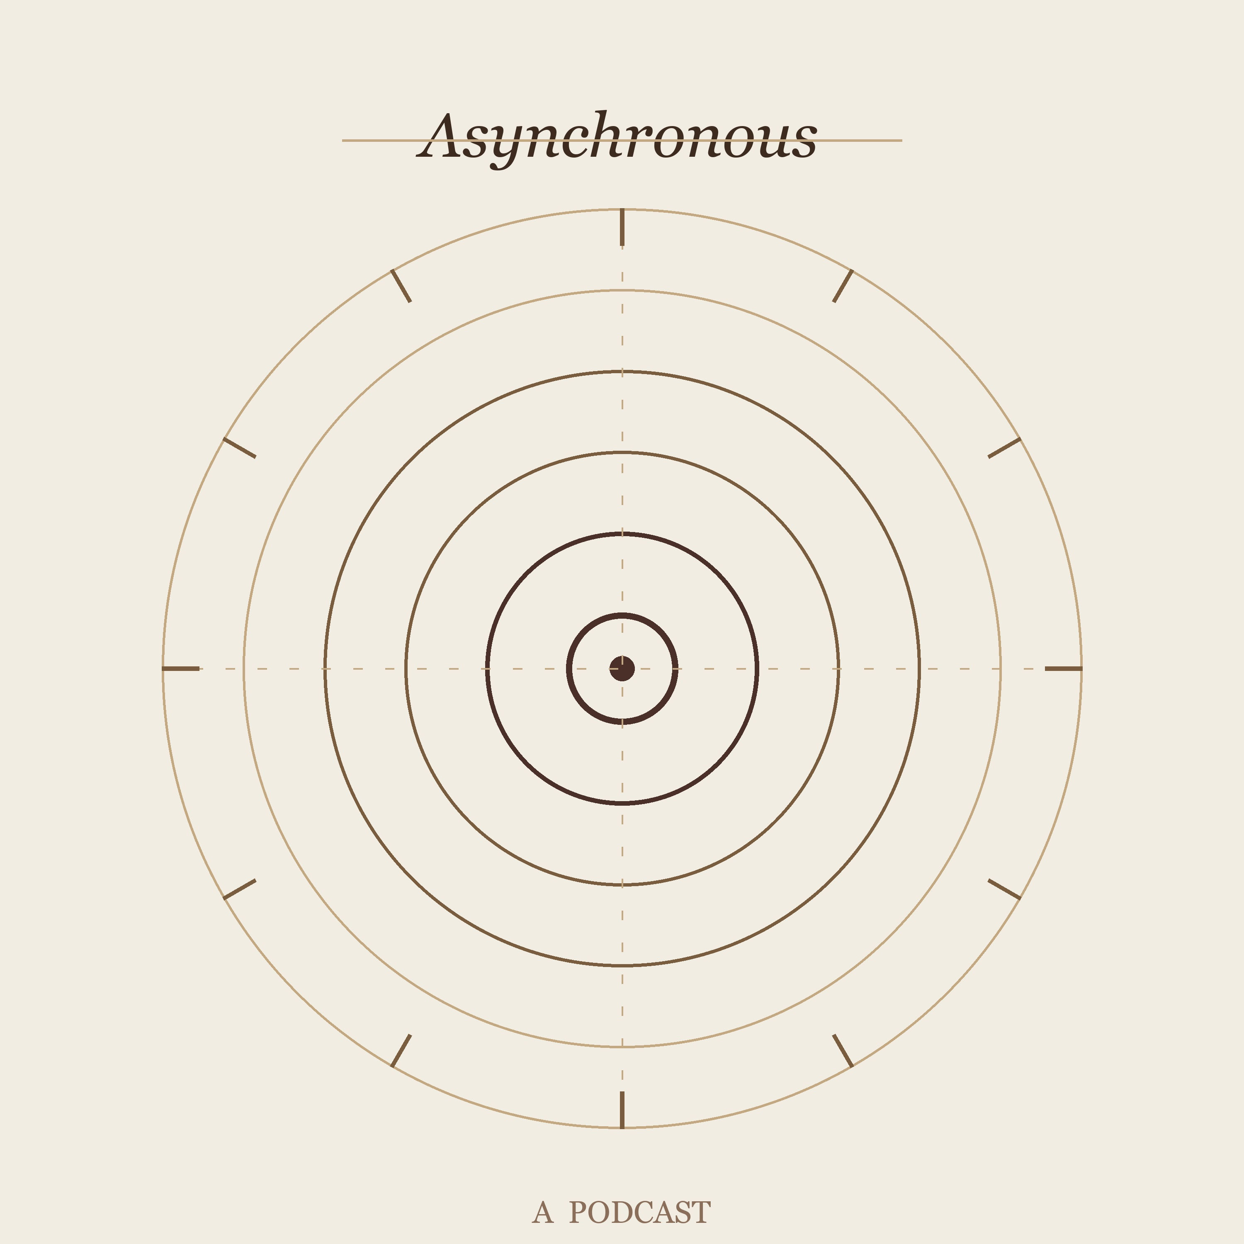
ASYNCHRONOUS / DIALOG
Consultant review | 2026-05-11
Make it a personal curiosity radio studio, not another AI podcast generator.
The repo already has an end-to-end engine. The next leap is editorial control, provenance, Telegram UX, and audio craft.
Keep
Scrap
Build
LOCAL PIPELINE
DERIVATIVE PITCH
MANIFEST + APPROVAL
Telegram -> research -> audio -> RSS is the valuable spine.
Public Radiolab positioning makes the work feel smaller.
Trust and control are the product moat.
01

Slide 2
EXECUTIVE VERDICT
The concept is strong; the generic category is not.
Worthwhile: a phone-to-home-studio curiosity loop with recurring hosts and owned publishing.
Keep
Scrap or park
The compact five-step pipeline, Telegram trigger, two-host identity, local GPU angle, RSS ownership, and debug-friendly work dirs.
Public imitation language, default-on YouTube clips, final-script source scraping, fake composer credit, and listener-page dead links.
Candid thesis
Immediate risk
Product opportunity
Architecture move
Operational overlap, broad clip/download surface, weak source provenance, inaccurate feed duration, and accidental Telegram triggers.
Director's Booth approval, source cards, learning paths, host chemistry controls, and a real companion player.
Introduce an EpisodeManifest first. Refactor around it later.
Evidence: repo review, generated artifacts, market/product docs
02

Slide 3
MARKET REALITY
Two AI hosts are now table stakes; editorial trust is the differentiator.
NotebookLM
Wondercraft
Podcastfy
Scale networks
Audio Overviews already offer AI-hosted source discussions, multiple formats, customization, and interactive mode.
Two-host Convo Mode, voice selection, delivery instructions, studio polish, translation, and creator workflows.
Open-source, programmatic NotebookLM alternative for multimodal, multilingual audio conversations.
Synthetic shows can be produced by the thousands. That makes low-effort audio feel disposable fast.
Strategic implication
Commodity risk
5/5
Do not compete on one-click topic-to-audio. Compete on personal context, source provenance, approval, and Cedar/Marin as recurring editorial voices.
Personal workflow moat
4/5
Current public trust signal
2/5
Potential educational value
5/5
Sources: NotebookLM Help, Wondercraft docs, Podcastfy PyPI, Hume case study, Podnews
03

Slide 4
PRODUCT STORY
The magic is not generation; it is capturing curiosity at the moment it appears.
1. Stray question
2. Telegram capture
3. Home studio
4. Commute episode
A topic arrives while walking, reading, or talking.
The phone becomes the inbox and control surface.
The tower researches, scripts, voices, mixes, and publishes.
Tomorrow's audio is waiting in the feed.
5. Follow-up loop
Positioning line
The bot asks what to clarify, quiz, or explore next.
Your personal research-radio duo
for questions you do not want to forget.
This story should replace the public imitation frame.
Best user story: Telegram guide and local home-machine workflow
04

Slide 5
CURRENT ARCHITECTURE
The pipeline is coherent, but metadata and control are missing.
Research
Script
Fact-check
Audio
RSS/git
Web-searched brief with facts, sources, angles.
Cedar/Marin dialogue with emotion tags.
Inline correction with web search.
Per-turn TTS, optional clips, optional music.
Append item, optionally commit and push.
What works
What breaks trust
What blocks scale
Readable orchestration, sensible fallbacks, two-host parsing, cached intro ident, local-first runtime.
Sources scraped from spoken script, clip attributions dropped, target duration published as actual.
No run manifest, process-local lock only, partial config validation, no approval state.
Design move: add manifest first, then split modules around it.
Evidence: generate_podcast.py, clip_mixer.py, music_gen.py, telegram_bot.py
05

Slide 6
ENGINEERING ASSESSMENT
The code is senior-prototype good; the system boundary is still hobby-script fragile.
Strength: compact spine
Strength: graceful degradation
Risk: config drift
Risk: no state
One file owns orchestration. That is not beautiful, but it keeps the mental model simple while behavior is still moving.
Music and clips can fail without killing the episode. Intro ident is cached. TTS chunking is practical.
Config loads from cwd, env overrides are partial, branch config is not honored, and invalid providers can publish nonsense.
A run is not a durable object. Failures, partial success, costs, clips, and sources are not first-class.
Risk: concurrency
Risk: publication
Risk: evidence
Opportunity
Telegram lock is in-memory only. CLI, watchdog restart, or future triggers can overlap on feed, git, logs, GPU.
RSS is string-edited, duration is target minutes, and a git failure leaves ambiguous local state.
Sources and clips should be structured metadata. Spoken dialogue should not be the database.
A manifest spine unlocks resume, approval, show notes, status, testing, and safer refactors.
Evidence: agents reviewed orchestration, Telegram, audio, and artifacts
06

Slide 7
SCRIPT GENERATION
The script needs an editorial pipeline, not just a bigger prompt.
Current
Failure mode
Target
Research brief -> full dialogue -> fact-check -> TTS.
Smooth, symmetrical, over-helpful conversation with spoken bibliography energy.
Source cards -> thesis -> beat sheet -> host stances -> draft -> anti-cliche rewrite -> performance script.
Humanization rules
Anti-template pass
Performance pass
Let hosts disagree, be briefly wrong, recover, callback, joke lightly, and move citations to show notes unless the source is story-critical.
Ban repeated crutches: 'that's the thing', 'not just X but Y', 'this changes everything', and generic wonder without concrete detail.
Use delivery tags sparingly. Add pauses and overlaps where they clarify the scene, not on every line.
Best first upgrade: approve the hook and beat sheet in Telegram before TTS.
Goal: less AI-sounding without losing factual density
07

Slide 8
AUDIO AND RIGHTS
The most fun audio feature is also the highest release risk.
Default-on YouTube clips
Timecode bug
Production gap
Model-generated cues drive yt-dlp search and download. Popularity scoring is not a rights, accuracy, or audio-quality strategy.
The code downloads a segment around the target timestamp, then seeks again to the original timestamp inside that short raw file.
Multiple 128 kbps MP3 encodes, hard concatenation, no loudness normalization, no ducking, and simple fades.
Risk / value profile
Fun and texture
5/5
Design answer
Publish risk
5/5
Default clips off for published runs. Add clip policy modes, rights ledger, approval, transcript-based timecodes, and a rights-safe sound library.
Current attribution quality
2/5
Audio answer: WAV/PCM intermediates -> crossfades/ducking -> loudness normalization -> one final MP3 encode.
Sources: YouTube Terms, YouTube Help, U.S. Copyright Office fair use guidance
08

Slide 9
TELEGRAM UX
Telegram should become the control room, not a bare text trigger.
/generate <topic>
/status + /cancel
/queue + /next
/doctor
Only explicit commands start expensive work. Private chat by default; group chats require allowed chat IDs.
Expose active stage, elapsed time, run id, and process-tree cancellation.
Capture curiosity all day, then run the next topic intentionally.
Check keys, ffmpeg, git, disk, branch, bot identity, GPU/music availability.
Approval card
Director's Booth
Before TTS, send hook, thesis, beat sheet, source cards, expected duration, clip policy, and estimated cost. Buttons: Approve, Shorter, Deeper, More skeptical, More wonder, No clips, Cancel.
Operational rule: bot and CLI both use the same lock file and manifest. The process-local asyncio lock is not enough.
Evidence: telegram_bot.py, telegram-instructions.md, watchdog.ps1
09

Slide 10
TARGET ARCHITECTURE
Make each episode a durable object, then let every stage read and write it.
Settings
EpisodeManifest
Research/script
Repo-root aware, typed, validated config.
Source cards, claims, beat sheet, performance script.
topic
options
models
source cards
claims
clips
audio stats
publish state
errors
Job controller
Audio/publish
Lock, PID, stale recovery, timeout, cancel.
Normalize, duration, show notes, RSS, git state.
Why this first?
It fixes observability, resume, Telegram status, RSS quality, testing, and safer module extraction in one move.
Design recommendation: manifest spine before broad refactor
10

Slide 11
ROADMAP
The next six phases turn a working script into a trustworthy studio.
P0
P1
P2
P3
P4
P5
Brand + safety
Manifest + RSS
Telegram control
Script quality
Audio craft
Companion player
Pick name, remove imitation copy, clips off, disclosure, env docs.
Source cards, duration, state, show notes, XML generation.
Commands, queue, status, cancel, doctor, cross-process lock.
Beat sheet, host stances, anti-cliche rewrite, approval.
Normalize, crossfade, duck, final encode, safe sound library.
Transcript, chapters, sources, clips, follow-up prompts.
Sprint 1 should ship: typed config, clip default off, manifest, true duration, /generate, /status, and lock file.
Recommendation: boring foundations first, show magic second
11

Slide 12
DECISION SHEET
First sprint: make the system trustworthy before making it flashier.
Decide
Implement
Harden
Brand name; default private/draft/publish mode; clip policy; whether the old email path stays archived.
Typed config, EpisodeManifest, true duration, structured sources, AI disclosure, clip default off.
Command-only Telegram, cross-process lock, runtime timeout, cancel, per-run logs, sanitized failure summaries.
Upgrade writing
Upgrade audio
Upgrade learning
Hook approval, beat sheet, host stance map, anti-cliche rewrite, show notes from metadata.
WAV intermediates, single final encode, loudness normalization, ducking, crossfades, rights-safe stingers.
Companion transcript, source cards, chapters, glossary, quiz/follow-up loop, learning-path mode.
Bottom line
Do not build more slop. Build a small, opinionated, source-backed radio machine that feels like it belongs to you.
First implementation design choices
12

