Slide 1
Basic Calculator
A Python Tkinter GUI Application
NextHikes IT Solutions | Project 2

Slide 2
Introduction
Goal: turn a console calculator into a graphical desktop app
Built with Python's standard GUI toolkit, Tkinter
Developed in Visual Studio Code, hosted on GitHub
Clickable buttons replace typed input

Slide 3
Project Features
Equation display screen for expressions and results
Buttons for digits 0-9 and decimal point
Addition, subtraction, multiplication, division
= to calculate and C to clear
Extras: backspace button and keyboard support

Slide 4
Tools & Learning Outcomes
Core Python: variables, functions, loops, error handling
Tkinter: Tk, Entry, Button, grid layout, events
Visual Studio Code as the IDE
GitHub for version control and submission
Application development in Python

Slide 5
How the Code Works
A variable (equation) stores what the user has typed
click(): adds the pressed button to the equation and shows it
calculate(): solves the equation with eval() when = is pressed
clear() and backspace(): empty the screen or delete the last digit
key_press(): lets the user type from the keyboard
try/except shows a message for errors like divide by zero

Slide 6
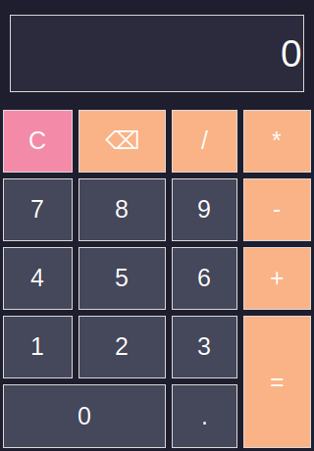
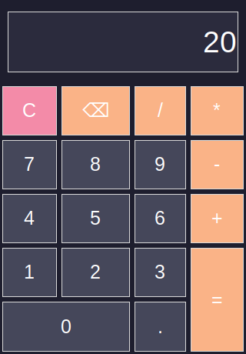

Output: Calculations
Start screen
12+8
7*6

Slide 7
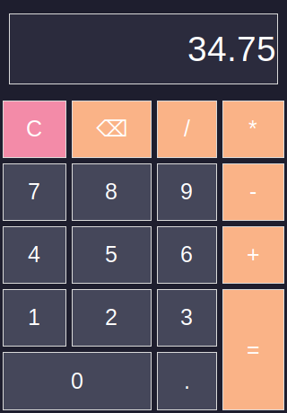
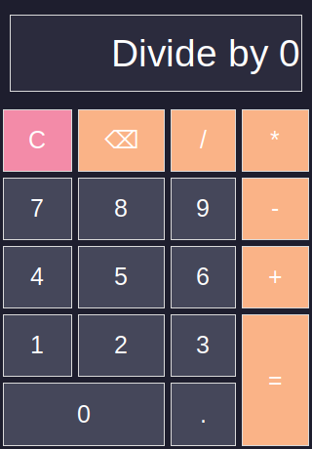
Output: Mixed & Error Handling
125/4+3.5 = 34.75
5/0 handled safely

Slide 8
Conclusion
Working GUI calculator built from scratch in Python
Practised event-driven programming with Tkinter
Possible upgrades: scientific functions, history, themes
Code available on GitHub: <add your repository link here>

