Slide 1
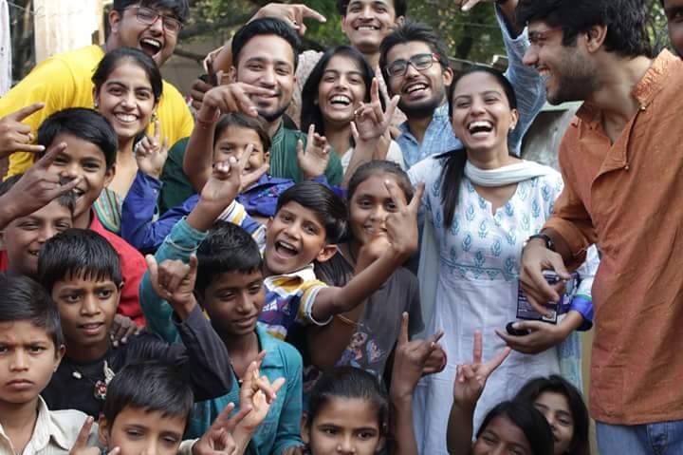
Sarvahitey
Working as One for the Good of All

Slide 2
About Sarvahitey
Sarvahitey is a cause based Non-Profit Organization striving to Preserve, Sustain and Refine the Society.
Established in 2015, Sarvahitey operates on charitable contributions, and works solely for social welfare, i.e., anything done for the betterment of the society, be it in the field of education, literature, health, environment, law or culture.
We are a movement of young people realizing the onus of empowering the marginalized of our community.

Slide 3
Philosophies of Sarvahitey
Parity: Sarvahitey believes in parity of everyone, be it a trustee or a volunteer, or even a recipient. The hierarchy of individuals in this organization is not defined by the post or position that he/she holds, but their level of participation. Even the decision making process is not insulated from anyone.
Transparency: Sarvahitey keeps total transparency regarding its activities and affairs. Anyone can make any queries and seek any clarifications regarding any action of its members, or the organization as such.
No Interest Groups: This organization is not run by any foundation, company, firm, institution or governmental agency. Sarvahitey doesn't promote interests of any particular entity, and has no bias or prejudice against anyone.
Real Ground Work: Sarvahitey believes in actual ground work, and not just cosmetic changes. Its various events and projects are organized in slums and villages, and no exclusive publicity is sought from it.
Money is Secondary: Perhaps this is the most distinctive aspect of Sarvahitey. It is one of the very few organizations wherein money is given secondary importance; the primary concern is towards participation. Whenever any help, or contribution is sought from anyone, firstly their participation is sought. It is only when a special need arises, that a monetary call for help is broadcasted

Slide 4
Where we are based?
Sarvahitey has two offices: one in Noida and one in Delhi.
Noida office: F-56, sector 51, Noida
Delhi office: D-7/7487, Vasant Kunj, New Delhi
However, the area of operation of an organization is not defined by its offices, but by its projects. Sarvahitey's projects are mostly based in the National Capital Region, i.e. Delhi, Noida, Greater Noida, Gurgaon, and Ghaziabad; though Sarvahitey has run projects in Assam, Bihar, Haryana and Himachal Pradesh as well.

Slide 5
Who are the members of Sarvahitey?
There are 6 Trustees, who are entrusted with the decision making process of the Trust, i.e. Sarvahitey: Prem Prakash, Managing Trustee, Sanskriti Srivastava, Ankit Malhotra, Bharat Datta and Smriti Mehrotra. Settlor of the Trust is Keshav Datta.
Apart from them, there are numerous other members, which we may refer to as ‘volunteers’. Volunteers are the life-blood of Sarvahitey; their enthusiasm and commitment forever keeps this NGO a vibrant one.
Mostly, the Trustees are responsible for planning, researching for, and managing the execution of all the events. Everyone's views and suggestions are taken into consideration; even the decision making process is not insulated from any person exhibiting interest in the functioning of this Trust. Sarvahitey organizes public meetings and discussions on regular basis, inviting any advices/suggestions/constructive criticisms that one may have to offer.

Slide 6
Working model of Sarvahitey
Sarvahitey has a very simple working model, which is conducive to the busiest of persons. Throughout the weekdays, the Core Members of Sarvahitey plan a particular event, and on a weekend, they execute it. The Core Members invite suggestions in the planning process, from any person interested in doing so. On the appointed date of execution, which is made public with comfortable prior notice, everyone is invited to spare a few hours, and take part in the festival of social work. Any person may come on the appointed date and time, and participate actively in the particular event.
The Core Members of Sarvahitey take on the responsibility of the entire planning process, engaging with the governmental authorities if need be, and so forth. On the actual occasion, everyone is invited to drink from the nectar of 'sharing and caring'. Since the event takes place on weekends, any student or working professional has the opportunity to take part in various drives.

Slide 7
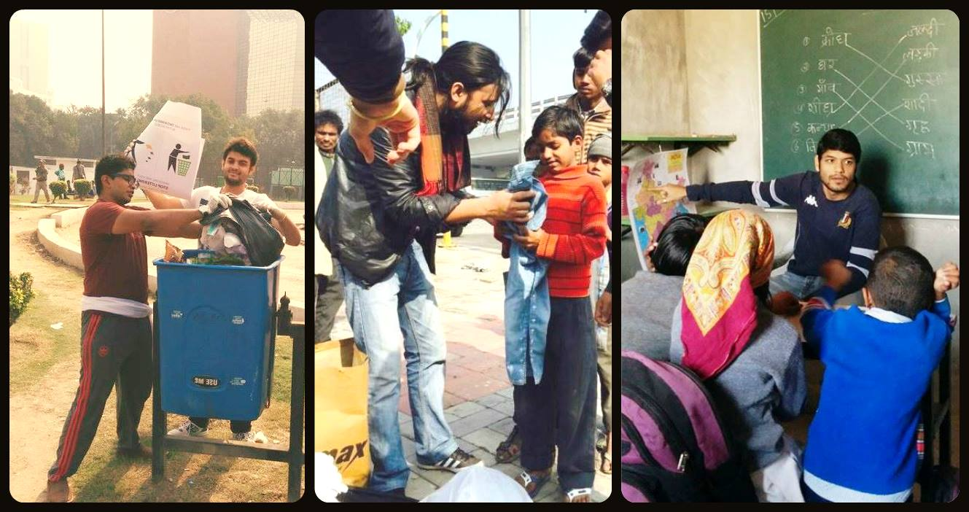
Projects run by Sarvahitey
Sarvahitey runs two types of Projects: Regular and Ad-Hoc (need based).

Slide 8
Our regular projects are:
Cleanliness Drives, i.e., 'Safai Abhiyaan'
Clothes Donation Drives
Project 'Vidya Vistar', i.e., teaching underprivileged children
Food Drive
Model Village
Vocational Training
Ad-Hoc (need based) projects of Sarvahitey:
Nepal Earthquake Relief Program
Go-Vote campaign
Assam Flood Relief Program
Dengue Prevention Drives

Slide 9
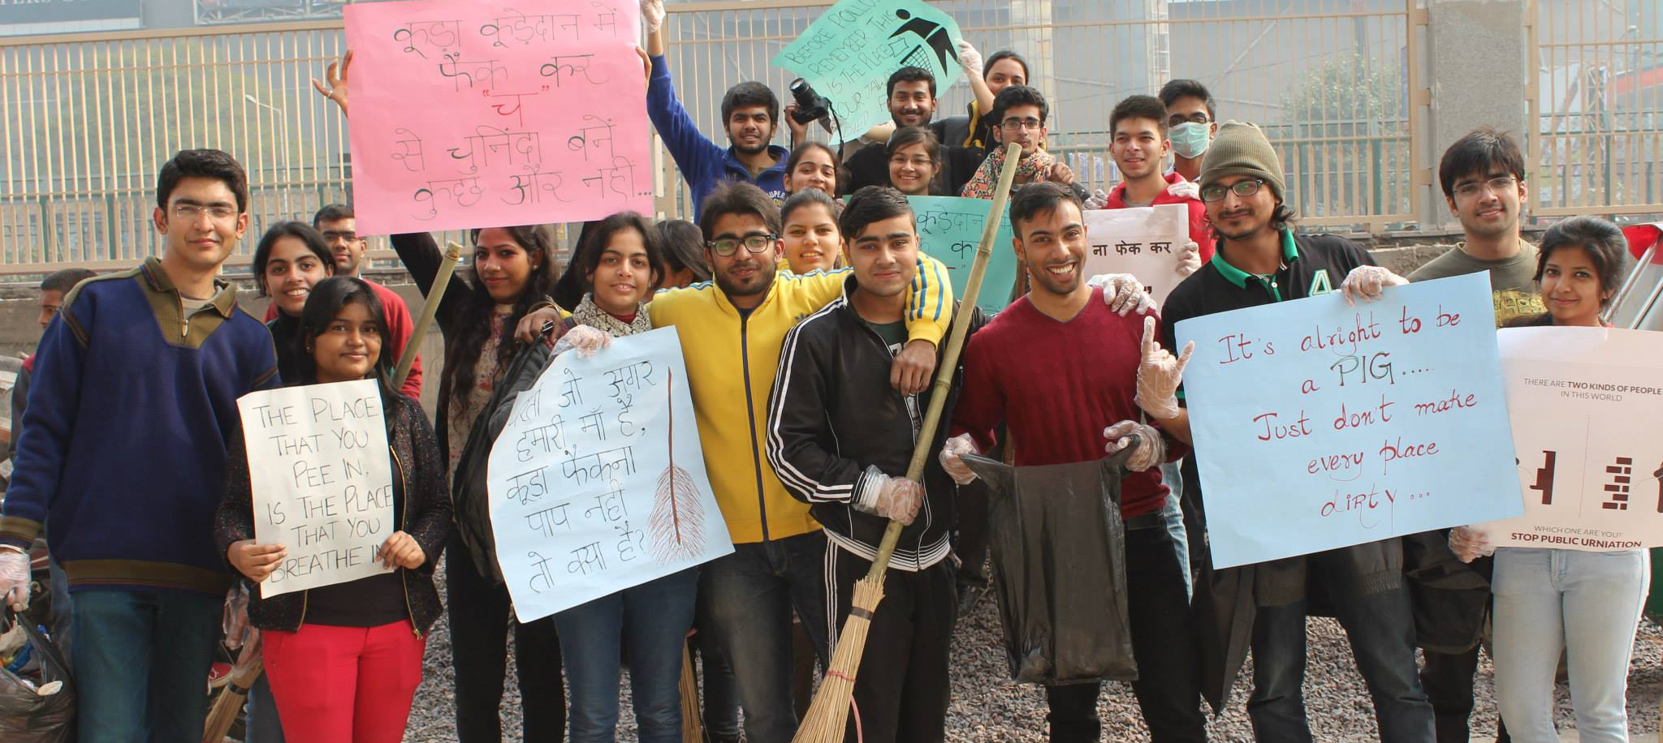
Cleanliness Drive
For, a clean mind, a clean body and a clean environment are the habitats of enlightened progress.

Slide 10
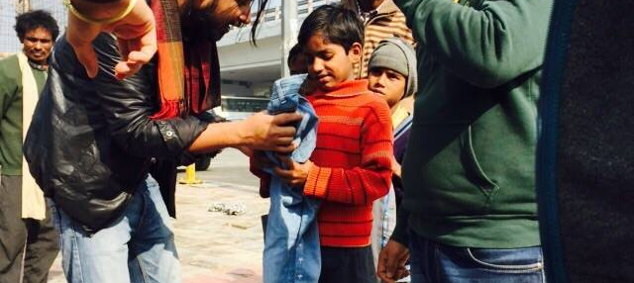
Clothes Donation Drive
For, a clothed body is a dignified body, and dignified lives breed dignified thoughts.

Slide 11
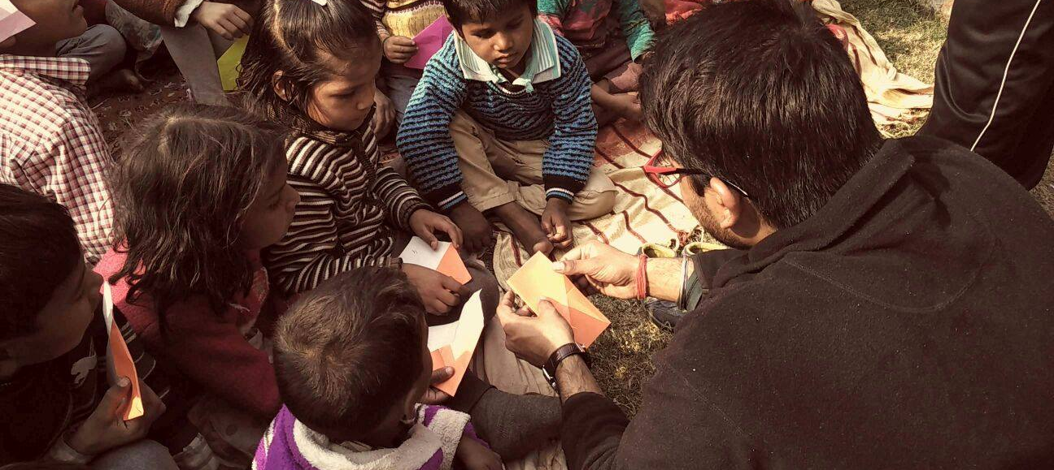
Project Vidya Vistar
For, Education is the prime and paramount prerequisite for a civilized and developed society.

Slide 12
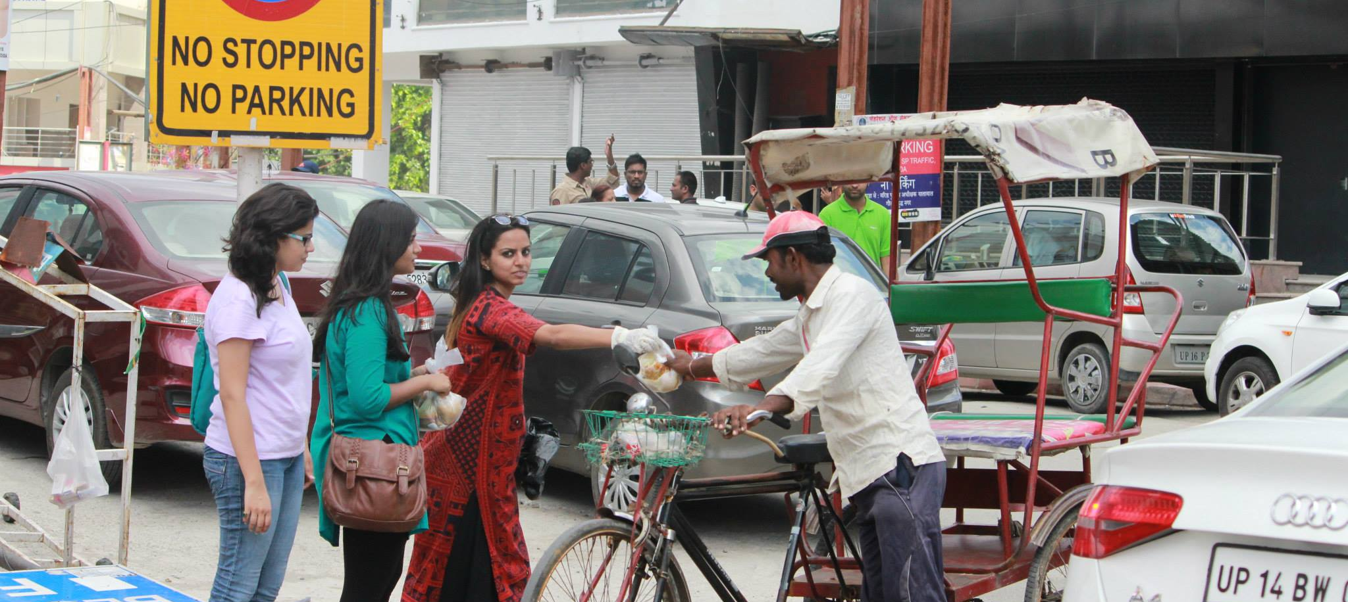
Food Drive
For, one cannot think well, love well, sleep well, if one has not dined well.

Slide 13
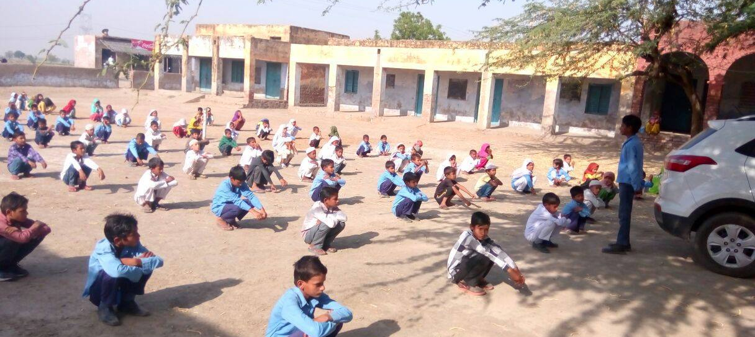
Model Village
For, the stronger the roots, the tastier the fruits. And India’s roots are in its rural population.

Slide 14
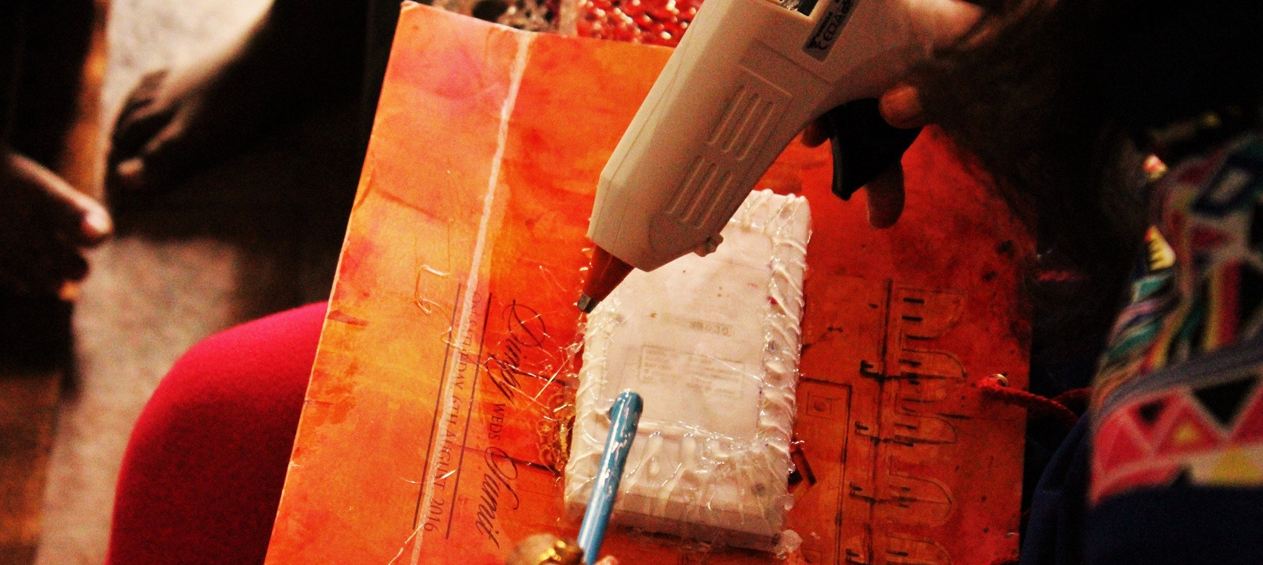
Vocational Training
For, a skilled individual is a valued asset.

Slide 15
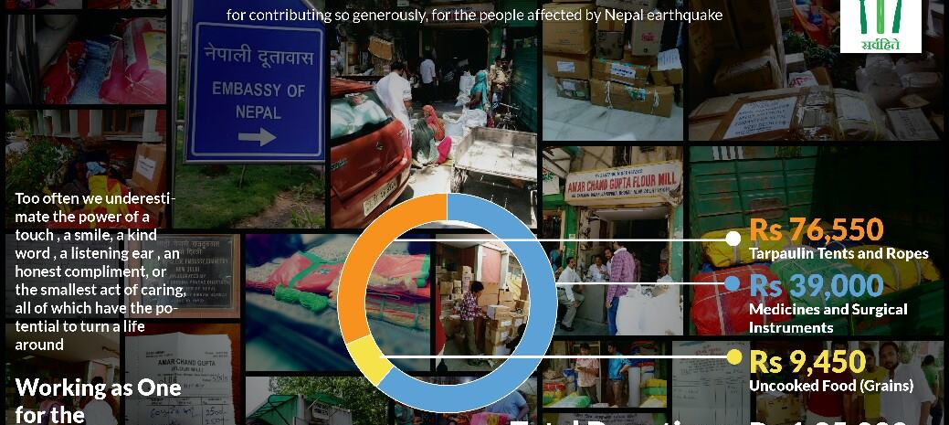
Nepal Earthquake Relief Program
For, when opportunity for service arises, Sarvahitey mobilizes, plans and acts to resolve issues requiring urgent redressal.

Slide 16
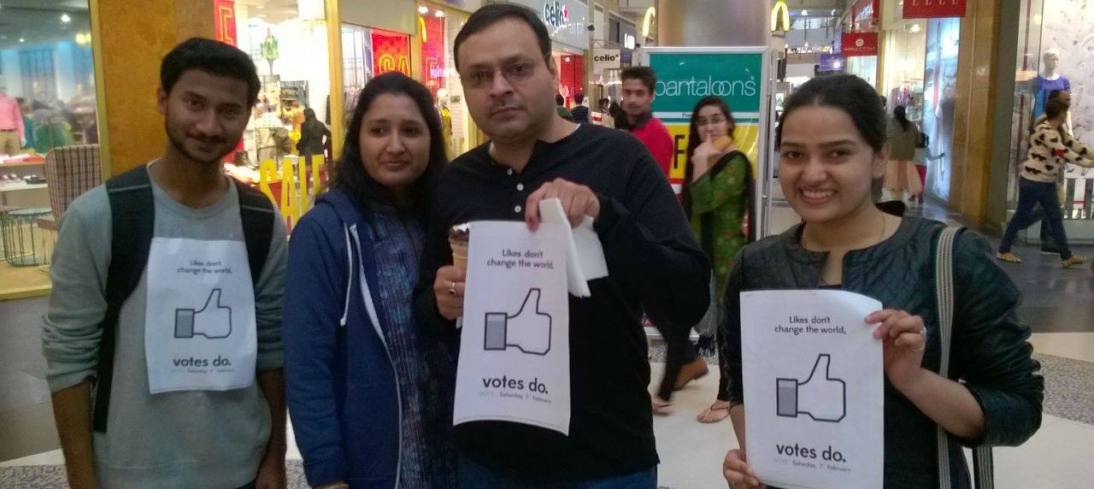
Go vote
For, a nation that votes, lets itself be heard.

Slide 17
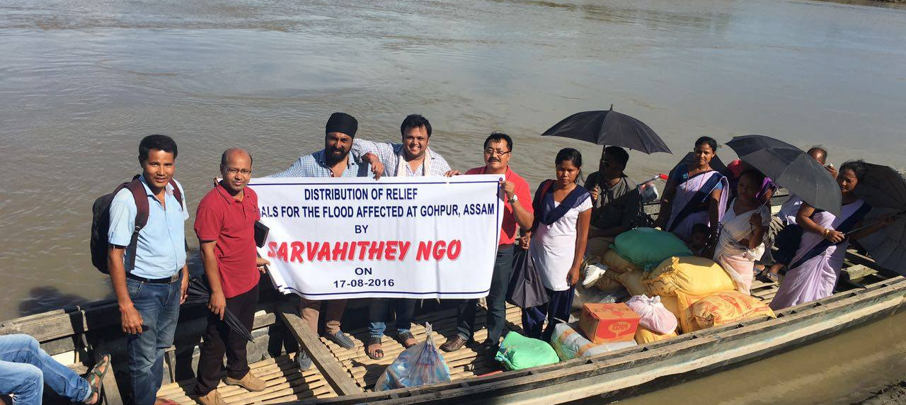
Assam Flood Relief Program
For, when opportunity for service arises, Sarvahitey mobilizes, plans and acts to resolve issues requiring urgent redressal.

Slide 18
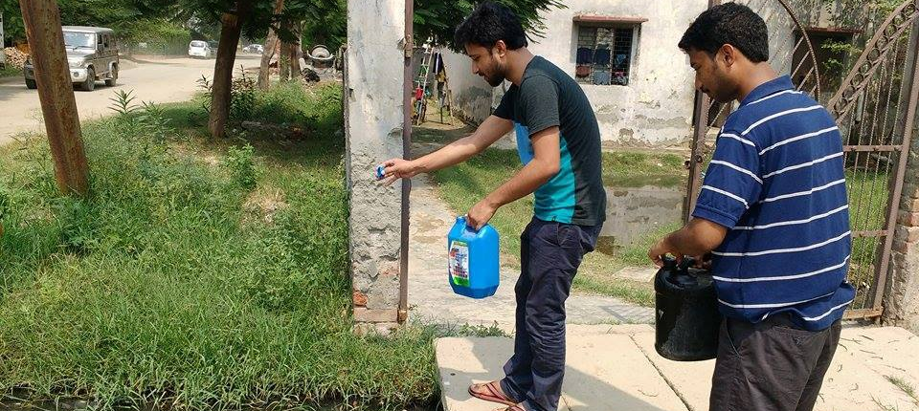
Dengue Prevention Drive
For, when opportunity for service arises, Sarvahitey mobilizes, plans and acts to resolve issues requiring urgent redressal.

Slide 19
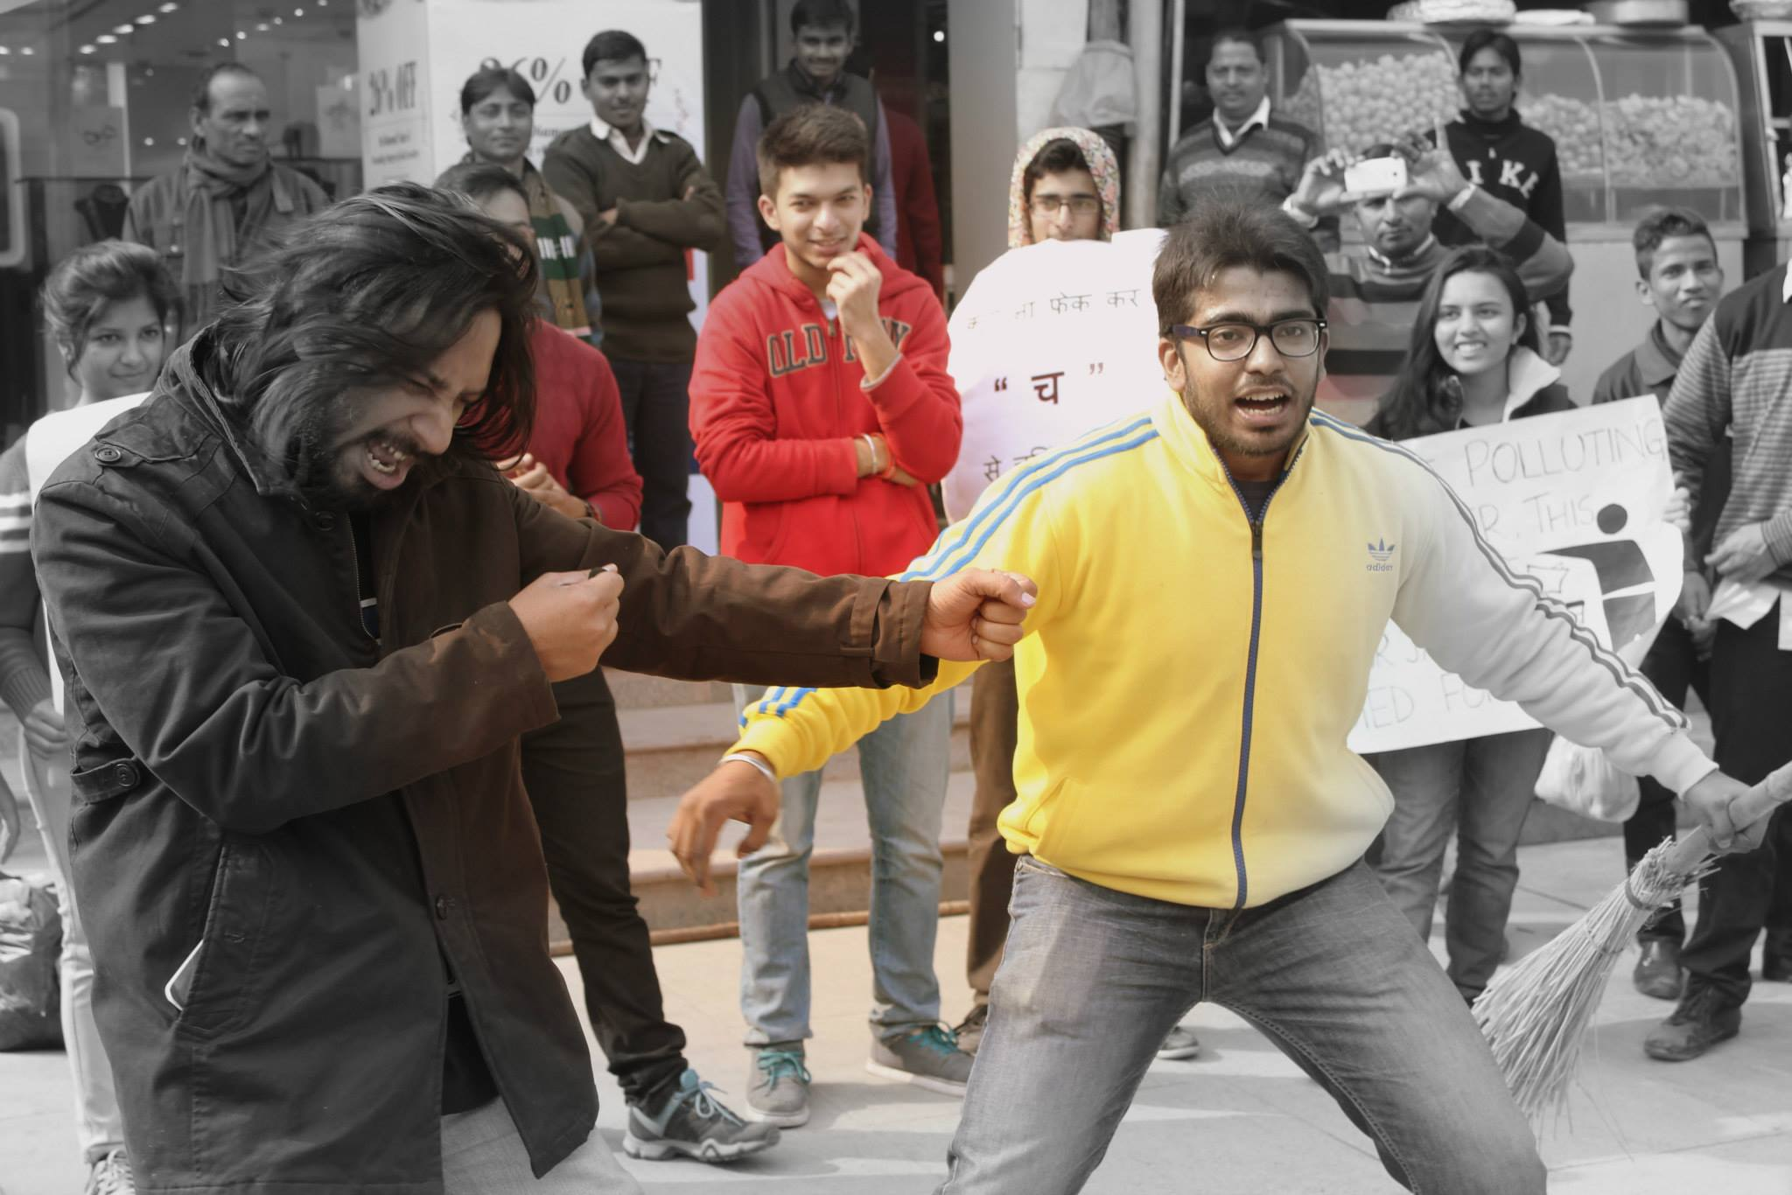
Spreading awareness through Street Plays
Sarvahitey boasts of a vibrant drama wing named 'Rangrasiya' which performs nukkad naataks on various socio-legal issues.
Some of the key issues that Rangrasiya has taken up are domestic violence, gender equality, women empowerment, legal rights of citizens, importance of cleanliness, among others.
Rangrasiya has performed at many public places in Delhi NCR like market places, colleges and slums.

Slide 20

Thank you

