Slide 1

“Every man is guilty of all the good he did not do”
- VOLTAIRE

Slide 2
WHAT IS THIS ABOUT?
An NGO/NPO
EXPLAINING ITS DOMAINS
WHAT DOES IT DO
ITS ACHIEVEMENTS
HOW CAN YOU CONTRIBUTE

Slide 3
WHERE IS THIS NGO?
IT IS BASED IN NCR, i.e. ITS AREA OF OPERATIONS ARE MOSTLY IN DELHI AND NOIDA.
IT HAS 3 OFFICES: 2 IN NOIDA AND ONE IN DELHI.
THE IMPORTANCE IS OF PROJECTS, NOT THE OFFICES.

Slide 4
MEANING OF SARVAHITEY
SARVAHITEY= 'SARVA' + 'HITEY'.
SARVA MEANS 'ALL'; HITEY MEANS 'IN THE WELFARE OF'
THUS, SARVAHITEY MEANS 'IN THE WELFARE OF ALL'

Slide 5
OUR PROJECTS
2 TYPES:
1. REGULAR
2. AD-HOC (NEED BASED)

Slide 6
REGULAR
1. CLOTH DONATION DRIVES
2. CLEANLINESS DRIVES (SAFAI ABHIYAAN)
3. VIDYA VISTAR
4. FOOD DRIVES

Slide 7
AD-HOC (NEED BASED)
1. NEPAL EARTHQUAKE RELIEF PROGRAM
2. GO-VOTE CAMPAIGN
3. MEDICAL AID

Slide 8
CLOTH DONATION

Slide 9
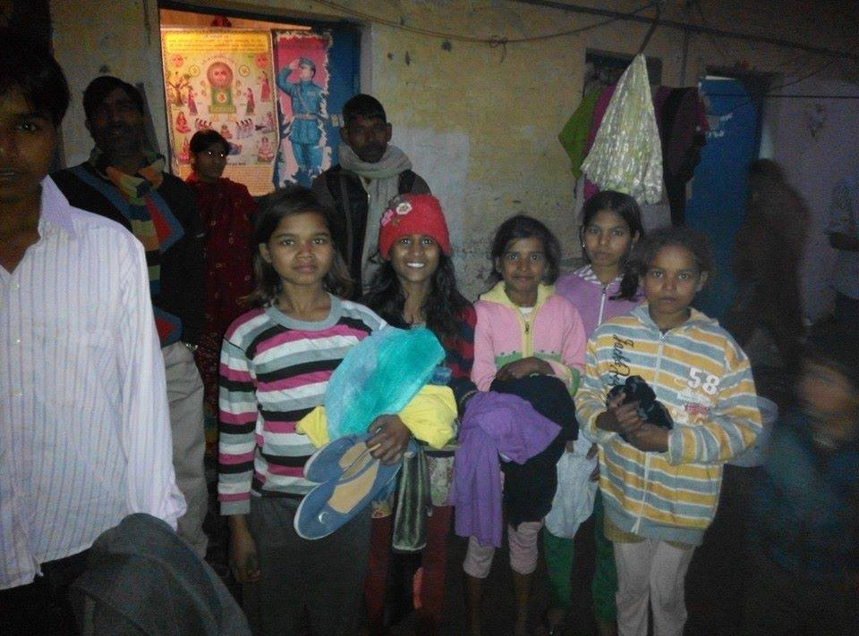

Slide 10
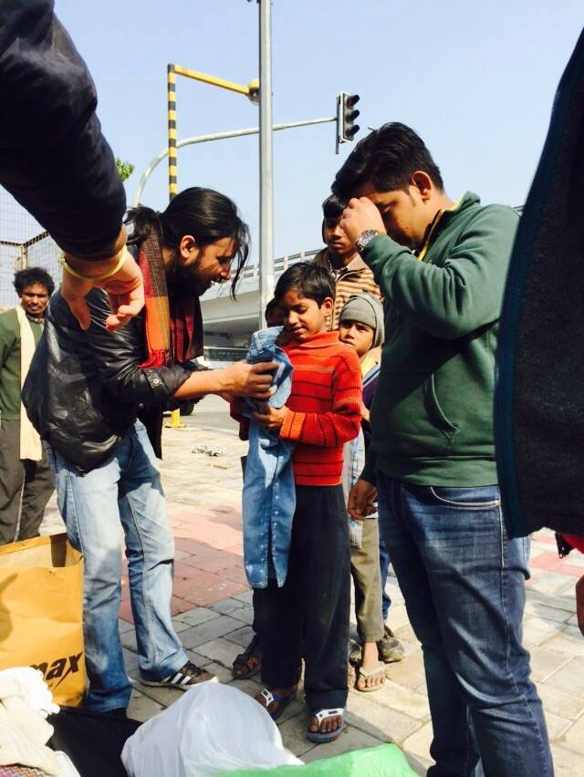

Slide 11
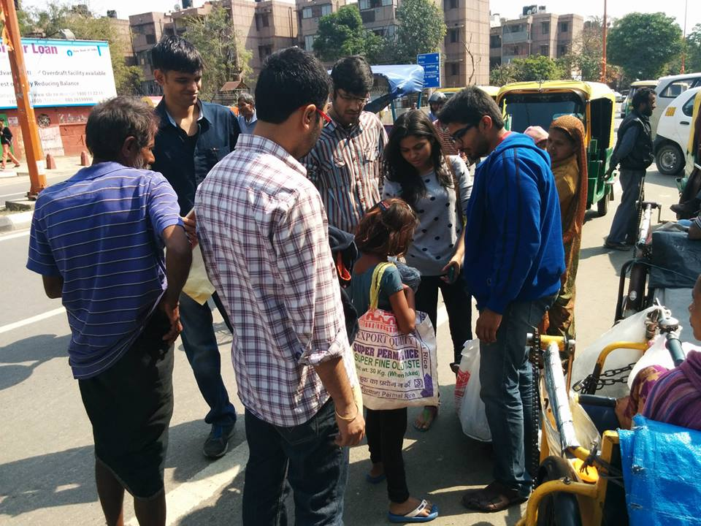

Slide 12
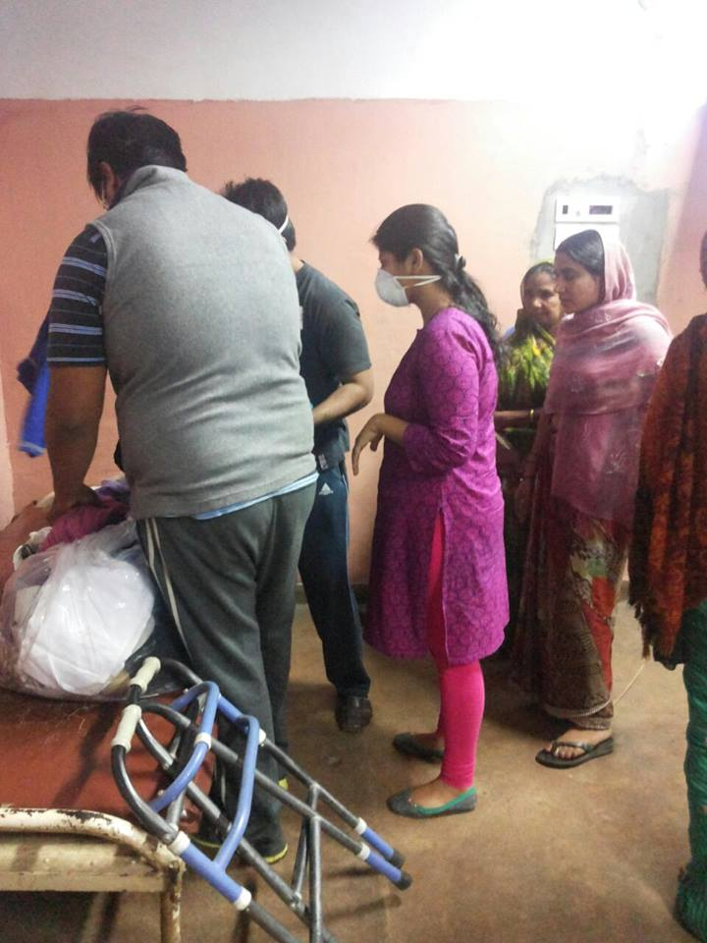

Slide 13
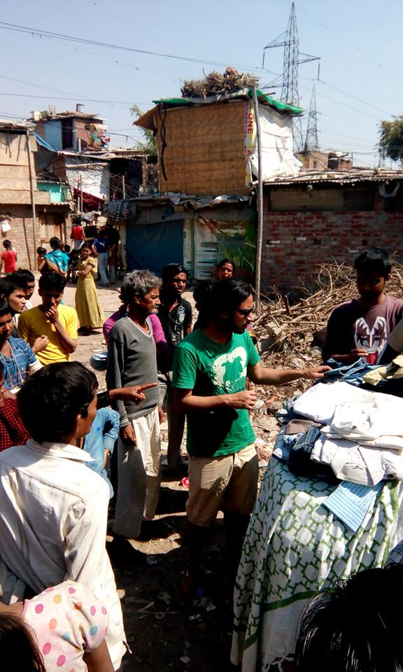

Slide 14
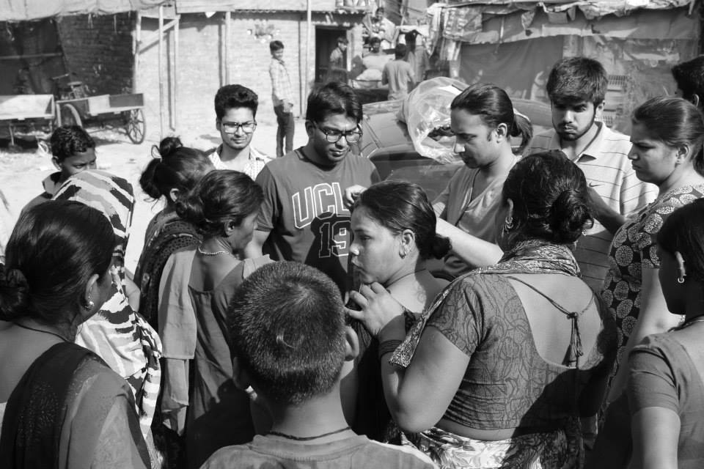

Slide 15
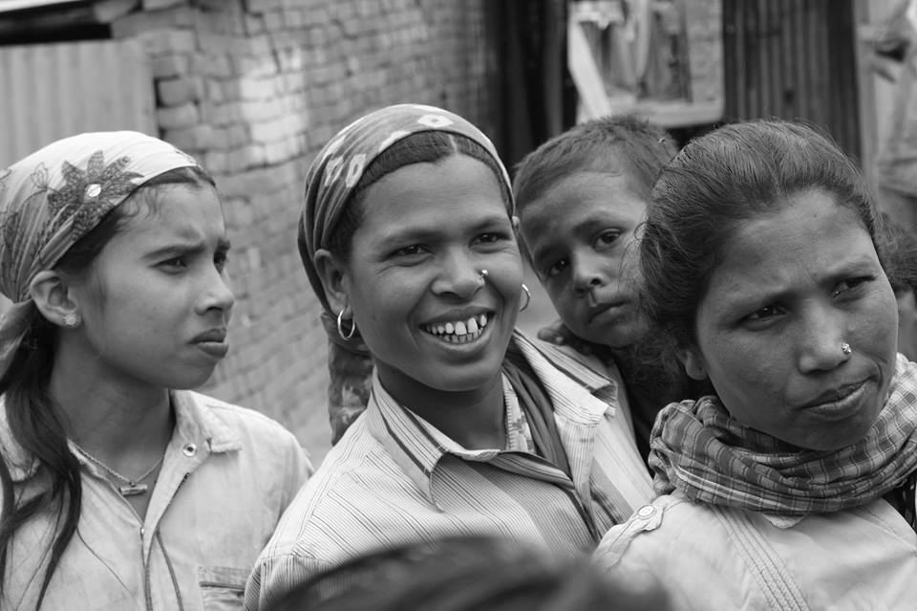

Slide 16
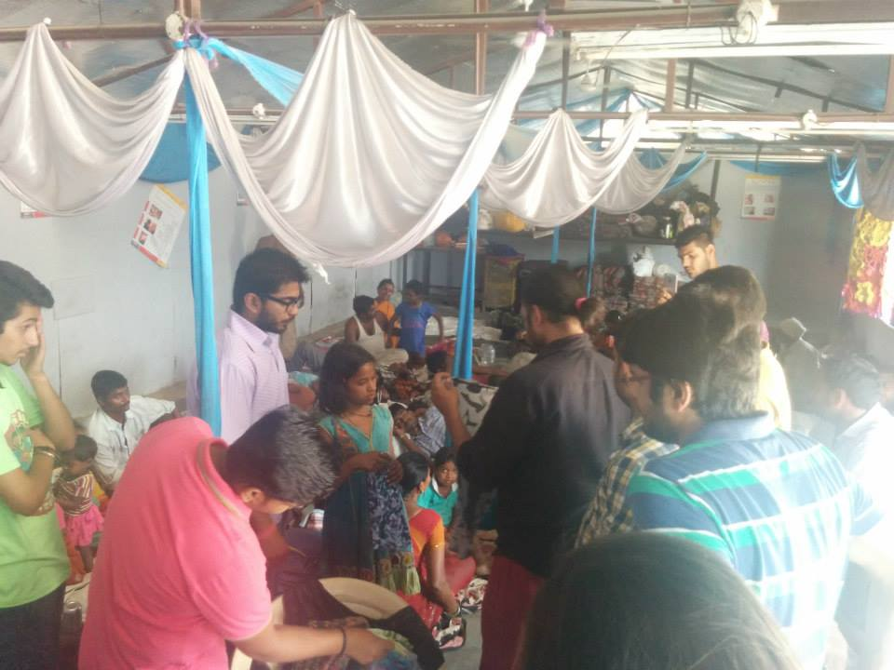

Slide 17
SAFAI ABHIYAAN

Slide 18
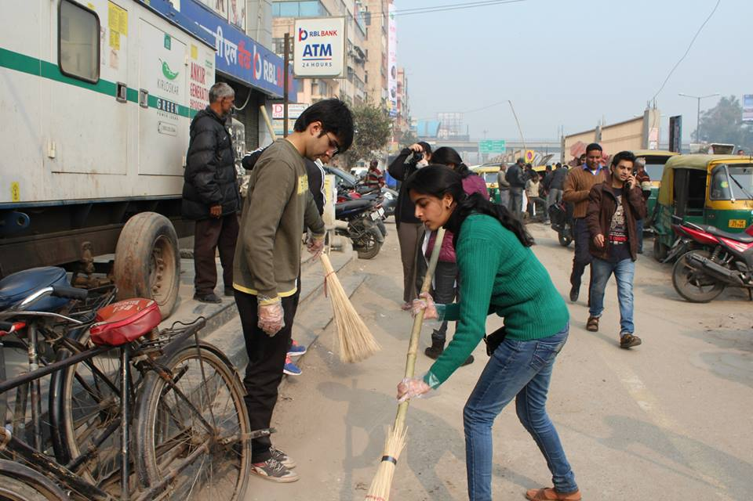

Slide 19
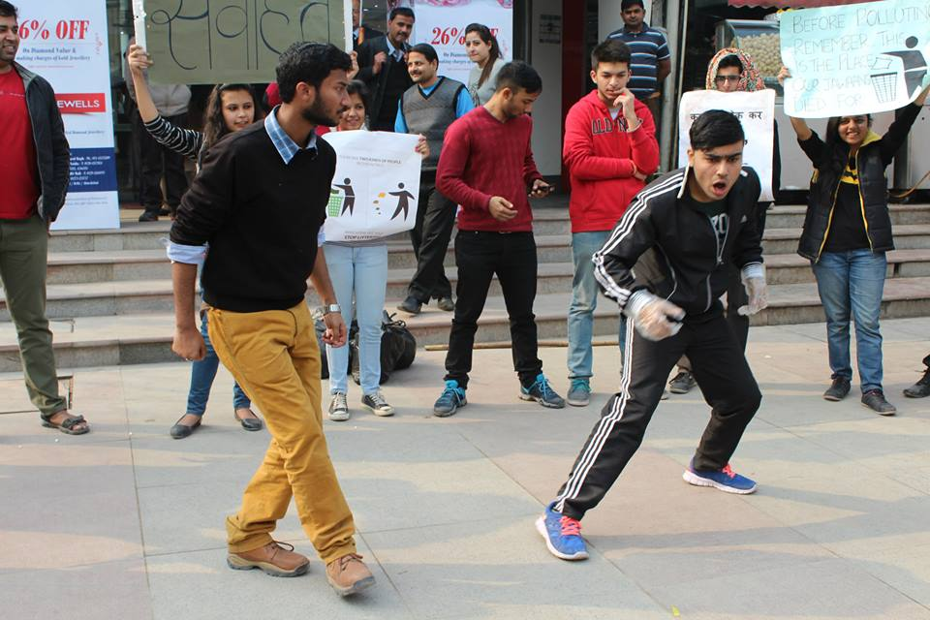

Slide 20
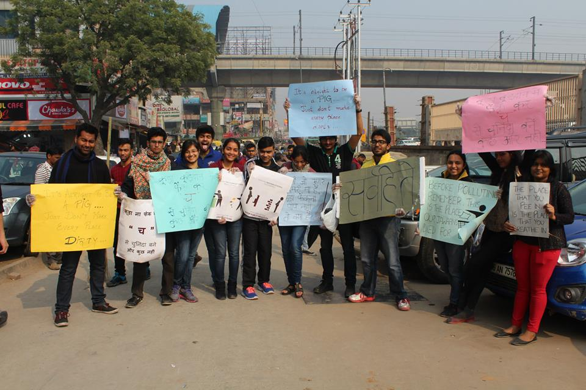

Slide 21
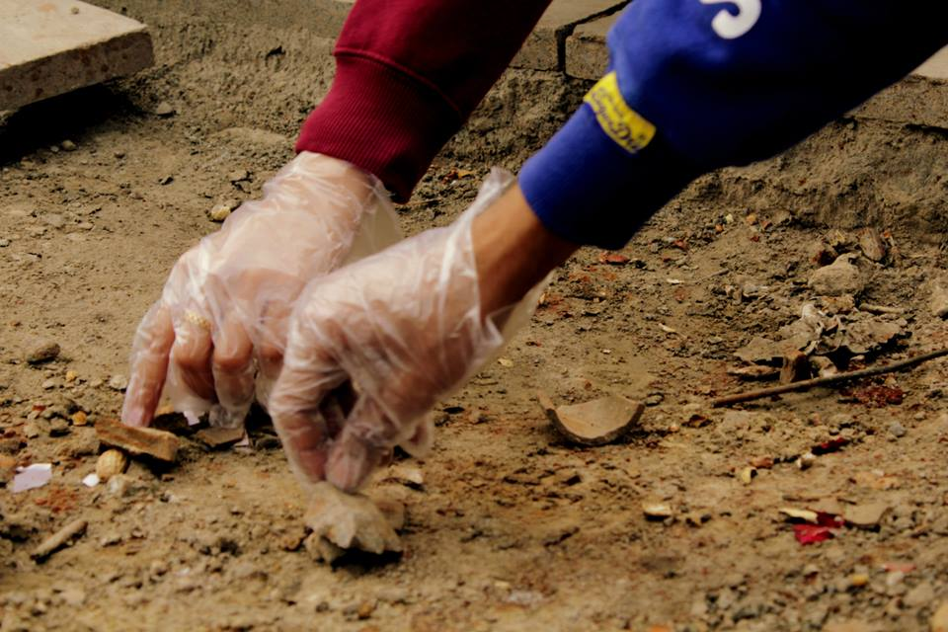

Slide 22
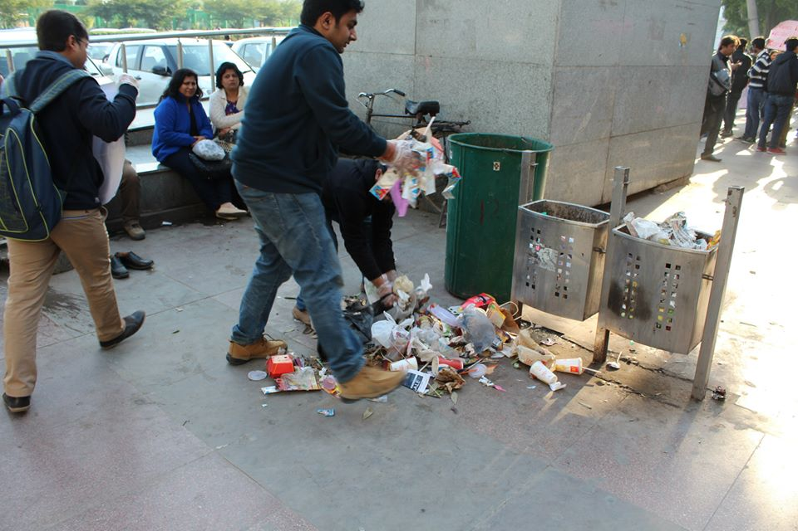

Slide 23
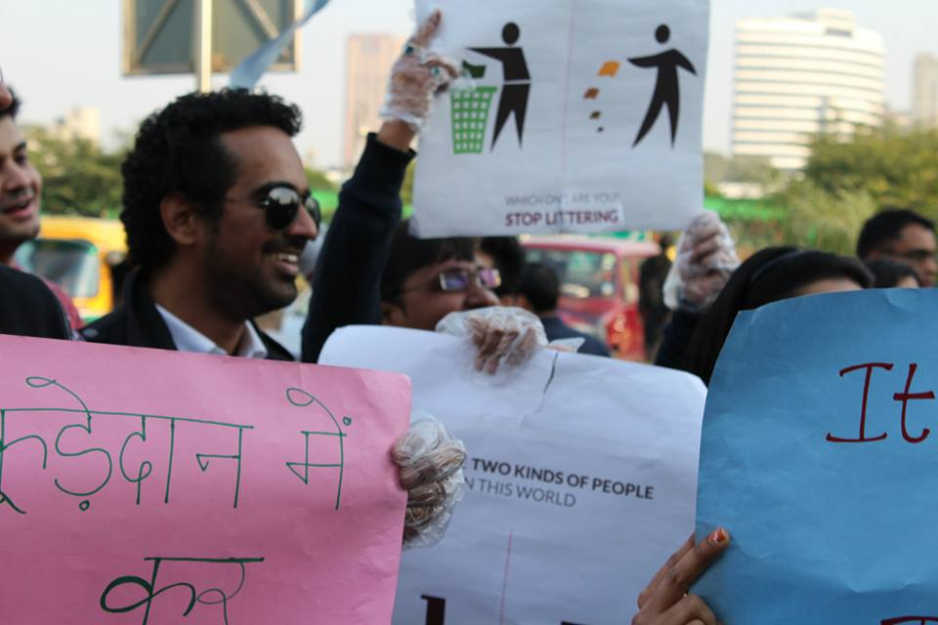

Slide 24
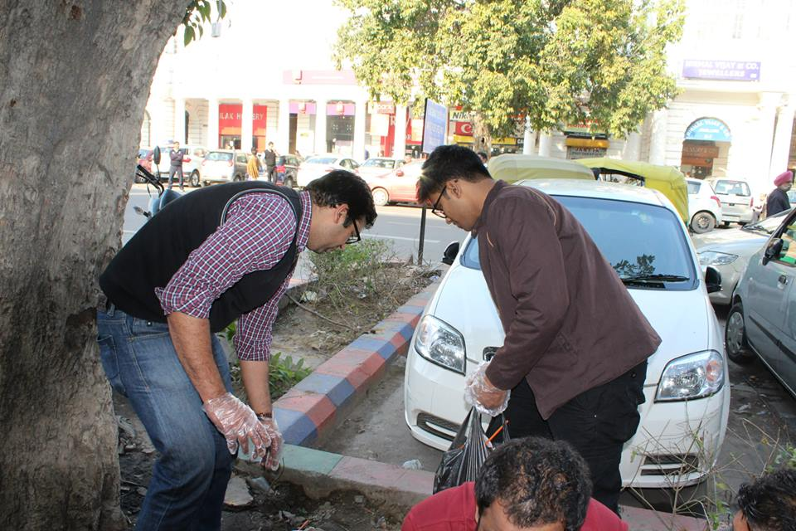

Slide 25
VIDYA VISTAR

Slide 26
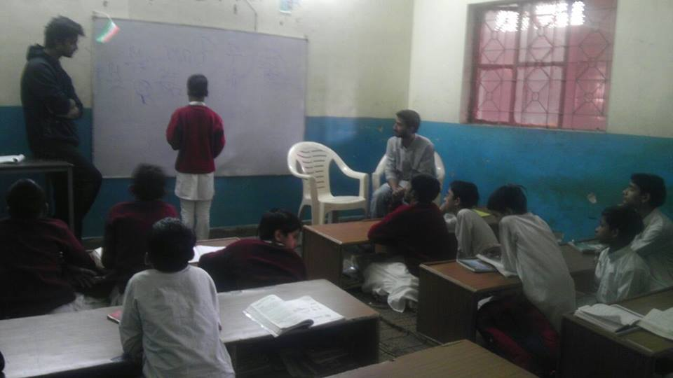

Slide 27
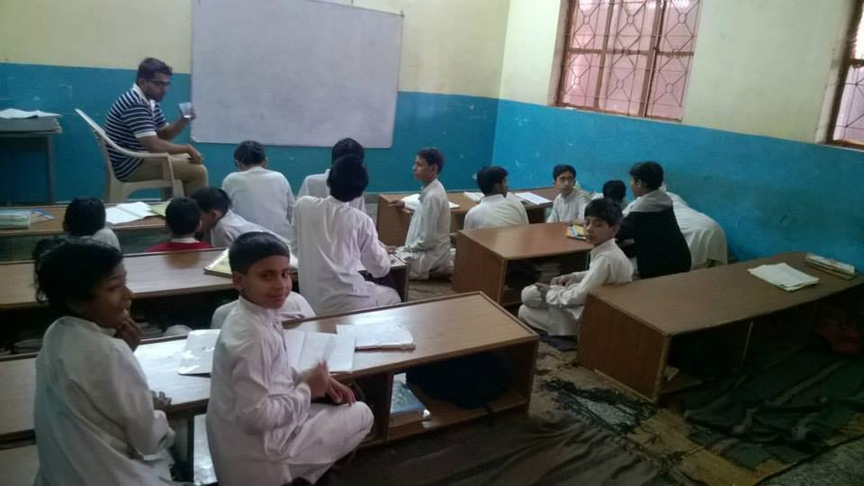

Slide 28
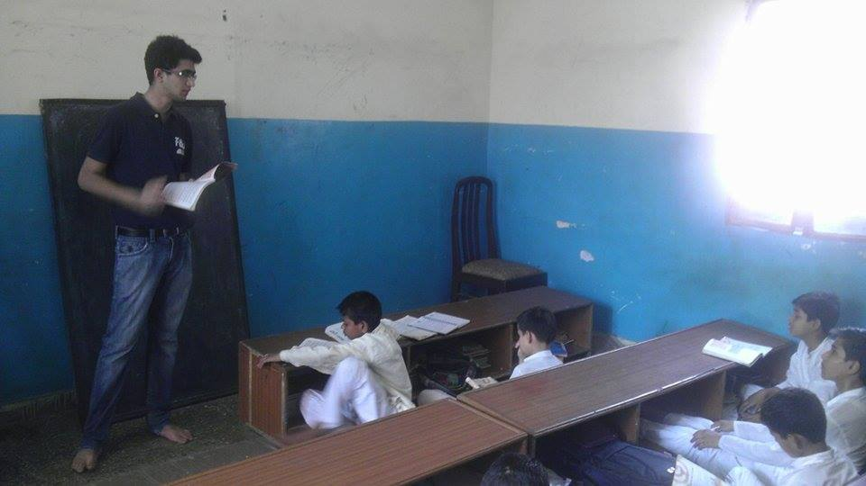

Slide 29
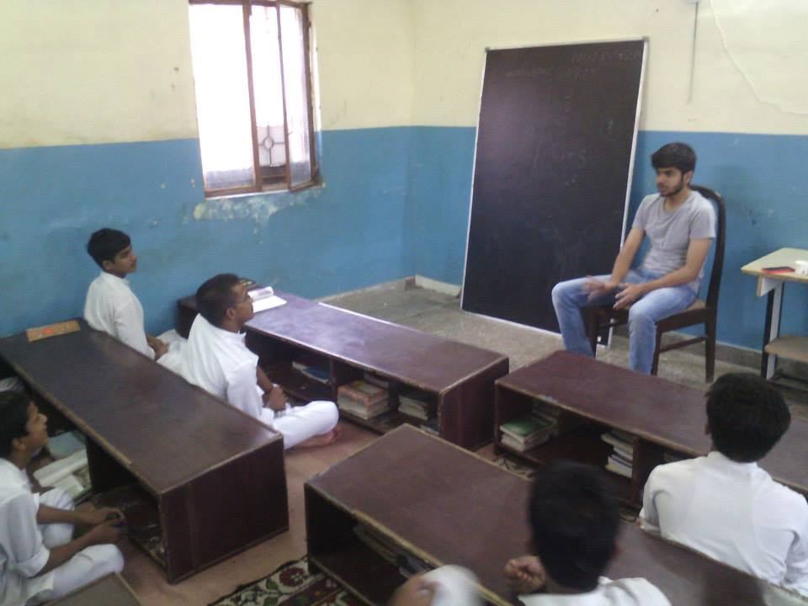

Slide 30
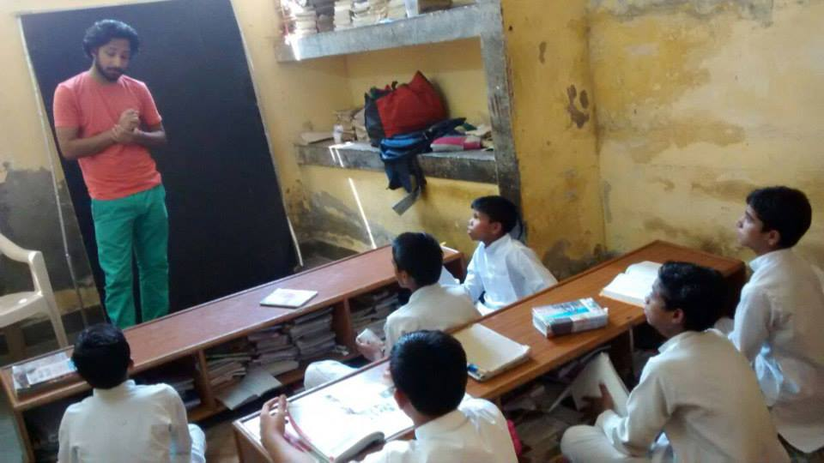

Slide 31
FOOD DRIVE

Slide 32
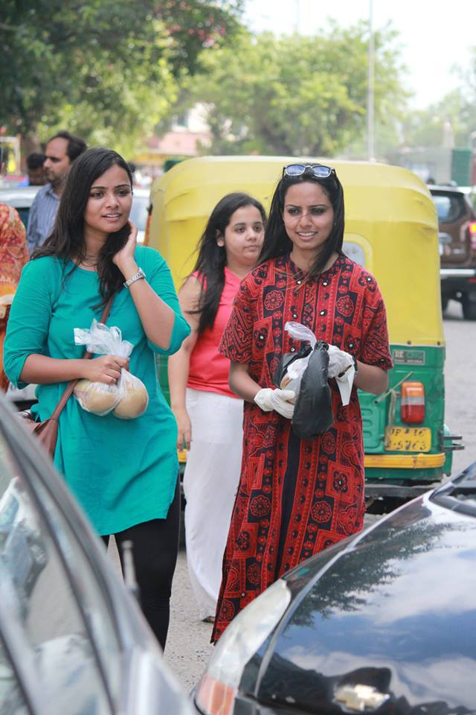

Slide 33
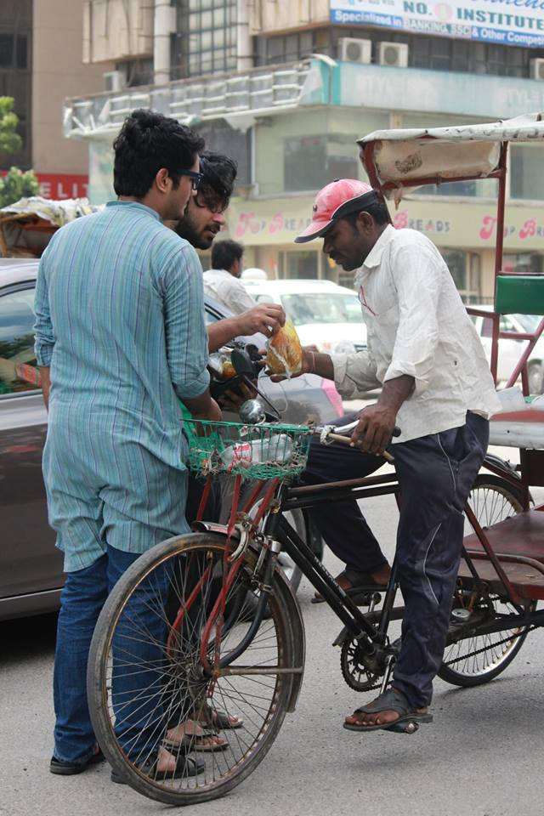

Slide 34
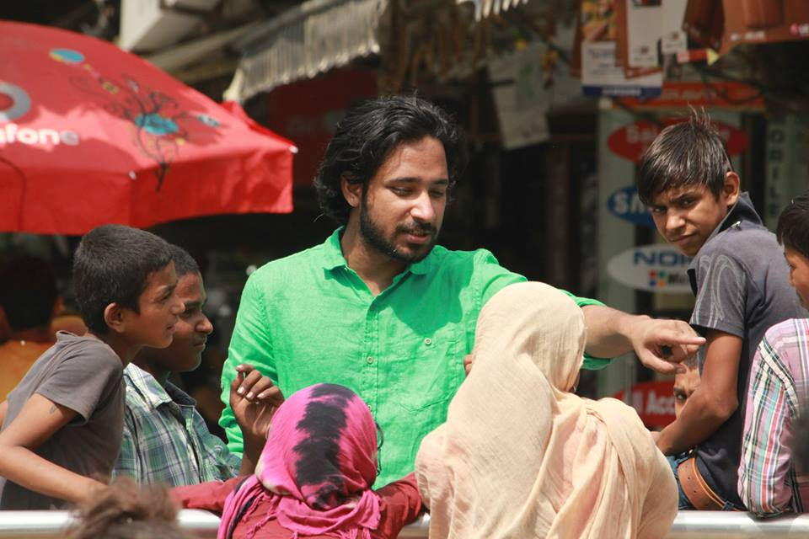

Slide 35
NEPAL EARTHQUAKE RELIEF PROGRAMME

Slide 36
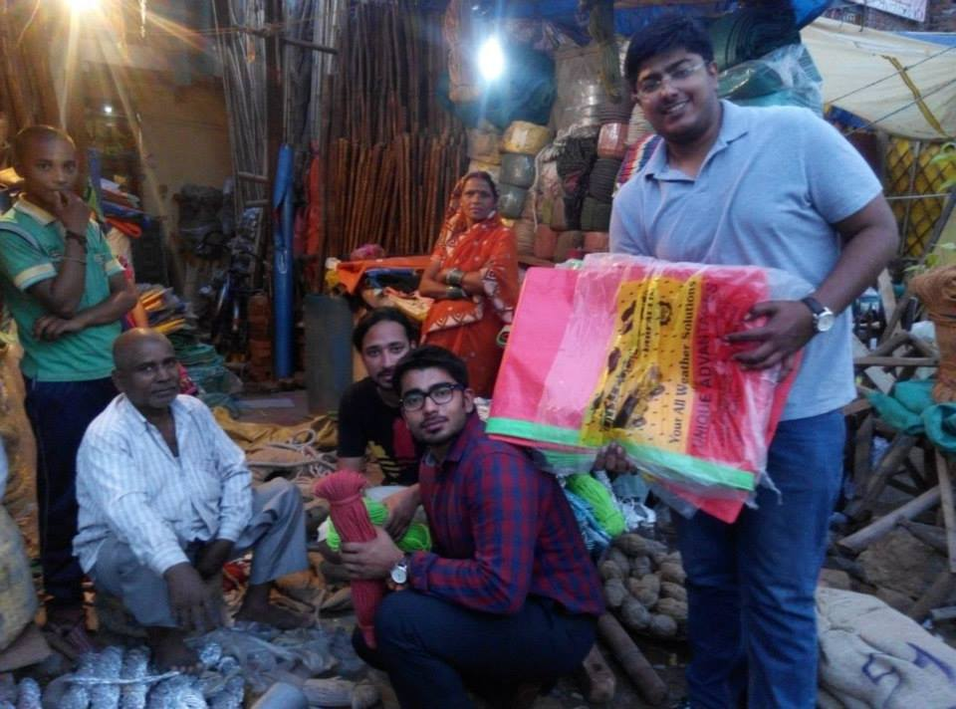

Slide 37
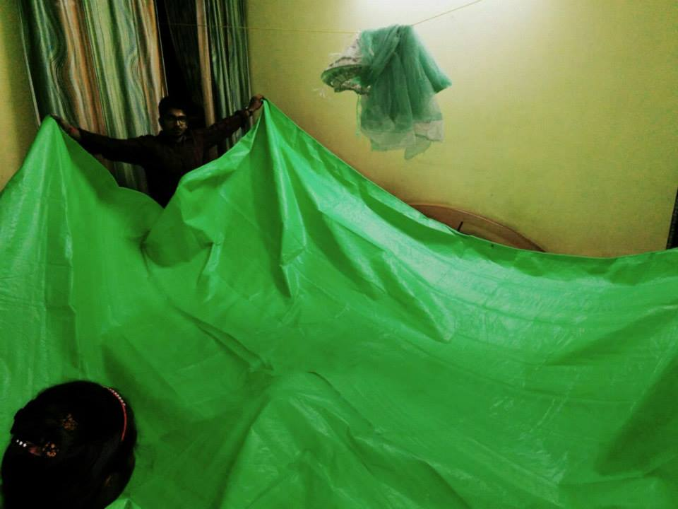

Slide 38
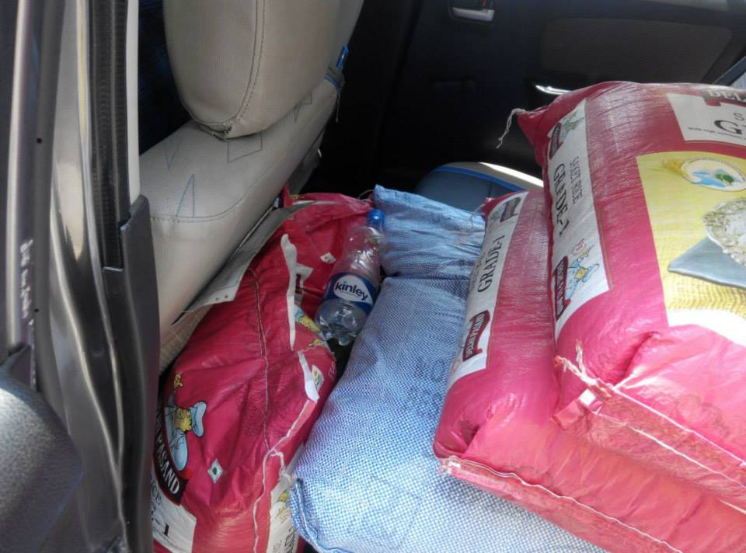

Slide 39
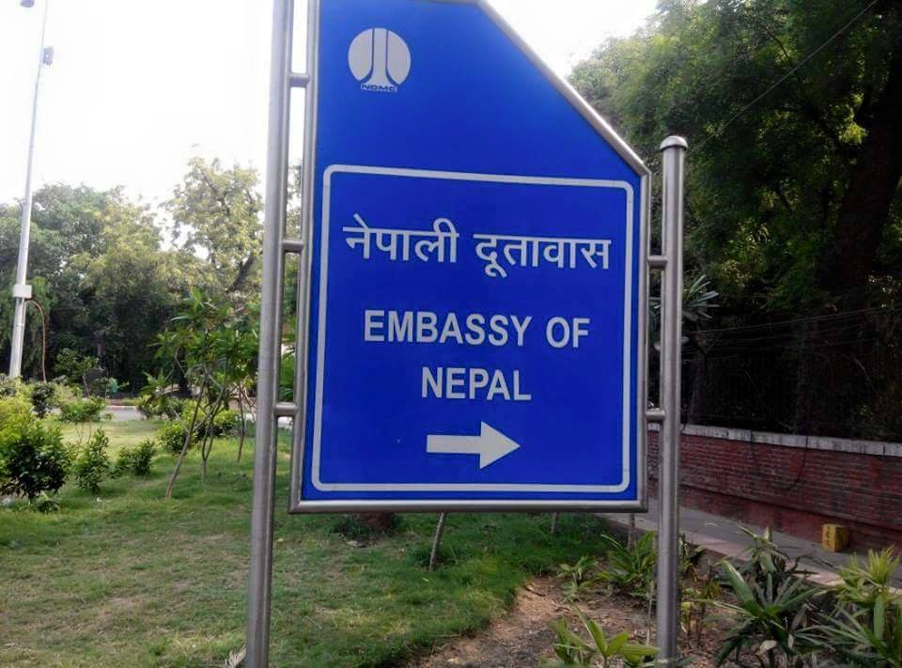

Slide 40
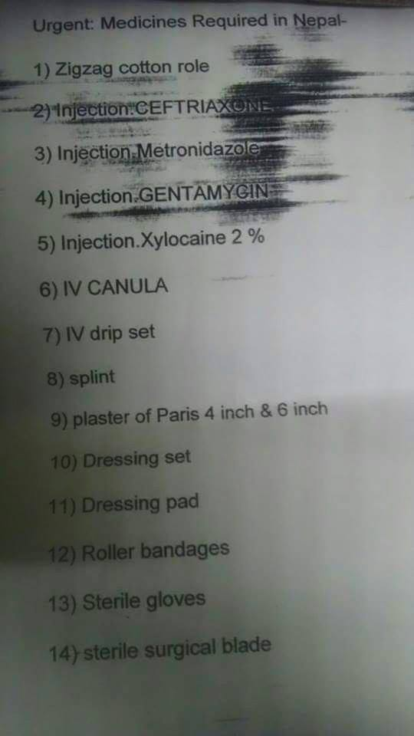

Slide 41
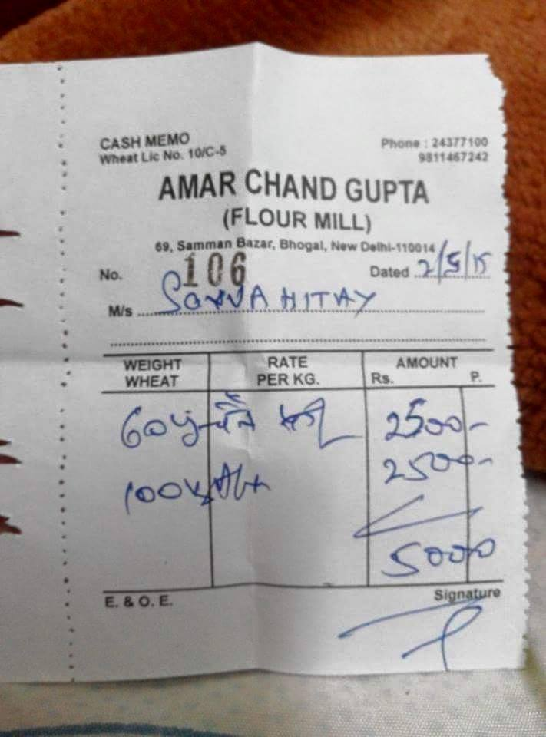

Slide 42
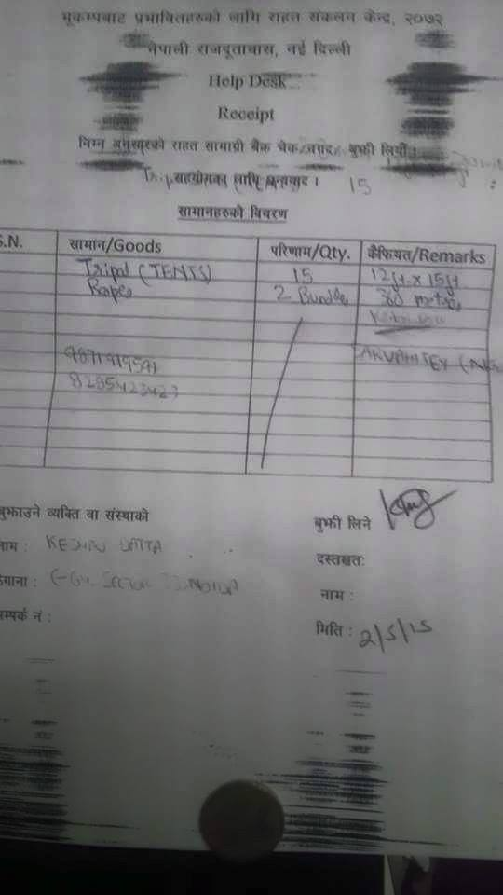

Slide 43
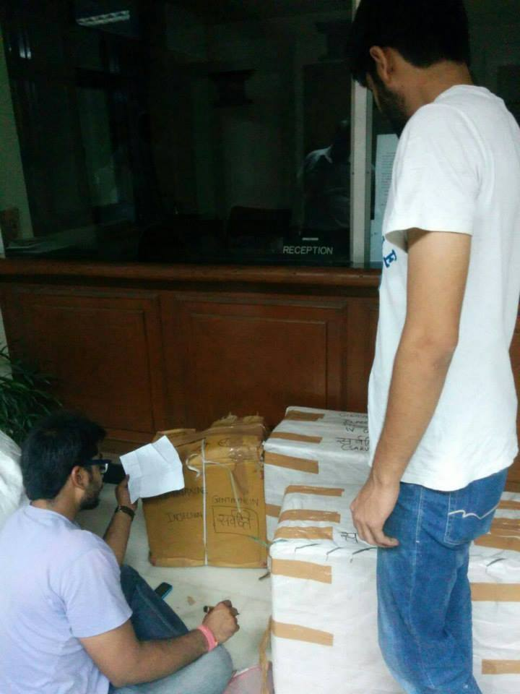

Slide 44
GO-VOTE CAMPAIGN

Slide 45
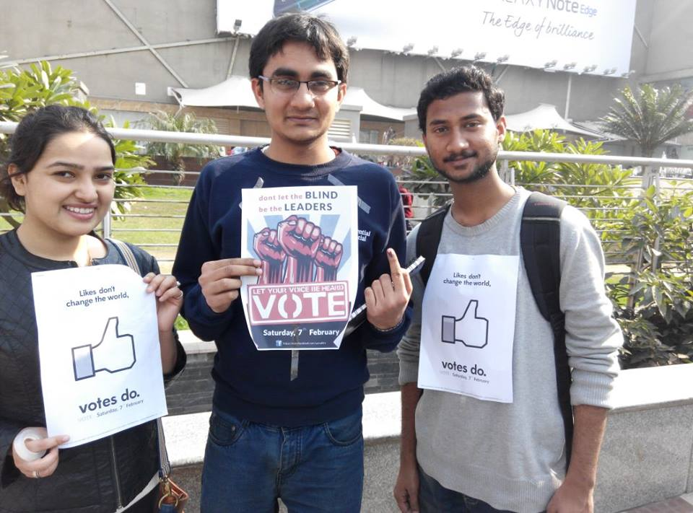

Slide 46
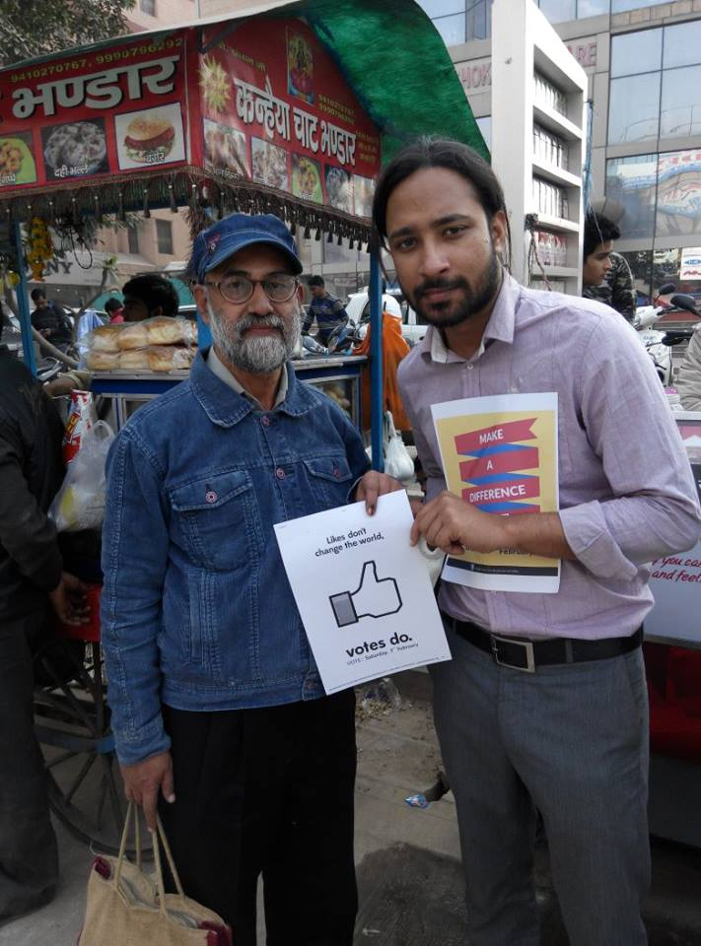

Slide 47
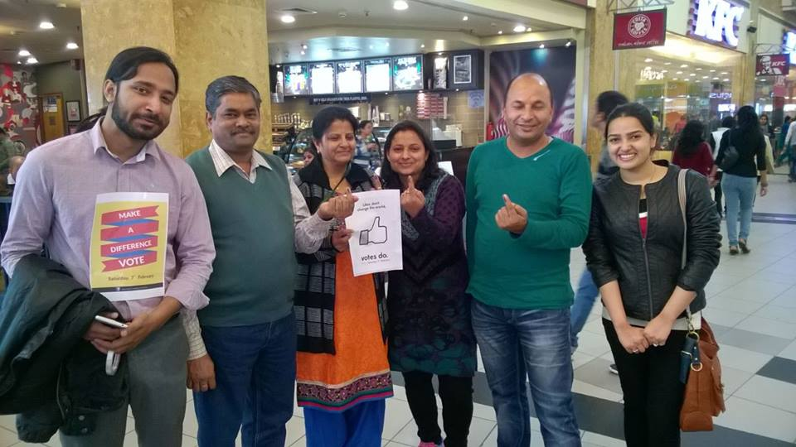

Slide 48
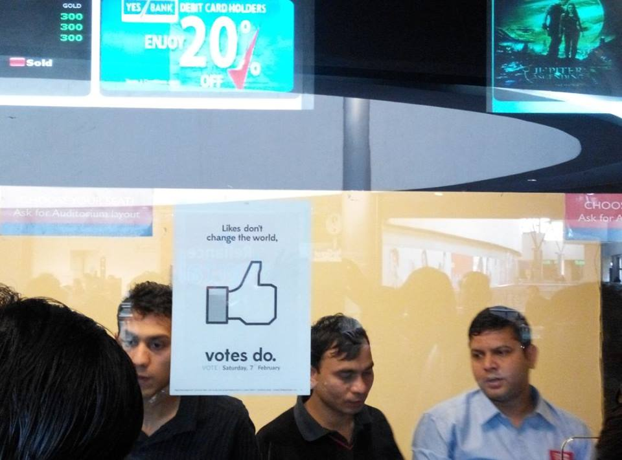

Slide 49
OUR WORKING MODEL
STEP 1:
PLAN OF WEEKDAYS
STEP 2:
EXECUTE ON WEEKENDS

Slide 50
OUR CORE MEMBERS
1. KESHAV DATTA
2. PREM PRAKASH
3. SANSKRITI SRIVASTAVA
4. ANKIT MALHOTRA
5. SMRITI MEHROTRA

Slide 51
PHILOSOPHY OF PARITY
#MyNGOYourNGOOurNGO

Slide 52
WHY SARVAHITEY
1. PARITY
2. TRANSPARENCY
3. CORE MEMBERS
4. NO INTEREST GROUP
5. REAL GROUND WORK
6. MONEY-SECONDARY

Slide 53
WHY SARVAHITEY
FINALLY,
DO YOU KNOW ANY OTHER NGO?

Slide 54
ACHIEVEMENTS
1. 80 STUDENTS BELONGING TO UNPRIVILEDGED SECTION TAUGHT
2. HELPED CREATE AWARENESS REGARDING CLEANLINESS AND SANITATION
3. 10 SUCCESFUL CLOTH DONATION DRIVES- 1000 PEOPLE AFFECTED
4. FOOD, MEDICINES AND TENTS WORTH Rs. 1,25,000 SENT TO NEPAL- 2500 PEOPLE AFFECTED

Slide 55
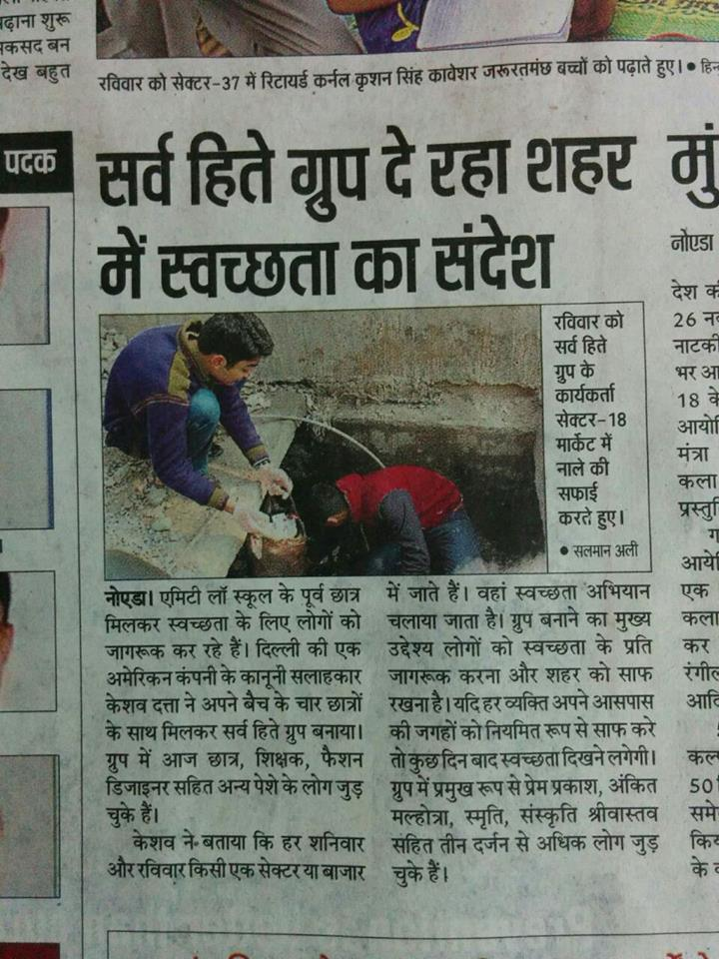
ACHIEVEMENTS

Slide 56
HOW CAN YOU HELP?
1. COME!
2. DONATE CLOTHES
3. PROVIDE TRANSPORTATION
4. COME!
5. DESIGN POSTERS
6. BECOME A TEACHER
7. DONATE MONEY
8. ADVICE!

Slide 57
CONTACT DETAILS
EMAIL: SARVAHITEY@GMAIL.COM
PHONE:
1. PREM PRAKASH: 8285423423
2. KESHAV DATTA: 9871919591

