Slide 1

PRESENTED BY: RAUSHAN KUMAR
ENROLMENT NO : 24103023
TOPIC : Day of the Week Finder

Slide 2
Efficient Date Calculation
Complexity
Instant Results
High risk of human
Rapid mathematical
error
algorithm processing
Time-
Offline
consuming
Operation
Requires significant
Functions without
manual effort
external API
dependencies
Inefficiency
Accuracy
Slow processing of
Precise calculation of
historical dates
date intervals

Slide 3
Day of the Week Finder Application
Features
Interactive GUI
1
A clean and user-friendly interface built with Python's Tkinter library.
Automatic Leap Year Detection
2
Flawlessly handles February 29th logic based on century and 4-year rules.
Strict Data Validation
3
Automatically blocks invalid dates (e.g., 31/04/2023) and alerts the user via
popups.
Keyboard Integration
4
Supports the Enter key for quick execution without needing a mouse.

Slide 4
Technologies & Tools Used
The application stack consists of core Python and its standard GUI toolkit.
Arithmetic Operators
tkinter.messagebox
Modulo and floor division for
Error handling mechanism for
calculations
user feedback
Tkinter
Python 3.x
Standard GUI toolkit for user
Core programming language for
interface
application development

Slide 5
The Mathematical Logic
Formula: (Day + Month
Code + Year Code + Last 2
Digits + Leap adjustments)
% 7
Month Codes: Leap Years
[0,3,4,0,2...] vs. Non-Leap
[1,4,4,0,2...]
Output Mapping: Remainder (0-6)
Input Values
Day of the
points to the Day Array
Day, Month,
Week
Year
Apply
Calculate
Map remainder
Calculate Remainder
Formula
Remainder
to day name
Add codes and
Divide by 7
Day of the Week
adjust for leap
year

Slide 6
Application Flow
User Input
Leap Check
Display
Validation
Processing

Slide 7
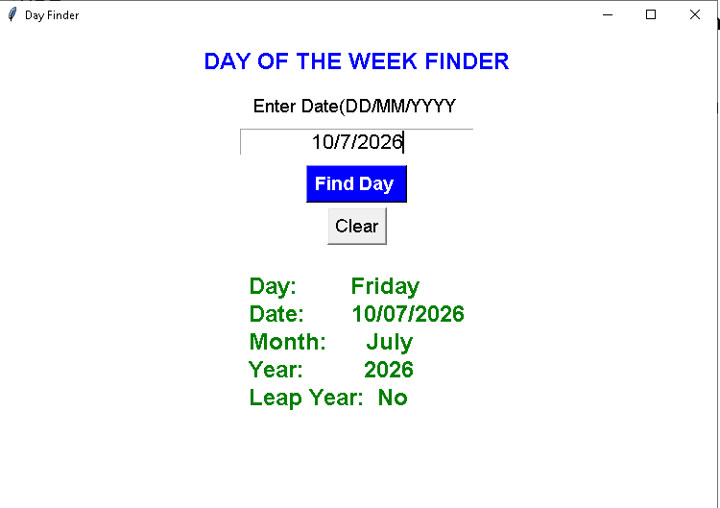
Live Demo: The Interface in Action

Slide 8
Day of the Week Finder Development
Status
Text-based Utility
Graphical Interface
Core Functionality
Enriched Content

