Slide 1
Cloud Computing
UNIT V

Slide 2
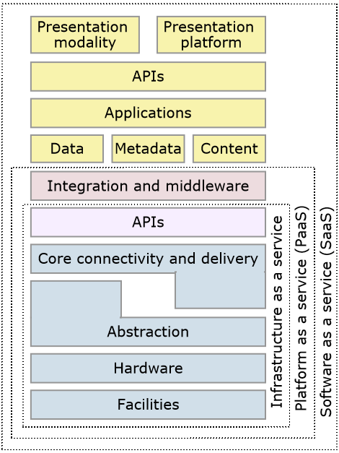
Cloud Security Reference Model
Security is top concern for the adoption of cloud services.
80% of enterprises consider security the #1 inhibitor to cloud adoptions.

Slide 3
How security gets integrated
Cloud providers offer more services for customers at the top of the stack. Going from SaaS to IaaS, more security the consumer is responsible for providing and managing.
SaaS security from the customer’s perspective is contractual. SaaS provides the highest level of consumer functionality with the least amount of flexibility, requiring strong security already built in.
PaaS provides a layer in which developers work, providing them the freedom to create functionality. This increased flexibility removes additional security layering that was provided in SaaS.
As customers move down the stack, such as an IaaS customer, they are responsible for building the security in their application and middleware layers.

Slide 4
Security Risks
IT security is a very complicated area of cloud computing for three reasons:
Security is trusted to the cloud provider, therefore if the provider has not done a good job, there may be problems.
Security is difficult to monitor, so problems may not be apparent until there is a problem.
Measuring the quality of the cloud provider’s security approach may be difficult because many cloud providers do not expose their infrastructure to customers.
Approximately 70% of security breaches are caused by insiders.
The security approach must deal with internal and external threats.
Often times with a cloud service agreement, the agreement is designed to protect the service provider, not the cloud customer
Cloud customers must have a deep level of understanding of the agreement.

Slide 5
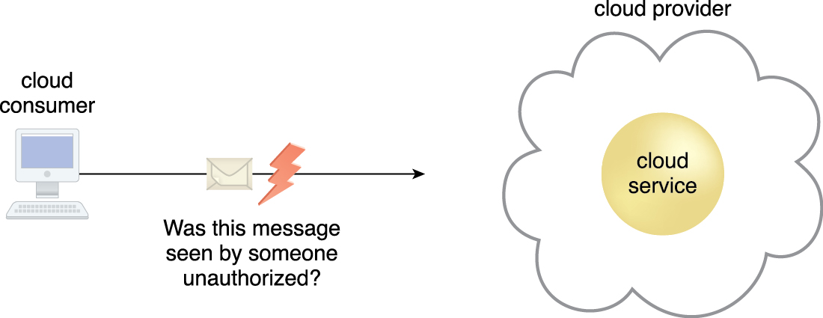

Risk is the possibility of loss or harm arising from performing an activity. Risk is typically measured according to its threat level and the number of possible or known vulnerabilities.

Slide 6
Principal Security Dangers to Cloud Computing
Virtualization and Multitenancy
Internal security breaches
Data corruption or loss
User account and service hijacking

Slide 7
Principal Security Dangers to Cloud Computing
1. Virtualization and Multitenancy
Virtualization and multitenancy make sharing of infrastructure possible. But these technologies were not designed with strong isolation in place.
Hypervisors have extended these risks, potentially exposing the operating system. Creating an environment where attackers can gain access at the operating system level (hypervisors).
To reduce these risks, consider:
Implement operating system security best practices.
Implement application systems security best practices such as authentication, authorization and auditing.

Slide 8
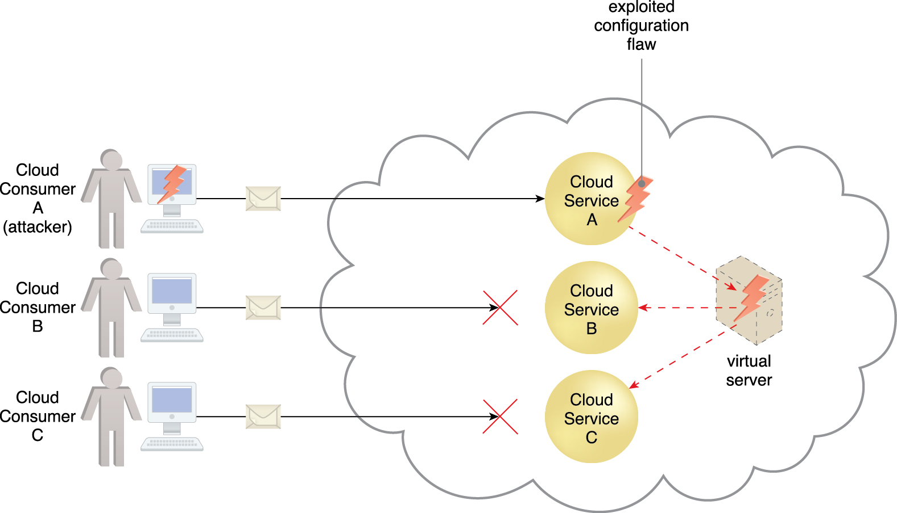
Principal Security Dangers to Cloud Computing
Cloud Service Consumer A’s message triggers a configuration flaw in Cloud Service A, which in turn causes the virtual server that is also hosting Cloud Services B and C to crash.

Slide 9
Principal Security Dangers to Cloud Computing
2. Internal Security Breaches
The IT industry has well documented that over 70% of security violations are internal. This threat is increased in cloud computing as both IT providers and consumers are under a single management domain.
To reduce these risks, consider the key components of the agreement between cloud provider and consumer:
Transparency in information and internal management practices.
Understand the human resources requirements.
Have a clear level of escalation and notification of a breach.
Ensure that contractually you are in the loop if an internal breach occurs with the cloud provider (with your data or another customer’s).

Slide 10
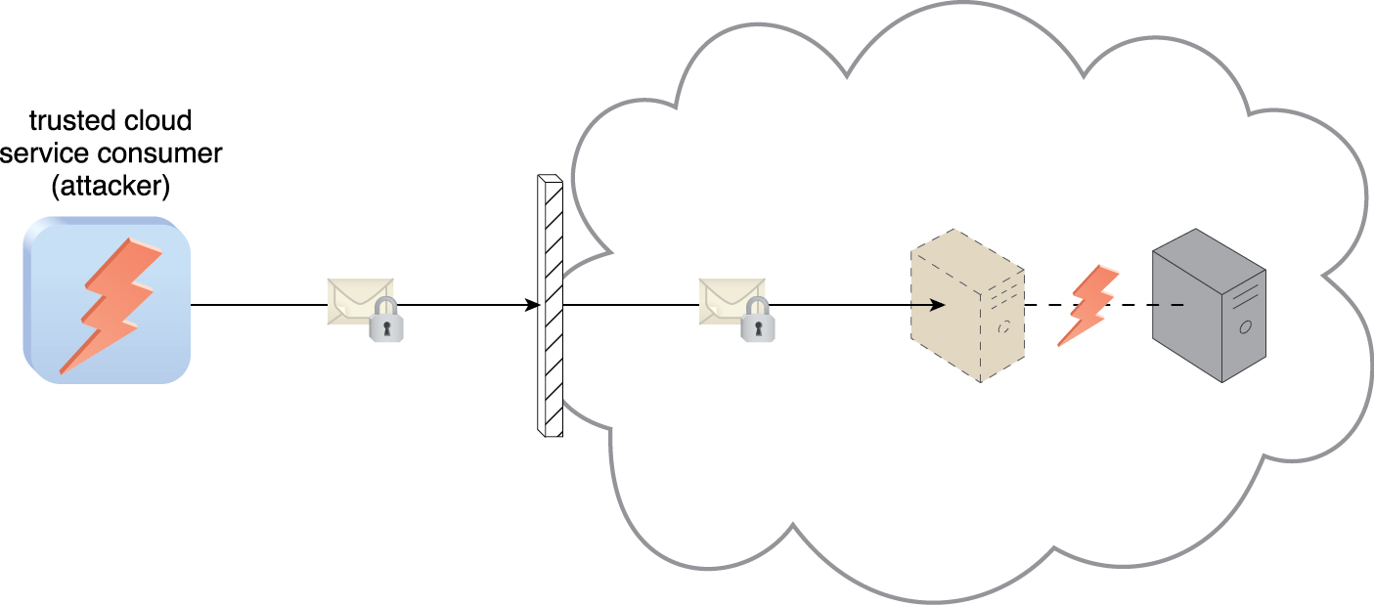
Principal Security Dangers to Cloud Computing
An authorized cloud service consumer carries out a virtualization attack by abusing its administrative access to a virtual server to exploit the underlying hardware.

Slide 11
Principal Security Dangers to Cloud Computing
3. Data Corruption or Loss
Data corruption or loss is amplified since the cloud provider is the source for all companies data, not the company itself.
These operational characteristics of the cloud environment at the PaaS and SaaS layers amplify the threat of data loss.
To reduce these risks, consider:
Implement application systems security best practices such as authentication, authorization and auditing.
Implement strong encryption, SSL, digital signatures and certificate practices.
Ensure that strong disaster recovery processes exist and are tested on a periodic basis.
Require that the persistent medium used to store the data is erased prior to releasing it back into the pool.

Slide 12
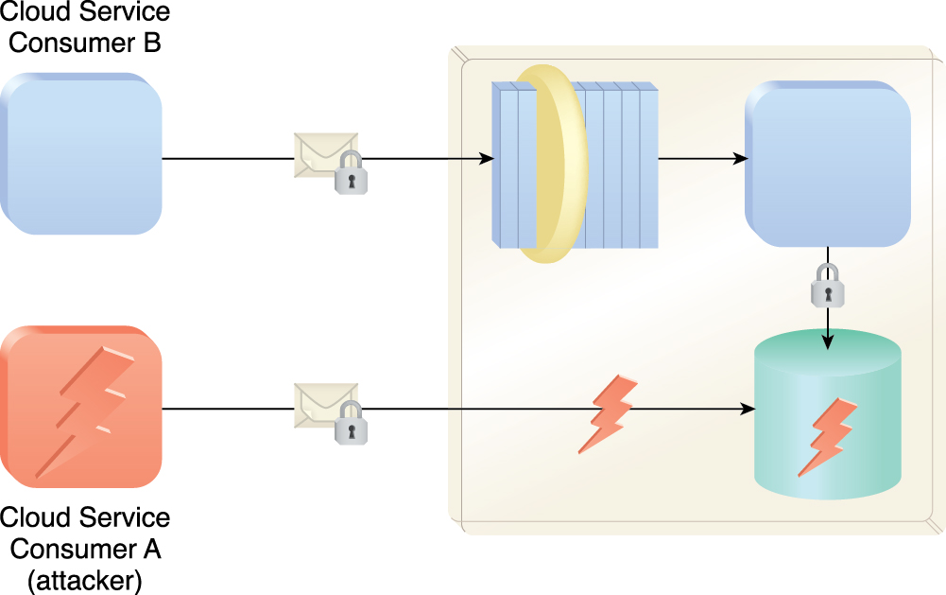
Principal Security Dangers to Cloud Computing
Cloud Service Consumer A gains access to a database that was implemented under the assumption that it would only be accessed through a Web service with a published service contract (as per Cloud Service Consumer B).

Slide 13
Principal Security Dangers to Cloud Computing
4. User Account and Service Hijacking
User account and service hijacking occurs when a attacker obtains the cloud services information and uses it to take over cloud access.
If attackers gain access to a cloud user’s credentials, they can eavesdrop on activities and transactions, manipulate or steal data, return falsified data and redirect clients to illegitimate sites.
To reduce these risks, consider:
Implement security best practices, including human processes, such as strong passwords, two-factor authentication, and prohibiting the sharing of user’s credentials.
Implement application systems security best practices such as authentication, authorization and auditing.
Implement strong encryption, SSL, digital signatures and certificate practices.
Ensure that auditing and logging is being used to monitor activities.

Slide 14
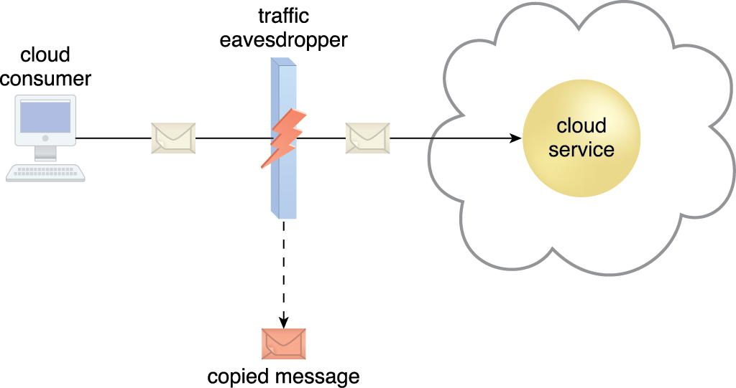
Principal Security Dangers to Cloud Computing
An attacker carries out a traffic eavesdropping attack by intercepting a message sent by the cloud service consumer to the cloud service. The service agent makes an unauthorized copy of the message before it is sent along its original path to the cloud service.

Slide 15
Steps to Reduce Cloud Security Breaches
Implement security best practices including human processes.
Implement operating system security best practices.
Implement application and API system security best practices.
Implement strong encryption, SSL, digital signatures and certificate practices.
Ensure that auditing and logging are being used to monitor activities.
Ensure that strong disaster recovery process exist.
Transparency in information and internal management practice.
Understand the human resources requirements.
Have a clear level of escalation and notification of a breach, ensuring that you are in the loop if an internal breach occurs with the cloud provider (with your data or another customer’s)
Use of products that can significantly contribute to security like
Identity management
Detection and forensics
Data encryption

Slide 16
Identity Management
Identity Management
Identity management is an area that deals with identifying individuals in a system and controlling access to the resources in that system by placing restrictions on the established identities of the individuals.
Identity management is important in cloud since the cloud is sharing and virtualizing physical resource across many internal users.
Identity management helps prevent security breaches and assists companies in meeting IT security regulations.

Slide 17

Identity Management
Malicious insiders are human threat agents acting on behalf of or in relation to the cloud provider. They are typically current or former employees or third parties with access to the cloud provider’s premises. This type of threat agent carries tremendous damage potential, as the malicious insider may have administrative privileges for accessing cloud consumer IT resources.

Slide 18
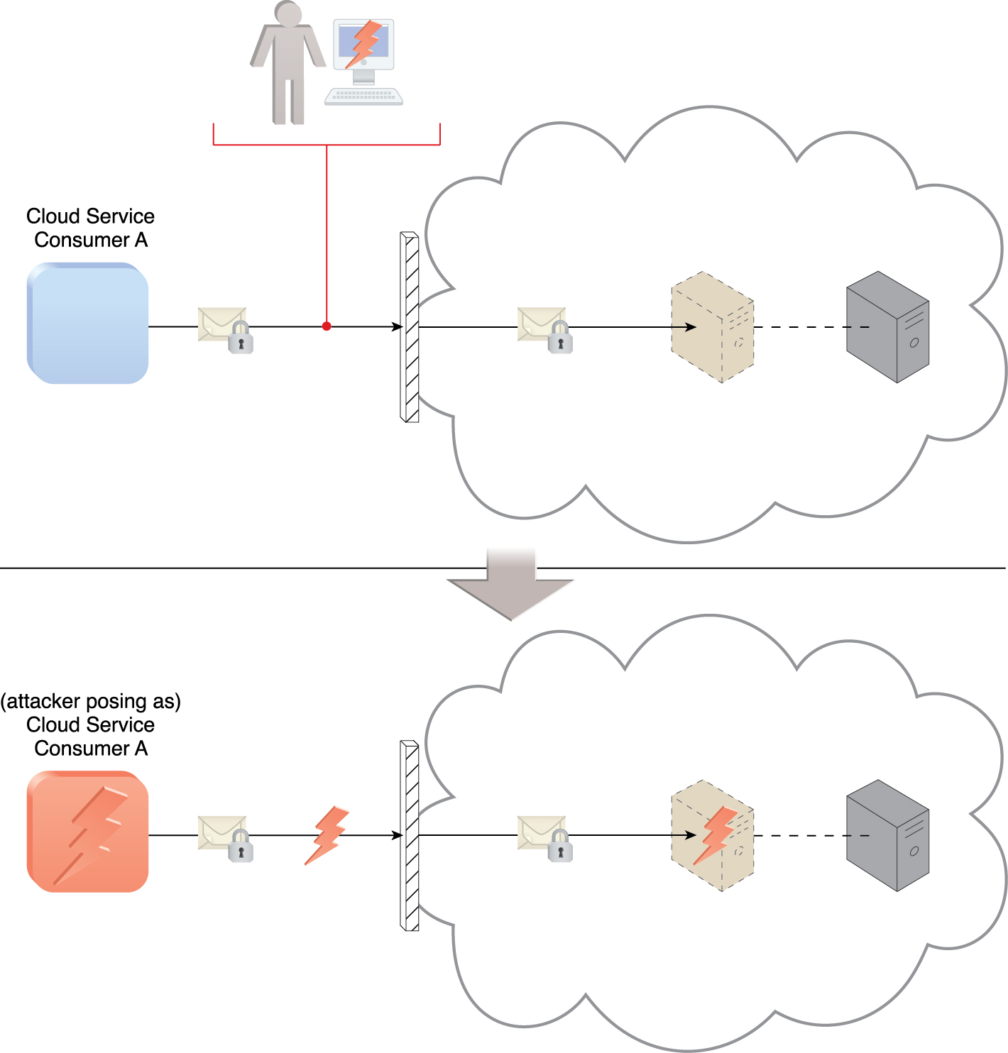
An attacker has cracked a weak password used by Cloud Service Consumer A. As a result, a malicious cloud service consumer (owned by the attacker) is designed to pose as Cloud Service Consumer A in order to gain access to the cloud-based virtual server.

Slide 19
Benefits of Identity Management
Improved user productivity – productivity improvement comes from simplifying the interface.
Improved customer and partner services – customers and partners benefit from a more secure process when accessing application data.
Reduced help desk costs – helps desks normally receive few password reset calls when an identity manage process is implemented.
Reduced IT costs – identity management enables automatic provisioning (providing and revoking user rights).

Slide 20
Detection and Forensics
Maintaining Activity logs
log files provide information but are costly in space.
Fooling attackers by spoofing
Spoofing is pretending to be something else, such as IP address, email accounts
Systems that pretend to be something else that tricks attackers into revealing details about where they are attacking from.

Slide 21
Encrypting Data
Encryption is a critical component of cloud computing which is used to ensure that data moving from point A to point B with being altered or intercepted.
Encryption methods:
Symmetric keys – A technique in which two parties share the same key for both encryption and decryption.
Asymmetric keys – A technique in which parties share two keys: a public key and a private key, so that the given message is encrypted with one key and decrypted with another.
Digital Signatures - The cloud user creates a message, and it is encrypted into cipher text. The cipher text is then hashed to create the message digest. The message digest is then encrypted using the cloud user’s private key; this creates the digital signature.
Secure Sockets Layer (SSL).

Slide 22
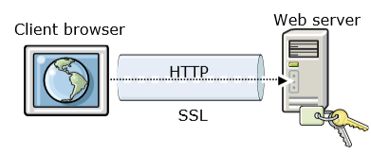
Encrypting Data
Secure Sockets Layer (SSL) is the standard security technology for establishing an encrypted link between a web server and a browser. This link ensures that all data passes between the web server and browsers remains private. SSL is an industry standard and is used by millions of website in the protection of their online transactions with their customers.

