Slide 1
Virtualization and Cloud Computing

Slide 2
Definition
Virtualization is the ability to run multiple operating systems on a single physical system and share the underlying hardware resources.
It is the process by which one computer hosts the appearance of many computers.
Virtualization is used to improve IT throughput and costs by using physical resources as a pool from which virtual resources can be allocated.

Slide 3
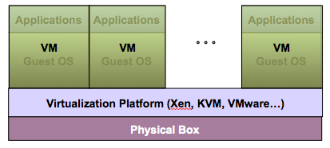
Virtualization Architecture
A Virtual machine (VM) is an isolated runtime environment (guest OS and applications)
Multiple virtual systems (VMs) can run on a single physical system

Slide 4
Benefits of Virtualization
Sharing of resources helps cost reduction
Isolation: Virtual machines are isolated from each other as if they are physically separated
Encapsulation: Virtual machines encapsulate a complete computing environment
Hardware Independence: Virtual machines run independently of underlying hardware
Portability: Virtual machines can be migrated between different hosts.

Slide 5
Virtualization in Cloud Computing
Cloud computing takes virtualization one step further:
You don’t need to own the hardware
Resources are rented as needed from a cloud
Various providers allow creating virtual servers:
Choose the OS and software each instance will have
The chosen OS will run on a large server farm
Can instantiate more virtual servers or shut down existing ones within minutes
You get billed only for what you used

Slide 6
Hypervisor
A hypervisor, a virtual machine manager/monitor (VMM), or virtualization manager, is a program that allows multiple operating systems to share a single hardware host.
Each guest operating system appears to have the host's processor, memory, and other resources all to itself. However, the hypervisor is actually controlling the host processor and resources, allocating what is needed to each operating system in turn and making sure that the guest operating systems (called virtual machines) cannot disrupt each other.

Slide 7
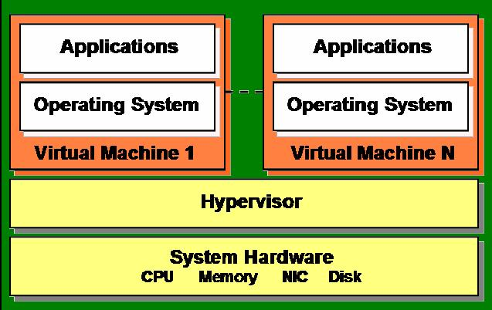
hypervisor
Hypervisor plays an important role in the virtualization scenario by virtualization of hardware. It provides support for running multiple operating systems concurrently in virtual servers created within a physical server.
The virtualization layer is the software responsible for hosting and managing all VMs. The virtualization layer is a hypervisor running directly on the hardware.
Example: VMWare, Xen, KVM.

Slide 8

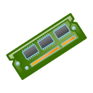
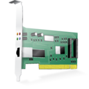
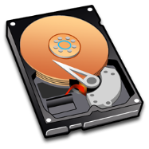
Server without virtualization
Hardware
CPU Memory NIC DISK
Operating System
Multiple Software Applications
Only one OS can run at a time within a server.
Under utilization of resources.
Inflexible and costly infrastructure.
Hardware changes require manual effort and access to the physical server.

Slide 9



Server with virtualization
Hardware
CPU Memory NIC DISK
Hypervisor
Can run multiple OS simultaneously.
Each OS can have different hardware configuration.
Efficient utilization of hardware resources.
Each virtual machine is independent.
Save electricity, initial cost to buy servers, space etc.
Easy to manage and monitor virtual machines centrally.
Virtual Server 1
Virtual Server 2
Operating System
Operating System
Multiple Software Applications
Multiple Software Applications

Slide 10
HYPERVISOR TYPE
Hardware
CPU Memory NIC DISK
Hypervisor
Full virtualization
Enables hypervisors to run an unmodified guest operating system (e.g. Windows 2003 or XP).
Guest OS is not aware that it is being virtualized.
E.g.: VMware uses a combination of direct execution and binary translation techniques to achieve full virtualization of server systems.
Virtual Server 1
Virtual Server 2
Operating System
Operating System
Multiple Software Applications
Multiple Software Applications
Notes:
Some guest operating systems hosted in full virtualization mode, can be configured to run the Novell* Virtual Machine Drivers instead of drivers originating from the operating system. Running virtual machine drivers improves performance dramatically on guest operating systems, such as Windows XP and Windows Server 2003.

Slide 11


HYPERVISOR TYPE
Hardware
CPU Memory NIC DISK
Hypervisor / VMM
Virtual Server 1
Virtual Server 2
Para virtualized Guest
Operating System
Para virtualized Guest
Operating System
Para virtualization
Involves explicitly modifying guest operating system (e.g. SUSE Linux Enterprise Server 11) so that it is aware of being virtualized to allow near native performance.
Improves performance.
Lower overhead.
E.g.: Xen supports both Hardware Assisted Virtualization (HVM) and Para-Virtualization (PV).
Multiple Software Applications
Multiple Software Applications
Notes:
Paravirtual mode does not require the host computer to support hardware-assisted virtualization technology, but does require the guest operating system to be modified for the virtualization environment. Typically, operating systems running in paravirtual mode enjoy better performance than those requiring full virtualization mode.
Operating systems currently modified to run in paravirtual mode are referred to as paravirtualized operating systems and include SUSE Linux Enterprise Server 11 and NetWare® 6.5 SP8.

Slide 12
Hypervisor implementation approaches
Bare metal Approach
Type I Hypervisor.
Runs directly on the system hardware.
May require hardware assisted virtualization technology support by the CPU.
Limited set of hardware drivers provided by the hypervisor vendor.
E.g.: Xen, VMWare ESXi
VM
VM
VM
Hypervisor
Kernel Driver
Hardware

Slide 13
Hypervisor implementation approaches
VM
VM
Hosted Approach
Type II Hypervisor.
Runs virtual machines on top of a host OS (windows, Unix etc.)
Relies on host OS for physical resource management.
Host operating system provides drivers for communicating with the server hardware.
E.g.: VirtualBox
Applications
Hypervisor
Host Operating System
Hardware

Slide 14
Popular hypervisors
Xen
KVM
QEMU
virtualBox
VMWare

