Slide 1

Design and Evaluation of Approximate
Logarithmic Multipliers for Low Power
Error-Tolerant Applications

Slide 2
Approximate (or inexact) computing is a
promising approach to possibly resolve power issues; exactness
is not so strict for increasing popular cognitive applications
related to human perception, such as multimedia signal
processing, machine learning and pattern recognition

Slide 3
BASIC OPERATIONS
Approximate techniques have been applied at several levels including circuits, architectures and algorithm/software.
Error metrics including the error rate (ER), error
distance (ED), mean error distance (MED), normalized mean
error distance (NMED) , and the worst case error (WCE)
have been proposed for evaluating the designs of approximate
arithmetic circuits.

Slide 4
BASIC OPERATIONS
Approximate design techniques can be applied
to different parts of a conventional multiplier, such as
operands, partial product (PP) generation,
PP tree and compressors
Currently,
artificial intelligence related methods have been proposed
for approximate multiplication such as those using genetic
programming

Slide 5
LOGARITHMIC MULTIPLIER
The logarithmic multiplier (LM) has been first proposed by Mitchell
it performs multiplication using shifts and addition only and by
converting the operands to approximate logarithmic numbers.

Slide 6
LOGARITHMIC MULTIPLIER
State-of-the-art designs of LMs improve accuracy using either a fine piecewise linear approximation, or an iterative technique.
inexact adders are used to compute the least significant bits of the mantissa adder in the logarithmic multipliers so that performance and power can be further improved.

Slide 7
A. Non-Iterative Logarithmic Multiplier
Case studies for image processing and pattern recognition (i.e., k-means clustering) are also investigated.
Mitchell’s algorithm is referred to as a non-iterative logarithmic multiplier in this work.

Slide 8

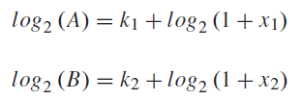
Assume A and B are two fixed-point operands of the logarithmic multiplier; they can be expressed as follows

Slide 9


An 8-bit example of Mitchell’s algorithm is shown in Fig. 1,
where 102 × 160 ≈ 15, 140 (= 16, 320). Note that Mitchell
logarithmic multiplier always underestimates the correct
value

Slide 10
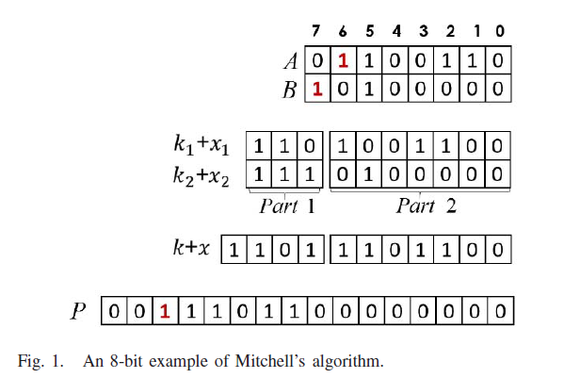
Mitchell's algorithm Example

Slide 11
Mitchell logarithmic multiplier steps
Mitchell logarithmic multiplier mainly includes four steps:
leading one detection,
binary to logarithm conversion,
Mantissa addition and
logarithm to binary conversion

Slide 12
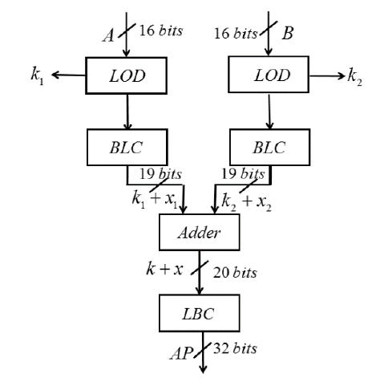
A 16-bit non-iterative logarithmic multiplier

Slide 13
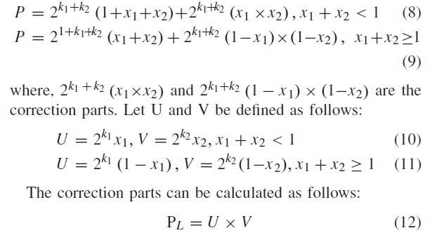
B. Iterative Logarithmic Multiplier
Errors are introduced by ignoring the correction parts. The exact product
can be rewritten as follows
PL is then added to the original LM product
(i.e., PH = A×B) to increase the accuracy of the final product

Slide 14
APPROXIMATE LOGARITHMIC MULTIPLIERS
The performance and power consumption of logarithmic multipliers are further improved by using inexact units during the mantissa addition; three inexact adders, namely,
lower-part-or adder (LOA) ,
approximate mirror adder-A3 (MAA3)
set-one adder (SOA) are used.
The SOA is proposed with truncated BLC in this work for approximate LMs.

Slide 15
1) ALM Using LOA (ALM-LOA):
ALM-LOA uses the lower-part-or adder (LOA) [12] in the mantissa adder. An n-bit LOA consists of two parts, i.e., an m-bit inexact adder and an (n-m)-bit exact adder (EA) (Fig. 3). The (n-m)-bit adder is used for the (n-m) most significant bits of the sum, while the m-bit adder consists of OR gates to compute the addition of
the least significant m bits (i.e., the lower m-bit adder is an
array of m 2-input OR gates).

Slide 16
1) ALM Using LOA (ALM-LOA):
ALM-LOA uses the lower-part-or adder (LOA) [12] in the mantissa adder
An n-bit LOA consists of two parts, i.e., an m-bit inexact adder and an
(n-m)-bit exact adder (EA) (Fig. 3). The (n-m)-bit adder is
used for the (n-m) most significant bits of the sum, while the
m-bit adder consists of OR gates to compute the addition of
the least significant m bits (i.e., the lower m-bit adder is an
array of m 2-input OR gates).

Slide 17

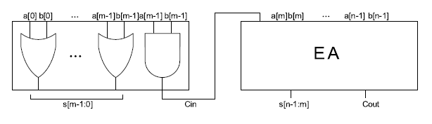
LOA with m inexact bits

Slide 18
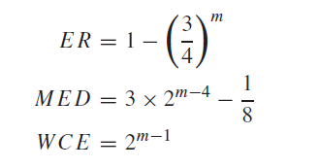
Error metrics

Slide 19
2) ALM Using MAA3 (ALM-MAA3):
ALM-MAA3 uses the
approximate mirror adder (MAA3) [13] in the mantissa adder.
An n-bit MAA3 also consists of two parts, i.e., an m-bit
inexact adder and an (n-m)-bit exact adder.
The (n-m)-bit adder is used for the (n-m) most significant bits of the sum;
while the sum of the m-bit adder is actually one
of its inputs.

Slide 20
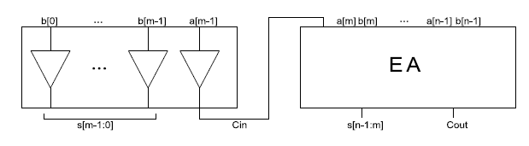
MAA3 with m inexact bits

Slide 21
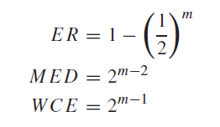
Error metrics

Slide 22
3) ALM Using SOA (ALM-SOA):
ALM-SOA uses both the
set-one adder as mantissa adder and a truncated BLC (TBLC).
An n-bit SOA consists of two parts, i.e., an m-bit inexact adder
and an (n-m)-bit exact adder.
The sum of the m-bit adder is set to logic one.

Slide 23
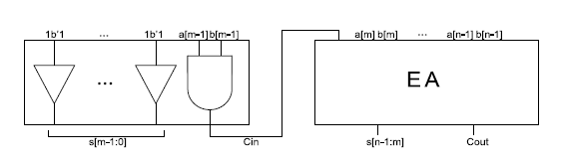
SOA with m inexact bits

Slide 24
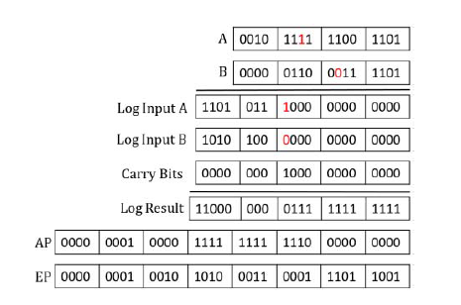
A 16-bit example of ALM-SOA (M = 11) with A = 12, 237 and
B = 1, 597. AP: approximate product. EP: exact product

Slide 25
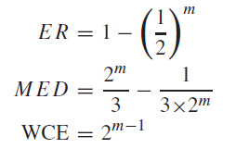
Error metrics

Slide 26
B. Iterative Approximate LMs (IALMs
the accuracy of ALM is affected by applying different number of inexact bits in the mantissa adder to achieve an even more efficient design compared with conventional LMs.
However, the error of ALMs in general, is large.
three iterative methods
ALMs (IALMs), namely, IALM-S (IALM using SOA and
Exact Adder3), IALM-SL (IALM using SOA and LOA) and
IALM-SM (IALM using SOA and MAA3), are proposed to
improve the accuracy of ALM.

Slide 27
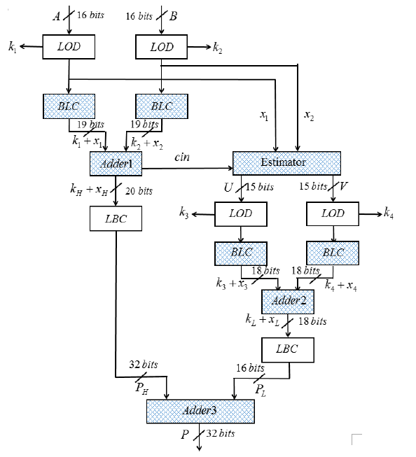
The proposed 16-bit IALM

Slide 28
1) IALM Using SOA and Exact Adder3 (IALM-S):
As SOA has the least complexity compared
with the other two inexact adders, both exact Adder1 and
Adder2 are replaced with SOA with M1 and M2, respectively.
TBLCs are used for both binary to logarithm conversions
before Adder1 and Adder2. The numbers of the truncated bits
of TBLCs are also M1 and M2, respectively. As the error is
sensitive to the operation of Adder3, an exact Adder3 is used
in IALM-S (M3 = 0 in this case).

Slide 29
2) IALM Using SOA and LOA (IALM-SL):
IALM-SL is
similar to IALM-S, SOAs and TBLCs are used for Adder1 and
Adder2. The numbers of truncated bits of TBLCs are the same
as the number of inexact bits of SOA. The difference is in
Adder3; in this case, it uses LOA with different M3; so as
Adder3 is sensitive to errors, SOA is not utilized.

Slide 30
3) IALM Using SOA and MAA3 (IALM-SM):
In IALM-SM,
Adder1 and Adder2 are the same as IALM-SL, where they
are replaced with SOAs and TBLCs. TBLCs are used for
the binary to logarithm conversion. However, Adder3 uses a
MAA3 instead of LOA. SOA is also not utilized in Adder3 due
to its low accuracy. The accuracy and power consumption
of both IALM-SL and IALM-SM are mostly dependent on
M1, M2 and M3. The tradeoff between error and the powerdelay
product is further studied in the next section.

Slide 31
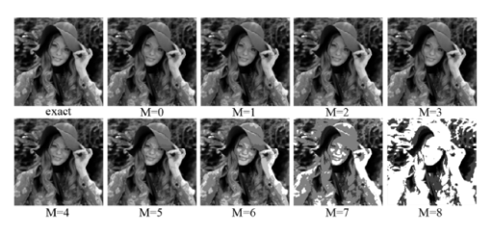
The multiplied images using the 8-bit ALM-SOA with different Ms

Slide 32
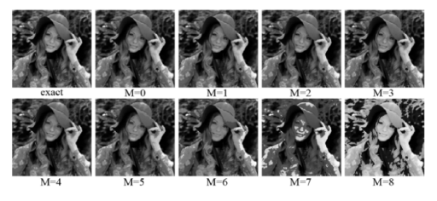
The multiplied images using the 8-bit ALM-LOA and
ALM-MAA3 with different Ms.

Slide 33
Applications
The proposed approximate logarithmic multipliers can be
applied to error-tolerant applications such as multimedia/signal processing,
data mining and analysis,
machine learning and
patter recognition.
In this section, two case studies into image processing and K-means clustering are provided to validate the proposed designs.

