Slide 1
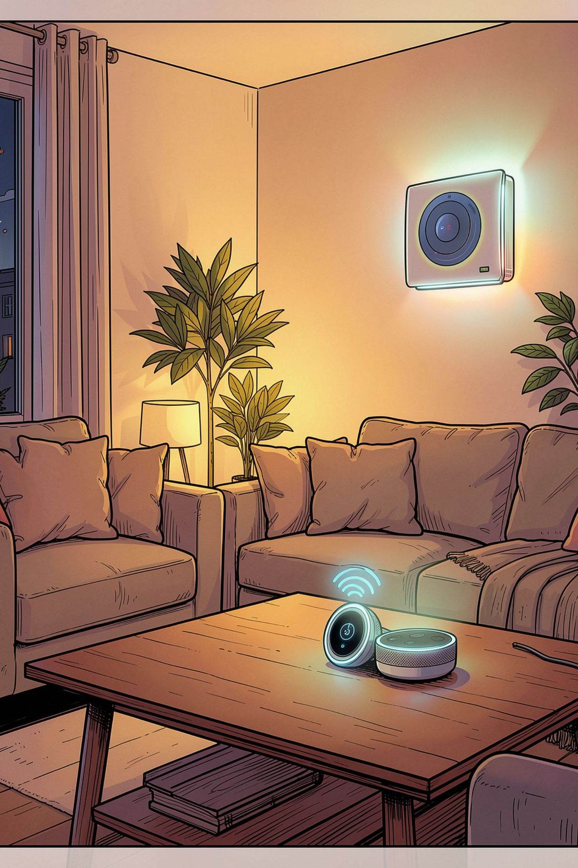
AI-Based Smart Home Agent: Performance, Environment, Actuators, Sensors
Overview of an intelligent agent that senses, reasons, and acts inside homes — with clear performance measures and practical architecture for real-world reliability.

Slide 2

Defining the Performance Measure
What makes an agent "smart"? We operationalize intelligence into measurable objectives that guide design and evaluation.
1
2
1 — Task Success
2 — Efficiency
Rate of completing user requests correctly (automation, commands, scheduled tasks).
Energy saved, latency to act, and reduction in user interventions.
3
4
3 — Robustness
4 — User Satisfaction & Trust
Performance under sensor noise, partial observability, and network disruptions.
Comfort, perceived usefulness, privacy-preserving behavior, and explainability.

Slide 3
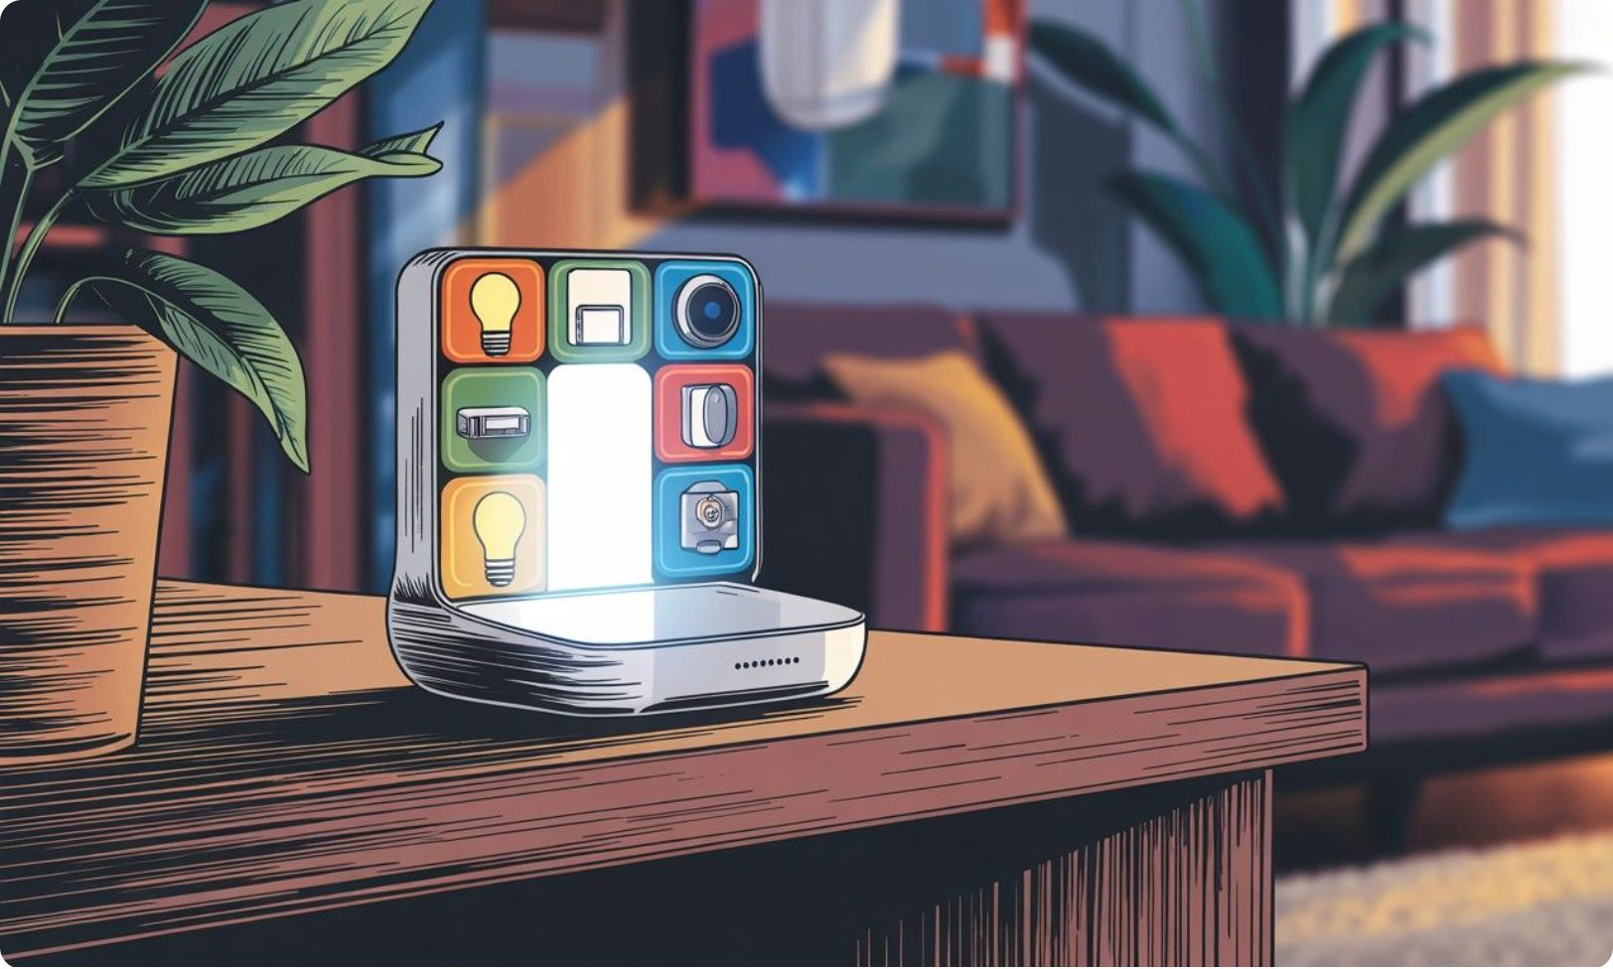
The Environment: Digital & Physical Landscape
The agent operates across overlapping spaces: physical rooms, device networks, edge hubs, and optional cloud services. Each layer imposes constraints and opportunities.
Environment Elements
State space: device states, occupancy, time, weather, user schedules
Dynamics: stochastic user behavior, delayed actuations, sensor drift
Observability: partial and noisy sensing; sometimes latent user intent
Constraints: privacy policies, bandwidth, device capabilities

Slide 4
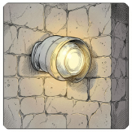
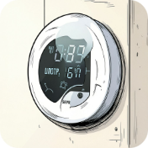


Sensors: The Agent’s Eyes & Ears
Sensors provide the raw inputs the agent must fuse into situational awareness. Reliability and correct interpretation are critical for performance.
Motion & Presence
Environmental
Contact & Door Sensors
Audio & Voice
Temperature, humidity, air quality — used for comfort control and health alerts.
Command recognition, event detection (glass break), with local processing for privacy.
Detect occupancy, activity patterns, and support fall or intrusion detection.
Entry/exit events, security triggers, and occupancy inference.

Slide 5
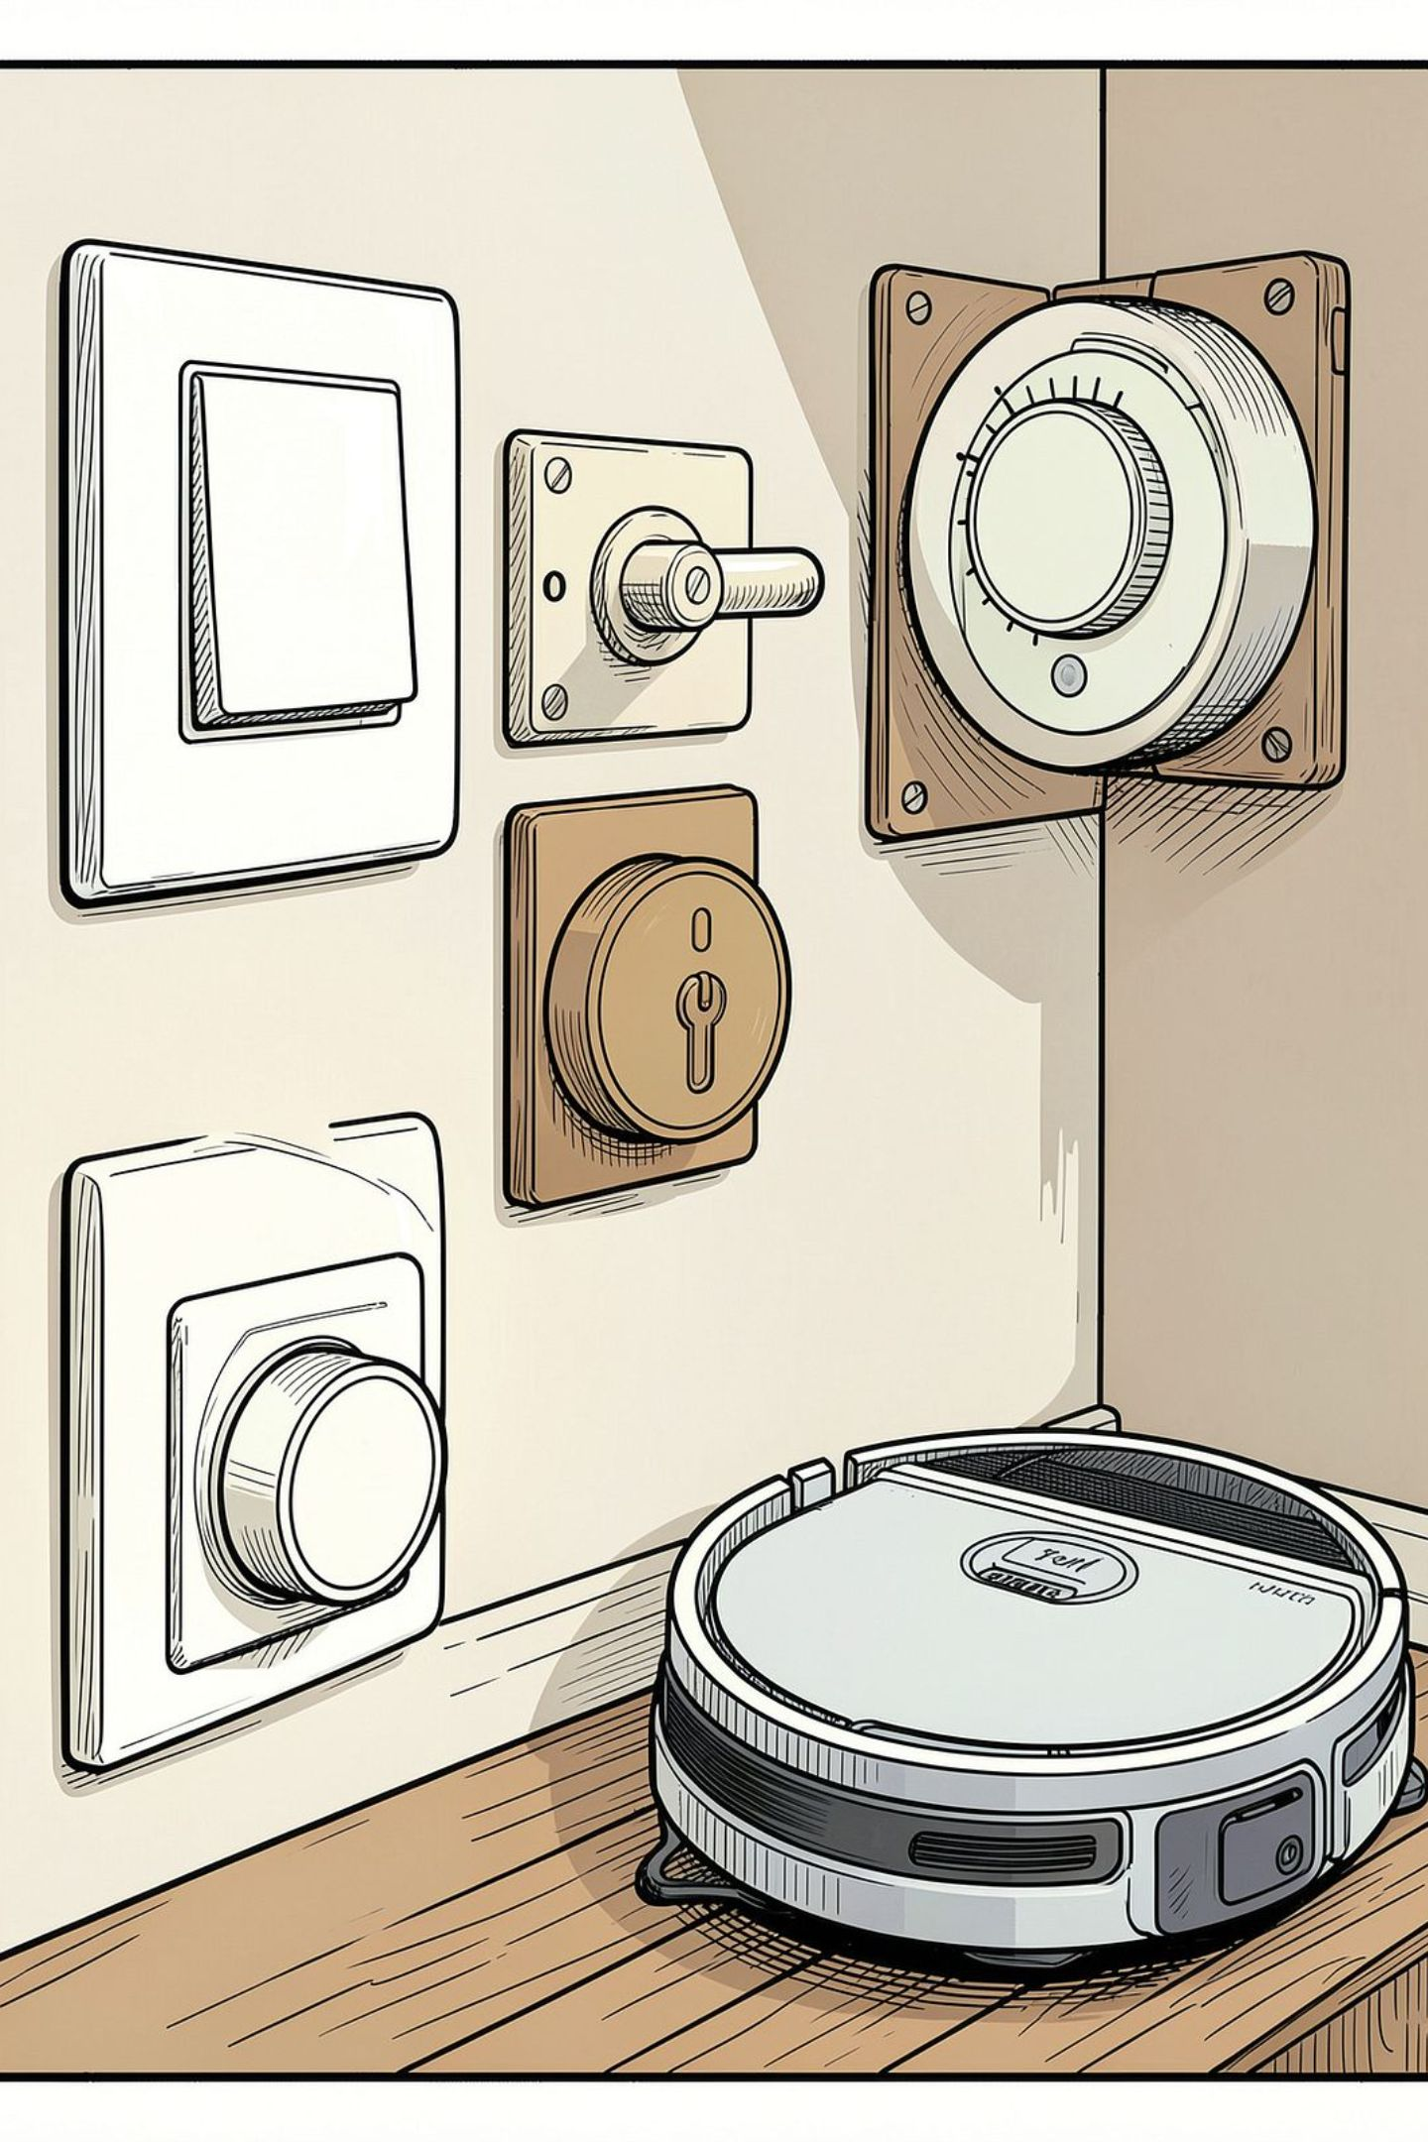
Actuators: The Agent’s Hands & Voice
Actuators execute decisions. Design focuses on safe, reversible, and context-aware actions to avoid unwanted outcomes.
Lighting Control
Adjust brightness and color for comfort, circadian alignment, and energy savings.
Locks & Entry
Secure access, temporary guest codes, and context-based lock/unlock policies.
HVAC & Climate
Thermostat adjustments balancing comfort with efficiency and occupant schedules.
Voice & Notifications
Voice confirmations, proactive prompts, and critical alerts to occupants.

Slide 6

Case Study: Morning Routine
Scenario: occupant wakes at 7:00. The agent coordinates devices to create a comfortable, efficient start to the day while respecting preferences and constraints.
1. Detect Wake Event
Motion + bedside device confirms occupant out of bed; confidence threshold passed.
2. Sequential Actions
Open blinds, warm bathroom via HVAC preheat, start kettle if user allowed.
3. Notifications & Learning
Ask one confirmation if unusual; record preference to refine future routines.
4. Safety Check
Verify doors locked and stove off; escalate if anomalies detected.

