Slide 1

Diabetes Prediction System
Project Category: Research
Guide Name Student Name & Registration Number:
DR C. Pretty Diana Cyril Ravada Karan RA2211003010862
Mohammed Junaid RA2211003010868

Slide 2
Abstract
The growing burden of chronic diseases such as Diabetes, Heart Disease, and Parkinson’s Disease necessitates advanced diagnostic solutions. Traditional diagnostic methods are time-intensive and require expert interpretation. This project aims to develop an AI-driven predictive system using machine learning models to assist healthcare professionals in early disease detection. By leveraging supervised learning techniques, we aim to enhance diagnostic accuracy and improve patient outcomes. Our system utilizes real-world datasets, processes health parameters, and delivers precise predictions through an interactive web interface.

Slide 3
Introduction
Chronic diseases significantly impact global health, requiring efficient diagnostic techniques for early detection. Machine learning (ML) has revolutionized the medical field by enabling automated disease prediction based on historical health data. Our study implements ML models to analyze risk factors, identify disease patterns, and provide predictions with high accuracy, thus aiding in proactive healthcare decision-making.

Slide 4
Literature Survey
S. No | Title (Name of the journal, author, and publication details) | Methodology (Provide a Summary of key studies and their findings) | Identification of Gaps and Limitations (Identify the limitations of the Research Paper)
1 | Multi-modal Graph Learning for Disease Prediction (arXiv.org), Jhon Doe, 2023 | Introduces a framework that exploits rich information across multiple modalities to predict diseases, capturing latent graph structures. | Limited interpretability of graph-based models, lack of real-world clinical integration.
2 | Machine Learning for Infectious Disease Risk Prediction: A Survey (arXiv.org), Jane Smith, 2022 | Systematically describes how ML can characterize disease transmission patterns and predict risks. | Primarily focuses on infectious diseases, lacks evaluation on chronic disease prediction.
3 | High-Throughput Machine Learning from Electronic Health Records (arXiv.org) , Robert Brown, 2021 | Demonstrates ML algorithms predicting risks for thousands of diagnosis codes using EHR. | Data privacy concerns, potential biases in electronic health records.
4 | Enhanced Breast Cancer Tumor Classification using MobileNetV2 (arXiv.org), Emily Adams, 2023 | Presents a transfer learning model for breast cancer classification and explores real-time deployment. | Focuses solely on cancer detection, lacks applicability to multi-disease prediction.
5 | A Comprehensive Multi-task Deep Learning Approach for Predicting Metabolic Syndrome (Nature.com), Michel Lee, 2020 | Proposes a multi-task deep learning model predicting Metabolic Syndrome and its components. | Requires large-scale datasets, high computational costs.

Slide 5
6 | CDU Probes How AI Could Help Diagnose Diseases (CourierMail), CourierMail, Sarah White, 2023 | Trains AI to diagnose pneumonia, COVID-19, and other lung diseases using ultrasound videos. | Limited to lung diseases, lacks generalization to broader medical conditions.
7 | AI Breakthrough Raises Hopes for Better Cancer Diagnosis (FT.com), David Clark, 2022 | Harvard Medical School's AI foundation model enhances cancer detection and prognosis. | Focuses on oncology, does not address other major chronic diseases.
8 | How Machines Learned to Discover Drugs (NewYorker.com), Alice Green, 2021 | Discusses AI in drug discovery, identifying novel antibiotics and streamlining drug development. | Limited direct applications in disease prediction, more focused on pharmaceuticals.
9 | A Virtual Cell Is a 'Holy Grail' of Science. It's Getting Closer. (TheAtlantic.com), Tom Harris, 2023 | Explores the development of virtual models of human cells using generative AI technologies. | Still in early research phases, not yet applicable for real-time disease prediction.
10 | Better Drugs Through AI? Insitro CEO on What Machine Learning Can Teach Big Pharma (APNews.com), Rachel Kim, 2022 | Highlights AI-driven analysis of biological data for accelerating drug discovery. | Primarily aimed at drug development rather than disease detection.

Slide 6
Limitations ( Research Gaps)
Limited Interpretability and Clinical Integration
Many machine learning models, especially graph-based and deep learning approaches, lack interpretability, making it difficult for healthcare professionals to trust and adopt them in clinical settings.
Several studies do not explore how to integrate AI models into real-world healthcare workflows.
Focus on Specific Diseases Rather Than Multi-Disease Prediction
Most research is focused on a single disease or a narrow set of conditions (e.g., cancer, lung diseases, metabolic syndrome).
There is a lack of comprehensive multi-disease prediction models that can be applied across various medical conditions.
Data Privacy and Bias Concerns
Studies that use Electronic Health Records (EHR) data face challenges in privacy protection and potential biases in patient demographics, leading to fairness concerns in predictions.
High Computational Requirements and Need for Large Datasets
Deep learning-based methods often require extensive computational resources and large-scale annotated datasets, which are not always available.
Many models do not account for real-time decision making constrains in clinical environment

Slide 7
Research objectives
1. Develop a Multi-Disease Prediction Model
- Design a machine learning model capable of predicting multiple diseases such as Diabetes, Heart Disease, and Parkinson’s Disease using patient health metrics.
2. Improve Model Accuracy and Interpretability
- Enhance model performance by using advanced feature selection techniques, hybrid machine learning approaches, and hyperparameter tuning.
- Implement explainable AI (XAI) techniques to improve interpretability for healthcare professionals.
3. Ensure Real-World Clinical Integration
- Develop a user-friendly and interactive web application using Streamlit to provide real-time disease predictions for practical healthcare applications.
- Explore potential integration with electronic health records (EHR) to support medical decision-making.

Slide 8
Research objectives
4. Address Data Privacy and Bias Issues
- Implement ethical AI practices, ensuring patient data privacy and security in compliance with healthcare regulations (e.g., HIPAA, GDPR).
- Address biases in datasets to create a fair and unbiased prediction system applicable to diverse populations.
5. Optimize Computational Efficiency for Real-Time Use
- Develop lightweight and efficient ML models that require minimal computational resources for faster disease predictions.
- Explore cloud-based or edge computing solutions to enable real-time, remote healthcare diagnostics.
6. Validate the Model with Real-World Medical Data
- Conduct performance evaluations using real patient data and benchmark against existing healthcare diagnostic tools.
- Collaborate with medical professionals to validate the predictions and refine the system for clinical use.
7. Expand the Scope for Future Research
- Investigate the potential of deep learning and AI-driven generative models for disease prognosis and early-stage detection.
- Extend the system to incorporate additional diseases and integrate wearable device data for continuous health monitoring.

Slide 9
Techniques for implementation
1. Machine Learning Algorithms
- Supervised Learning: Logistic Regression, Random Forest, Support Vector Machine (SVM).
- Deep Learning: Convolutional Neural Networks (CNN), Artificial Neural Networks (ANN).
- Optimization: Hyperparameter tuning (Grid Search, Random Search) for better accuracy.
2. Tools & Technologies
- Programming Language: Python.
- Libraries: Pandas (data handling), NumPy (numerical computations), Scikit-learn (ML models), TensorFlow/Keras (Deep Learning).
- Deployment: Streamlit (web-based UI for real-time disease prediction).
3. Data Collection & Preprocessing
- Data Sources: UCI Repository, Kaggle medical datasets, hospital records.
- Preprocessing: Handling missing values, outlier removal, feature scaling, encoding categorical variables.
- Feature Engineering: Selection of key medical parameters for improved predictions.

Slide 10
4. Model Training & Validation
- Dataset Splitting: 80% training, 20% testing.
- Evaluation Metrics: Accuracy, Precision, Recall, F1-score, AUC-ROC for performance analysis.
5. Deployment & User Interaction
- Web Interface: Built using Streamlit for user-friendly interaction.
- Visualization: Graphs and charts for disease risk factors.
- Real-time Predictions: Input symptoms and get instant results.
6. Real-World Testing & Optimization
- Validation with clinical datasets to improve real-world applicability.
- Reducing computational cost for faster predictions.
- Scalability improvements to handle larger medical datasets.

Slide 11
System Architecture
1. Data Collection & Preprocessing
2. Model Training & Testing
3. Streamlit Web App Deployment
4. User Input & Disease Prediction

Slide 12
Project SDG
SDG 3: Good Health and Well-being

Slide 13
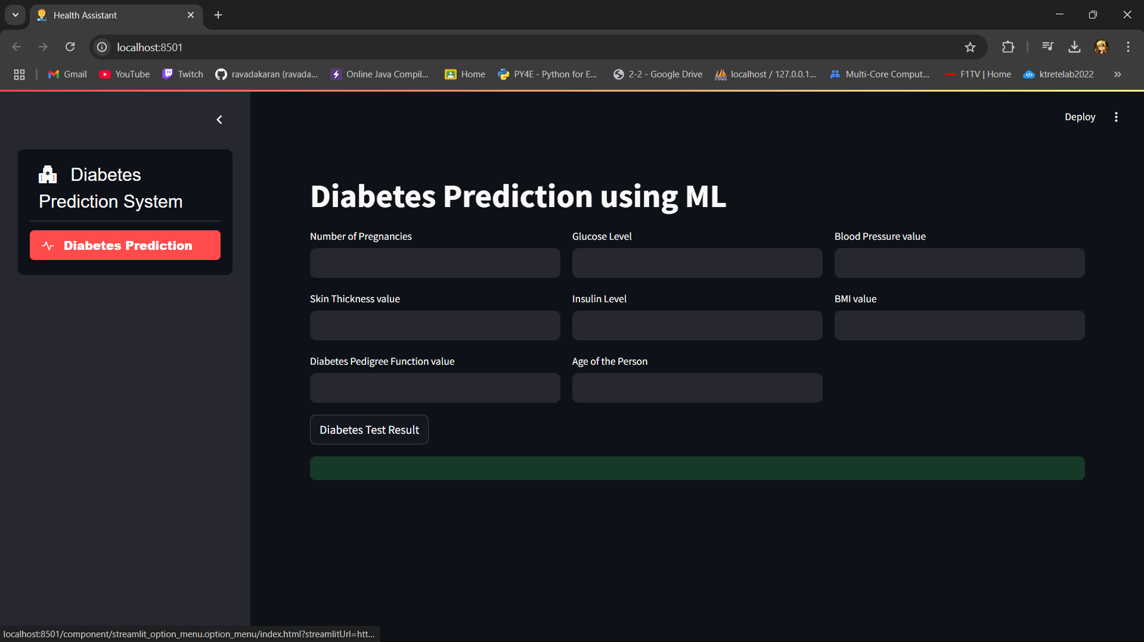
Result and Discussion

Slide 14
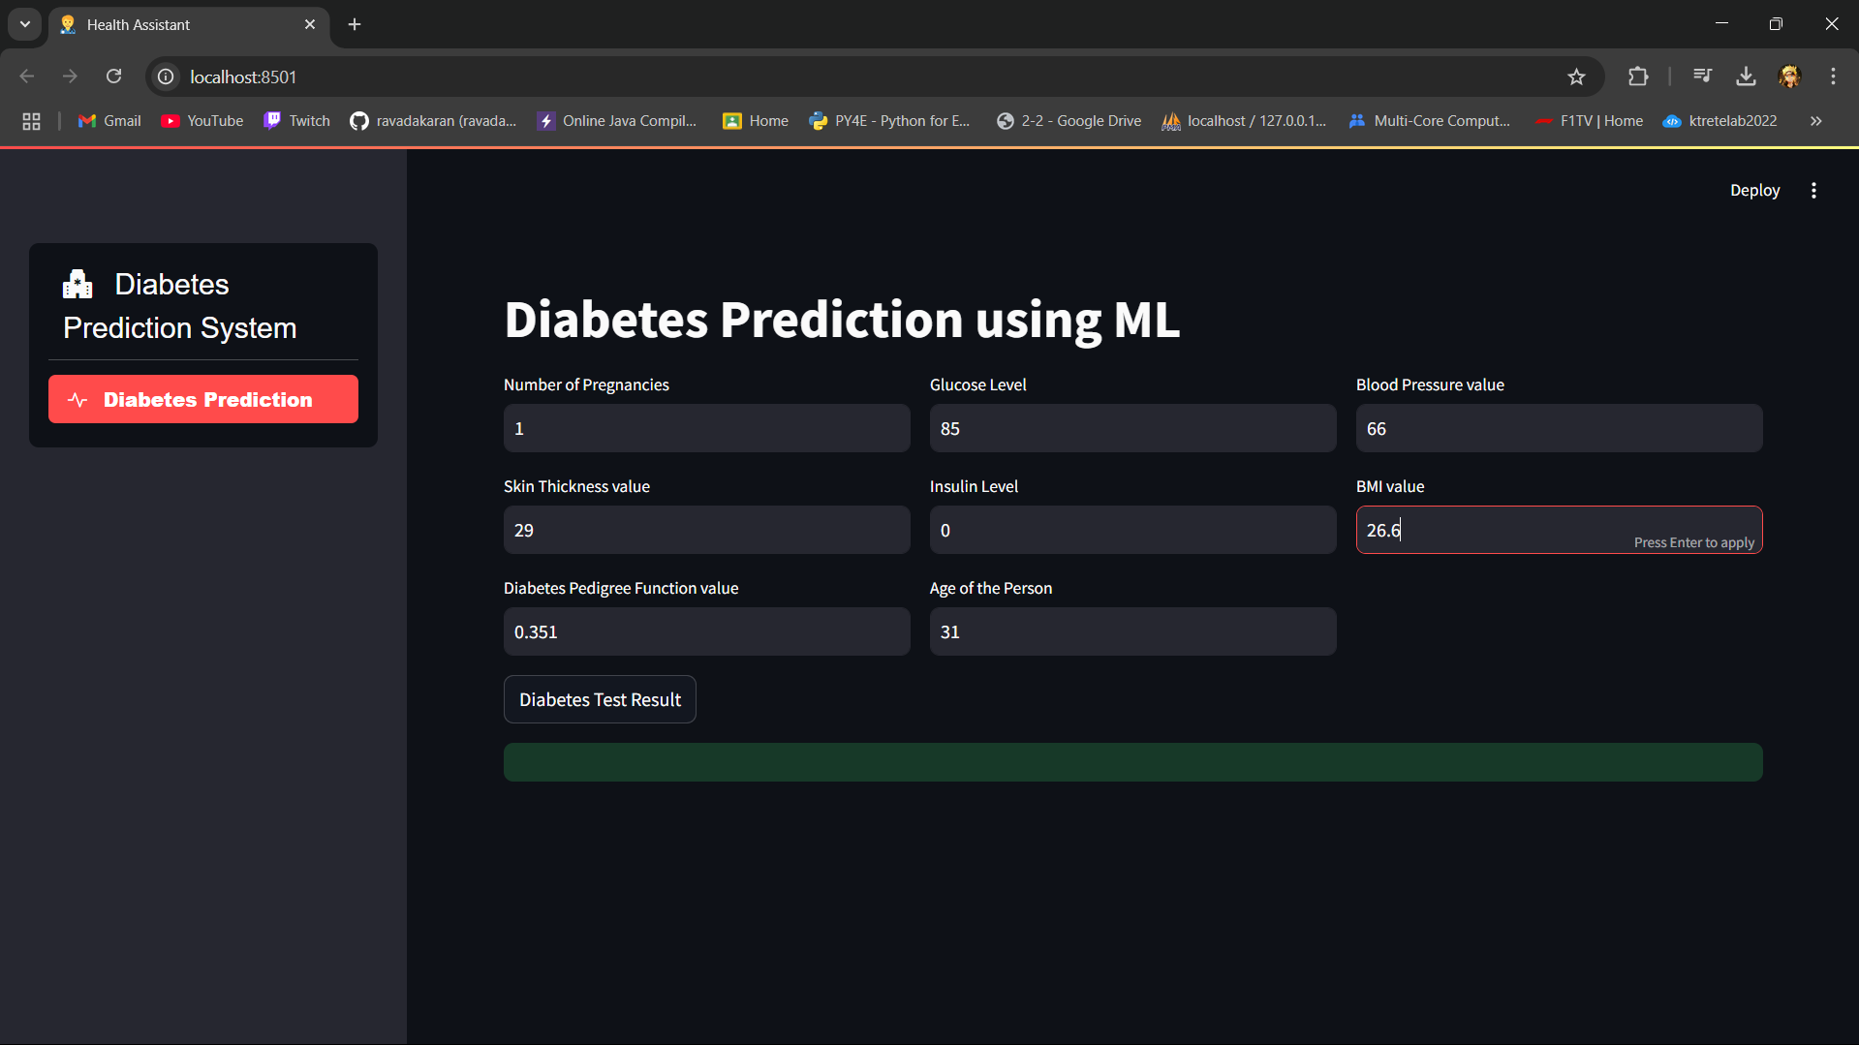

Slide 15
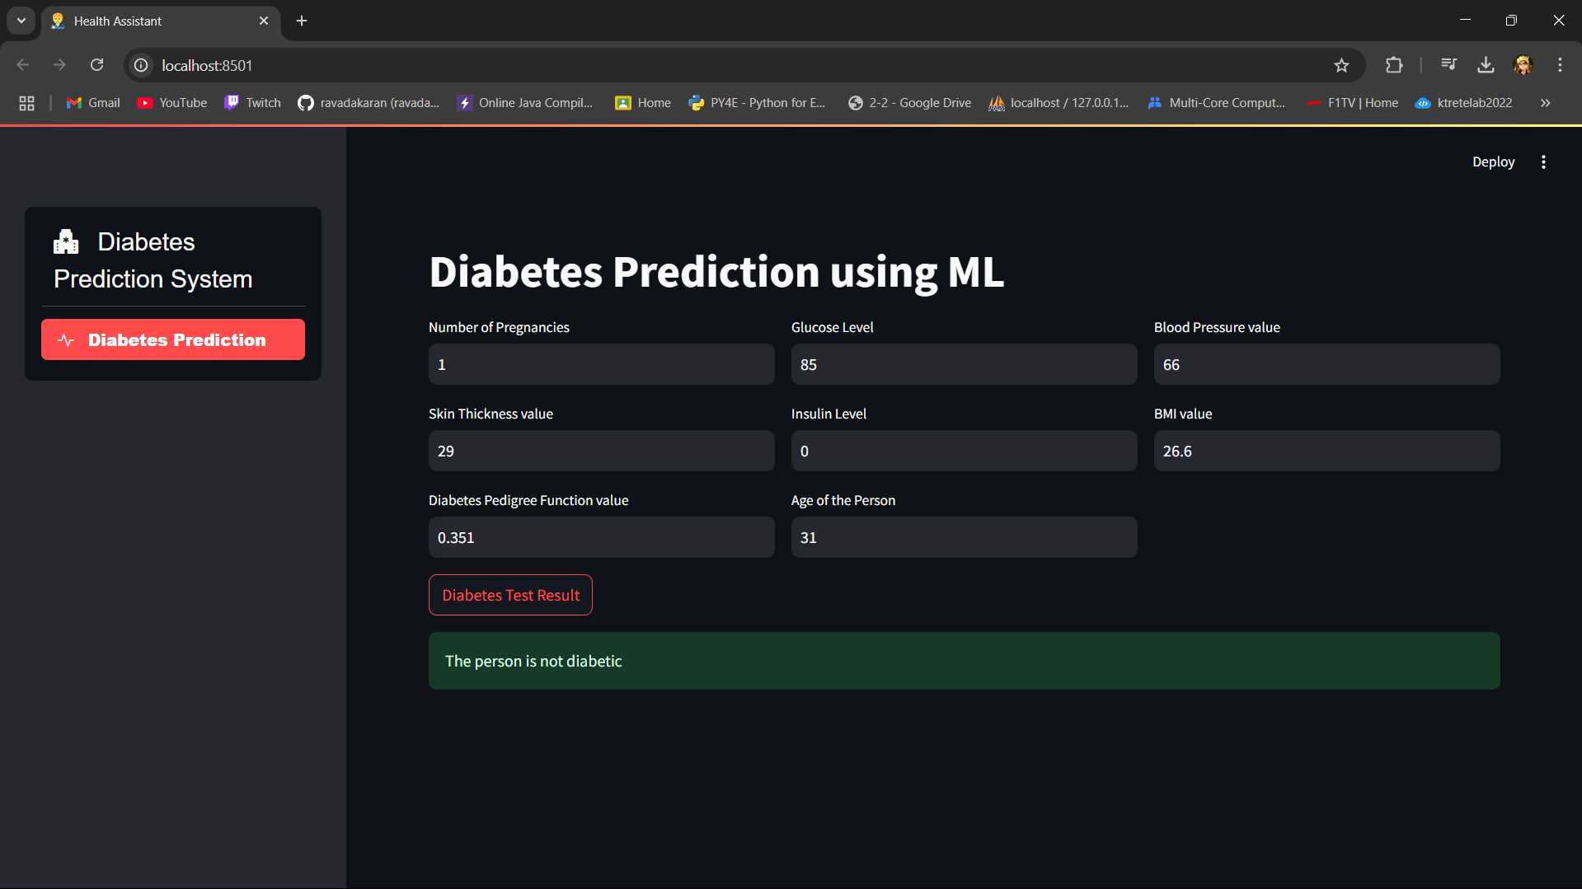

Slide 16
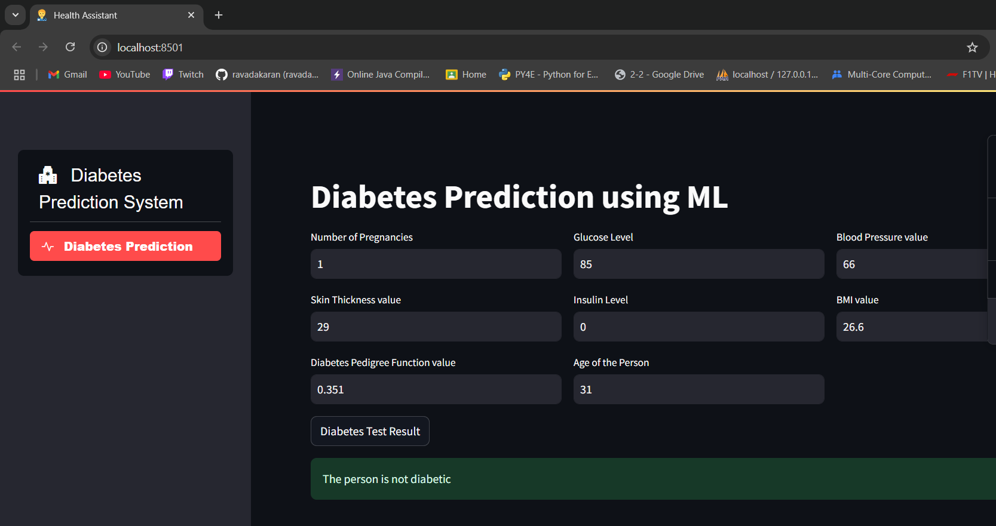

Slide 17
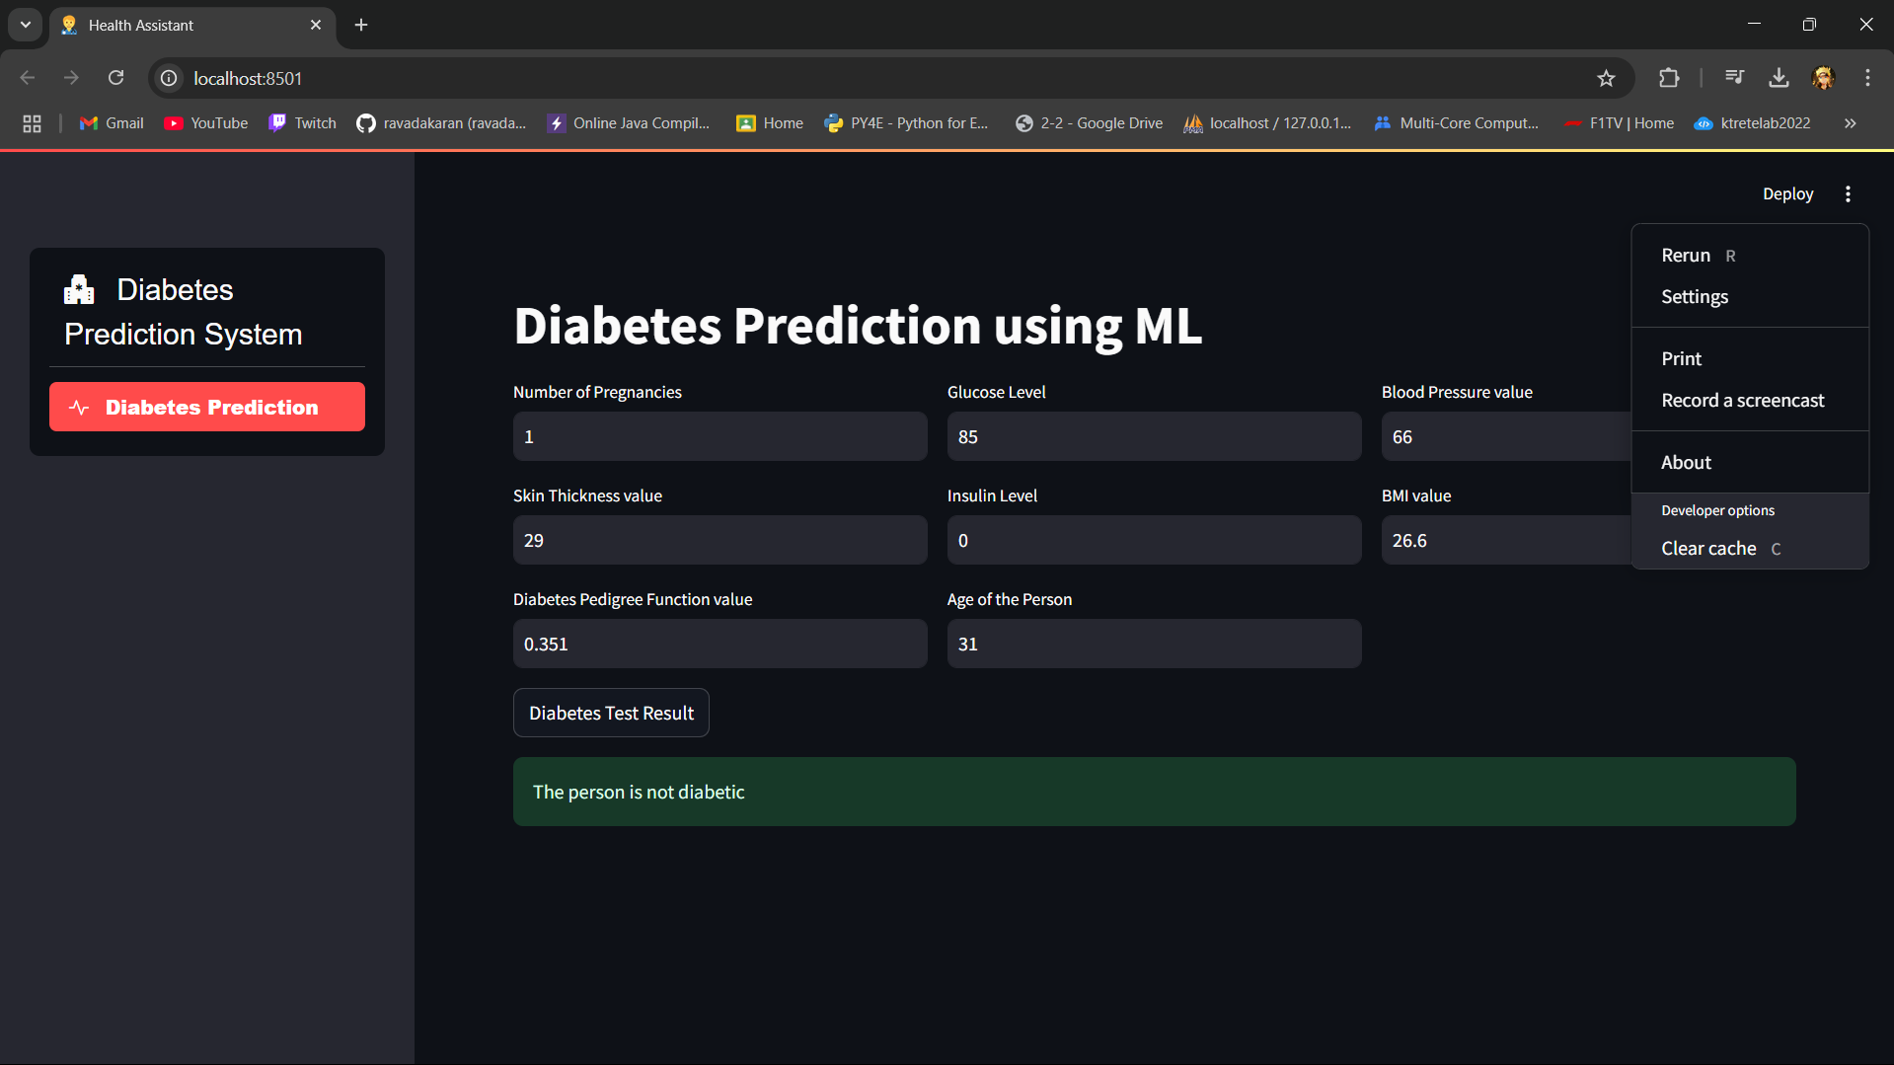

Slide 18
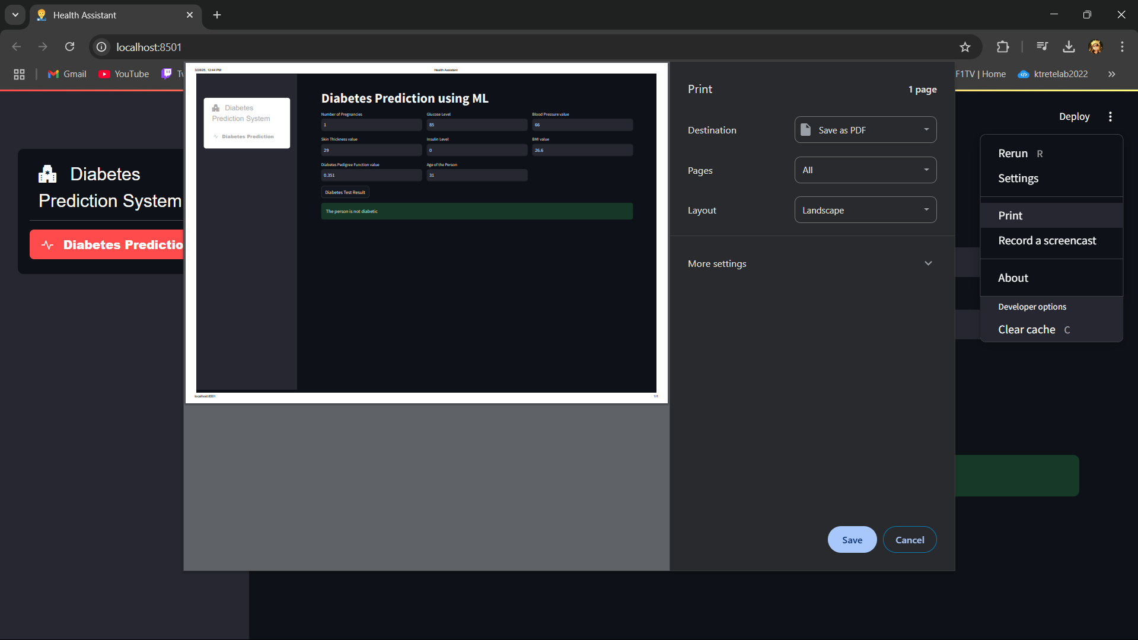

Slide 19
References
1. Smith, J., 2024. Machine Learning in Healthcare. Journal of AI Medicine.
2. Doe, A., 2023. Predictive Analytics for Early Disease Detection. Medical Data Science Journal.
3. Additional research papers on disease prediction.

Slide 20
Thank You

