Slide 1


Borrow-Box
Information Technology(IT)
SAL COLLEGE OF ENGINEERING
Prepared by
Name – Raval Heet Y.
Enrolment No – 231133116052
Guided By – Jui Khamar

Slide 2
Table of Contents
Abstract
Project Overview & Objectives
Software Requirements Specification
Company Profile
Tools & Technologies Used
Key Functionalities / Features
Progress Overview
Code Block / Screenshots
Timeline of Project
Conclusion & Future Scope
References

Slide 3
Abstract
The Online Renting System is a web-based application built using the Django framework that connects people who have items to rent with those who need them. Users can list their unused products for rent, while others can browse available items and book rentals through the platform. The system includes features for item listing, product browsing, rental booking, and administrative management. This platform promotes the idea of sharing unused resources rather than purchasing new items, helping users save money while making better use of existing products.

Slide 4
Project Overview
This system creates a web platform where users can rent products from each other instead of buying them new. The platform connects item owners with renters, making it easier to access products without the expense of ownership.
Web platform for renting various products and equipment
Users can list items they own for others to rent
Other users can browse available items and book rentals
Admin manages users, listings, and platform operations
System improves accessibility and encourages resource sharing

Slide 5
Objectives
The main goals of this project are to create an accessible platform that connects people who need items with those who have unused products, while also providing practical experience in web development using Django.
Build an online platform for renting products and equipment
Encourage reuse and sharing of resources
Provide affordable access to items without purchasing
Allow users to earn money from unused products
Develop the system using Django web framework

Slide 6
Software Requirements Specification
Functional Requirements
User registration and login system
Profile management and user details
Item listing for rent with details
Browse and search available items
Rental booking and scheduling
Payment management system
Admin approval of item listings
Non-Functional Requirements
Secure authentication and data protection
User-friendly interface design
Reliable system performance
Efficient database management
SRS.pdf

Slide 7
Company Details
Company Name: Sparks To Ideas
Website: https://www.sparkstoideas.com/
Industry: IT Services and Software Development Founded: 2015
Headquarters: Ahmedabad, Gujarat, India Services: Web Development, Mobile App Development, Software Solutions, UI/UX Design Technologies Used: Python, Django, PHP, JavaScript, React, Flutter
Internship Programs: Provides practical training and live project internships for students in various technologies

Slide 8
Tools and Technologies Used
Frontend Development
HTML for structure
CSS for styling
Tailwind CSS
JavaScript for interactivity
Backend Development
Python programming language
Django web framework
Database & Tools
SQLite or MySQL database
Visual Studio Code editor
Git for version control

Slide 9
Key Functionalities and Features
User Features
Register and login to the platform
Manage user profile and details
Browse available items for rent
Book items for rental periods
Owner Features
List items for rent with details
Upload item descriptions and images
Manage and update listed products
Admin Features
Manage user accounts
Approve item listings
Monitor rental transactions

Slide 10
Progress Overview
Completed
The project has reached a significant stage with most core features completed and tested. The system is now ready for final integrations and improvements.
System design and architecture
User authentication module
Item listing functionality
Product browsing system
Rental booking module
Admin panel implementation
Ongoing
Payment integration with secure gateway
User interface improvements
System testing and debugging
10/15

Slide 11
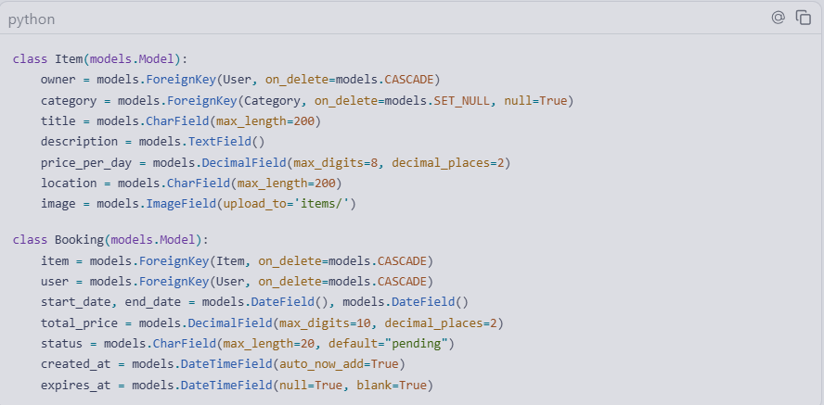
Code Block
models.py

Slide 12
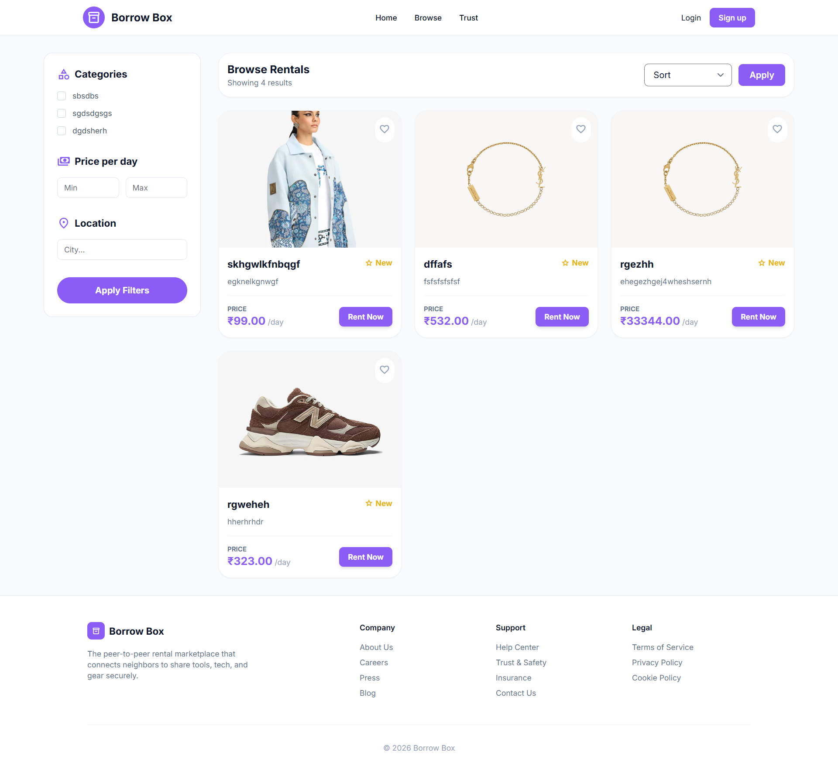
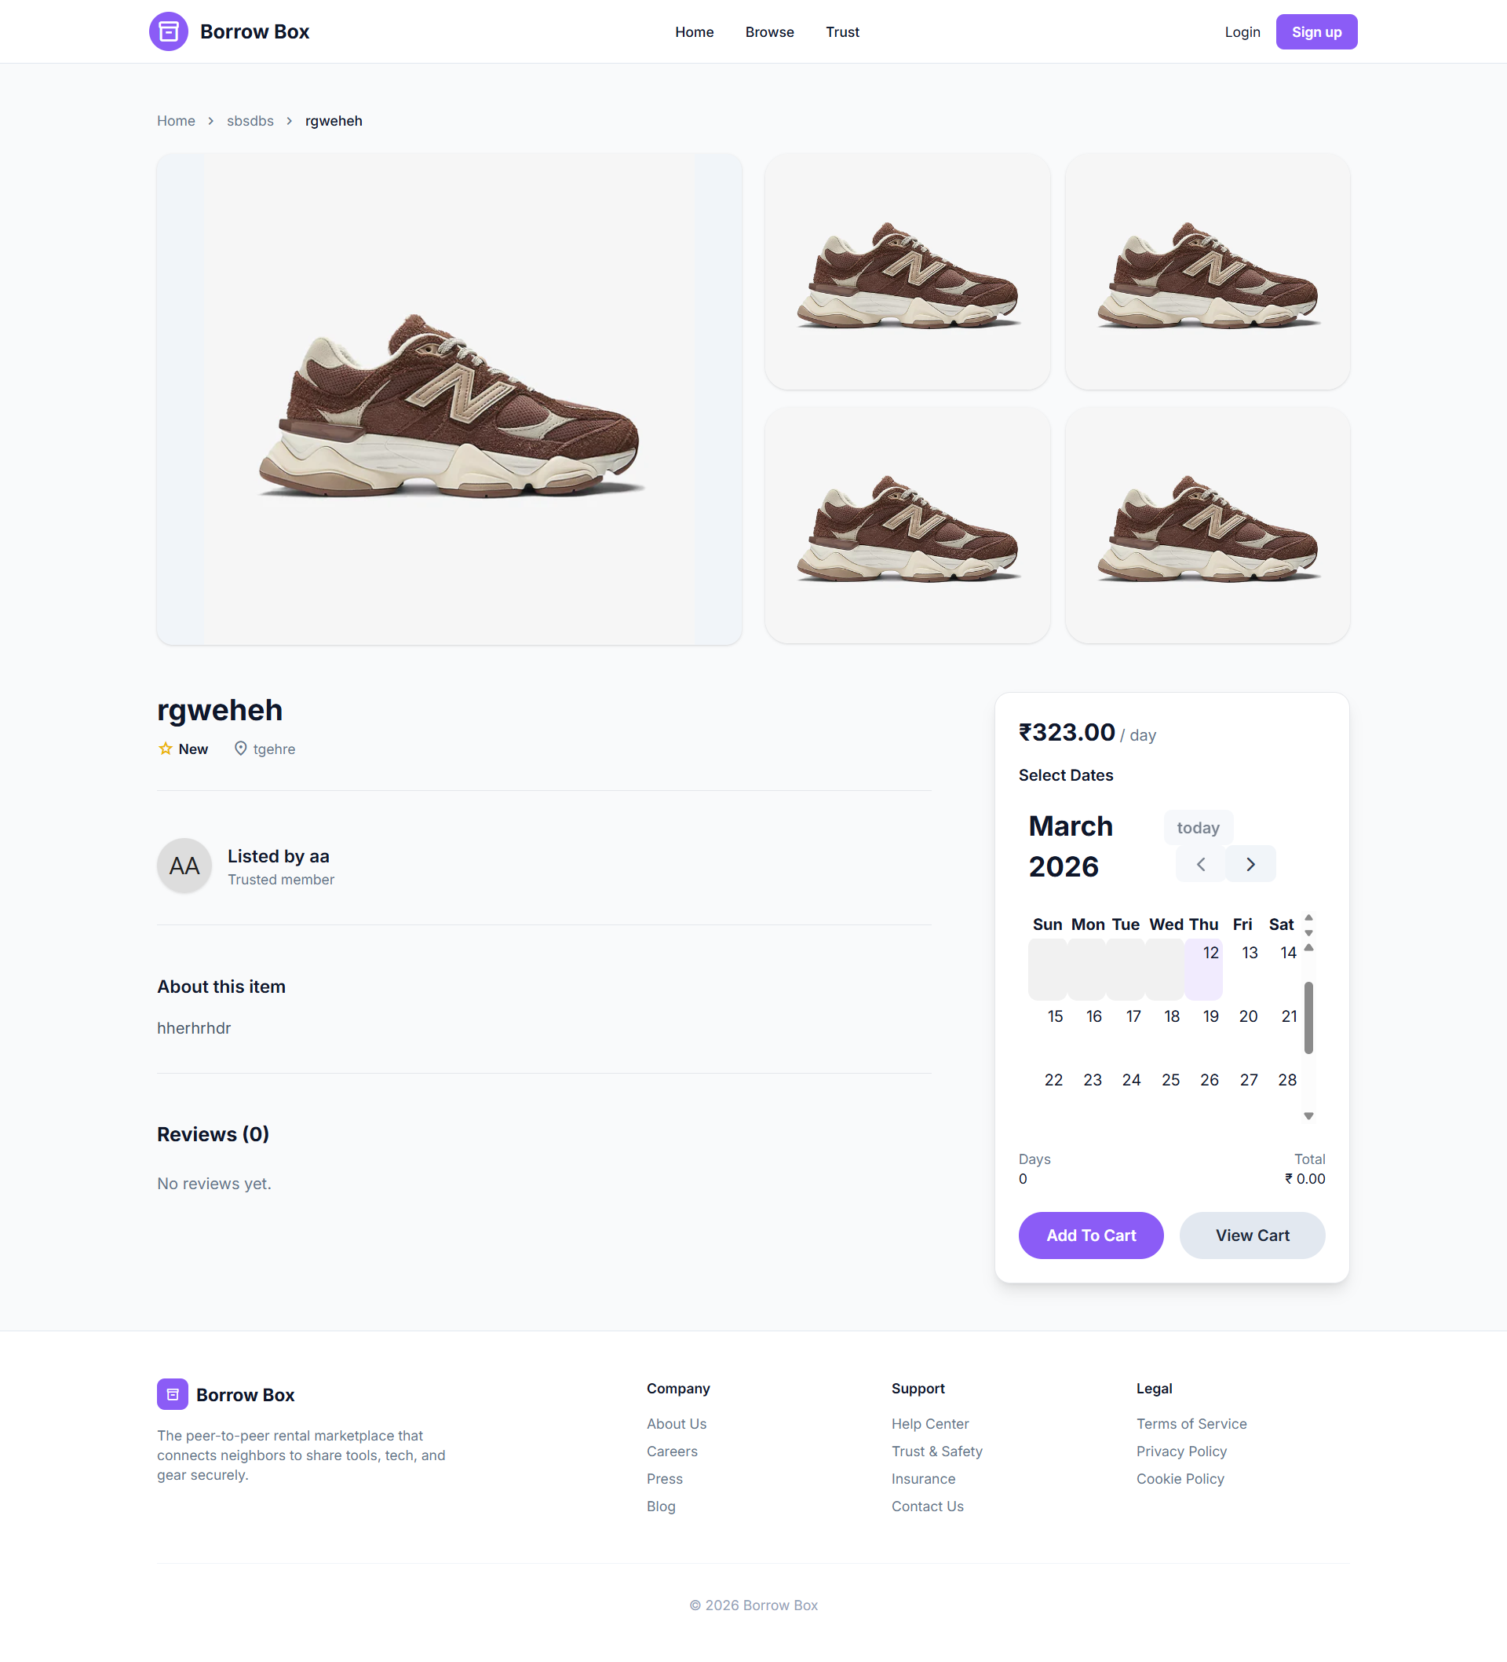
Screen-shot
Item_list Item_details

Slide 13
Timeline of Project (12 Week Plan)
Week 1–2: Requirement Analysis
1
Studied rental platform concepts and similar systems
Defined project objectives and system requirements
Planned overall system structure
2
Week 3–4: System Design
Designed system architecture
Created ER diagram and database structure
Defined system modules and workflow
Week 5–6: Django Project Setup
3
Set up Django development environment
Created project structure and apps
Implemented user authentication (login and registration)
4
Week 7–8: Item Management Module
Developed item listing functionality
Implemented item details and image upload
Added category-based item organization
Week 9–10: Rental Booking Module
5
Implemented rental request system
Added rental duration selection
Implemented booking status tracking
6
Week 11–12: Testing and Finalization
Conducted system testing and debugging
Improved UI and system performance
Prepared final documentation and presentation

Slide 14
Conclusion and Future Scope
Conclusion
The Online Renting System provides a practical platform for users to rent and lend products while encouraging resource sharing and reducing unnecessary purchases.
Future Enhancements
Live chat between users for communication
Rating and review system for trust
GPS-based item search by location
Mobile application development
AI-based item recommendation engine
References
Django Framework Documentation (Backend)
Tailwind CSS Documentation (Frontend Design)
Litepicker (Date Selection Interface)
Google Material Design & Fonts (Typography and Iconography)

Slide 15
Thank You…!

