Slide 1

AMAZON PRODUCT REVIEW
DATA ANALYSIS
Presented by :
Ravali K

Slide 2


Objective
To monitor and analyze customer reviews to gain valuable insights on customer preferences and behavior.
To use the insights gained from customer reviews to improve the success rate of existing and new products and marketing campaigns.

Slide 3

Amazon overview
Amazon is an American multinational technology company focusing on E-commerce, cloud computing, cloud computing online advertising digital streaming, and artificial intelligence. It has been referred to as "one of the most influential economic and cultural forces in the world“
Amazon was founded by Jeff Bezos from his garage in Bellevue, Washington, on July 5, 1994. Initially an online marketplace for books, it has expanded into a multitude of product categories.

Slide 4

Data Collection
In this project we were used 4 datasets,
Office Products
Office Products Meta Data
CD’s and Vinyl Data
CD’s and Vinyl Meta Data
Extracted important columns from meta data → 'asin’, 'brand’, 'category’ and ‘main_cat’
Based on common column (asin) from original data and meta data we merged 2
data frames of each categories into one data.

Slide 5


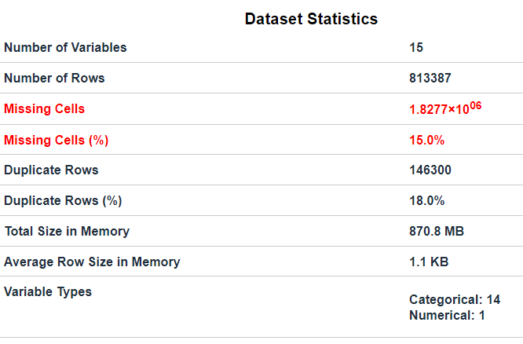
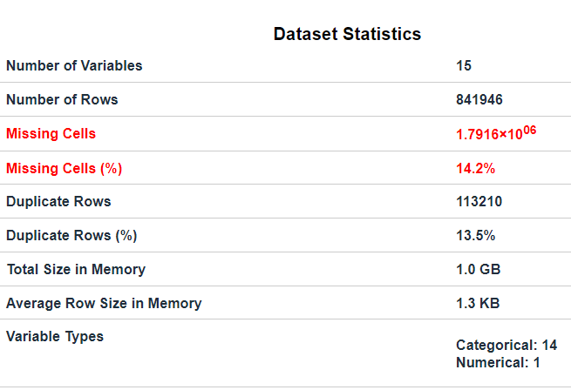
.
Dataset’s Overview

Slide 6
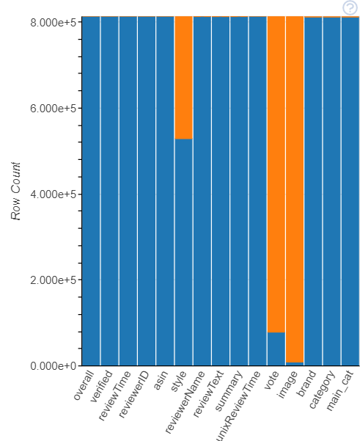
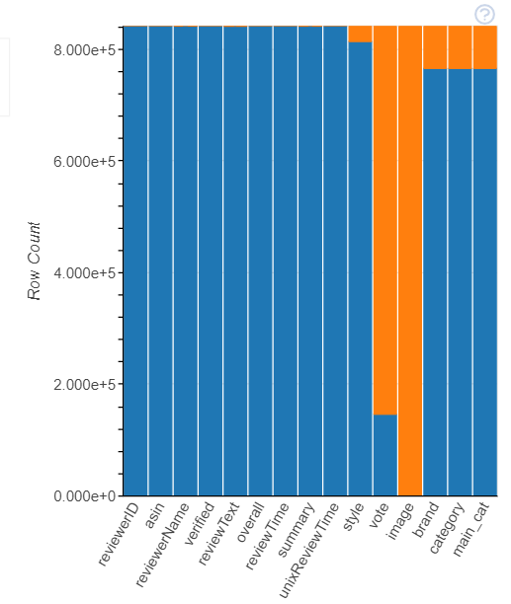

Data Understanding
Missing Columns for Office data
Missing Columns for CD’s and Vinyl data
Dropped columns → ‘image’,
‘vote’ and
‘style’
Imputation → ‘main_cat’,
‘brand’ and
‘category’
Dropped rows → Nan rows
columns
columns

Slide 7

Data Cleaning and Data Preprocessing
Null Value Treatment
Imputation technique → Mode, KNN Imputer
Columns → ‘main_cat ’, ‘brand’, and ‘category’
Dropped → Duplicate records
Final Data
Features
reviewerID | product_id | reviewer Name | verified | review Text | rating | date | summary | brand | category | main_cat
Final Shape : (1373582,11) Final Data : link

Slide 8

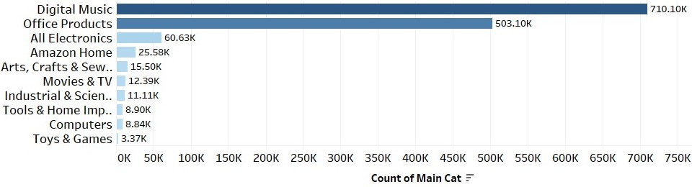
Exploratory Data Analysis (EDA)
Top 10 Main categories

Slide 9
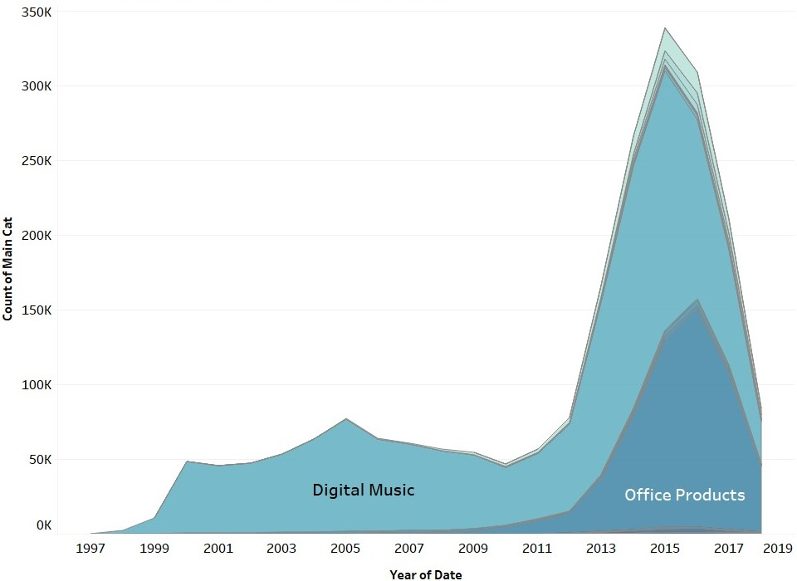
Sales of category over years

Slide 10
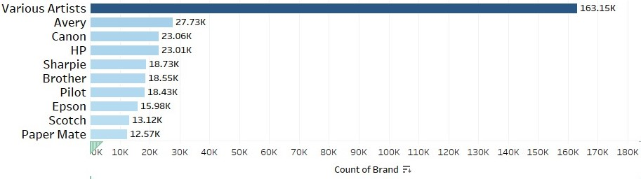
Top 10 Brands

Slide 11
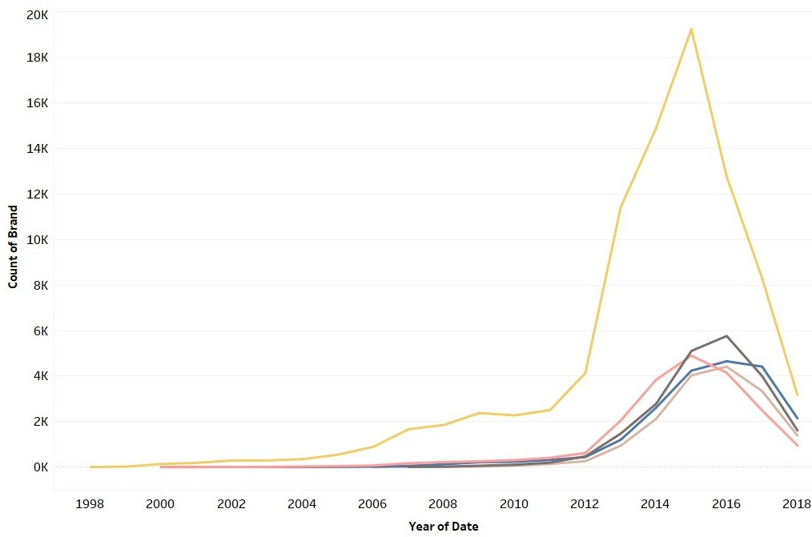
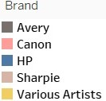
Sales of top 5 brands over years

Slide 12
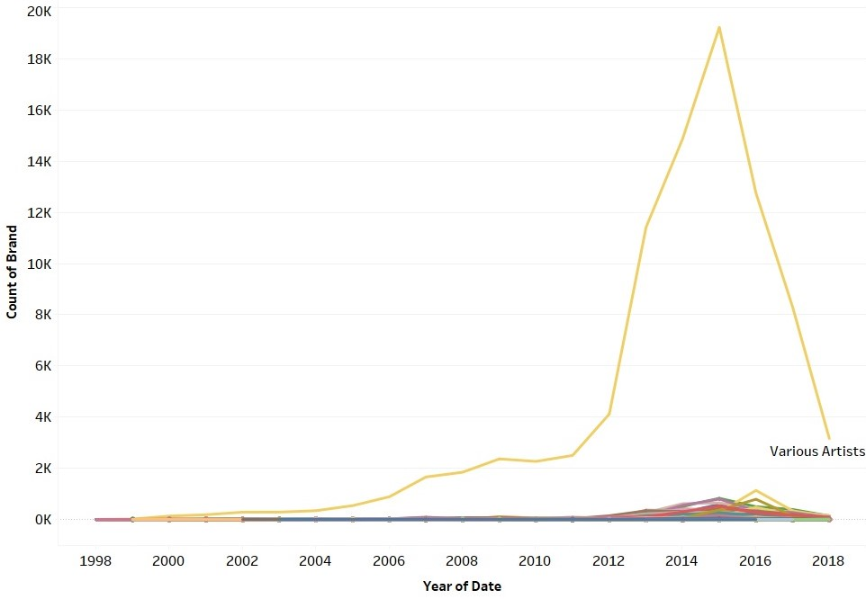
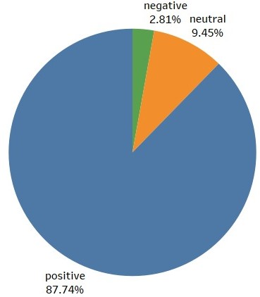
Brand that was in demand over the years of Digital Music Category
Distribution of sentiment of Digital Music with Various Artists brand

Slide 13

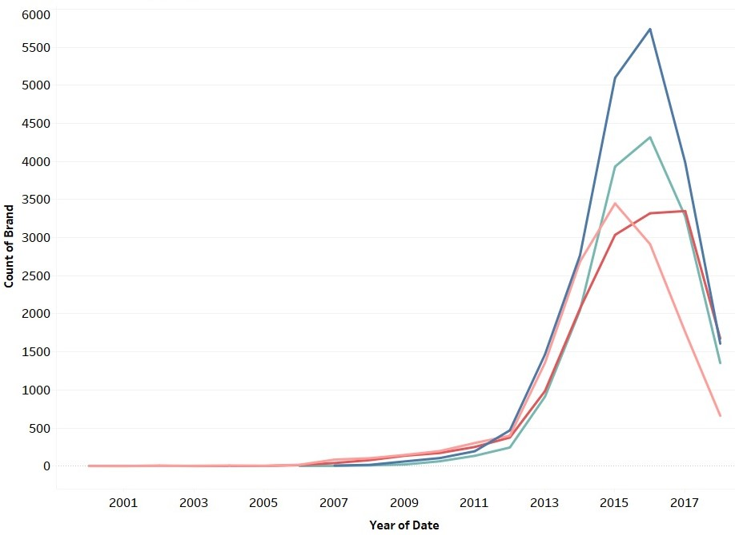
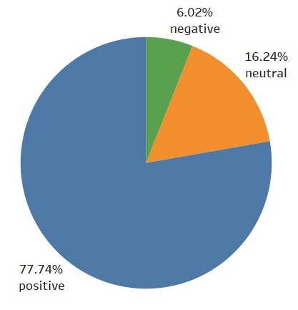
Brand that was in demand over the years of the Office Products Category
Distribution of sentiment of Office Products with Avery brand

Slide 14
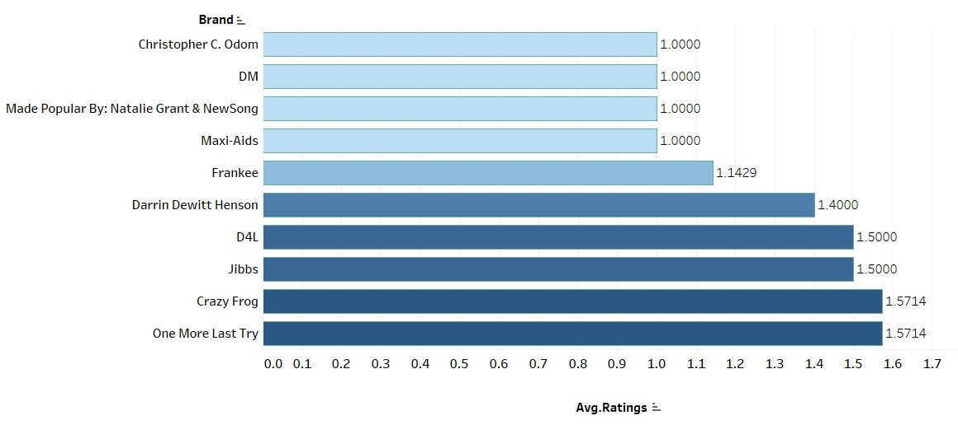
Top 10 Brands that focus on Customer Retention
Tableau dashboard → link

Slide 15
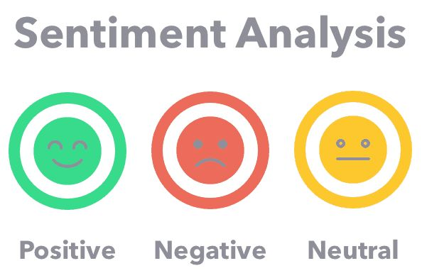
Sentiment Analysis
Objective : To predict the sentiment based on the Review Text.
.
Data Preparation for Sentiment Analysis
Cleaned the data using clean text and neat text libraries.
After cleaning data, we calculated “Polarity Scores” based on review text using TextBlob library.

Slide 16
Comparing Text Blob and VADER Sentiment Analyzer
Word | Text Blob Score | Text Blob Sentiment | VADER Score | VADER Sentiment
good | 0.7 | Positive | 0.4 | Positive
fan | 0.0 | Neutral | 0.3 | Positive
perfect | 1.0 | Positive | 0.5 | Positive
tasteless | -0.6 | Negative | 0.0 | Neutral
Recommend | 0.0 | Neutral | 0.3 | Positive

Slide 17
Cross Validation Results
Models | Precision | Recall | F1-score
Fast-Text | 0.98 | 0.98 | 0.98
Logistic Regression (OVR) | 0.94 | 0.94 | 0.94
Multinomial NB | 0.83 | 0.80 | 0.71
Model : Fast-Text
Input : Review of the product
Output : Neutral or Positive or Negative
Source : code link ,
positive brands ,
negative brands,
neutral brands

Slide 18
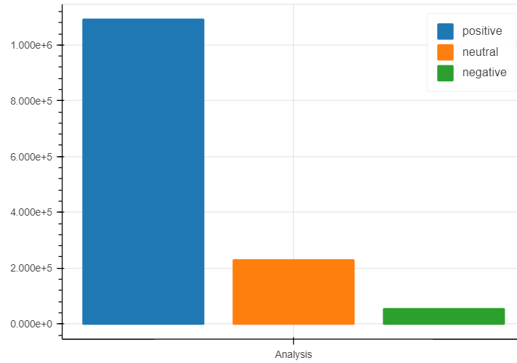
Results
Count of Sentiments
Output of Fast Text Model
Enter a text : I loved that particular book
Actual Results Polarity Score : 0.4 This review is : Positive
Predicted Results ('__label__positive’) with probability of [1.0]
Count

Slide 19

Customer Retention Based on Categories using Classification Model
Objective : To identify the categories that plays a main role in Customer Retention
Goal : The ultimate goal of churn analysis is to reduce churn and increase profits. As more customers stay longer, revenue should increase, and profits should follow.

Slide 20
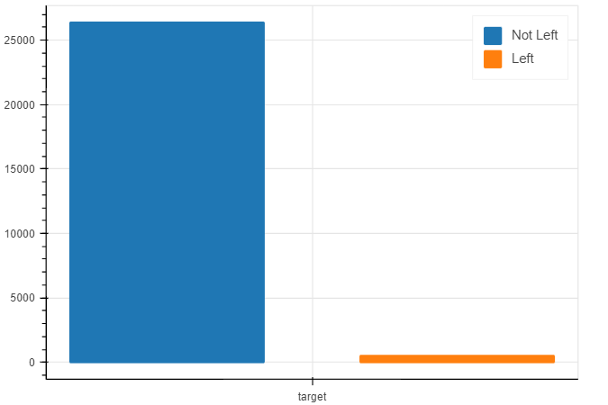
Modelling
Count of Target (Left vs Not Left )
.
Model : XGB Classifier
Input Data : main_cat and brand
Output : left or not left
Source Code : code link
Count of target

Slide 21

Results
Customer Retention categories with count of brands
Output of XGB Classifier Model
Main Category | Count of Brand
Digital Music | 413
Office Products | 34
Movies & TV | 16
All Electronics | 10
Amazon Home | 9
Industrial & Scientific | 5
Tools & Home Improvement | 4
Books | 3
Health & Personal Care | 3
Arts, Crafts & Sewing | 2
Automotive | 2
Camera & Photo | 2
Cell Phones & Accessories, Computers, Software, Sports & Outdoors, Home Audio & Theater, Toys and Games | 1
Output
Enter Category | All Beauty
Enter Brand | 3M
Label | 1 (Not Left)
Brand : link

Slide 22

Time Series Analysis
Objective : To Predict which product would be in demand among 2 categories (Digital Music, Office Products)
Data Preparation for Timeseries Analysis:
Extracted the records where main_cat is ‘Digital Music. And resampled into monthly data.
Similarly for ‘Office Products’. And trained the data using SARIMA model

Slide 23
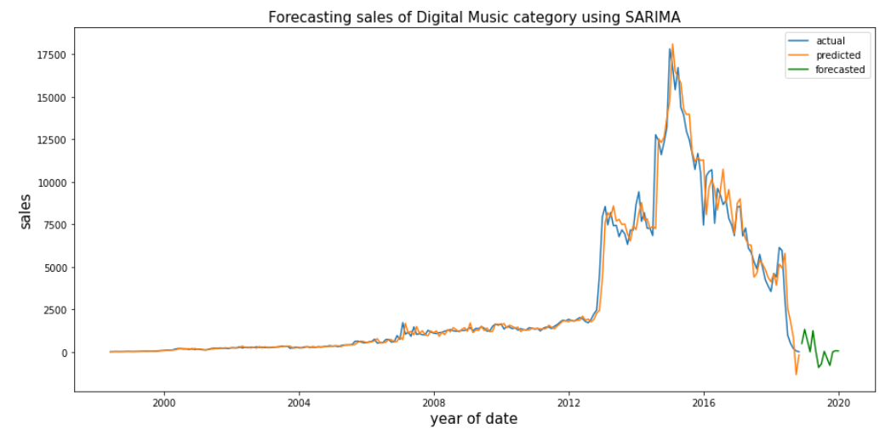
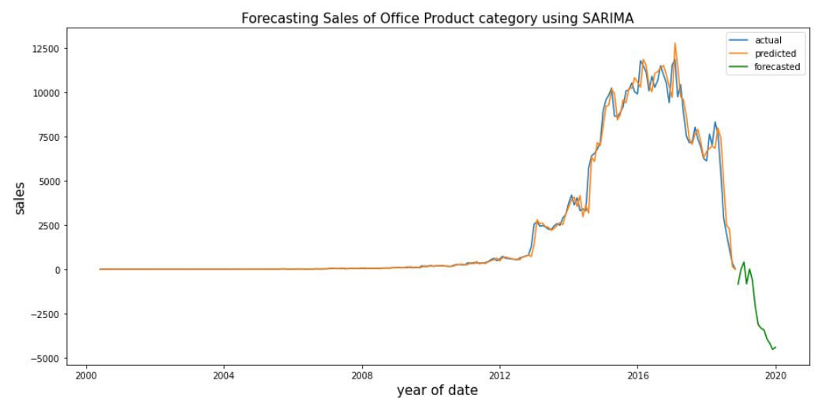
Sales of products over years

Slide 24
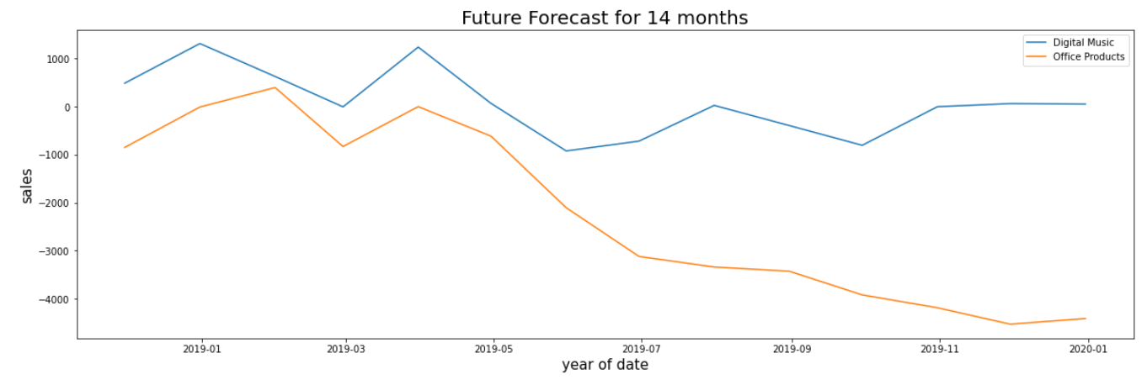
Conclusion : Demanded category would be Digital Music
Source Code : link

Slide 25
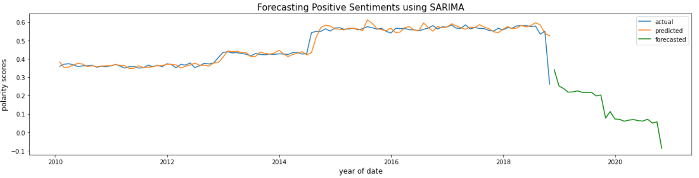
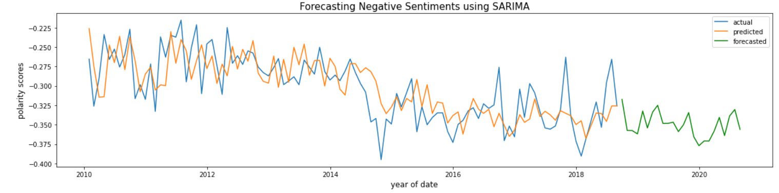
Sentiment Forecast Analysis
Objective: To forecast the future sentiments of the customers of the Digital Music category

Slide 26
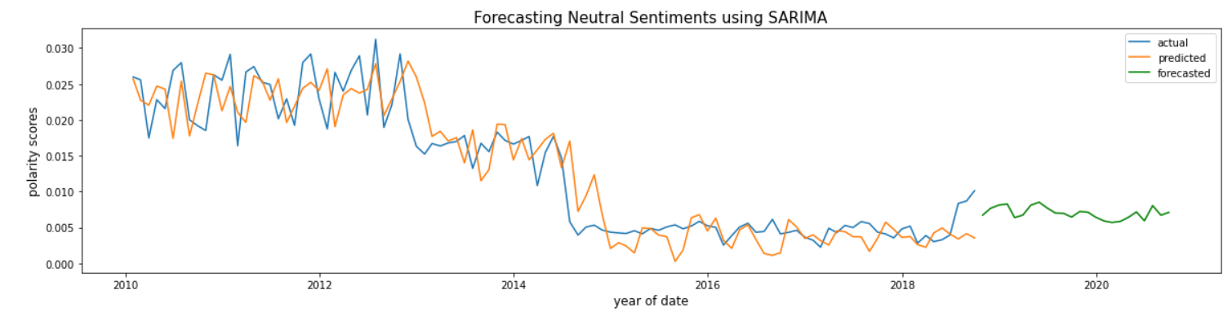
Neutral Sentiment Forecasts
Source Code : link

Slide 27

Conclusion
Most of the amazon customers were reviewed as positive
In Customer Retention few of the main categories and brands like (“Digital Music”, “ 70's Party Classics Killers”) , (“Movies & TV”, “DEAD BOYS”) plays a main role in increase of retention. So to reduce retention it is better to stop those brands.
“Digital Music” is the category that will be in high demand in the future.

Slide 28

Conclusion
Finally, we can say that most of the amazon customers were satisfied with the services and products quality.

Slide 29


