Slide 1

CMR TECHNICAL CAMPUS Accredited by NBA, Approved by AICTE, affiliated to JNTUH Kandlakoya (V), Medchal Road, Hyderabad -501401
DEPARTMENT OF COMPUTER SCIENCE AND ENGINEERING
Students Live behaviour monitoring in online classes using Artificial intelligence
Under the guidance
Dr. K. Maheswari
GROUP NAMES
Humera Naaz (187R1A05E6)
Bijja Ravali (187R1A05D6)
Bommala Shruthi (187R1A05D7)

Slide 2
CONTENT
Abstract
Existing System
Disadvantages
Proposed System
Advantages
Hardware Requirements
Software Requirements
Project Architecture
Modules
UML diagrams
Use case diagram
Class diagram
Sequence diagram
Activity diagram
Dataflow diagram
Sample Code
Results
Conclusion
Future Enhancement

Slide 3
ABSTRACt
Due to the health emergency situation, which forced universities to stop using their centers as a means of teaching, many of them opted for virtual education.
Affecting the learning process of students, which has predisposed many of them to become familiar with this new learning process, making the use of virtual platforms more common.
In this project live student behaviour analysis is performed using artificial intelligence and machine learning models.

Slide 4
EXISTING SYSTEM
Teaching is at a distance where the use of different means of videoconferencing is relevant in education.
Since, it has a very significant role in the learning experience of the students .
This indicates that ICT (Information and Communication Technology) has contributed to the new educational reforms.
Google meet was mostly used by students in work meetings as opposed to teachers who preferred to zoom in on class meetings.

Slide 5
DISADVANTAGES
In an investigation, explains that students have learning effectiveness during their online classes using Zoom, as it allows access to requested activities and availability.

Slide 6
PROPOSED SYSTEM
In proposed system artificial intelligence is used to predict behavior of student in online classes when student is live.
Student features are captured from every frame and data is analyzed based on different types of activity related to eye movement, mouth movements, head movements and analysis is done on student active status on that respective class.
Graphical representation is used to show performance of student.

Slide 7
ADVANTAGES
Helps in understanding interest of student for respective class.
Teachers can take decisions in improving effective ways of teachings.

Slide 8
HARDWARE REQUIREMENTS
System : Intel Core i5
Hard Disk : 10 GB
Input Devices : Keyboard, Mouse
Ram : 4 GB

Slide 9
SOFTWARE REQUIREMENTS
Operating system : Windows XP/7/10.
Coding Language : Python
Tool : Anaconda
Interface : Flask web app

Slide 10
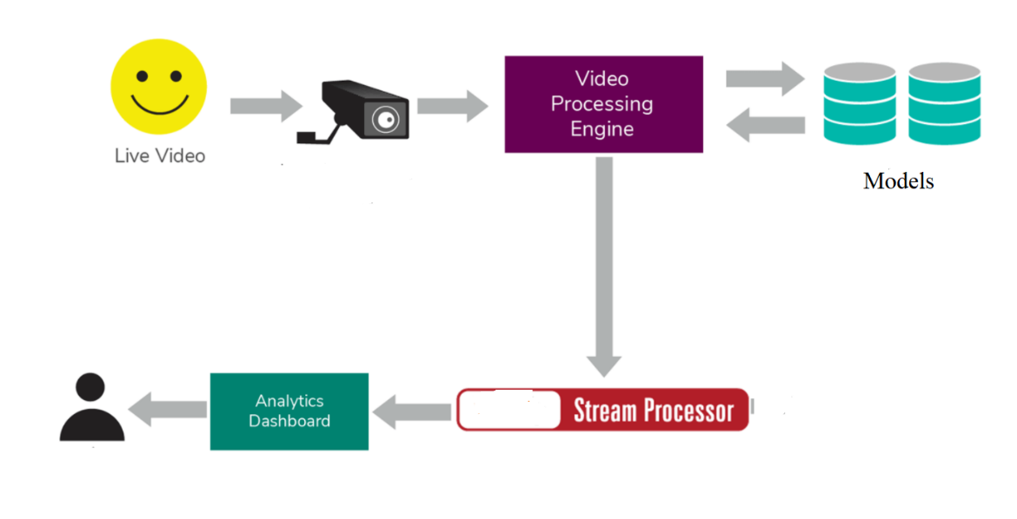
PROJECT ARCHITECTURE

Slide 11
MODULES
Client
Server Module
Face Processing Module

Slide 12
Client:
This application is run by student where camera will open and student’s video is displayed on screen. Details of each frame are shared is sent to other modules for processing and analyzing with trained model. Result is shown in graph after analysis.

Slide 13
Server Module:
This module is executed to track details of student and analyze actual performance. Each frame is sent to face processing module for checking with trained model. Server Module is used to process data between client and face processing module.

Slide 14
Face Processing Module:
This module each frame is taken as input and shape predictor model is used to predict various aspects of features like (eye aspect ratio, mouth aspect ratio, drowsy, yawn, head pose. After calculating these values are sent to server module.

Slide 15
UML DIAGRAMS
Usecase diagram
Class diagram
Sequence diagram
Activity diagram

Slide 16
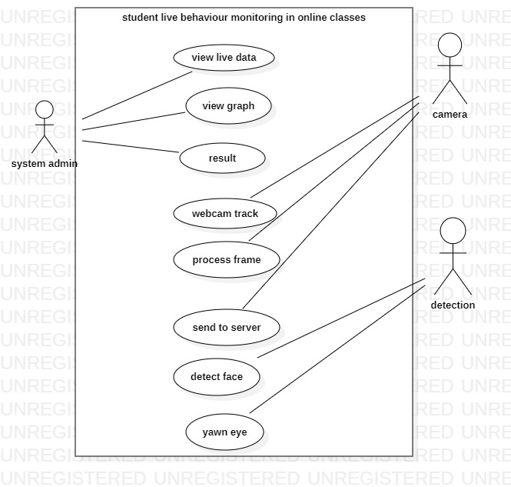
USECASE DIAGRAM

Slide 17
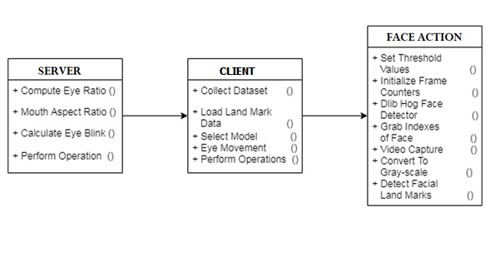
CLASS DIAGRAM

Slide 18
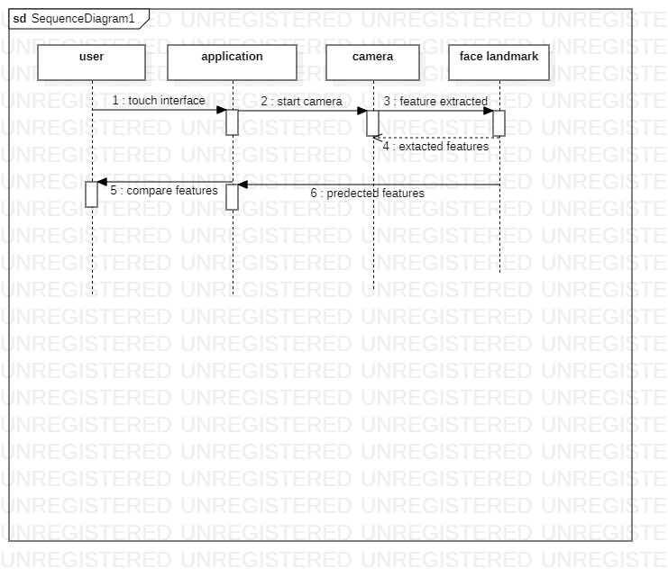
SEQUENCE DIAGRAM

Slide 19
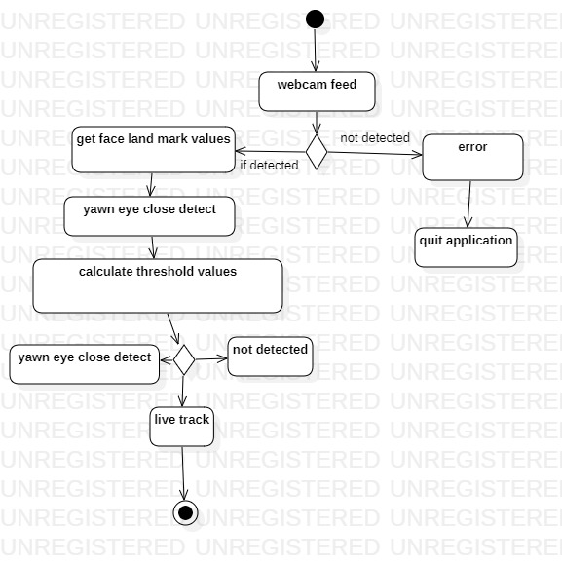
ACTIVITY DIAGRAM

Slide 20
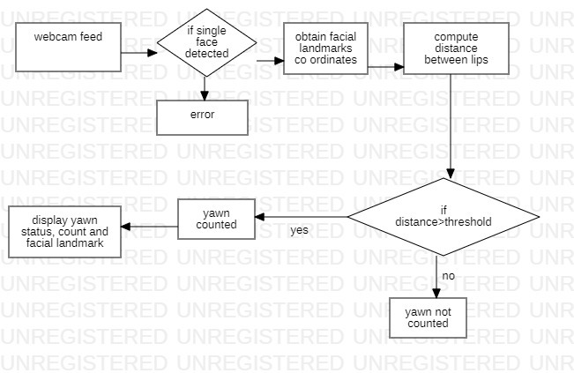
DATAFLOW DIAGRAM

Slide 21
SAMPLE CODE
from flask import Flask, render_template, request, url_for, redirect, jsonify
import json
app = Flask(__name__)
userdata = 0
@app.route('/')
def hello_world():
return render_template('index.html')
@app.route('/new')
def new():
print("Here we are")
return render_template('result.html')
# return jsonify(userdata)
@app.route('/getdata', methods=['GET'])
def getdata():
print("here getedata")
return jsonify(userdata)

Slide 22
@app.route('/result', methods=['GET', 'POST'])
def your_func():
print(request.form)
# print(type(request.form['data']))
# print(json.loads(request.form))
global userdata
userdata = request.form
# print(request.method)
# print(request.form)
# if (request.method == 'POST'):
# print("here I am")
# return render_template('result.html')
return redirect(url_for('new'))
if __name__ == '__main__':
app.run(debug=True, host='127.0.0.1', port=5500)

Slide 23
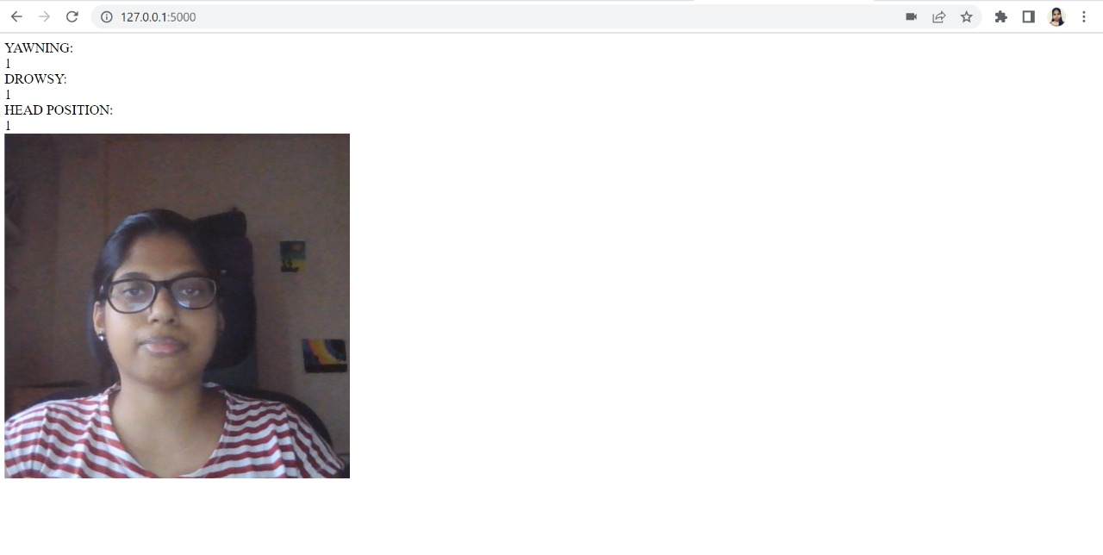
RESULT
FACE ACTION NOTICES:

Slide 24
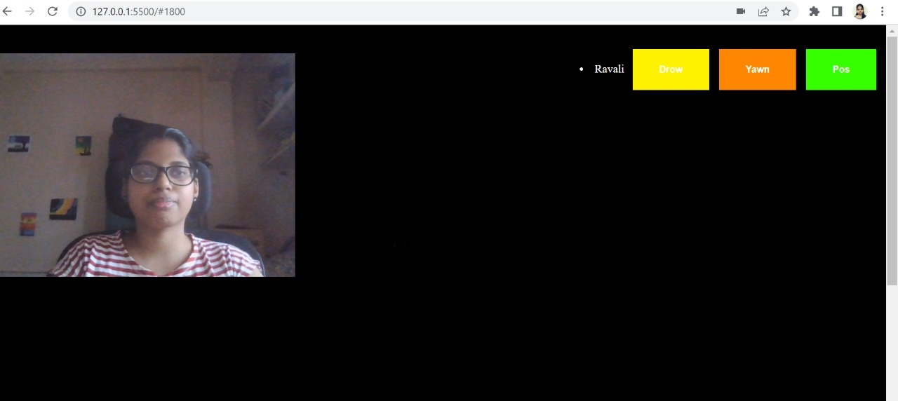
MAIN SERVER SITE

Slide 25
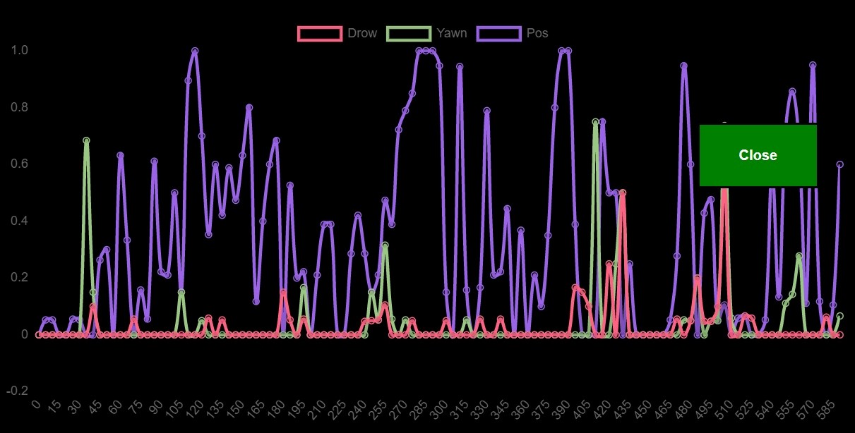
OUTPUT GENERATION-1

Slide 26
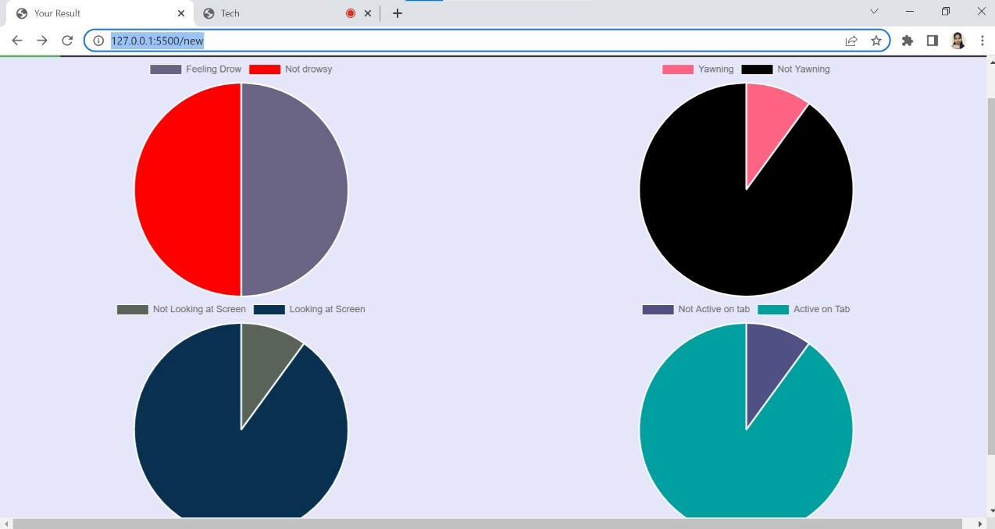
OUTPUT GENERATION-2

Slide 27
CONCLUSION
It is used to evaluate the student's observable actions in the classroom teaching system.
Student features are captured from every frame and data is analysed based on different types of activity related to eye movement, mouth movements, head movements and analysis is done on student active status on that respective class.
Which display’s the live identification of student actions based on specified scenes. The evaluation was created right after the live feed review.

Slide 28
FUTURE ENHANCEMENT
The future scope is that it is to create a self-sufficient agent that can offer information to both teachers and pupils.
The level of student involvement is directly related to important academic outcomes like critical thinking and the marks students get in a topic.

Slide 29
THANK YOU

