Slide 1


Name of Project : Water Resource Management
Student Name : Gundarapu Ravali

Slide 2

Learning Objectives
Understand the importance of water and the hydrological cycle.
Identify and assess surface water & groundwater resources.
Learn sustainable water use and conservation practices.
Recognize challenges like scarcity, pollution, and climate change.
Study policies, governance, and community participation.
Apply data, technology, and models for water management.
Promote ethical use and social awareness in water conservation.
GOAL

Slide 3
Tools and Technology used
Geographic Information System (GIS) – for mapping and analyzing water resources.
Remote Sensing (Satellite & Drones) – to monitor rainfall, water bodies, land use, and drought.
Hydrological Models – to predict water flow, floods, and groundwater levels.
SCADA (Supervisory Control and Data Acquisition) – for real-time monitoring of water supply systems.
IoT Sensors – to measure water quality, flow, and usage.
Artificial Intelligence & Machine Learning – for demand forecasting, pollution detection, and smart water management.
Rainwater Harvesting Systems – to conserve and store rainwater.
Water Treatment Technologies – filtration, desalination, recycling, and purification methods.

Slide 4
Methodology
Data Collection – Gather data from rainfall records, river flow, groundwater levels, and satellite images.
Analysis using Tools – Use GIS, remote sensing, and hydrological models to analyze availability and usage.
Assessment – Identify problems like water scarcity, pollution, and overuse.
Implementation of Solutions – Apply conservation techniques (rainwater harvesting, efficient irrigation, recycling).
Monitoring & Evaluation – Use IoT sensors, SCADA, and AI models for continuous monitoring and improvement.

Slide 5
Problem Statement:
Water is a vital resource for human survival, agriculture, industry, and ecosystems, yet its availability is increasingly under threat due to population growth, urbanization, pollution, and climate change. Inefficient usage, lack of proper monitoring, and unequal distribution of water resources further worsen the crisis. Effective water resource management is required to ensure sustainable utilization, conservation, and equitable distribution of water while addressing challenges such as scarcity, quality deterioration, and increasing demand.

Slide 6
Solution:
To address water resource challenges, sustainable management practices must be adopted. This includes:
Efficient Usage – Promote water-saving technologies like drip irrigation and smart meters.
Conservation – Encourage rainwater harvesting, groundwater recharge, and recycling.
Pollution Control – Implement advanced water treatment and strict regulations on waste discharge.
Technology Integration – Use GIS, remote sensing, IoT sensors, and AI for real-time monitoring and forecasting.
Policy & Awareness – Strengthen government policies, community participation, and public awareness programs.

Slide 7
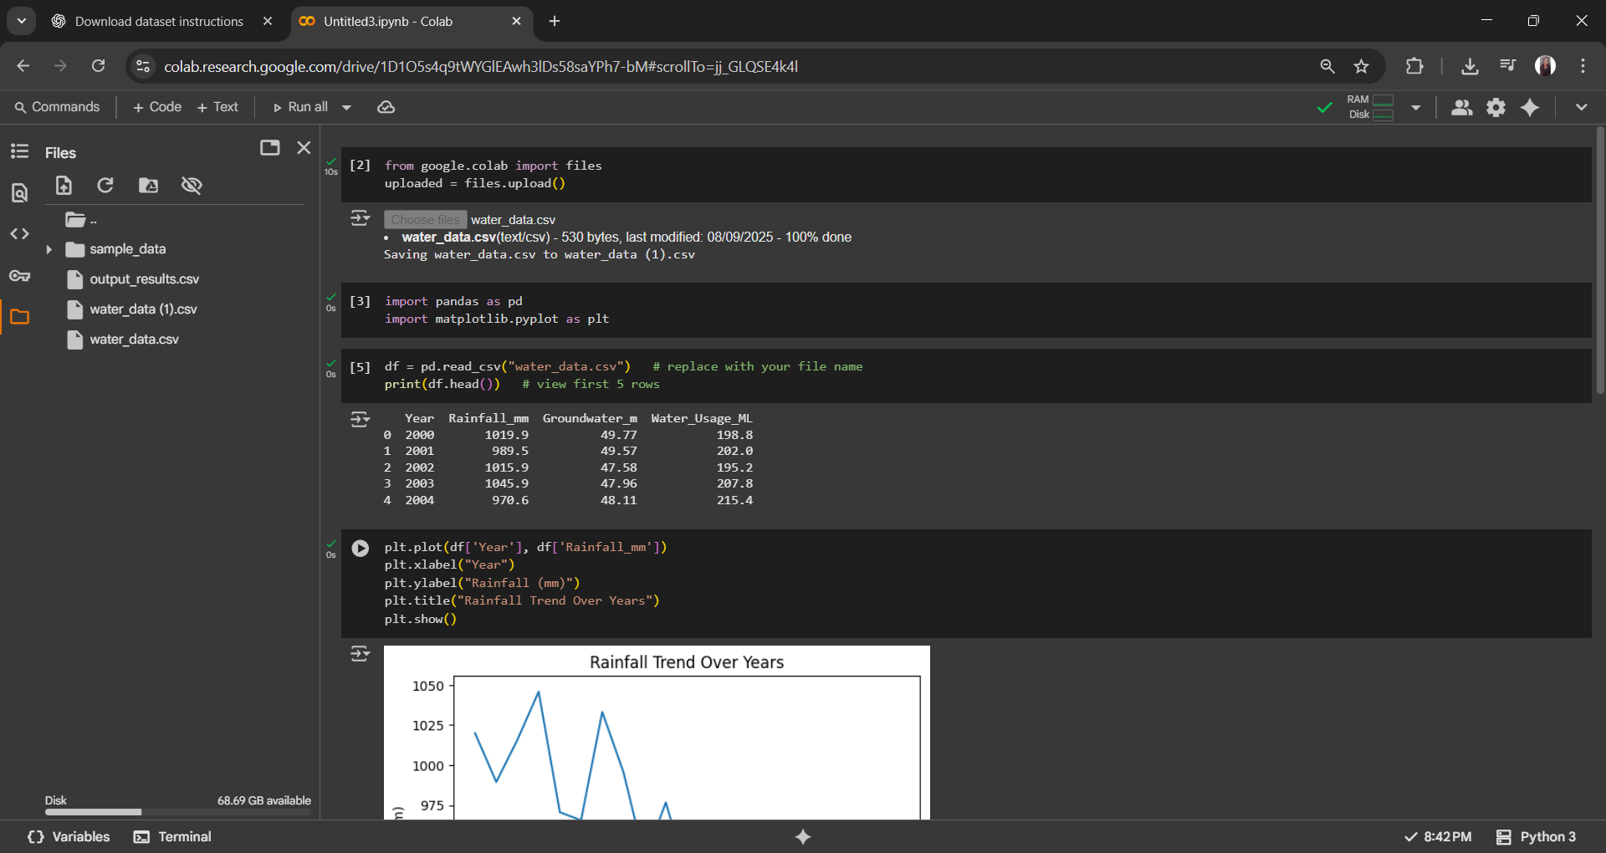
Screenshot of Output:

Slide 8
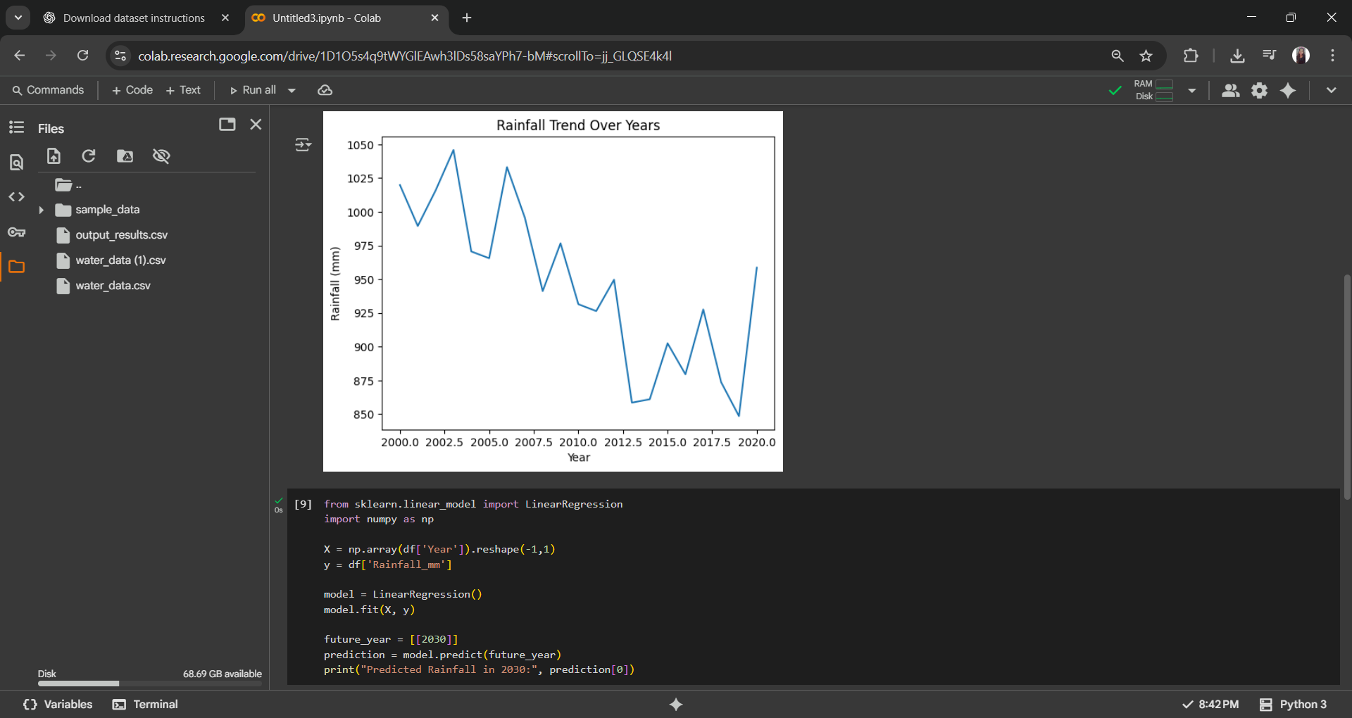

Slide 9
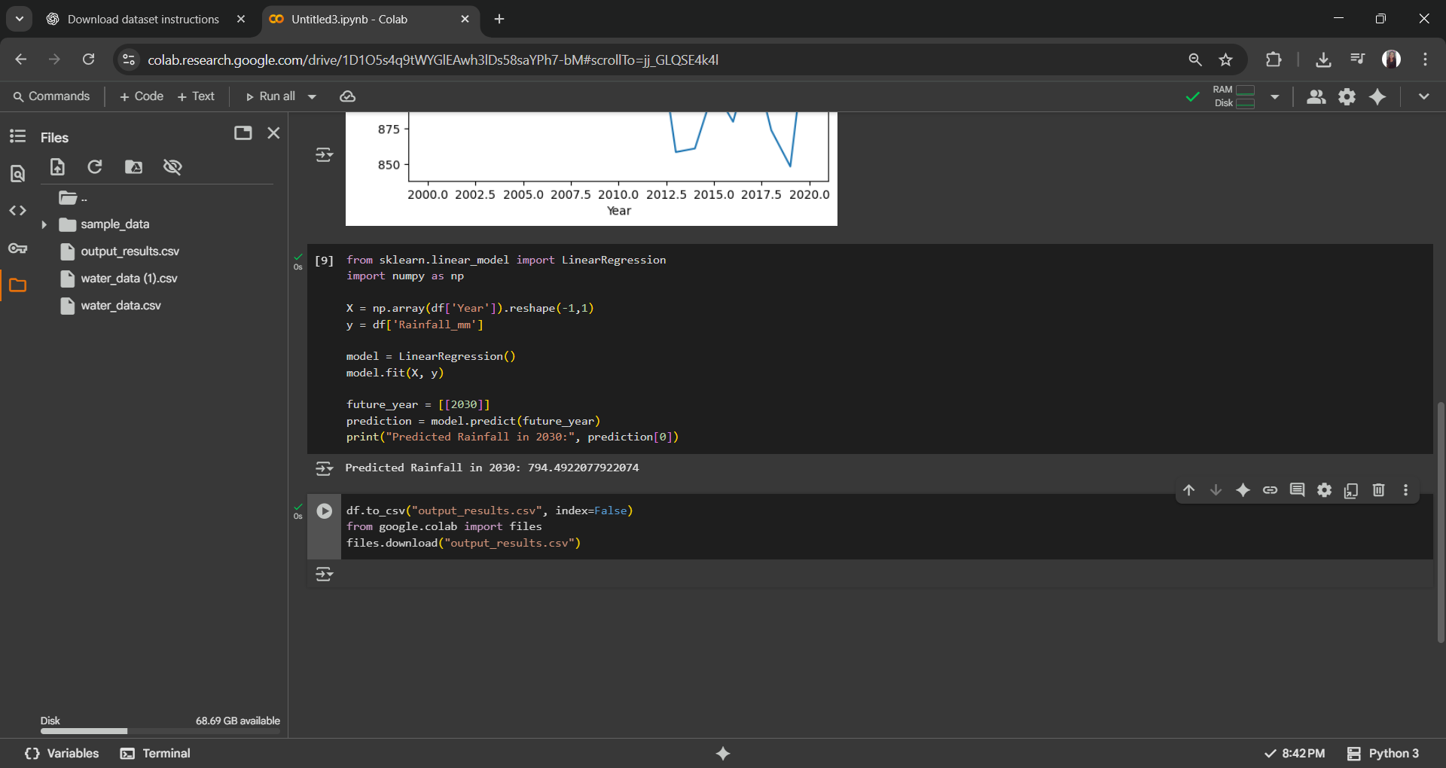

Slide 10


Slide 11
Conclusion:
Water is one of the most essential natural resources, and its sustainable management is critical for human life, agriculture, industry, and the environment. The study shows that increasing demand, pollution, and climate change are major challenges affecting water availability and quality. By applying modern technologies such as GIS, remote sensing, IoT, and AI, along with traditional conservation practices like rainwater harvesting and efficient irrigation, water resources can be utilized more effectively. Strong policies, community participation, and awareness are equally important to ensure equitable distribution and long-term sustainability of water resources.

