Slide 1
Scientific Calculator Using Python Tkinter
Presented By : Ravalika Organization : NextHikes IT Solutions

Slide 2
Project Overview
1.Objectives:
Transitioning from basic CLI scripts to high-performance Graphical User Interfaces (GUI). Focusing on enhanced presentation, user interaction, and reusability.
2.Scope:
Developing a professional-grade scientific calculator with advanced mathematical capabilities, memory functions and interactive history logs.

Slide 3



TECHNOLOGY STACK
Python Core
The backbone of the application, managing backend evaluation logic and mathematical parsing.
Tkinter GUI
The primary toolkit used to build the responsive and interactive scientific interface.
VS Code & Git
Professional development environment with GitHub Integration for version control.

Slide 4



High-Performance Features
Advanced Math
Support for Trigonometry, Logarithms, Power functions and Degree/Radian mode toggles.
Memory Engine
Full memory integration including Store (M+), Subtract (M-), Recall (MR) and Clear (MC).
Live History
A separate history window to track all previous computations with instant detail recall.

Slide 5
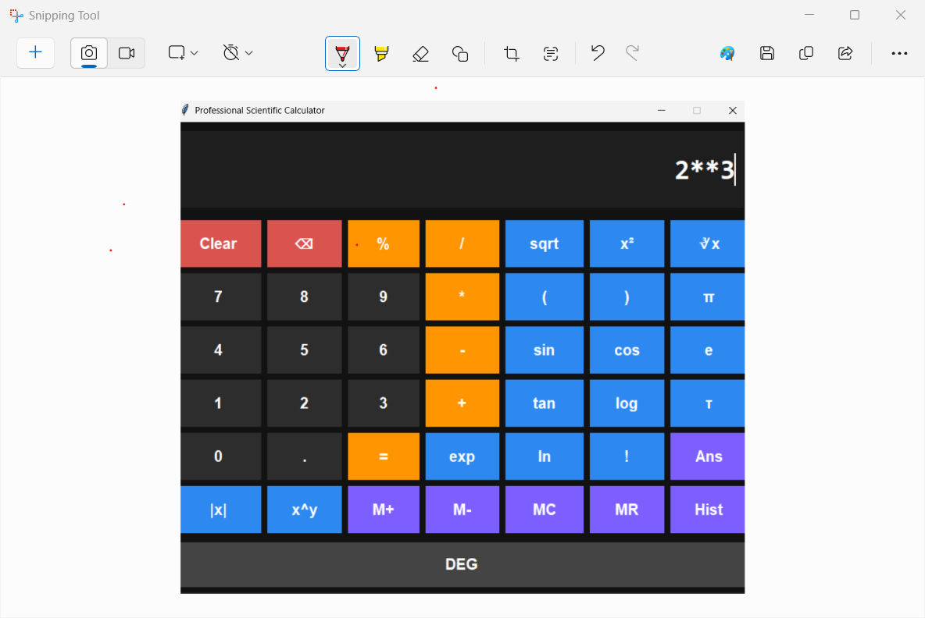
Advanced UI Design
Modern Theme:
High-contrast dark mode with#121212 background.
Grid Layout:
Precise 7-column layout for scientific operations.
UX Features:
Dynamic hover effects, tooltips and real-time history tracking.

Slide 6
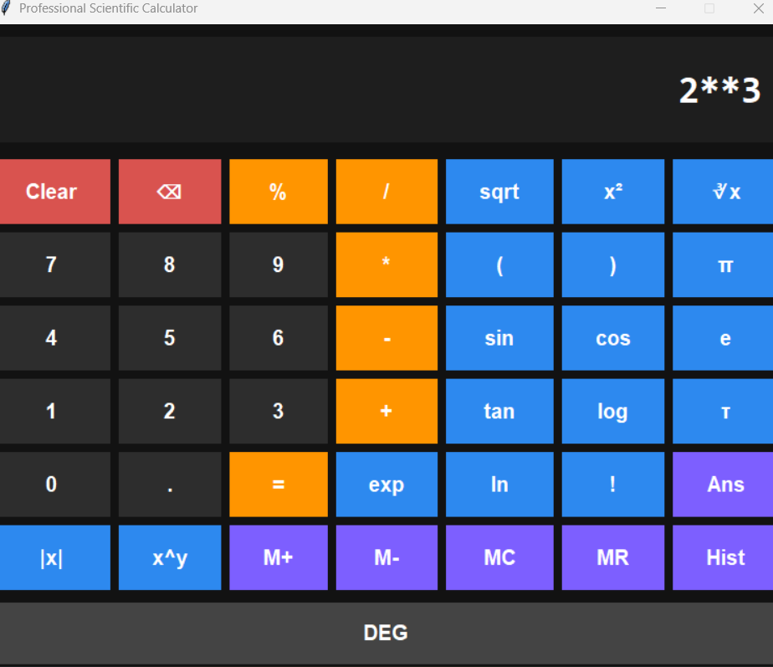
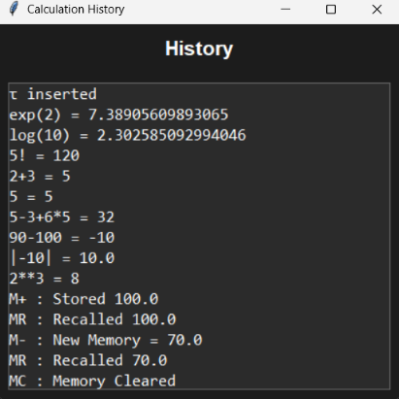

Slide 7
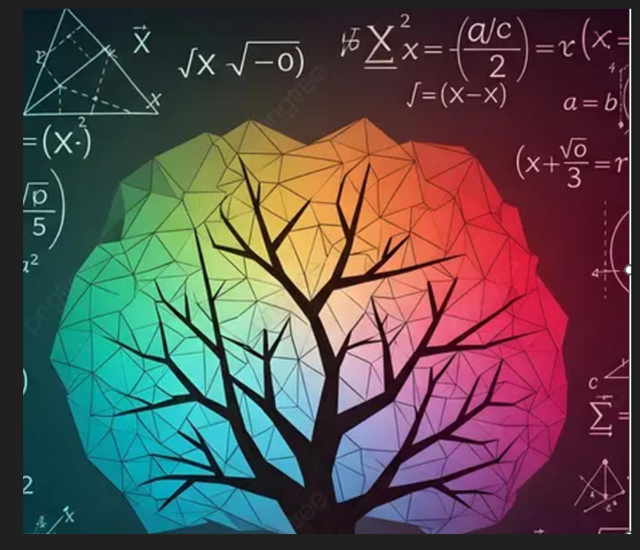
Computational Logic
The backend utilizes python’s math module and string parsing to handle complex nested operations:
Trigonometry(Sin, Cos, Tan) with Degree/Radian modes.
Advanced Calculus: Sqrt, Log10, Ln and Factorials.
Exception Handling: Robust error- catching for illegal operations.
Dual interaction: Virtual buttons and Keyboard bindings.

Slide 8
THANK YOU

