Slide 1
TELECOM USER ANALYTICS
Customer Engagement • Experience • Satisfaction
Presented by: Ravalika
Organization: NextHikes IT Solutions

Slide 2
Project Objective
Analyze telecom xDR data and convert usage/network behavior into customer insights
• Understand the customer base, handset adoption and traffic behavior.
• Measure customer engagement using sessions, duration and data usage.
• Measure experience using TCP retransmission, RTT and throughput.
• Combine engagement and experience into a customer satisfaction score.
• Create actionable recommendations for growth and investment decisions.
ANALYSIS UNIT
RAW RECORDS
MAIN METHODS
90,037 customers
150,001 xDR rows
EDA + K-Means

Slide 3
Dataset & Analytical Workflow
RAW DATA
CUSTOMER LEVEL
DELIVERY
150,001 rows • 55 columns
90,037 unique MSISDNs
SQL Server + notebook
• Load and inspect the xDR dataset.
• Standardize column names and convert numeric fields.
• Treat missing values and perform the existing outlier-treatment phase.
• Create application totals and customer-level aggregates.
• Run EDA, clustering, satisfaction scoring and SQL export.

Slide 4
Data Cleaning & Preparation
MISSING VALUES
CUSTOMER IDS
APPLICATIONS
0 after treatment
90,037 unique
7 usage groups
• Column names were standardized for consistent analysis.
• Numeric fields were converted to numeric data types.
• Missing values were treated before aggregation.
• Outlier treatment was completed in the cleaning phase; it was not repeated during clustering.
• Application totals were created for Social Media, Google, Email, YouTube, Netflix, Gaming and Other.

Slide 5
User Overview — Handset Adoption
#1 HANDSET
Huawei B528S-23A
#2 HANDSET
Apple iPhone 6S
#3 HANDSET
Apple iPhone 6
Note: “undefined” is retained because it appears in the source data.

Slide 6
User Overview — Manufacturers & Applications
Gaming and Other account for the largest traffic volumes in the notebook analysis.

Slide 7
Exploratory Data Analysis
Univariate, Bivariate, Trivariate, correlation, decile and PCA analysis
• Session duration and total traffic were examined at distribution level.
• Application usage showed Gaming and Other as the highest-volume categories.
• Trivariate analysis compared YouTube, Netflix and total traffic.
• DL and UL throughput were strongly related (correlation ≈ 0.749).
• PCA produced seven principal components with similar explained-variance ratios.
DL–UL THROUGHPUT CORRELATION
0.7489
GAMING ↔ TOTAL TRAFFIC
0.9983
PCA
7 components

Slide 8
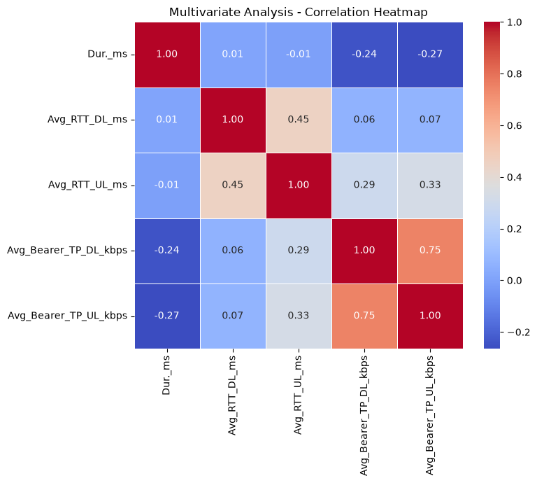
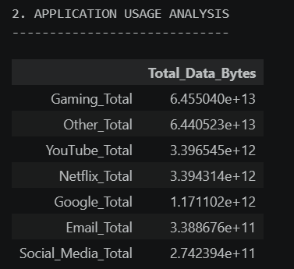

Slide 9
Cluster 0 = largest mainstream segment; Cluster 2 = higher-use segment; Cluster 1 = one extreme high-usage customer.
Engagement— Customer Segmentation
FEATURES
METHOD
Sessions • Duration • DL • UL
StandardScaler + K-Means
Cluster 0 = largest mainstream segment; Cluster 2 = higher-use segment; Cluster 1 = one extreme high-usage customer.

Slide 10
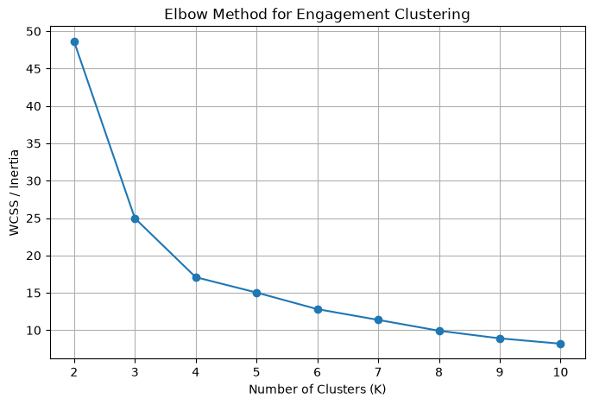
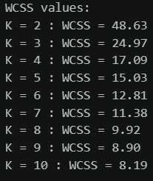
Engagement — Elbow Method
SELECTED K
3 clusters
The largest improvement occurs before K=3, supporting a 3-cluster solution for engagement.

Slide 11
User Experience Analysis
METRICS
METRICS
METRICS
TCP retransmission
Average RTT
Average throughput
Experience clustering produced 3 customer groups: 37,186 / 22,555 / 30,296 users.
Cluster 2 has substantially higher average throughput; Cluster 1 has the highest average RTT among the three.

Slide 12
Experience by Handset Type
• Top average-throughput handset examples include Xiaomi Communica. M1803E1A, HTC 2Q6E100 and Huawei Y5 2017.
• The analysis also identified handset types with high average TCP retransmission.
• These results can help prioritize device/network compatibility checks.
• Handset labels contain source-data naming variations, so interpretation should focus on repeated patterns rather than exact model naming.
HIGH THROUGHPUT EXAMPLE
Xiaomi M1803E1A ≈ 25,471 kbps
HIGH TCP EXAMPLE
Galaxy Core 2 ≈ 2.33×10⁷
BUSINESS USE
Prioritize device/network quality checks

Slide 13
Customer Satisfaction Analysis
SATISFACTION ROWS
MEAN SCORE
MISSING VALUES
90,037
0.9955
0
Satisfaction score = average of the engagement score and experience score.

Slide 14
Satisfaction Regression
MAE
RMSE
R²
COEFFICIENTS
0.0000
0.0000
1.0000
0.5 + 0.5
• Linear regression used Engagement_Score and Experience_Score as inputs.
• The model achieved R² = 1.0 because Satisfaction_Score was mathematically defined as their average.
• Therefore, this model validates the scoring formula rather than proving independent predictive power.

Slide 15
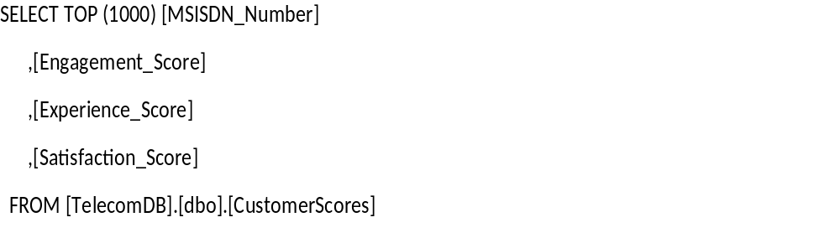
SELECT TOP (1000) [MSISDN_Number]
,[Engagement_Score]
,[Experience_Score]
,[Satisfaction_Score]
FROM [TelecomDB].[dbo].[CustomerScores]
SQL Server Data Delivery
DATABASE
TABLE 1
TABLE 2
TelecomAnalysis
TelecomData • 1,000 rows
CustomerScores • 90,037 rows
• Python connects to local SQL Server instance .\SQLEXPRESS using SQLAlchemy + pyodbc.
• TelecomData contains the uploaded 1,000-row sample for database delivery.
• CustomerScores contains MSISDN, Engagement_Score, Experience_Score and Satisfaction_Score.
• SSMS can be used to run SELECT queries and capture the final verification screenshot.

Slide 16
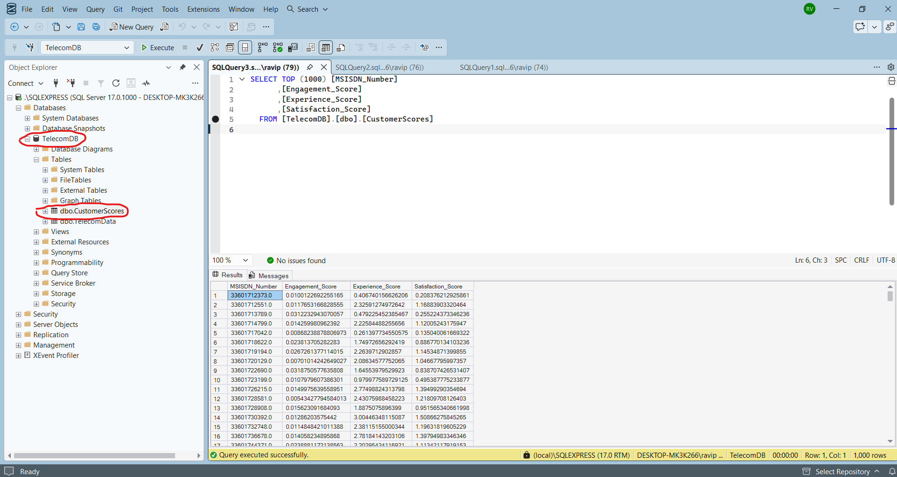

Slide 17
Key Findings & Recommendation
• 90,037 unique customers were analyzed from 150,001 xDR records.
• Gaming and Other were the largest application traffic categories.
• Engagement analysis supports 3 customer clusters; one customer forms an extreme high-usage cluster.
• Experience analysis identifies clear differences in RTT, retransmission and throughput.
• Growth should focus on high-value usage segments while improving network experience for weaker clusters.
• Purchase recommendation: proceed only with due diligence, especially financial, churn and revenue data that are outside this xDR analysis.

Slide 18
THANK YOU

