Slide 1
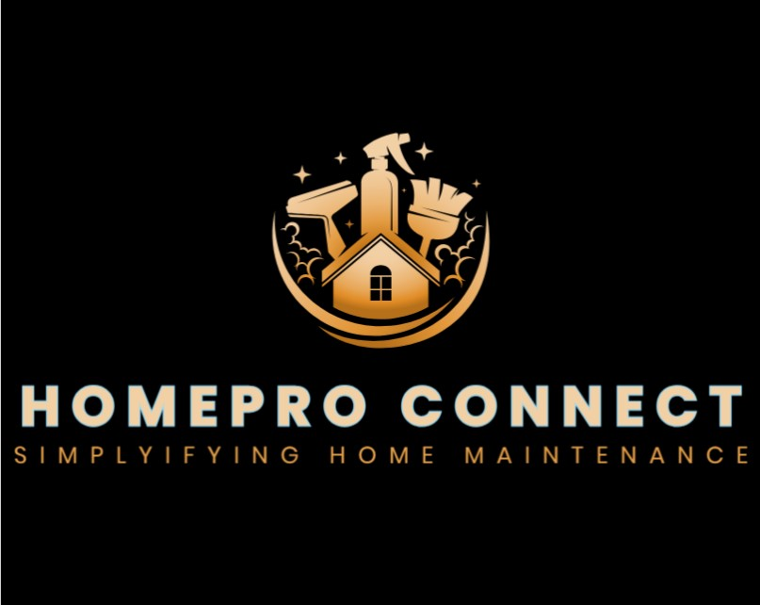
HomePro Connect
Team: 08
Client: General Public
Team Members:
Adithi, Gundeti
Ravali, Kolloju
Nidhi, Kumari
Hari Chandana ,Daggubati
Logo created on Canva

Slide 2
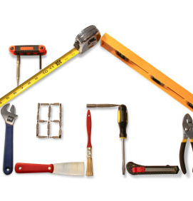
Introduction
HomePro Connect is a software application that assists individuals seeking indoor and/or outdoor housing services in connecting with and booking services from skilled and verified local contractors in just minutes.
Our mission: to streamline home maintenance tasks and enhance the overall customer experience.
Key objectives:
Prioritize user satisfaction, convenience, and trust.
Efficiently connect clients with skilled, verified contractors [3].
Enhance safety and trust through rigorous contractor verification processes [3].
Utilize location-based services for easy contractor discovery.
Offer efficient customer support to alleviate common hassles associated with home maintenance tasks.
This Photo by Unknown author is licensed under CC BY-SA-NC.
Image taken from google

Slide 3
Existing and Developed Models
Existing applications like HomePro Connect include TaskRabbit, Thumbtack, and Angie's List.
These platforms offer various home services and connect users with local contractors. Here are some common drawbacks associated with these existing applications:
Lack of Contractor Verification: Some existing platforms not have robust processes in place for verifying contractors, leading to concerns regarding the quality and reliability of services provided [2].
Limited Transparency: Users may encounter challenges in accessing transparent information about contractors, such as pricing, reviews, and availability, making it difficult to make informed decisions [2].
Inefficient Booking Processes: The booking processes on certain platforms may be cumbersome and time-consuming, requiring multiple steps and causing delays in service delivery [2].
HomePro Connect aims to address these drawbacks by implementing the following strategies:
Thorough Contractor Verification: HomePro Connect will conduct rigorous background checks, past client reviews, screenings, and interviews to ensure that all contractors are skilled, trustworthy, and reliable.
Enhanced Transparency: The platform will provide comprehensive information about contractors, including pricing, ratings, reviews, and availability, enabling users to make well-informed decisions.
Streamlined Booking Process: HomePro Connect will offer a user-friendly interface with an intuitive booking process, allowing users to connect with contractors and schedule services quickly and efficiently.

Slide 4
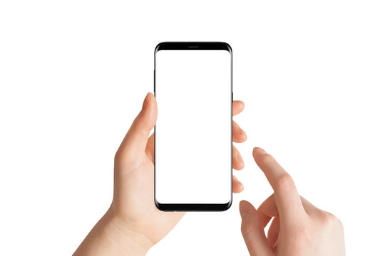
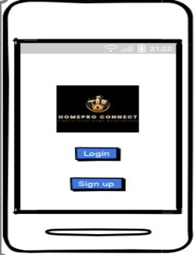
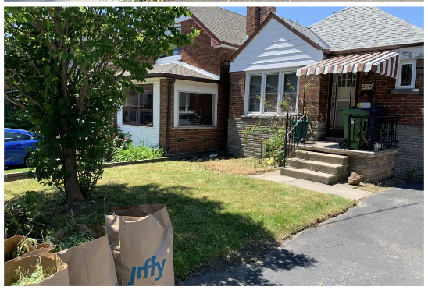


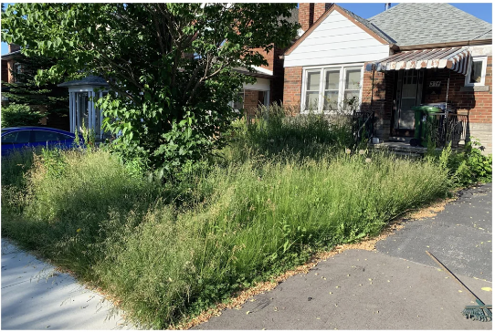
Ecological Perspective Interaction Perspective Emotional Perspective
Whether it's a sudden leak, malfunctioning appliance, or routine maintenance task, HomePro offers a reliable platform for users.
In various scenarios of home maintenance emergencies or scheduled upkeep needs, such as plumbing issues, electrical faults, or appliance repairs, users turn to HomePro to swiftly connect with verified service providers.
The user-friendly interface enhances engagement through simple mobile taps
HomePro Connect alleviates client frustration, ensuring prompt and worry-free service booking.
Clients experience relief and happiness prompt and worry-free service booking.
Images taken from google

Slide 5
Methodology
Research: Conducted market research to understand existing solutions and identify gaps.
User Interviews: Gathered insights from potential users regarding their pain points and preferences.
Competitor Analysis: Studied competitors to identify strengths and weaknesses.
Prototype Development: Created initial prototypes to visualize platform functionalities.
User Testing: Conducted usability testing to gather feedback and iterate on design.
Iterative Development: Continuously refined the platform based on user feedback and market trends.
Implementation: Translated finalized designs into a functional platform ready for deployment.

Slide 6
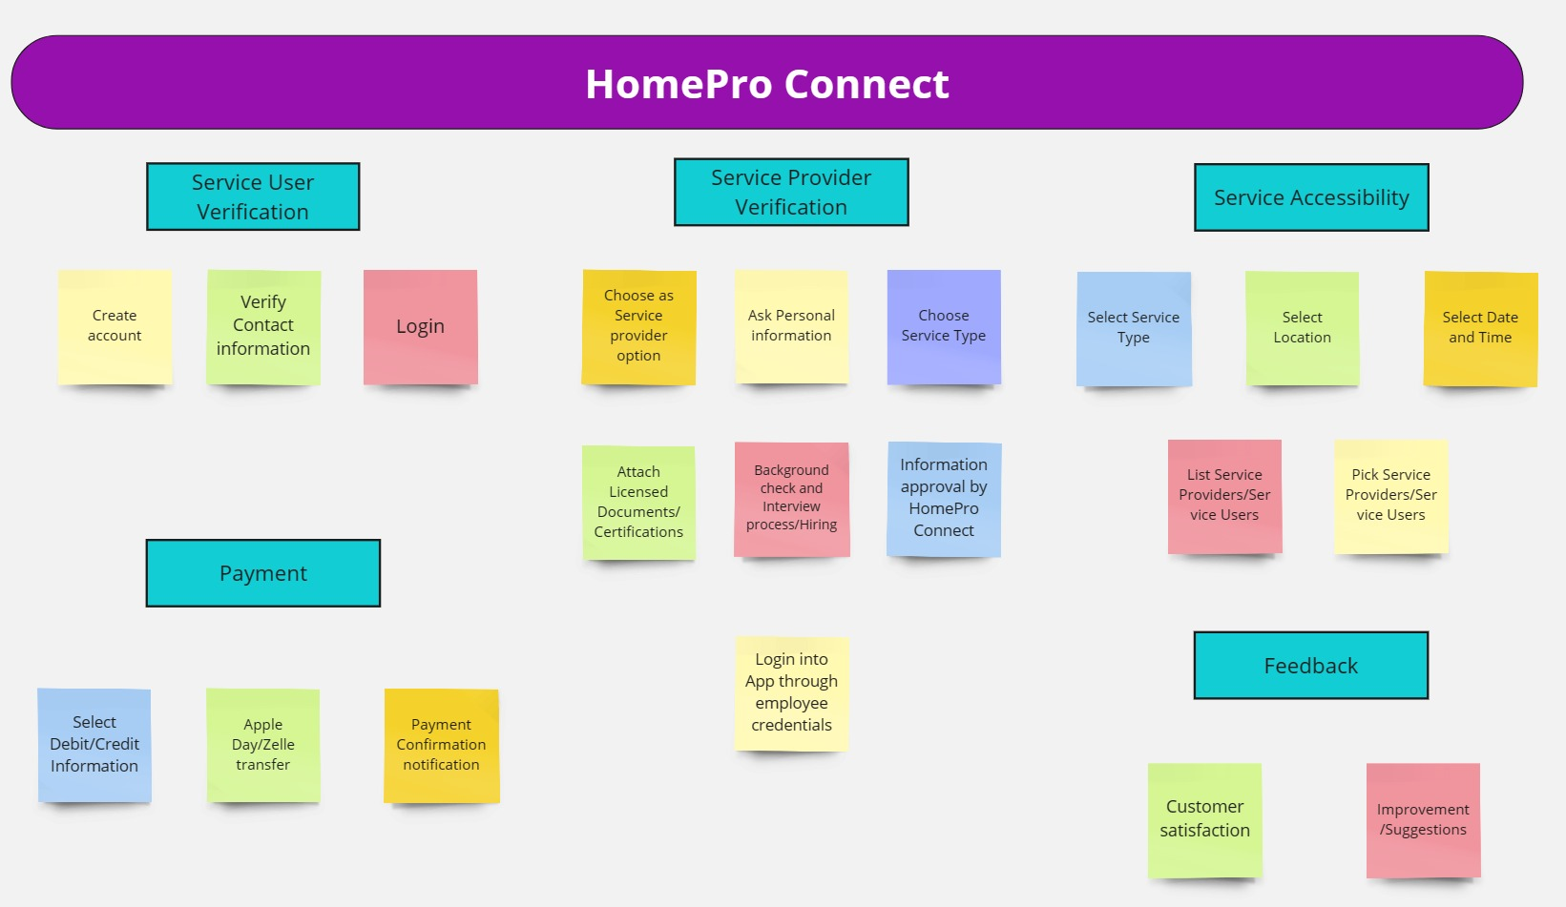
Work Activity Affinity Diagram
Image edited in miro.com [1]

Slide 7

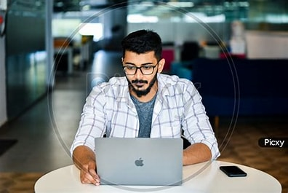

Design Persona
Designing a character for the Home Pro Connect app is like making a virtual friend. Identifying the different types of users is the first step in our systematic approach. Students, working professionals, and retired employees are the three primary user categories we identified for our application. The development of subsequent characters to represent each of these groups resulted from their distinctive goals and demands.
Keerthi - Student Keerthi is a student who is pursuing her master's. Being a master's student, she lives in a rented house where she needs workers for appliance repairs, electricians, plumbers, etc. She uses Home Pro Connect to get workers for her location for different household problems who are skilled along with customer satisfaction by budget savings.
Karthik - Working professional Karthik is a working professional who is looking for bathroom cleaners and pest controllers for his apartment which is in a rural area where he finds it difficult to find skilled workers at his locality. He relies on the Home Pro Connect application for skilled contractors for his location.
Retired employee Anna is a retired employee who lives in her home which is constructed many years ago. frequently faces issues inside the home for different reasons. She needs skilled contractors frequently for different purposes. She uses the Home Pro Connect application for skilled contractors for different works in one place which is time saving for her.
Images taken as reference from google images

Slide 8
Implementation
Interaction Requirements
Software Requirements
HomePro Connect Application: Downloadable from App Store (iOS) or Play Store (Android).
Active Internet Connection: Required for browsing services, making bookings, and receiving updates.
GPS Functionality: Enables location-based service provider search.
Notification Permission: Needed for alerts about appointments and updates.
Browsing and Filtering Services: Allows users to filter services based on location and preferences.
Appointment Booking/Scheduling: Enables users to book appointments easily.
Hardware Requirements
Mobile Phone
User Registration and Authentication
Search and Discovery
Contractor Profile Interaction
Appointment Scheduling
Payment Processing
Feedback and Review System
Customer Support and Assistance
Mobile Responsiveness
Notification System
Accessibility Features

Slide 9
Roles:
Major roles :[4]
Service seeker/clients
Service Provider/contractors
Home Pro Connect Admin
Sub roles:
Appointment Schedular
Feedback Provider
Payment Initiator
Machine Roles:
Smart Phones/PCs
Email/Phone
Notification
Payment
Image made on PPT

Slide 10
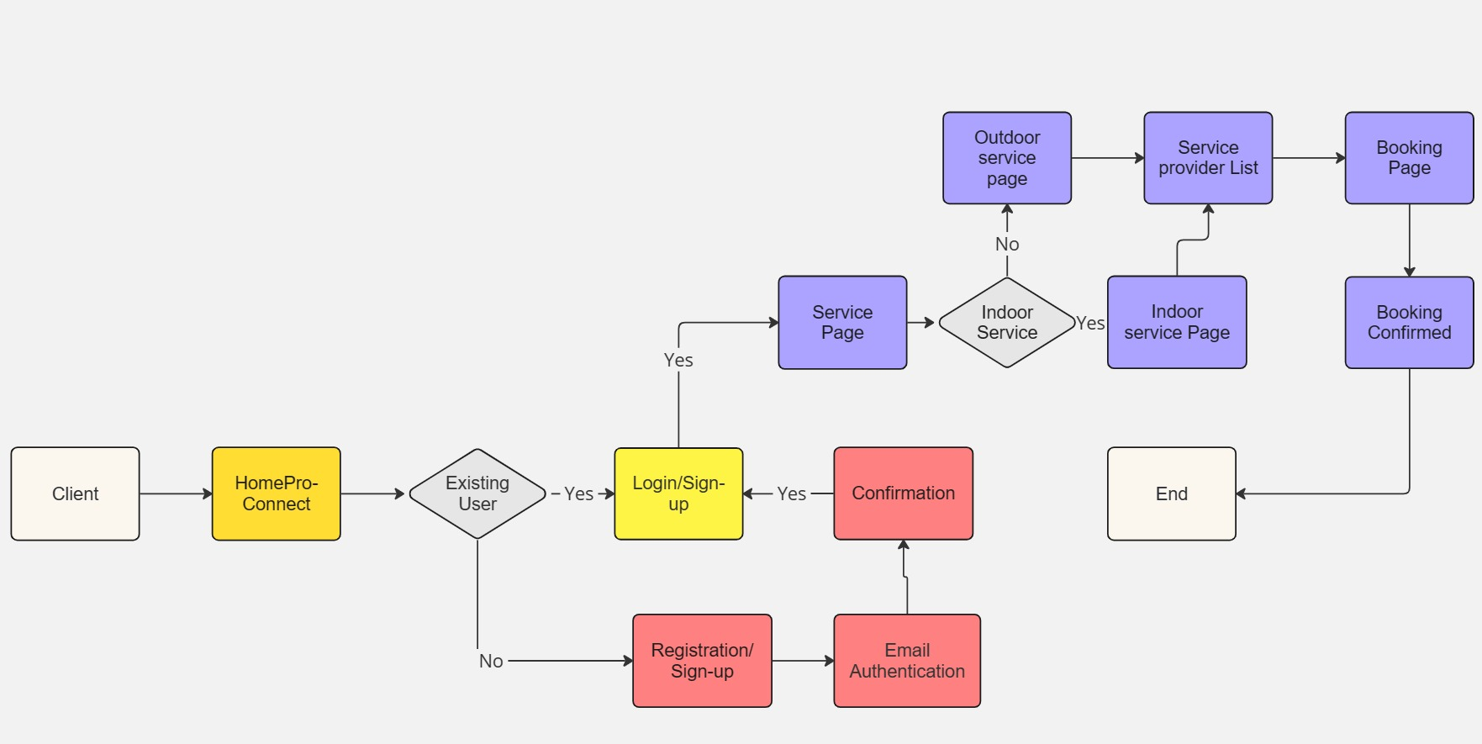
Workflow
Image edited in miro.com [1]

Slide 11
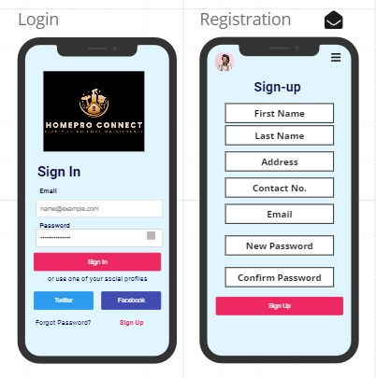
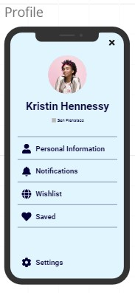
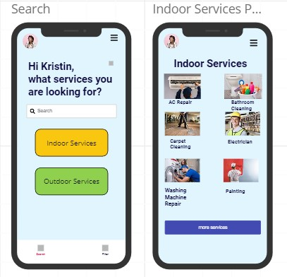
Wireframes
Image edited in miro.com [1]

Slide 12
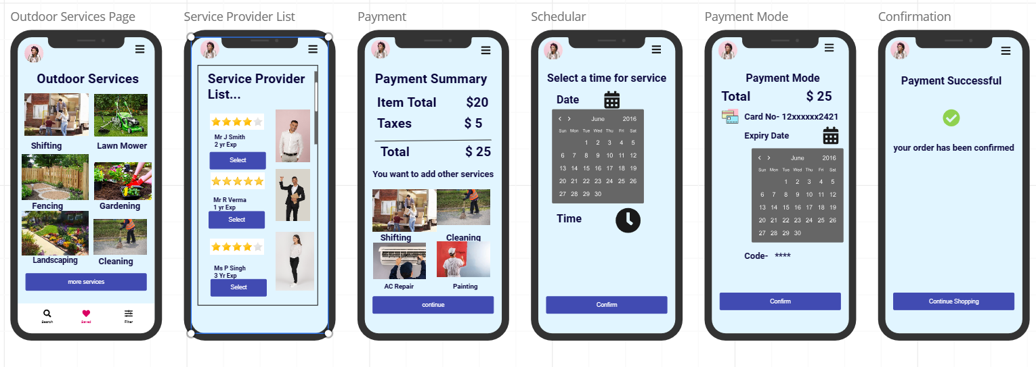
Image edited in miro.com [1]

Slide 13
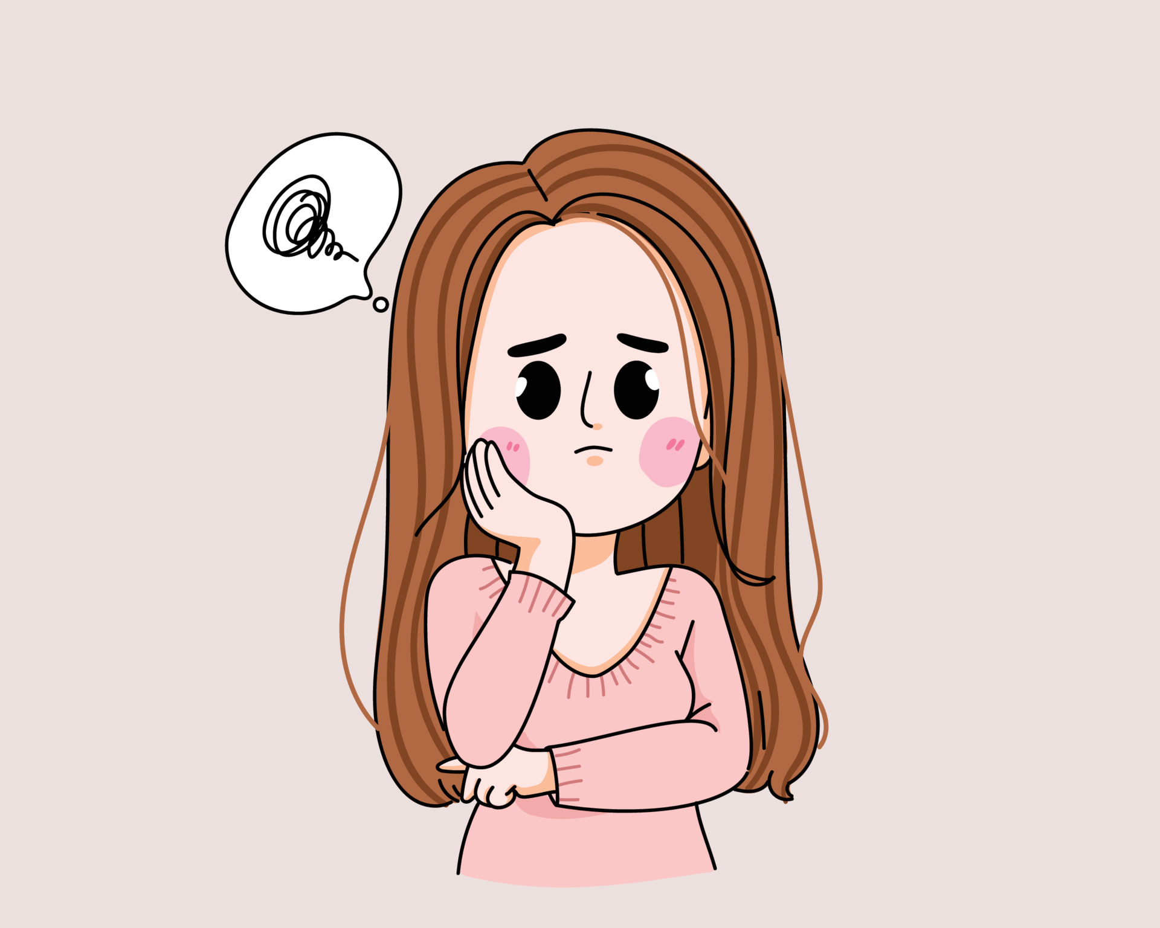
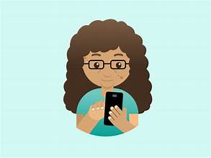

Emotional Impact:
Hmm.! I am using home pro connect app
Images taken from google images
Key features to enhance positive emotional impact:
Our location-based service allows clients to connect with local contractors in just few taps.
Enables clients to filter contractors based on their ratings and reviews and experience.
Can choose their favourite contractor multiple times.
Provide human customer service, which makes it easy for the clients as it provides quick resolutions to their queries.

Slide 14

Lessons Learnt:
We have learnt how to use effectively Balsamiq application for design the UX of the project .We also got to know how the teamwork helps to decrease the time in decreasing the project.
While developing the UX of the Home pro connect app we have learned to prioritize the user interaction and budget friendly , also we have taken the real-life incidents to make the good user interface.
We have conducted many user interviews from this we got to know how the users are struggling while using Home pro connect app. So we made adjustments to the applications and user mode.
We learnt what is paper prototyping and how it is helpful to develop an application like Home pro connect.
Image taken from google images

Slide 15
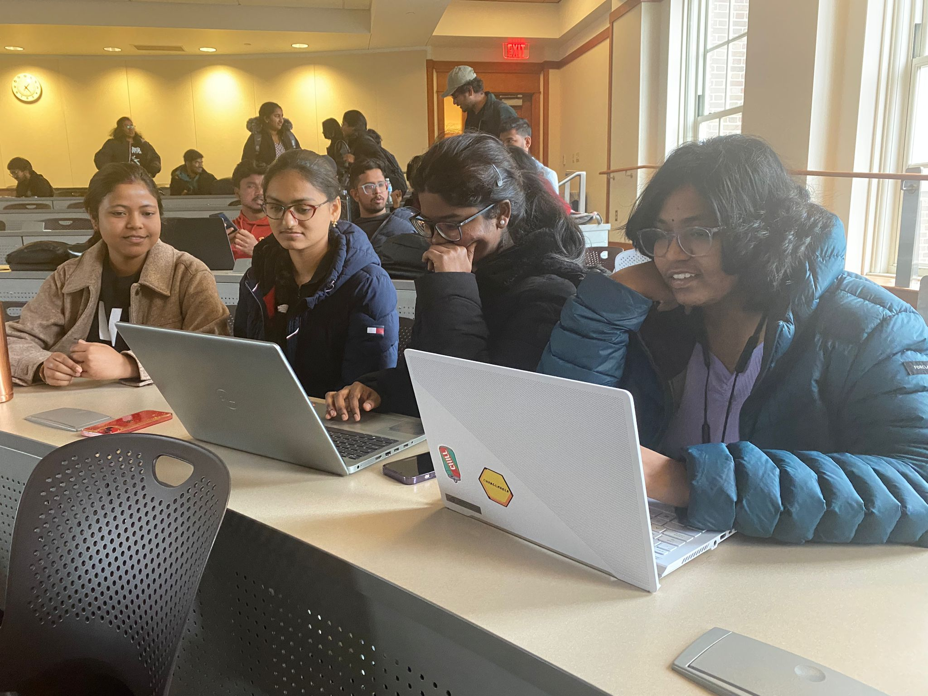
Overall Experience
We have gained good knowledge of designing project and what are the steps that are involved while developing the projects. We followed design cycle which consists User needs, Design solutions, Prototyping and Evaluate UX.
We have very little experience at the start of the project but after some learning and some research we have gained knowledge.
We also had a good experience in talking with the users and questioning them about their experiences so we can make necessary changes to the applications. To summarize our experience the project is about learning while developing the Home pro connect app. It involved discovering user needs, adapting to previous experiences, and connecting with Home pro connect app users for valuable insights.
Image taken on Mar 18,2024 in TDC - 350
References:
[1]. Miro | Visual Workspace for Innovation
[2]. https://www.reddit.com/r/TaskRabbit/comments/157z4wt/1_year_review/
[3].https://www.indeed.com/hire/c/info/background-check-for-employment?gad_source=1&gclid=Cj0KCQjwlN6wBhCcARIsAKZvD5gKk3Mg1N0IfM6KkpE7QkvawlWfeg9IOl2lBbZ42hFv3XUs_8ypjpwaAqXwEALw_wcB&aceid=&gclsrc=aw.ds
[4]. Interaction Design Foundation - IxDF. 2016. What is Human-Computer Interaction (HCI)? Retrieved April 12, 2024 from https://www.interaction-design.org/literature/topics/human-computer-interaction

