Slide 1
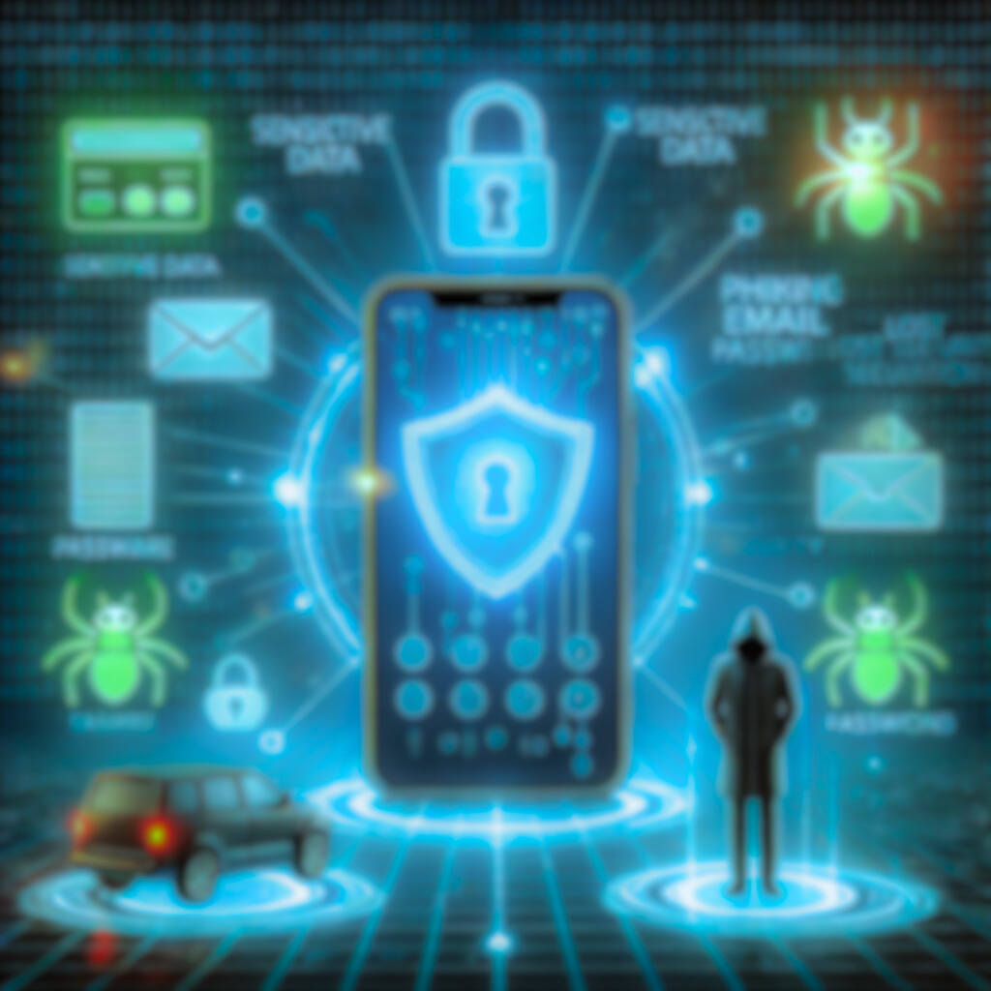
Mobile Security: Threats and Best Practices article written by Paweł Weichbroth and Łukasz Łysik

Slide 2
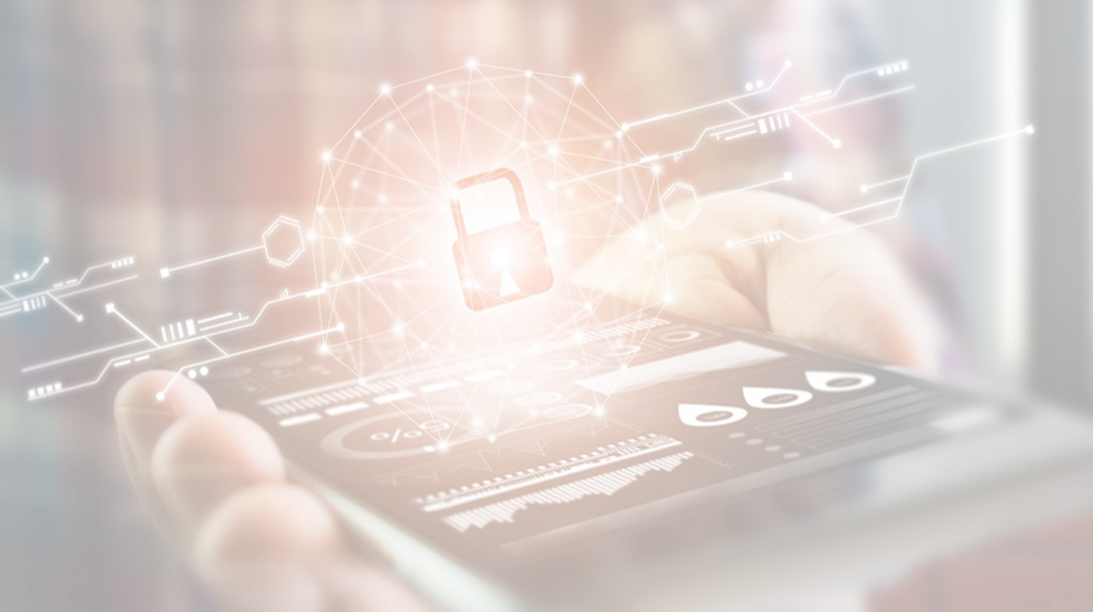

Mobile Revolution and Security Concerns
Mobile devices are integral to daily life for communication, financial transactions, and data storage.
This widespread adoption increases the risk of cyberattacks.
Cybercriminals target vulnerabilities to steal data and disrupt services.
Understanding and addressing mobile security concerns is essential for individuals and organizations.

Slide 3

Exponential Growth of Mobile Device Usage
Mobile phone subscriptions are rapidly increasing—expected to reach 9 billion by 2025.
More users conduct online transactions, open emails, and search the web on mobile devices.
Increased mobile data consumption creates new security challenges.
Key Insight: As mobile usage grows, so does the importance of securing mobile activities.

Slide 4

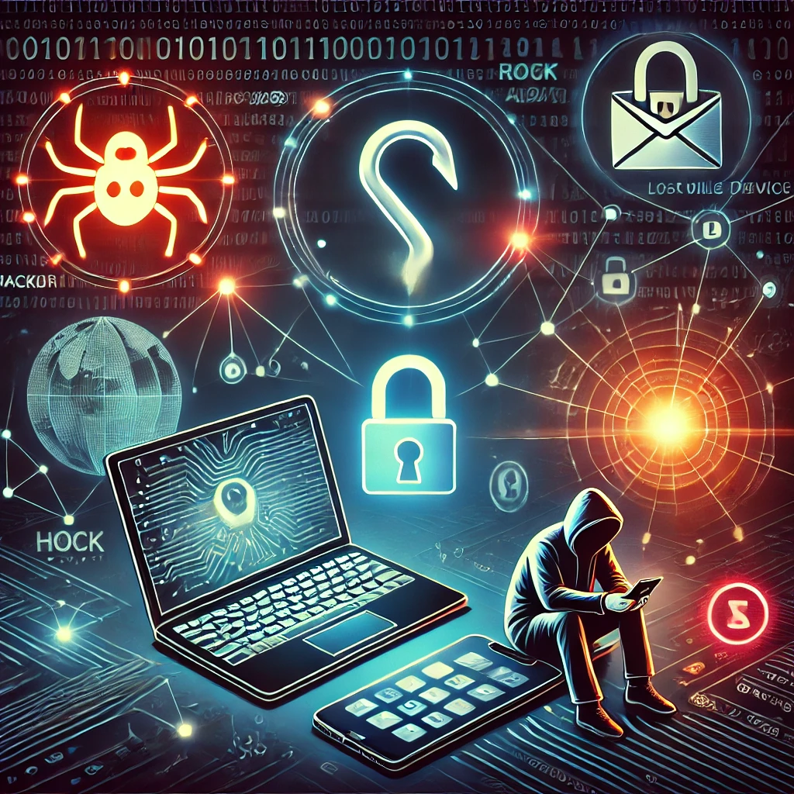
Mobile Security Threats
Malware: Spyware, crypto miners, fake apps, trojanized apps.
Phishing & Social Engineering: Exploiting human psychology via emails, SMS (smishing), and social media.
Direct Hacker Attacks: Man-in-the-middle (MITM) attacks, OS vulnerabilities.
Lost or Stolen Devices: Increased risk of data breaches and identity theft.
Visual Aid Suggestion: Icons or images representing each threat type.

Slide 5
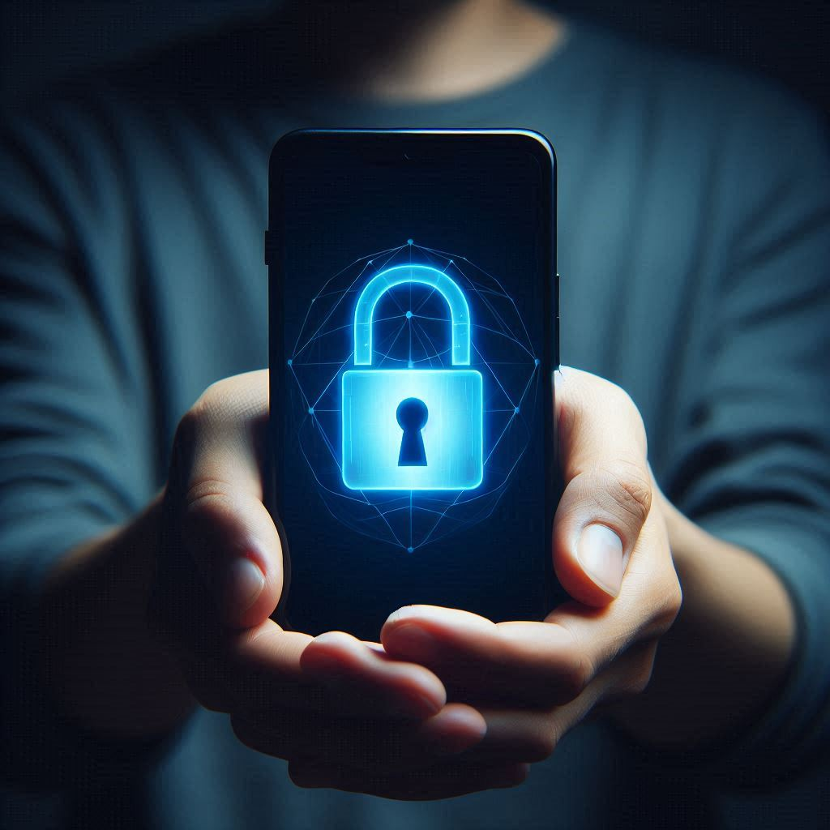
User Behavior and Mobile Security
Users prioritize convenience over security, leading to risky actions like:
Downloading apps from untrusted sources.
Using weak passwords.
Connecting to insecure Wi-Fi networks.
Security awareness and training are critical for promoting safe practices.

Slide 6
Mobile Security Best Practices: Device and Data Protection
Use strong authentication (passwords, biometrics, MFA).
Regularly update OS and apps with patches.
Back up important data securely.
Enable encryption for data on devices and in transit.
Enable remote data wipe for lost or stolen devices.
Visual Aid Suggestion: A checklist graphic with icons for each best practice.

Slide 7
Mobile Security Best Practices: Network and App Security
Disable Bluetooth and Wi-Fi when not in use.
Use VPNs on public networks.
Avoid jailbreaking/rooting devices.
Regularly review and minimize app permissions.
Visual Aid Suggestion: A visual flowchart showing steps for secure network usage.

Slide 8
Additional Security Measures
Install reputable mobile security apps with antivirus and anti-theft features.
Implement regular security awareness training programs in organizations.
Educate users on recognizing threats and reporting suspicious activities.
Visual Aid Suggestion: Icons representing security apps, training, and education.

Slide 9
Future of Mobile Security
5G Networks: Faster speeds bring new security challenges.
AI in Security: Enhanced threat detection and endpoint protection.
Biometrics: Increased use of facial and fingerprint recognition.
Key Message: Continued research is essential to combat evolving threats.
Visual Aid Suggestion: A futuristic-themed graphic with AI, 5G, and biometrics icons.

