Slide 1



Research Project
A STUDY ON QUALITY OF WORKLIFE BALANCE AND OCCUPATIONAL STRESS AMONG EMPLOYEES
Kodukula Sravani – 121321044033
Ravalkol Pravalika -- 121321044050

Slide 2


Contents
1
Abstract
2
Introduction
3
Objectives
4
Methodology
5
Statistical Analysis Part 1: Frequency Tables, Pie Charts, Bar Charts
6
Statistical Analysis Part 2: Cross Tabulations, Chi-square Tests
7
Inference
8
Project Report
9
Conclusion
10
Questionnaire
11
References

Slide 3
Abstract
This project aims to investigate the intricate relationship between the quality of work life and occupational stress experienced by employees in contemporary workplaces. Quality of work life encompasses various factors, including job satisfaction, work-life balance, organizational culture, and employee well-being. Understanding these elements is crucial for fostering a positive work environment and enhancing overall employee satisfaction. The first part of the study involves an in-depth exploration of the current literature on quality of work life and occupational stress, laying the groundwork for a comprehensive analysis.
The second phase of the project involves empirical research, employing surveys and interviews to collect data directly from employees across diverse industries. By examining the day-to-day experiences of workers, we aim to identify specific factors influencing their quality of work life and the sources of occupational stress. This data-driven approach allows for a nuanced understanding of the challenges employees face, providing valuable insights for organizations seeking to improve working conditions and create a supportive atmosphere. The project will utilize both qualitative and quantitative methods to ensure a well-rounded perspective on the subject.
In the final phase, the project will offer practical recommendations based on the findings, designed to enhance the quality of work life and mitigate occupational stress among employees. These recommendations will be tailored to address specific issues identified during the research, providing actionable insights for organizations to implement positive changes. Ultimately, this project contributes to the ongoing discourse on workplace well-being, offering a valuable resource for employers, human resource professionals, and policymakers striving to create environments that promote both professional success and employee satisfaction.

Slide 4

Introduction
Quality of Work Life (QWL) refers to the overall well-being of employees in their work environment, encompassing various factors that influence their job satisfaction and performance. This concept emphasizes the importance of creating a positive and supportive workplace culture.
Key components of the Quality of Work-Life concept include:
Job Satisfaction
Work-Life Balance
Physical and Mental Health
Workplace Culture
Career Development Opportunities
Compensation and Benefits
By prioritizing the various dimensions of QWL, organizations can create environments where employees feel valued, motivated, and empowered to achieve their full potential, ultimately leading to enhanced productivity, retention, and overall organizational effectiveness.

Slide 5
Introduction
Occupational stress is the physical, mental, or emotional strain experienced by individuals in the workplace. It can have a range of negative effects on health, well-being, and job performance. Organizations need to address and manage occupational stress to promote a healthy and productive work environment.
Occupational stress can be influenced by the following factors:
Workload
Interpersonal Conflicts
Job Insecurity
Inadequate Work-life Balance
Personal Factors
Altogether, occupational stress refers to the physical, mental, and emotional strain that individuals experience due to their work.

Slide 6

Objectives
1. To examine work-life balance and its impact on employee performance and satisfaction.
2. To identify key factors influencing job satisfaction and overall well-being of the employees.
3. To investigate interpersonal relationship and their role in shaping the work environment.
4. To analyze workload, role ambiguity, and organizational culture as potential stress factors.
5. To propose strategies and interventions to improve the quality of work life.
6. To contribute to creating a more positive, fulfilling, and sustainable work environment.

Slide 7
Methodology
Both primary and secondary research has been carried out for this project.
• Sample design: Random samples of 150 respondents were chosen for the research through the questionnaires developed to find out the activities in which present-day people are more interested and are involved.
• Tools and Technique of Analysis: The analysis done for the data obtained by the technique of random sampling is primarily descriptive in nature.
• Source of data:
1. Primary Data: The data, that has been collected for the first time and is original, is primary data. In this project, the primary data is in the form of a structured questionnaire.
2. Secondary Data: The secondary information is mostly taken from websites, books, journals, and magazines.

Slide 8


Methodology
DIAGRAMATIC REPRESENTATAION:
Bar Diagram: A bar graph is a chart that uses bars to show comparisons between categories of data. The bars can be either horizontal or vertical. Bar graphs with vertical bars are sometimes called vertical bar graphs.
Pie chart: A pie chart is a circular chart divided into sectors; each sector shows the relative size of each value

Slide 9
Methodology
DATA TYPE
Data:
The data used in the study is primary data. The primary data for the research project was acquired through questionnaires and the secondary sources of information were magazines, publications, and the Internet. The primary data was further studied using the chi-square test of independence between the attributes in the questionnaires.
Mode of data collection:
Data is collected through the questionnaire method.
Questionnaire:
The questionnaire was formed with care ensuring that it is clear, brief nonambiguous, and with non-offending statements.
Population:
The population considered for study is the population of 18 years and above.
Sample:
A sample of 150 people was taken from various families in Hyderabad.
Data tabulation:
The questionnaire was serially numbered, and data was coded and tabulated using SPSS Statistics 26th version.

Slide 10
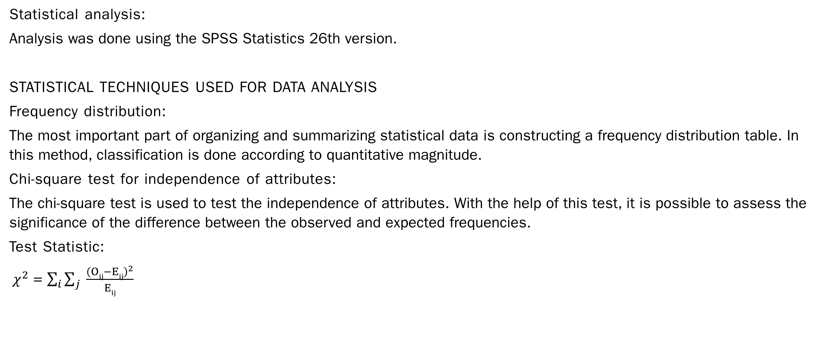
Methodology
Statistical analysis:
Analysis was done using the SPSS Statistics 26th version.
STATISTICAL TECHNIQUES USED FOR DATA ANALYSIS
Frequency distribution:
The most important part of organizing and summarizing statistical data is constructing a frequency distribution table. In this method, classification is done according to quantitative magnitude.
Chi-square test for independence of attributes:
The chi-square test is used to test the independence of attributes. With the help of this test, it is possible to assess the significance of the difference between the observed and expected frequencies.
Test Statistic:
$χ^{2}$ = $\sum_{i}{\sum_{j}{ \frac{{\left(Oij−Eij\right)}^{2}}{Eij}}}$

Slide 11
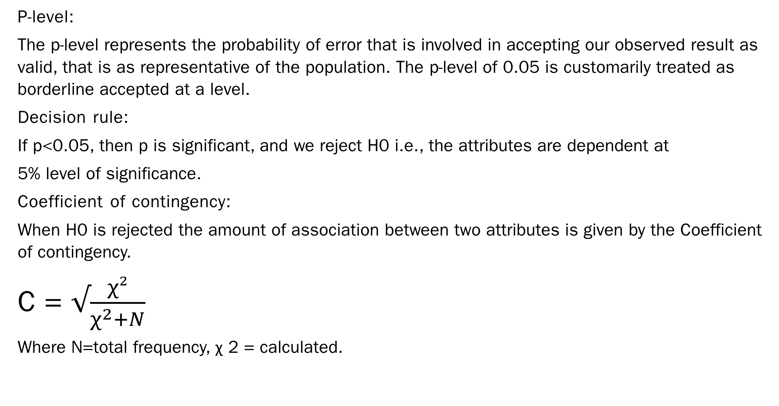
Methodology
P-level:
The p-level represents the probability of error that is involved in accepting our observed result as valid, that is as representative of the population. The p-level of 0.05 is customarily treated as borderline accepted at a level.
Decision rule:
If p<0.05, then p is significant, and we reject H0 i.e., the attributes are dependent at
5% level of significance.
Coefficient of contingency:
When H0 is rejected the amount of association between two attributes is given by the Coefficient of contingency.
C = $√\frac{χ²}{χ^{2}+N}$
Where N=total frequency, χ 2 = calculated.

Slide 12

Statistical Analysis Part 1:
Frequency Tables,
Pie Charts,
Bar Charts

Slide 13
1. OCCUPATIONAL SECTOR
a) Government b) Private c) Business d) Others
CONCLUSION:
According to the survey, among 150 respondents,
86 (57.3%) respondents are private employees.
35 (23.3%) respondents are government employees.
17(11.3%) respondents are business professionals.
12(8%) respondents are from other sectors.

Slide 14
2. ANNUAL INCOME
a) Less than Rs.3,00,000 b) Rs.3,00,000 to Rs.5,00,000
c) Rs.5,00,000 to Rs.10,00,000 d) Greater than Rs.10,00,000
CONCLUSION:
According to the survey, among 150 respondents,
48 (34%) respondents’ annual income is between Rs.5,00,000 to Rs. 10,00,000.
41 (34%) respondents’ annual income is between Rs.3,00,000 to Rs. 5,00,000.
38 (34%) respondents' annual income is less than Rs.3,00,000.
23 (34%) respondents' annual income is greater than Rs.10,00,000.

Slide 15
3. NUMBER OF WORKING HOURS
a) Less than 6 hours b) 6 to 10 hours c) More than 10 hours
CONCLUSION:
According to the survey, among 150 respondents,
104 (69.3%) respondents working hours are between 6 to 10 hours.
20(13.3%) respondents working hours are less than 6 hours.
26(17.3%) respondents working hours are more than 10 hours.

Slide 16
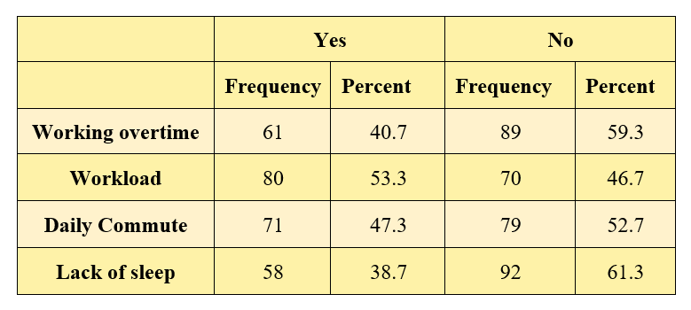
4. WHAT ARE THE COMMON CAUSES OF WORK STRESS IN YOUR LIFE?
(Choose more than one option)
a) Working overtime b) Workload c) Daily commute d) Lack of sleep
CONCLUSION:
According to the survey, 53.3% of the population identified workload as the primary cause of work stress. The daily commute was chosen by 47.3% of respondents while 40.7% cited working overtime as a cause of stress. Additionally, 38.7% identified lack of sleep as a common cause of work stress.

Slide 17
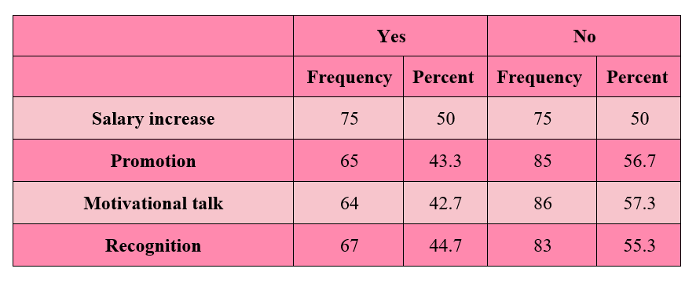
5. WHICH FACTOR MOTIVATES YOU THE MOST IN YOUR ORGANIZATION?
(Choose more than one option)
a) Salary increase b) Promotion c) Motivational talk d) Recognition
CONCLUSION:
According to the survey, 50% of the population selected salary increase as the most motivating factor in their organization, 44.7% chose recognition, 43.3% opted for promotion, and 42.7% chose motivational.

Slide 18
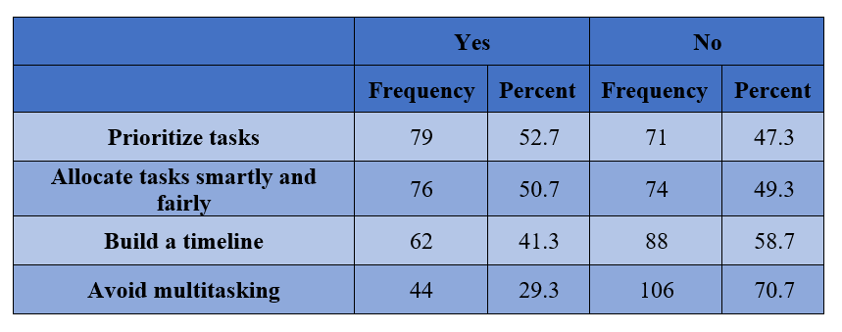
6. HOW CAN EMPLOYEES MANAGE THEIR WORKLOAD EFFECTIVELY?
(Choose more than one option)
a) Prioritize tasks b) Allocate tasks smartly and fairly
c) Build a timeline d) Avoid multitasking
CONCLUSION:
According to the survey, 52.7% of the population chose prioritizing tasks as the reason to manage their workload effectively, 50.7% selected allocating tasks smartly and fairly, 41.3% opted for building a timeline, and 29.3% chose avoiding multitasking.

Slide 19
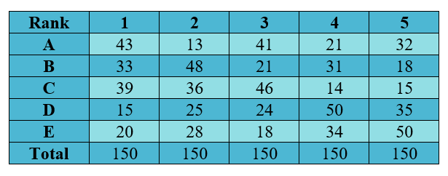
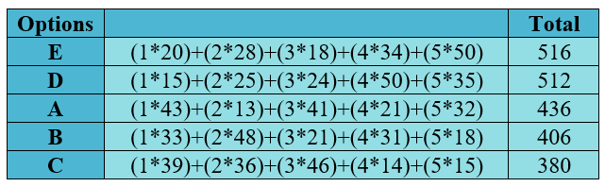
7. HOW WOULD YOU RANK THE FOLLOWING ON A SCALE OF 1-5?
(1- poor 2 - fair 3 - good 4 -Very Good 5 - excellent )
CONCLUSION:
The total highest score indicates the first preference ranking. The results indicate the following rank ordering:
I work a manageable number of hours (E)
The training opportunities have helped in improving the quality of work (D)
Your work environment is positive and supportive (A)
Job suit my educational qualification (B)
You have access to stress management programs at your current workplace (C)

Slide 20
8. HOW SATISFIED WOULD YOU SAY YOU ARE WITH YOUR JOB?
a) Very satisfied b) Somewhat satisfied
c) Not too satisfied d) Not at all satisfied
CONCLUSION:
According to the survey, among 150 respondents,
82(54.7%) of the respondents are somewhat satisfied with their job.
37(24.7%) of the respondents are very satisfied with their job.
25(16.7%) of the respondents are not too satisfied with their job.
6(4%) of the respondents are not at all satisfied with their job.

Slide 21
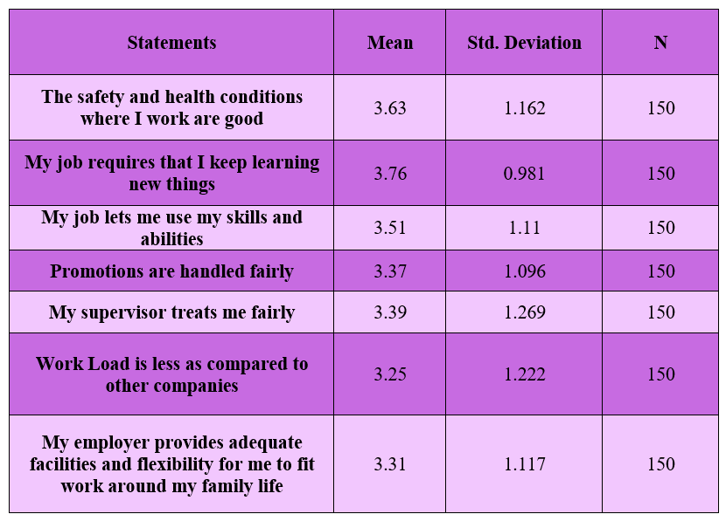
9. PLEASE INDICATE HOW MUCH YOU AGREE OR DISAGREE WITH THE FOLLOWING STATEMENTS.

Slide 22
CONCLUSION:
From the above table, it is observed that
• Most of the respondents agreed that:
My job requires that I keep learning new things. (mean =3.76)
The safety and health conditions where I work are good. (mean =3.63)
My job lets me use my skills and abilities. (mean =3.51)
My supervisor treats me fairly. (mean =3.39)
Promotions are handled fairly. (mean =3.37)
My employer provides adequate facilities and flexibility for me to fit work around my family life. (mean =3.31)
• Most of the respondents disagreed that:
Work Load is less as compared to other companies. (mean =3.25)

Slide 23
Statistical Analysis Part 2:
Cross Tabulations,
Chi-square Tests

Slide 24
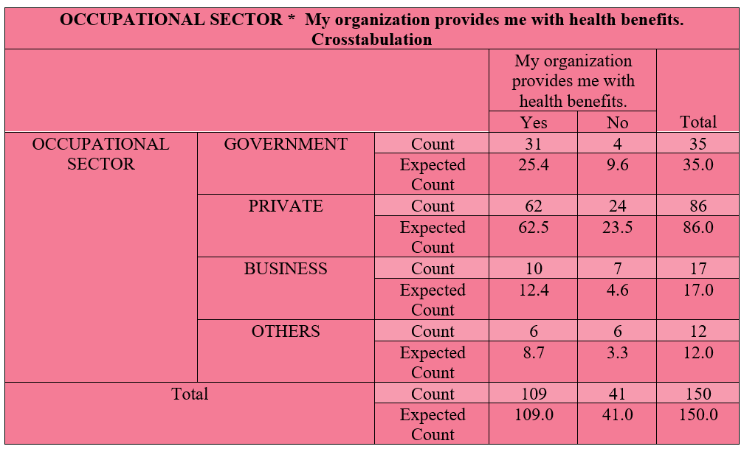
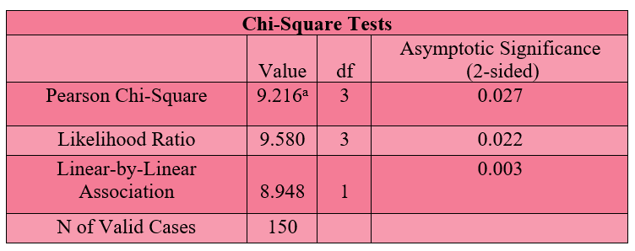
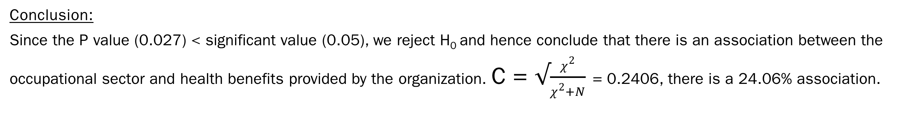
1) OCCUPATIONAL SECTOR * MY ORGANIZATION PROVIDES ME WITH HEALTH BENEFITS.
Null Hypothesis(H₀): There is no association between the occupational sector and health benefits provided by the organization.
Alternative Hypothesis(H₁): There is an association between the occupational sector and health benefits provided by the organization.
Conclusion:
Since the P value (0.027) < significant value (0.05), we reject H₀ and hence conclude that there is an association between the occupational sector and health benefits provided by the organization. C = $√\frac{χ^{2}}{χ^{2}+N}$ = 0.2406, there is a 24.06% association.

Slide 25
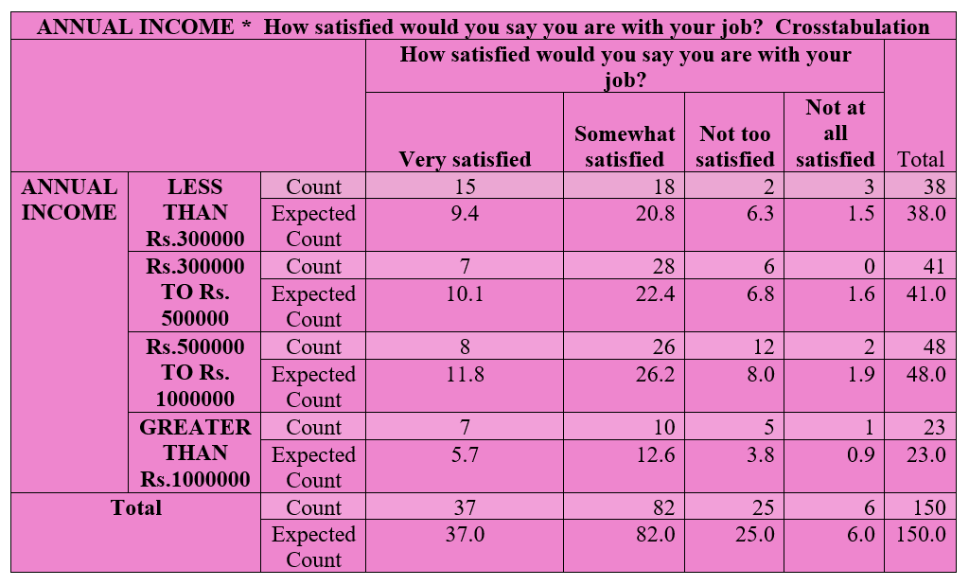
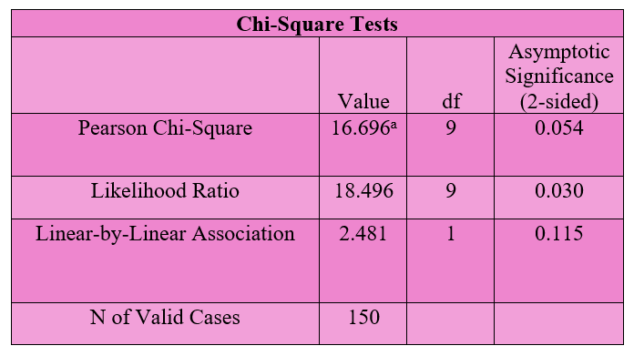
2) ANNUAL INCOME * HOW SATISFIED WOULD YOU SAY YOU ARE WITH YOUR JOB?
Null Hypothesis(H₀): There is no association between annual income and satisfaction with the job.
Alternative Hypothesis(H₁): There is an association between annual income and satisfaction with the job.
Conclusion:
Since the P value (0.054) > significant value (0.05), we accept H₀ and hence conclude that there is no association between annual income and satisfaction with the job.

Slide 26
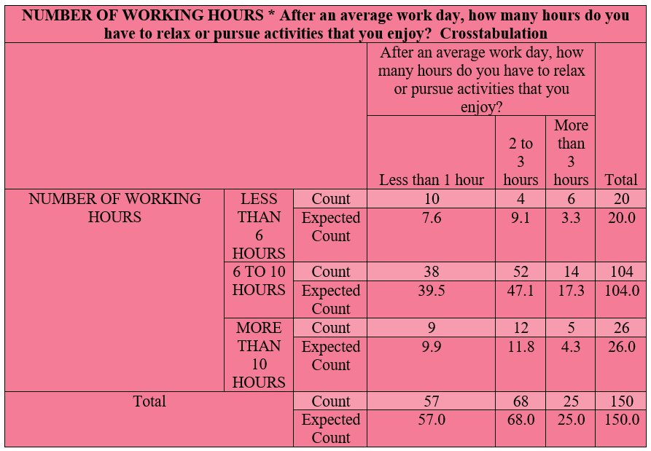
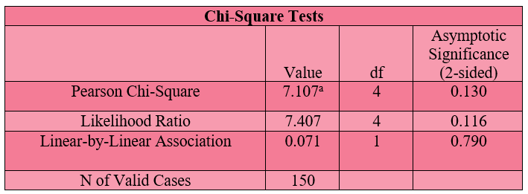
3) NUMBER OF WORKING HOURS * AFTER AN AVERAGE WORK DAY, HOW MANY HOURS DO YOU HAVE TO RELAX OR PURSUE ACTIVITIES THAT YOU ENJOY?
Null Hypothesis(H₀): There is no association between the number of working hours and the time you have to relax or pursue activities that you enjoy.
Alternative Hypothesis(H₁): There is an association between the number of working hours and the time you have to relax or pursue activities that you enjoy.
Conclusion: Since the P value (0.130) > significant value (0.05), we accept H₀ and hence conclude that there is no association between the number of working hours and the time you have to relax or pursue activities that you enjoy.

Slide 27
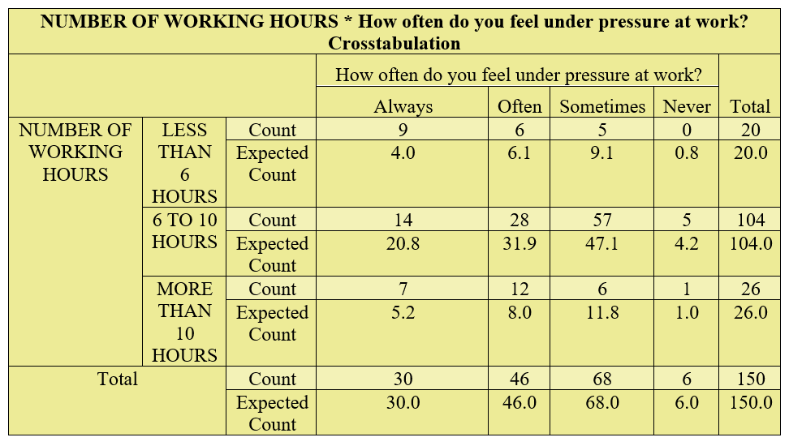
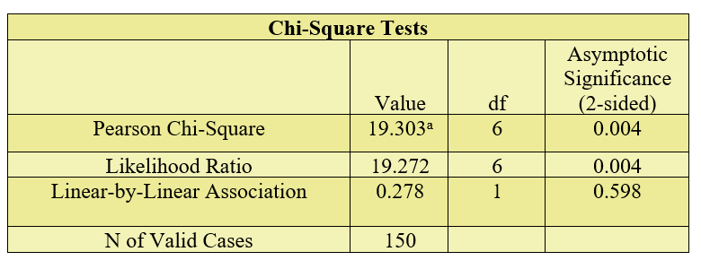
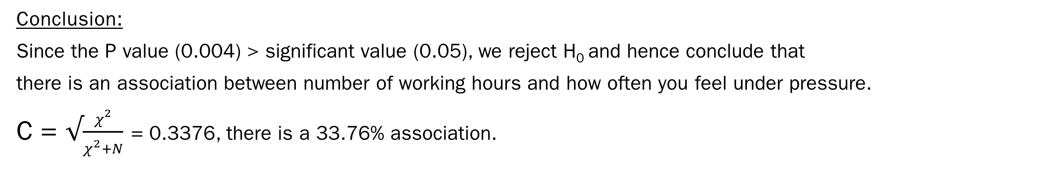
4) NUMBER OF WORKING HOURS * HOW OFTEN DO YOU FEEL UNDER PRESSURE AT WORK?
Null Hypothesis(H₀): There is no association between the number of working hours and how often you feel under pressure.
Alternative Hypothesis(H₁): There is an association between the number of working hours and how often you feel under pressure
Conclusion:
Since the P value (0.004) > significant value (0.05), we reject H₀ and hence conclude that
there is an association between number of working hours and how often you feel under pressure.
C = $√\frac{χ^{2}}{χ^{2}+N}$ = 0.3376, there is a 33.76% association.

Slide 28

Inferences

Slide 29
62(41.334%) respondents are under age group 18-25; 45(30%) respondents are under the age group 25-40; 36(24%) respondents are under the age group 40 & above; 7(4.666%) respondents are under 18.
81(54%) respondents are male; 69(46%) respondents are female.
69 (46.0%) respondents' education level is graduation; 57(38.0%) respondents' education level is post-graduation; 15(10.0%) respondent's education level is intermediate; 9 (6.0%) respondents education level is other than intermediate, graduation, and post-graduation.
86 (57.3%) respondents are private employees; 35 (23.3%) respondents are government employees; 17(11.3%) respondents are business professionals; 12(8%) respondents are from other sectors.
48 (34%) respondents annual income is between Rs.500000 to Rs. 1000000; 41 (34%) respondents annual income is between Rs.300000 to Rs. 500000; 38 (34%) respondents annual income is less than Rs.300000; 23 (34%) respondents annual income is greater than Rs.1000000.
104 (69.3%) respondents working hours are between 6 to 10 hours; 20(13.3%) respondents working hours are less than 6 hours; 26(17.3%) respondents working hours are more than 10 hours.
68(45.33%) respondents are somewhat satisfied with their current working hours; 43(28.66) respondents are very satisfied with their current working hours; 28(18.66) respondents are not too satisfied with their current working hours; 11(7.33%) respondents are not at all satisfied with their current working hours.

Slide 30
75 (50.0%) respondent’s daily commute is between 1 to 2 hours; 38 (25.3%) respondents daily commute is less than 1 hour; 37 (24.7%) respondents' daily commute is more than 2 hours.
68 (45.3%) respondents have been working in the present organization for less than one year; 45 (30%) respondents have been working in the present organization for approximately 1 to 5 years; 37 (24.7%) respondents have been working in the present organization for more than 5 years
86 (57.3%) respondents have day shift as their usual work schedule; 33 (22%) respondents have the night shift as their usual work schedule; 21 (14%) respondents have split shifts as their usual work schedule; 10 (6.7%) respondents have irregular shifts as their usual work schedule.
73 (48.7%) respondents work 2 to 3 hours of overtime; 54 (36%) respondents work 1 hour of overtime; 23 (15.3%) respondents work more than 3 hours of overtime.
64 (42.7%) respondents sleep more than 6 hours on an average work night; 61 (40.7%) respondents sleep 4 to 6 hours on an average work night; 25 (16.7%) respondents sleep less than 4 hours on an average work night.
68(45.3%) respondents have 2 to 3 hours to relax or pursue activities; 57(38%) respondents have less than 1 hour to relax or pursue activities; 25(16.7%) respondents have more than 3 hours to relax or pursue activities.

Slide 31
73(48.7%) respondent's jobs sometimes interfere with their family life; 34(22.7%) respondent's jobs often interfere with their family life; 31(20.7%) respondent's jobs rarely interfere with their family life; 12(8%) respondent's jobs never interfere with their family life.
101(67.3%) respondents have missed their personal events because of work; 49(32.7%) respondents have not missed their personal events because of work.
53.3% of the population identified workload as the primary cause of work stress. The daily commute was chosen by 47.3% of respondents, while 40.7% cited working overtime as a cause of stress. Additionally, 38.7% identified lack of sleep as a common cause of work stress.
47.3% of the population identified loss of emotional hygiene as the consequence of work-life stress, 43.3% chose screen fatigue, 40% cited no interest in social interaction, and 35.3% identified a lack of personal growth.
50% of the population selected salary increase as the most motivating factor in their organization, 44.7% chose recognition, 43.3% opted for promotion, and 42.7% chose motivational talks.
139 (92.7%) respondents think that the quality of work life in the organization helps to improve their productivity; 11 (7.3%) respondents do not think that the quality of work life in the organization helps to improve their productivity.

Slide 32
52.7% of the population chose prioritizing tasks, 50.7% selected allocating tasks smartly and fairly, 41.3% opted for building a timeline, and 29.3% chose avoiding multitasking.
45.3% of the respondents sometimes feel under pressure at work. 30.7% of the respondents often feel under pressure at work; 20% of the respondents always feel under pressure at work; and 4% of the respondents never feel under pressure at work.
41.3% of the respondents sometimes take part with others in making decisions that affect them; 33.3% of the respondents often take part with others in making decisions that affect them; 20.7% of the respondents always take part with others in making decisions that affect them; 4.7% of the respondents never take part with others in making decisions that affect them.
42% of the respondents believe that unrealistic demands are the biggest threat to their work-life balance; 27.3% of the respondents believe that technology troubles are the biggest threat to their work-life balance; 21.3% of the respondents believe that social perceptions are the biggest threat to their work-life balance; 9.3% of the respondents believe that Lack of skills is the biggest threat to their work-life balance.
87 (58%) of the respondents feel that the income from their job alone is enough to meet their family's usual monthly expenses and bills; 62(42%) of the respondents do not feel that the income from their job alone is enough to meet their family's usual monthly expenses and bills.

Slide 33
The most preferred category was ranked in the following orders:
I work a manageable number of hours
The training opportunities have helped in improving the quality of work
Your work environment is positive and supportive
Job suit my educational qualification
You have access to stress management programs at your current workplace
56(37.3%) of the respondents never work at home as part of their job.; 44(29.3%) of the respondents work at home as part of their job more than once a week; 36(24%) of the respondents work at home as part of their job about once a week; 14(9.3%) of the respondents mainly work at home as part of their job.
109 (72.7%) of the respondents declared that their organization provides them with health benefits; 41(27.3%) of the respondents declared that their organization does not provide them with health benefits.
82(54.7%) of the respondents are somewhat satisfied with their job; 37(24.7%) of the respondents are very satisfied with their job; 25(16.7%) of the respondents are not too satisfied with their job; 6(4%) of the respondents are not at all satisfied with their job.

Slide 34
The most preferred category was ranked in the following orders:
Appreciation for your work
Learning and career development
Job security
Attractive fixed salary
123(82%) respondents think that employees in their organization are skilled, motivated, and productive; 27(18%) respondents think that employees in their organization are not skilled, motivated, and productive.
According to the table
Most of the respondents agreed that:
My job requires that I keep learning new things. (mean =3.76)
The safety and health conditions where I work are good. (mean =3.63)
My job lets me use my skills and abilities. (mean =3.51)
My supervisor treats me fairly. (mean =3.39)
Promotions are handled fairly. (mean =3.37)
My employer provides adequate facilities and flexibility for me to fit work around my family life. (mean =3.31)
Most of the respondents disagreed that:
Work Load is less as compared to other companies. (mean =3.25)

Slide 35
Project Report

Slide 36
It can be concluded from the response that 53.7% of the respondents are private employees.
Majority of the respondents work between 6-10 hours and most of them are somewhat satisfied with their working hours.
From the study, it can be observed that the common causes of work stress are majorly working overtime and workload.
It can be evident from the study that only 58% of the respondents are able to meet their family usual monthly’s expenses and bills with their incomes.
Educational level and job satisfaction are positively associated.
57% of the respondents have less than 1 hour to relax or pursue activities after an average work day.
It can be concluded that 47.3% of the respondents have lost emotional hygiene as a consequence of work-life stress.
There is a 24.06% association between the occupational sector and health benefits provided by the organization.
Number of working hours and current working hours satisfaction are positively associated.
From the survey, it can be concluded that the majority of the respondents agree that prioritizing tasks can be the reason to manage their workload effectively for task organization and select allocating tasks smartly and fairly for efficient distribution.

Slide 37
42% of the respondents say that unrealistic demands are the biggest threat to their work-life balance.
According to the survey, 50% of the population selected salary increase as the most motivating factor in their organization due to financial incentives, and 44.7% chose recognition due to acknowledgment of their efforts.
It can be concluded that appreciation for your work, learning, and career development gives job satisfaction to the majority of the respondents.
82% of the responses say that employees in their organization are skilled, motivated, and productive.
From the survey, half of the respondents need 1 to 2 hours for their daily commute.
67.3% of the respondents have missed personal events due to work.
Majority of the respondents say that the quality of the work life of the organization improves the productivity of the employees.
According to the survey, there is an association between number of working hours and period of working overtime.

Slide 38
Conclusion

Slide 39
From the survey, it can be concluded that,
Number of working hours and current working hours satisfaction is 35.64% positively associated.
Half of the respondents need 1 to 2 hours for their daily commute.
Majority of the respondents work between 6-10 hours and most of them are somewhat satisfied with their working hours.
Educational level and job satisfaction are 38.70% positively associated.
Most of the respondents have less than 1 hour to relax or pursue activities after an average work day.
From the study, it can be observed that the common causes of work stress are majorly working overtime and workload.
There is a 24.06% association between the occupational sector and health benefits provided by the organization.
42% of the respondents say that unrealistic demands are the biggest threat to their work-life balance.
Least employees have access to stress management programs at their current workplace.

Slide 40

Questionnaire

Slide 41
1. Age group
Under 18 b) 18-25 c) 25-40 d) 40 & above
2. Gender
a) Male b) Female
3. Education level:
a) Intermediate b) Graduation c) Post Graduation d) Others
4. Occupational sector:
a) Government b) Private c) Business d) Others
5. Annual income:
a) Less than Rs.3,00,000 b) Rs.3,00,000 to Rs.5,00,000
c) Rs.5,00,000 to Rs.10,00,000 d) Greater than Rs.10,00,000
6. Number of working hours
a) Less than 6 hours b) 6 to 10 hours c) More than 10 hours

Slide 42
7. How satisfied are you with your current working hours?
a) Very satisfied b) Somewhat satisfied c) Not too satisfied d) Not at all satisfied
8. How long is your daily commute
a) Less than 1 hour b) 1 to 2 hours c) More than 2 hours
9. How long have you worked in your present organization?
a) Less than 1 year b) 1-5 years c) More than 5 years
10. Which of the following best describes your usual work schedule?
a) Day shift b) Night shift c) Split shift d) Irregular shift
11. How often do you work overtime?
a) 1 hour b) 2 to 3 hours c) More than 3 hours
12. How many hours do you sleep on an average work night?
a) Less than 4 hours b) 4 to 6 hours c) More than 6 hours

Slide 43
13. After an average work day, how many hours do you have to relax or pursue activities that you enjoy?
a) Less than 1-hour b) 2 to 3 hours c) More than 3 hours
14. How often do the demands of your job interfere with your family life?
a) Often b) Sometimes c) Rarely d) Never
15. Have you missed a personal event because of work?
a) Yes b) No
16. What are the common causes of work stress in your life?
a) Working overtime b) Workload c) Daily commute d) Lack of sleep
17. What are the consequences of work-life stress? (Choose more than one option)
a) No interest in social interaction b) Loss of emotional hygiene c) Screen fatigue d) Lack of personal growth
18. Which factor motivates you the most in your organization? (Choose more than one option)
a) Salary increase b) Promotion c) Motivational talk d) Recognition

Slide 44
19. Do you think the quality of work life of the organization helps to improve your productivity?
a) Yes b) No
20. How can employees manage their workload effectively? (Choose more than one option)
a) Prioritize tasks b) Allocate tasks smartly and fairly c) Build a timeline d) Avoid multitasking
21. How often do you feel under pressure at work?
a) Always b) Often c) Sometimes d) Never
22. How often do you take part with others in making decisions that affect you?
Always b) Often c) Sometimes d) Never
23. What do you believe is the biggest threat to your work-life balance?
Technology troubles b) Unrealistic demands c) Social perceptions d) Lack of skills
24. Do you feel that the income from your job alone is enough to meet your family's usual monthly expenses and bills?
Yes b)No

Slide 45
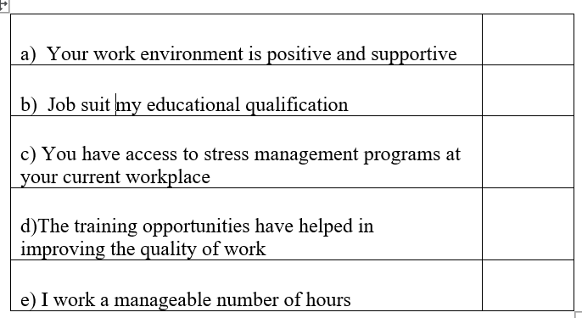
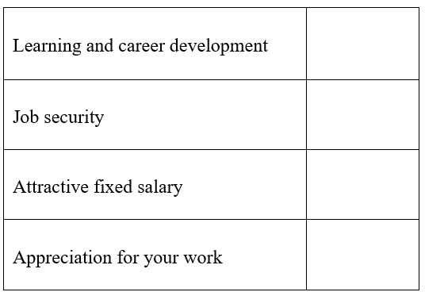
25. How would you rate the following on a scale of 1-5?
(1-excellent 2-very good 3-good 4-fair 5-poor)
26. How often do you work at home as part of your job?
a) Never b) About once a week
c) More than once a week d) Worker works mainly at home
27. My organization provides me with health benefits.
a) Yes b) No
28. How satisfied would you say you are with your job?
a) Very satisfied b) Somewhat satisfied
c) Not too satisfied d) Not at all satisfied
29. What is job satisfaction according to you (rate from 1-4)
(1-excellent 2-very good 3-good 4-poor)

Slide 46
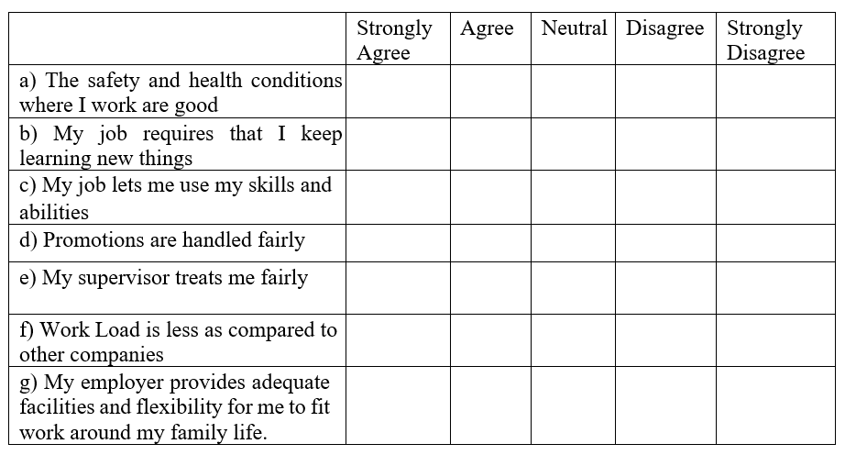
30. What do you think that employees in your organization are skilled, motivated, and productive?
Yes b) No
31. Please indicate how much you agree or disagree with the following statements.

Slide 47

Bibliography

Slide 48
Bibliography
REFERENCES
https://www.who.int/news-room/questions-and-answers/item/ccupational-health-stress-at-the-workplace
https://dictionary.apa.org/occupational-stress
https://www.scirp.org/journal/paperinformation?paperid=110026#:~:text=The%20women%20identified%20recreation%2C%20self,prevent%20the%20negative%20health%20impact.
https://www.mbaknol.com/human-resource-management/quality-of-work-life-qwl/
https://www.dspmuranchi.ac.in/pdf/Blog/u5%20p1.pdf
https://www.ncbi.nlm.nih.gov/pmc/articles/PMC5299810/#:~:text=In%20comparison%20to%20workers%20reporting,adjusted%20models%20%5BTable%203%5D.
https://pubmed.ncbi.nlm.nih.gov/22040944/
https://ijamtes.org/gallery/163-mar2019.pdf
https://blog.vantagecircle.com/quality-of-work-life-qwl/
https://www.forbes.com/health/mind/how-to-deal-with-stress-at-work/

Slide 49


THANKYOU
SRAVANI KODUKULA
121321044033
RAVALKOL PRAVALIKA
121321044050

