Slide 1



LearnVault
01
Project presented by TEAM : NOOBS

Slide 2

Background
Overview of the project
A platform where all schools, colleges and universities can host their online class meetings and exams and students can easily attend classes and exams in low network connections
02

Slide 3




The Problem
03
What we want to solve
Hypothesis
Internet connectivity is still a huge problem in case of low network connection. In the case of a concurrent number of exams, internet connectivity can be a huge challenge for the smooth flow and execution of the online classes and exams.
We are trying to make a platform where student can attend their classes and exams at both low and high internet connectivity and does not face a problem in uploading the image of answer during exam.

Slide 4
Objectives
Access to education is a right not a privilege. We are presenting a web application which ensures that low internet connectivity will not render in the path of learning.
What we want to achieve
04

Slide 5

Significance
of the Project
05
In terms of resources
In terms of time
It will provide students one discrete destination for all the problems they face in day to day online classes.
Managing time is one of the most tedious work we face on a daily basis. The user friendly interface will allow students to access through the web application very efficiently

Slide 6

Methods
06
Part 02

Slide 7



Softwares Used
.
.
.
.
.
.
.
.
07

Slide 8



Students can enter chat rooms to interact with teachers and get their doubts solved even in low internet connectivity.
08
Examination process wont cause stress and anxiety anymore. Students can very easily surf through the examination process (like uploading answer scripts ) very smoothly .

Slide 9
Project Timeline
Phase 02
Phase 04
Created a work breakdown structure(WBS),starting from our scope statement and then breaking our deliverables into smaller pieces.(Work Packages) . Divided each work package into tasks
Identifying resource availability for the project .
Different softwares and tools required .
Setting milestones
.
09
01
02
03
04
05
Phase 01
Phase 03
Phase 05
We started the out with our problem statement and then created an idea . Decided on all the features the web application will have . Ranging from classrooms to exam facilites in low speed internet connectivity
Determining project dependencies . Creating a flowchart or diagram. Determining total time needed for each task
Integratting all the work packages and finalizing it . Going through all the things finally

Slide 10

Results
10
Part 03

Slide 11
.
Glimpse of our web application :
.
11

Slide 12

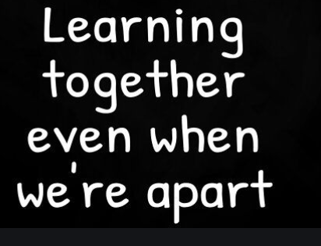


12

Slide 13

Thank You

