Slide 1

Final Project: Sentiment Stability Across News & Social Engagement
Uday Raval
Enterprise Analytics – Final Presentation December 2025

Slide 2

Research Question & Motivation
Research Question:
Which industries (Tech, Retail, Healthcare, Finance) show the most stable and predictable sentiment across financial news and social media tweets?
Why This Matters
Companies face both controlled news sentiment and emotional public sentiment
News influences investor outlook and market confidence
Tweets reflect public reaction, controversies, and real-time emotions
Comparing both helps identify:
Reputation stability
Market risk signals
Audience sensitivity
Communication effectiveness

Slide 3
Data Sources Overview
Two datasets from AWS DB1:
Financial News (2019–2020)
Tweets (2021–2022)
Industries Covered:
Tech (AAPL, MSFT, TSLA, GOOG)
Retail (Walmart, Amazon, McDonald's)
Healthcare (CVS, J&J)
Finance (Visa, Berkshire Hathaway)

Slide 4
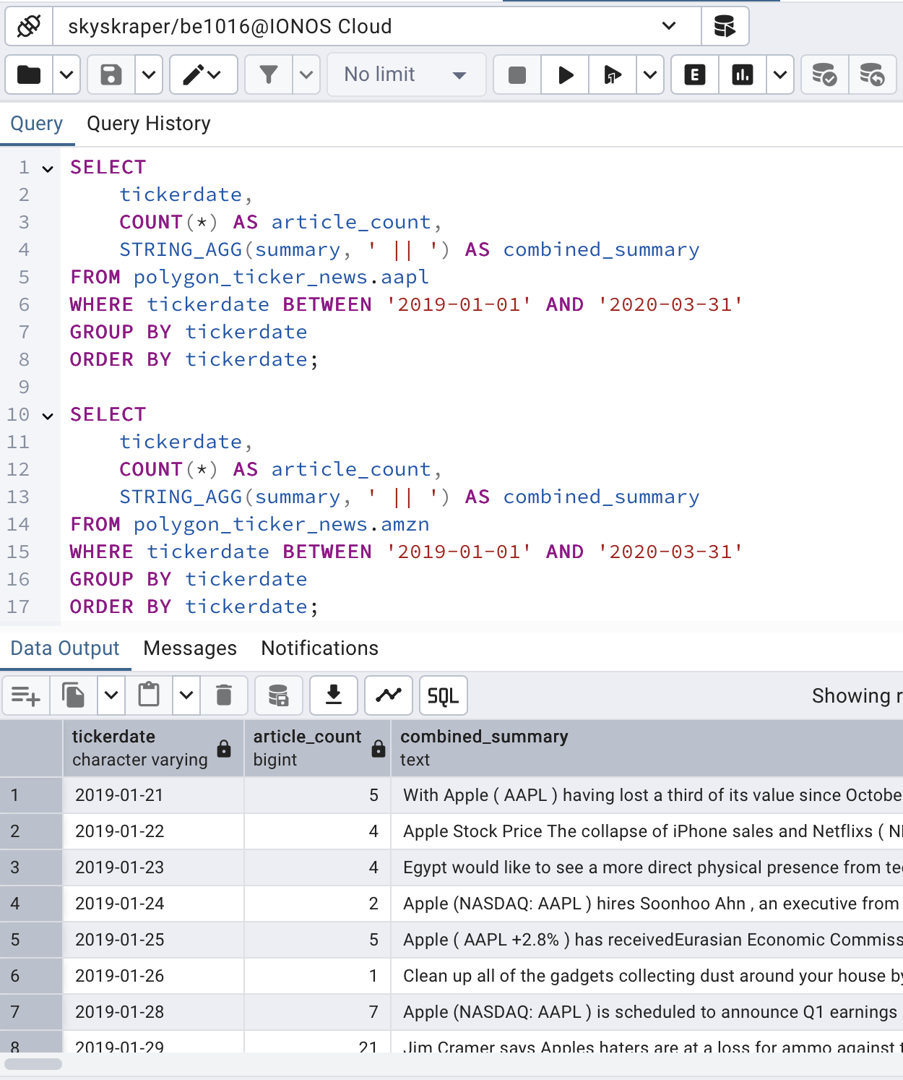
SQL Data Extraction (News)
SQL Query Highlights:
Pulled article count per day
Extracted sentiment scores
Aggregated daily data

Slide 5
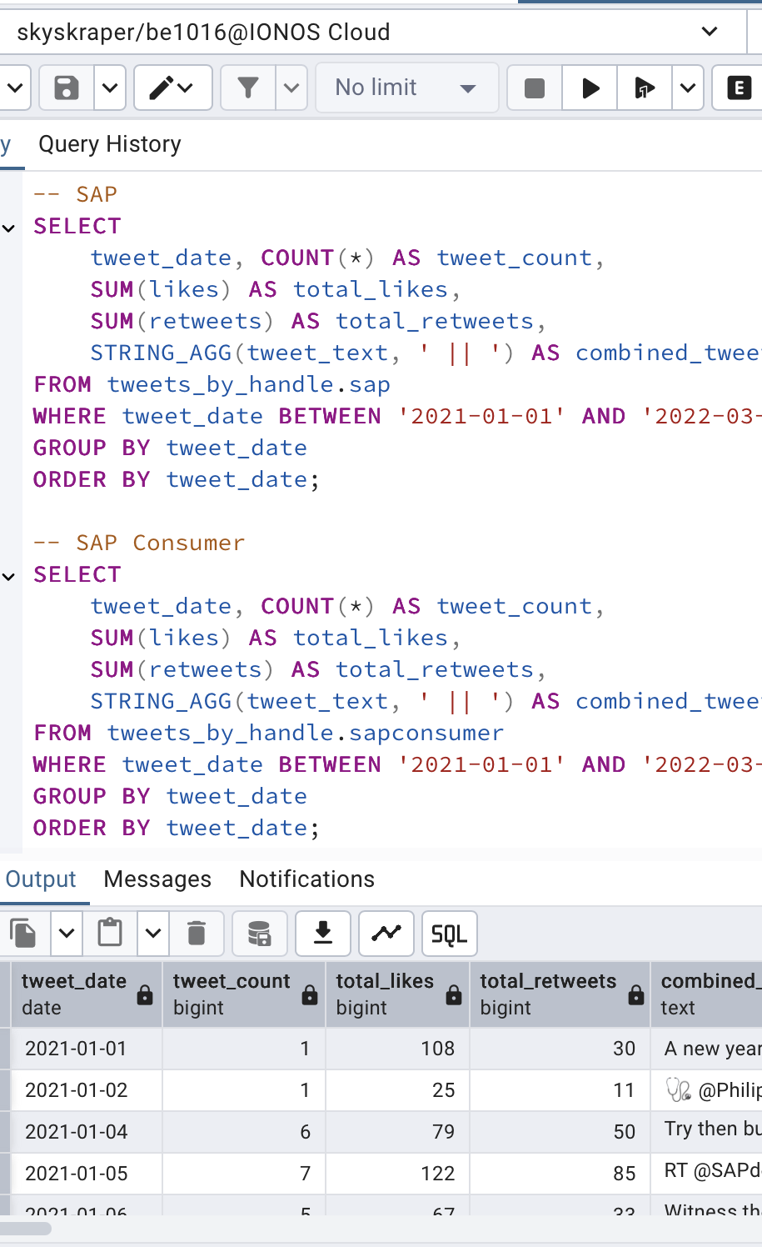
SQL Data Extraction (Tweets)
SQL Query Highlights:
Pulled tweet frequency
Likes, retweets
Sentiment score per day

Slide 6
Tools Used for Analysis
SQL (AWS DB1) - data retrieval
RStudio - main analytics framework
Sentiment scoring (tidytext)
Monthly aggregation
ETS forecasting
ggplot2 visualizations

Slide 7
R Workflow Pipeline
Step-by-step processing flow:
Import CSV
Tokenize text
Join with Bing sentiment lexicon
Count positive & negative words
Compute net sentiment
Aggregate to monthly data
Build ETS models
Visualize trends

Slide 8
Volume Analysis: News vs Tweets
2019–2020
News Volume
Stable
Narrow range
2021–2022
Tweet Volume
Large spikes
Event-driven surges

Slide 9
Sentiment Analysis Results
2019–2020
News Sentiment:
Controlled language
Narrow variation
2021–2022
Tweet Sentiment:
Emotional reactions
Wide jumps in positivity/negativity

Slide 10
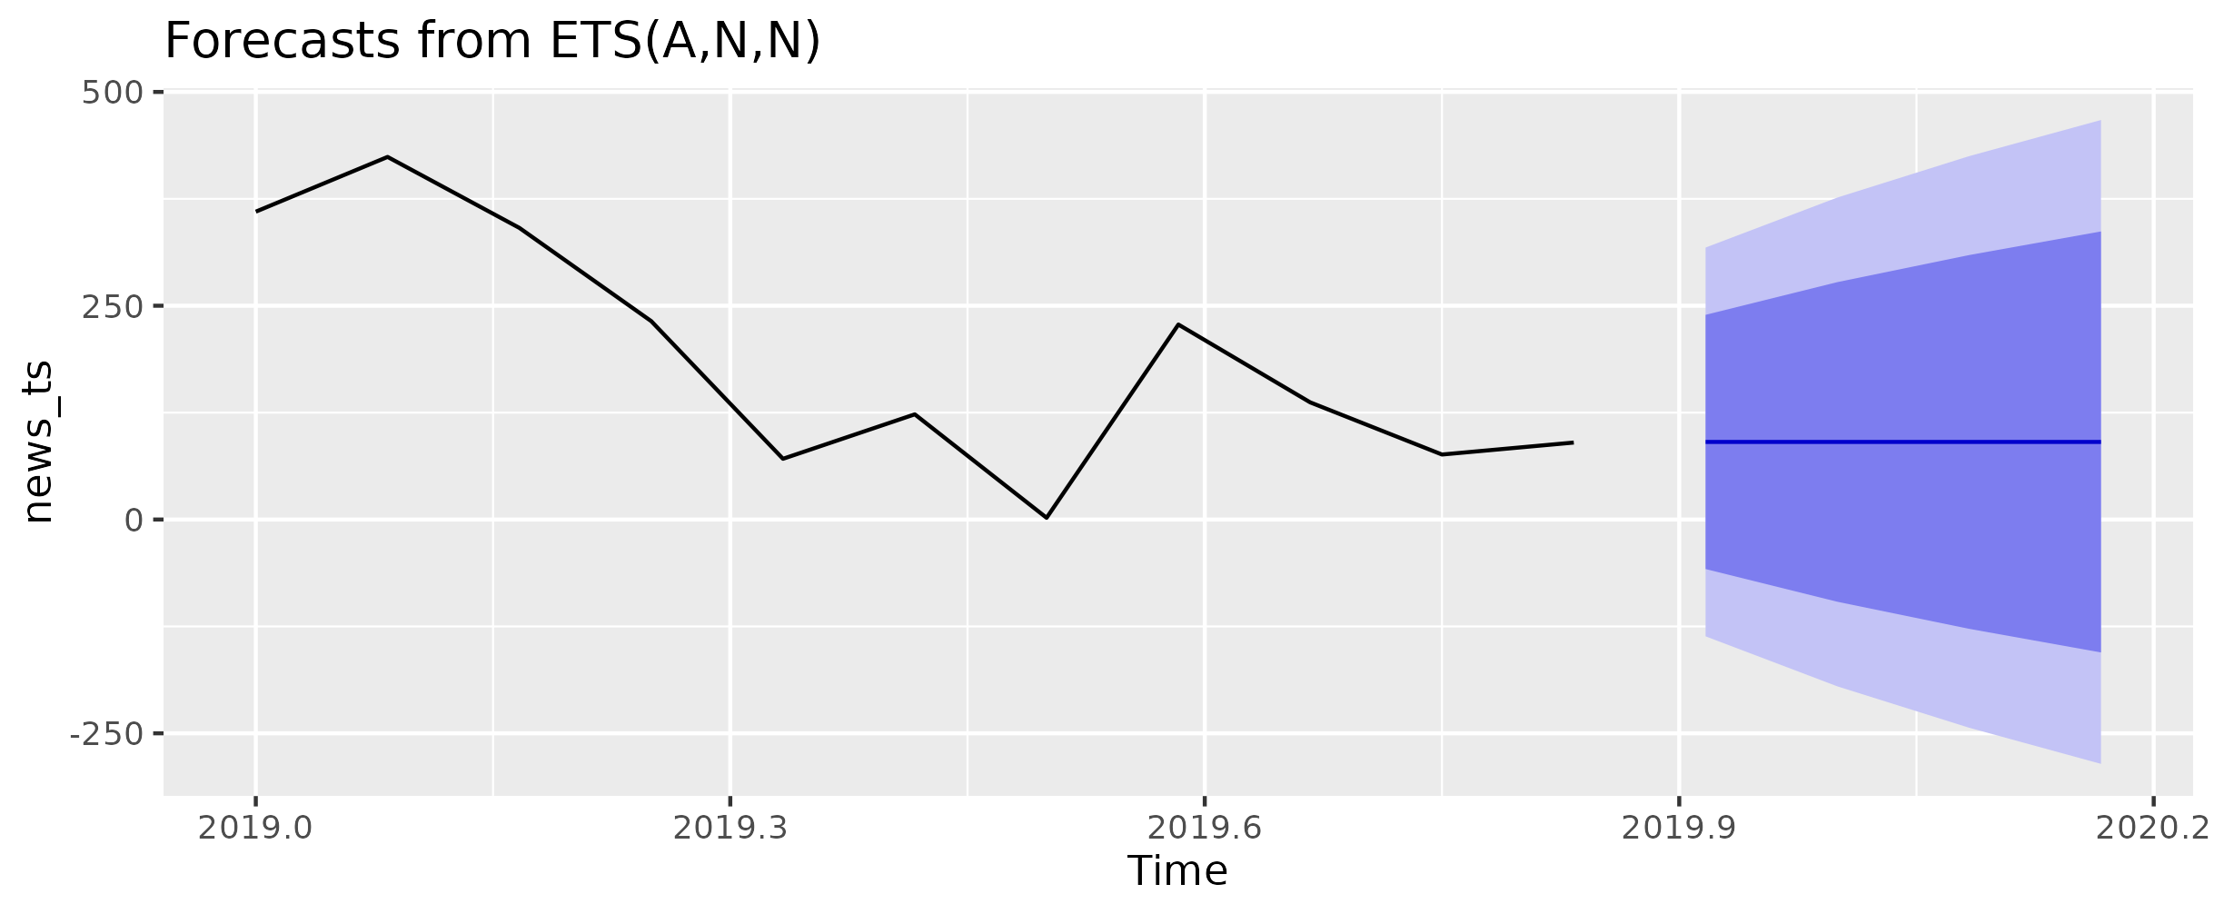
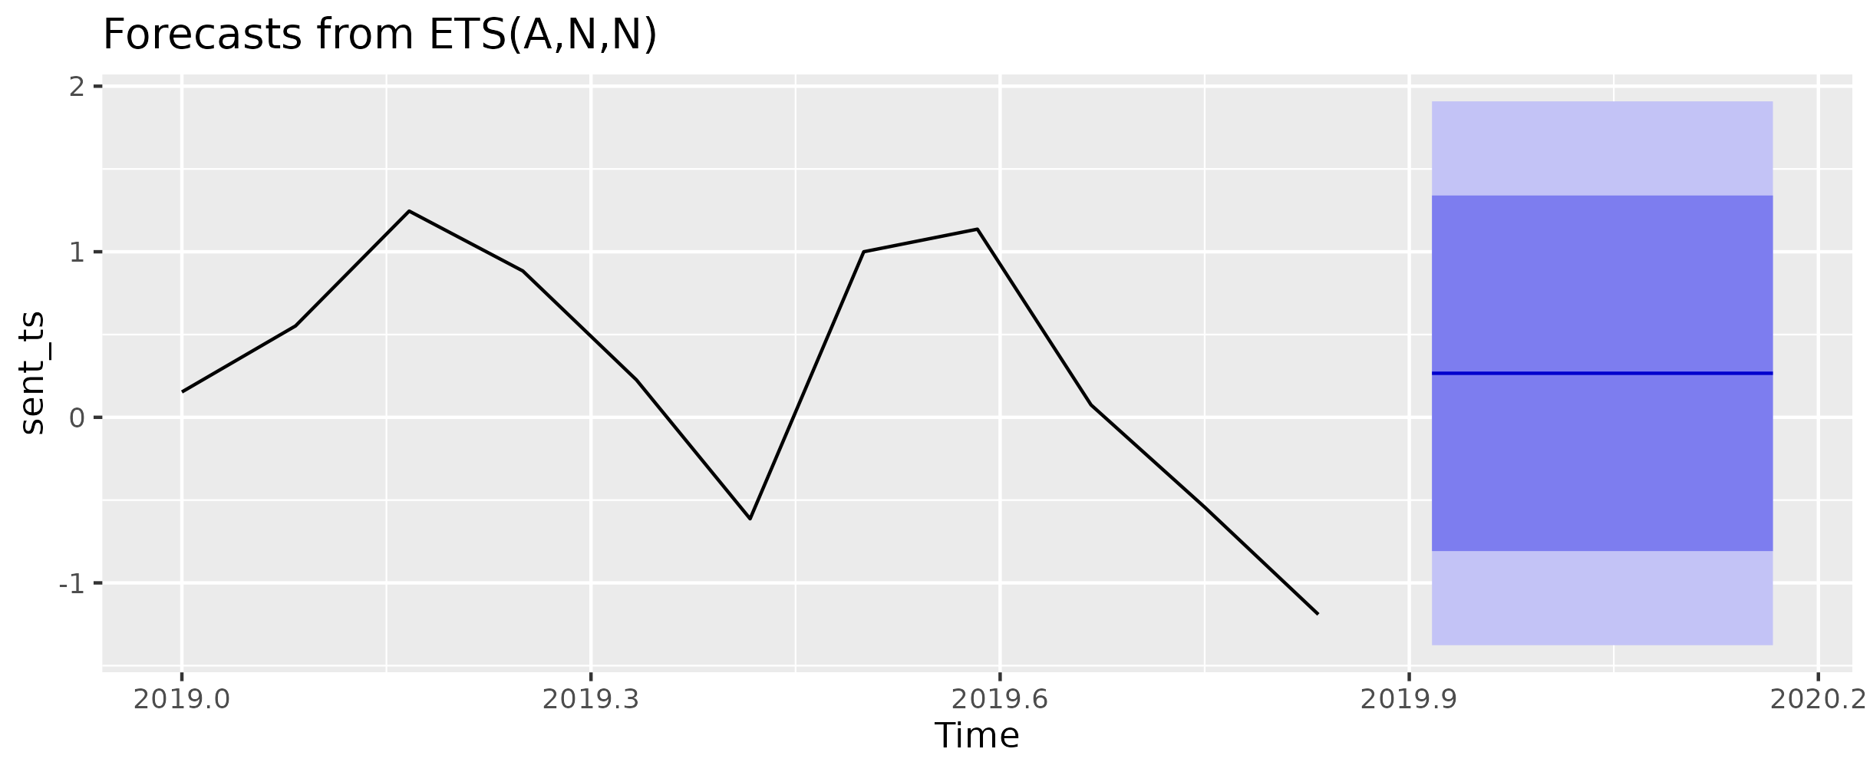
ETS Forecasting (News)
News ETS results:
Smooth trend
Narrow confidence intervals
High predictability

Slide 11
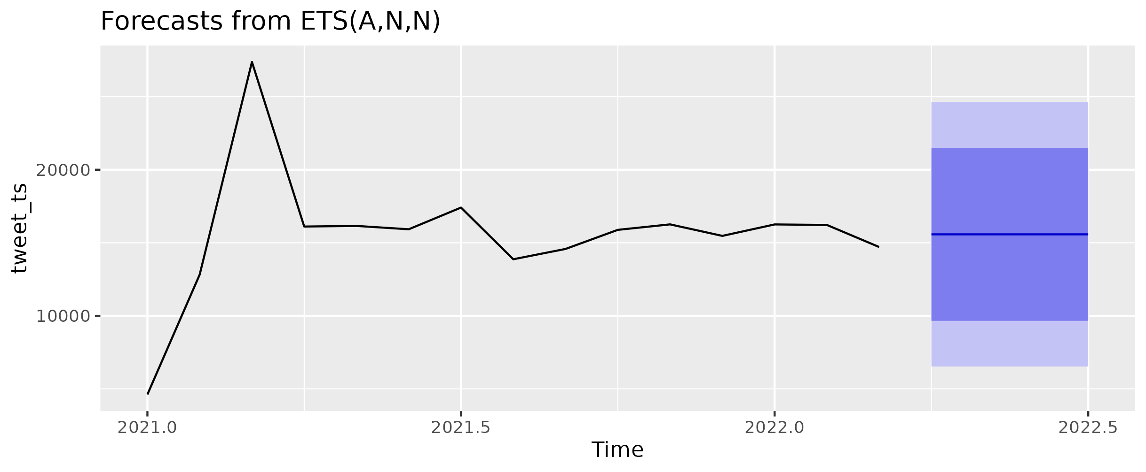
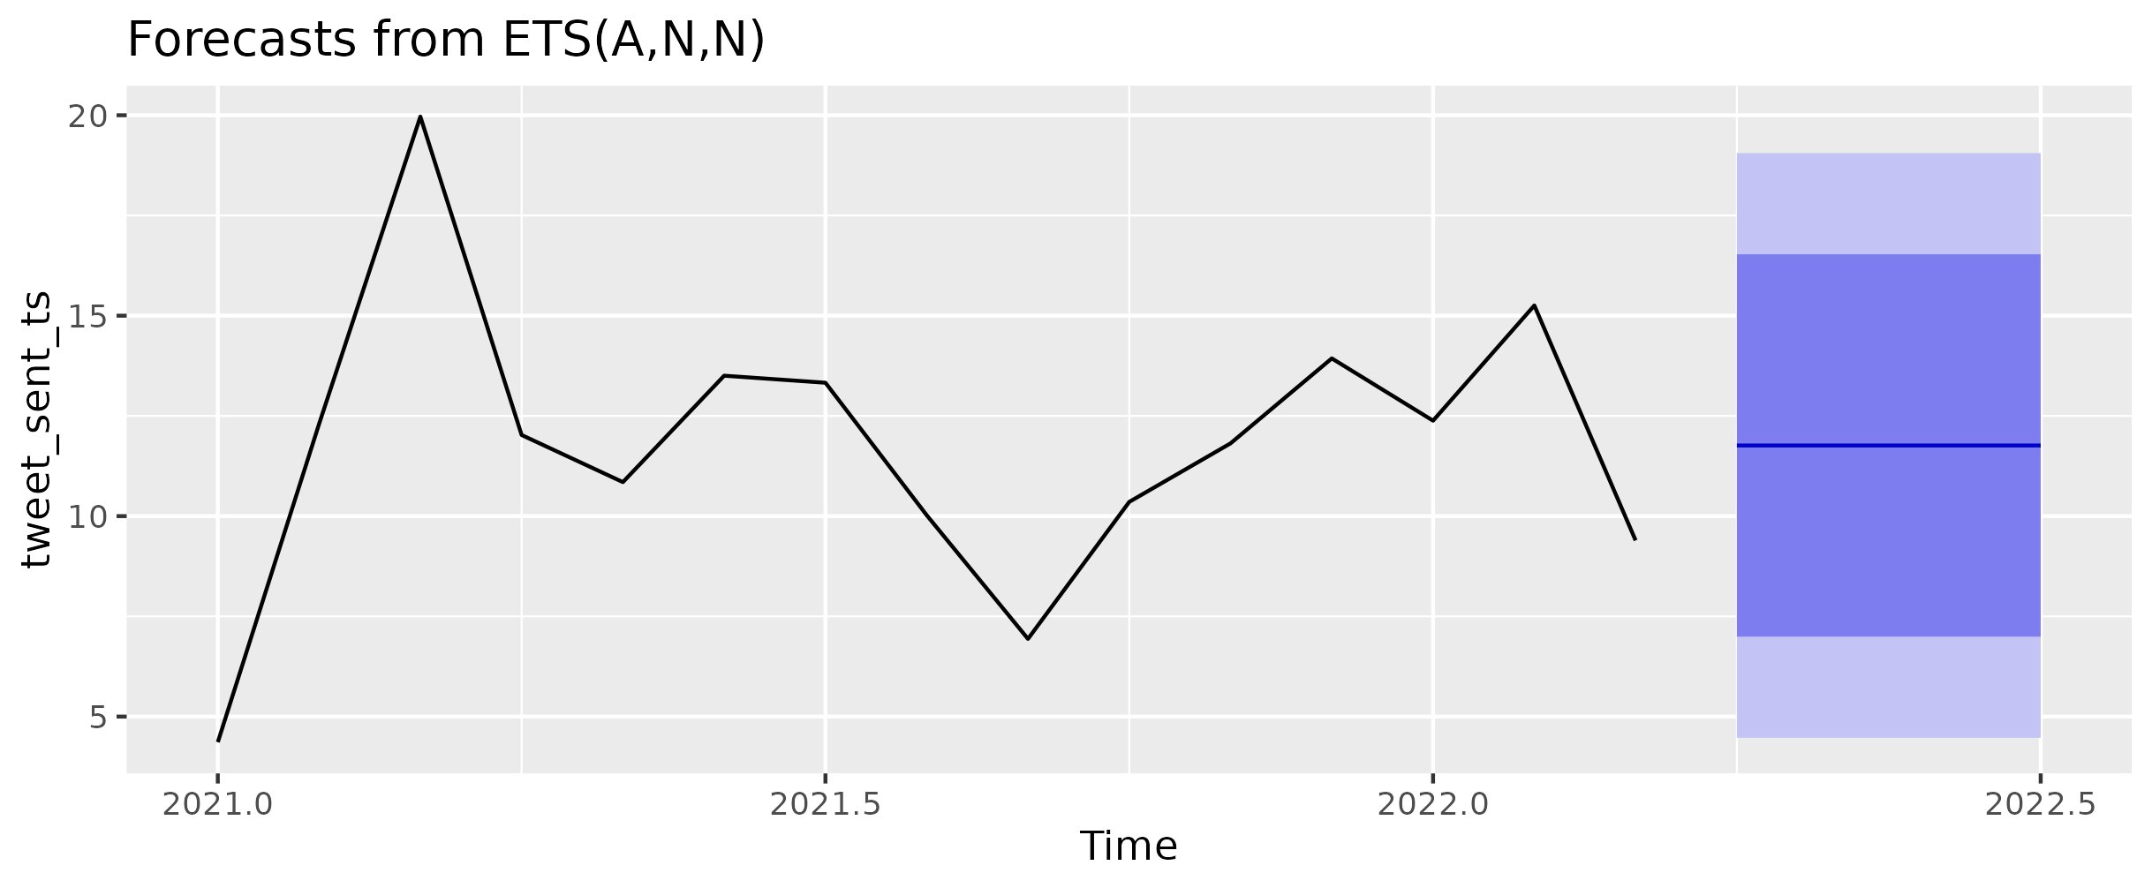
ETS Forecasting (Tweets)
Tweet ETS results:
Volatile pattern
Very wide forecast intervals
Low predictability

Slide 12
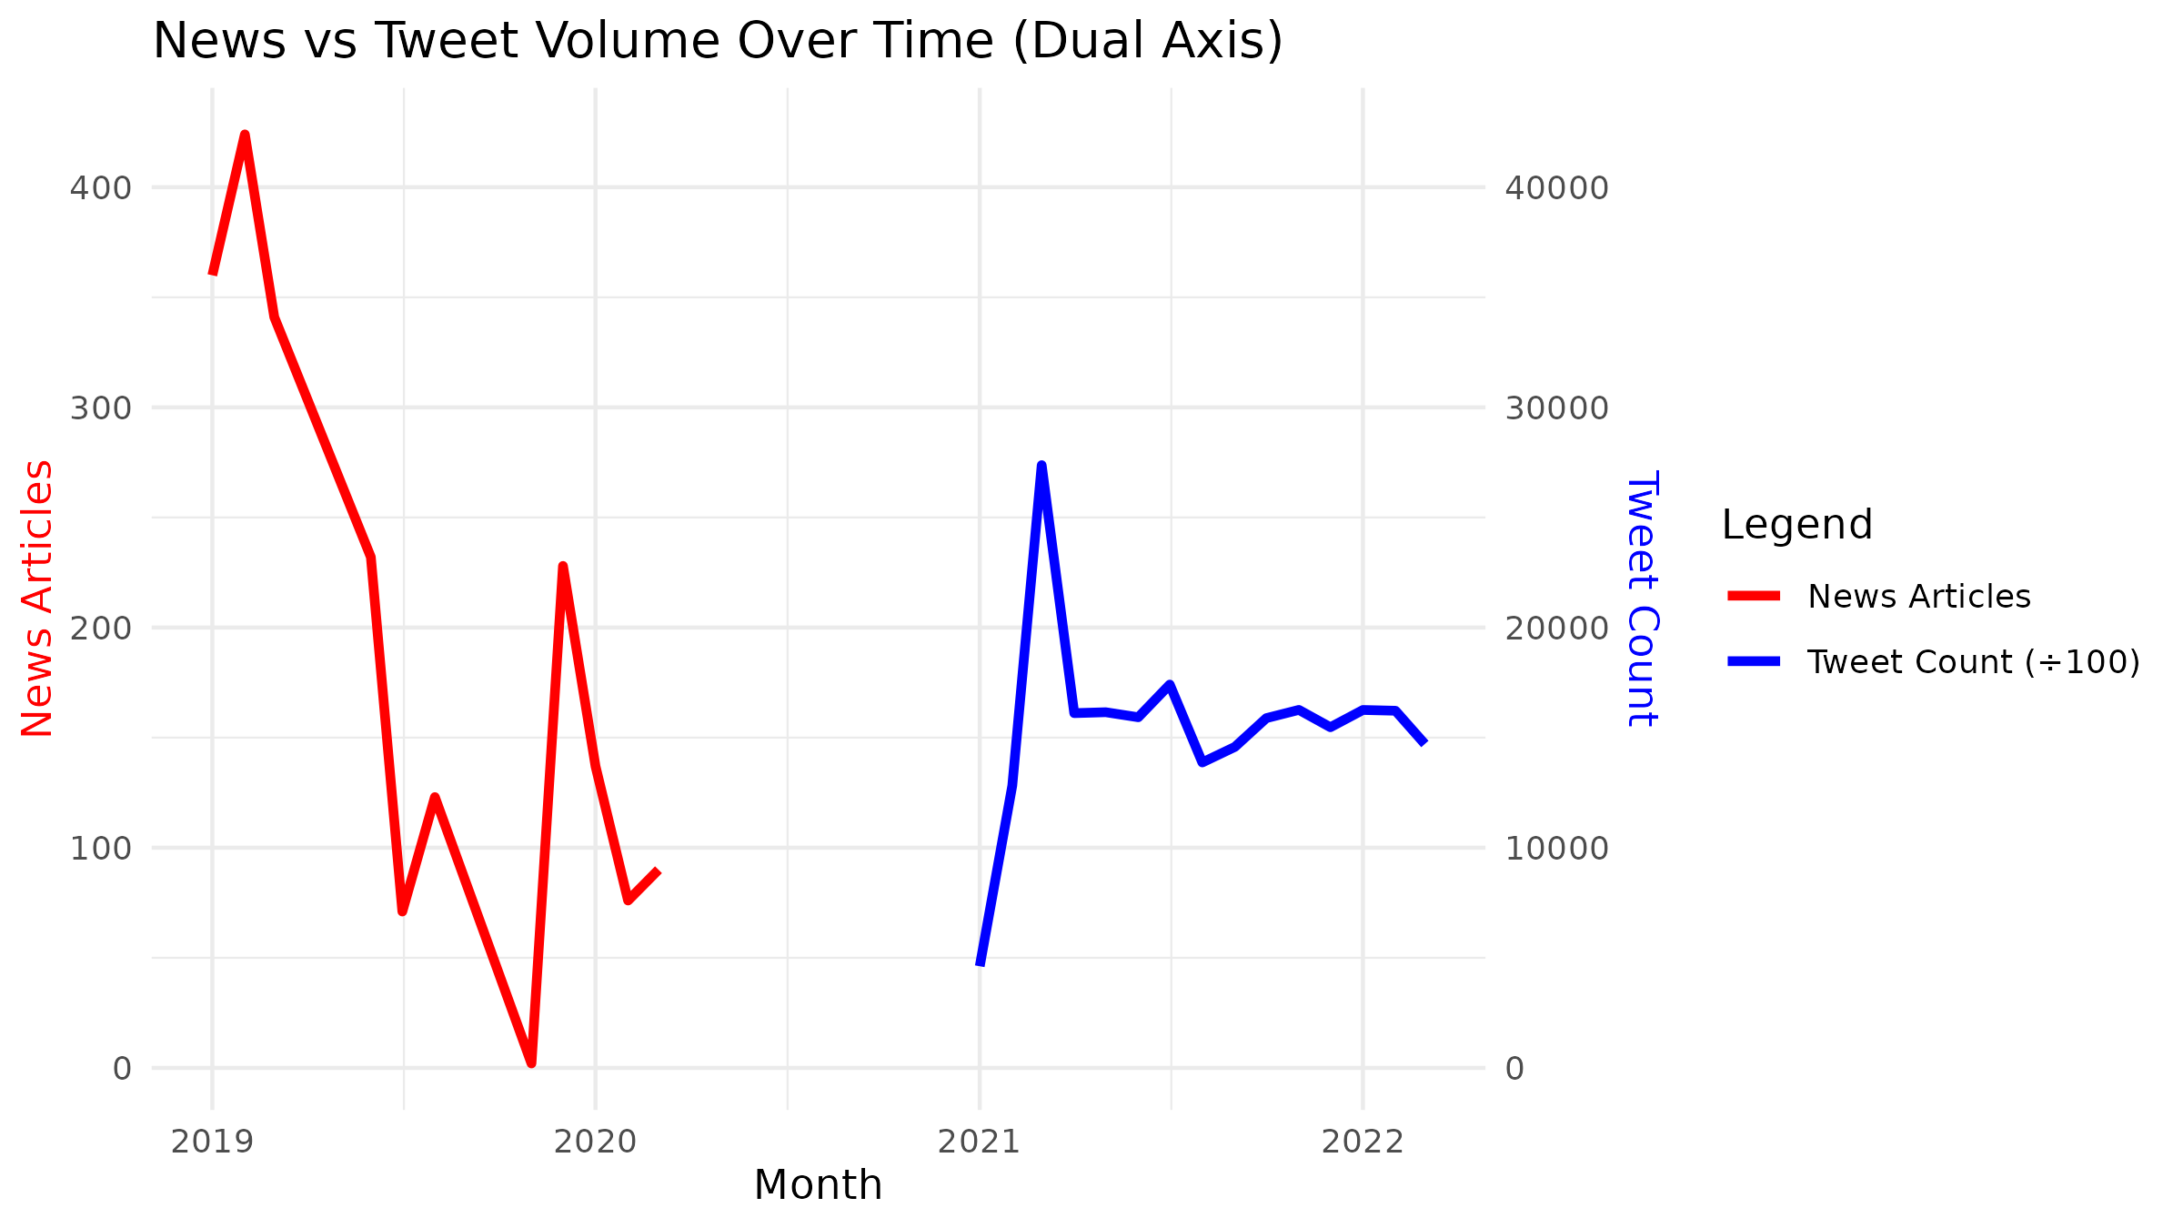
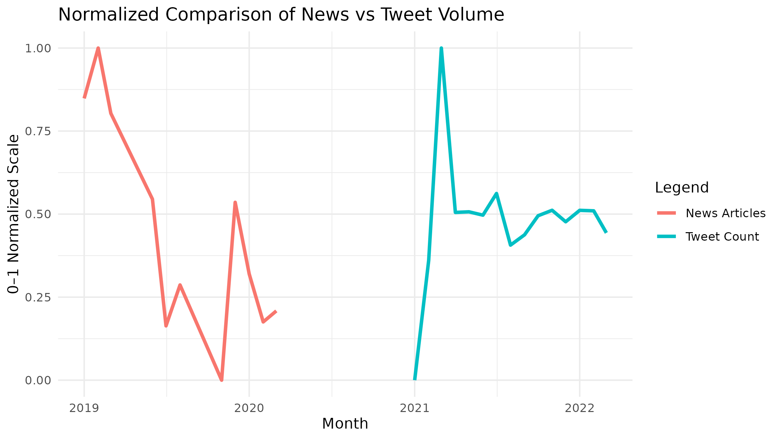
Industry-Level Comparison
Tech & Finance:
Stable news sentiment
Highly reactive tweets
Retail:
Tweet spikes during promotions or issues
Tweet spikes during promotions or issues
Sensitive sentiment swings during medical events

Slide 13
Combined Insights
News provides consistency → better for forecasting
Tweets are reactive → better for detecting real-time shifts
Combining both sources gives a complete sentiment profile
Forecasts prove stability differences between communication channels

Slide 14
Conclusion
News = stable, predictable
Tweets = volatile, event-driven
Industries respond differently
Public sentiment fluctuates faster than media reporting

Slide 15
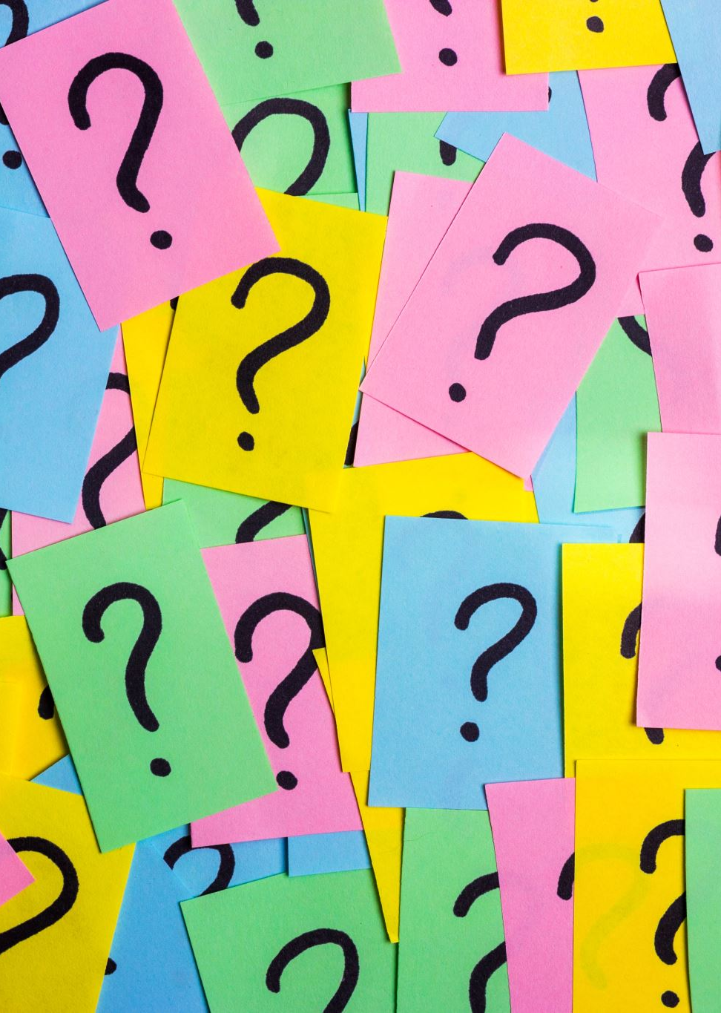
Thank You
Questions?

