Slide 1

Final Presentation: Manage the Analytics Development Lifecycle
Presented by:
Youginkumar Raval

Slide 2
Content
Information about the dataset
Why I selected the database?
Purpose of analysis
Data Model
Measures
Dashboard
Conclusion

Slide 3
INFORMATION ABOUT THE DATASET
Dataset is taken from : https://codebasics.io/challenge/codebasics-resume-project-challenge/5
The name of company is AtliQ mart, which is a growing FMCG manufacturer headquartered in Gujarat, India.
It is currently operational in three cities Surat, Ahmedabad and Vadodara.

Slide 4
PURPOSE:
Problems with the delivery’s service level.
The goal of Supply Chain Analytics team is to monitor every customer’s OT%‘On-time delivery (OT) %’, ‘In-full delivery (IF) %’, and OnTime in full (OTIF) %’ of the customer orders daily basis against the target service level set for each customer.

Slide 5
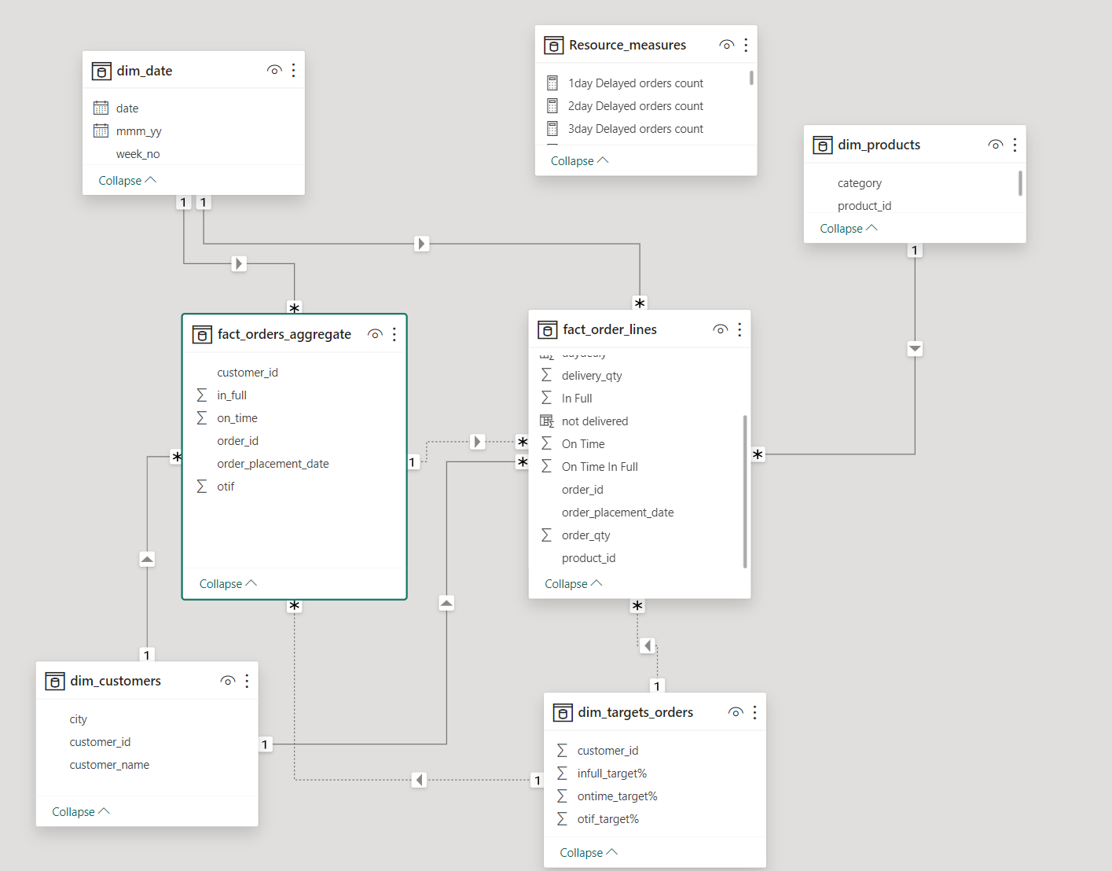
DATA MODEL

Slide 6
MEASURES
Sno | Measures | Abbreviation | Description
1 | Total Order Lines |  | Count of all order lines in fact_orders table
2 | Line Fill Rate | LIFR % | Number of order lines shipped In Full Quantity / Total Order Lines
3 | Volume Fill Rate | VOFR % | Total Quantity shipped / Total Quantity Ordered
4 | Total Orders
5 | On Time Delivery % | OT % | Number of orders delivered On Time / Total Number of Orders
6 | In Full Delivery % | IF % | Number of orders delivered in Full quantity / Total Number of Orders
7 | On Time In Full % | OTIF % | Number of orders delivered both IN Full & On Time / Total Number of Orders
8 | On Time Target |  | Average of On-Time Target
9 | In Full Target |  | Average of In-Full Target
10 | On Time In Full Target |  | Average of OTIF Target

Slide 7
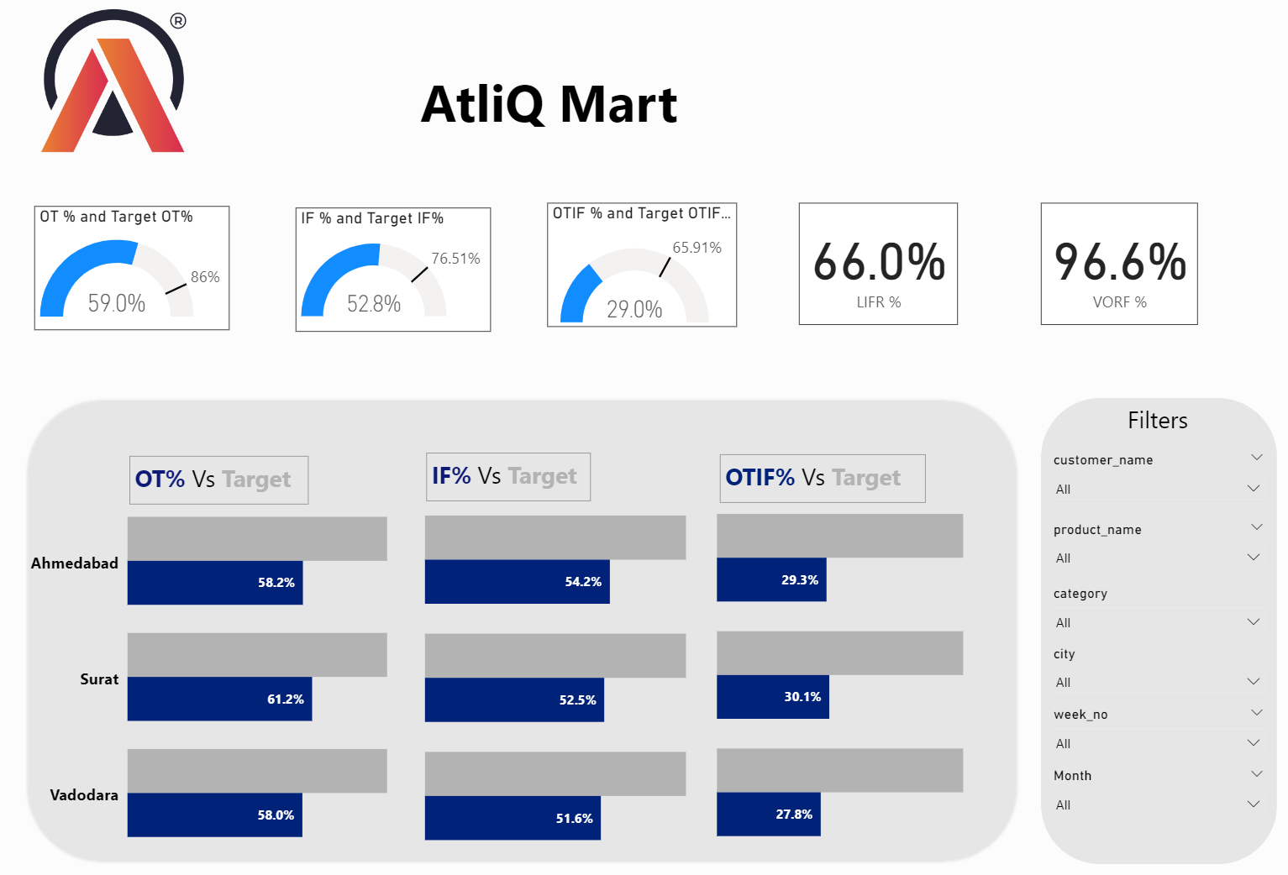
EXECUTIVE DASHBOARD

Slide 8
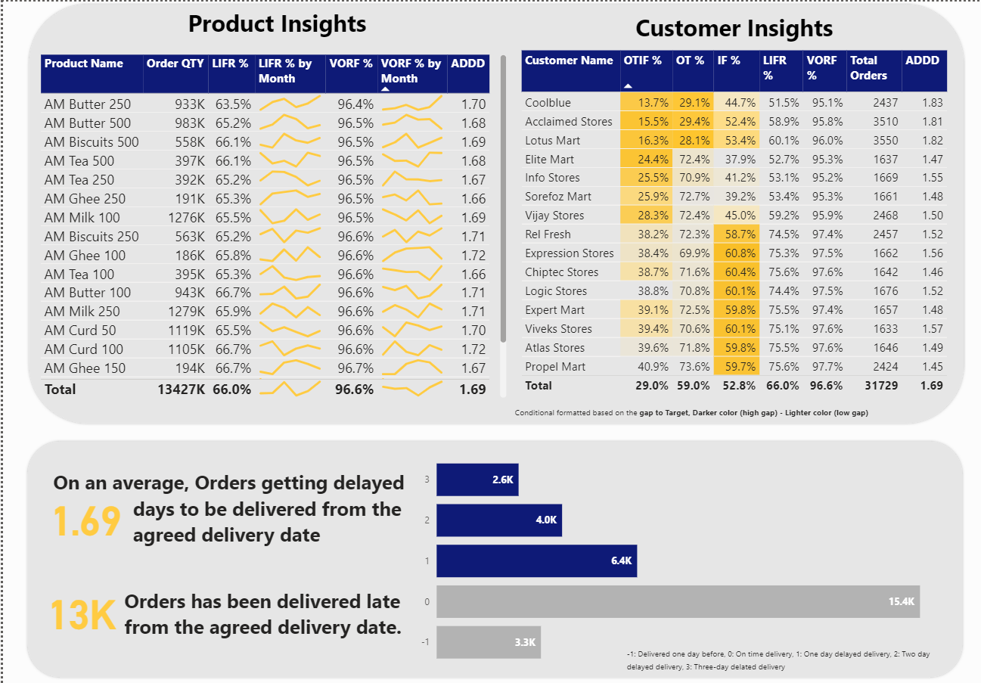
INSIGHTS DASHBOARD

Slide 9
CONCLUSION:
The metrics like OT%, IF%, OTIF% are far behind the set target.
Orders are delayed 0.69 days from the agreed date of delivery on an average.
Lotus Mart, Coolblue, Acclaimed stores have the highest orders, also the most to deliver the products on time
Ghee, curd and butter products are most delayed to get delivered.
There is a huge gap in IF% for most of the customers.

