Slide 1
welcome

Slide 2
Project name
HOSPITAL MANAGEMENT
SYSTEM
Project Partners Name
Amruta Suresh Borate(2658)
Rohan Vaibhav Londhe (2683)

Slide 3
INTRODUCTION
The purpose of the project entitled as “HOSPITAL MANAGEMENT SYSTEM” is to computerize the Front Office Management of Hospital to develop software which is user friendly, simple, fast, and cost – effective. It deals with the collection of patient’s information, diagnosis details, etc. Traditionally, it was done manually. The main function is to register and store patient details and doctor details and retrieve these details as and we required and also to manipulate these details meaningfully.

Slide 4
scope
Project has been developed in keeping in view of requirement of the Hospital. As far as my projects cover all important details of information of Hospital, therefore in future it will help to gather such information about the information of Hospital. The main scope of
Generates the important report on day wise or month wise.
Storing large amount of data for future point of view.
Keeping records of admission of patient.
Scheduling the appointment of Patient with Doctor (Consultant) to make it convenient for both.

Slide 5
Hospital currently use a manual system for the management and maintenance of critical information. The current system requires numerous paper forms, with data stores spread throughout the hospital management infrastructure. Often information (on forms) is in complete, or does not follow management standards. Forms are often lost in transit between departments requiring a comprehensive auditing process to ensure that no vital information is lost. Multiple copies of the same information exist in the hospital and may lead to inconsistencies in data in various data stores
Existing System

Slide 6
The Hospital Management System is designed for Any Hospital to replace their existing manual, paper based system. The new system. The new system is to control the following information; patient information, room availability, staff and operating room schedules, and patient invoices.
These services are to be provided in an efficient, cos effective manner, with the goal of reducing the time and resources currently required for such tasks.
PROPOSED SYSTEM

Slide 7
MODULES REQUIRED
This module records basic patient related information.
Admission Patient Details:
It keeps track of all details about both in-patient .Patient id, Patient name, Address, Appointment date, Doctor name, stored for future reference.
Billing Details:
This module bills the patient comes to hospital.

Slide 8
HARDWARE SPECIFICATION
Processor : 11th Gen Intel(R) Core(TM) i3-1115G4
Ram : 8.00GB
Hard Disk : 256ssd
SOFTWARE SPECIFICATION
Operating SysteM :: Windows 11
Front-End :: HTML,CSS,Bootstrap
Back End :: PHP
SYSTEM & HARDWERE REQUIRMENTS

Slide 9
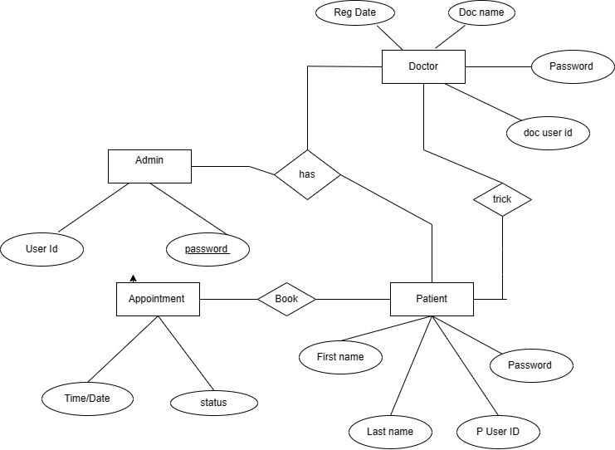
Erd Diagram

Slide 10
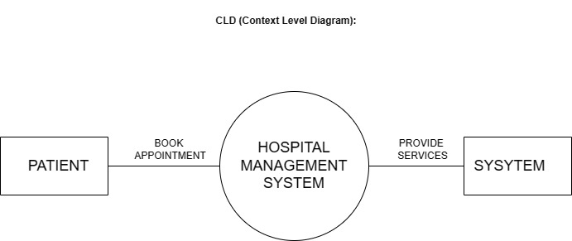
Context Level Diagram):

Slide 11
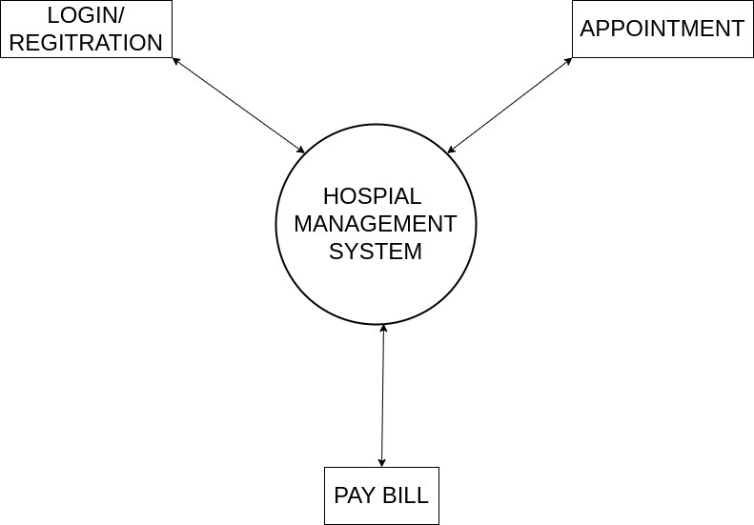
DFD Diagram

Slide 12
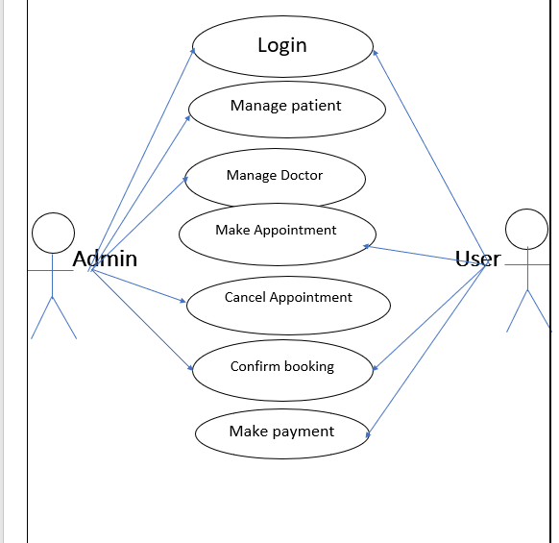
Use case diagram

Slide 13
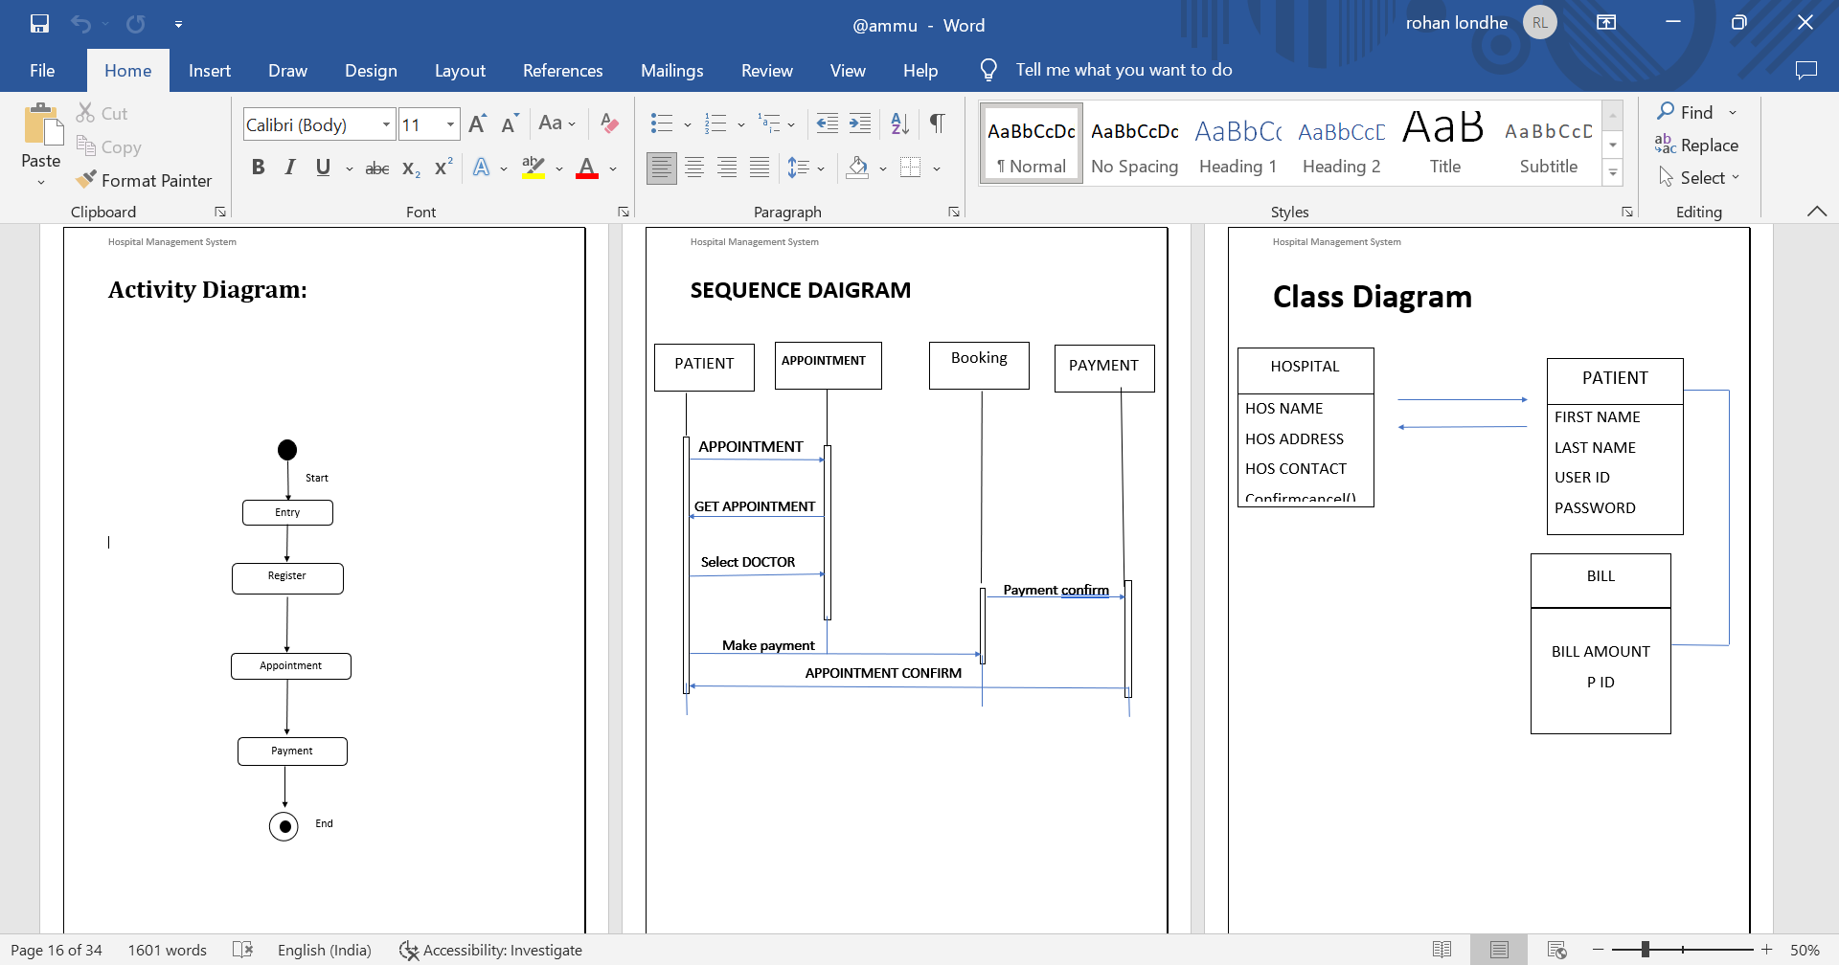
Activity Diagram:

Slide 16
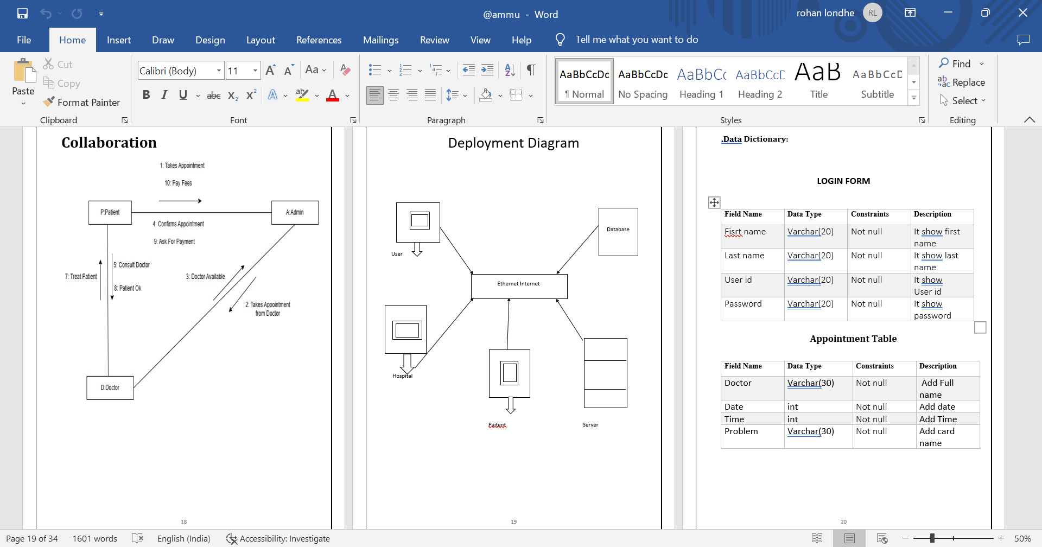

Slide 18
THANK YOU

