Slide 1

COLLEGE PROJECT PRESENTATION & VIVA
PROJECT DETAILS
DJ MART
PROJECT NAME
DJ MART E-Commerce
STUDENT NAME
Candidate / Student Name
E-Commerce Website
REGISTER NUMBER
[Register Number]
"Smart, Simple & Convenient Online Shopping"
DEPARTMENT
Dept. of Computer Science & Engg.
DEGREE & YEAR
⚡ Developed using Antigravity
B.E. / B.Tech (Final Year)
INSTITUTION
[Engineering College / University]
ACADEMIC YEAR
2025 – 2026
DJ MART — E-Commerce Website
Developed using Antigravity
01 / 16

Slide 2
PROJECT OVERVIEW
Introduction
A Modern Online Shopping Platform for Effortless Retail Convenience
🛍️ Online Product Browsing
🔍 Real-Time Product Discovery
📋 Comprehensive Product Details
Intuitive catalog exploration enabling users to effortlessly discover luxury, electronic, fashion, and everyday products from any device.
Instant keyword search coupled with dynamic category filtering allowing shoppers to find target items in milliseconds.
Rich product presentation featuring high-resolution images, transparent pricing in ₹, live inventory badges, and full descriptions.
🛒 Interactive Shopping Cart
📦 Streamlined Online Ordering
✨ User-Friendly & Responsive UI
Seamless quantity adjustments (+/-), instant price recalculation, item removal, and persistent session storage without page reloads.
Frictionless checkout experience with complete delivery address capture, payment preference, and instant order confirmation.
A premium luxury design aesthetic crafted with mobile-first responsiveness, ensuring a delightful experience on smartphones, tablets, and desktops.
DJ MART — E-Commerce Website
Developed using Antigravity
02 / 16

Slide 3
MARKET CHALLENGES & NEED
Problem Statement
Addressing Traditional Retail Constraints with a Frictionless Digital Solution
⚠️ TRADITIONAL SHOPPING PROBLEMS
✅ THE DJ MART DIGITAL SOLUTION
• Mandatory Store Visits: Requires physical commute, fuel costs, traffic congestion, and parking hassles.
✔ Universal 24/7 Access: Shop from anywhere, anytime using any smartphone, tablet, or laptop.
• Time-Consuming Process: Hours spent walking physical aisles and standing in long billing queues.
✔ Sub-Second Checkout: Browse, add to cart, and place orders in under two minutes without queues.
• Difficult Product Comparison: Hard to compare alternative brands, technical specifications, and fair pricing.
✔ Transparent Comparison: Instant access to prices, specifications, high-res images, and reviews.
• Restricted Operating Hours: Inaccessible outside standard retail hours; no late-night or holiday access.
✔ Always Open & Accessible: Uninterrupted shopping experience available round-the-clock, 365 days a year.
• Uncertain Inventory Visibility: Customers travel to stores only to discover desired products are out of stock.
✔ Live Inventory Visibility: Real-time stock indicators prevent ordering out-of-stock items.
DJ MART — E-Commerce Website
Developed using Antigravity
03 / 16

Slide 4
PROJECT SCOPE & GOALS
Project Objectives
Key Engineering & Business Goals Established for DJ Mart
01
02
03
04
Develop Modern Web App
Intuitive Product Browsing
Real-Time Search & Query
Structured Categorization
Build a secure, full-stack e-commerce platform using Antigravity AI engineering.
Deliver an elegant catalog structure across diverse luxury, tech, and lifestyle goods.
Implement rapid keyword search with instantaneous product filtering.
Organize catalog into distinct categories (Electronics, Fashion, Home, Books).
05
06
07
08
Dynamic Cart Management
Frictionless Checkout
Responsive User Interface
Elevate Shopping Experience
Enable adding items, quantity updates (+/-), and real-time total recalculation.
Provide an easy order process with address validation and order confirmation.
Create a mobile-first visual design that adapts effortlessly across all screen sizes.
Offer a distinctive, luxury brand identity that surpasses generic templates.
DJ MART — E-Commerce Website
Developed using Antigravity
04 / 16

Slide 5
ENGINEERING STACK
Technologies & Tools Used
Only Technologies Actually Implemented & Verified in DJ Mart
AI & DEVELOPMENT ENVIRONMENT
FRONTEND TECHNOLOGIES
SERVER-SIDE PRESENTATION
Google Antigravity
HTML5, CSS3 & Vanilla JS
Jakarta Server Pages (JSP)
Core Development Platform
Client-Side Interface
View Layer & Templates
Advanced agentic AI coding assistant utilized for full-stack architecture design, Java code implementation, debugging, and verification.
Custom luxury design system with CSS custom properties (variables), native ES6+ JavaScript API client, and zero heavy frontend dependencies.
Jakarta JSP 3.1 & JSTL 3.0 standard tag library for clean, secure server-rendered pages with XSS escaping and modular header/footer components.
BACKEND ARCHITECTURE
DATABASE & RELATIONAL STORAGE
CONNECTION POOL & SECURITY
Jakarta Servlet 6.0 & Java 17
H2 Relational Database Engine
HikariCP 5.1 & jBCrypt Security
Server Controllers & Services
Embedded SQL Data Store
Performance & Cryptography
High-performance Java enterprise web container architecture implementing Layered MVC (Servlets, Filter Chain, Services, and DAOs).
Embedded SQL database (jdbc:h2:./data/djmart) with ACID transactions, foreign keys, CHECK constraints, and automated schema migration.
Blazing-fast connection pooling via HikariCP, salted BCrypt password hashing, and CSRF synchronizer token protection across all state mutations.
DJ MART — E-Commerce Website
Developed using Antigravity
05 / 16

Slide 6
SYSTEM DESIGN & STRUCTURE
System Architecture
Multi-Tier Layered MVC Architecture & Complete Request Lifecycle
1. USER / CLIENT BROWSER
2. APACHE TOMCAT 10.1
3. FILTER CHAIN
4. SERVLET CONTROLLERS
5. SERVICE & DAO LAYER
➔
➔
➔
➔
HTML5, CSS3, Vanilla JS (Fetch API)
Jakarta EE 6 Web Container
Encoding, Security, CSRF & Auth
Product, Cart, Order, Auth Servlets
OrderService, ProductDAO, HikariCP
▼ [HikariCP Connection Pool]
LAYER RESPONSIBILITIES & SEPARATION OF CONCERNS
🗄️ H2 RELATIONAL DATABASE (SQL ENGINE)
• Presentation Layer (JSP & JS): Renders dynamic HTML using JSTL and initiates asynchronous JSON API requests.
• Schema: users, products, orders, order_items, cart_items, reviews
• Embedded Storage: jdbc:h2:./data/djmart;AUTO_SERVER=TRUE
• Data Integrity: Strict Foreign Keys & CHECK constraints
• ACID Transactions: Order placement stock decrement rollback protection
• High-Throughput: HikariCP connection pool with 10 max pool size
• Security Layer (Jakarta Filters): Validates UTF-8 encoding, security headers, CSRF synchronizer tokens, and RBAC authentication.
• Controller Layer (Servlets): Intercepts HTTP requests, validates inputs, invokes services, and routes to JSPs or JSON.
• Business Logic Layer (Services): Enforces business rules, inventory availability, price calculation, and transactional consistency.
• Data Access Layer (DAOs): Executes parameterized JDBC PreparedStatements ensuring 100% defense against SQL injection.
DJ MART — E-Commerce Website
Developed using Antigravity
06 / 16

Slide 7

USER INTERFACE SHOWCASE
DJ Mart – Home Page
Elegant Landing & Product Discovery Experience with Real-Time Navigation
01. Sticky Luxury Navbar
Features official DJ Mart branding, primary navigation links, category dropdowns, dynamic cart counter badge, and user authentication menu.
02. Integrated Search Bar
Allows users to instantly search products by keywords with real-time query handling.
03. Hero Promotional Banner
High-impact editorial hero section ("Timeless Elegance, Modern Luxury") establishing an elevated shopping atmosphere.
04. Curated Category Shortcuts
Direct access cards for Electronics, Fashion, Home & Kitchen, and Books & Stationery.
05. Featured Product Grid
Showcases luxury items with high-res photography, currency pricing in ₹, star ratings, and one-click "Add to Cart" triggers.
DJ MART — E-Commerce Website
Developed using Antigravity
07 / 16

Slide 8

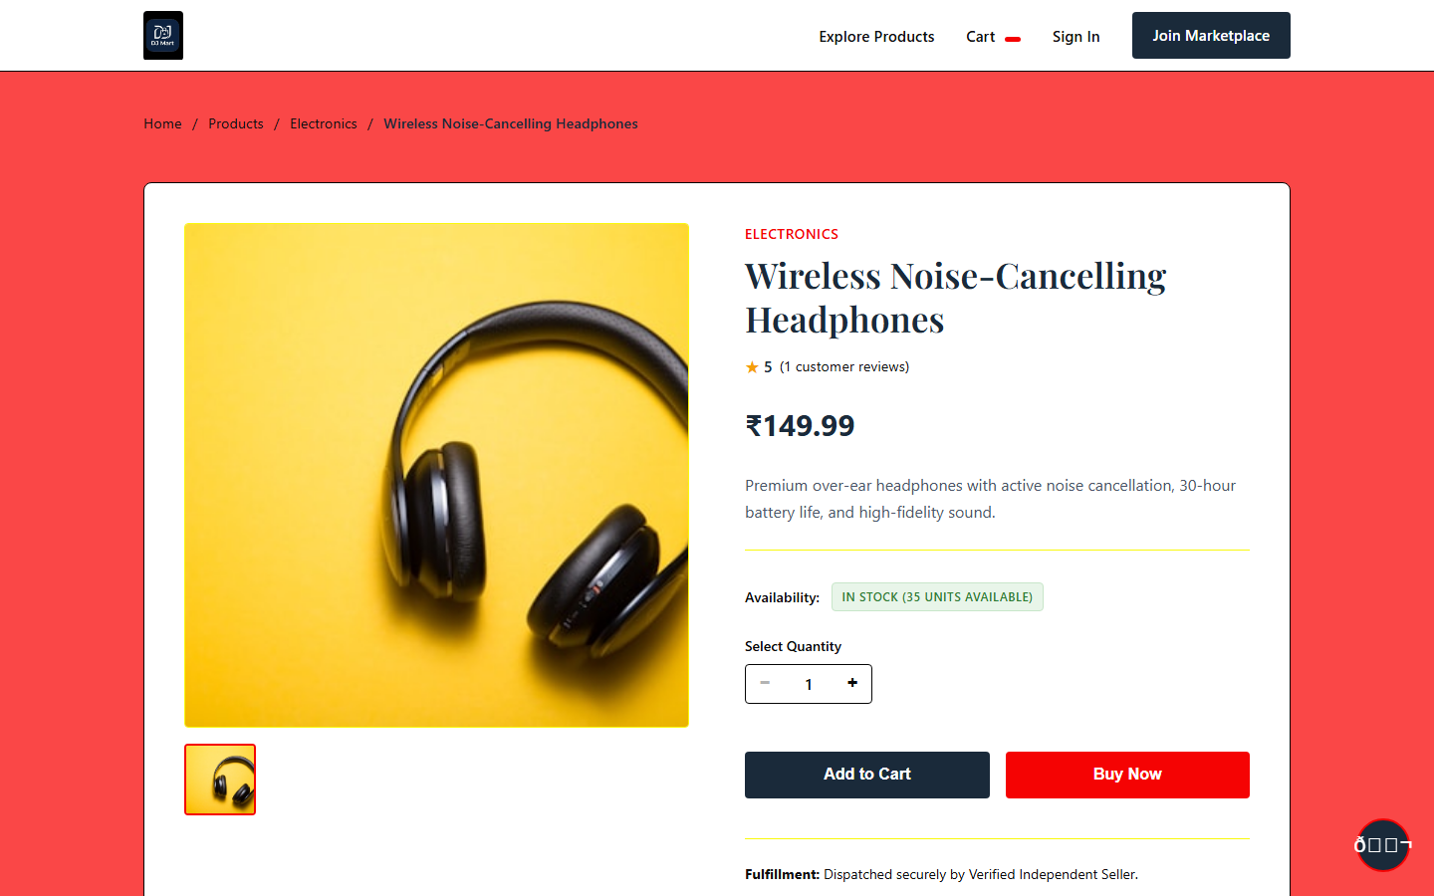
CATALOG & DISCOVERY
Product Browsing & Details
Comprehensive Catalog Filtering & Detailed Product Presentation
CATALOG LISTING WITH FILTERS & SORT
EXPANDED PRODUCT DETAILS & REVIEWS VIEW
KEY CAPABILITIES: • Multi-category filtering (Electronics, Fashion, Home) • Price sorting (Low to High / High to Low) • High-resolution photo gallery • Live stock indicator badges • Full technical specifications • Direct "Add to Cart" action with instant feedback
DJ MART — E-Commerce Website
Developed using Antigravity
08 / 16

Slide 9
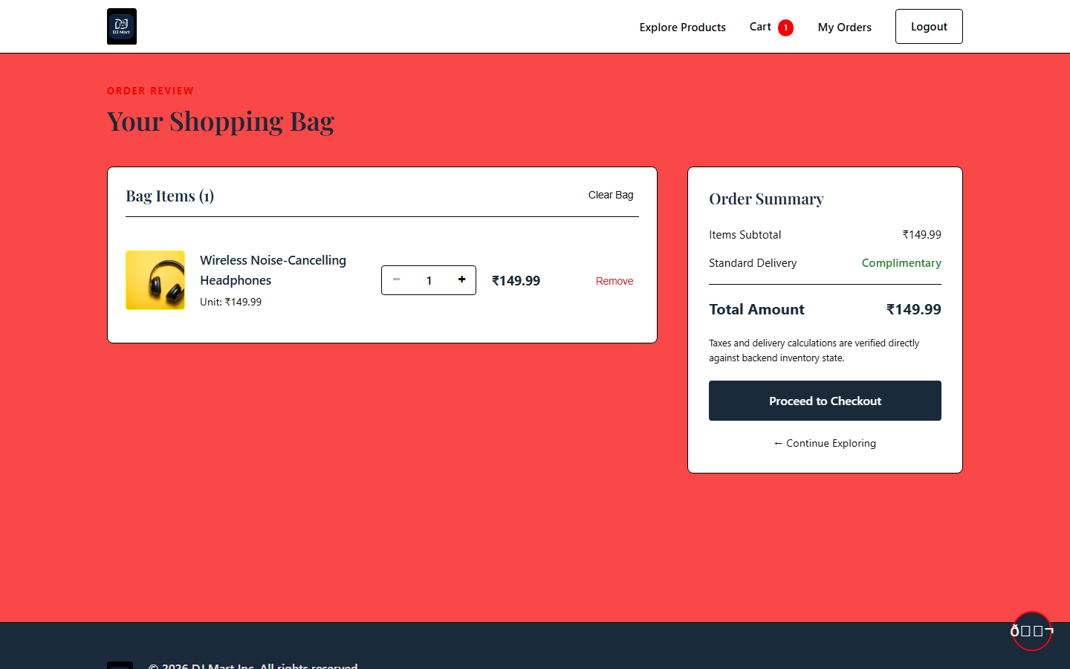
ORDER MANAGEMENT
Shopping Cart
Interactive Cart Management, Dynamic Price Calculation & Order Review
01. Selected Product Overview
Displays item thumbnails, titles, unit prices, and line-item totals clearly for buyer verification.
02. Dynamic Quantity Stepper
Users can increment (+) or decrement (-) quantities. JavaScript communicates with /api/v1/cart/items to update subtotals without page reload.
03. Instant Item Removal
One-click item deletion updates session cart state and header badge count instantly.
04. Comprehensive Order Summary
Itemized price breakdown: cart subtotal, shipping estimates, tax calculation, and final grand total.
05. Direct Checkout Trigger
Prominent "Proceed to Checkout" button guiding authenticated customers into fulfillment.
DJ MART — E-Commerce Website
Developed using Antigravity
09 / 16

Slide 10
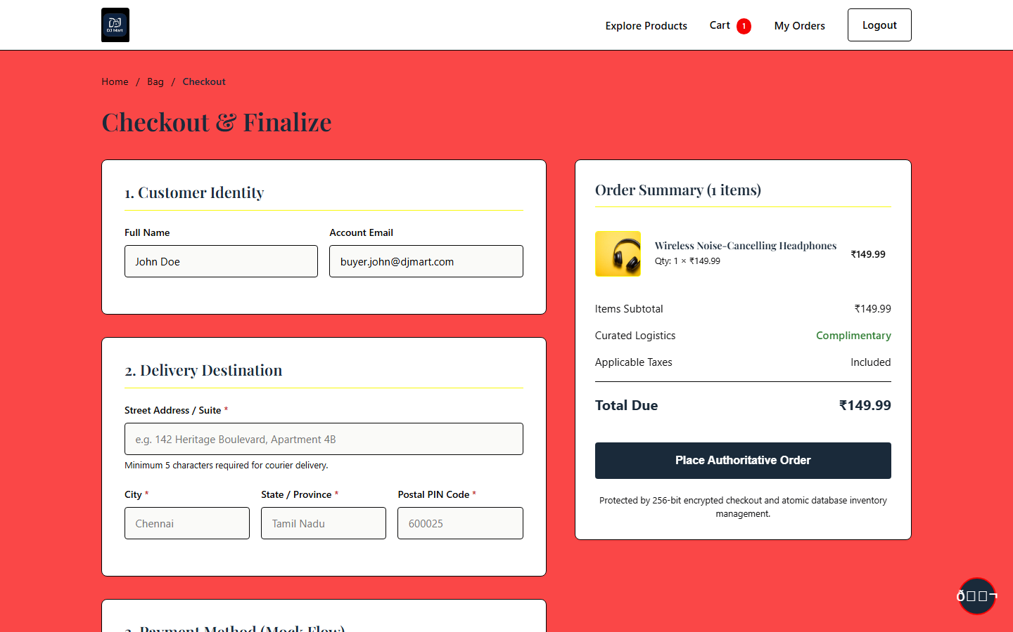
FULFILLMENT LIFECYCLE
Checkout & Order Process
Seamless Transition from Cart Review to Verified Order Confirmation
END-TO-END ORDER EXECUTION FLOW
1
Browse Products
Customer discovers products and views real-time specifications.
2
Add to Cart
Item added to session cart via asynchronous /api/v1/cart/items call.
3
Review Cart
Quantities verified, price subtotals confirmed by buyer.
4
Delivery Details
Shipping address, phone number, and fulfillment preferences entered.
5
Payment Selection
Payment method selected (Cash on Delivery / Instant Checkout).
6
Place Order & Commit
Server runs ACID transaction: validates stock, decrements inventory, creates order record, and empties cart.
DJ MART — E-Commerce Website
Developed using Antigravity
10 / 16

Slide 11
PLATFORM CAPABILITIES
Key Features of DJ Mart
Robust Features Implemented & Operational in Current Release
👑 User-Friendly & Classical UI
⚡ Fast Keyword Product Search
📂 Structured Product Categories
🔍 Full Product Details View
Distinctive luxury brand visual identity with custom gold accents, deep obsidian typography, and zero generic template styling.
Search bar enabling real-time product discovery across names, categories, and descriptions.
Multi-category taxonomy organizing electronics, fashion, home essentials, and stationery.
Dedicated views with high-res photos, detailed specifications, stock count, and price breakdowns.
🛒 Dynamic Interactive Cart
📝 Validated Checkout & Orders
📱 Mobile-First Responsive Layout
🛡️ Enterprise Security Defenses
AJAX-powered quantity adjustments (+/-), live total recalculation, and single-click item removal.
Comprehensive delivery address validation and safe order generation with status tracking.
Fluid media queries, slide-out mobile drawer, and touch-optimized buttons (44x44px min).
100% PreparedStatements against SQL injection, CSRF synchronizer tokens, and salted BCrypt passwords.
DJ MART — E-Commerce Website
Developed using Antigravity
11 / 16

Slide 12
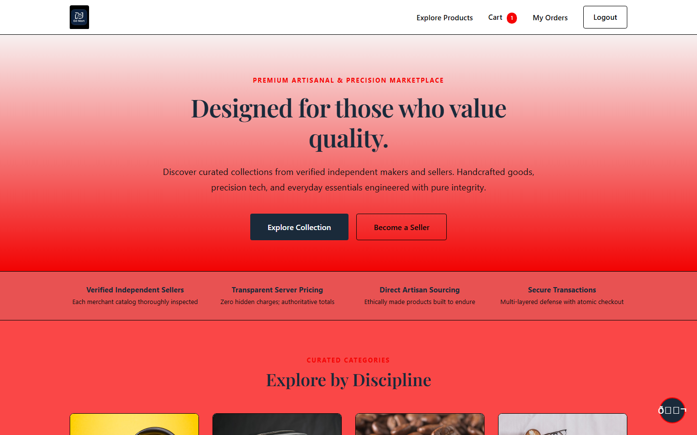
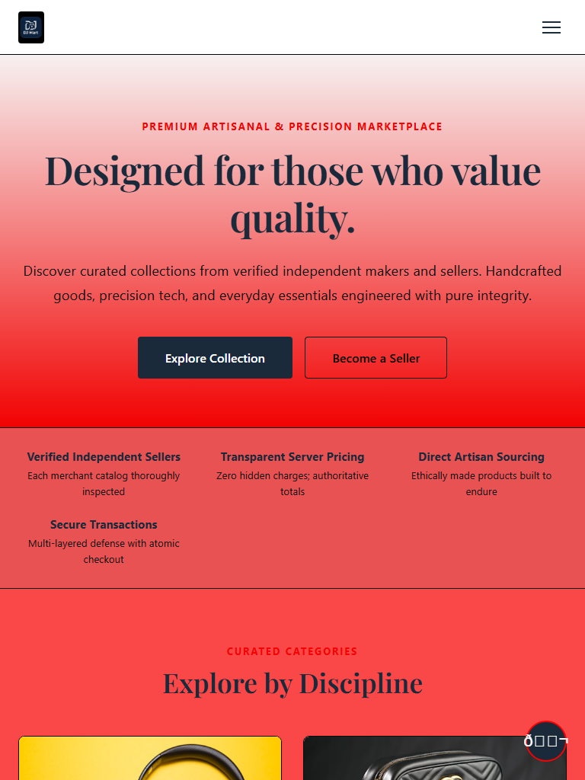

CROSS-DEVICE COMPATIBILITY
Responsive Design
Verified Adaptive Layout Across Desktop, Tablet, and Mobile Formats
🖥️ DESKTOP DISPLAY (1440px+)
📱 TABLET DISPLAY (768px – 1024px)
📲 MOBILE DISPLAY (390px)
Full multi-column product grid, sticky horizontal navigation bar, expanded category filter drawer, and detailed cart sidebars.
Optimized 2-to-3 column grid, fluid container widths, and collapsible category menus maintaining comfortable touch interaction.
Single-column stacked catalog, slide-out hamburger navigation drawer, and minimum 44x44px touch targets.
CONSISTENT VISUAL IDENTITY ACROSS ALL SCREENS: The luxury aesthetic—including gold accents, serif typography, high-res photography, and smooth transitions—is preserved uniformly whether accessed from a 4K monitor, iPad, or mobile phone.
DJ MART — E-Commerce Website
Developed using Antigravity
12 / 16

Slide 13
VALUE PROPOSITION
Advantages of DJ Mart
Key Technical & Practical Benefits for Shoppers & Administrators
💡 Simplicity & Ease of Use
⏱️ Saves Valuable Shopping Time
🌐 Convenient 24/7 Access
🔍 Transparent Information
Intuitive user interface requiring zero prior training or learning curve.
Eliminates travel, parking, and checkout lines; completes purchases in seconds.
Uninterrupted online availability allows shopping anytime from any location.
Live stock badges, clear pricing in ₹, and detailed technical specifications.
🚀 Lightweight & Blazing Fast
📱 Multi-Device Accessibility
🔒 Enterprise-Grade Security
📈 Modular & Highly Scalable
Pure Vanilla JS and optimized Jakarta Servlets avoid heavy framework bloat.
Flawless visual presentation and navigation across desktop, tablet, and mobile.
Salted BCrypt hashing, CSRF synchronizer tokens, and SQLi protection.
Layered MVC structure enables simple integration of future enterprise modules.
DJ MART — E-Commerce Website
Developed using Antigravity
13 / 16

Slide 14
PROJECT ROADMAP
Future Enhancements
Strategic Roadmap for Future Enterprise Scale & Advanced Features
FUTURE ROADMAP
FUTURE ROADMAP
FUTURE ROADMAP
FUTURE ROADMAP
💳 Live Payment Gateway
🚚 Real-Time Order Tracking
❤️ Customer Wishlist
🤖 AI-Based Recommendations
Integration with Razorpay, Stripe, and UPI for automated real-time digital payments and instant webhooks.
Interactive parcel status tracker with live carrier integration and map-based delivery updates.
Ability for customers to bookmark luxury products for future purchases and receive price drop alerts.
Machine learning algorithms suggesting relevant products based on browsing history and affinities.
FUTURE ROADMAP
FUTURE ROADMAP
FUTURE ROADMAP
FUTURE ROADMAP
📊 Advanced Seller Management
🔔 Automated Notifications
📲 Native Mobile Applications
📈 Predictive Business Analytics
Dedicated seller portal with automated inventory alerts, barcode scanning, and bulk CSV uploads.
Multi-channel SMS and Email alerts for order confirmation, shipping updates, and invoice delivery.
Cross-platform mobile apps for iOS and Android built using Flutter or React Native for app store distribution.
Deep business intelligence dashboards with sales forecasting, customer retention, and inventory churn metrics.
DJ MART — E-Commerce Website
Developed using Antigravity
14 / 16

Slide 15
PROJECT SUMMARY
Conclusion
Summary of Project Achievements & Technical Milestones
🏆 Successful Development Using Antigravity
🎯 Complete End-to-End Shopping Experience
DJ MART successfully demonstrates the rapid, robust development of a modern e-commerce web application using Google Antigravity, achieving clean architecture and enterprise code quality.
Delivered an operational shopping workflow from catalog exploration, real-time search, and category filtering to cart adjustments, address capture, and atomic order placement.
⚙️ Demonstration of Modern Web Concepts
🚀 Extensible & Production-Ready Foundation
Proved the effectiveness of Jakarta EE 6 Servlets, JSTL server rendering, Vanilla JS API clients, H2 SQL database transactions, and bank-grade OWASP security protections.
The layered MVC codebase adheres to industry separation-of-concerns principles, establishing a solid foundation primed for live payment gateways and multi-cloud deployment.
DJ MART — E-Commerce Website
Developed using Antigravity
15 / 16

Slide 16
THANK YOU
Questions & Answers
"Smart, Simple & Convenient Online Shopping"
DJ MART — E-Commerce Website
Developed using Antigravity
College Project Presentation & Viva
Academic Year 2025 – 2026
DJ MART — E-Commerce Website
Developed using Antigravity
16 / 16

