Slide 1

Project Title -
Seasonal Agriculture Performance Analysis
Student Name : Sadi Ravanthi
College Name: Miracle Educational Society Group Of Instituions
AICTE STU ID : STU6a6c4ba2481b51785482146

Slide 2

PROBLEM STATEMENT
Agricultural performance varies across seasons due to changes in environmental conditions, farming practices, resource availability, and market conditions.
Raw agricultural data does not clearly reveal how these factors relate to crop yield, production, resource utilization, and economic performance across different seasons.
This project focuses on analyzing agricultural data to:
Identify seasonal patterns and trends.
Compare yield, production, profitability and resource usage.
Examine relationships between environmental conditions and agricultural outcomes.
Identify significant variations and unusual patterns.
Generate evidence-based insights for seasonal agricultural planning.

Slide 3
Project Description
This project analyzes a dataset containing agricultural activities across different seasons, crops, states and farming conditions.
The analysis covers:
Agricultural productivity — Yield and Production
Environmental conditions — Rainfall, Temperature, Humidity and Soil Moisture
Resource utilization — Water, Fertilizer and Pesticides
Economic performance — Revenue, Cost and Profit
Agricultural risk — Disease and Pest Risk
Seasonal and crop-wise performance comparisons
The analysis uses data cleaning, exploratory analysis, statistical relationships and visualization techniques to identify meaningful seasonal patterns.

Slide 4

WHO ARE THE END USERS?
This analysis can provide useful insights to:
🌾 Farmers
Compare seasonal crop performance.
Understand resource requirements.
Observe productivity and profitability patterns.
🏛️ Agricultural Planners & Government Departments
Understand regional and seasonal agricultural patterns.
Support evidence-based agricultural planning.
📊 Agricultural Analysts & Researchers
Analyze relationships between environmental conditions and agricultural outcomes.
Identify areas requiring further investigation.
💼 Agricultural Businesses
Understand production, market and profitability patterns.
Don't put too much text. Four categories are enough.

Slide 5

Technology Used
Programming Language
Python
Development Environment
Google Colab / Jupyter Notebook
Libraries
Pandas – Data cleaning & analysis
NumPy – Numerical operations
Matplotlib – Data visualization
Seaborn – Statistical visualization
Techniques
Data Cleaning
Exploratory Data Analysis (EDA)
Aggregation & Comparison
Correlation Analysis

Slide 6
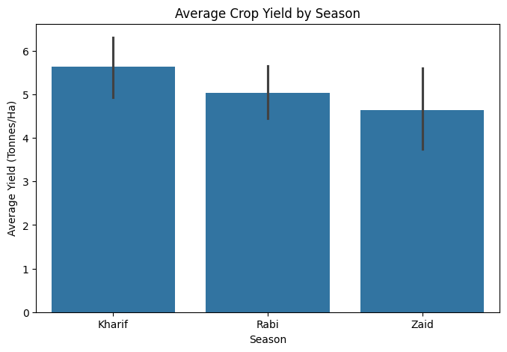
RESULTS
The analysis compares average crop yield across Kharif, Rabi and Zaid seasons. The comparison helps identify seasonal differences in agricultural productivity.

Slide 7
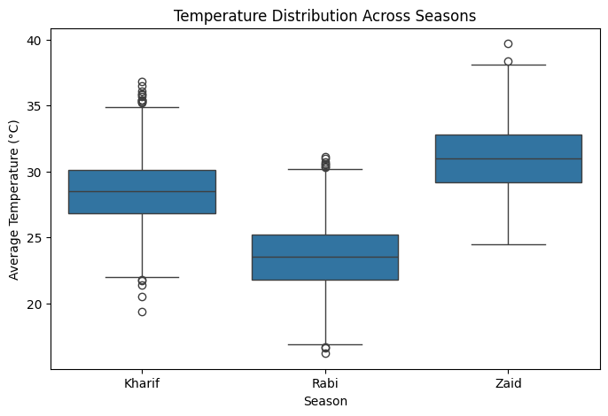
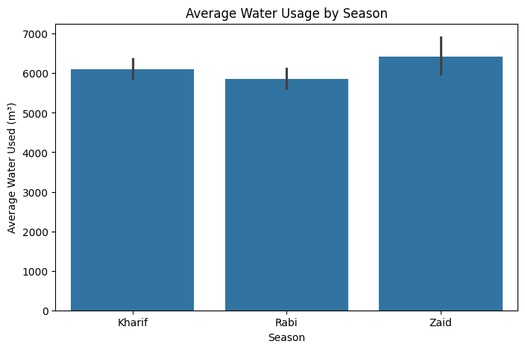
RESULTS
]

Slide 8
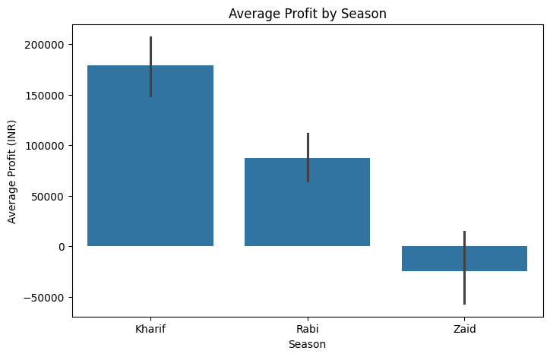
RESULTS
Seasonal profitability was compared using average profit, revenue and production-related measures. The analysis highlights differences in economic outcomes across seasons.

Slide 9
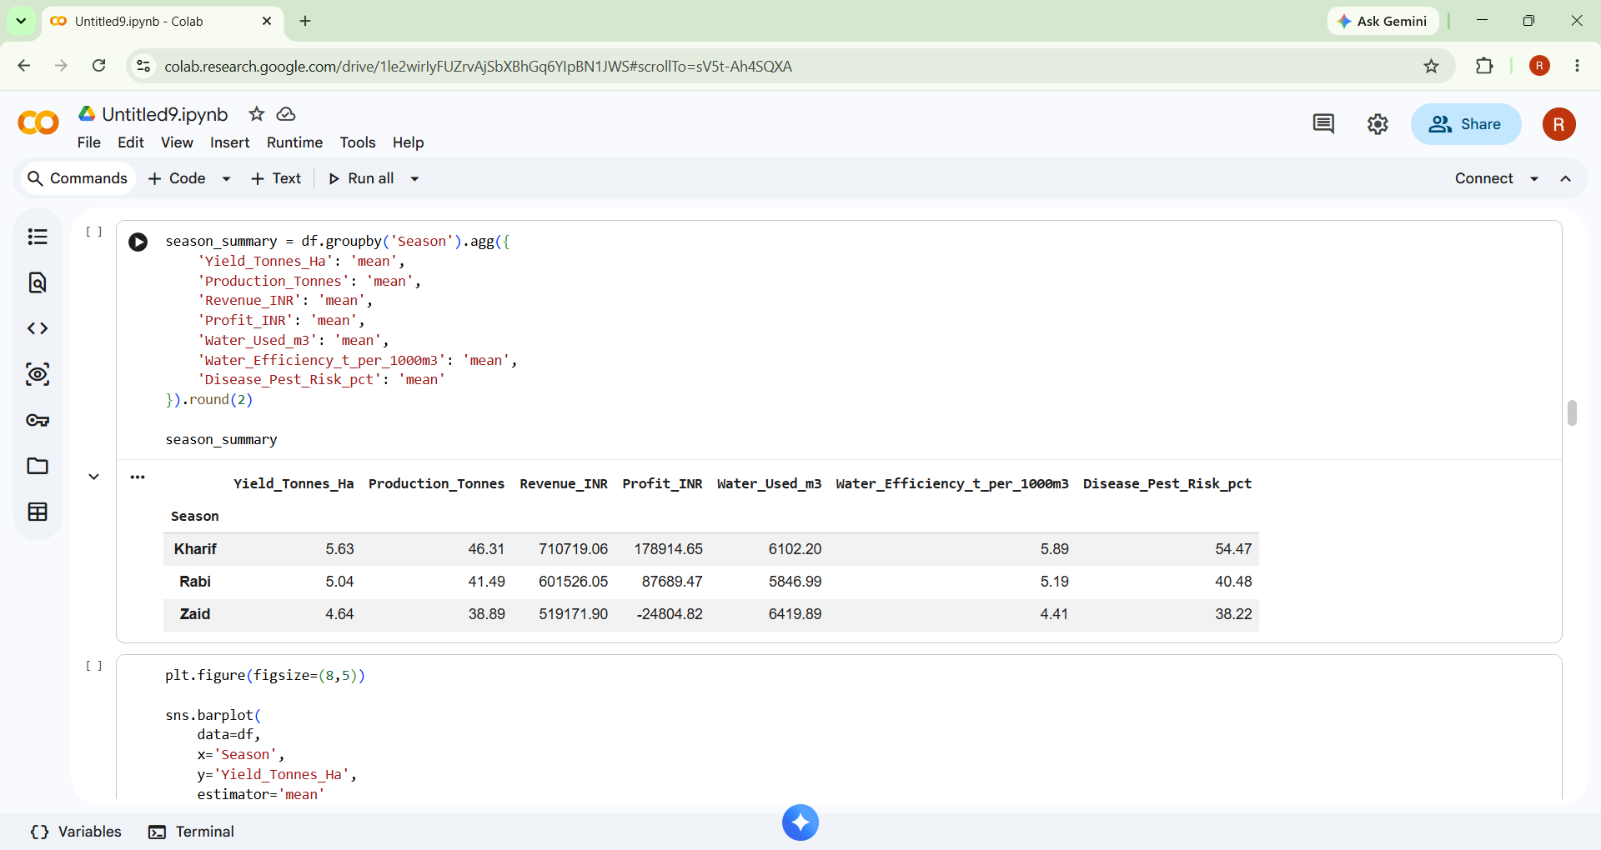
RESULTS

Slide 10
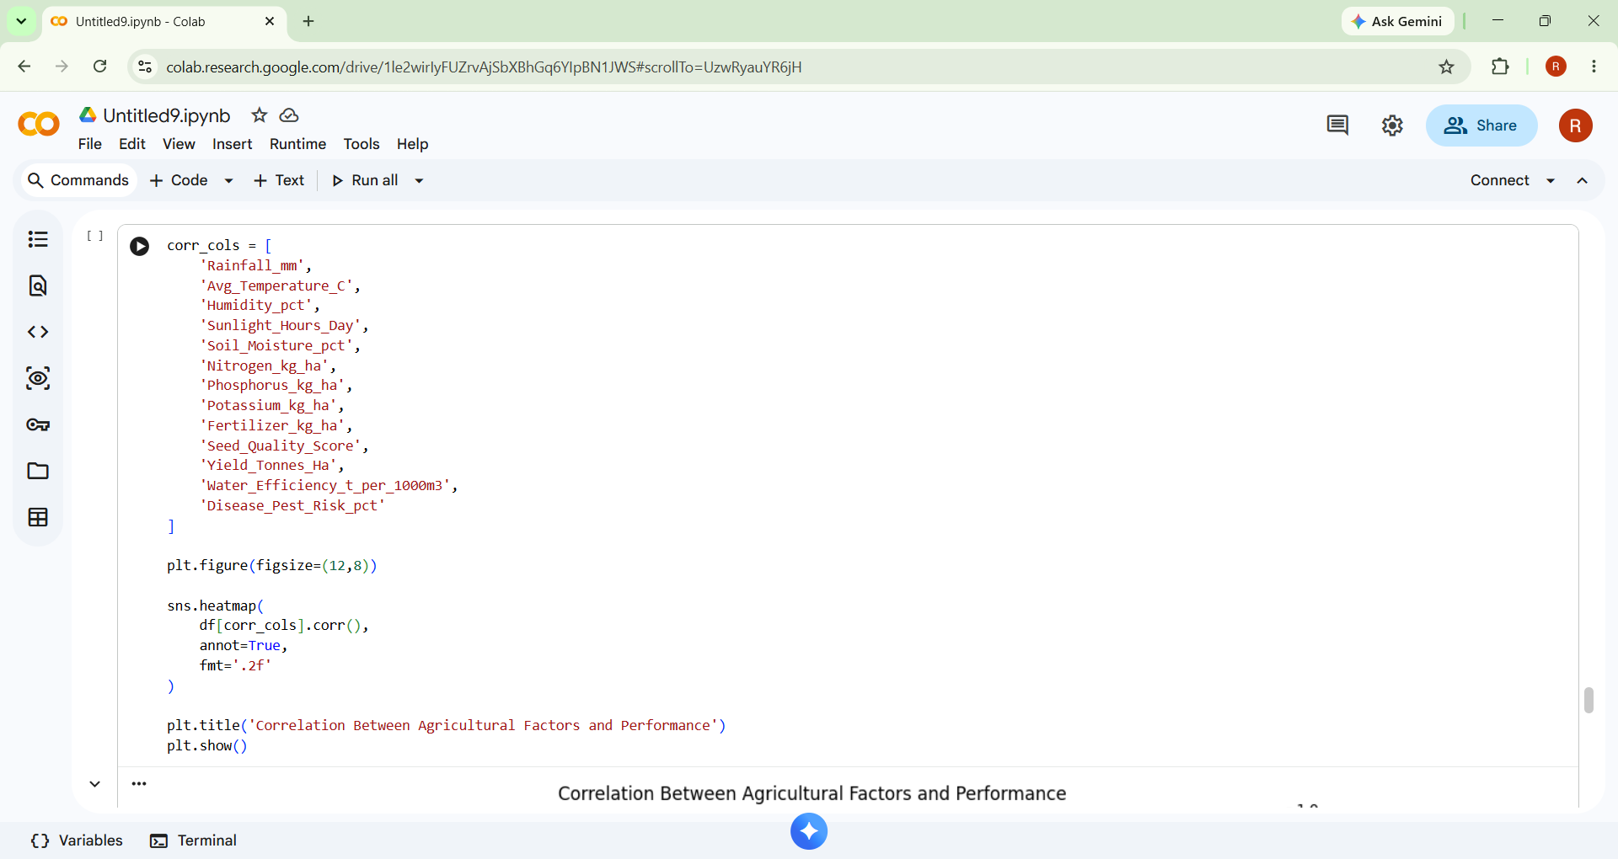
RESULTS

Slide 11
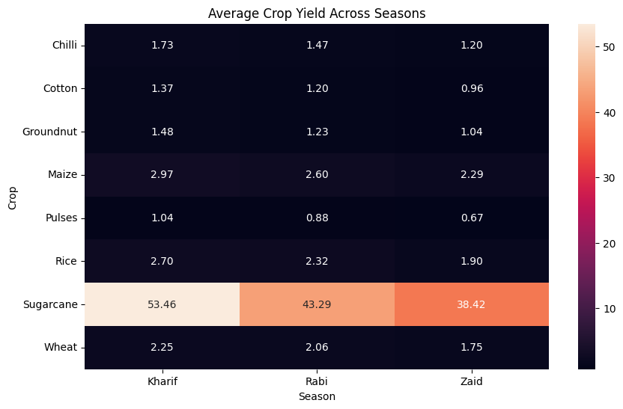
RESULTS

Slide 12
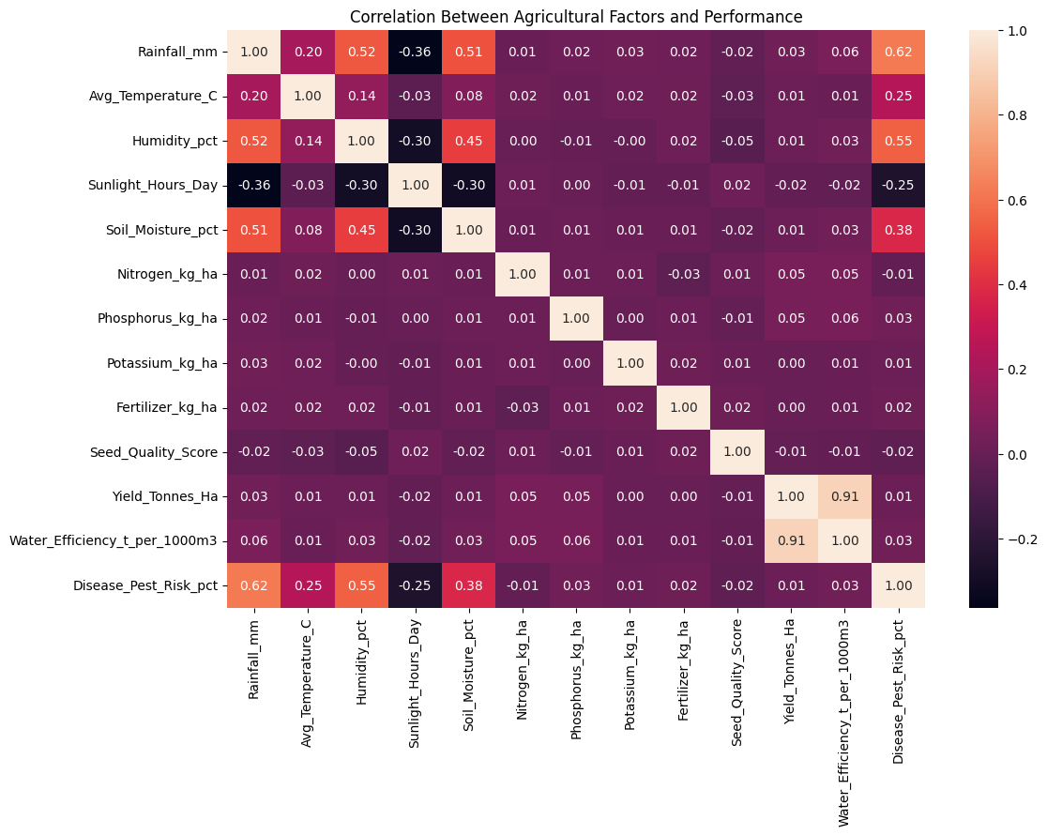
RESULTS

Slide 13
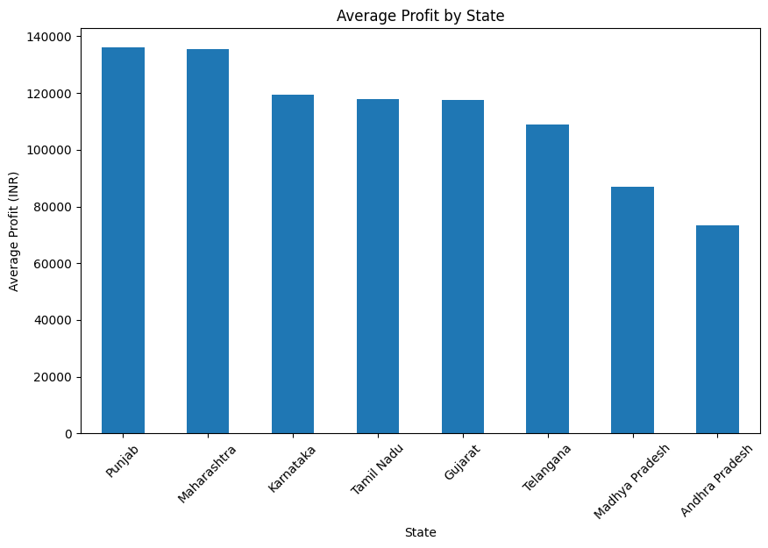
RESULTS

Slide 14
Future scope
Future Scope
Develop an interactive Power BI dashboard for real-time exploration of seasonal agricultural performance.
Incorporate additional weather and soil datasets for deeper analysis.
Apply machine learning models to predict crop yield and agricultural risks.
Extend the analysis with more regions, crops and historical data.
Develop a decision-support system for seasonal crop and resource planning.
Integrate live market information to study changes in crop prices and profitability.
This is enough. Don't claim that you've already done these things.

Slide 15
GitHub Link
https://github.com/ravanthi26/Seasonal-Agriculture-Performance-Analysis

Slide 16


VOIS Course completion certificate -
Course name- Data Visualization
RAVANTHI SADI
Data Visualization
August 20, 2026
VFLMS26_167426

Slide 17
Thank you
Seasonal Agriculture Performance Analysis
Sadi Ravanthi
.
.

