Slide 1
Session 7!!!
November 9, 2020
Notes:
Names: Hannah, Megan, Zuha, Ana + Paula, Angel, Sasha, Nina

Slide 2
Today’s Agenda
Log On to Arduino web editor
Women-in-Tech Spotlight
Review of Last Week
Kahoot!
Activity
Capacitors
Objects, Methods, and Classes
Servo Motor
Stand ups – anyone who wants to!

Slide 3
Women in Tech Spotlight Placeholder

Slide 4
Review

Slide 5
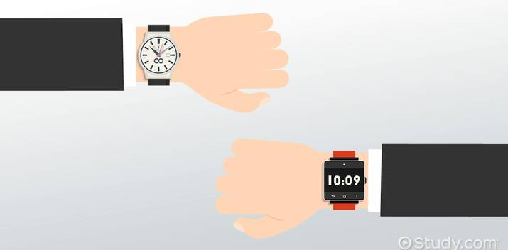
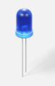
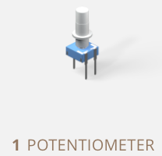
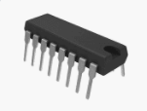
Review: Analog vs Digital
An analog signal is continuous.
A digital signal is discrete.
analogWrite(pin, value)
Writes an analog value (PWM wave)
to a pin.
value can be 0 to 255
digitalWrite(pin, value)
Writes a digital value to a pin.
value can be HIGH or LOW.
HIGH>3V, LOW<1.5V

Slide 6
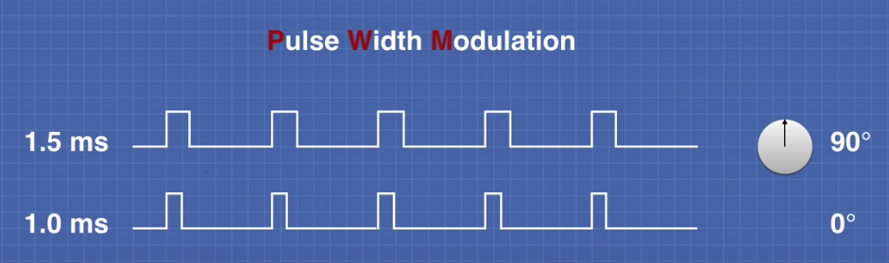
Review: Analog vs Digital
An analog signal is continuous.
analogWrite(pin, value)
Writes an analog value (PWM wave)
to a pin.
value can be 0 to 255

Slide 7
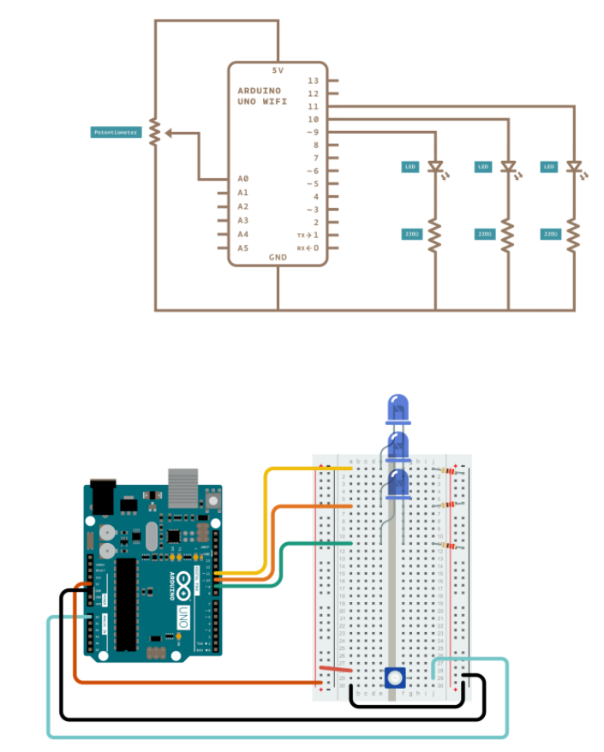
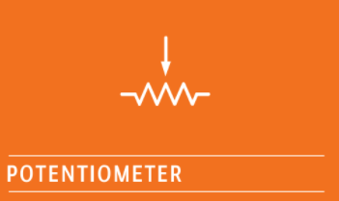
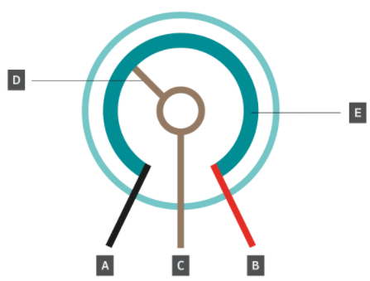
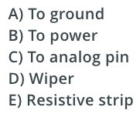
Review: Potentiometer
A potentiometer is a type of variable resistor. In other words, it can be changed to have no resistance or to have a great deal of resistance. The potentiometers in your kit have a range of 0 to 10,000 ohms.

Slide 8
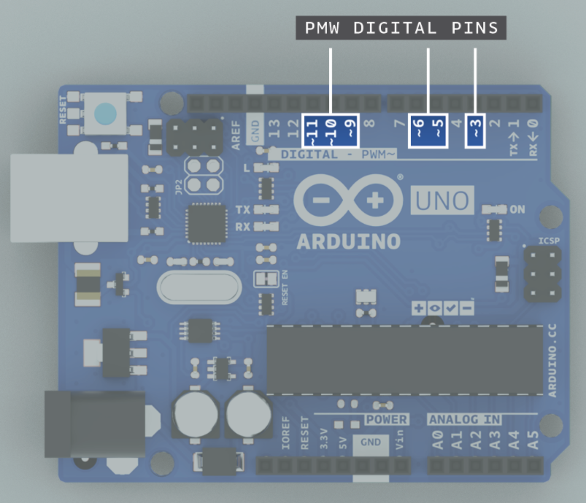
Review: Potentiometer
~ = PWM

Slide 9
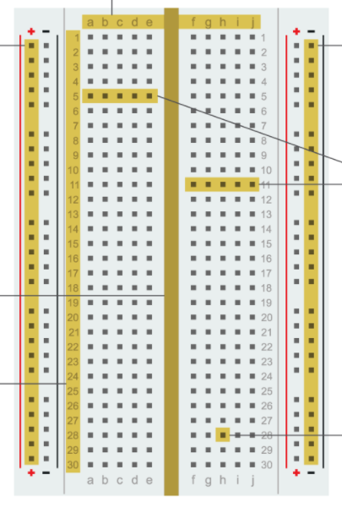
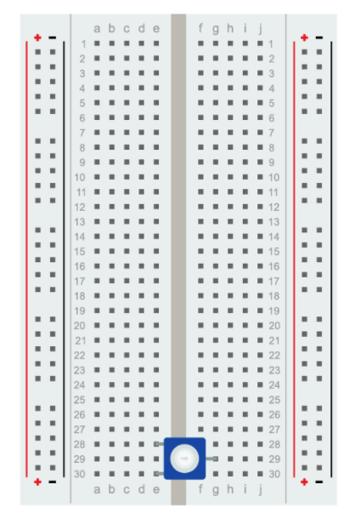
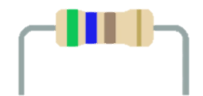
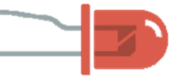

Review: Breadboard

Slide 10
Kahoot!

Slide 11
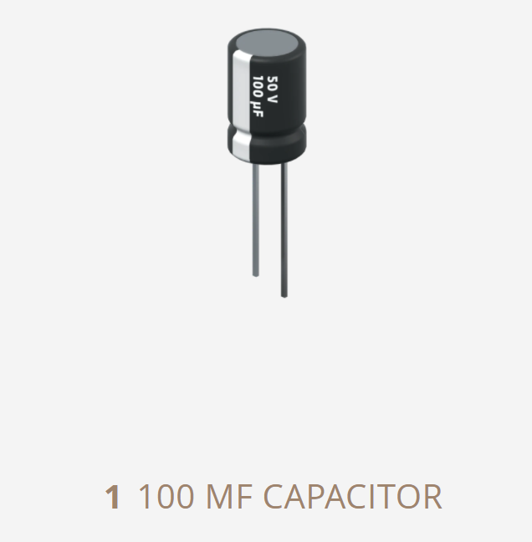
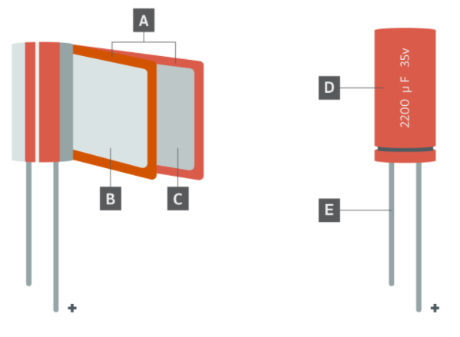

Capacitor – An electrical component that stores an electric charge.
Capacitors store charge in a much different way than batteries do. Batteries use a chemical reaction to produce electrons on one terminal and absorb electrons on the other terminal. Capacitors don’t produce electrons like batteries do. Capacitors are storage units where electrons are stored and released through the same terminal they came in.
Capacitors have two terminals. Some capacitors, like the ones in your kit, are polarized. They have an anode and a cathode. With polarized capacitors, electrons flow in only one direction. Therefore, polarized capacitors are generally used in DC applications where current flows in one direction. Non-polarized capacitors allow electrons to flow in either direction. This makes them great for AC applications where current alternates directions. However, they can also be used in DC circuits.
$$μF$$
Inside a capacitor, the terminals are connected to conductive metal plates that are separated by an insulator. The insulator that separates the plates is called a dielectric and can be made from ceramic, porcelain, glass, and even air. The dielectric material is what gives capacitors a wide range of types and uses.
A) Separator B) Anode foil (+) C) Cathode foil (-) D) Container E) Terminal

Slide 12
This Week’s Activity
Notes:
https://wcrsyyc.github.io/ardx/circ08.html

Slide 13
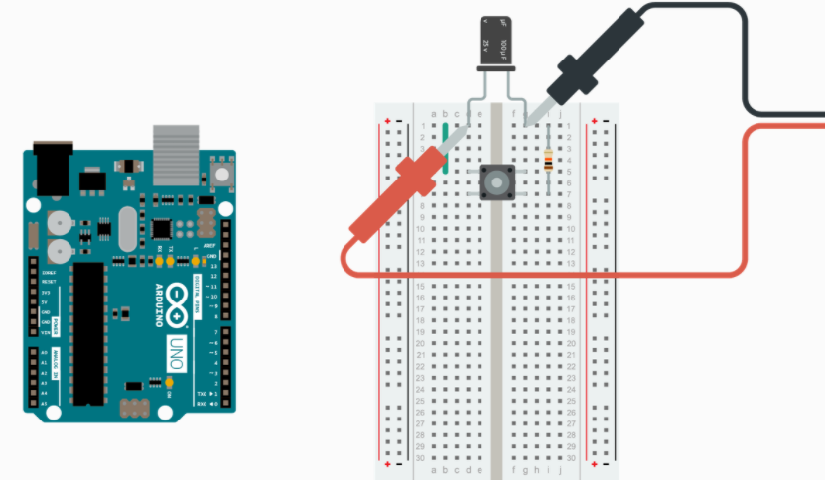
Capacitor Exercise
Touch the red test lead from the multimeter to the anode and the black test lead to the cathode. If your capacitor has fully discharged, the multimeter should read zero or near zero volts.

Slide 14
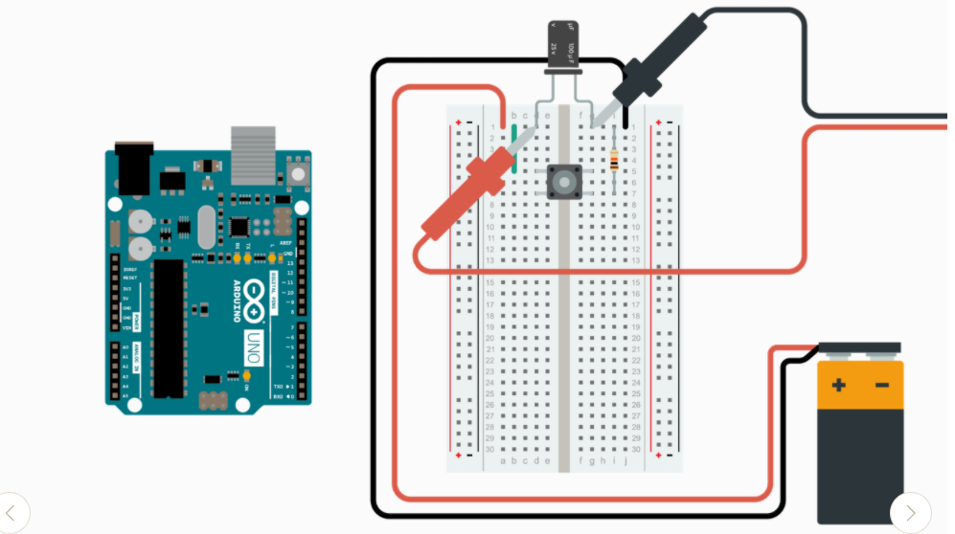
Capacitor Exercise
While still measuring voltage across the capacitor, charge the capacitor by connecting the battery to its terminals. Notice the voltage reading on the multimeter. The capacitor should be charged with about nine volts.

Slide 15
Capacitor Exercise
Disconnect the battery from the breadboard and move it out of the way. This leaves the capacitor as the only power source for the circuit
Measure the voltage across the capacitor. Touch the red test lead from the multimeter to the anode and the black test lead to the cathode. The multimeter should start at nearly nine volts, the voltage of the battery. However, you should notice that the voltage decreases as the capacitor discharges its stored energy.
The capacitor discharges because the multimeter acts as a load on the circuit with a resistance of one megaohm (1,000,000 ohms). With a resistance this high, the capacitor discharges slowly (about 500 seconds).

Slide 16
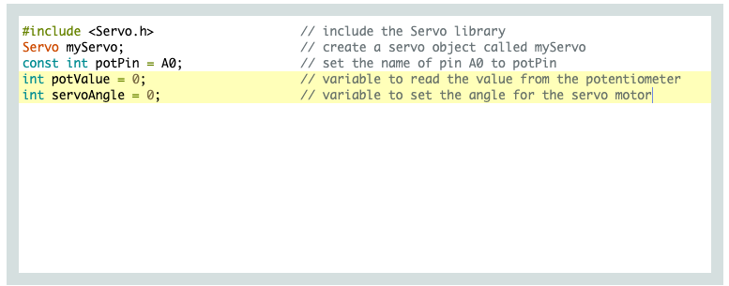
Objects, Methods, and Classes
A class is like a template that holds a lot of information in different variables or properties. These variables or properties describe an object.
An object is a specific example that belongs to the class. In other words, if a class is a template, an object is a completed template that describes all the characteristics of a certain example.
Classes also hold the code for objects to perform certain behaviors or actions. These behaviors are called methods.
For example, a dog could be considered a class. Properties for the dog class could be breed, weight, age, and color. Methods that could be included in the dog class are eat, sleep, run, sit, fetch, and roll over. An object of the dog class would be Labrador retriever that weighs 40 pounds (18 kilograms), is seven years old, and is brown.
https://github.com/ravedawg/GirlsWhoCode
-> Resistor_Activity.pdf

Slide 17
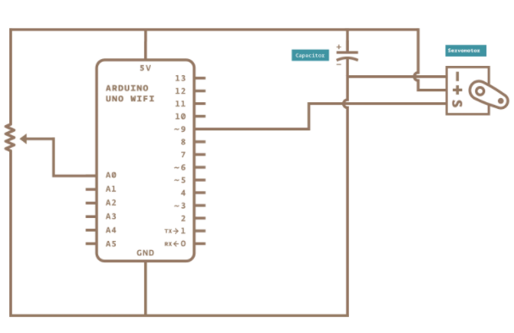
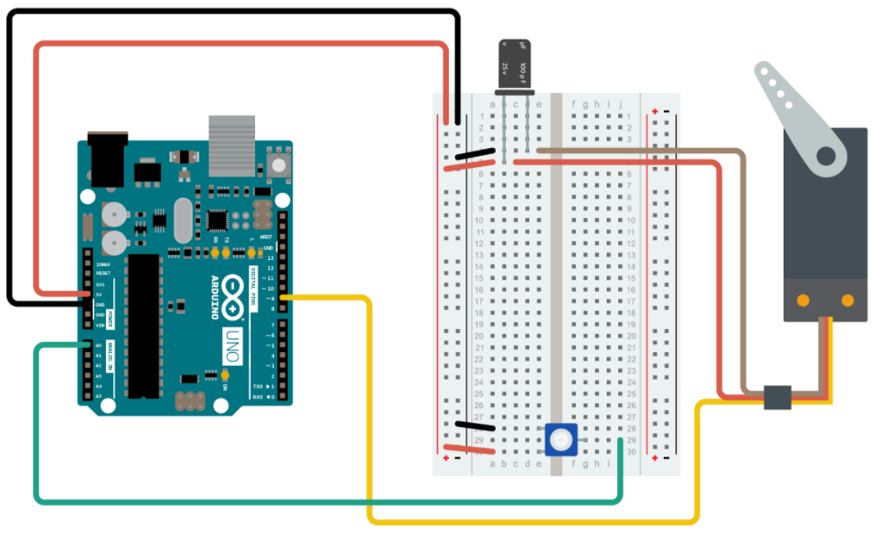
Servo Motor Exercise – control the arm with the potentiometer
Your columns might be in different order.
servo motor
These wires might change order from the base of the servo motor to the connector – make sure red connects to red, black/brown connects with black/brown, and white/yellow connects to white/yellow.
potentiometer

Slide 18
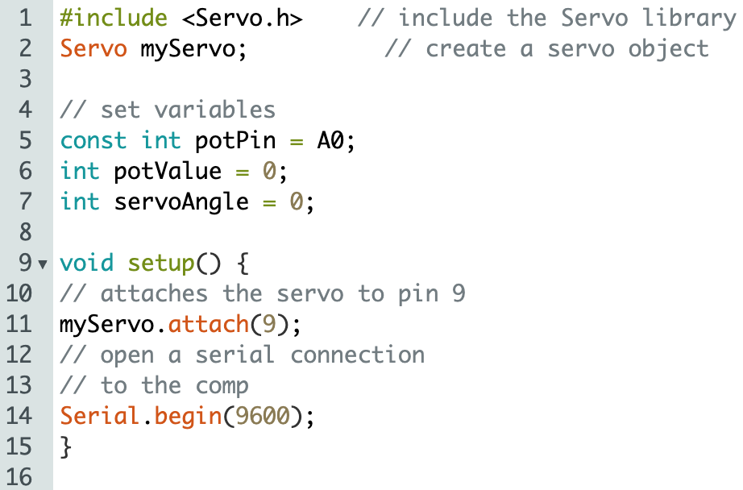
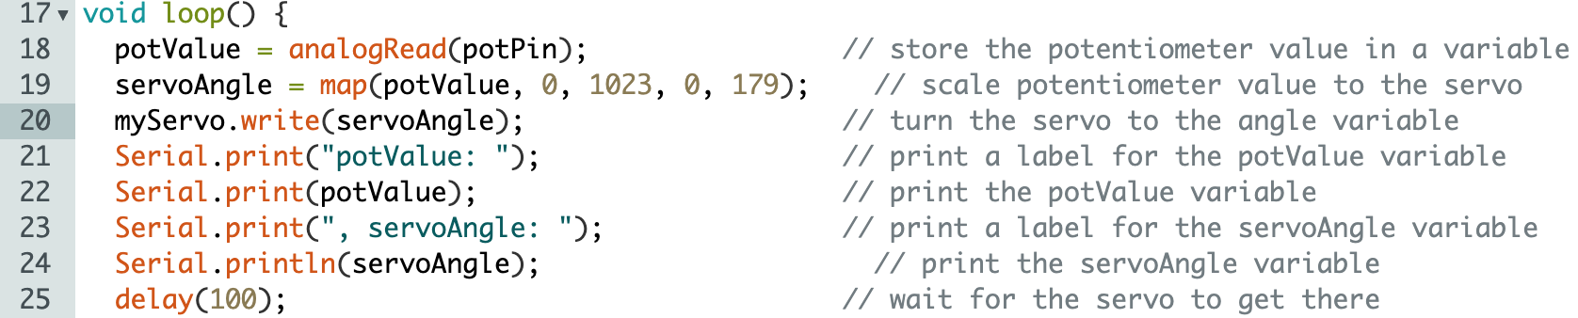
Servo Motor Exercise - control the arm with the potentiometer

Slide 19
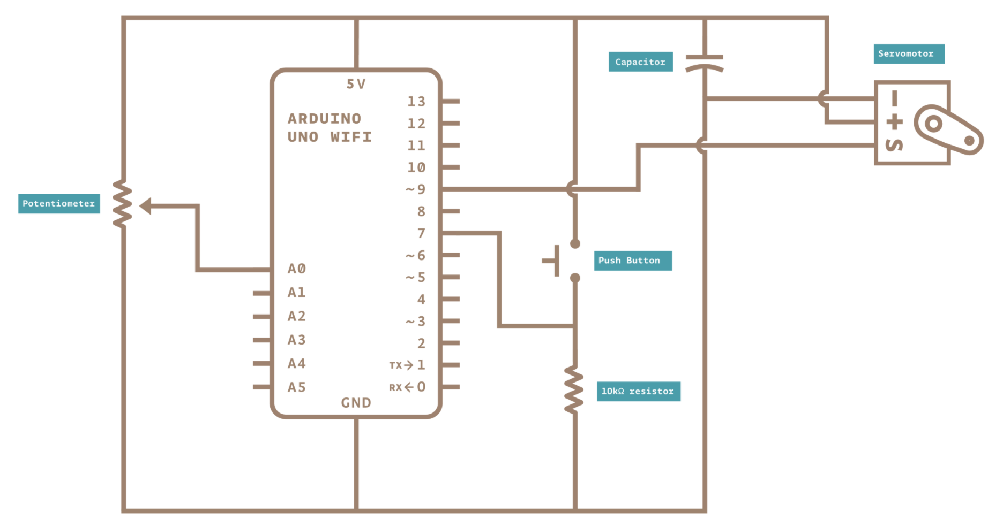
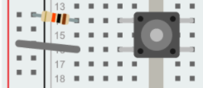
Servo Motor BONUS Exercise – Add a button to your circuit!
pushbutton
10kΩ resistor
pin7

Slide 20
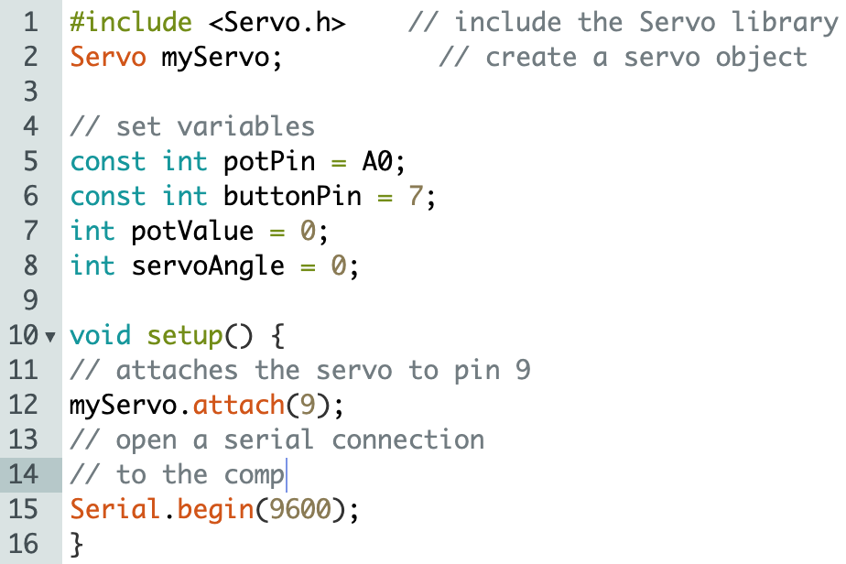
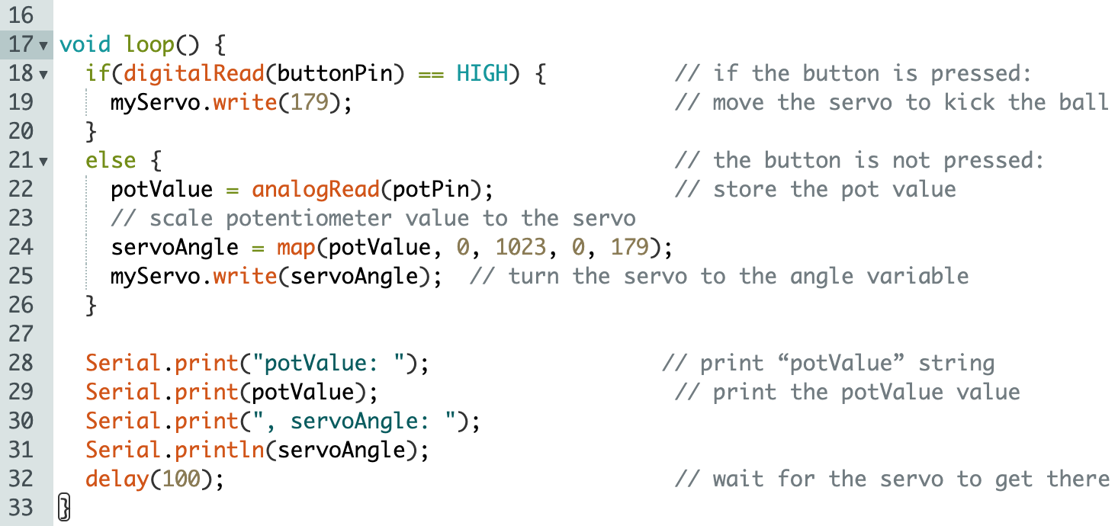
Servo Motor BONUS Exercise – Add a button to your code!

Slide 21
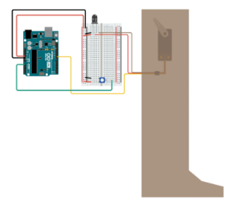
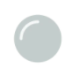
Homework!!!!

Slide 22
Stand Ups
What did you learn this week?
What do you need help with/ what would you like to know more about?
What do you think this lesson would be useful for?

Slide 23
Resources
Arduino tutorials: https://www.arduino.cc/en/Tutorial/HomePage?from=Main.Tutorials
MIT’s Scratch program is a great stepping stone that uses block coding, allowing you to learn the structure of programming before learning the actual languages themselves.
Code.org provides numerous resources connected to coding for those interested in learning the basics.
Code Academy is an interactive guide to learning multiple languages like JavaScript, HTML/CSS, and more.
Khan Academy has instructional courses on computer programming and computer science, it is an especially good resource for learning how to animate with code.
Also if you have any computer science classes offered at your school, I highly recommend taking them.
Typershark or any basic typing tutorial/software/class. Might seem boring, but proper typing skills will pay off in the future a thousand times over – you don’t want something so simple holding you back!
Maybe robotics and programming isn’t as interesting as you thought it would be, or maybe it’s just not enough! Explore these adjacent fields: Data Science, Robotics, Graphic Design, Engineering, Cybersecurity, Hacking, Machine Learning, Natural Language Processing, Network Design, Website creation.

Slide 24
Backup Material
Fei-Fei Li: How we are teaching computers to understand pictures. https://www.ted.com/talks/fei_fei_li_how_we_re_teaching_computers_to_understand_pictures?language=en

Slide 25
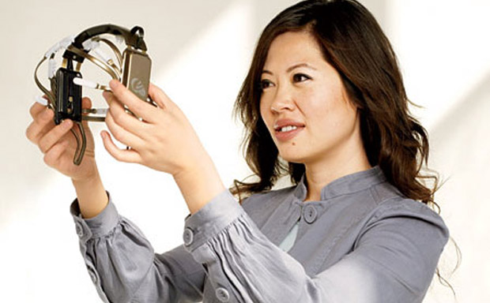
Women in Tech Spotlight: Tan Le
Accomplishments
Tan Le is the CEO and founder of Emotiv - a bioinformatics company.
The company is exploring a new “remote control” where a headset uses EEG technology to control digital devices by reading brain activity.
She is a refugee from Vietnam at age 4, she entered college at 16 and has since become a vital young leader in her home country of Australia. She attended Monash University in Melbourne, Australia where she studied law and commerce.
https://www.ted.com/talks/tan_le_a_headset_that_reads_your_brainwaves

Slide 26
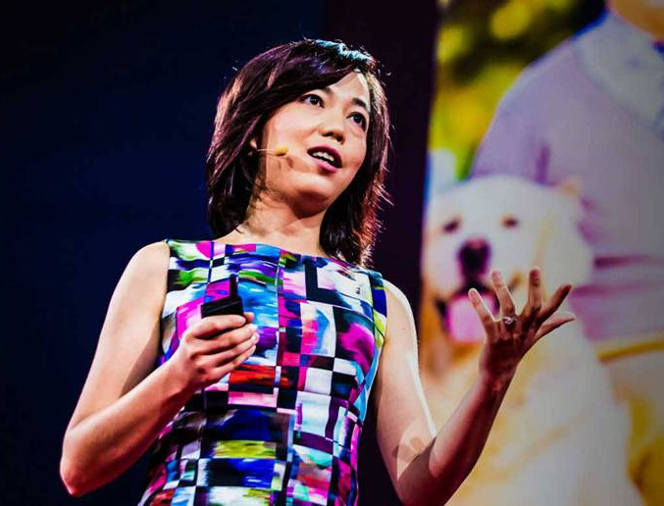
Women in Tech Spotlight: Fei Fei Li
Accomplishments
Current director of Stanford Artificial Intelligence Lab, as well as the Stanford Vision Lab, Head of Google Cloud AI
B.S. in Physics from Princeton, with High Honors
PHD in Electrical Engineering from Cal Inst. Of Tech
2011 Sloan Fellowship recipient (43 fellows have gone on to win Nobel Peace Prizes)
Currently working to solve AI’s trickiest problems, including image recognition, learning, and language processing
Also works in cognitive neuroscience: studies how human brains work in order to apply those lessons to teaching machines to learn better
https://www.ted.com/talks/fei_fei_li_how_we_re_teaching_computers_to_understand_pictures

Slide 27
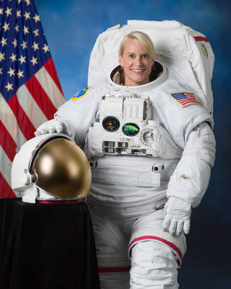
Women in Tech Spotlight: Kate Rubins
BS in Molecular Biology from University of California, San Diego
PhD in Cancer Biology from Stanford University Medical School
Fellow/Principal Investigator of a Lab at the Whitehead Institute for Biomedical Research of MIT studying viral diseases that primarily affect Central and West Africa and conducted research in the Democratic Republic of Congo
Selected to the Astronaut Corps in 2009
Expeditions 48 and 49 participating in more than 275 different scientific experiments
First person to sequence DNA in space, sequencing over 2 billion base pairs of DNA
Performed 2 space walks, including installing the new International Docking adapter, a new docking port for the US commercial crew spacecraft (i.e. the SpaceX flight that took place earlier this year)
Currently on board the International Space Station for Expedition 63/64
https://www.nasa.gov/astronauts/biographies/kathleen-rubins/biography

