Slide 1
Welcome to Session 1!!!!
March 5th, 2018 – Design Phase
Notes:
Names: Hannah, Megan, Zuha, Ana + Paula, Angel, Sasha

Slide 2
Club Schedule
Week 1 | 21Sep2020 | Intros, electronics concepts, kit familiarization
Week 2 | 28Sep2020 | Electronics concepts, kit familiarization
Week 3 | 05Oct2020 | Start first project
Skip for Columbus Day
Week 4 | 19Oct2020 | Finish first project
Week 5 | 26Oct2020 | Second project
Week 6 | 02Nov2020 | Third project
Week 7 | 09Nov2020 | Fourth project
Week 8 | 16Nov2020 | Fifth project
Skip for Thanksgiving
Week 9 | 30Nov2020 | Collaborative project design
Week 10 | 07Dec2020 | Collaborative project prototype / demo
Week 11 | 14Dec2020 | Showcase and Celebration – Families invited!
We meet Mondays from 7-9pm on zoom. You should each have a unique link and passcode already (the same one your parents used for the 101 session).
We skip 2 weeks for holidays.
If you can’t make a session, need to get a hold of us, or have questions:
raven.r.holm@gmail.com
Notes:
Names: Hannah, Megan, Zuha, Ana + Paula, Angel, Sasha

Slide 3
Today’s Agenda
Welcome – Sam + Raven
Intros – Everyone! (Name, age, school, and why you’re interested in STEM)
Enrollment to GWC HQ – anyone not already enrolled
Women-in-Tech Spotlight – Raven
Arduino safety and kit walkthrough – Sam
Electrical engineering concepts
Breadboard exercise – Raven
Multimeter exercise – Sam
Programming install – Sam (+ Raven for Mac) https://www.arduino.cc/en/Main/Software
Schedule, resources – Raven
Stand ups – anyone who wants to!

Slide 4
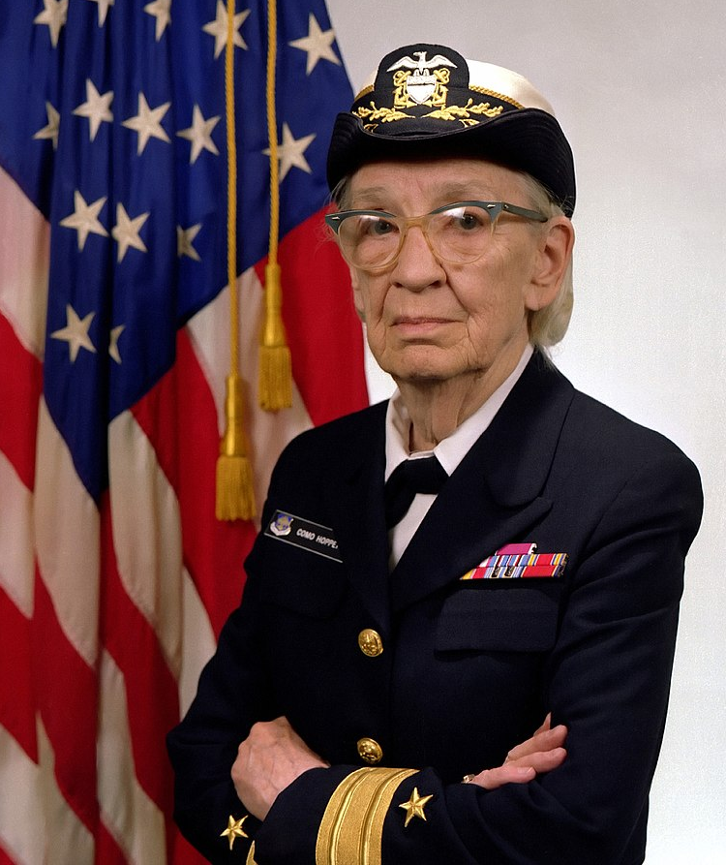
Women in Tech Spotlight: ADM Grace Hopper
Accomplishments
USN Rear Admiral
Made the first ever compiler (took English-based code, and translated to Computer-interpretable instructions)
Invented the concept of machine-agnostic languages
Awarded 40 honorary degrees
Posthumously awarded the Presidential Medal of Freedom
https://youtu.be/Fg82iV-L8ZY
http://fivethirtyeight.com/features/the-queen-of-code/

Slide 5
Breadboard Exercise

Slide 6
Multimeter Exercise

Slide 7
Standup
Standup: a common practice in the tech industry that’s designed to make progress updates focused and effective. Last 5 minutes of each day.
Answer 3 questions:
1. What did you accomplish today?
2. What will you accomplish next week?
3. What do you need help with?

Slide 8
Resources
Arduino tutorials: https://www.arduino.cc/en/Tutorial/HomePage?from=Main.Tutorials
MIT’s Scratch program is a great stepping stone that uses block coding, allowing you to learn the structure of programming before learning the actual languages themselves.
Code.org provides numerous resources connected to coding for those interested in learning the basics.
Code Academy is an interactive guide to learning multiple languages like JavaScript, HTML/CSS, and more.
Khan Academy has instructional courses on computer programming and computer science, it is an especially good resource for learning how to animate with code.
Also if you have any computer science classes offered at your school, I highly recommend taking them.
Typershark or any basic typing tutorial/software/class. Might seem boring, but proper typing skills will pay off in the future a thousand times over – you don’t want something so simple holding you back!
Maybe robotics and programming isn’t as interesting as you thought it would be, or maybe it’s just not enough! Explore these adjacent fields: Data Science, Robotics, Graphic Design, Engineering, Cybersecurity, Hacking, Machine Learning, Natural Language Processing, Network Design, Website creation.

Slide 9
Backup Material
Fei-Fei Li: How we are teaching computers to understand pictures. https://www.ted.com/talks/fei_fei_li_how_we_re_teaching_computers_to_understand_pictures?language=en

