Slide 1
Welcome Back!!!
February 22, 2021
Notes:
Names: Hannah, Megan, Zuha, Ana + Paula, Angel, Sasha, Nina

Slide 2
Today’s Agenda
Accounts and Software
Women-in-Tech Spotlight
Review – Code vocab, skeleton, loops
Review – Potentiometer
DMM exercise
Circuit – Potentiometer and LED
Code – skeleton, pin assignment, read pot input, send output
Put it all together!
Stand ups

Slide 3
Women in Tech Spotlight

Slide 4
Code Review

Slide 5
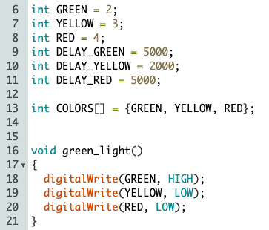
Code Review:
Word bank:
array
COLORS[] is an _________
GREEN is a ______
The ______of YELLOW in COLORS[] is two
green_light() is a ____________
variable
index
function

Slide 6
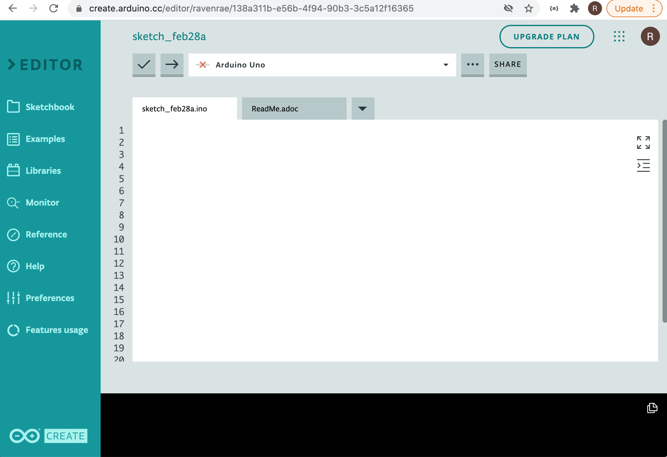
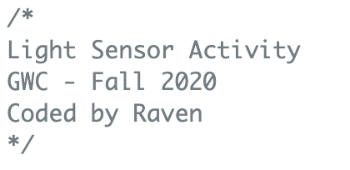
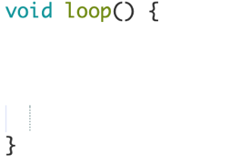

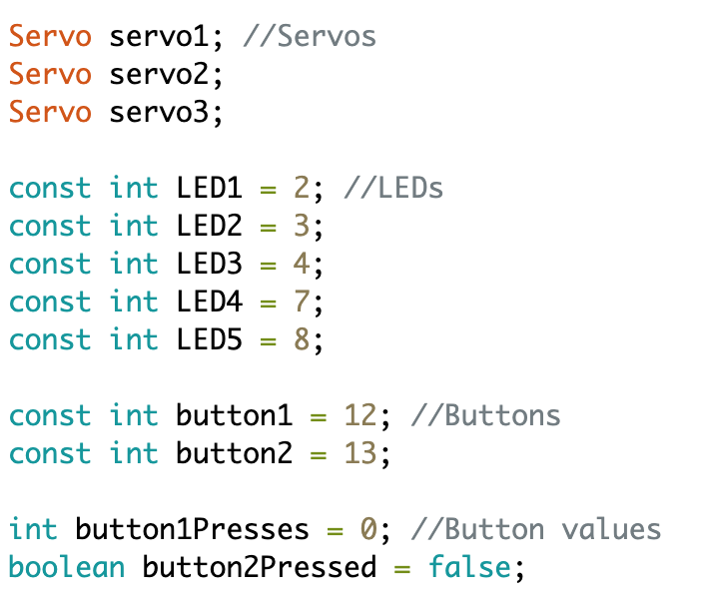
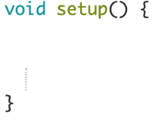
Place these objects in the right order
First
Second
Third

Slide 7
Place these objects in the right order

Slide 8
Circuit Review

Slide 9

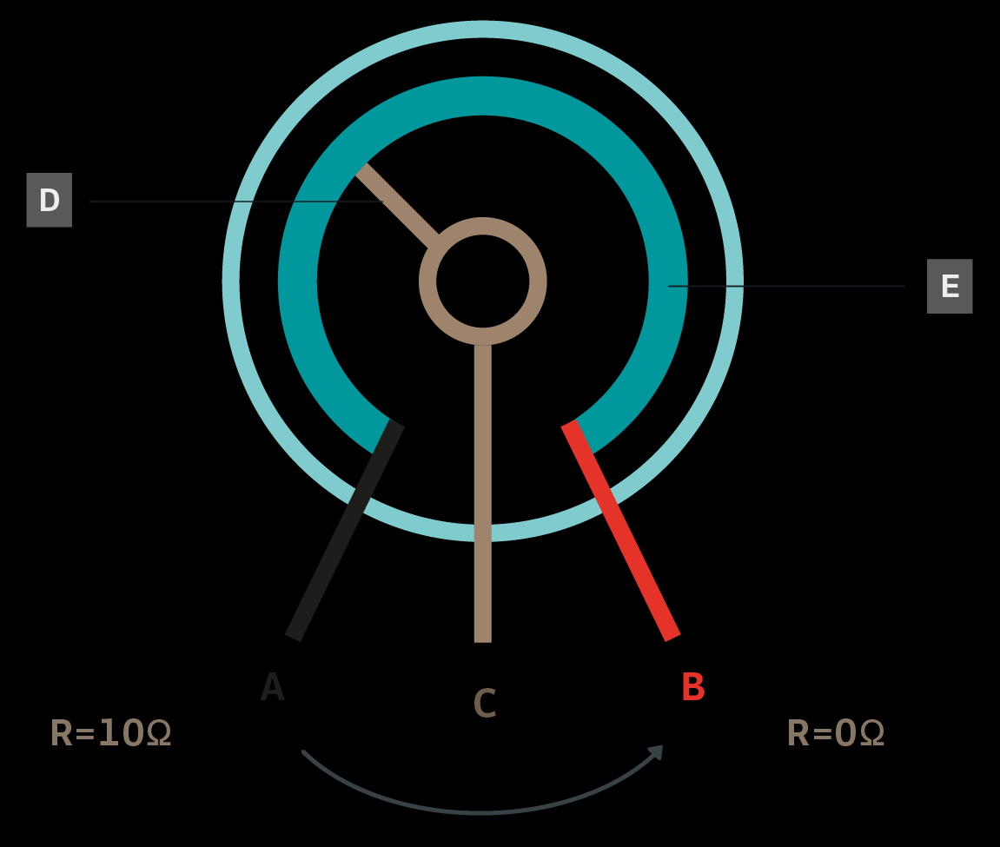
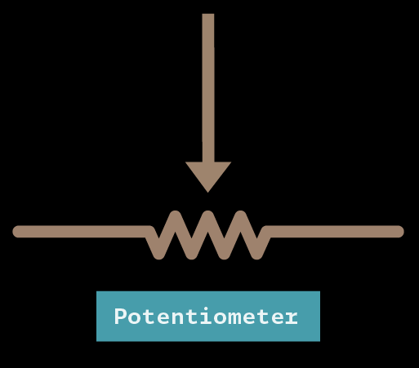
Potentiometer
How it works: Inside the potentiometer is a resistive material and a wiper that slides along the material. Each end of the material is connected to a pin. The third pin is connected to the wiper and the resistance depends on the position of the wiper. The potentiometer changes the resistance in the circuit by having more resistive material for the current to pass through, increasing the resistance.
Potentiometer symbol in a circuit:

Slide 10
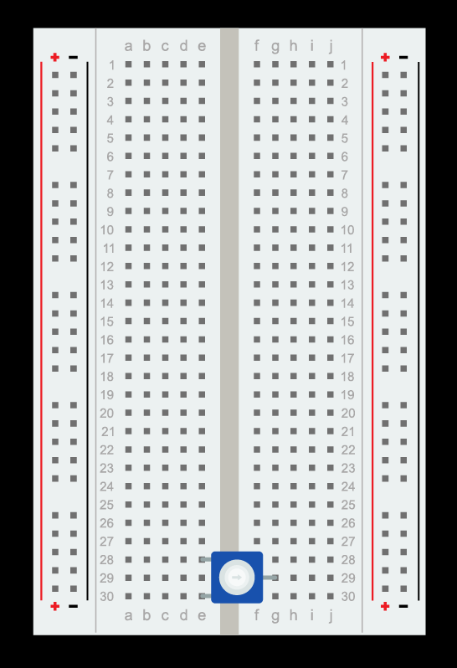
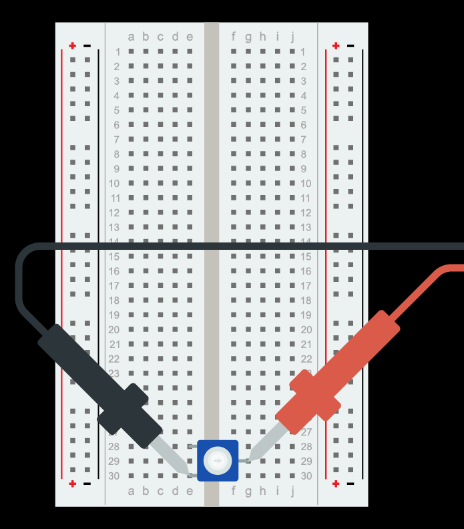
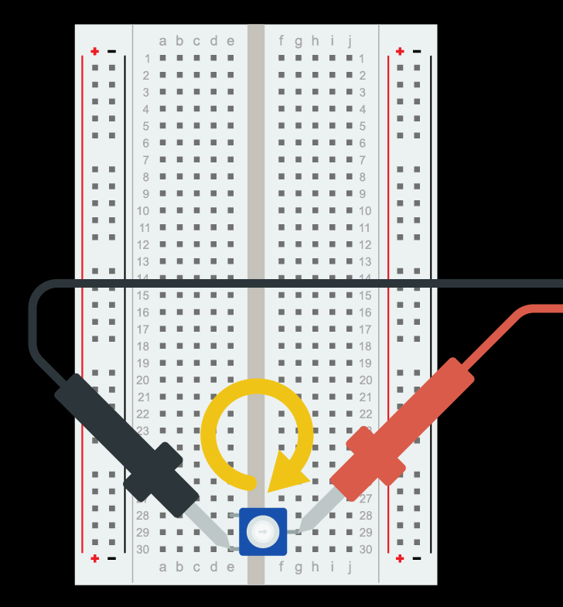
- Attach the Potentiometer to 28E and 30E - Set the Multimeter to 20KOhm - Touch the red lead to the singular pin and the black lead to one of the two pins - Slowly turn the knob to see the resistance value change

Slide 11
Circuit

Slide 12
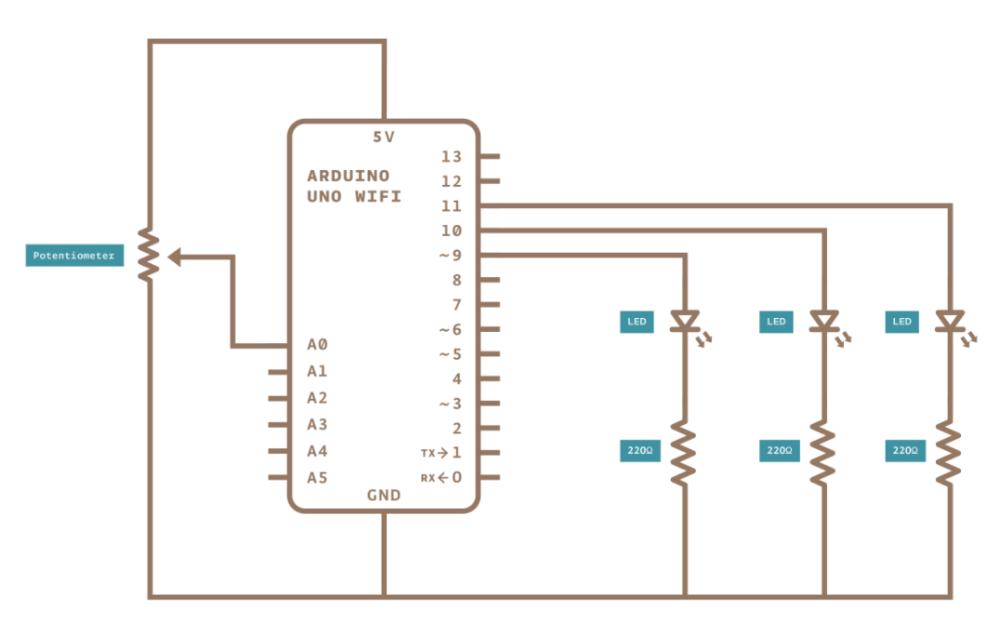

Slide 13
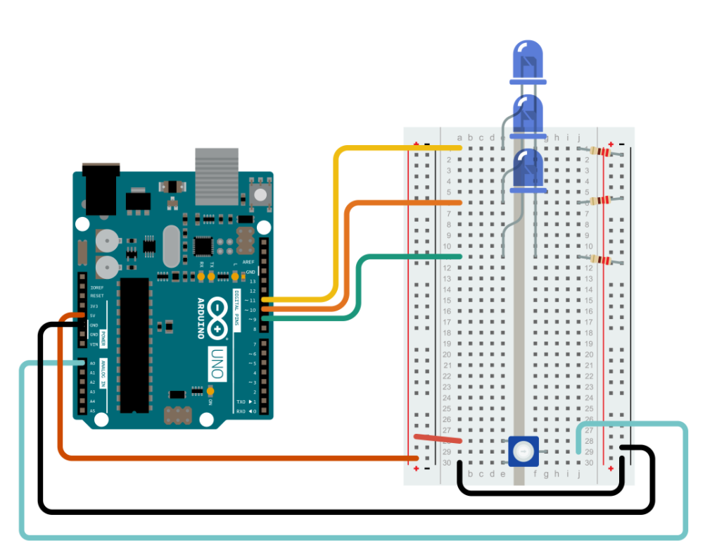
https://studentkit-registration.arduino.cc/login

Slide 14
Code

Slide 15
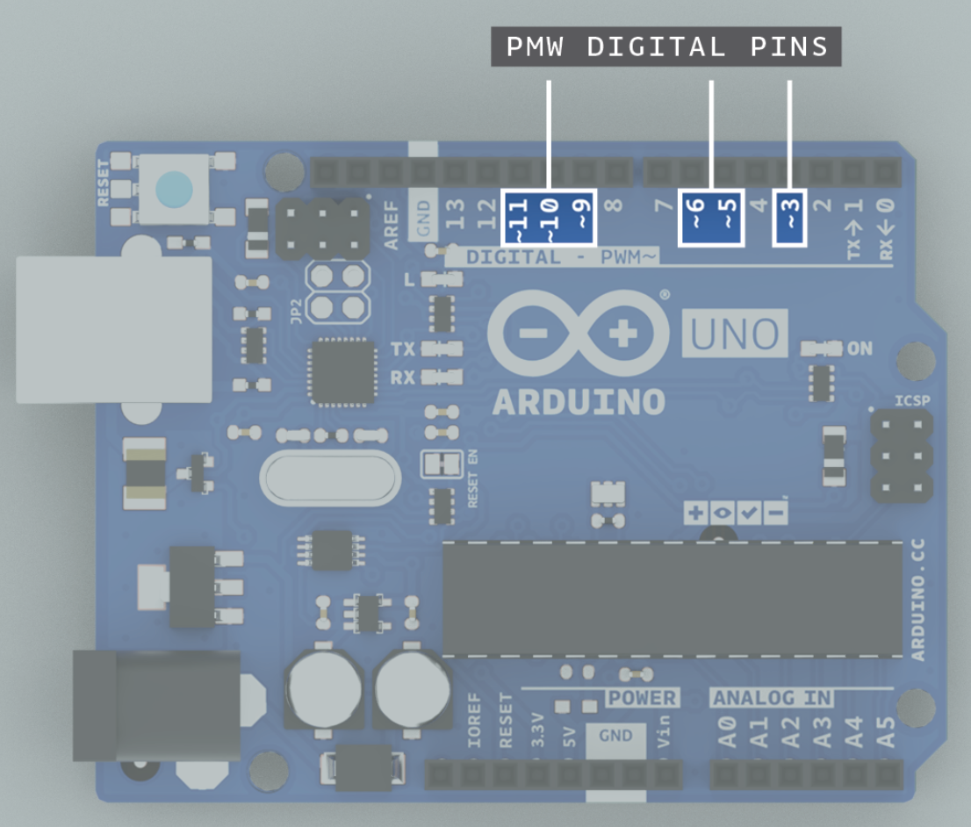
Pseudo code
1) Create variables to store input and output information. 2) Setup the Arduino pins as output pins. 3) Start the main loop.
a) Store the value of the potentiometer as a variable. b) Determine the output value to the LEDs based on the potentiometer variable. c) Set the LED brightness based on the output variable.
4) End the main loop.
Command bank
pinMode() - Use the pinMode() command to declare these pins as OUTPUT
analogWrite(pin, value) - to set the brightness of the LEDs, use the analogWrite(pin, value) command.
readValue = analogRead(A0) - Use readValue to store the value of the potentiometer
writeValue = readValue / 4; // divide the readValue by 4 and store as the writeValue

Slide 16
Put it all together!

Slide 17
Resources Review:
Student kit (all the circuit diagrams and code we used in the club): https://studentkit.arduino.cc/
Arduino tutorials: https://www.arduino.cc/en/Tutorial/HomePage?from=Main.Tutorials
MIT’s Scratch program is a great stepping stone that uses block coding, allowing you to learn the structure of programming before learning the actual languages themselves.
Code.org provides numerous resources connected to coding for those interested in learning the basics.
Code Academy is an interactive guide to learning multiple languages like JavaScript, HTML/CSS, and more.
Khan Academy has instructional courses on computer programming and computer science, it is an especially good resource for learning how to animate with code.
Also if you have any computer science classes offered at your school, I highly recommend taking them.
Typershark or any basic typing tutorial/software/class. Might seem boring, but proper typing skills will pay off in the future a thousand times over – you don’t want something so simple holding you back!
Maybe robotics and programming isn’t as interesting as you thought it would be, or maybe it’s just not enough! Explore these adjacent fields: Data Science, Robotics, Graphic Design, Engineering, Cybersecurity, Hacking, Machine Learning, Natural Language Processing, Network Design, Website creation.

Slide 18
int readValue = 0;
int writeValue = 0;
void setup() {
pinMode(9, OUTPUT); // declare the first LED pin as output
pinMode(10, OUTPUT); // declare the second LED pin as output
pinMode(11, OUTPUT); // declare the third LED pin as output
}
void loop() {
readValue = analogRead(A0); // store the value from the potentiometer
writeValue = readValue / 4; // divide the readValue by 4 and store as the writeValue
analogWrite(9, writeValue); // set LED 1 brightness to writeValue
analogWrite(10, writeValue); // set LED 2 brightness to writeValue
analogWrite(11, writeValue); // set LED 3 brightness to writeValue
}

Slide 19

Women in Tech Spotlight: Tan Le
Accomplishments
Tan Le is the CEO and founder of Emotiv - a bioinformatics company.
The company is exploring a new “remote control” where a headset uses EEG technology to control digital devices by reading brain activity.
She is a refugee from Vietnam at age 4, she entered college at 16 and has since become a vital young leader in her home country of Australia. She attended Monash University in Melbourne, Australia where she studied law and commerce.
https://www.ted.com/talks/tan_le_a_headset_that_reads_your_brainwaves

Slide 20
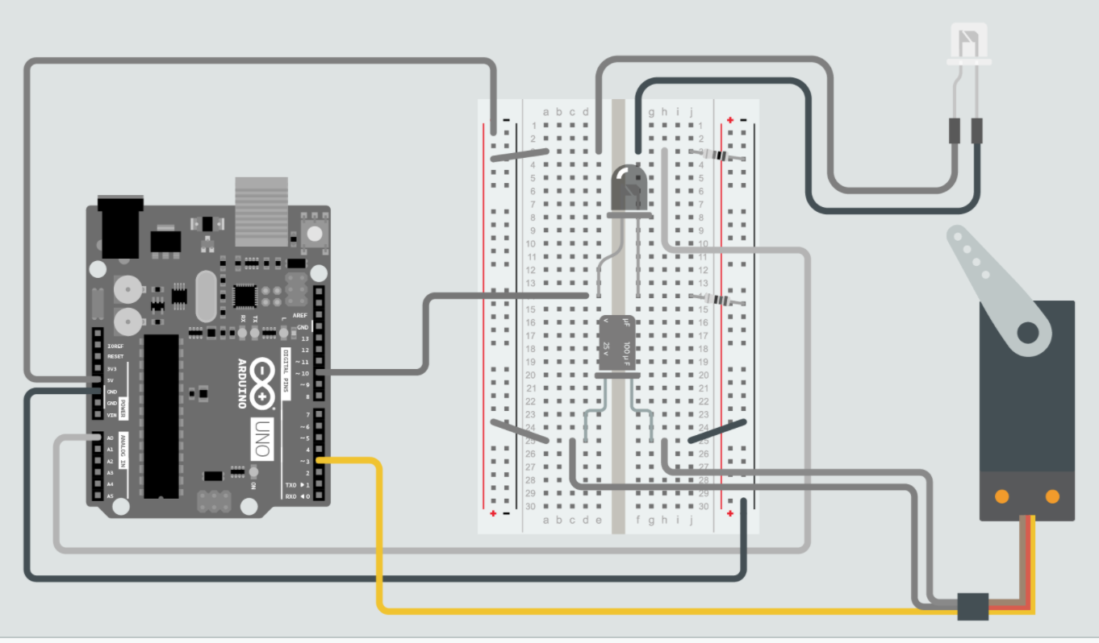
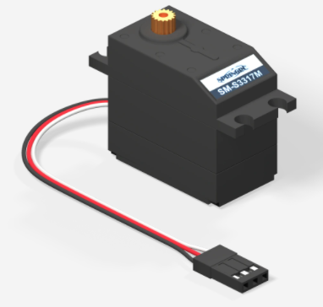
Review: Servo Motor

Slide 21
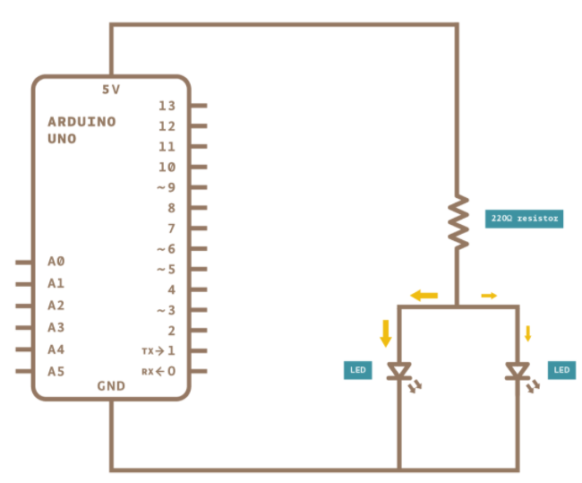
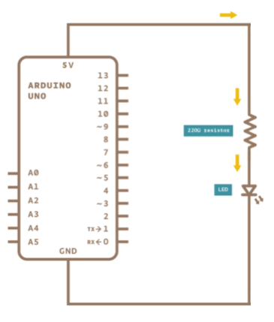
Circuit Review: Series vs Parallel
????
????
Electricity has one path and must go through both components one after another, i.e. in series!
Electricity has two parallel paths!

Slide 22
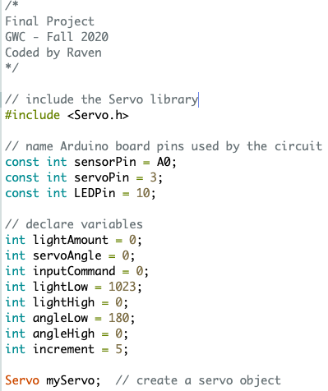
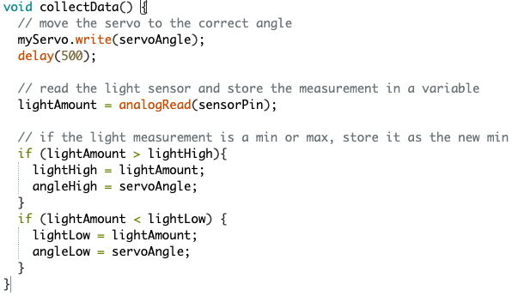
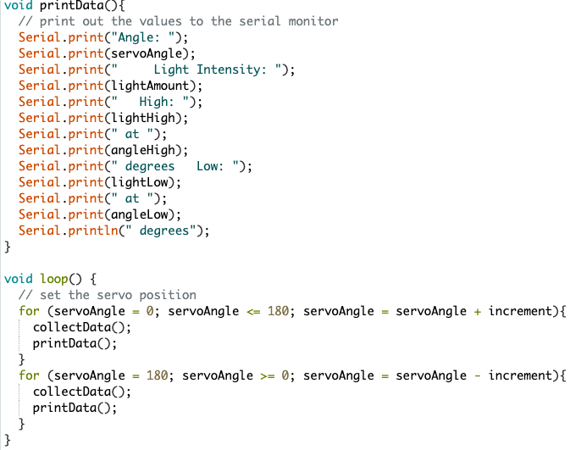
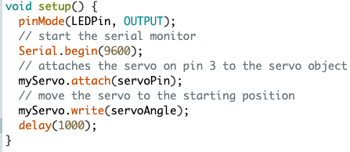
Light Wave RADAR

