Slide 1
GWC Spring Session 4!
March 15th, 2021
Notes:
Names: Hannah, Megan, Zuha, Ana + Paula, Angel, Sasha, Nina

Slide 2
Today’s Agenda
Accounts and Software Check
Women-in-Tech Spotlight
Kahoot
Servo motor review and lesson ☺
Stand ups

Slide 3
Women in Tech Spotlight

Slide 4
Kahoot!

Slide 5
Servo Motor Review and Lesson

Slide 6
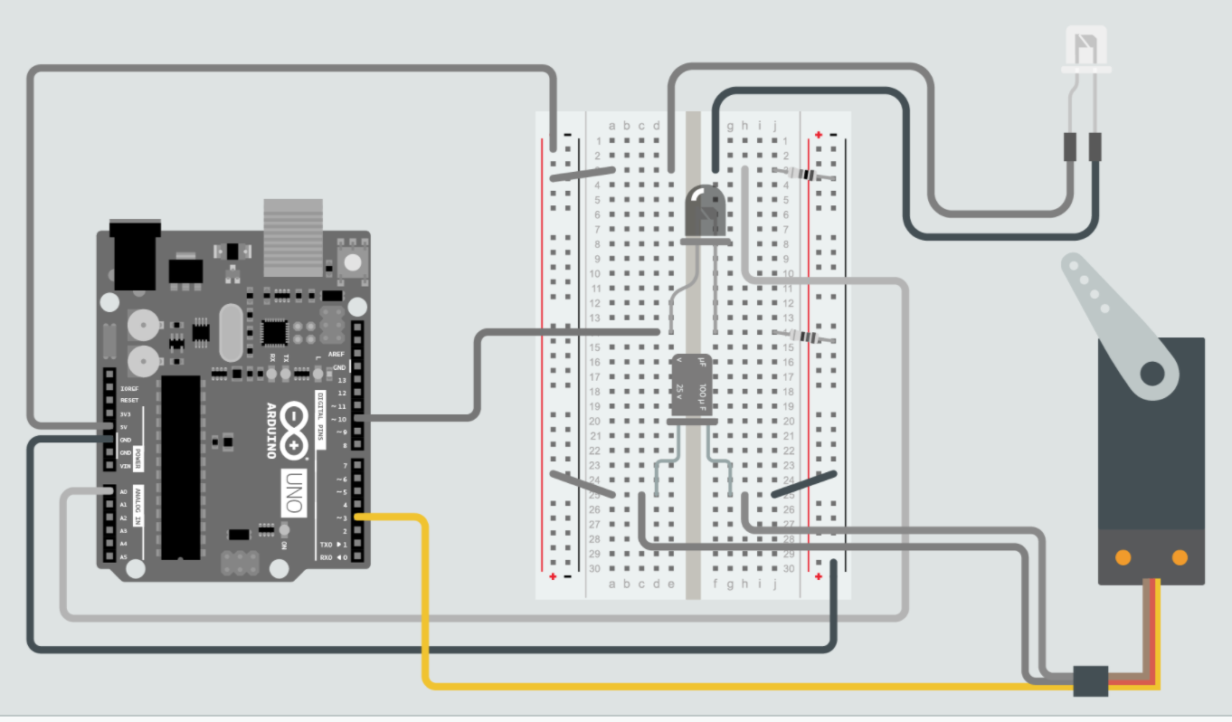
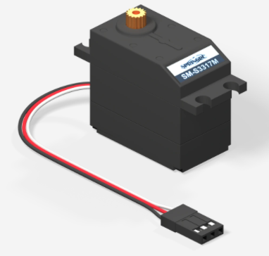
Review: Servo Motor

Slide 7
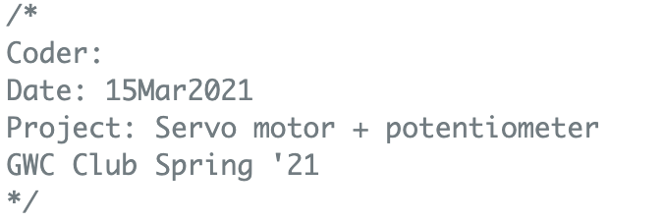
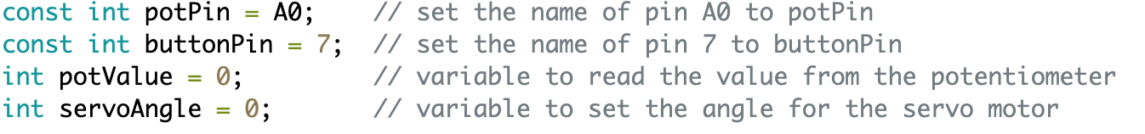
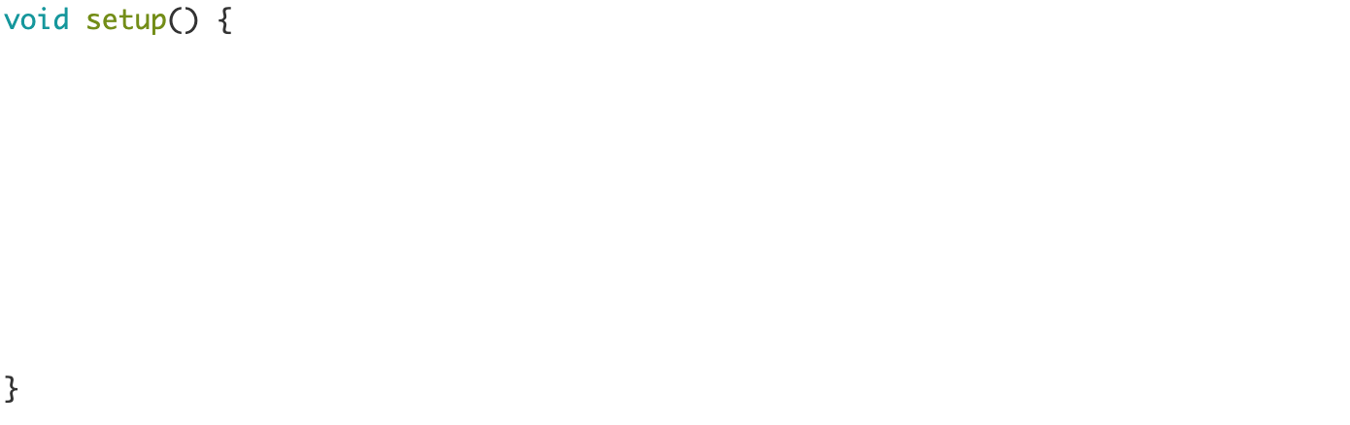
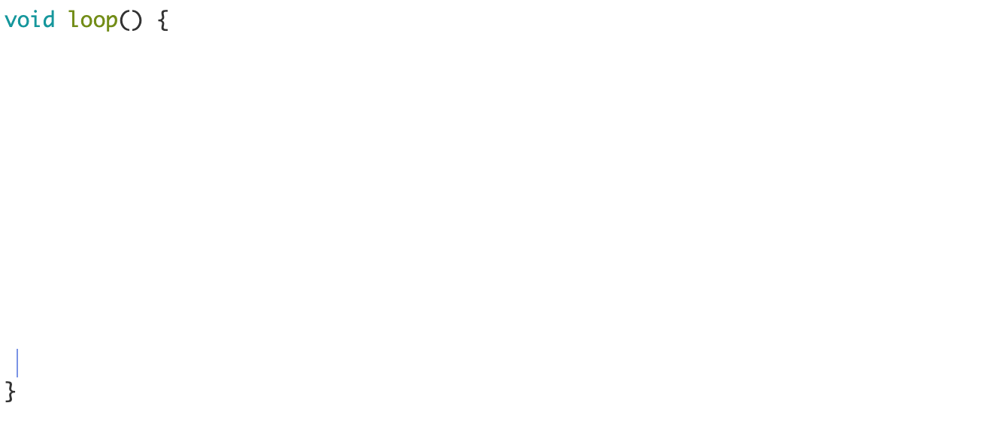
Code bank
Place these in order!

Slide 8
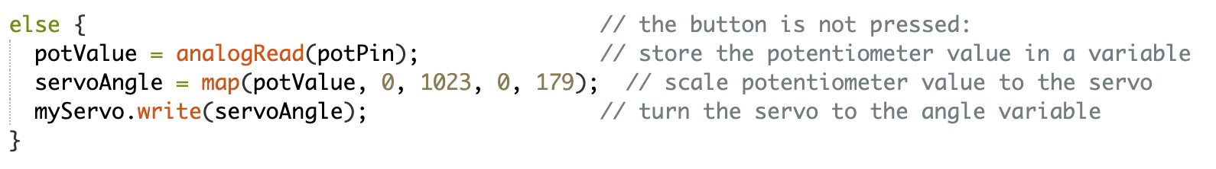
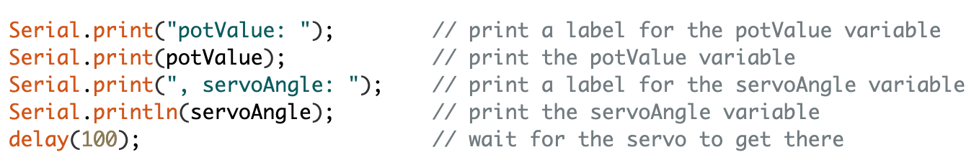
Fill in the functions!
Code bank

Slide 9
Mini Code Lesson

Slide 10
Stand Ups!

Slide 11
Resources Review:
Student kit (all the circuit diagrams and code we used in the club): https://studentkit.arduino.cc/
Arduino tutorials: https://www.arduino.cc/en/Tutorial/HomePage?from=Main.Tutorials
MIT’s Scratch program is a great stepping stone that uses block coding, allowing you to learn the structure of programming before learning the actual languages themselves.
Code.org provides numerous resources connected to coding for those interested in learning the basics.
Code Academy is an interactive guide to learning multiple languages like JavaScript, HTML/CSS, and more.
Khan Academy has instructional courses on computer programming and computer science, it is an especially good resource for learning how to animate with code.
Also if you have any computer science classes offered at your school, I highly recommend taking them.
Typershark or any basic typing tutorial/software/class. Might seem boring, but proper typing skills will pay off in the future a thousand times over – you don’t want something so simple holding you back!
Maybe robotics and programming isn’t as interesting as you thought it would be, or maybe it’s just not enough! Explore these adjacent fields: Data Science, Robotics, Graphic Design, Engineering, Cybersecurity, Hacking, Machine Learning, Natural Language Processing, Network Design, Website creation.

Slide 12
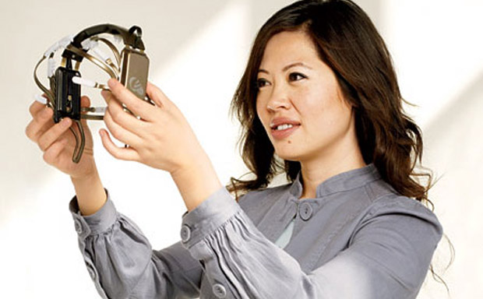
Women in Tech Spotlight: Tan Le
Accomplishments
Tan Le is the CEO and founder of Emotiv - a bioinformatics company.
The company is exploring a new “remote control” where a headset uses EEG technology to control digital devices by reading brain activity.
She is a refugee from Vietnam at age 4, she entered college at 16 and has since become a vital young leader in her home country of Australia. She attended Monash University in Melbourne, Australia where she studied law and commerce.
https://www.ted.com/talks/tan_le_a_headset_that_reads_your_brainwaves

Slide 13
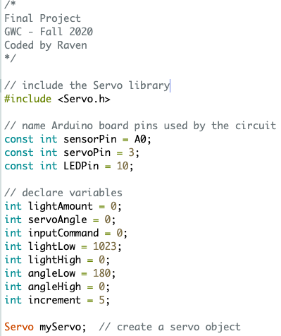
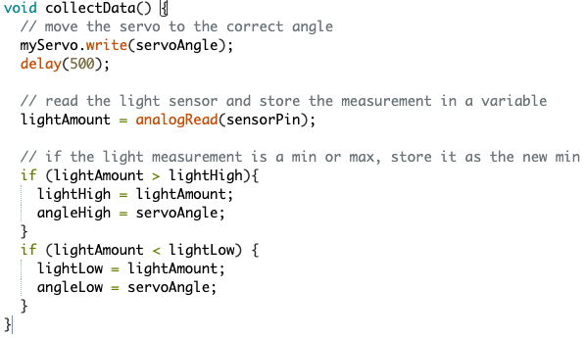
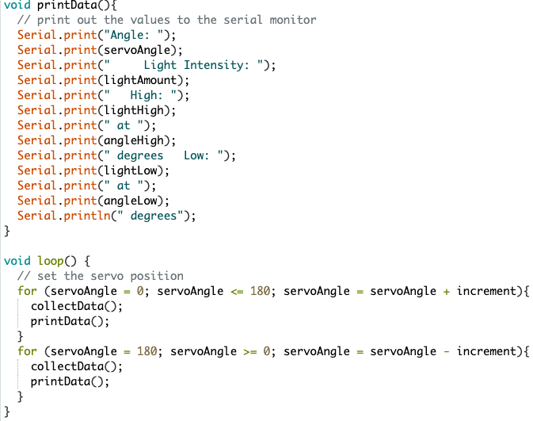
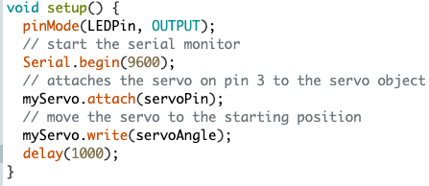
Light Wave RADAR

