Slide 1
Kubernetes
The Helmsman

Slide 2
Container Orchestration
Orchestration is the automated configuration, coordination, and management of computing units.
The standard challenges of container orchestration and application growth are
  Service Discovery, Load Balancing,
  Secrets/configuration/storage management,
  Health checks, and auto deployment
These are solved by the following architectural principle: decoupling.
A single container cannot work without the others.

Slide 3
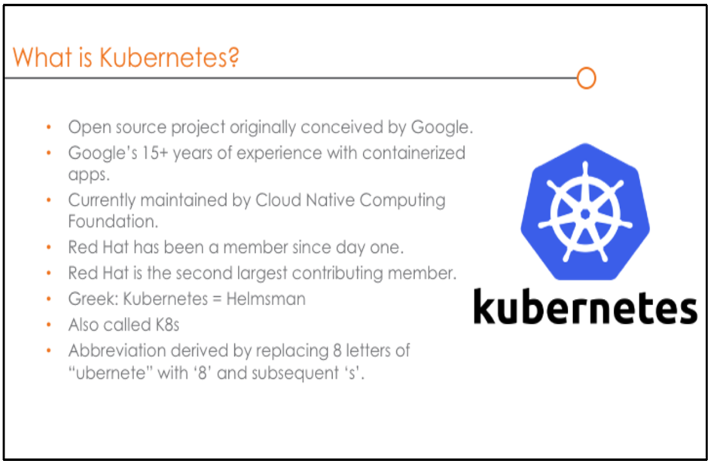

Slide 4
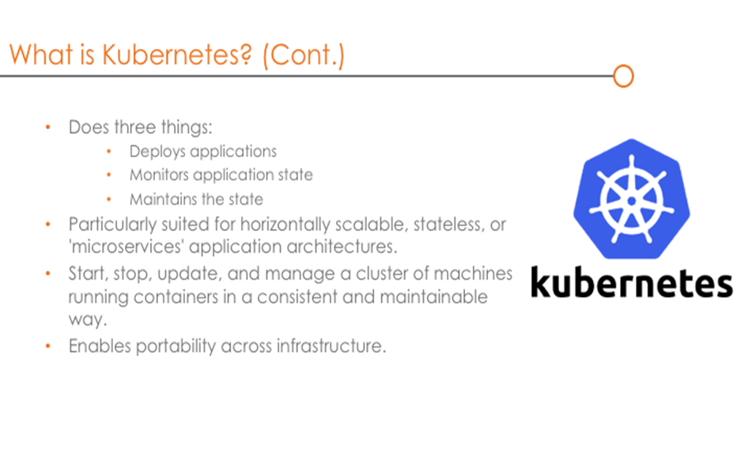

Slide 5
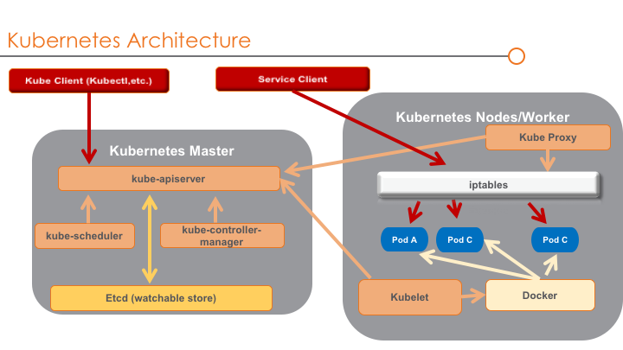

Slide 6
Master Node
Master components provide the cluster’s control plane.
Master components make global decisions about the cluster (for example, scheduling), and detecting and responding to cluster events (starting up a new pod)
Kube API server
- The API server is the entry points for all the REST commands used to control the cluster. It is the front-end for the Kubernetes control plane.
Kube scheduler
  Component on the master that watches newly created pods that have no node assigned, and selects a node for them to run on.
Kube Controller Manager
  Component on the master that runs controllers Logically, each controller is a separate process, but to reduce complexity, they are all compiled into a single binary and run in a single process.

Slide 7
kube-controller-manager
Node Controller: Responsible for noticing and responding when nodes go down.
Replication Controller: Responsible for maintaining the correct number of pods for every replication controller object in the system.
Endpoints Controller: Populates the Endpoints object (that is, joins Services & Pods).
Service Account & Token Controllers: Create default accounts and API access tokens for new namespaces.

Slide 8
Agent/Worker Node
Kubelet An agent that runs on each node in the cluster. It makes sure that containers are running in a pod.
Kube Proxy Kube-proxy enables the Kubernetes service abstraction by maintaining network rules on the host and performing connection forwarding.

Slide 9
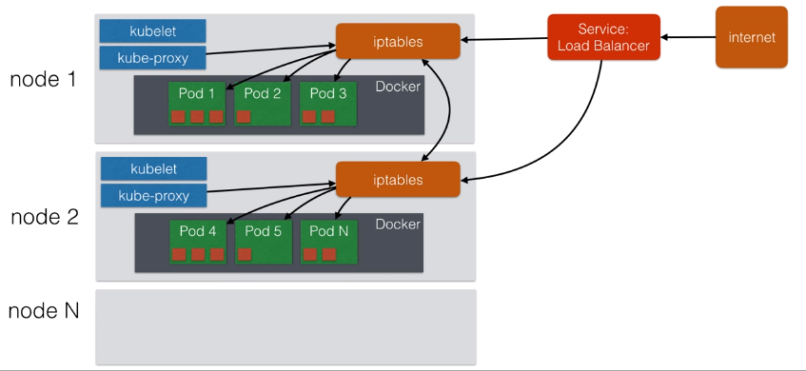

Slide 10
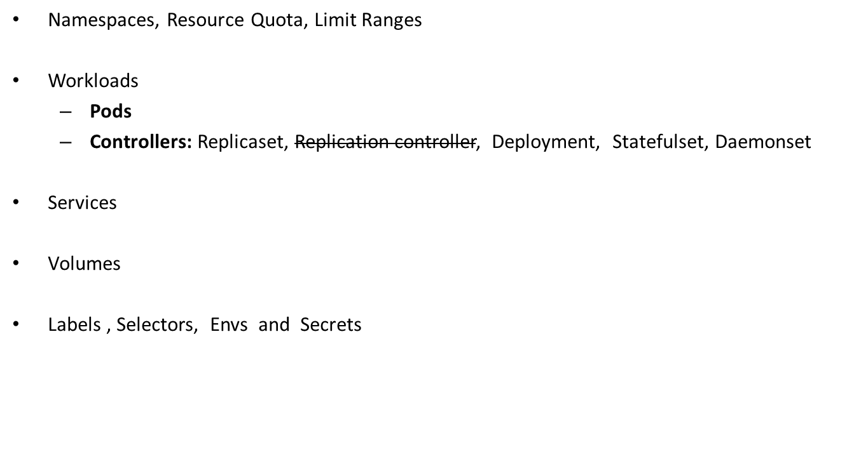
Kubernetes Objects:

Slide 11
Namespaces, Resource Quota, Limit Ranges
Namespaces are a way to divide cluster resources between multiple users (via resource quota).
Namespace provides a 'logical' structure to host the applications.
A single physical cluster can be divided into multiple namespaces (logical clusters).
ResourceQuota object, provides constraints that limit aggregate resource consumption per namespace.
It can limit the quantity of objects that can be created in a namespace by type, as well as the total amount of compute resources that may be consumed by resources in that project.
Limit Range is a policy to constrain resource by Pod or Container in a namespace.
Commands:
  kubectl get resourcequota
  kubectl get limitrange

Slide 12
Pods
A Pod is the basic execution unit of a Kubernetes application–the smallest and simplest unit in the Kubernetes object model that you create or deploy.
A Pod represents processes running on your Cluster.
A Pod is a group of one or more containers with shared storage/network, and a specification for how to run the containers.
Pods aren’t intended to be treated as durable entities.
They should almost always use controllers even for singletons.

Slide 13
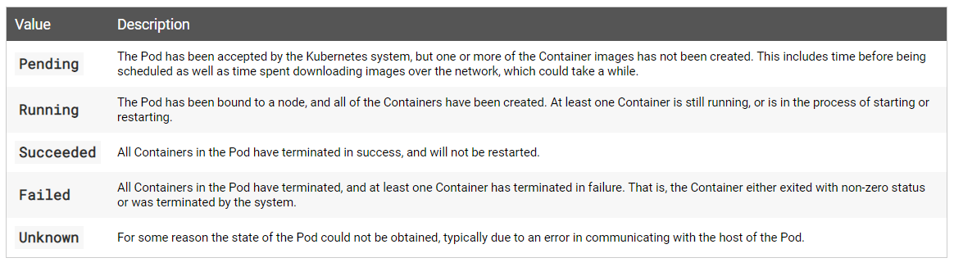

Pod phases:

Slide 14
Replicaset
A ReplicaSet’s purpose is to maintain a stable set of replica Pods running at any given time.
it is often used to guarantee the availability of a specified number of identical Pods.
A ReplicaSet identifies new Pods to acquire by using its selector.

Slide 15
Deployment(Recommended)
A Deployment controller provides declarative updates for Pods and ReplicaSets.
Deployment controller changes the actual state to the desired state at a controlled rate.
Deployments, intended to replace Replication Controllers, provide the same replication functions (through Replica Sets) but additionally provide the ability to roll out and roll back the changes if required.
The Pod life cycle is managed by Deployment.
Deployment Tasks (DIY)
  Create a Deployment to rollout a ReplicaSet
  Declare the new state of the Pods
  Rollback to an earlier Deployment revision
  Scale up the Deployment to facilitate more load.

Slide 16
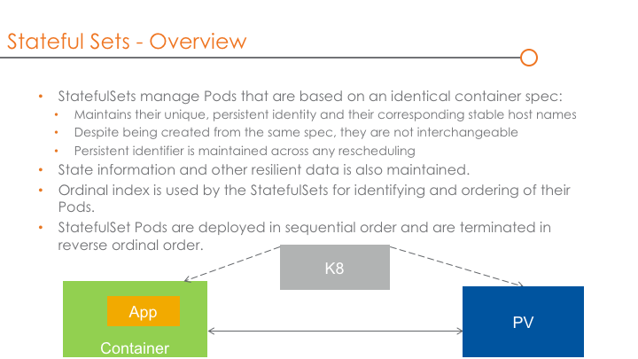
Statefulsets

Slide 17
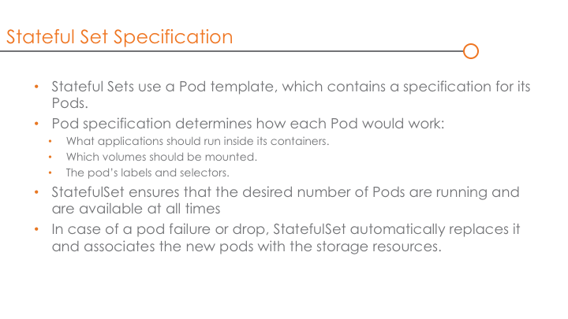

Slide 18
Daemonset
A DaemonSet ensures that all Nodes run a copy of a Pod.
As nodes are added to the cluster, Pods are added to them.
As nodes are removed from the cluster, those Pods are garbage collected.
Usage of Daemonsets:
  running a cluster storage daemon, such as glusterd, ceph, on each node
  running a logs collection daemon on every node, such as fluentd or logstash
  running a node monitoring daemon on every node, such as Prometheus Node Exporter

Slide 19
Services
Service is An abstract way to expose an application running on a set of pods.
ClusterIP: Exposes the Service on a cluster-internal IP. Choosing this value makes the Service only reachable from within the cluster. This is the default ServiceType
NodePort: Exposes the Service on each Node’s IP at a static port (the NodePort). You’ll be able to contact the NodePort Service, from outside the cluster, by requesting <NodeIP>:<NodePort>
LoadBalancer: Exposes the Service externally using a cloud provider’s load balancer. NodePort and ClusterIP Services, to which the external load balancer routes, are automatically created.
Headless service:
  “headless” Services, by explicitly specifying "None" for the cluster IP (.spec.clusterIP).
  These can be accessed from endpoints.

Slide 20
Volumes
Why Volumes?
  When a Container crashes, kubelet will restart it, but the files will be lost - the Container starts with a clean state.
  when running Containers together in a Pod it is often necessary to share files between those Containers.
  To use a volume, a Pod specifies what volumes to provide for the Pod (the .spec.volumes field) and where to mount those into Containers (the .spec.containers.volumeMounts field).
  PersistentVolume (PV): A piece of storage in the cluster that has been provisioned by an administrator. It is a resource in the cluster just like a node is a cluster resource. PersistentVolume resources are used to manage durable storage in a cluster. It is the low level representation of a storage volume. It represents the exclusive usage of a Persistent Volume by a particular Pod.

Slide 21
  PersistentVolumeClaim (PVC): A request for storage by a cluster user. It is similar to a pod.The way pods consume node resources and PVCs consume PV resources.
  StorageClass: A StorageClass provides a way for administrators to describe the “classes” of storage they offer. Different classes might map to quality-of-service levels, or to backup policies, or to arbitrary policies determined by the cluster administrators.

Slide 22
Labels & Selectors
Labels are key/value pairs that are attached to objects, such as pods.
Labels can be attached to objects at creation time and subsequently added and modified at any time.
Via a label selector, the client/user can identify a set of objects.
The label selector is the core grouping primitive in Kubernetes.
Execute:
  Kubectl get pods –show-labels
  Kubectl get pods -l run=nginx1
  kubectl get pods -l "run in (nginx1)"

Slide 23
Environment variables
Define an environment variable for a container.
Exposing pod information as environment variable

Slide 24
Secrets
A Secret is an object that contains a small amount of sensitive data such as a password, a token, or a key.
Users can create secrets, and the system also creates some secrets.
Creating a Secret Using kubectl create secret

Slide 25
Pod, Deployment, Service, Network Policy
A Kubernetes object is a “record of intent”–once you create the object, the Kubernetes system will constantly work to ensure that object exists.
By creating an object, you’re effectively telling the Kubernetes system what you want your cluster’s workload to look like; this is your cluster’s desired state.
A Pod is the basic execution unit of a Kubernetes application–the smallest and simplest unit in the Kubernetes object model that you create or deploy.
A Pod represents processes running on your Cluster.
A ReplicaSet’s purpose is to maintain a stable set of replica Pods running at any given time.
As such, it is often used to guarantee the availability of a specified number of identical Pods.
A Deployment controller provides declarative updates for Pods and ReplicaSets.
Deployment controller changes the actual state to the desired state at a controlled rate.

Slide 26
Service is An abstract way to expose an application running on a set of pods.
ClusterIP: Exposes the Service on a cluster-internal IP. Choosing this value makes the Service only reachable from within the cluster. This is the default ServiceType
NodePort: Exposes the Service on each Node’s IP at a static port (the NodePort). You’ll be able to contact the NodePort Service, from outside the cluster, by requesting <NodeIP>:<NodePort>
LoadBalancer: Exposes the Service externally using a cloud provider’s load balancer. NodePort and ClusterIP Services, to which the external load balancer routes, are automatically created.
A network policy is a specification of how groups of pods are allowed to communicate with each other and other network endpoints.

