Slide 1

DOCKER CONTAINERS

Slide 2
Agenda
Containers & Terminology
  Linux kernel , cgroups, namespaces.
  Containers vs Virtual machines.
  Other container technologies.
Docker overview
  Docker architecture
  Docker platform(Docker engine, Docker daemon, Docker client, registries)
  Docker Objects(Docker images, containers)
Docker networking & volumes
  Network overview, network drivers
  Bridge, overlay, host networking.
  Volumes, types
  Volume drivers
Docker CLI & GUI
  Docker commands
  Docker API
  DOCKER File usage

Slide 3
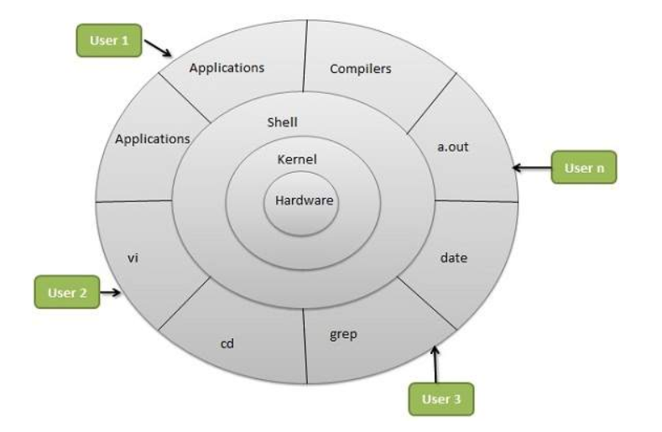
Linux Kernel

Slide 4
Containers & Terminology
Linux Kernel, cgroups, namespaces
cgroups (abbreviated from control groups) is a Linux kernel feature that limits, accounts for, and isolates the resource usage (CPU, memory, disk I/O, network, etc.) of a collection of processes.
Namespaces are a feature of the Linux kernel that partitions kernel resources such that one set of processes sees one set of resources while another set of processes sees a different set of resources.
Docker Engine uses namespaces such as the following on Linux:
The pid namespace: Process isolation (PID: Process ID).
The net namespace: Managing network interfaces (NET: Networking).
The ipc namespace: Managing access to IPC resources (IPC: InterProcess Communication).
The mnt namespace: Managing filesystem mount points (MNT: Mount).
The uts namespace: Isolating kernel and version identifiers. (UTS: Unix Timesharing System).

Slide 5
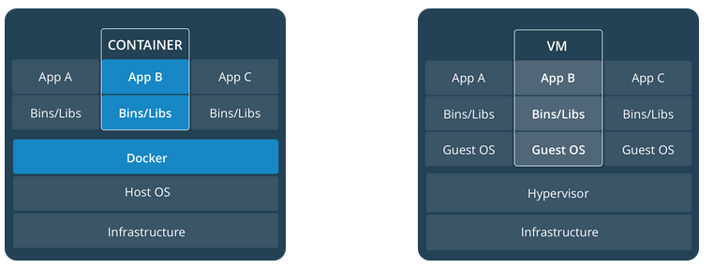
Containers vs Virtual machines.
A container runs natively on Linux and shares the kernel of the host machine with other containers. It runs a discrete process, taking no more memory than any other executable, making it lightweight.
A virtual machine (VM) runs a full-blown “guest” operating system with virtual access to host resources through a hypervisor. In general, VMs provide an environment with more resources than most applications need.

Slide 6
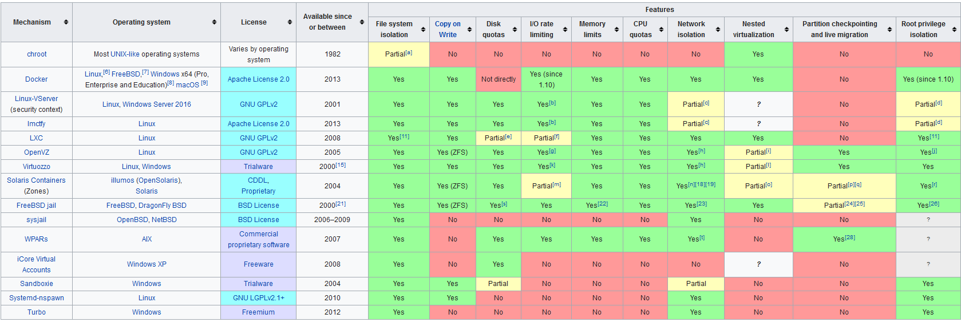
Other container technologies.

Slide 7
Docker overview
Why Docker containers?
Fast, consistent delivery of your applications.
Responsive deployment and scaling.
Running more workloads on the same hardware.
Footprint
Resources
Automation
Instantiation
Collaboration

Slide 8
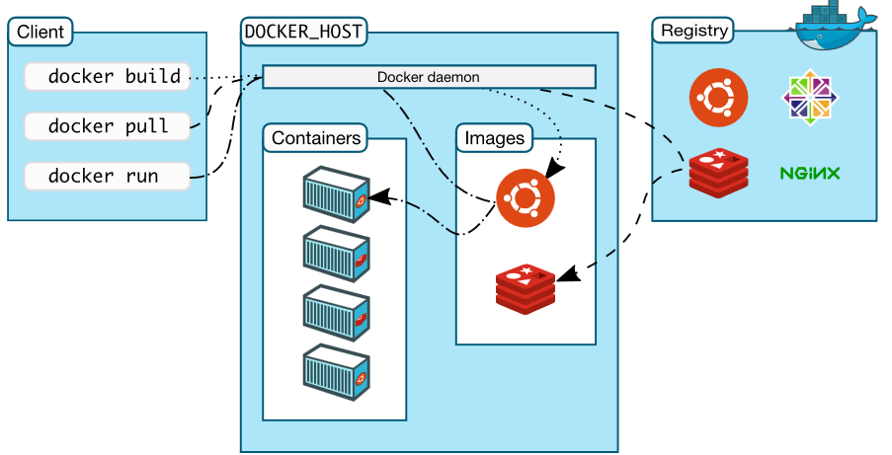
Docker architecture
Docker uses a client-server architecture.
The Docker client and daemon communicate using a REST API, over UNIX sockets or a network interface.

Slide 9
Docker platform
The Docker daemon
  The Docker daemon (dockerd) listens for Docker API requests and manages Docker objects such as images, containers, networks, and volumes. A daemon can also communicate with other daemons to manage Docker services.
The Docker client
  The Docker client (docker) is the primary way that many Docker users interact with Docker. When you use commands such as docker run, the client sends these commands to dockerd, which carries them out. The docker command uses the Docker API. The Docker client can communicate with more than one daemon.
  Docker registries
  A Docker registry stores Docker images.
  Hub.docker.com
  docker pull or docker run vs docker push

Slide 10
Docker Objects
Images
  An image is a read-only template with instructions for creating a Docker container. Often, an image is based on another image, with some additional customization.
  Image creation uses Dockerfile with simple syntax.
  Containers
    A container is a runnable instance of an image.
    Container states are create, start, stop, move, or delete a container using the Docker API or CLI.
    Container is relatively well isolated from other containers and its host machine

Slide 11
Docker lifecycle
# docker run -i -t ubuntu /bin/bash
If you do not have the ubuntu image locally, Docker pulls it from your configured registry, as though you had run docker pull ubuntu manually.
Docker creates a new container, as though you had run a docker container create command manually.
Docker allocates a read-write filesystem to the container, as its final layer. This allows a running container to create or modify files and directories in its local filesystem.
Docker creates a network interface to connect the container to the default network, since you did not specify any networking options. This includes assigning an IP address to the container. By default, containers can connect to external networks using the host machine’s network connection.
Docker starts the container and executes /bin/bash. Because the container is run interactively and attached to your terminal (due to the -i and -t flags), you can provide input using your keyboard and output is logged to your terminal.
When you type exit to terminate the /bin/bash command, the container stops but is not removed. You can start it again or remove it.

Slide 12
Docker networking
bridge:
  The default network driver. If you don’t specify a driver, this is the type of network you are creating. Bridge networks are usually used when your applications run in standalone containers that need to communicate.
  Host :
    For standalone containers, remove network isolation between the container and the Docker host, and use the host’s networking directly. host is only available for swarm services on Docker 17.06 and higher.
  Overlay :
    The overlay network driver creates a distributed network among multiple Docker daemon hosts.
    This network sits on top of (overlays) the host-specific networks, allowing containers connected to communicate securely. Docker transparently handles routing of each packet to and from the correct Docker daemon host and the correct destination container.
  Macvlan:
    Macvlan networks allow you to assign a MAC address to a container, making it appear as a physical device on your network. The Docker daemon routes traffic to containers by their MAC addresses. Using the macvlan driver is sometimes the best choice when dealing with legacy applications that expect to be directly connected to the physical network, rather than routed through the Docker host’s network stack.

Slide 13
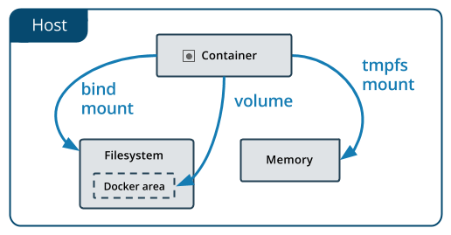
Docker volumes
Volumes are stored in a part of the host filesystem which is managed by Docker (/var/lib/docker/volumes/ on Linux). Non-Docker processes should not modify this part of the filesystem. Volumes are the best way to persist data in Docker.
Bind mounts may be stored anywhere on the host system. They may even be important system files or directories. Non-Docker processes on the Docker host or a Docker container can modify them at any time.
tmpfs mounts are stored in the host system’s memory only, and are never written to the host system’s filesystem.

Slide 14
Docker CLI
docker [OPTIONS] COMMAND [ARG...]
Images:
  docker images
  docker rmi
  docker build
  docker run
  Containers:
    docker attach <container-id>
    docker exec <container-id>
    docker ps
    docker logs
    docker inspect
    docker start
    docker stop
    docker rm
    docker rename

Slide 15
Repository:
  docker login
  docker logout
  docker push
  docker pull
  Network & Volume :
  docker network
  docker volume
  Miscellaneous :
  docker stats
  docker tag
  docker history <image-id>

Slide 16
Docker API
The daemon listens on unix:///var/run/docker.sock
It is possible to bind Docker to another host/port or a Unix socket.
Endpoints:
  Containers:
    GET /containers/json
    POST /containers/create
  Images
    GET /images/json
    POST /build
    POST /images/create
    Examples:
      # curl --unix-socket /var/run/docker.sock -X GET http:/v1.29/containers/json
      # curl --unix-socket /var/run/docker.sock -X GET http:/v1.29/images/json

Slide 17
Dockerfile
Docker can build images automatically by reading the instructions from a Dockerfile.
A Dockerfile is a text document that contains all the commands a user could call on the command line to assemble an image.
“#docker build “ command can be used to build docker image using a Dockerfile.
Syntax:
FROM <image>
  The FROM instruction initializes a new build stage and sets the Base Image for subsequent instructions.
  RUN <command>
  The RUN instruction will execute any commands in a new layer on top of the current image and commit the results.
  The command is run in a shell, which by default is /bin/sh –c
  CMD command param1 param2
  The main purpose of a CMD is to provide defaults for an executing container.
  RUN actually runs a command and commits the result; CMD does not execute anything at build time, but specifies the intended command for the image.
  ADD [--chown=<user>:<group>] <src>... <dest>:
  The ADD instruction copies new files, directories or remote file URLs from <src> and adds them to the filesystem of the image at the path <dest>.
  ADD only copies files, but not directories.

Slide 18
COPY [--chown=<user>:<group>] <src>... <dest>
  The COPY instruction copies new files or directories from <src> and adds them to the filesystem of the container at the path <dest>.
  ENTRYPOINT ["executable", "param1", "param2"]
  An ENTRYPOINT allows you to configure a container that will run as an executable.
  Lot more to discuss in next sessions:
  EXPOSE
  LABEL
  VOLUME
  WORKDIR
  USER
  ENV

Slide 19
Q & A

Slide 20
Docker work session
Basics docker working session

Slide 21
Agenda
Docker Overview
  Installation
  Docker daemon customization
  Docker process
Docker containers & images
  Docker images
  Docker registry
  Docker container
Docker networking
  Docker network
Docker volumes
  Docker volumes
  Docker file

Slide 22
Docker installation
SET UP THE REPOSITORY
  Install yum-utils,device-mapper-persistent-data, lvm2
  # sudo yum install -y yum-utils device-mapper-persistent-data lvm2
Configure repo
  # sudo yum-config-manager --add-repo https://download.docker.com/linux/centos/docker-ce.repo
INSTALL DOCKER CE
  # sudo yum install docker-ce
  # sudo systemctl enable docker
  # sudo systemctl start docker
  Ref : https://docs.docker.com/install/linux/docker-ce/centos/#install-docker-ce-1

Slide 23
Docker daemon customization
/etc/docker/daemon.json
  Default dockerd daemon configuration file.
Customize docker socket
  “-H” , --host list
  tcp /unix sockets
Customize docker storage
  --data-root string
Ref: https://docs.docker.com/engine/reference/commandline/dockerd/

Slide 24
Docker containers & images
docker run [OPTIONS] IMAGE[:TAG] [COMMAND] [ARG...]
  --cpus decimal Number of CPUs
  -d, --detach Run container in background and print container ID
  --dns list Set custom DNS servers
  -e, --env list Set environment variables
  -h, --hostname string Container host name
  -i, --interactive Keep STDIN open even if not attached
  -m, --memory bytes Memory limit
  -p, --publish list Publish a container's port(s) to the host
  -t, --tty Allocate a pseudo-TTY
  -v, --volume list Bind mount a volume
  -w, --workdir string Working directory inside the container

Slide 25
Additional commands
Images:
  docker images
  docker rmi
  docker build
  docker run
  Containers:
    docker attach <container-id>
    docker exec <container-id>
    docker ps
    docker logs
    docker inspect
    docker start
    docker stop
    docker rm
    docker rename
    docker commit

Slide 26
Docker network
#docker network <COMMAND>
docker network connect Connect a container to a network
docker network create Create a network
docker network disconnect Disconnect a container from a network
docker network inspect Display detailed information on one or more networks
docker network ls List networks
docker network prune Remove all unused networks
docker network rm Remove one or more networks
Ref: https://docs.docker.com/engine/reference/commandline/network/

Slide 27
Docker volumes
docker volume create Create a volume
docker volume inspect Display detailed information on one or more volumes
docker volume ls List volumes
docker volume prune Remove all unused local volumes
docker volume rm Remove one or more volumes
Ref: https://docs.docker.com/engine/reference/commandline/volume/

Slide 28
Docker file
The FROM instruction initializes a new build stage and sets the Base Image for subsequent instructions.
  FROM <image>[:<tag>]
The RUN instruction will execute any commands in a new layer on top of the current image and commit the results.
  RUN <command>, which by default is /bin/sh -c
  RUN ["executable", "param1", "param2"]
The main purpose of a CMD is to provide defaults for an executing container.
  CMD ["executable","param1","param2"]
The LABEL instruction adds metadata to an image.
  LABEL <key>=<value> <key>=<value> <key>=<value> ...
The EXPOSE instruction informs Docker that the container listens on the specified network ports at runtime.
  EXPOSE <port> [<port>/<protocol>...]
The ENV instruction sets the environment variable <key> to the value <value>.
  ENV <key> <value>
The ADD instruction copies new files, directories or remote file URLs from <src> and adds them to the filesystem of the image at the path <dest>.
  ADD <src>... <dest>

Slide 29
The COPY instruction copies new files or directories from <src> and adds them to the filesystem of the container at the path <dest>.
  COPY <src>... <dest>
An ENTRYPOINT allows you to configure a container that will run as an executable.
  ENTRYPOINT ["executable", "param1", "param2"]
The WORKDIR instruction sets the working directory for any RUN, CMD, ENTRYPOINT, COPY and ADD instructions that follow it in the Dockerfile.
  WORKDIR /path/to/workdir
Environment variables (declared with the ENV statement) can also be used in certain instructions as variables.
Parser directives
Ref: https://docs.docker.com/engine/reference/builder/

Slide 30
Note:
ADD vs COPY
  ADD allows <src> to be an URL
  If the <src> parameter of ADD is an archive in a recognised compression format, it will be unpacked
RUN vs CMD
  all the RUNneeded to setup your environment, and your (only) CMD launches the process running in your container
  Docker Hub
    Create account here : https://hub.docker.com/
  Best Practices:
    Follow best practices here : https://docs.docker.com/develop/develop-images/dockerfile_best-practices/

Slide 31
Thank you ☺

