Slide 1




Python requests module
REST
Flask

Slide 2


Request
URI,Header,Body(json)
WebServer
Client: Web Browser,cURL,postman
Response
Status code, Header, Body(json)

Slide 3
RESTful WebService/API
Representational state transfer (REST) is a software architectural style that used for creating Web services.
Client-server architecture
Statelessness
HTTP methods --- GET, POST, PUT, PATCH, DELETE
Web service APIs that adhere to the REST architectural constraints are called RESTful APIs.

Slide 4
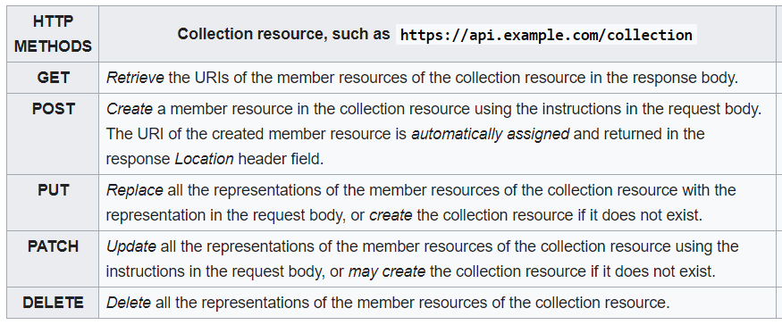
Similarity with CRUD

Slide 5
python requests module
HTTP methods(GET, POST, PUT, DELETE).
Headers
Authentication
Params
Payload

Slide 6
Sample code:
>>> import requests
>>> r = requests.get('https://api.github.com/events')
>>> r.json()
>>> r.status_code
HTTP Methods:
>>> r = requests.get('https://api.github.com/events')
>>> r = requests.post('https://httpbin.org/post', data = {'key':'value'})
>>> r = requests.put('https://httpbin.org/put', data = {'key':'value'})
>>> r = requests.delete('https://httpbin.org/delete')

Slide 7
Authentication/Headers:
>>> import requests
>>> requests.get('https://api.github.com/user', auth=('user', 'pass’))
>>> url = 'https://api.github.com/some/endpoint'
>>> headers = {'user-agent': 'my-app/0.0.1'}
>>> r = requests.get(url, headers=headers)
Payload/Params:
>>> import requests
>>> payload = {'key1': 'value1', 'key2': 'value2'}
>>> r = requests.get('https://httpbin.org/get', params=payload)
>>> print(r.url)
https://httpbin.org/get?key2=value2&key1=value1
>>> payload = {'some': 'data'}
>>> r = requests.post(url, data=json.dumps(payload))

Slide 8
References
https://www.w3schools.com/python/module_requests.asp#:~:text=The%20requests%20module%20allows%20you,encoding%2C%20status%2C%20etc).
https://requests.readthedocs.io/en/master/
https://kubernetes.io/docs/reference/generated/kubernetes-api/v1.18/#node-v1-core

Slide 9
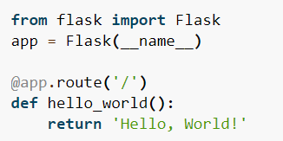
FLASK
Flask is a micro web framework written in Python
Flask supports extensions that can add application features as if they were implemented in Flask itself.

Slide 10
Running flask application
$ export FLASK_APP=hello.py
$ python -m flask run --host=0.0.0.0
* Running on http://0.0.0.0:5000/

Slide 11
Let’s do Demo..!

