Slide 1
College Management system
NAME : R.MONISHA
REG NO : 43130678
DEPARTMENT : ECE
PROJECT : COLLEGE MANAGEMENT SYSTEM
FULL STACK DEVELOPMENT

Slide 2
Abstract
This project presents a comprehensive College Management System (CMS) implemented to integrate and automate various academic and administrative tasks within a college.
The system efficiently manages student information, faculty details, courses, attendance, grades, and other essential functions.
By providing secure access to both students and faculty, the CMS enables seamless handling of critical data such as student enrollment, course registration, grading, and attendance tracking.
A key feature of the system is its ability to generate reports for real-time monitoring of academic and administrative activities.
Developed with user-friendly interfaces and robust data validation, CMS ensures secure, accurate, and reliable management of college operations.

Slide 3
Existing System
• Manual management of student and faculty data.
• Time-consuming and prone to human errors.
• Difficulty in maintaining attendance and results.
• Lack of centralized access to information.
• Inefficient coordination between departments.

Slide 4
Proposed System
The College Management System (CMS) aims to replace the traditional manual process with a fully automated and centralized digital platform.
It manages all college operations efficiently, such as student enrollment, faculty management, attendance tracking, and marks entry.
The system ensures data accuracy, transparency, and quick information retrieval through a secure login interface for Admin, Faculty, and Students
. It also enables real-time monitoring of academic performance, simplifies report generation, and improves communication between departments.
By integrating all core functions, the CMS provides a user-friendly, scalable, and secure solution for effective college administration.

Slide 5
Advantages
Simplifies college operations through automation.
Provides secure, role-based access.
Reduces paperwork and time consumption.
Generates instant academic and administrative reports.

Slide 6
Disadvantages
Requires initial setup and configuration.
Internet or server dependency.
Technical training needed for new users.

Slide 7
Hardware Requirements
• Processor: Intel Core i3 or above
• RAM: Minimum 4 GB
• Hard Disk: 500 GB
• Input Devices: Keyboard, Mouse
• Display: 15” Monitor

Slide 8
Software Requirements
• Operating System: Windows 10 or above
• Programming Language: Java
• Frontend: Swing Framework
• Backend: MySQL Database
• IDE: NetBeans / Eclipse
• JDK Version: 8 or higher

Slide 9
Modules
1️⃣ Login Module
2️⃣ Student Management Module
3️⃣ Faculty Management Module
4️⃣ Course Management Module
5️⃣ Attendance Module
6️⃣ Chat Forum Module
7️⃣ Result Module

Slide 10
Module Description
1. Login Module
- Entry point of the system.
- Verifies user credentials and provides role-based access for Admin, Faculty, and Students.
• Admin: Manage courses, faculty, and student records.
• Faculty: Upload marks, manage attendance, and communicate with students.
• Student: View personal data, attendance, and results.
2. Student Management Module
- Maintains complete student records and registration.
- Links students with their courses and semesters.
- Allows updating, editing, or deleting records.

Slide 11
Module Description
3. Faculty Management Module
- Manages faculty information, assigned courses, and attendance handling.
- Enables course reassignment and monitoring of faculty activities.
4. Attendance Module
- Simplifies attendance marking and tracking.
- Generates monthly reports and identifies defaulters.
5. Course & Subject Management Module
- Creates and manages courses and subjects.
- Assigns subjects to faculty and tracks enrollment statistics.

Slide 12
Module Description
6. Notification & Chat Module
- Real-time notifications and communication between Admin, Faculty, and Students.
- Enables announcements and direct messaging.
7. Marks & Results Module
- Automates result calculation and report generation.
- Allows students to view grades securely.

Slide 13
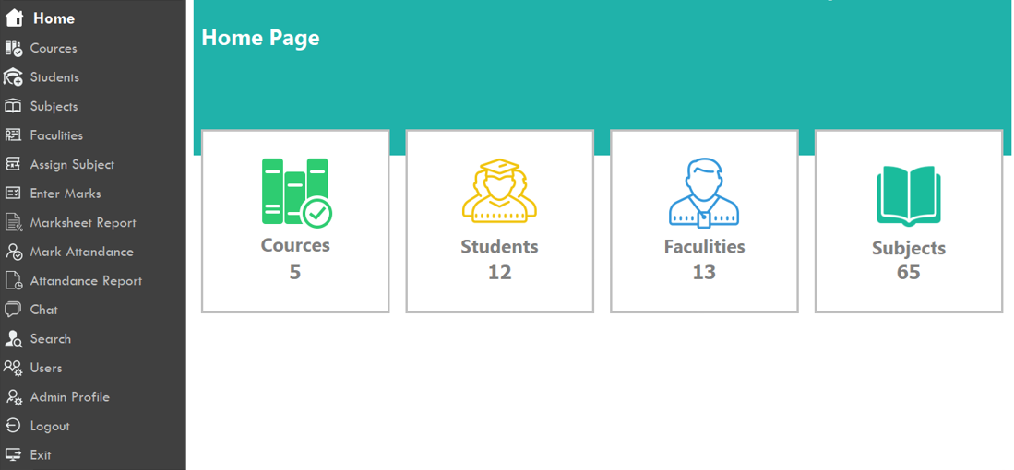
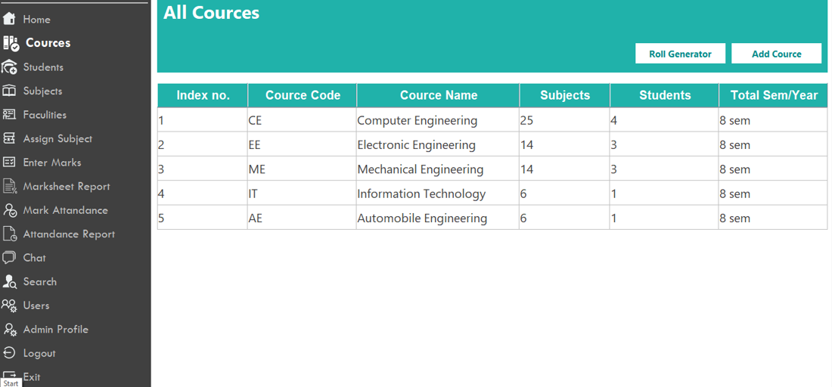
Sample Output

Slide 14
Conclusion
The College Management System (CMS) is a comprehensive and efficient solution that automates the administrative and academic workflow of a college.
It integrates modern technologies like Java for programming and MySQL for database management.
The system ensures accurate management of students, faculty, courses, attendance, and results.
The user-friendly GUI and powerful backend enhance usability and performance.
With added features like real-time chat and notifications, the CMS improves collaboration within the institution.
Overall, it demonstrates how technology can streamline college operations while promoting efficiency, accuracy, and teamwork.

