Slide 1
MNIST Digit Classification
Using Neural Networks
INTERNSHIP PROJECT 1 •
July / August 2026
Presented by
Raveena
B.Sc. Agriculture
Chaudhary Charan Singh Haryana Agricultural University
Deep Learning
Handwritten digit recognition using CNN
PyTorch • MNIST
MNIST Digit Classification | Raveena | B.Sc. Agriculture

Slide 2
Introduction
OVERVIEW
What the project does
A Convolutional Neural Network (CNN) recognizes handwritten digits from the MNIST dataset.
99.11%
Test accuracy
Framework
Dataset
PyTorch — a leading deep learning library.
MNIST — standard benchmark for digit classification.
10,000
Test images
End-to-end pipeline
Data loading → training → evaluation → inference demo The project is modular, reproducible, and ready for GitHub.
MNIST Digit Classification | Raveena | B.Sc. Agriculture
02

Slide 3
Problem Statement
WHY IT MATTERS
Core problem
Goal
Handwritten digit recognition is a fundamental computer vision task.
Classify grayscale images into digits 0–9 using a CNN.
Applications
Challenge
Postal mail sorting Bank cheque processing Form digitization
Handwriting varies in: • style • stroke width • orientation
> 99%
Target test accuracy
MNIST Digit Classification | Raveena | B.Sc. Agriculture
03

Slide 4
Objectives
PROJECT GOALS
Design and implement a compact CNN arc
Train the model on the MNIST training
Evaluate performance on the MNIST test
1
2
3
Design and implement a compact CNN architecture for digit classification.
Train the model on the MNIST training set (60,000 images).
Evaluate performance on the MNIST test set (10,000 images).
Generate comprehensive evaluation metr
4
Demonstrate inference on a real handwr
Package the project for professional G
5
6
Generate comprehensive evaluation metrics and visualizations.
Demonstrate inference on a real handwritten digit sample image.
Package the project for professional GitHub submission.
MNIST Digit Classification | Raveena | B.Sc. Agriculture
04

Slide 5

MNIST Dataset
DATASET
What is MNIST
Modified National Institute of Standards and Technology dataset.
70,000
60,000
Total images
Training
10,000
28 × 28
Example handwritten digit Single-channel grayscale
Test
Pixels / image
Pixel values: 0 (black) → 255 (white) Digits: 0–9
MNIST Digit Classification | Raveena | B.Sc. Agriculture
05

Slide 6
Data Preprocessing
PIPELINE
Normalize
Validation split
Augment
Test data
Mean 0.1307 Std 0.3081
10% of training data Seeded for reproducibility
Rotation ±10° Affine: translate 8%, shear 5°
Normalization only No augmentation
1
2
3
4
Data loading
torchvision.datasets.MNIST with automatic download.
MNIST Digit Classification | Raveena | B.Sc. Agriculture
06

Slide 7
CNN Architecture — SimpleCNN
MODEL
INPUT
CONV 1
CONV 2
CONV 3
FLATTEN
FC 1
FC 2
28 × 28 × 1
1 → 32 3×3 + ReLU
32 → 64 3×3 + ReLU + Pool
64 → 128 3×3 + ReLU + Pool
128 × 7 × 7 = 6,272
6,272 → 256 ReLU + Dropout
256 → 10 Output classes
Regularization & size
Dropout = 0.25 • Total parameters ≈ 1.7M
MNIST Digit Classification | Raveena | B.Sc. Agriculture
07

Slide 8
Training Methodology
TRAINING
Optimizer
Loss function
Batch size
Adam Learning rate = 0.001
CrossEntropyLoss
64 training 256 evaluation
Checkpointing
Reproducibility
Logging
Best model saved based on validation loss.
Random seed = 42 for all random operations.
Training & validation metrics logged per epoch (CSV + JSON).
Optional learning-rate scheduler: StepLR
MNIST Digit Classification | Raveena | B.Sc. Agriculture
08

Slide 9
Evaluation Metrics
EVALUATION
Accuracy
Precision
Recall
Fraction of correctly classified samples.
TP / (TP + FP).
TP / (TP + FN).
F1-Score
Confusion Matrix
Test set
Harmonic mean of precision and recall.
Per-class classification performance.
Full 10,000-image evaluation.
Per-class and aggregate (macro/weighted) metrics are reported.
MNIST Digit Classification | Raveena | B.Sc. Agriculture
09

Slide 10
Results
PERFORMANCE
99.11%
10,000
Test accuracy
Test samples
9,911
89
Correct
Incorrect
Sample Prediction: Digit 3
Top Probability: 0.999983
Aggregate metrics
Macro Precision ≈ 99.10% • Macro Recall ≈ 99.10% • Macro F1 ≈ 99.10%
MNIST Digit Classification | Raveena | B.Sc. Agriculture
10

Slide 11
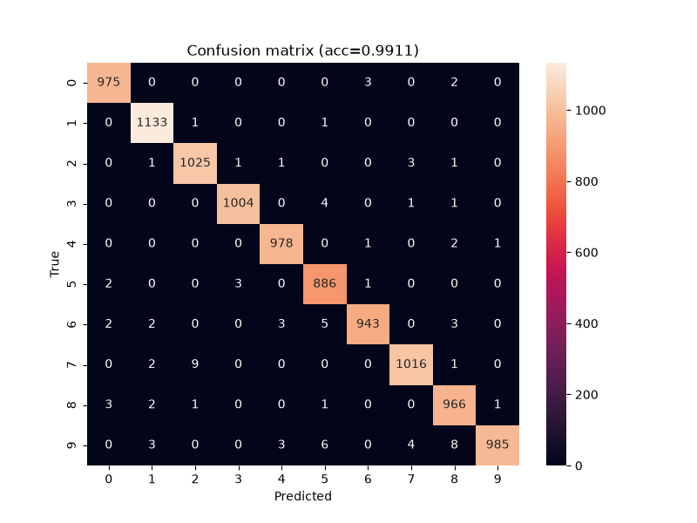
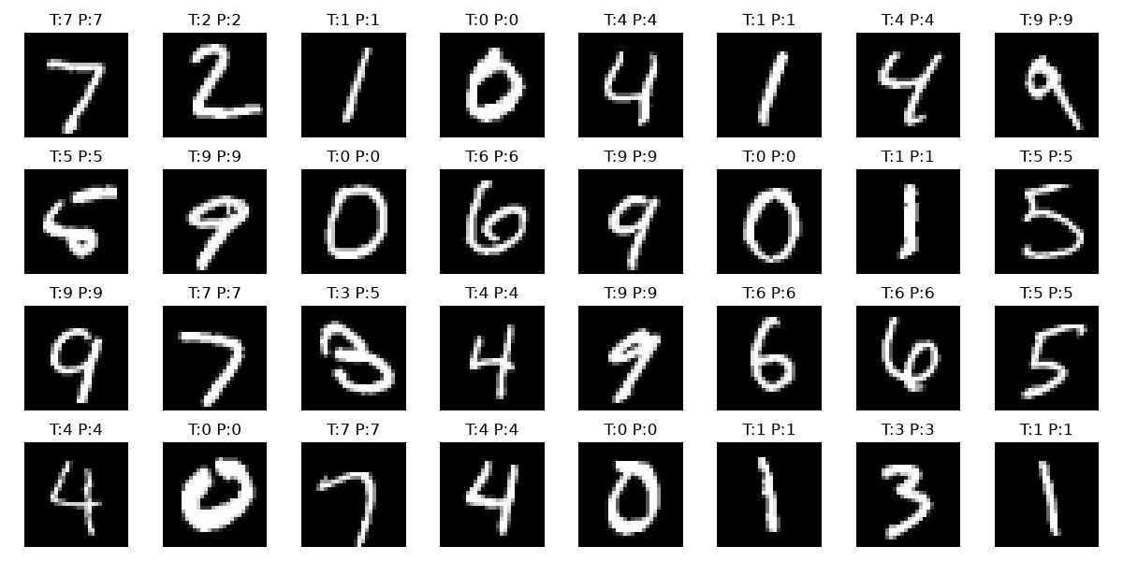
Confusion Matrix & Sample Predictions
RESULTS
Diagonal = correct classifications
T = True / actual • P = Predicted
MNIST Digit Classification | Raveena | B.Sc. Agriculture
11

Slide 12
Conclusion & Future Scope
WRAP-UP
Conclusion
Future Scope
Successfully built a CNN achieving 99.11% accuracy on MNIST. Complete pipeline: data preprocessing, training, evaluation, and inference. Comprehensive visualizations: confusion matrix, predictions, misclassified samples. Project packaged for professional GitHub submission.
Extend to more complex datasets: Fashion-MNIST, EMNIST, SVHN. Experiment with deeper architectures: ResNet, EfficientNet. Deploy as a web application with real-time digit drawing. Explore model compression for edge deployment (quantization, pruning).
THANK YOU
MNIST Digit Classification | Raveena | B.Sc. Agriculture
12

