Slide 1



Water Quality Prediction
Raveendra Gunapu
24A35A0508

Slide 2

Learning Objectives
Understand the basics of water quality parameters and
their environmental significance
Apply RFR to predict key water metrics accurately
Evaluate model performance using regression
metrics like RMSE, R²
GOAL
Build and Train the Model
Reflect on the real-world impact of predictive
monitoring on public health
Source :
www.freepik.com/

Slide 3
Tools and Technology used
Python
Pandas & NumPy
Streamlit
Jupyter Notebook
Joblib & pickle
CSV Data Files
Visual Studio Code

Slide 4
Methodology
1️⃣ Problem Identification
2️⃣ Data Acquisition
3️⃣ Data Preprocessing
4️⃣ Model Development
5️⃣ Evaluation & Validation
6️⃣ Prototype & Visualization
7️⃣ Local Deployment

Slide 5
Problem Statement:
Access to clean and safe drinking water remains a critical challenge across urban and rural regions. Traditional water quality monitoring methods rely heavily on manual sampling and lab-based testing, which are time-consuming, resource-intensive, and often delayed in response. As water sources become increasingly vulnerable to pollution due to industrial discharge, agricultural runoff, and population growth, there's a growing need for real-time and predictive monitoring systems.

Slide 6
Solution:
Polluted water doesn’t always look dirty but hidden contaminants like nitrates, heavy metals, or high turbidity levels can seriously impact health and the environment. Waiting days for lab results just isn’t fast enough when people’s safety is at stake.
This project uses machine learning to spot pollutants before they become a bigger problem. By analyzing data from sensors and past samples, the model learns to recognize patterns that reveal which harmful substances are present and how much. With a smart dashboard built in Python, it turns raw data into clear, usable insights that help communities act fast and stay safe.
With this analysis of data the model will show us the pollutants that are present in wate and its values and use that data to predict the quality od the water

Slide 7
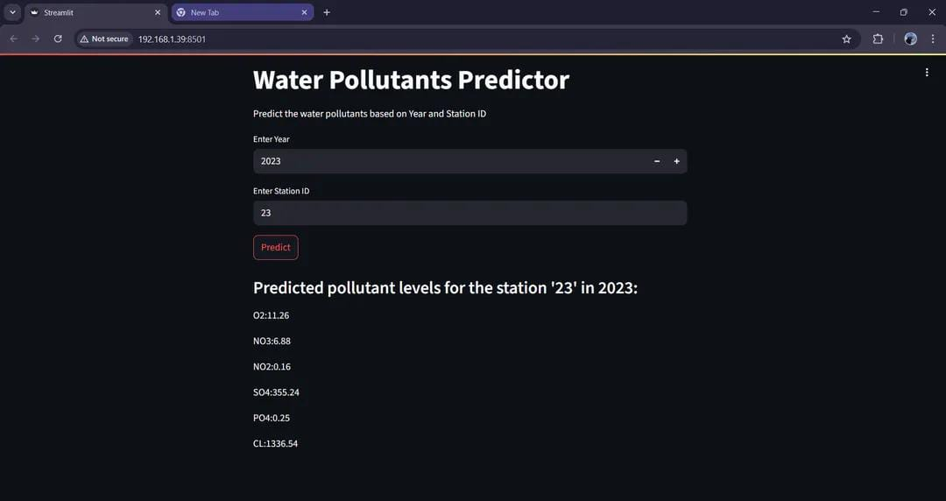
Screenshot of Output:

Slide 8
Screenshot of Output:

Slide 9
Conclusion:
By training a model with real-world water data, we built a system that can flag unsafe conditions faster and more accurately. And with a simple dashboard, anyone from field workers to official can understand the results and take action quickly.
It’s a small shift with big impact: giving communities the tools to stay ahead of pollution and make water safer for everyone.
Git:
https://github.com/raveendra-7/WaterQualityPred_AICTE.git

