Slide 1

Trading Strategy Based on Reinforcement Learning
Presented by: Ajaz Ahmad & Raveendra Pujari
Subject: Applied Reinforcement Learning
Instructor: Dr. Rodrigue Rizk
Spring 2025
University of South Dakota

Slide 2
Introduction
Why is stock trading challenging?
Financial markets are unpredictable — prices move up and down based on countless factors like news, earnings, and investor sentiment.
This makes the environment non-stationary, meaning patterns that worked yesterday might not work tomorrow.
On top of that, there's a lot of noise in price data. Not every price move is meaningful, and spotting real opportunities becomes difficult.
Where does Reinforcement Learning fit in?
Traditional models often struggle because they rely on fixed rules or assumptions.
Reinforcement Learning (RL) takes a different approach. It learns by doing — like a human learning a skill through trial and error.
In our case, the RL agent interacts with the market, makes decisions (buy, sell, hold), and learns what actions lead to good outcomes based on the rewards it receives.
What are we trying to do?
Our goal is to train an RL agent that learns how to trade profitably by analyzing historical stock data.
Instead of predicting prices, we focus on teaching the agent to take the right actions at the right time.
The ultimate objective is to build a system that can adapt to market conditions, maximize profit, and provide clear visual feedback on its decisions.

Slide 3
Our Contributions
1. Smarter Market Understanding We designed a way for the RL agent to understand the market using a sliding window of recent price and volume changes. This dynamic state representation helps the agent track trends and momentum — it’s like giving it memory of the last few days so it can make smarter decisions.
2. Profit-Focused Model Selection Instead of saving every model, we built a system that keeps only the best-performing version — the one that made the most profit. This ensures that the final model used for evaluation or deployment is always the most effective one.
3. Clear Visualization of Actions To avoid confusion from noisy trading signals, we visualize actions only from the best-performing episode. This helps us clearly see where the agent chose to buy or sell and how those decisions impacted performance.
4. User-Friendly Interface We developed an interactive Streamlit dashboard where users can upload data, adjust training parameters, and view trading outcomes. It makes the entire system more accessible — no coding needed to test or retrain the agent.

Slide 4
Related Work
Moody & Saffell (2001) They were among the first to apply reinforcement learning to financial trading. Their work introduced direct reinforcement strategies to handle decision-making in dynamic environments like stock markets.
Mnih et al. (2015) This was a breakthrough paper where Deep Q-Networks (DQNs) were introduced. It showed how neural networks could learn to play Atari games directly from pixels — and inspired many financial applications where high-dimensional input data (like stock prices) needs to be handled.
Liang et al. (2018) They brought the idea of adversarial reinforcement learning into portfolio management. By simulating tough, unpredictable markets, they made agents more robust and adaptable to market volatility.
Multi-Agent Systems in Finance Recent studies have explored using multiple RL agents that either compete or collaborate in a trading environment. These setups mimic real-world market dynamics more closely and open the door to more advanced trading simulations.

Slide 5
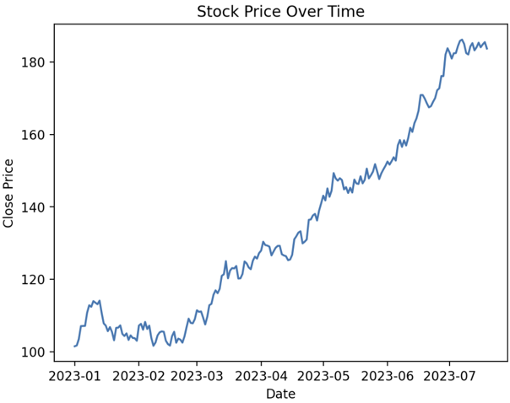
Data Preprocessing
What kind of data are we using? We use market data in the OHLCV format — Open, High, Low, Close, and Volume — which captures essential stock behavior at each time step.
How do we prepare this data for the RL agent? We calculate raw differences between time steps rather than percentage changes. This gives us: ΔXₜ = Xₜ − Xₜ₋₁ This approach preserves directional price movement without scaling distortion.
How does the agent view the market? We give the agent a sliding window of 10 time steps. Since we compute differences, we get 9 rows of feature differences, each with 5 values (OHLCV). This results in a 45-dimensional input vector for the neural network.

Slide 6
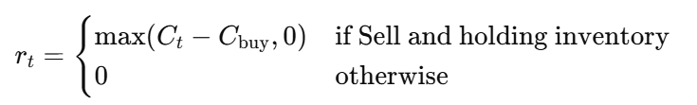
Reward Function
How does the agent know if it made a good decision?
We use a reward system to guide the agent’s learning. After each action (Buy, Sell, or Hold), the agent receives feedback based on the outcome of that choice.
What happens if it buys or sells?
If the agent chooses to Buy or Sell, the reward is calculated as profit from selling compared to the buy price. But we also subtract a small penalty (β) to simulate transaction costs. This teaches the agent to trade only when it’s worth it:
What if it decides to Hold?
If the agent decides to Hold, it gets no reward or penalty. This makes Hold a 'safe' action — useful when the market is uncertain:
rₜ = 0
Why include a penalty β?
Trading too often can reduce profits due to fees or slippage. The β term encourages the agent to avoid unnecessary trades and only act when confident. Note: Although a transaction cost β is discussed conceptually to discourage overtrading, it is not implemented in the current code. This aspect is marked for future improvement.

Slide 7
DQN Architecture
What does the agent actually learn from? We feed the RL agent a 45-dimensional input vector, created by flattening 9 rows of OHLCV differences (5 features × 9 rows) from the past 10 timesteps.
How is this input processed? The input passes through a small neural network made up of two layers:
First layer: 64 neurons with ReLU activation
Second layer: 32 neurons, also using ReLU
These layers help the model learn patterns in recent price and volume changes.
What does the output mean? The final output layer gives us three Q-values — one for each possible action:
Buy
Sell
Hold
The agent chooses the action with the highest Q-value.
How is it trained? We use the Adam optimizer for efficient gradient updates and apply an ε-greedy strategy during training. This means the agent sometimes explores random actions to avoid getting stuck in local optima — and gradually shifts toward exploitation as it learns.

Slide 8
Model Selection
Why do we need model selection? Not every model trained during the learning process performs well — some episodes might result in random or even loss-making trades.
What’s our solution? We designed a system to track the most profitable model during training. After every episode, the agent’s performance is evaluated, and only the model that achieves the highest total profit is saved.
What else do we save? We also save the actions from the best-performing episode, labeled as A_best. This helps us later visualize and analyze exactly how the agent succeeded in achieving high profits.
Why does this matter? By keeping only the top-performing policy and its decisions, we make our results more reliable, interpretable, and less affected by randomness from weaker training episodes.

Slide 9
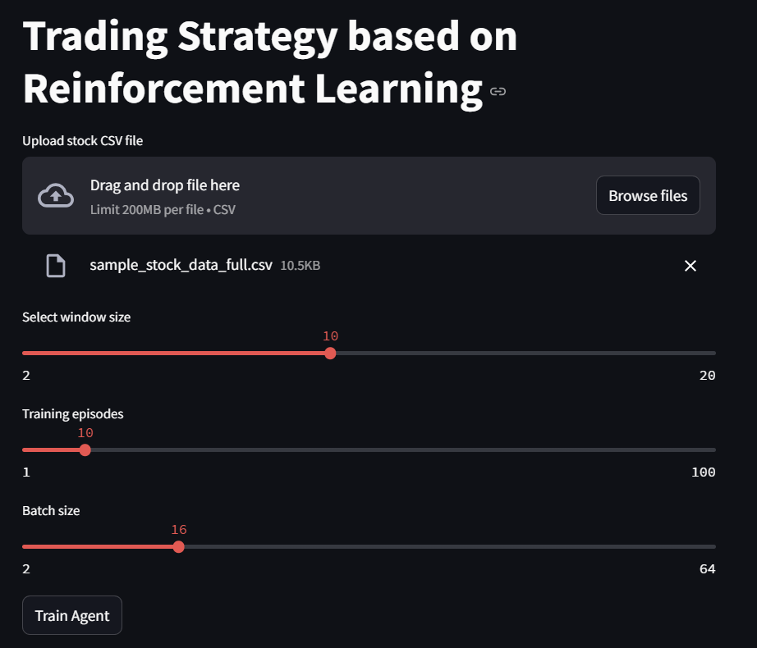
Experiment Setup
What kind of data was used? We worked with a sample OHLCV dataset — this includes Open, High, Low, Close prices and trading Volume. Although it doesn’t represent a real company’s stock, it captures realistic market patterns.
How was the agent trained? The reinforcement learning agent was trained across 10 full episodes, with each episode running over the entire dataset. This gave it multiple chances to learn and improve its decision-making.
How did we make the system interactive?
We built a Streamlit-based interface where users can:
Upload their own CSV files,
Adjust training parameters (like window size, batch size),
And view results visually — including buy/sell signals and profit curves — in real time.

Slide 10
Hyperparameters
These are the key settings we used during training to control how the agent learns:
Window Size = 10 The number of past time steps the agent sees at each decision point.
Discount Factor (γ) = 0.95 Determines how much future rewards matter compared to immediate ones.
Replay Buffer Size = 1000 Stores past experiences so the agent can learn from them in batches.
Exploration Rate (ε): starts at 1.0 → decays to 0.01 Controls how often the agent explores new actions vs. exploiting what it knows.
Batch Size = 16 Number of experiences sampled at a time during training updates.

Slide 11
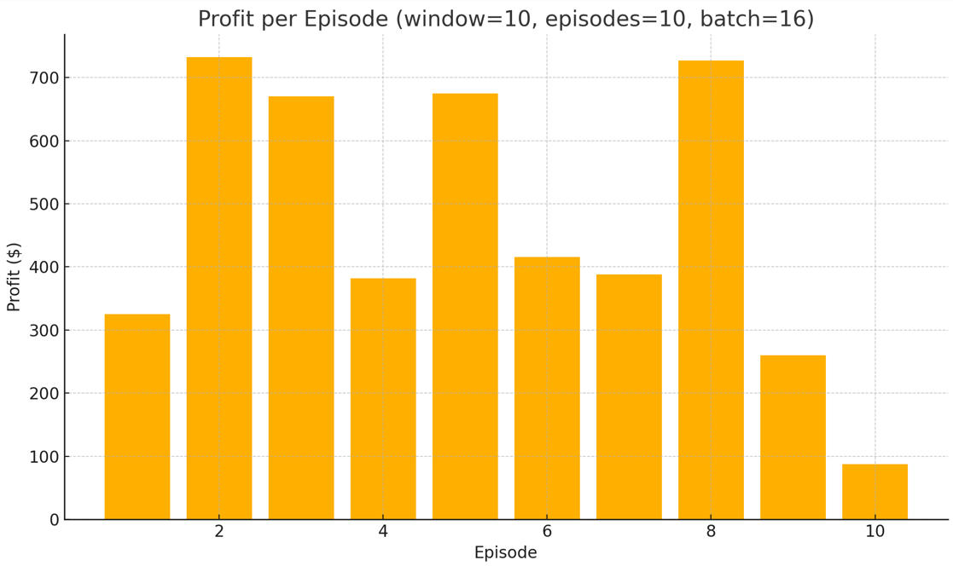
Results
How well did the agent perform?
The best episode generated a total profit of $731.93, showing that the agent could learn a profitable strategy from the data.
It avoided trading in sideways markets, where random actions could lead to small gains or losses — this shows it learned to recognize when not to act.
Compared to a random baseline strategy, our agent achieved higher profitability, proving the value of reinforcement learning in trading.
The action plots revealed that the agent followed momentum-based behavior, often buying during upward trends and exiting at peaks.

Slide 12
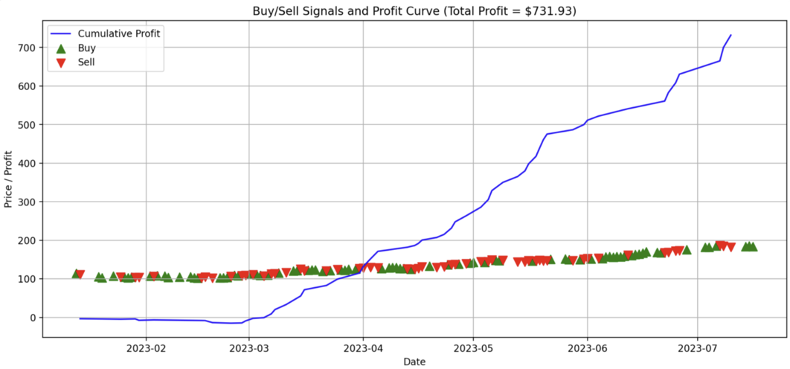
Visual Output
How do we show what the agent did?
The plot displays trading actions and cumulative profit for the best-performing episode.
Green triangles mark the agent’s Buy decisions.
Red triangles indicate Sell actions.
The blue line tracks cumulative profit over time, showing how performance evolves as trades occur.
This visualization helps us evaluate the effectiveness and timing of the agent’s decisions at a glance.

Slide 13
Conclusion
We successfully trained a Deep Q-Network (DQN) agent to make informed trading decisions using raw OHLCV market data.
A performance-based model selection mechanism ensured that only the most profitable policy was retained.
We built an interactive Streamlit dashboard allowing users to:
Upload custom stock data,
Adjust model parameters,
Visualize trading actions and performance without writing any code.
Overall, the system provides a reproducible, interpretable, and user-friendly approach to applying reinforcement learning in financial markets.

Slide 14
Future Work
What can be improved or added next?
Include slippage and limit order modeling Real-world trading involves price slippage and execution delays. Adding these factors can help simulate more realistic trading conditions.
Explore ensemble reinforcement learning Combining multiple agents could improve decision stability and reduce overfitting to specific data patterns.
Deploy as a cloud-based microservice Hosting the model in the cloud would allow real-time trading, remote access, and integration with live data feeds for testing or production use.
Incorporate a Target Network: Using a separate target network for stable Q-value estimation can improve learning stability and reduce overestimation bias in DQNs.
End-of-Episode Liquidation:
End-of-episode liquidation is not applied. Unsold inventory at episode end is ignored in profit calculation.
Multi-Asset Portfolio Support: The current system handles only a single asset. Extending to multi-asset environments would allow portfolio optimization and diversified trading strategies.

Slide 15
Thank You

